Slide 1
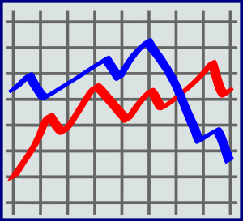
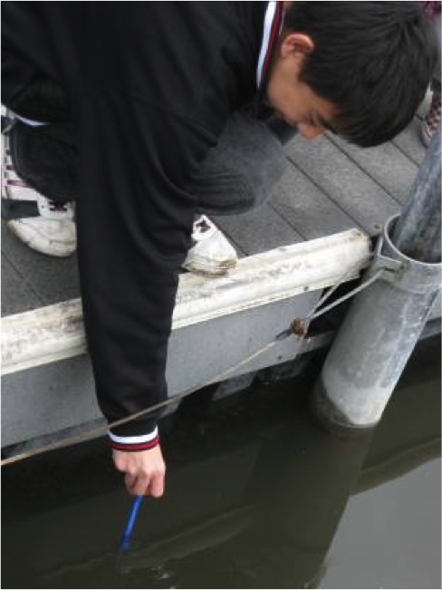
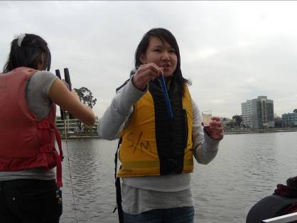
Concise Title of Less Than 15 Words That Summarizes the Study
Collaboration Team Names
School Name
School Logo
Abstract
Research Methods
Results
Discussion
a. Concise (less than 300 words)
b. Context of research
c. Research questions
d. Objectives set
e. Brief methods description
f. Results
g. Conclusions
h. Recommendations for a way forward
i. Key words that emphasize key ideas in the paper (3-5 words)
Planning Investigations
Describes the planning process
a. There is a direct link provided between the datasets and research question(s)
b. Study site: A map and description of the study site. It should mention area of study, climatic characteristics and basic aspects of land cover
c. Data collection: A description of GLOBE protocols used to answer the research question as well as where and how data was gathered in the field (sampling method: Where, how many samples were measured)
d. Print screen of data entry in the Web page of GLOBE.
e. Data analysis: Mention what kind of mathematical calculation was applied to analyze the data
f. The data presented are sufficient to answer the research question(s)
Carrying Out Investigations
Describes what happened
Describe the GLOBE protocols, NASA assets, or other data sources actually used
Describes data collection activities including discussions of the specific locations at a site where data sampling occurred
Describes the specifics about the data (e.g., the kinds of data, amounts of data)
Describes the steps for data collection (e.g., frequency of sampling or measurement activities; the protocols used, the role of each team member in collecting data, etc.)
Analyzing Data
a. Tables and graphics applying statistical analysis of data to show mean, dispersion, or grouping data.
b. Data support the conclusions
c. Print screen of GLOBE Visualization page
Interpreting Data
a. Interpretation of results
b. Possible sources of error
c. Comparison with similar studies
d. Discuss whether results answer research questions or not, and how
Research Question
Figure #1
Asking Questions
a. Include why they are important and are of scientific interest
b. Concern some aspect of Earth’s environment (local or global issue)
c. Provide significant insight into both the topic of investigation and the research process
d. Answering them requires an advanced understanding of the subject matter
e. Require a thoughtful research plan
f. Are answerable through scientific research appropriate to the scope of the report.
GLOBE Data Used
Describe the GLOBE protocols and/or data that you used in your research
Where did the data come from? Did you collect it using GLOBE protocols (if so, which ones), or download it from the GLOBE website?
How did you use this data in your research?
Introduction
Content Knowledge
a. Thorough (150-300 words)
b. Description of the problem
c. Importance
d. Community relevance
e. At least 3-5 references. Do not include wikis or Q&A sites such as answers.com. (Look at The Purdue "OWL" for guidance and resources: owl.english.purdue.edu)
Conclusions
Figure #2
Drawing Conclusions & Next Steps
a. Gives a thorough and insightful explanation as to how the conclusion was reached
b. Put findings in context, stating why they are important or relevant
c. What follow-on research and actions could be taken; future protocols that could be added
d. Impact of working with a project mentor
Map of Study Site(s)
Bibliography
References
a. Materials correctly cited
b. GLOBE materials used
c. Sources beyond those powered by GLOBE
Field Photos (requires release forms)

