Slide 1
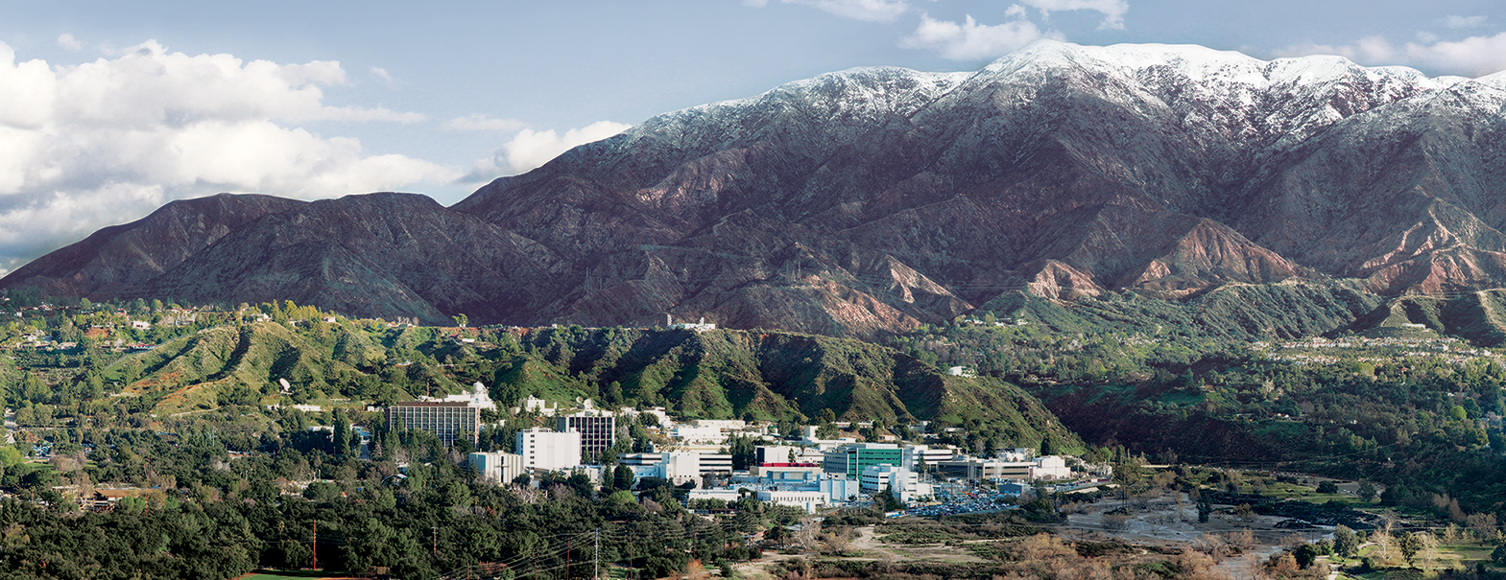
Presentation to The GLOBE Earth System Science Community
NASA Resources: Connecting Students to Science
Peter Falcon, NASA/JPL Earth Science Communications
March, 19th, 2021
pcfalcon@jpl.nasa.gov

Slide 2
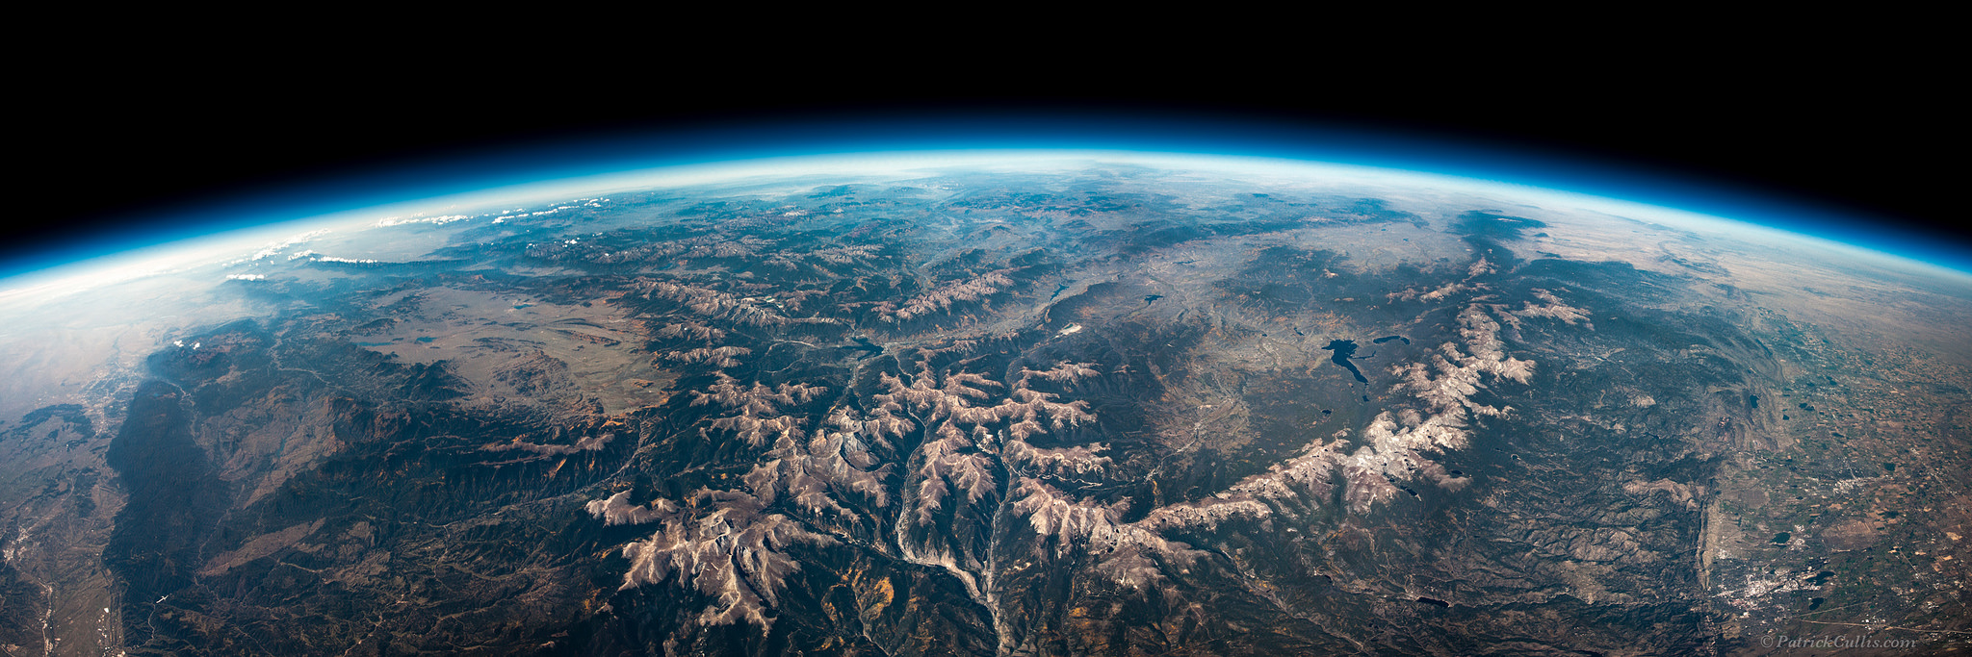



Thanks to Deanna Tebockhorst and John Ristvey

Slide 3


Slide 4



Slide 5
What Do You Want?

Slide 6
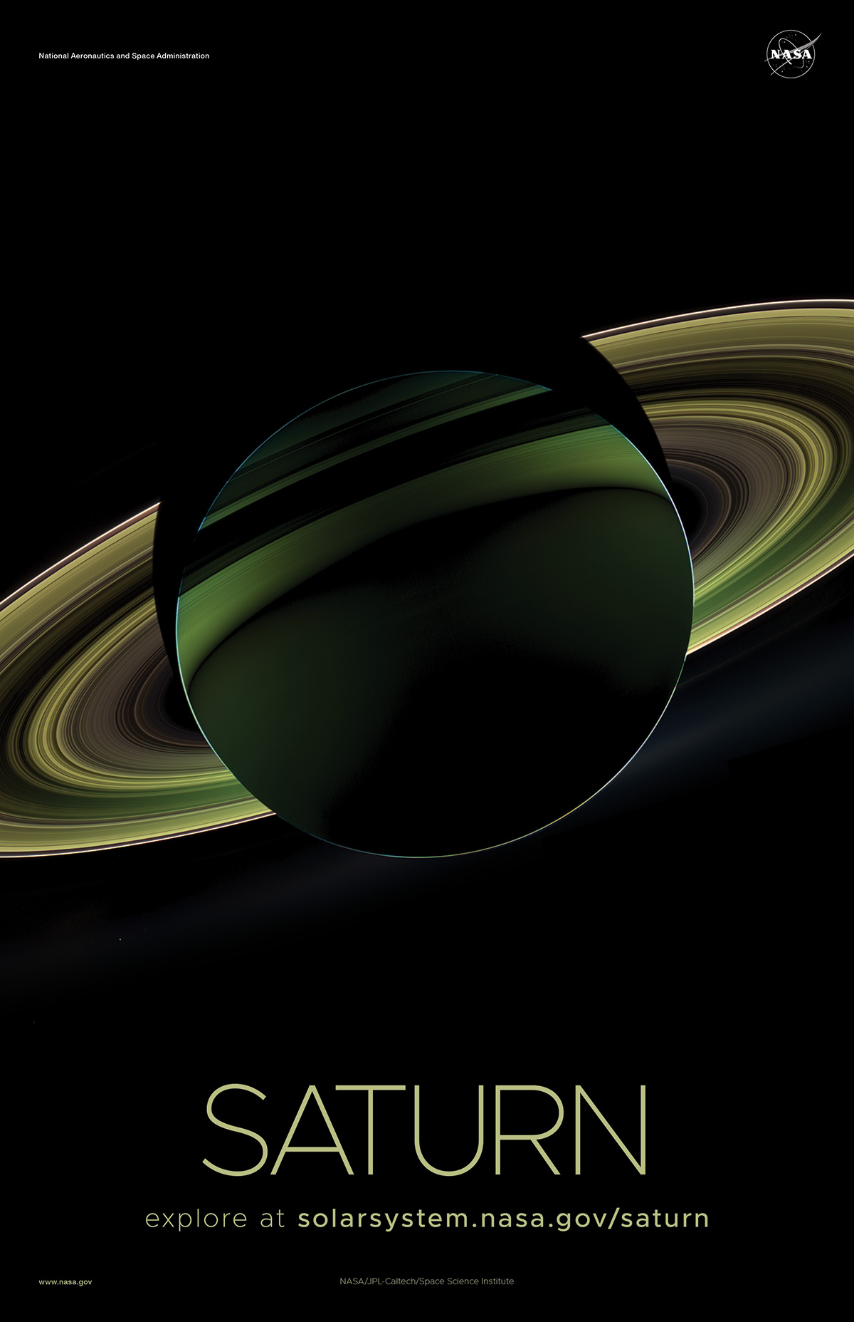
NASA Science

Slide 7
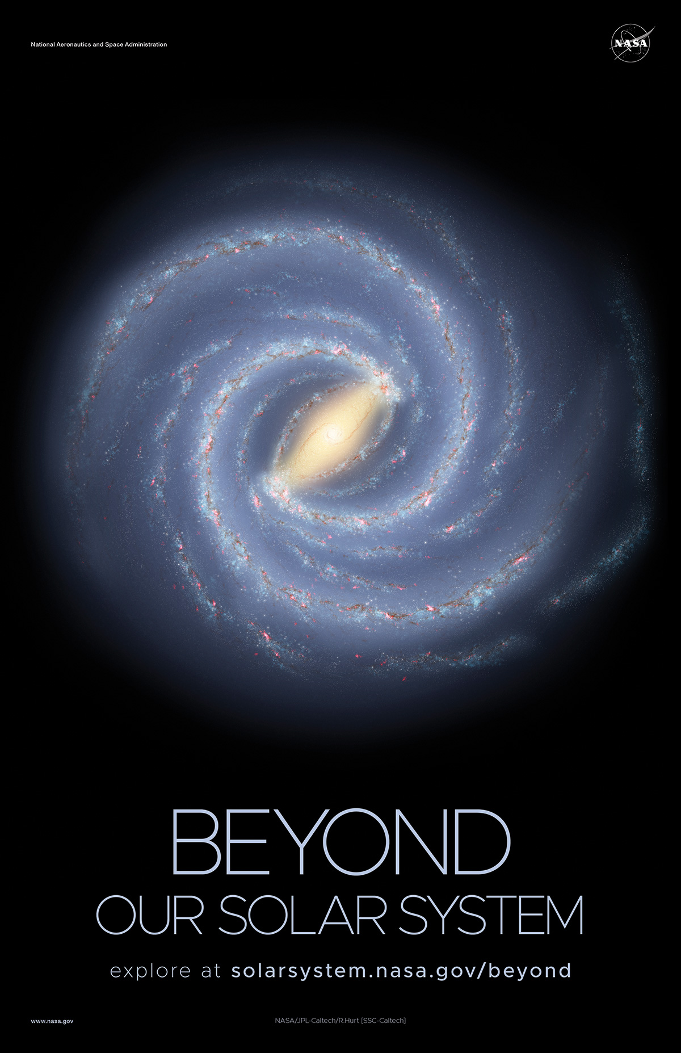
NASA Science

Slide 8
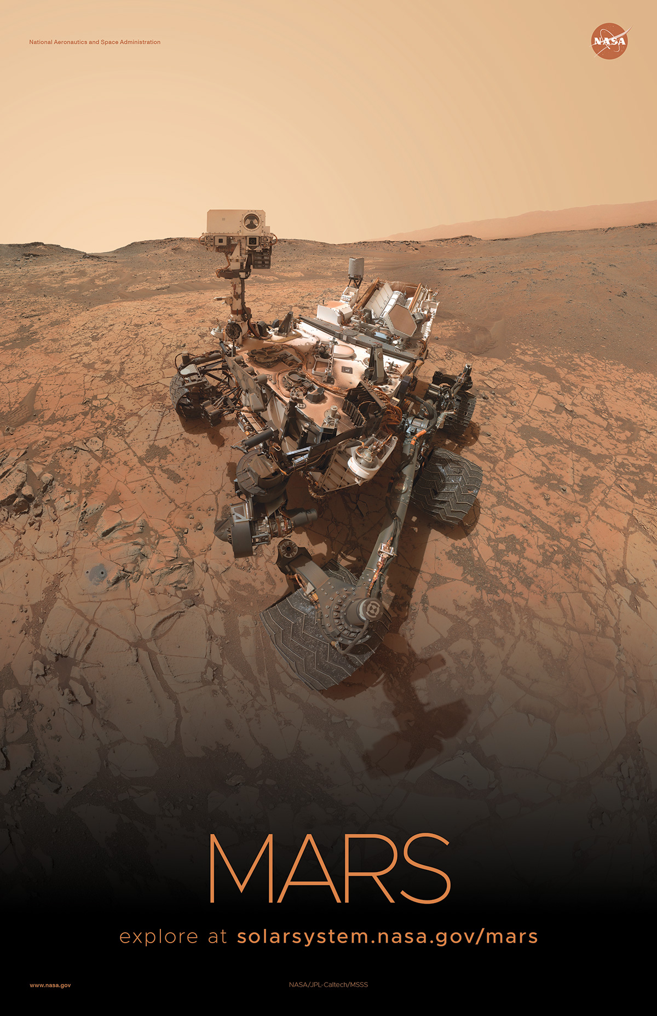
NASA Science

Slide 9
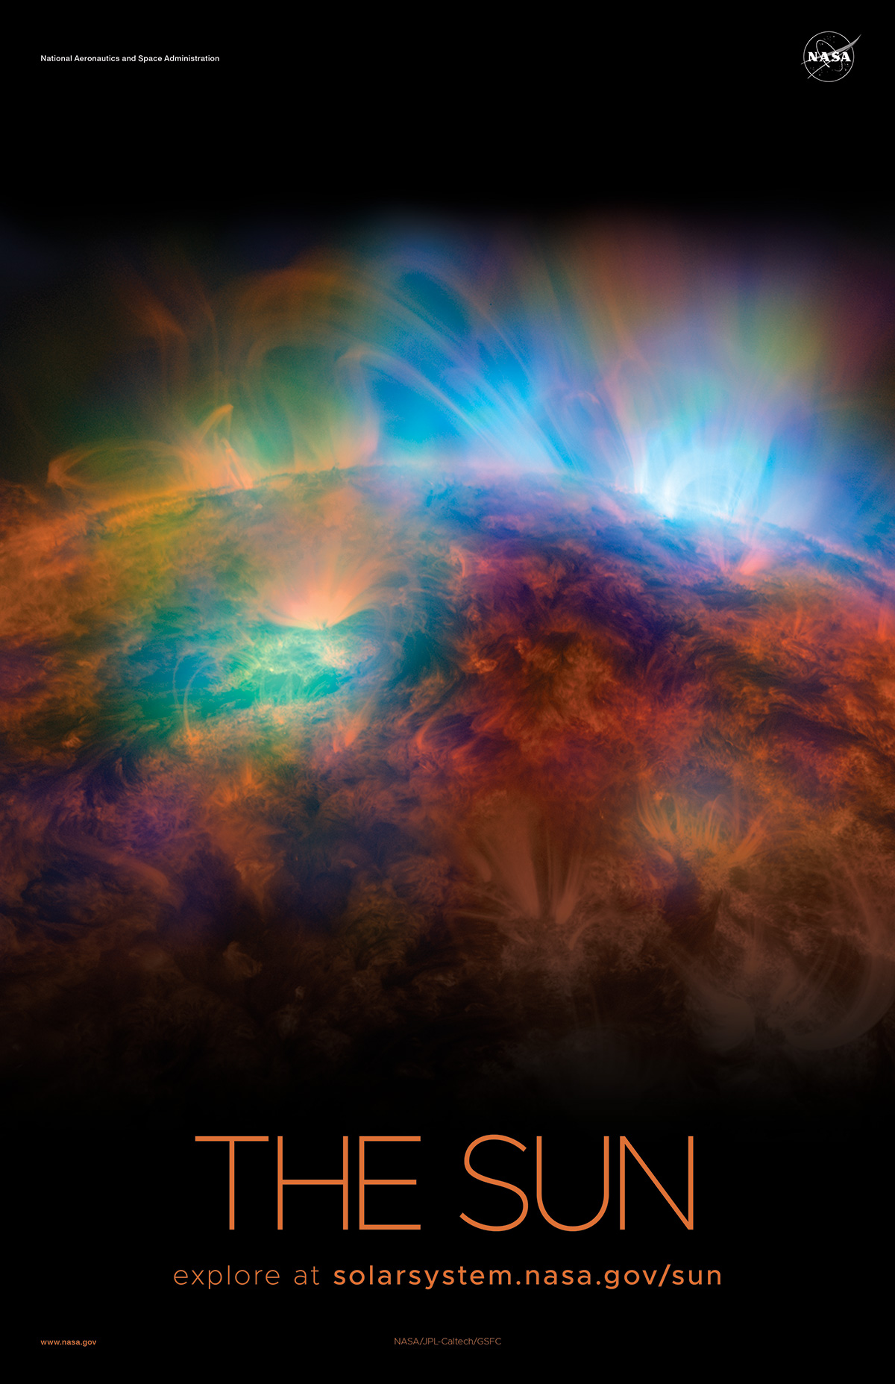
NASA Science

Slide 10
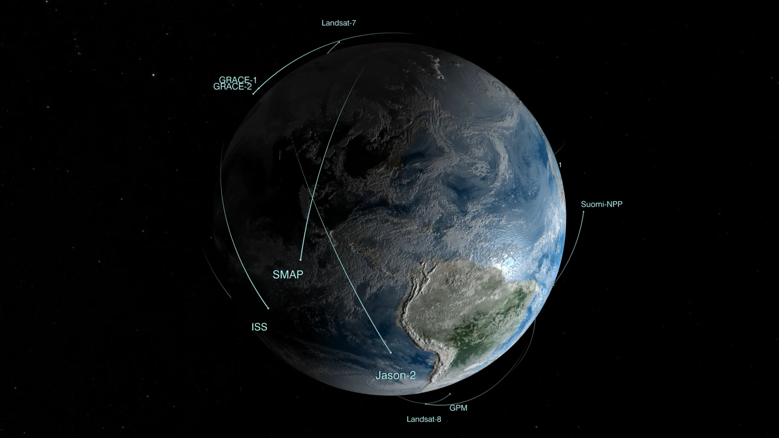
NASA Science

Slide 11
Notes:
The Trump Administration proposed to remove STEM Engagement Funding, but The House and Senate ultimately deciede to put money into the budget.
https://www.nasa.gov/sites/default/files/atoms/files/fy2021_summary_budget_brief.pdf

Slide 12
Notes:
The Trump Administration proposed to remove STEM Engagement Funding, but The House and Senate ultimately deciede to put money into the budget.
https://www.nasa.gov/sites/default/files/atoms/files/fy2021_summary_budget_brief.pdf

Slide 13

https://go.nasa.gov/3r2uH86

Slide 14
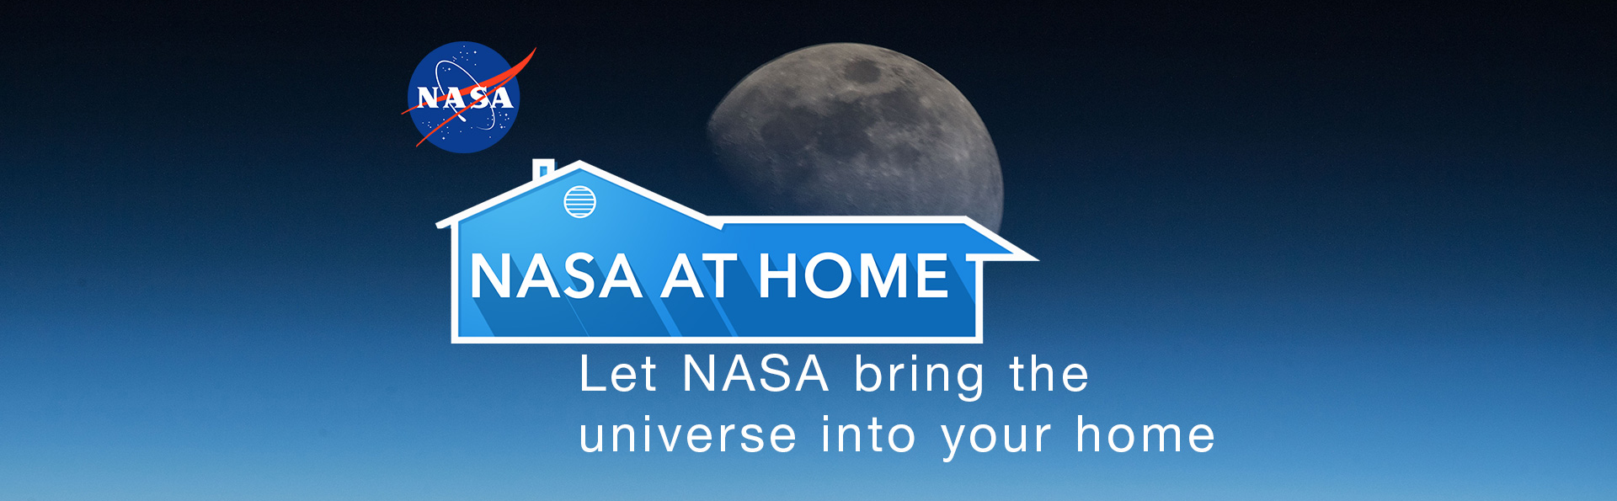
Science Resources
NASA At HOME
https://go.nasa.gov/3tBzFdK

Slide 15
Science Resources
Pre–Kindergarten & Elementary
Middle School
High School/University
Data Visualizations and Animations

Slide 16

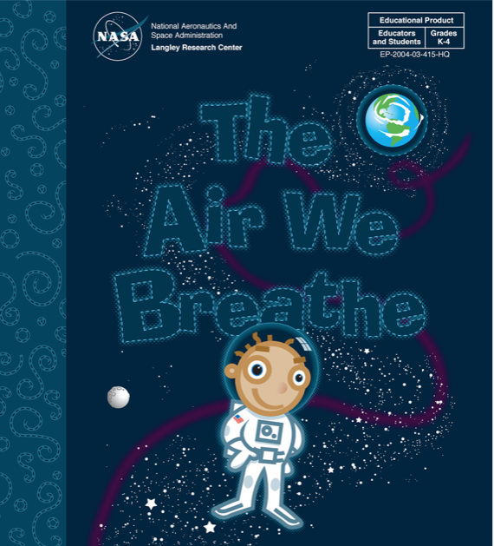


Pre-K & Elementary
Websites – Lessons, Activities, Games, Stories
Aeronautics for Pre-K https://go.nasa.gov/3tBFwQe (Great for informal settings, libraries etc.)
Space Place https://spaceplace.nasa.gov/
The Aire We Breathe https://go.nasa.gov/3bWPTbw
Earth Observatory Kids https://go.nasa.gov/38Wrv82
Imagine The Universe https://go.nasa.gov/2P4RR0C
Climate Kids https://climatekids.nasa.gov
NASA’s Kids’ Club https://go.nasa.gov/2NCPKAM
Notes:
ESA – CleaSpace-1 Satellite to pick up debris

Slide 17
Middle School
Websites – Lessons, NGSS Activities, Coding
NASA’s Earth Minute https://go.nasa.gov/3tAcall (White Board Videos)
Solar System Exploration https://solarsystem.nasa.gov/
NASA STEM Engagement https://go.nasa.gov/3vFsxPw
Code a Mars Rover https://go.nasa.gov/2QkmVKm (Activities Using Coding)
3D models - 3D printable https://nasa3d.arc.nasa.gov/models/printable
Space Math @ NASA https://spacemath.gsfc.nasa.gov/ (Math Problems 3rd grade - Calculus)
JPL Education - Teach https://www.jpl.nasa.gov/edu/teach/
Global Climate Change https://climate.nasa.gov/
Notes:
ESA – CleaSpace-1 Satellite to pick up debris

Slide 18
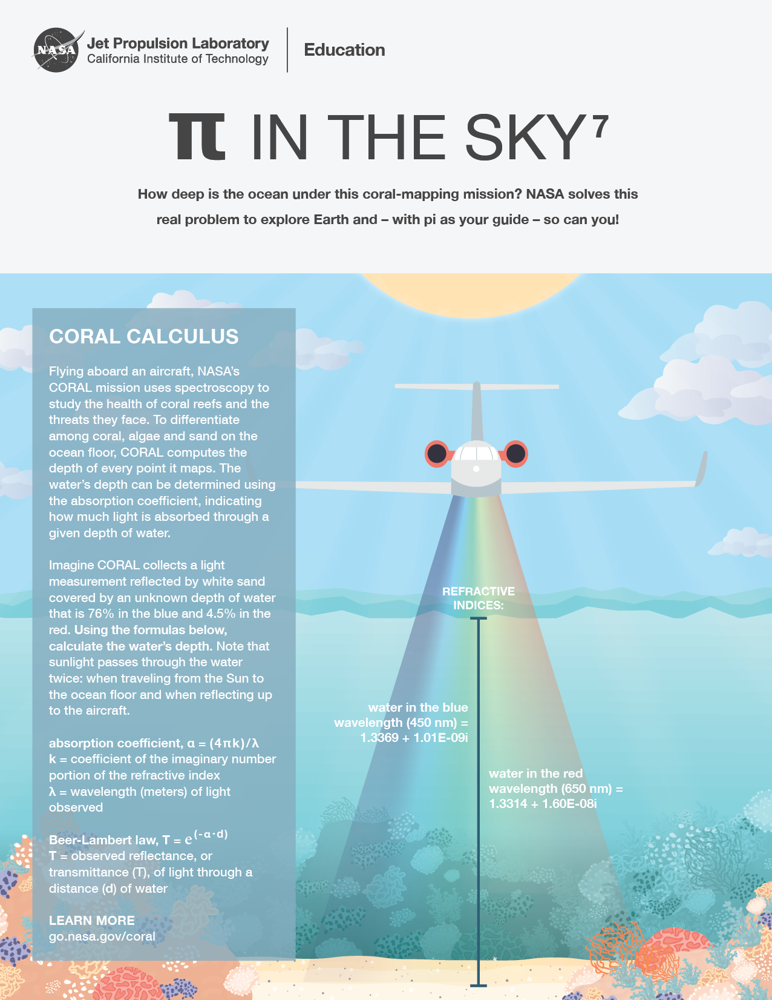
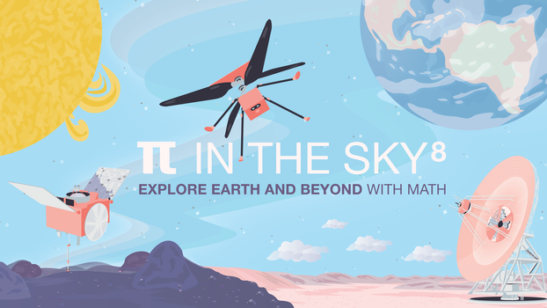
High School - University
Websites – Lessons, NGSS Activities, Internships
Solar System Ambassadors https://go.nasa.gov/3cTjvpE
Sea Level Change https://sealevel.nasa.gov/
Tour of the Electromagnetic Spectrum https://science.nasa.gov/ems
Internships https://intern.nasa.gov/
JPL Internships https://www.jpl.nasa.gov/edu/intern/
eClips https://nasaeclips.arc.nasa.gov/
Global Climate Change https://climate.nasa.gov/
Notes:
ESA – CleaSpace-1 Satellite to pick up debris

Slide 19
Data Visualizations and Animations
Websites for NASA Data, and Scientific Animations
Eyes on the Earth https://eyes.nasa.gov/eyes-on-the-earth.html (Informal w/monthly averages)
Worldview https://worldview.earthdata.nasa.gov
Earth Observatory https://earthobservatory.nasa.gov/ (NASA Imagery and Stories)
EarthData https://earthdata.nasa.gov/
Hyperwall Animations and Talks https://go.nasa.gov/3r2x4I4
Scientific Visualization Studio https://svs.gsfc.nasa.gov
Images of Change https://go.nasa.gov/313BbsN (Informal, Before & After photos of the world)
Notes:
ESA – CleaSpace-1 Satellite to pick up debris

