Slide 1
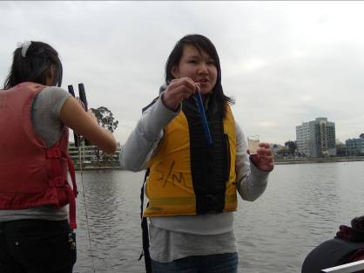
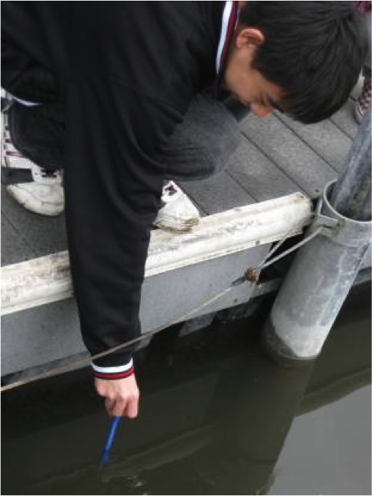
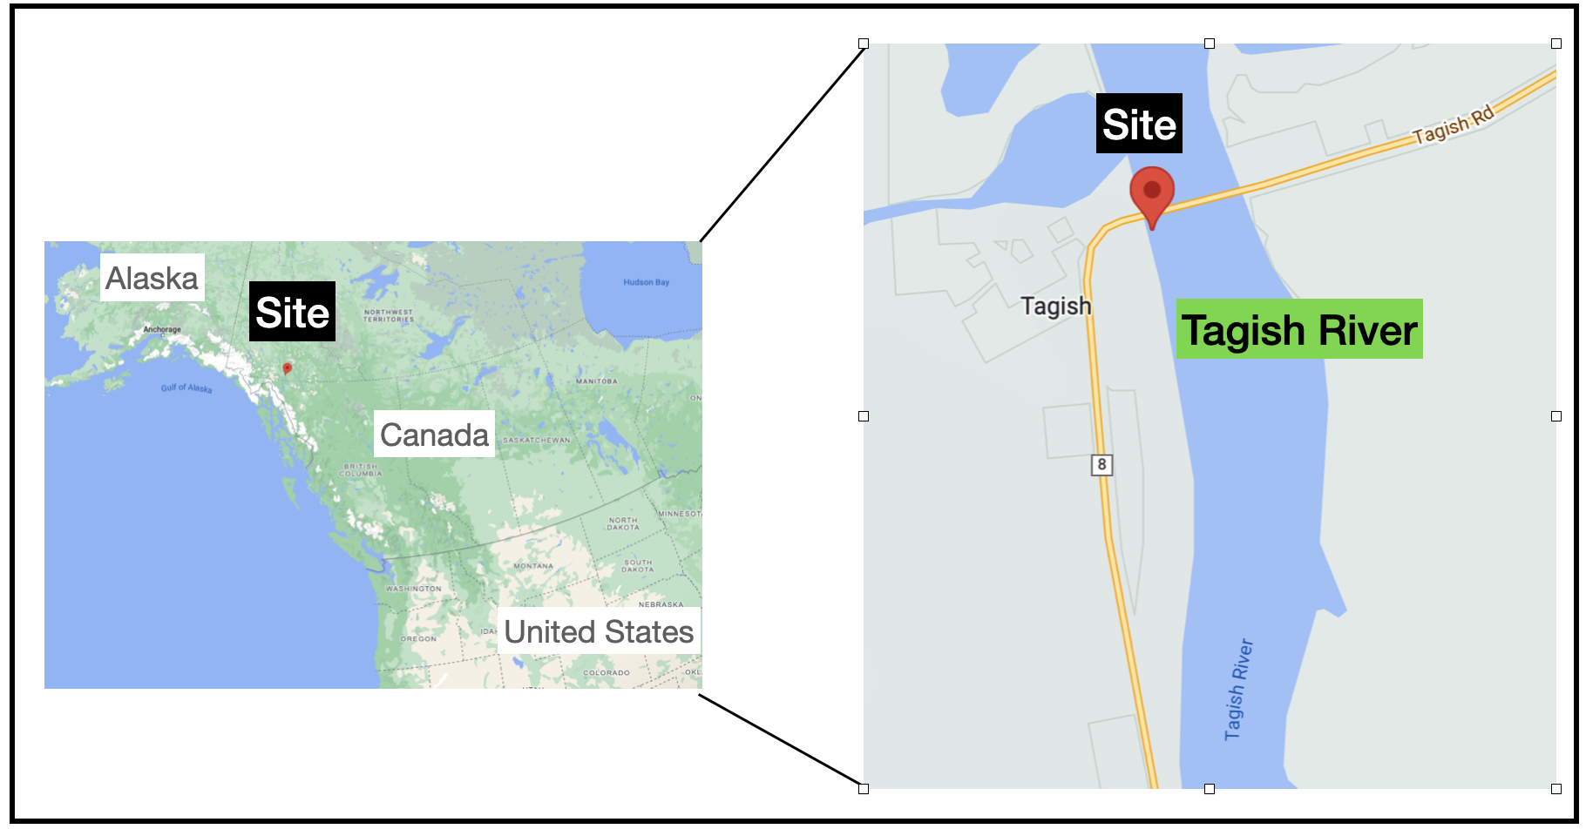
Research Project Title
Authors
School or Organization Name
School or Organization Logo
Abstract (Summary)
Planning and Carrying out the Investigation
Data Analysis
Data Interpretation
State the research question.
• Our research question is _____.
Describe why you chose this research question: What do you wonder?
• We wondered about this because __________.
Describe the investigation you planned and conducted.
• We collected data from __________.
State your claim and describe your supporting or refuting evidence (data).
• The data showed________, so we conclude that _____.
Data Visualization
Relating Data to the Research Question
State whether the research question can be answered based on the data, and why.
• The data (do or do not) help answer the research question because _______.
State whether your data support or refute your claim (hypothesis/prediction), and how.
• The data (can or cannot) be used as evidence to support our claim by_______.
Describe the uncertainties and limitations of the investigation including possible sources of error.
• Uncertainties and limitations, including possible sources of error, in our investigation were ______.
State whether there might or might not be a cause and effect relationship.
• There (might or might not) be a cause and effect relationship because the results show _______.
Identify the type or source of the data that you collected or downloaded, e.g., observations you made, GLOBE data you found.
• Our plan for the investigation was to collect data from/by _______
How were the data collected (i.e., when, where, how often, etc.)
• We planned to collect/analyze ___ data from______.
Include a map showing where the data were collected.
• The study location was _____.
(Optional) Describe changes that were made to the data collection plan and explain why these changes were made.
• (Optional) We ended up making (this change to our plan): ______, because _______.
• (Optional) We had other problems carrying out our investigation or answering our research question because _______.
Show your data in two ways using graphs, figures, and/or tables.
Add a title for each visual that describes the graph, figure, and/or table.
Data Relationships and Patterns
Describe any trends, patterns, or other relationships you notice in the data.
• As shown in our data graphs/charts/tables, _____ our results show _______ (patterns or lack of patterns).
Background Information for Research
Figure 2: Daily Cloud Cover at Tagish, Yukon, Canada
May 2012 to August 2012
State how you decided to do this research.
• We decided to do this research because we wondered ________.
What prior knowledge did you have about this research topic?
• We already knew ______ about this topic before the study from _____ (e.g., personal experience, background research, statements from experts in your field and community members).
Conclusion/Next Steps
Describe how your thinking about the research question has changed.
• We used to think ____ and now we think _____ about the research question.
Describe another way that you could interpret your data.
• Another way to interpret our data could be_______.
Discuss ways you could improve how you planned and/or carried out the investigation.
• Improvements to our investigation could be_______.
Discuss recommendations for follow-up investigations/future research.
• Future research could include.
(Optional) Describe additional background information that could support your conclusion.
• (Optional) Other sources could include: _______, which would help us _______.
• One thing we liked about this project is______.
Research Question & Hypothesis
Field Photos (requires release forms)
Figure 3: Water temperature of the Tagish River, Yukon, Canada
May 2012 to August 2012
Write the research question.
• Our research question is _____.
Write your claim, prediction, or hypothesis.
• Our claim (prediction/hypothesis) is _____.
How does the question relate to an environmental or global community issue?
• This topic is important because it relates to _____ (environmental or community) issue that can be understood through science inquiry or engineering.
Figure 1: Map of the study site location on the Tagish River, Yukon, Canada. May 2012 to August 2012
References/ Bibliography
Cite the GLOBE website.
(Optional) List GLOBE materials and/or NASA assets that were used.
(Optional) Cite any other relevant sources.
(See owl.english.purdue.edu for guidance and resources)

