Slide 1
GLOBE International STEM Network (GISN)
Science, Technology, Engineering, and Mathematics
The nuts and bolts of the GLOBE International STEM Network
October 2018

Slide 2
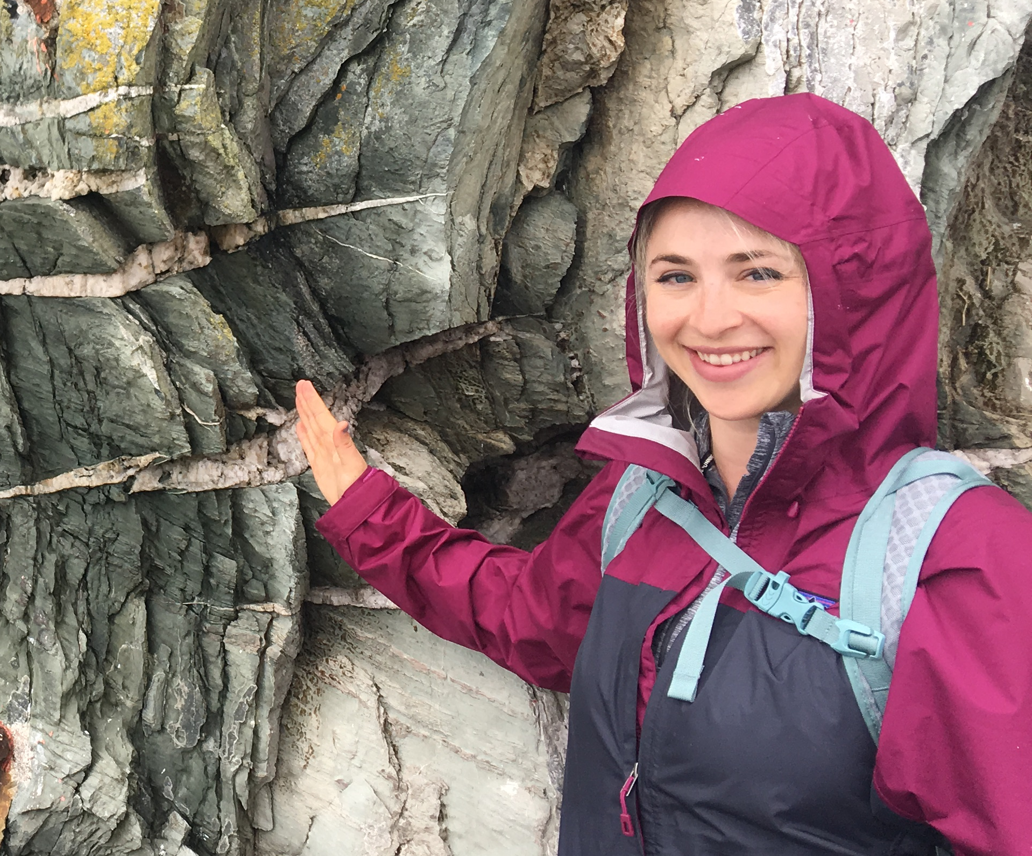
Presenter
Amy Barfield
GLOBE Implementation Office
Program Specialist
Member: GISN Early Career STEM Professionals

Slide 3
Agenda
What is GLOBE?
  Brief overview of the GISN
  GISN Members
Applying to the GISN
  Setting up your GLOBE profile
Participate as an individual in the GISN
  Writing and posting a blog for globe.gov
  Proposing a field campaign
  GISN Resources
  Participation Requirement
How to partner with GLOBE
  Connecting with a GLOBE teacher, school, institution
  Using globe.gov to connect with GLOBE members

Slide 4
Agenda
What is GLOBE?
  Brief overview of the GISN
  GISN Members
Applying to the GISN
  Setting up your GLOBE profile
Participate as an individual in the GISN
  Writing and posting a blog for globe.gov
  Proposing a field campaign
  GISN Resources
  Participation Requirement
How to partner with GLOBE
  Connecting with a GLOBE teacher, school, institution
  Using globe.gov to connect with GLOBE members

Slide 5
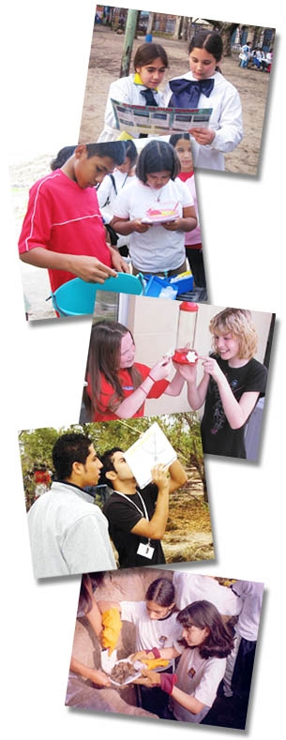
Global Learning and Observations to Benefit the Environment
Program Goals:
Improve student understanding across the curriculum;
Enhance environmental awareness;
Contribute to scientific understanding of Earth as a system; and
Inspire and Connect the next generation of global STEM professionals
Notes:
International science and education program. Launched in 1995.
Mission:To promote the teaching and learning of science, enhance environmental literacy and stewardship, and promote scientific discovery.

Slide 6
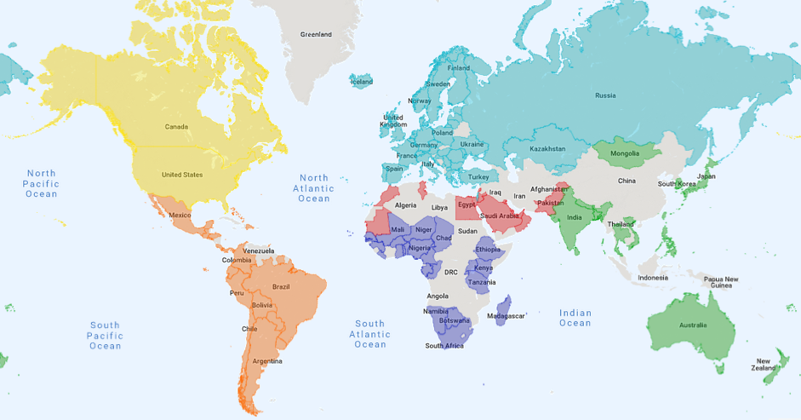
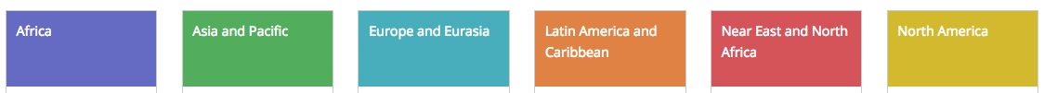
121 Countries across 6 GLOBE regions
GLOBE has trained 33,000+ teachers representing 30,000+ schools worldwide
With over 157 million measurements

Slide 7
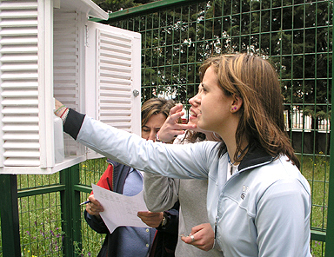
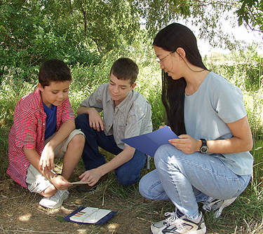
GLOBE Protocols and Measurements
Hydrosphere
Water temperature
Transparency
Water chemistry
  pH, dissolved Oxygen, alkalinity, nitrate,
  salinity and conductivity
Freshwater macro-invertebrates
Mosquitoes (MHM app)
Atmosphere
Air temperature (Maximum, Minimum, Current)
Surface temperature
Precipitation (Rain, Snow, pH)
Cloud Cover/Type including contrails (APP)
Relative humidity
Barometric pressure
Aerosols and water vapor

Slide 8
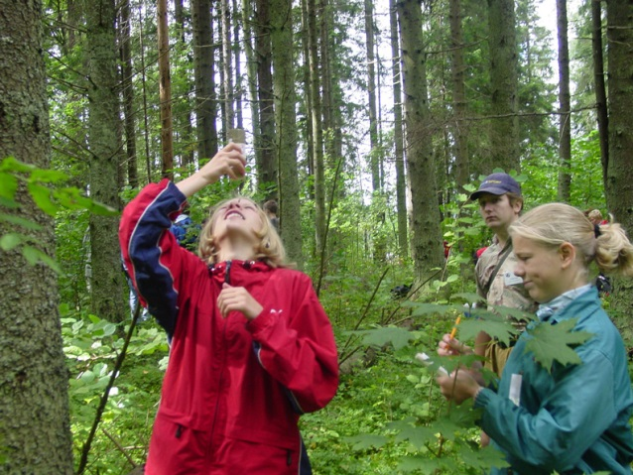
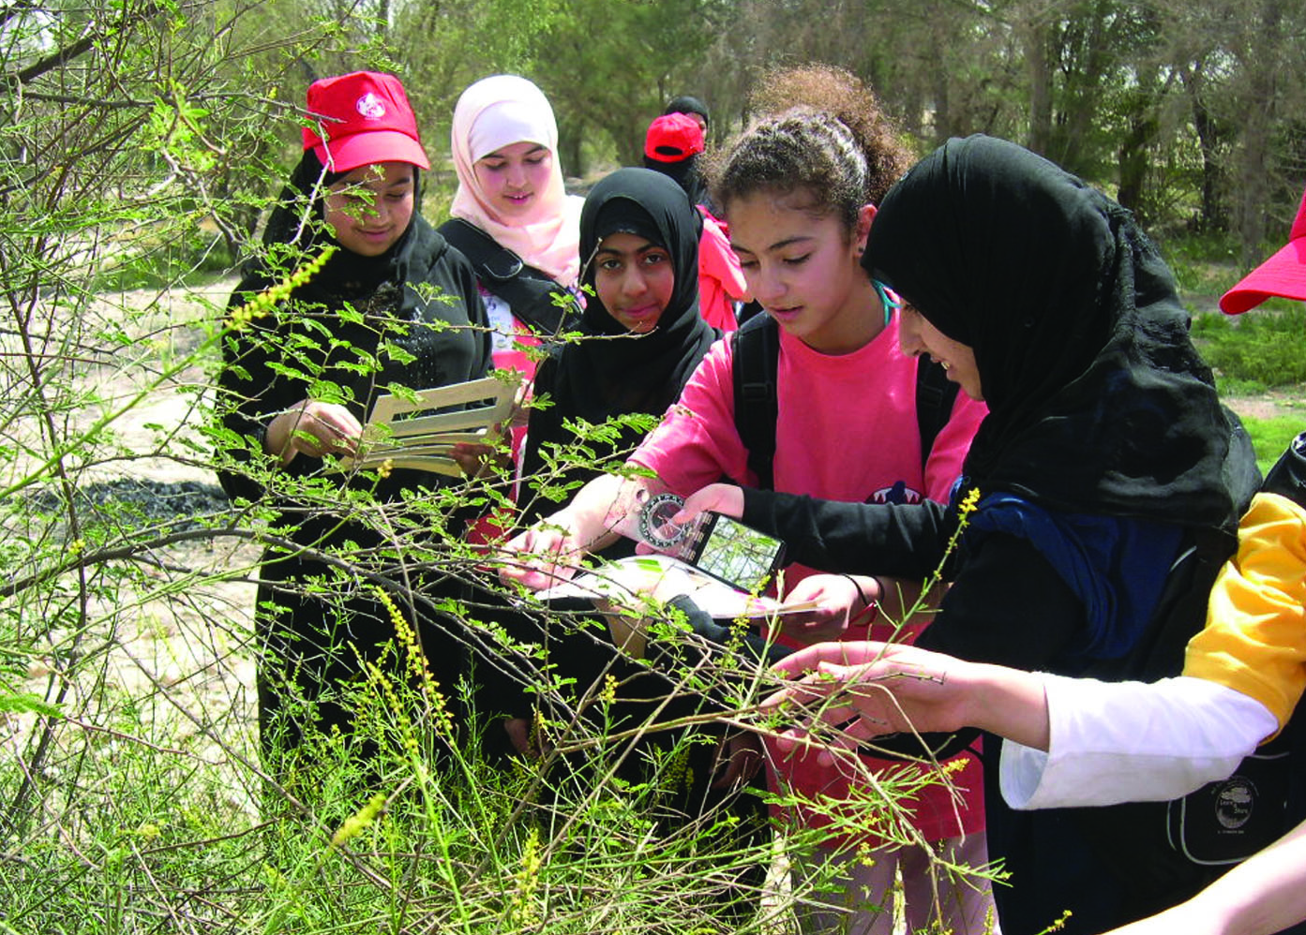
GLOBE Protocols and Measurements
Biosphere
Land Cover (APP)
Land Cover Classification
Biometry (canopy and ground cover, tree and shrub
height, tree diameter, grass biomass, species id)
Fire fuel ecology
Carbon Cycle
Phenology
Green-up and green-down
Ruby-throated hummingbird monitoring
Phenological gardens
Common and cloned lilacs
Seaweed reproductive phenology
Arctic bird migration monitoring

Slide 9
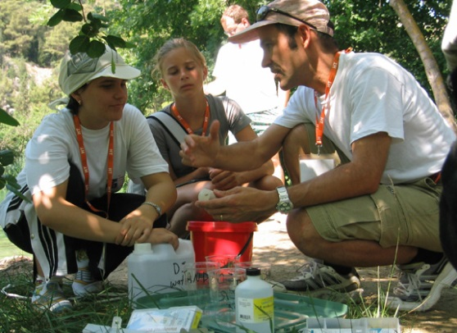
GLOBE Protocols and Measurements
Soils (Pedosphere)
Soil temperature, soil moisture
Soil bulk density, pH, particle size distribution, particle density, fertility
Soil characterization
  Structure, color, texture, consistency
Frost Tube

Slide 10
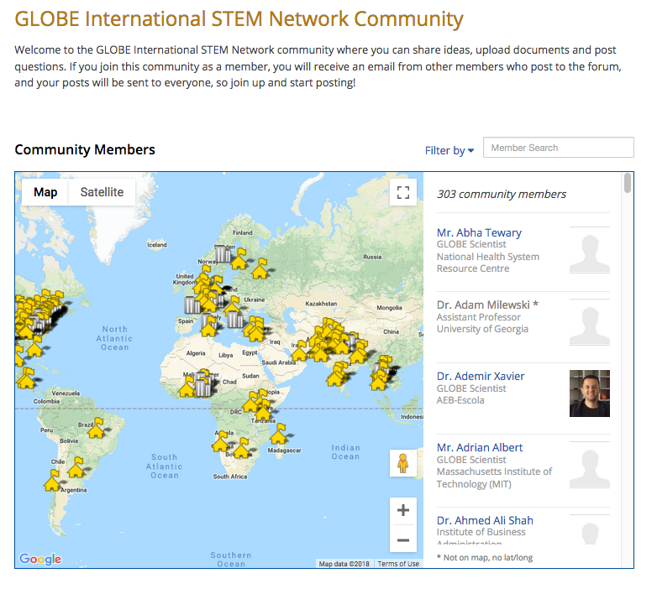
GLOBE International STEM Network

Slide 11
GLOBE International STEM Network
Network of scientists and STEM (Science, Technology, Engineering, Mathematics) professionals from all 6 GLOBE regions
Meet certain criteria:
  Reside and/or be employed in a GLOBE country*
  Hold a Master's or Ph.D. in a science, technology, engineering, or mathematics (STEM) field
  Be working toward a Ph.D. in a STEM field
  Hold a B.S. in a STEM field, plus have at least five years' experience working in a STEM field
  Early Career STEM Professionals are a sub-group of the GISN, and must be upper-level undergraduate or master's students pursuing a degree in a STEM field or be a recent graduate working in a STEM field but have fewer than five years’ of professional experience
  (instructions to apply can be found here: https://www.globe.gov/get-started/become-a-globe-scientist)
Partner with GLOBE schools in a variety of ways
Are engaged with GLOBE and are willing to do at least one GISN-related activity per year
* If you are not in a GLOBE country and would like to get your country involved, email help@globe.gov
Notes:
Mention if not in a globe country email help@globe.gov... Also mention them sooner

Slide 12
GLOBE International STEM Network
Why scientists participate in the GISN
Strong desire to mentor and inspire young minds
GLOBE scientific database to supplement standard research data
GLOBE students can collect additional data
Establish an international component to research
GLOBE students want to be a part of real-world, cutting edge science

Slide 13
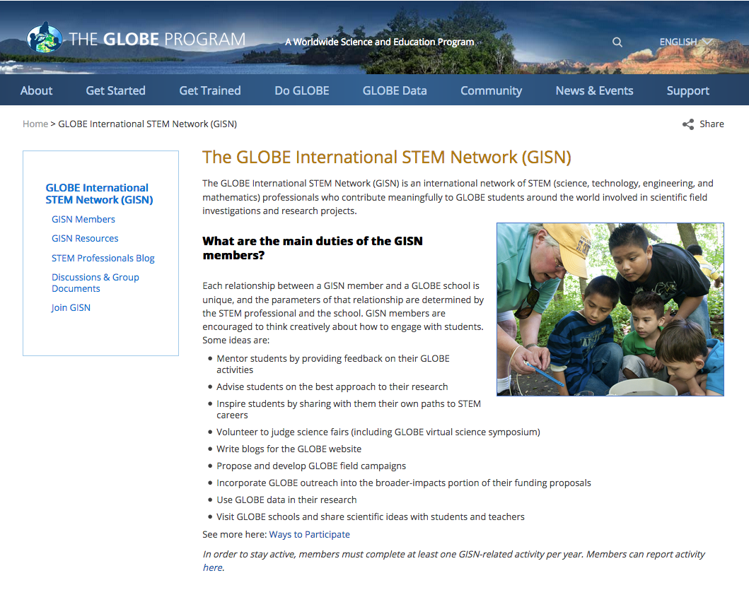
GLOBE International STEM Network Members

Slide 14
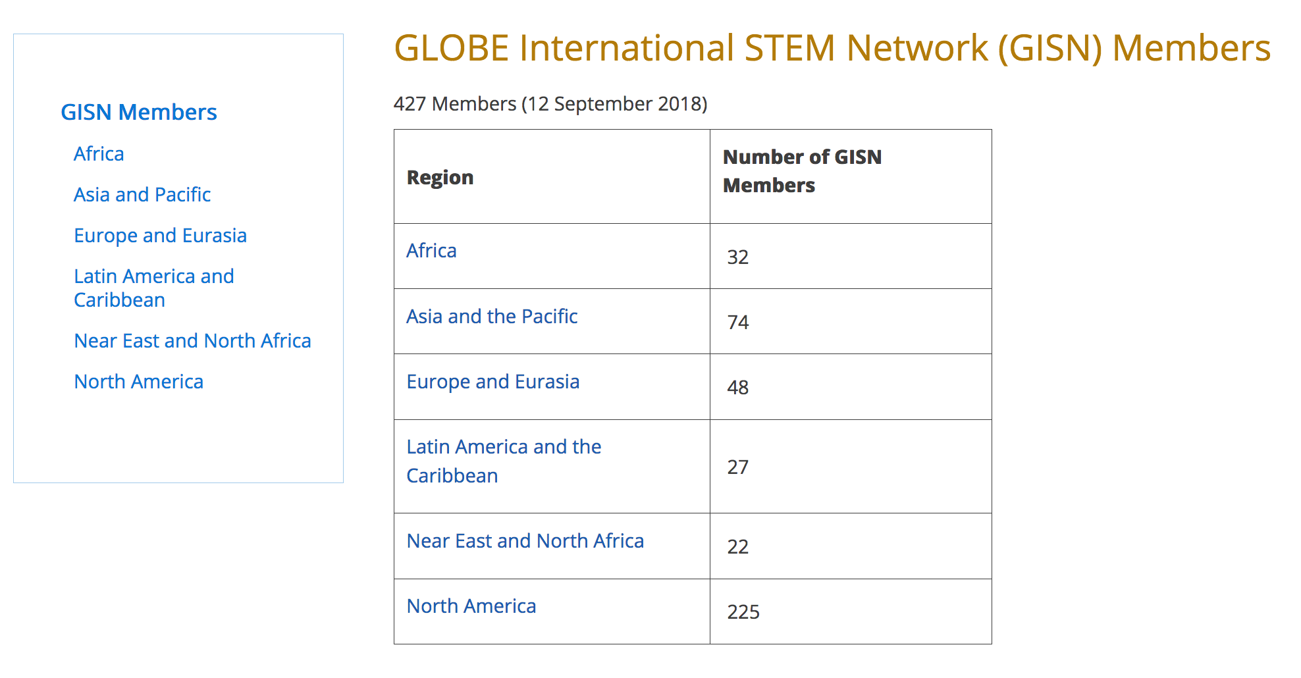
GLOBE International STEM Network Members
Members divided by region
Select the region to see a list of members in that region
Notes:
https://www.globe.gov/web/globe-international-stem-network/overview/gisn-members

Slide 15
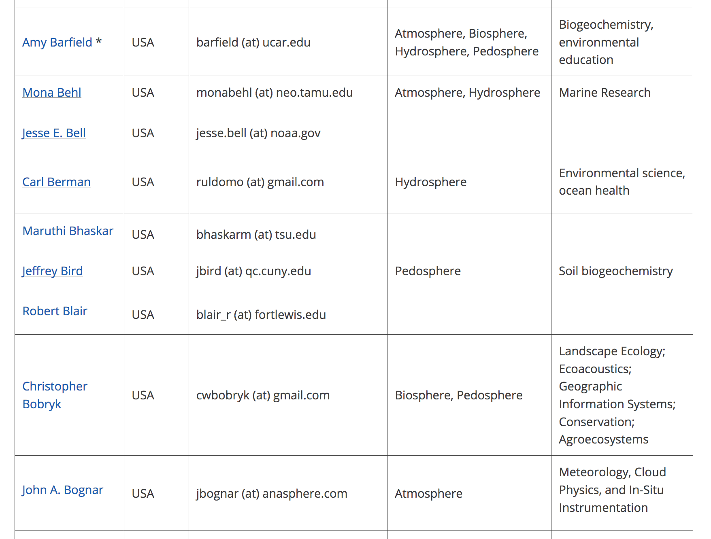
GLOBE International STEM Network Members
Members divided by region
Notes:
https://www.globe.gov/web/globe-international-stem-network/overview/gisn-members

Slide 16
GLOBE International STEM Network Members
An asterisk (*) next to the name indicates Early Career STEM Professional
Members divided by region
Notes:
https://www.globe.gov/web/globe-international-stem-network/overview/gisn-members

Slide 17
GLOBE International STEM Network Members
An asterisk (*) next to the name indicates Early Career STEM Professional
Members divided by region
Click on the name to see the member’s profile
Notes:
https://www.globe.gov/web/globe-international-stem-network/overview/gisn-members

Slide 18
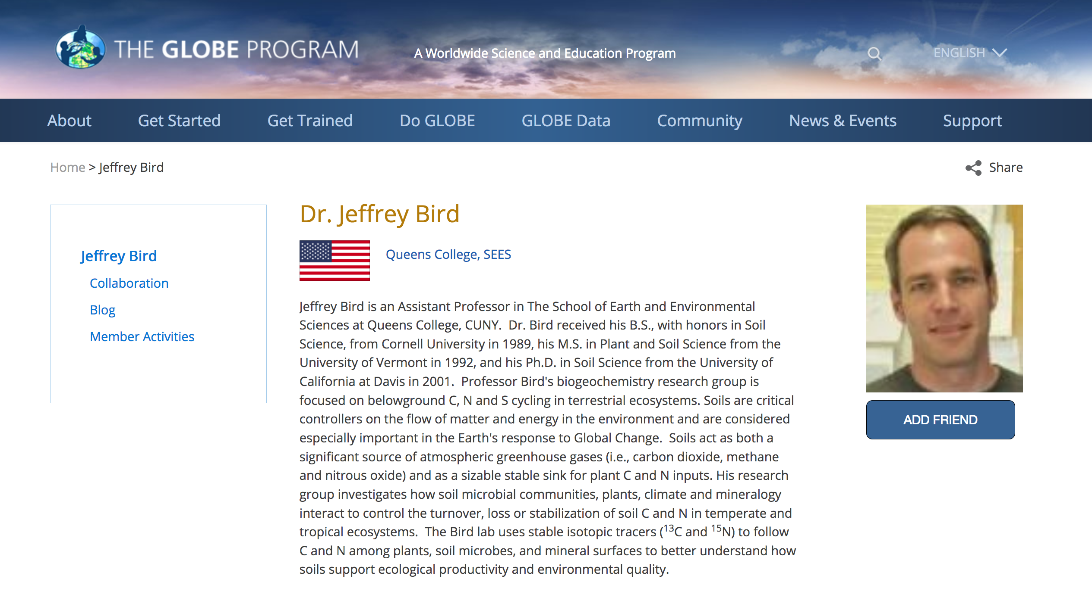
GLOBE International STEM Network Members
An asterisk (*) next to the name indicates Early Career STEM Professional
Members divided by region
Click on the name to see the member’s profile
(More on profiles in a minute)
Notes:
https://www.globe.gov/web/globe-international-stem-network/overview/gisn-members

Slide 19
GLOBE International STEM Network Members
An asterisk (*) next to the name indicates Early Career STEM Professional
Members divided by region
Click on the name to see the member’s profile
Member’s country, email, GLOBE ”spheres”, and specific research interests are listed here so you can easily identify potential collaborators
Notes:
GLOBE spheres are Atmos…
https://www.globe.gov/web/globe-international-stem-network/overview/gisn-members

Slide 20
Agenda
What is GLOBE?
  Brief overview of the GISN
  GISN Members
Applying to the GISN
  Setting up your GLOBE profile
Participate as an individual in the GISN
  Writing and posting a blog for globe.gov
  Proposing a field campaign
  GISN Resources
  Participation Requirement
How to partner with GLOBE
  Connecting with a GLOBE teacher, school, institution
  Using globe.gov to connect with GLOBE members

Slide 21
Interested in the GISN?
If you meet the criteria…
  Reside and/or be employed in a GLOBE country
  Hold a Master's or Ph.D. in a science, technology, engineering, or mathematics (STEM) field
  Be working toward a Ph.D. in a STEM field
  Hold a B.S. in a STEM field, plus have at least five years' experience working in a STEM field
  Early Career STEM Professionals are a sub-group of the GISN, and must be upper-level undergraduate or master's students pursuing a degree in a STEM field or be a recent graduate working in a STEM field but have fewer than five years’ of professional experience
The next step is to create a GLOBE account…
https://www.globe.gov/get-started/globe-observers-citizen-scientists/create-an-account
Notes:
https://www.globe.gov/get-started/become-a-globe-scientist
https://www.globe.gov/get-started/globe-observers-citizen-scientists/create-an-account
https://www.globe.gov/support/faqs/globe-website-tutorials/name

Slide 22
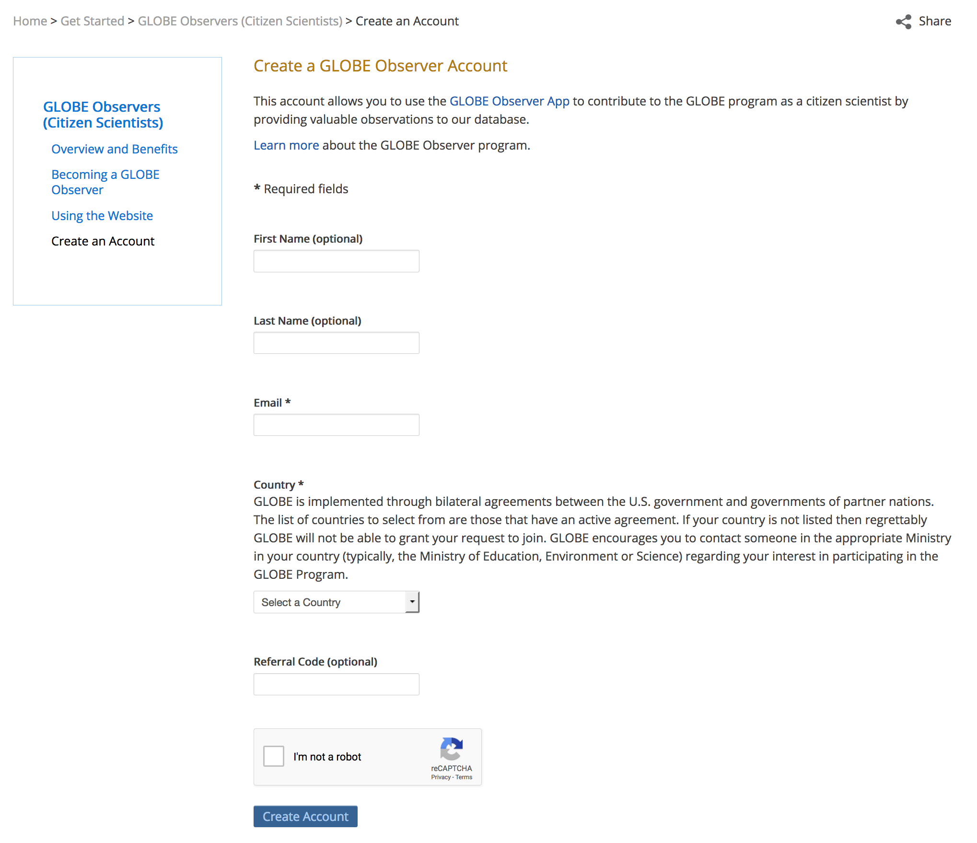
Creating a GLOBE account
First, create an account
Notes:
https://www.globe.gov/support/faqs/globe-website-tutorials/name
https://www.globe.gov/get-trained/protocol-etraining

Slide 23
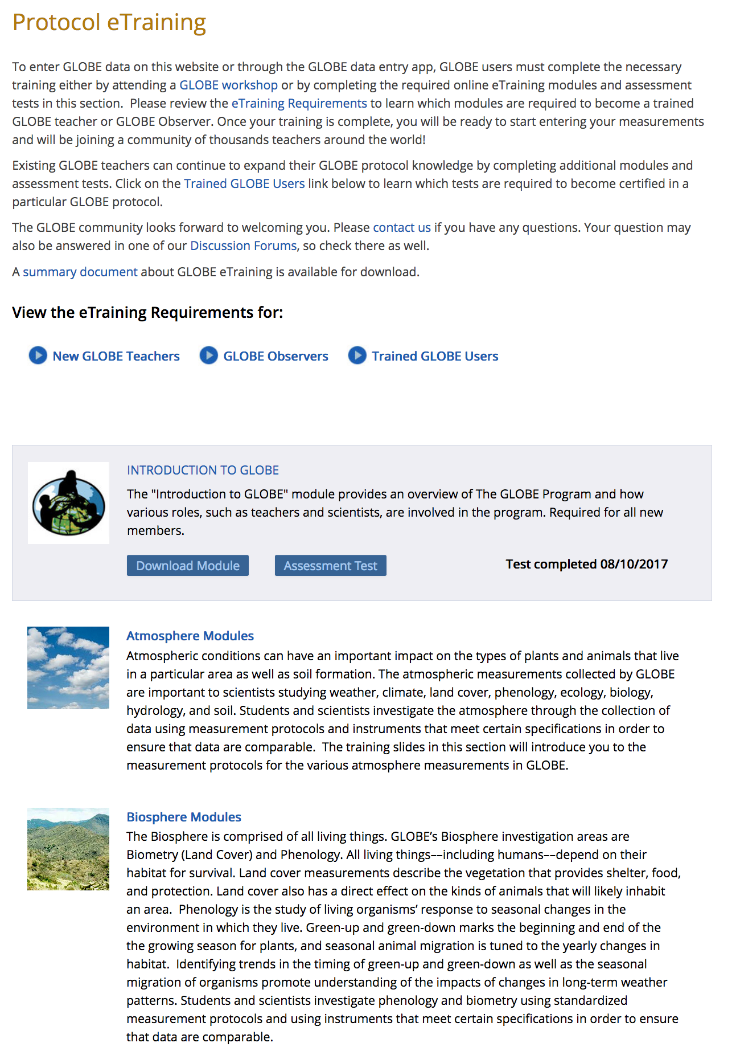
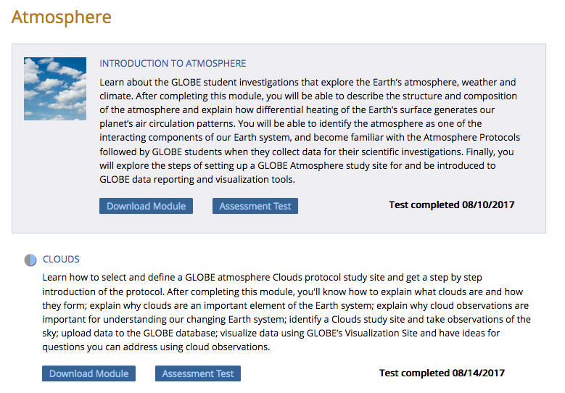
Creating a GLOBE account
2
1
3
Next, complete the Introduction to GLOBE e-training assessment, a sphere assessment, a one protocol eTraining module and assessment
Notes:
https://www.globe.gov/support/faqs/globe-website-tutorials/name
https://www.globe.gov/get-trained/protocol-etraining

Slide 24
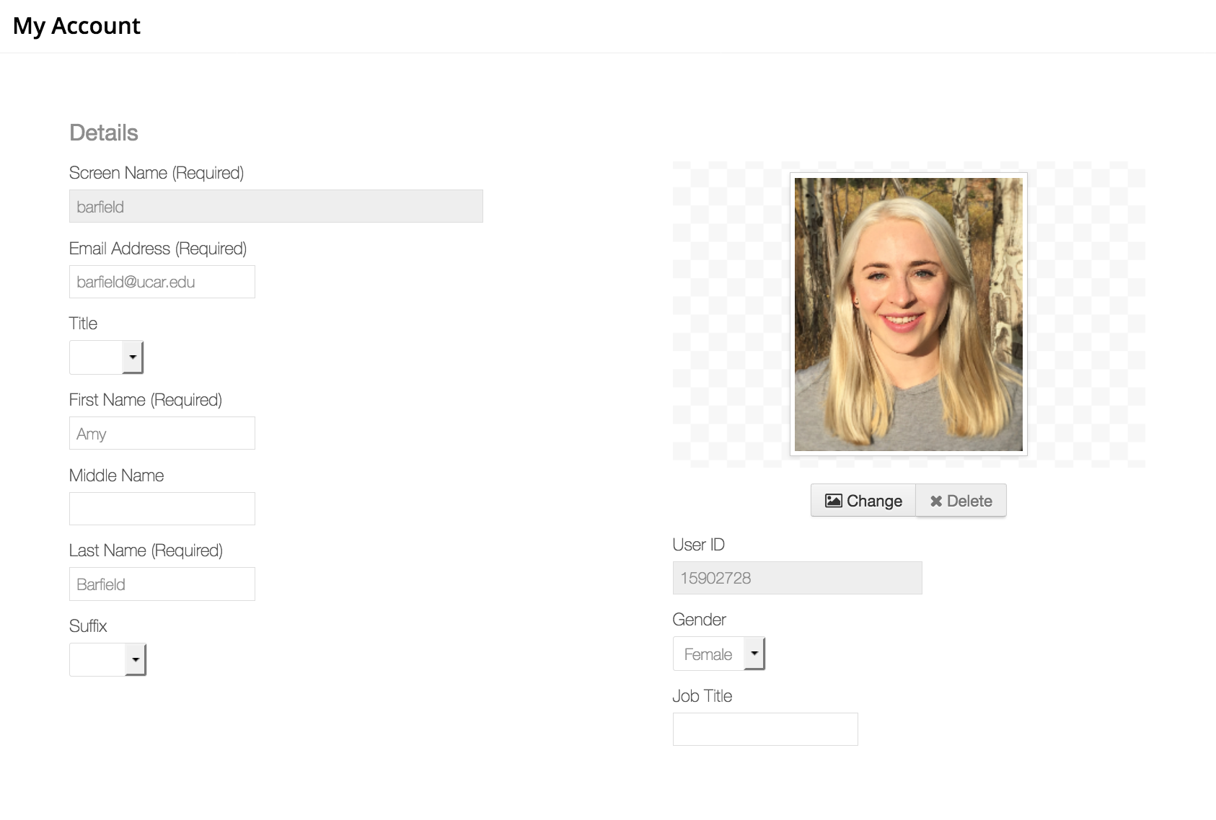
Creating a GLOBE account
Next, change your name on your account.
You will automatically be given the name “Citizen Scientist” when you create your account but you will need to change your name in order to access the GISN application
For help on this, view the tutorial here: https://www.globe.gov/support/faqs/globe-website-tutorials/name
Notes:
https://www.globe.gov/support/faqs/globe-website-tutorials/name

Slide 25
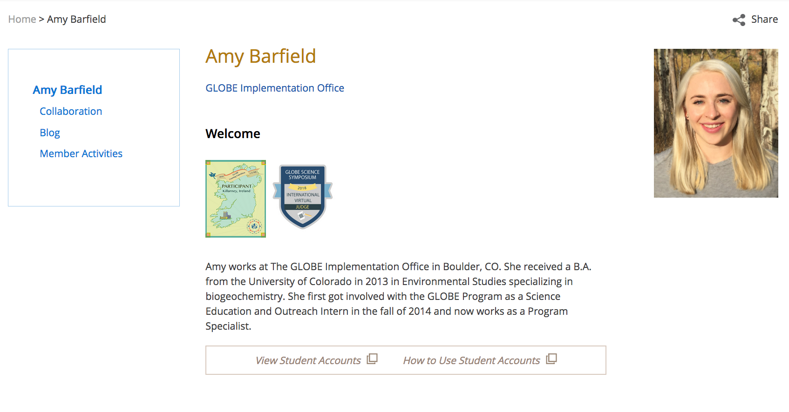

Creating a GLOBE account
Later, you can change your photo and add some personal information (education, current research projects, etc.)
Click in this icon to edit your account
Notes:
https://www.globe.gov/support/faqs/globe-website-tutorials/name

Slide 26
Creating a GLOBE account
Later, you can change your photo and add some personal information (education, current research projects, etc.)
In case you are wondering, these are virtual badges. You can get them from judging International Virtual Science Symposium (IVSS) projects, attending certain GLOBE events, participating in campaigns, and more!

Slide 27
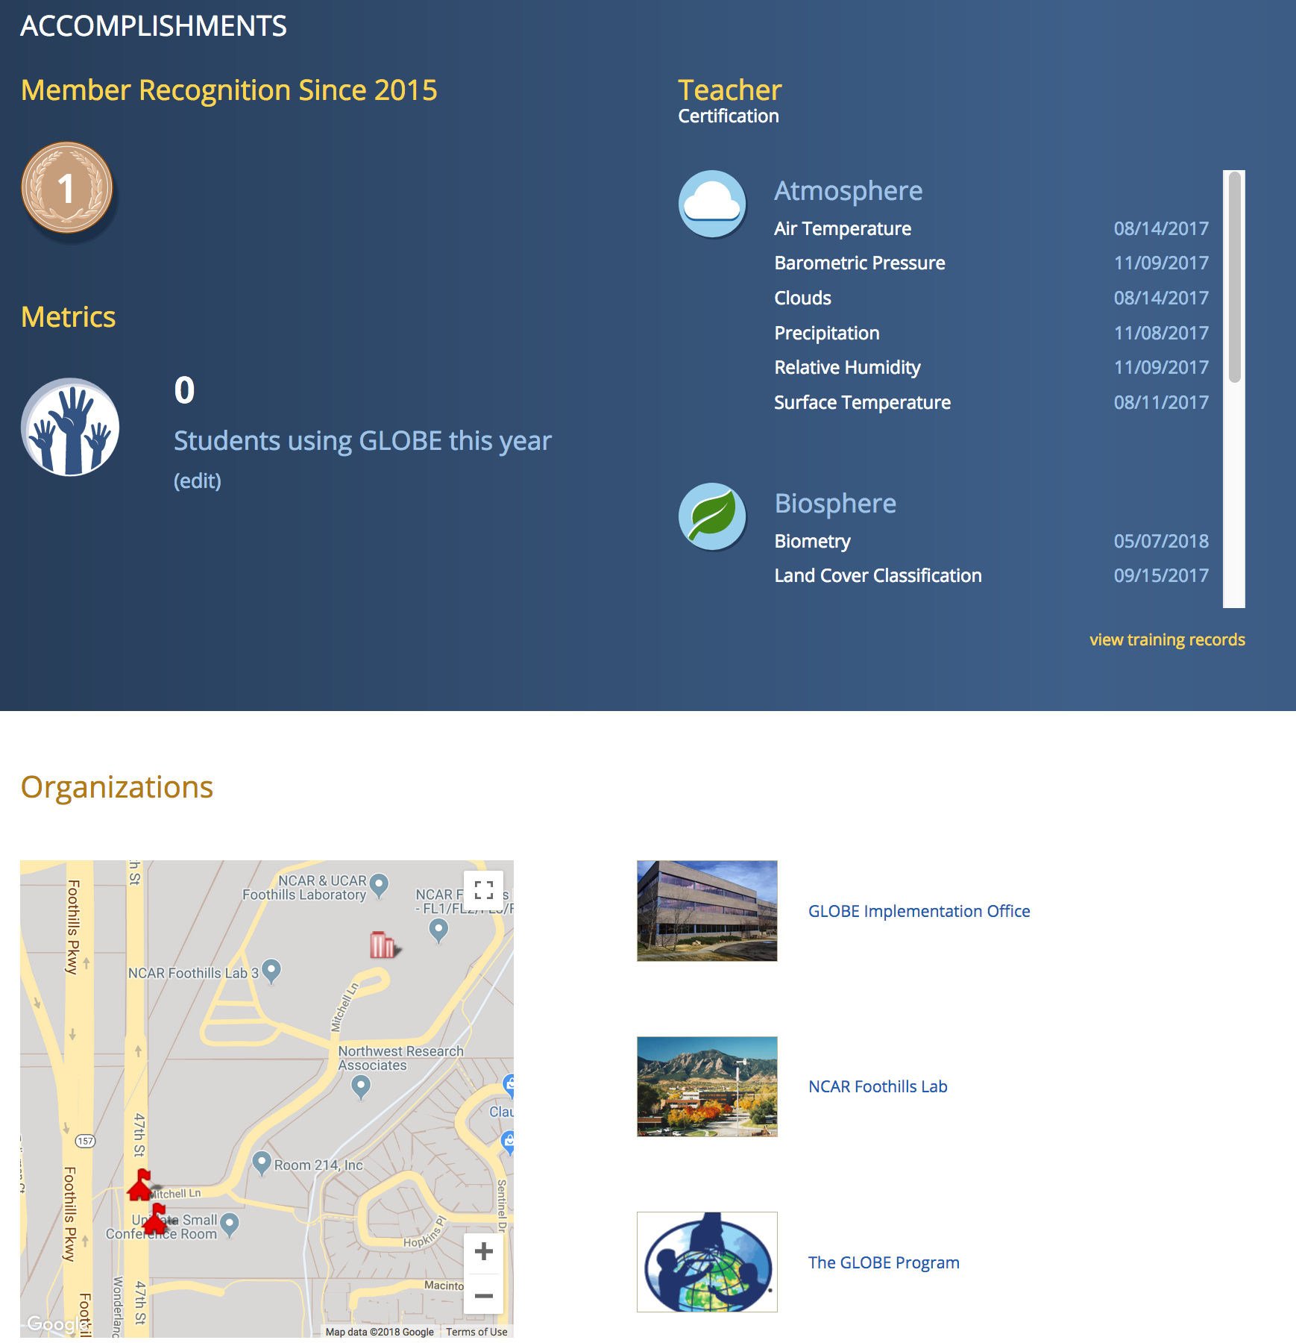
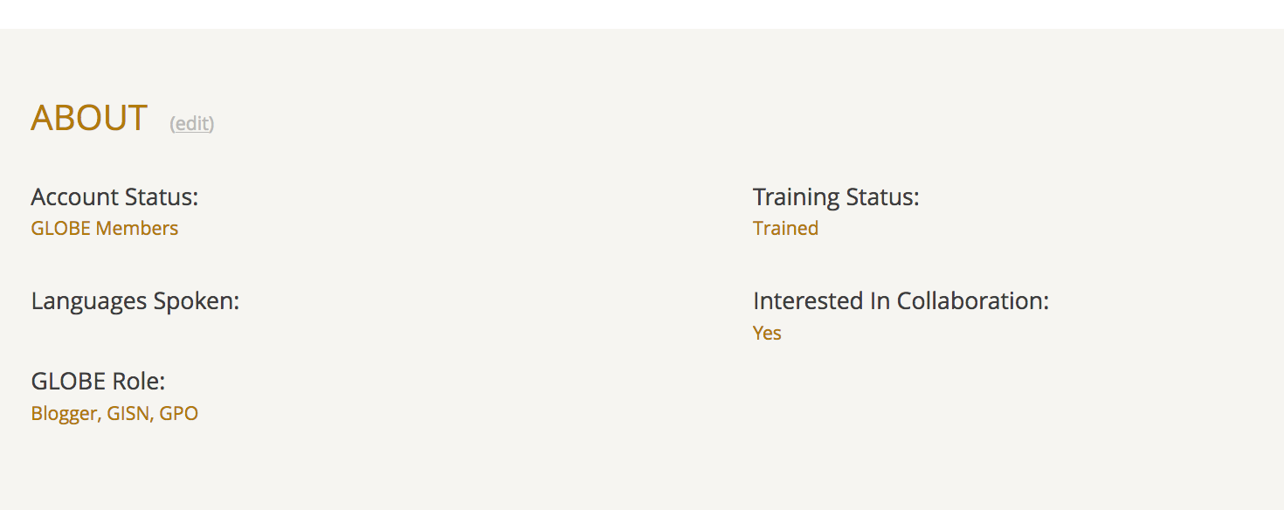
Your GLOBE account
Scrolling down, you can see
  how many students you have using GLOBE,
  any trainings (such as e-Trainings) you have completed,
  which organizations you belong to (i.e. your school)
  and your GLOBE role. If you are accepted to the GISN, you will see “GISN” appear in your roles.
Notes:
If you want to be a part of/associated with an organization, email help@globe.gov
m

Slide 28
Your GLOBE account
You also have sub-pages:
  Collaboration
  Blog
  Member activities

Slide 29
Your GLOBE account
You also have sub-pages:
  Collaboration
  Blog
  Member activities

Slide 30
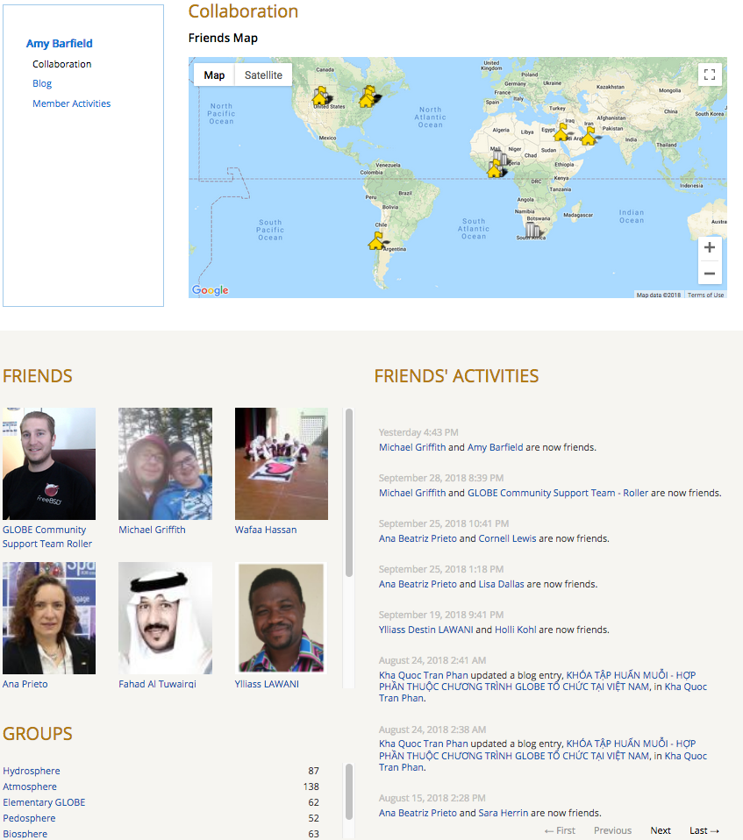
See your groups, friends, and friend’s activities

Slide 31
Your GLOBE account
You also have sub-pages:
  Collaboration
  Blog
  Member activities

Slide 32
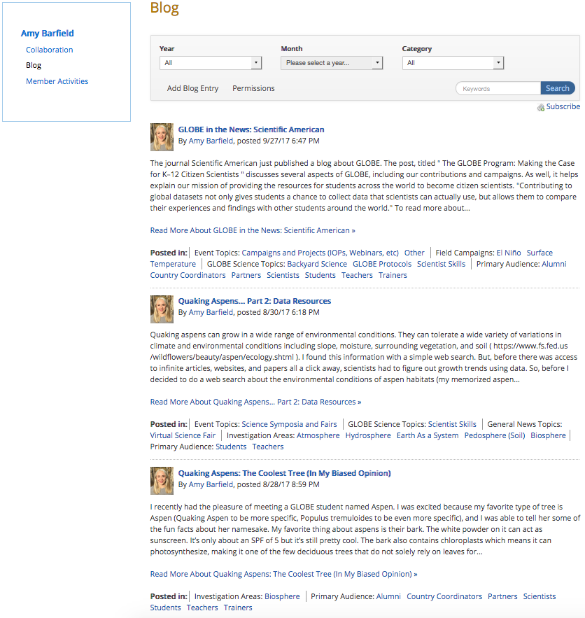
See all of the blogs you have written on globe.gov

Slide 33
Interested in the GISN?
If you meet the criteria…
  Reside and/or be employed in a GLOBE country
  Hold a Master's or Ph.D. in a science, technology, engineering, or mathematics (STEM) field
  Be working toward a Ph.D. in a STEM field
  Hold a B.S. in a STEM field, plus have at least five years' experience working in a STEM field
  Early Career STEM Professionals are a sub-group of the GISN, and must be upper-level undergraduate or master's students pursuing a degree in a STEM field or be a recent graduate working in a STEM field but have fewer than five years’ of professional experience
And you’ve created a GLOBE account…
The next step is to apply!
Notes:
https://www.globe.gov/get-started/become-a-globe-scientist

Slide 34

Interested in the GISN?
If you meet the criteria…
  Reside and/or be employed in a GLOBE country
  Hold a Master's or Ph.D. in a science, technology, engineering, or mathematics (STEM) field
  Be working toward a Ph.D. in a STEM field
  Hold a B.S. in a STEM field, plus have at least five years' experience working in a STEM field
  Early Career STEM Professionals are a sub-group of the GISN, and must be upper-level undergraduate or master's students pursuing a degree in a STEM field or be a recent graduate working in a STEM field but have fewer than five years’ of professional experience
And you’ve created a GLOBE account…
The next step is to apply!
Locate this button on https://www.globe.gov/get-started/become-a-globe-scientist
Notes:
You will not see this button unless you have changed the name on your account
https://www.globe.gov/get-started/become-a-globe-scientist

Slide 35
Applying to the GISN
Notes:
https://www.globe.gov/get-started/become-a-globe-scientist

Slide 36
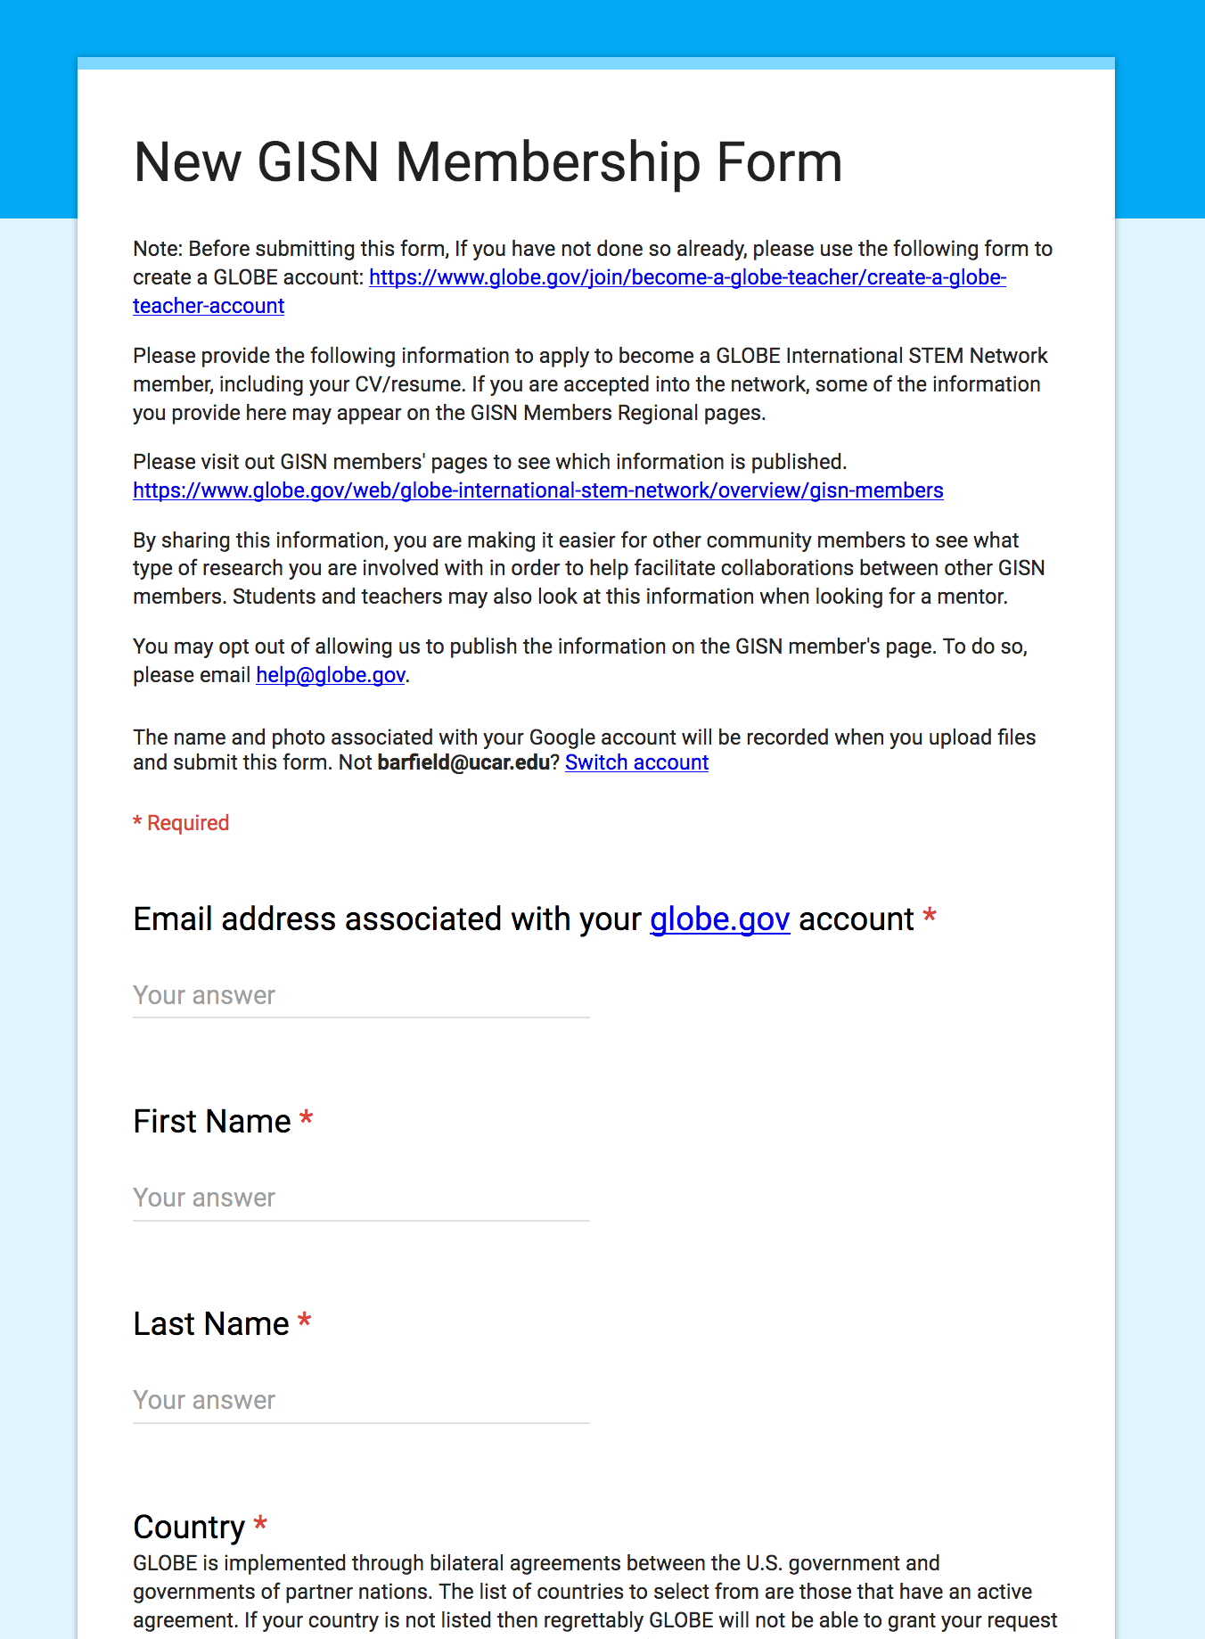
Interested in the GISN?
Fill out this form to apply to the GISN
  Name
  Email associated with your GLOBE account
  Country
  CV/Resume
  Paragraph on how you see yourself fitting in with GLOBE and participating in the GISN
  Education
  GLOBE spheres related to your research interests
  Specific research areas
Once you submit the form, the Community Support Team will reach out to you and let you know if you have been accepted or not.
Notes:
Organization name is where you work, your school or research institution…
If you are unsure if you qualify, email help@globe.gov before creating an account and they can do a courtesy review of your CV to let you know if it is likely that you will get in
https://www.globe.gov/get-started/become-a-globe-scientist

Slide 37
Agenda
What is GLOBE?
  Brief overview of the GISN
Applying to the GISN
  Setting up your GLOBE profile
Participate as an individual in the GISN
  Writing and posting a blog for globe.gov
  Proposing a field campaign
  GISN Resources
  Participation Requirement
How to partner with GLOBE
  Connecting with a GLOBE teacher, school, institution
  Using globe.gov to connect with GLOBE members

Slide 38
GISN Resources

Slide 39
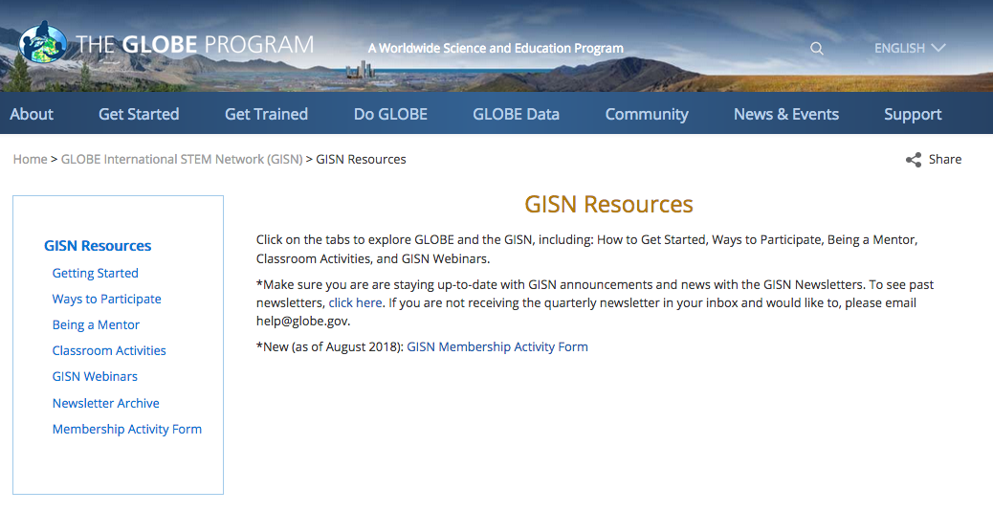
GISN Resources

Slide 40
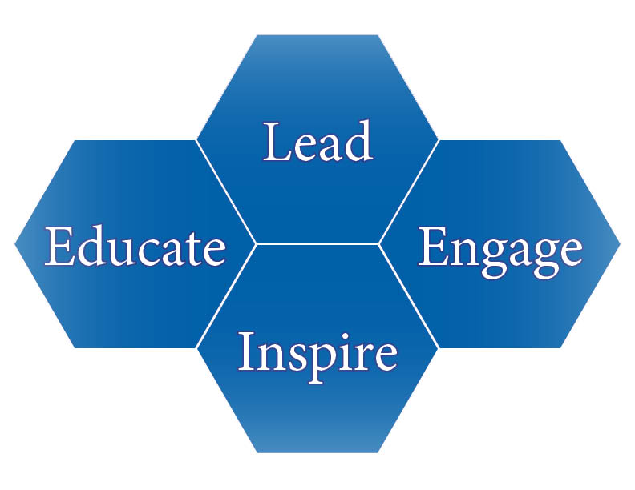
Ways to Participate
Notes:
https://www.globe.gov/web/globe-international-stem-network/overview/outreach-resources/ways-to-participate

Slide 41
Ways to Participate
Lead:
Assume responsibility for a GLOBE protocol (Guidelines for Proposing New Protocols)
Involve GLOBE teachers and students in your scientific research
Assume responsibilities for GLOBE student research campaigns (Guidelines for Proposing GLOBE Student Research Campaigns)
Become a GLOBE Partner
Notes:
https://www.globe.gov/web/globe-international-stem-network/overview/outreach-resources/ways-to-participate

Slide 42
Ways to Participate
Engage:
Sponsor a GLOBE student science fair
Affiliate with a GLOBE partner
Become a GLOBE trainer
Notes:
https://www.globe.gov/web/globe-international-stem-network/overview/outreach-resources/ways-to-participate

Slide 43
Ways to Participate
Inspire:
Visit a GLOBE school to do an activity
Write blogs about science topics and experience related to GLOBE and your field of expertise
Judge virtual GLOBE science symposium projects
Judge local, in-person GLOBE science fairs
Mentor STEM students
Notes:
https://www.globe.gov/web/globe-international-stem-network/overview/outreach-resources/ways-to-participate

Slide 44
Ways to Participate
Educate:
Partner with a GLOBE teacher or school
Use GLOBE data in your research
Publish a journal article involving GLOBE data
Notes:
https://www.globe.gov/web/globe-international-stem-network/overview/outreach-resources/ways-to-participate

Slide 45
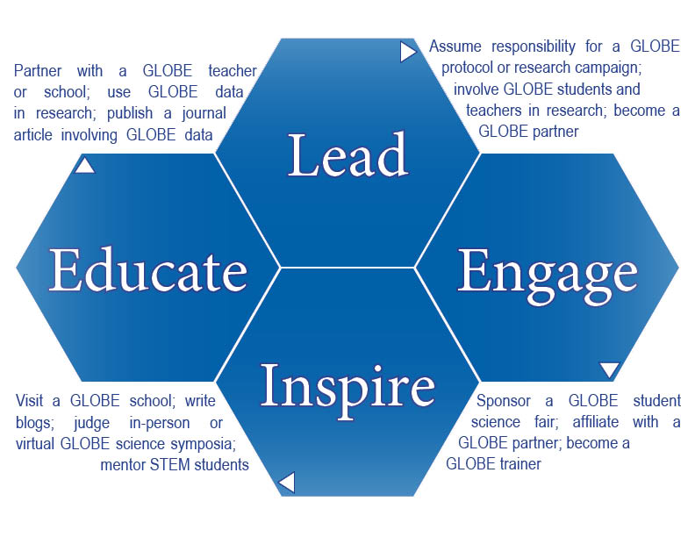
Ways to Participate
Each relationship with a GLOBE school is uniquely determined by you and the school. Members of the GLOBE International STEM Network are mentors and role models for students. You can participate at a level that is appropriate to your skills, resources, availability, and interest.

Slide 46
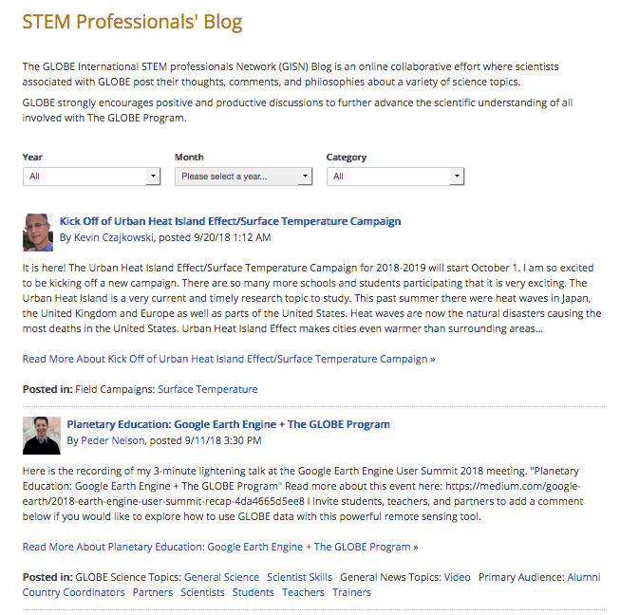
Writing a blog post on globe.gov
If you write blogs (or are interested in writing blogs), we have a blogging platform on globe.gov
Pictured here is our blog aggregator. If you have a blog tab on your profile, your blog post will automatically appear in this aggregator.
Blogs are often shared on our other social media platforms (Facebook and Twitter) so this can be a great way to communicate your science to a wider audience as well.
Notes:
https://www.globe.gov/web/globe-international-stem-network/overview/scientists-blogs

Slide 47
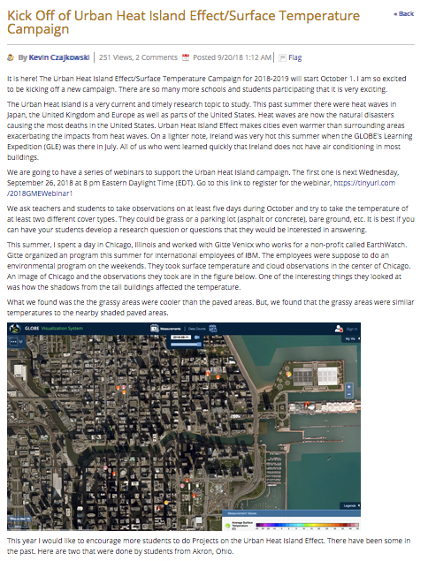
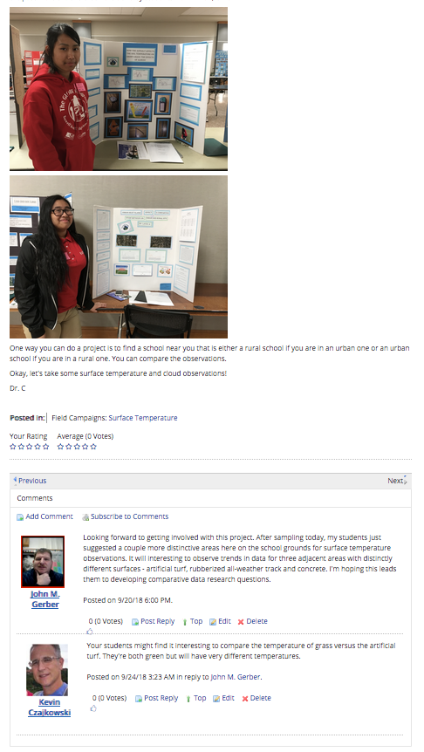

Slide 48
How to write blogs
Remember this?

Slide 49
How to write blogs
Remember this?

Slide 50
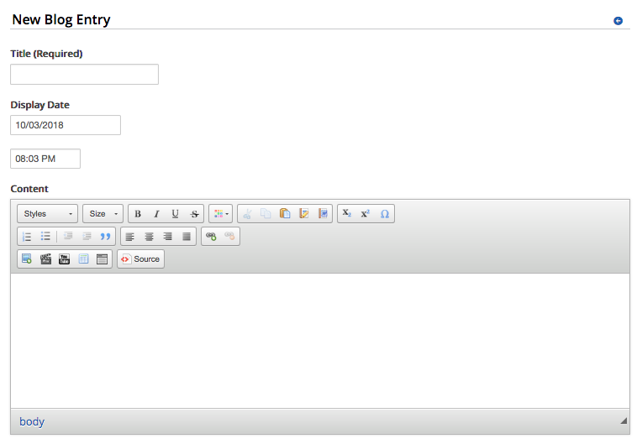
How to write blogs
Tutorial available: https://www.globe.gov/support/faqs/globe-website-tutorials/blog
Add text/videos/pictures here!
Notes:
Blog tutorial: https://www.globe.gov/support/faqs/globe-website-tutorials/blog

Slide 51
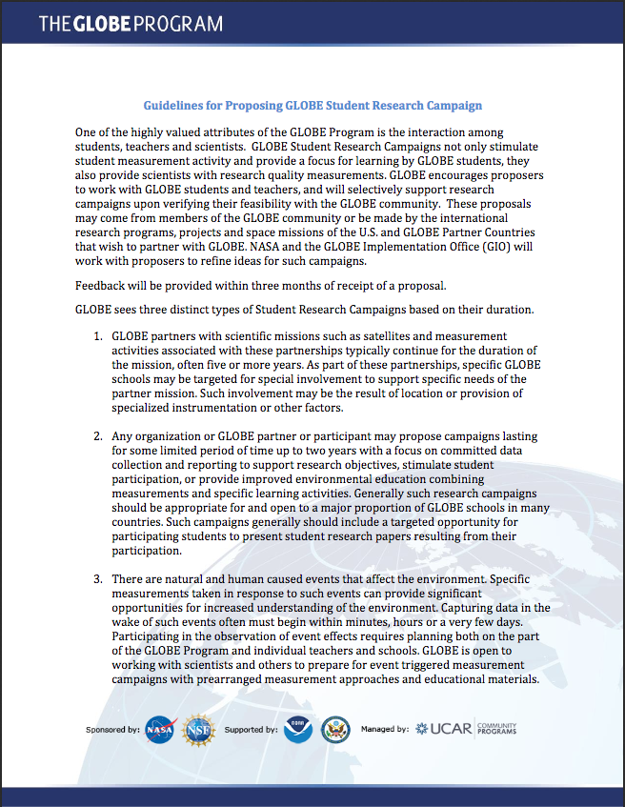
Proposing a Field Campaign
You can either participate in current field campaigns (find them here: https://www.globe.gov/do-globe/measurement-campaigns/field-measurement-campaigns) or you can propose your own.
If you need a lot of data or need data from a specific area, you can propose a campaign and have students help you collect measurements for your research!
Notes:
https://www.globe.gov/documents/10157/9033487/Guidelines+for+Campaigns.Final.2013.pdf

Slide 52
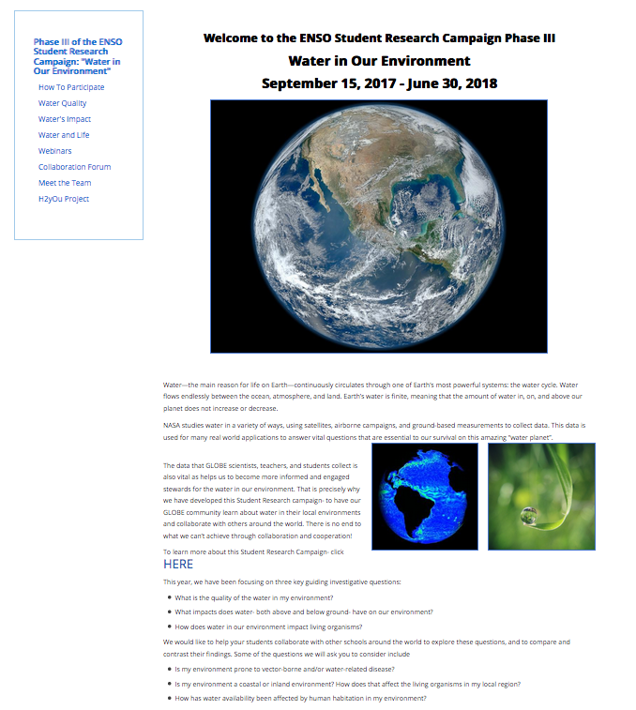
Proposing a Field Campaign
Look for additional campaign info and links here

Slide 53
Volunteer @ GLOBE Events
International Virtual Science Symposium (IVSS)
  Score projects, mentor students
  http://globe.gov/science-symposium
U.S. Regional Student Research Symposia (SRS)
  Host, score projects
  https://www.globe.gov/web/united-states-of-america/home/student-research-symposia
GLOBE Annual Meeting and GLOBE Learning Expedition (GLE)
  Student chaperone, trainer/coach, moderator
  https://www.globe.gov/news-events/meetings_symposia
GLOBE Games and other regional events
  https://www.globe.gov/news-events/calendar
Notes:
IVSS judging has training!!

Slide 54
GISN Resources
One way to participate as a scientist in GLOBE is by mentoring students and/or teachers.
Mentoring can provide both unique opportunities and challenges. According to The Leadership Alliance, the willingness to guide, instruct and assist students to reach their objective with their research is key to a successful mentorship experience.
The resources on this page will provide general information that can be tailored to your own unique relationship with GLOBE students and teachers.
Notes:
https://www.globe.gov/web/globe-international-stem-network/overview/outreach-resources/being-a-mentor

Slide 55
GISN Resources
Another way to participate is by going to a school to do a GLOBE activity with students.
The Classroom Activities page has a selection of downloadable GLOBE learning activities associated with the four investigation areas and Earth as a System.
  You can also find GLOBE Learning Activities and Protocols in the GLOBE Teacher’s Guide. (https://www.globe.gov/do-globe/globe-teachers-guide)
There are also a couple of additional recommended classroom activity resources listed on this page.
Notes:
https://www.globe.gov/web/globe-international-stem-network/overview/outreach-resources/classroom-activities

Slide 56
GISN Resources
The GISN Webinars page has a variety of helpful webinars covering a range of topics.
You can find this webinar on that page as well!
Notes:
https://www.globe.gov/web/globe-international-stem-network/overview/outreach-resources/gisn-webinars

Slide 57
GISN Resources
There is a quarterly newsletter sent to GISN members.
Find previous newsletters here.
Notes:
https://www.globe.gov/web/globe-international-stem-network/overview/outreach-resources/gisn-webinars

Slide 58
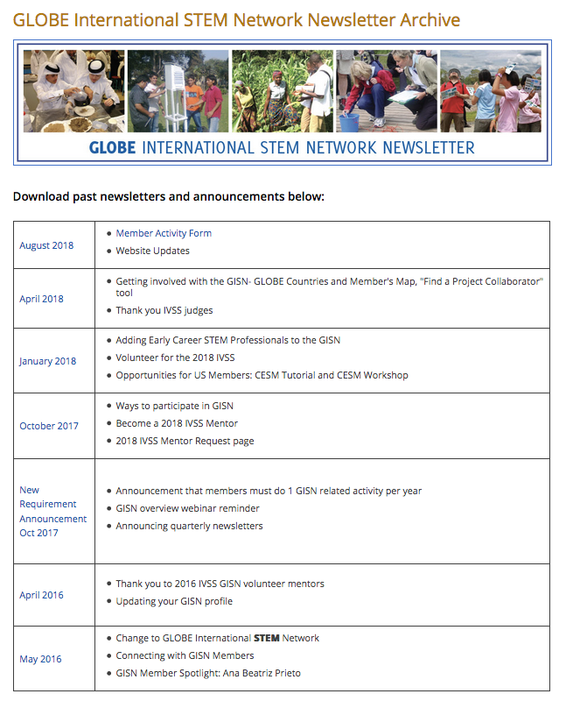
Stay up-to-date on all GISN news as well as announcements on ways to participate

Slide 59
GISN Resources
Participation Requirement
**
Notes:
https://www.globe.gov/web/globe-international-stem-network/overview/outreach-resources/gisn-webinars

Slide 60
Participation Requirement
Members must complete one GISN activity per calendar year (January-December)
Failure to do so will result in being removed from the GISN

Slide 61
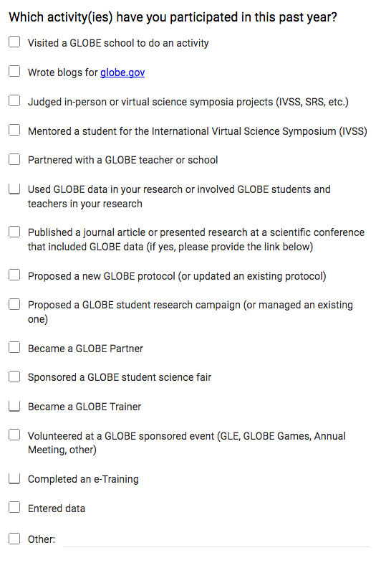
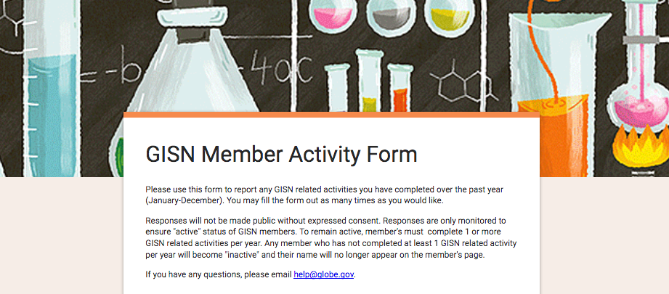
Participation Requirement
Member activity is “monitored” using a Google Form.
Fill out the form before December 31st to remain an active member of the GISN
Notes:
Doing an etraining while applying does count your first year, but please consider doing more!
https://goo.gl/forms/koUqK86hOmyrIS8E2

Slide 62
Agenda
What is GLOBE?
  Brief overview of the GISN
  GISN Members
Applying to the GISN
  Setting up your GLOBE profile
Participate as an individual in the GISN
  Writing and posting a blog for globe.gov
  Proposing a field campaign
  GISN Resources
  Participation Requirement
How to partner with GLOBE (i.e. Find a Collaborator)
  Connecting with a GLOBE teacher, school, institution
  Using globe.gov to connect with GLOBE members

Slide 63
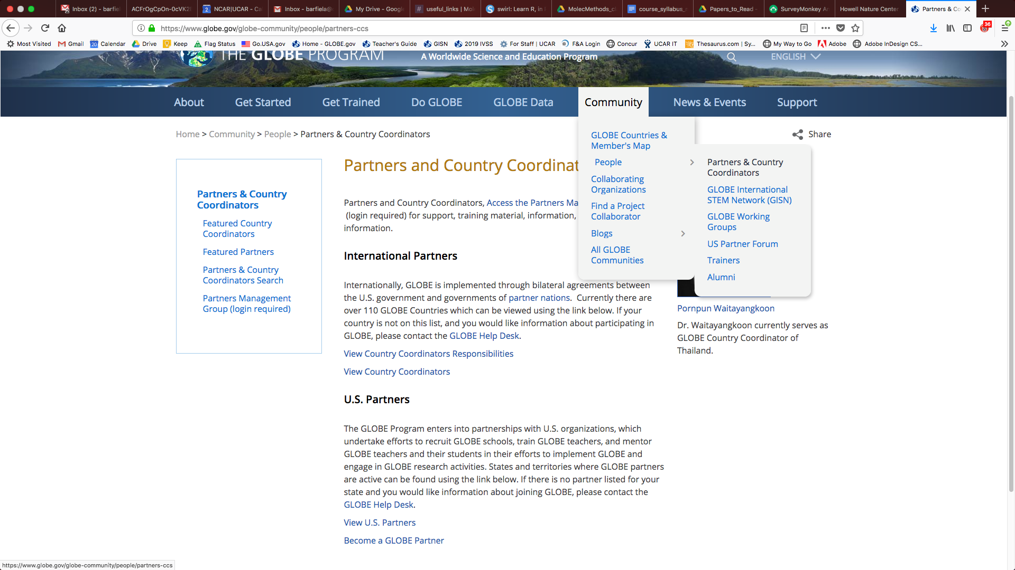
How to Find and Connect With GLOBE Partners
You can find GLOBE partners using the ‘Partners & Country Coordinator’ tab or the ‘GLOBE Countries & Member’s Map’ tab. Both are under the ‘Community’ drop-down menu
Notes:
why find find partner? if interested in getting involved in a workshop or SRS
https://www.globe.gov/globe-community/people/partners-ccs
https://www.globe.gov/globe-community/community-map

Slide 64
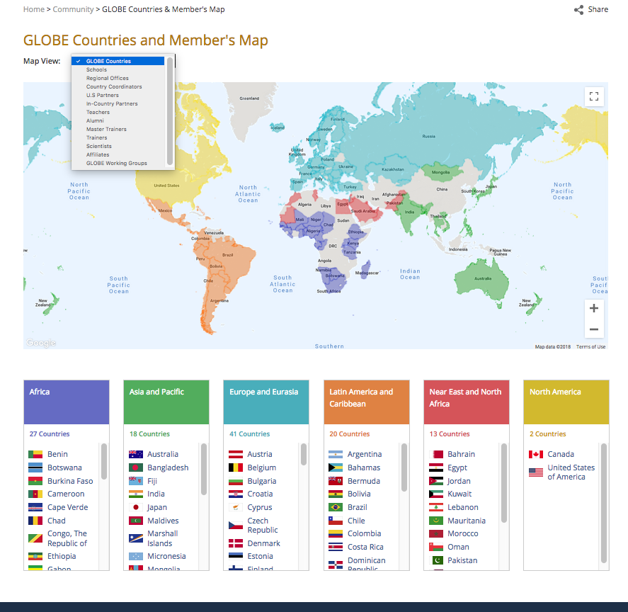
Find GLOBE Partners
Drop down list of filters to find people who occupy different roles
Zoom in and out to explore the map
Countries by region also listed below. Click on them to visit the Country pages
Notes:
Use the map to find someone based on region and based on role
https://www.globe.gov/globe-community/people/partners-ccs
https://www.globe.gov/globe-community/community-map

Slide 65
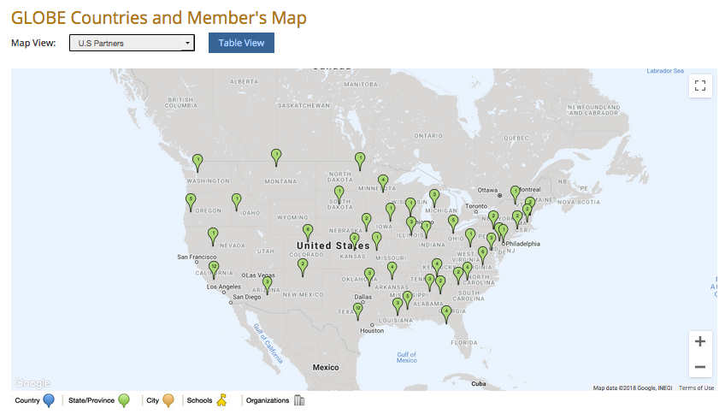
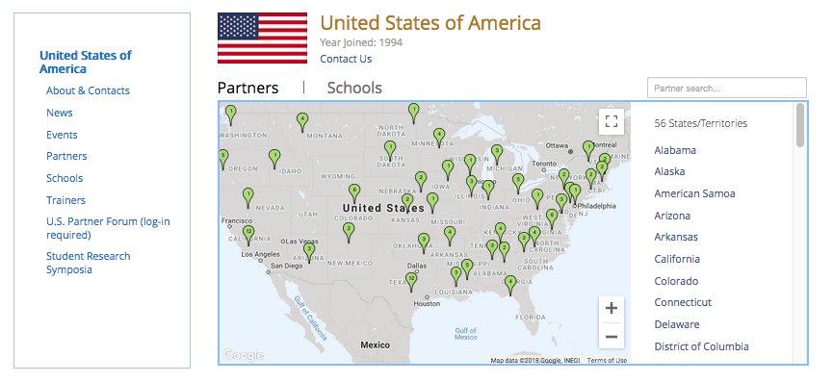
Find GLOBE Partners
The map of U.S. Partners from the GLOBE Community Member’s Map
Partners, as well as other people can be found by visiting the country page
Notes:
https://www.globe.gov/globe-community/people/partners-ccs
https://www.globe.gov/globe-community/community-map

Slide 66
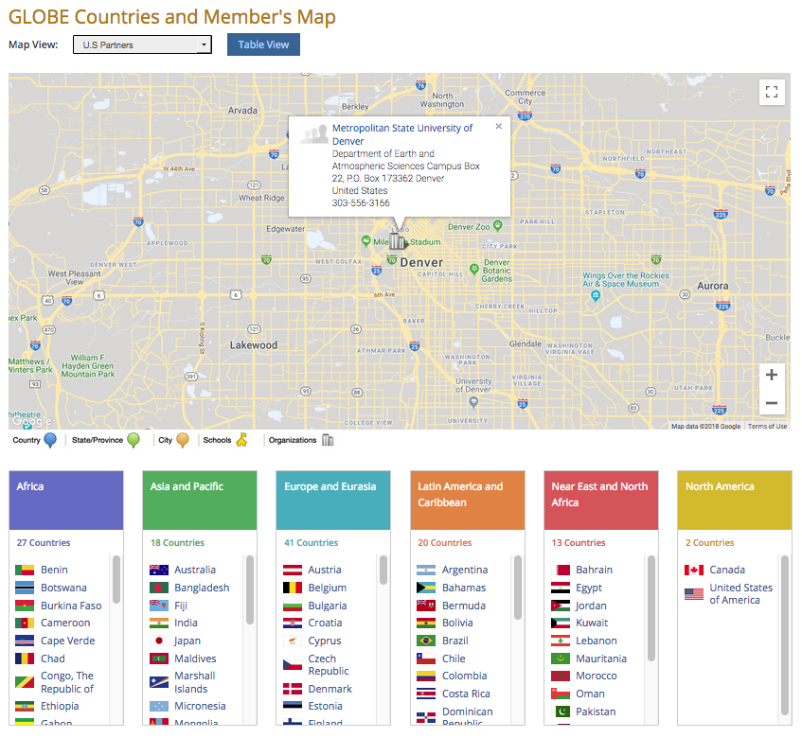
Find GLOBE Partners
You can zoom in on your specific region to see if there is a GLOBE Partner near you or to see if your institution is already a Partner
Notes:
https://www.globe.gov/globe-community/people/partners-ccs
https://www.globe.gov/globe-community/community-map

Slide 67
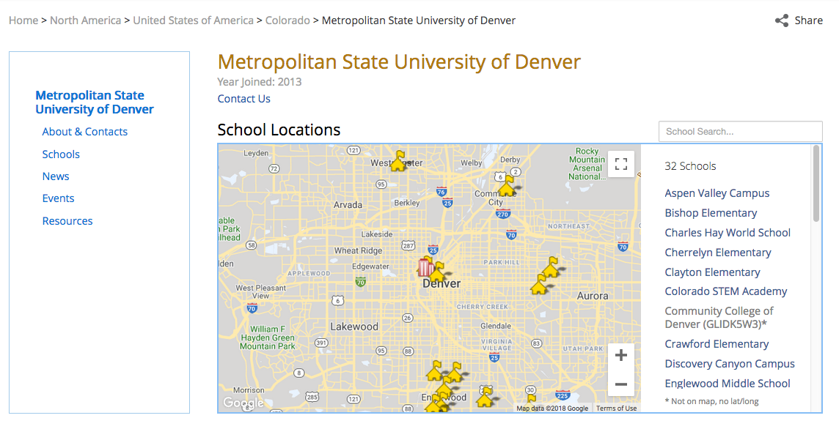
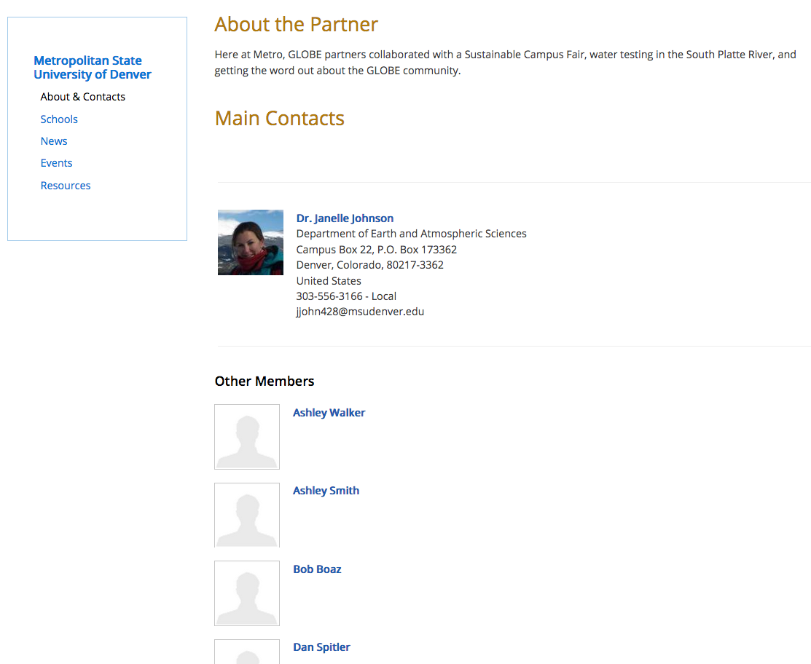
Explore Partner Information
All GLOBE Partners are affiliated with an institution. Go to the institution’s page to find out more information.
Go to About & Contacts for a description of the institution, find who the main contact person is, and find other GLOBE affiliates connected with that institution.
Notes:
If you want to be a part of/associated with an organization, email help@globe.gov
https://www.globe.gov/globe-community/people/partners-ccs
https://www.globe.gov/globe-community/community-map

Slide 68
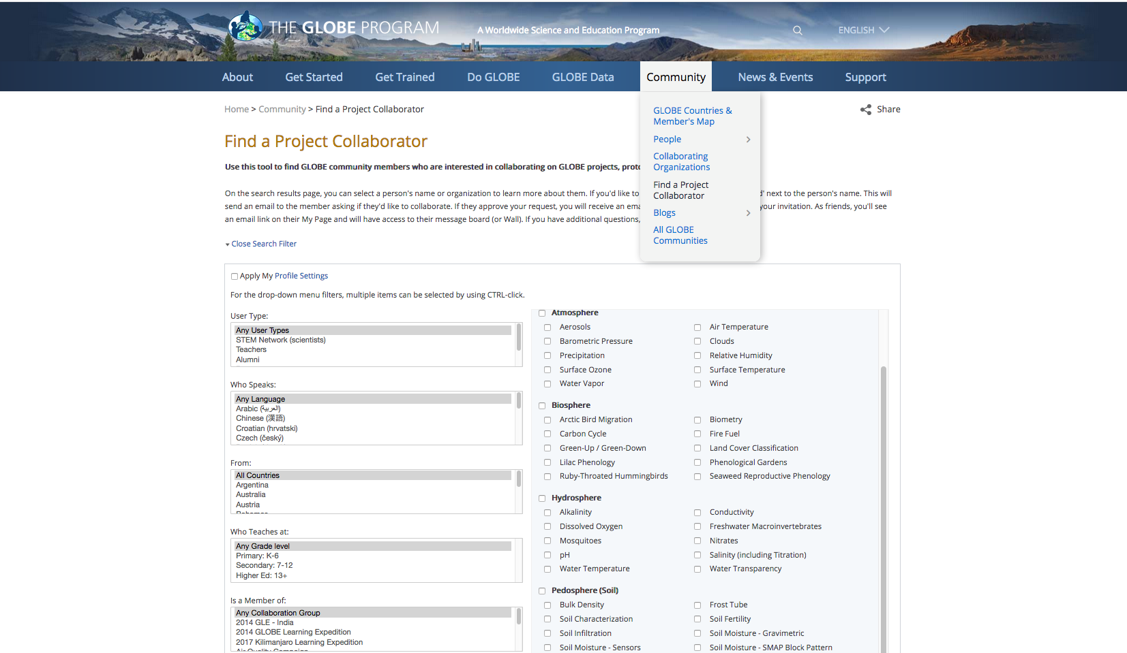
How can I use globe.gov to create new collaborations, both in my local community and virtually?
Use the “Find a Project Collaborator” tool
Notes:
PCT is to find someone based on research area

Slide 69
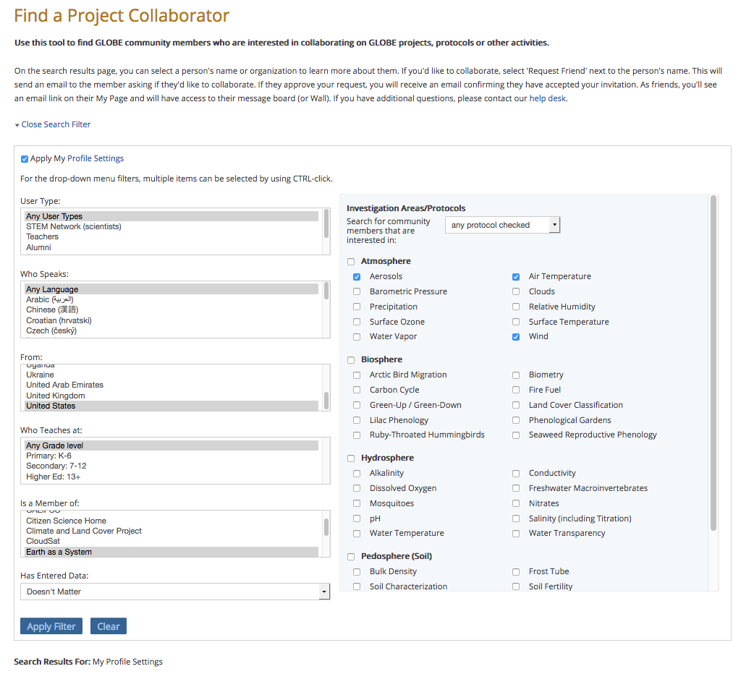
How can I use globe.gov to create new collaborations, both in my local community and virtually?
What are you looking for in a collaboration partner?
You can customize it to your profile settings by selecting this button
Add the protocols you do, you are trained in, or you are interested in
Look for fellow GISN members
Narrow your search by language, country, grade level, and groups

Slide 70
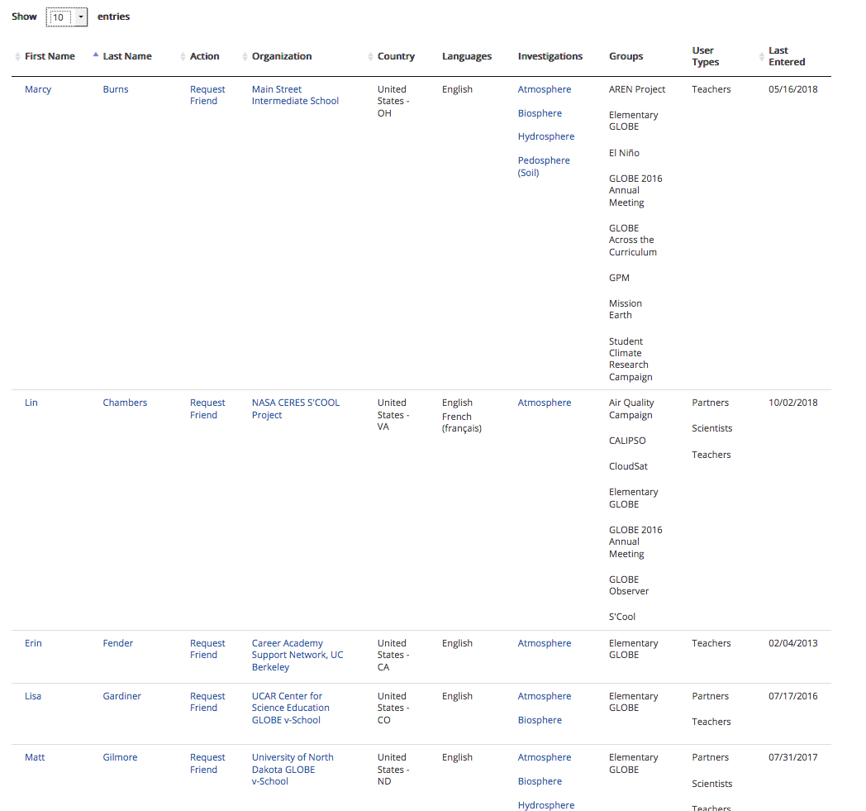
How can I use globe.gov to create new collaborations, both in my local community and virtually?
A list of matches is generated based on the criteria you selected.
From here you can “Request Friend” to begin direct communication.

Slide 71
Add friends to your network by clicking on the “ADD FRIEND” box on a person’s profile

Slide 72
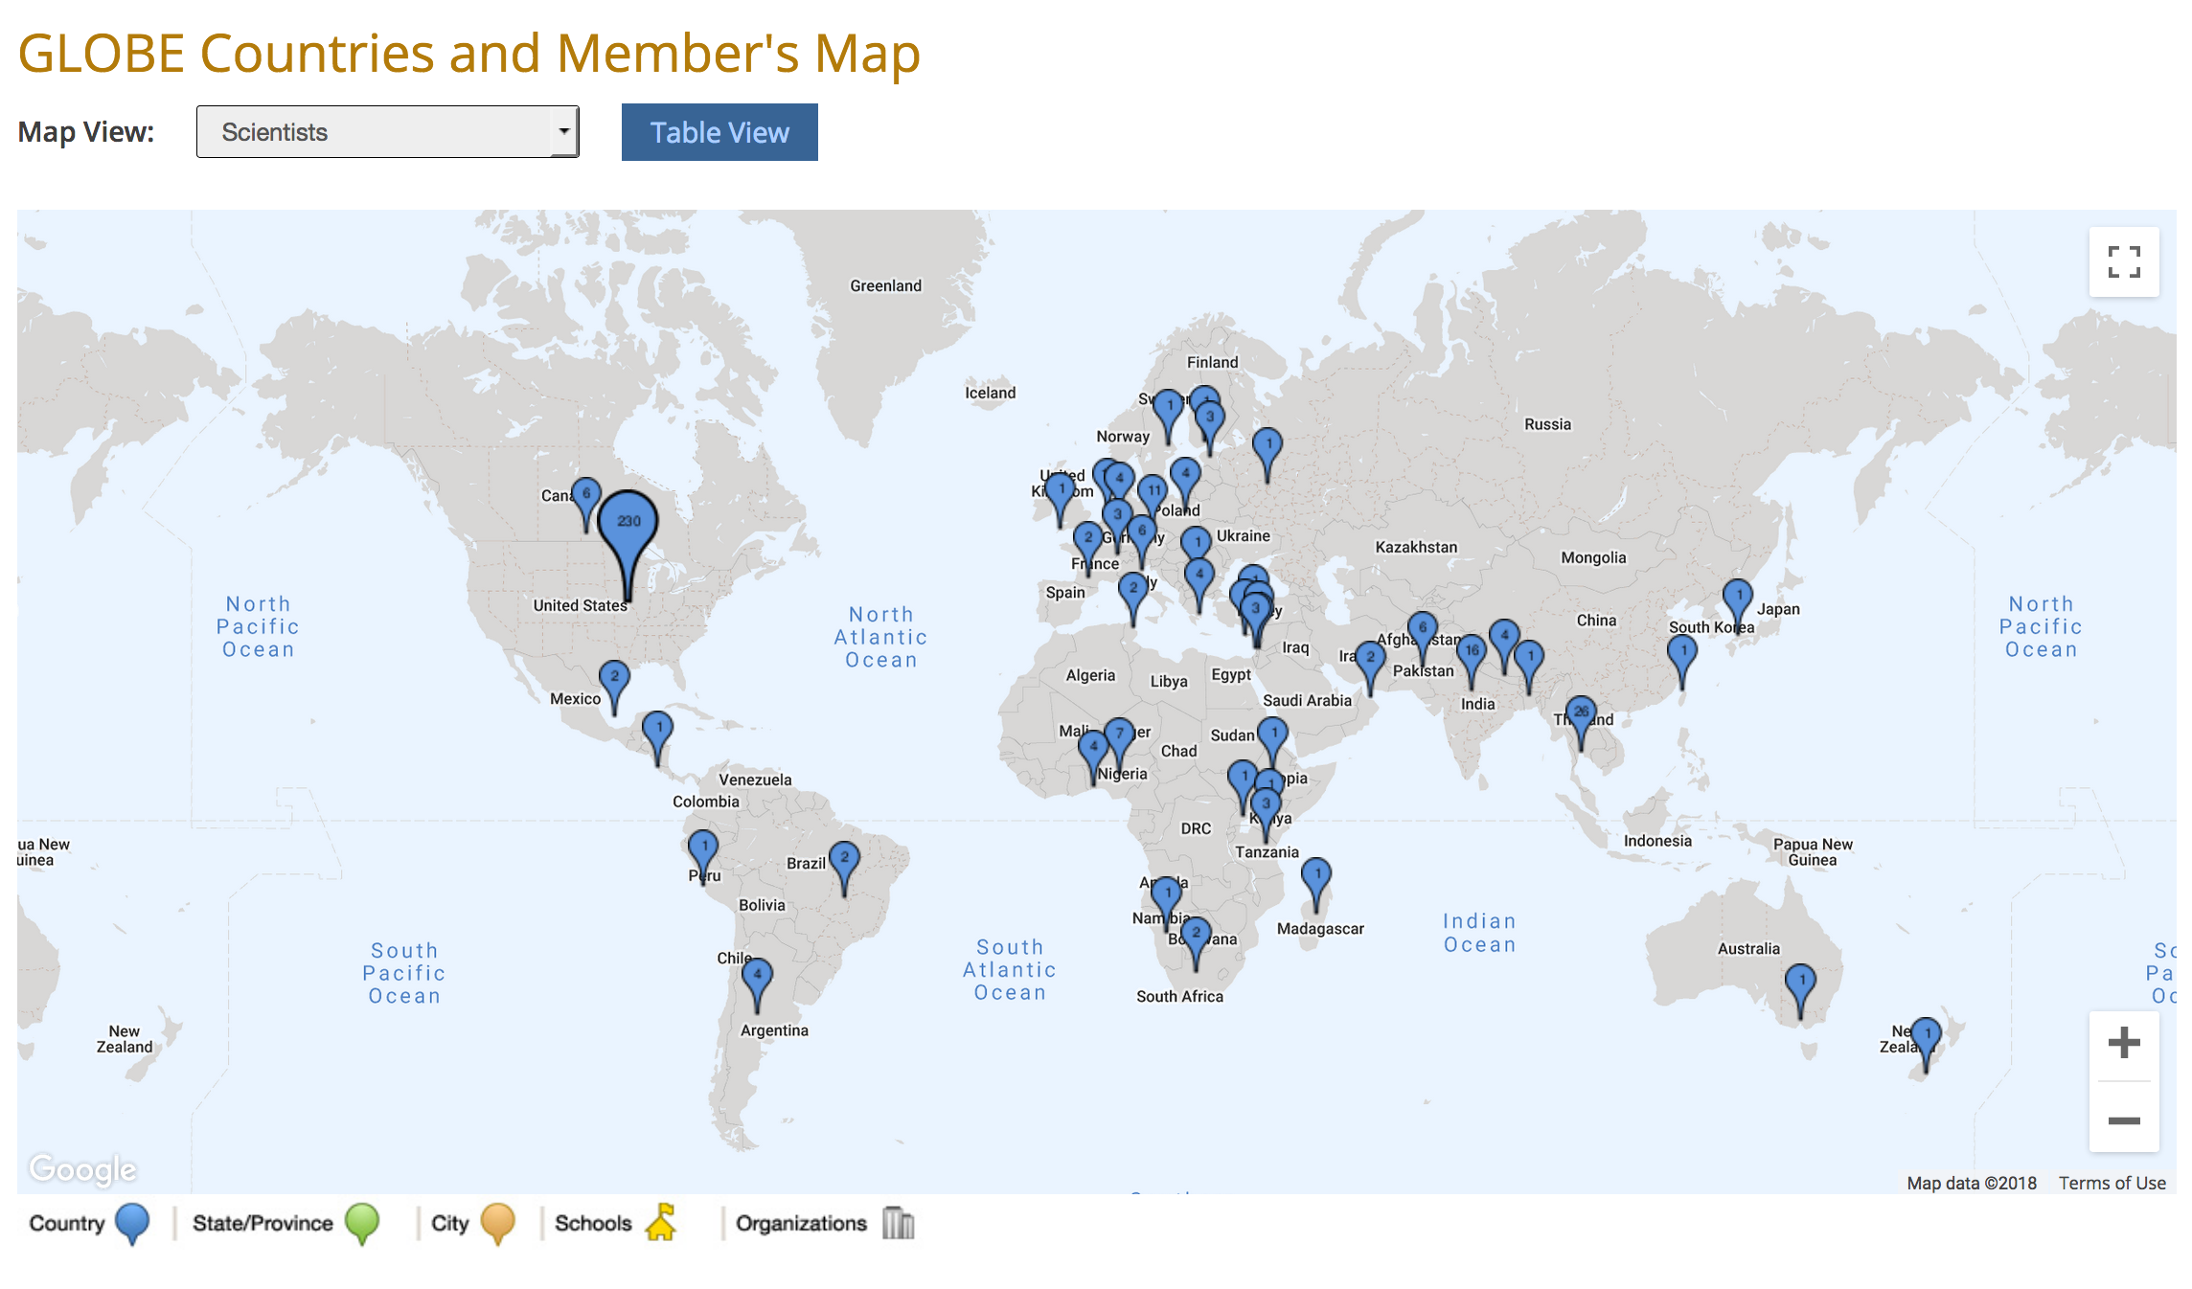
Thank you for listening!
www.globe.gov

Slide 73
www.globe.gov
For GISN questions or help, email help@globe.gov

