Slide 1
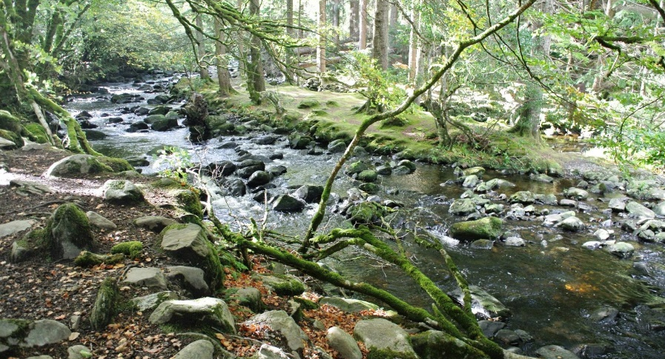
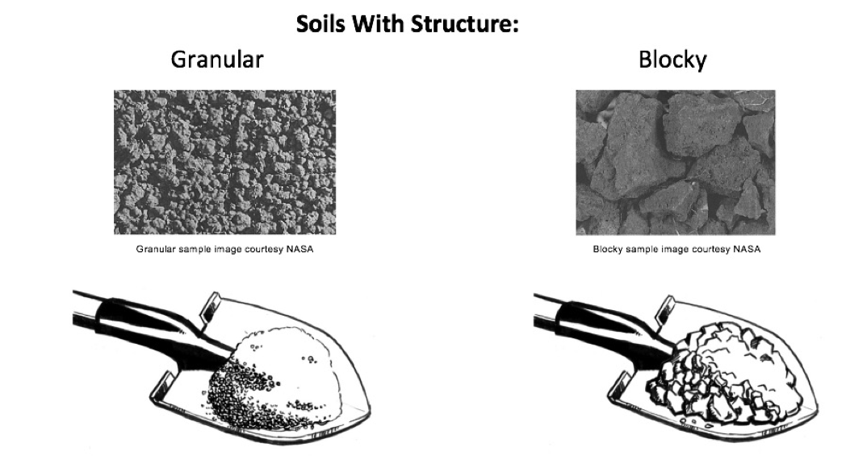
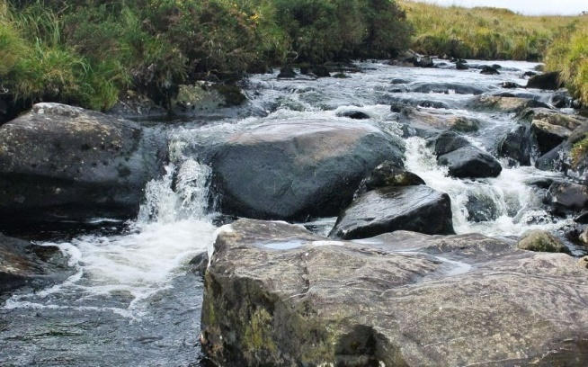
RIVER EROSION
River Gradient
Cross-section Profile
The processes of erosion shapes the landscape
The water erosion shapes the valley around the river
The erosion at upper course of the river works different than erosion at the lower course
Shows the angle at which water is flowing down
Steeper river is faster flowing
Contains waterfalls, rapids…
Clinometer
Width, depth and shape
The shape of cross-section shows if the erosion is vertical or lateral
Measurements used to calculate hydraulic radius which shows channels efficiency for transporting water
Transect tape, meter sticks, chain (rope)
River Banks
Steeper slope of the bank indicates vertical erosion (V-shaped valley)
Clinometer
Bedload Rock Shape & Size
River Discharge
= volume of water passing a point on the bank in 1 second (m3 / s)
Higher discharge shows that the river has more power for erosion
Use velocity to calculate
Velocity = speed of water flow (m/s)
Faster moving water is higher in energy, which means more capable of erosion
Larger and more angular rocks have more capacity to cause vertical erosion by abrasion
Rocks get smaller and more round farther downstream

Slide 2
RIVER EROSION
River Gradient
Cross-section Profile
The processes of erosion shapes the landscape
The water erosion shapes the valley around the river
The erosion at upper course of the river works different than erosion at the lower course
Shows the angle at which water is flowing down
Steeper river is faster flowing
Contains waterfalls, rapids…
Clinometer
Width, depth and shape
The shape of cross-section shows if the erosion is vertical or lateral
Measurements used to calculate hydraulic radius which shows channels efficiency for transporting water
Transect tape, meter sticks, chain (rope)
River Banks
Steeper slope of the bank indicates vertical erosion (V-shaped valley)
Clinometer
Bedload Rock Shape & Size
River Discharge
= volume of water passing a point on the bank in 1 second (m3 / s)
Higher discharge shows that the river has more power for erosion
Use velocity to calculate
Velocity = speed of water flow (m/s)
Faster moving water is higher in energy, which means more capable of erosion
Larger and more angular rocks have more capacity to cause vertical erosion by abrasion
Rocks get smaller and more round farther downstream

