Slide 1
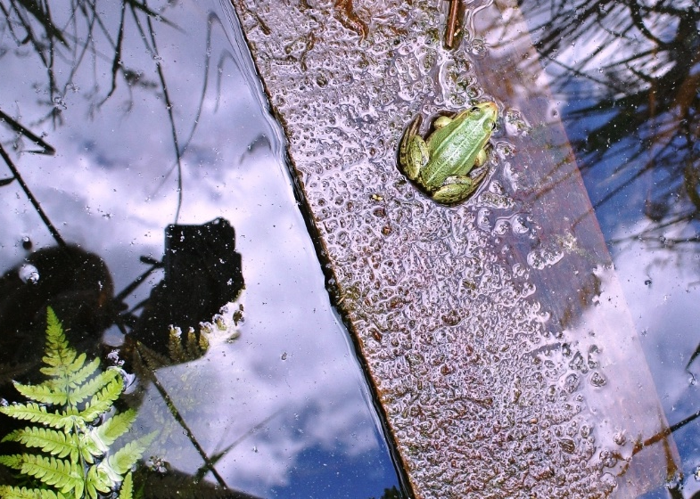
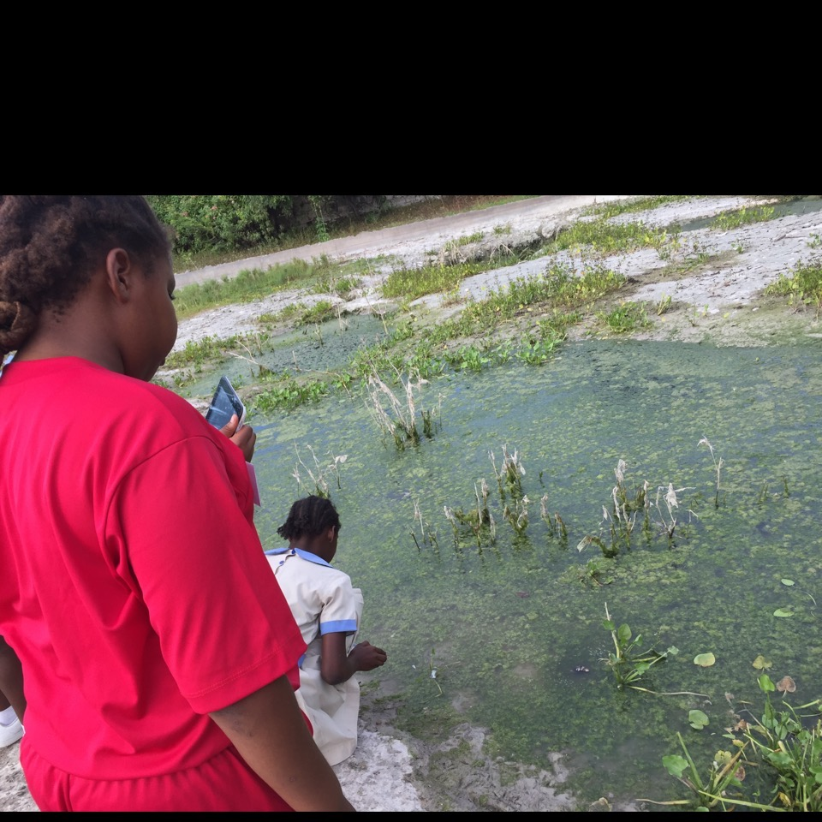
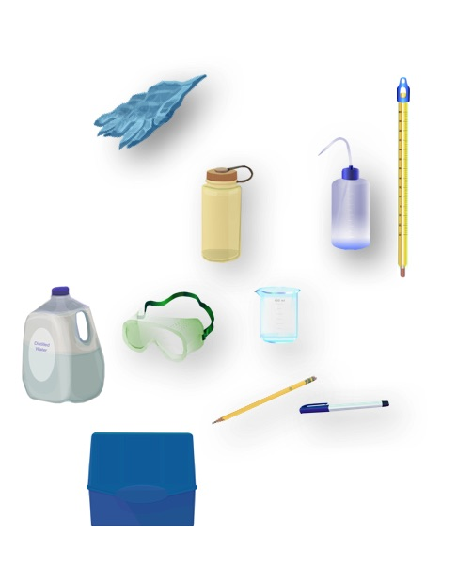
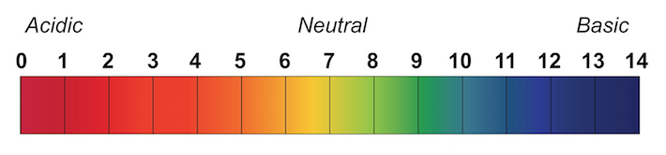
WATER HEALTH
Conductivity
The concentration of salts and other impurities in the water
Measures the amount of electricity (S) dissolved ions conduct through 1 cm of water
significant changes in conductivity can be an indication of pollution, such as oil spill or sewage water
Electrical conductivity meter/probe, µS/cm
Water quality is essential for life of plants and animals around rivers and lakes
The use of water depends on water quality: drinking, irrigation, fishing, recreation and many more.
Water Temperature
Relates to algae growth and blooms in summers
Increase or decrease in temperature impacts dissolved oxygen concentration
Thermometer, °C / F
Insect Survey
Water insects are bioindicators of water health
Play a crucial role in the ecosystem food chain - they are source of food for many larger animals
Magnifying glasses, small nets
pH
Dissolved Oxygen (DO)
Organisms are sensitive to changes in water pH: Most insects, amphibians and fish are absent in water bodies with pH below 4 (acidic) or above 10 (basic/alkaline)
Affects how particles dissolve in water and what nutrients are available there, extreme pH can cause an increase of toxic materials in water
pH meter, litmus paper
Measures amount of dissolved oxygen (O₂) in water, not amount of oxygen in water molecule (H₂O)
Crucial for life of water animals as they breathe the oxygen dissolved in water
Colder water can dissolve more oxygen than warm water
Chemical test kit/probe, mg/l

Slide 2
WATER HEALTH
Conductivity
The concentration of salts and other impurities in the water
Measures the amount of electricity (S) dissolved ions conduct through 1 cm of water
significant changes in conductivity can be an indication of pollution, such as oil spill or sewage water
Electrical conductivity meter/probe, µS/cm
Water quality is essential for life of plants and animals around rivers and lakes
The use of water depends on water quality: drinking, irrigation, fishing, recreation and many more.
Water Temperature
Relates to algae growth and blooms in summers
Increase or decrease in temperature impacts dissolved oxygen concentration
Thermometer, °C / F
Insect Survey
Water insects are bioindicators of water health
Play a crucial role in the ecosystem food chain - they are source of food for many larger animals
Magnifying glasses, small nets
pH
Dissolved Oxygen (DO)
Organisms are sensitive to changes in water pH: Most insects, amphibians and fish are absent in water bodies with pH below 4 (acidic) or above 10 (basic/alkaline)
Affects how particles dissolve in water and what nutrients are available there, extreme pH can cause an increase of toxic materials in water
pH meter, litmus paper
Measures amount of dissolved oxygen (O₂) in water, not amount of oxygen in water molecule (H₂O)
Crucial for life of water animals as they breathe the oxygen dissolved in water
Colder water can dissolve more oxygen than warm water
Chemical test kit/probe, mg/l

