Slide 1
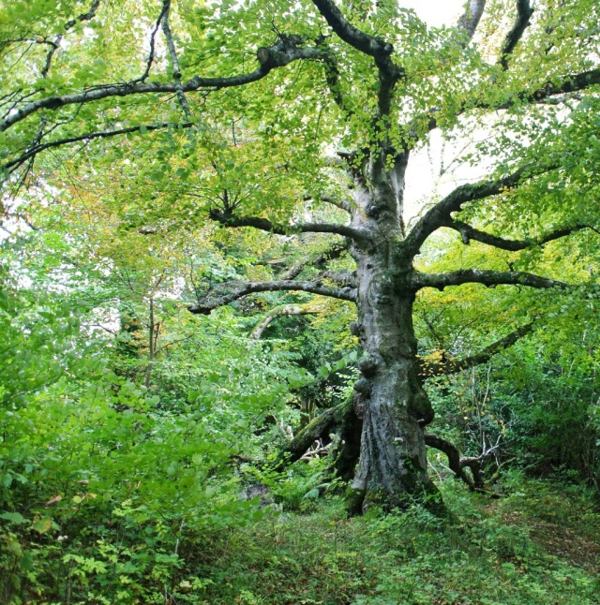
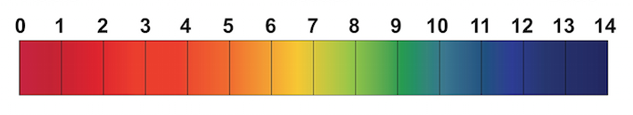
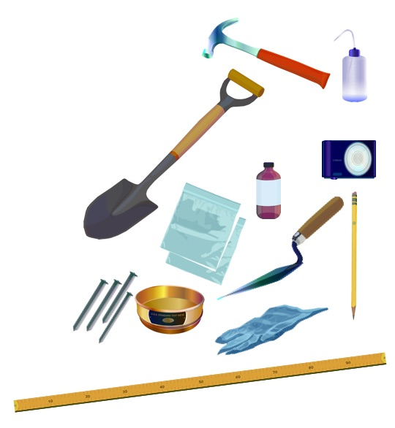
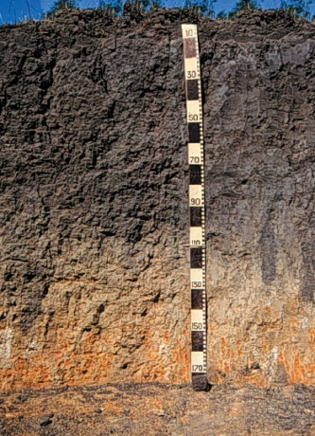
WOODLAND HABITAT
Relative Humidity
Surface Temperature
How much water vapor is in the atmosphere: rainwater evaporates back into the air and some is transpired by plants
Changes over time with the weather (temperature, wind, sun)
Supports a specific microclimate of the ecosystem, for example high humidity is good for the growth of moss
Sling psychrometer , %
The radiating temperature emitted as electromagnetic energy of the Earth’s surface
Various types of surfaces absorb or reflect the heat in different ways
Infrared thermometer, °C / F
Soil type and quality are essential for the diversity of the woodland, it determines what vegetation can grow at a given place
The woodland has a characteristic microclimate that differs from open areas such as grasslands, fields or river banks.
Fauna and Flora Survey
Soil Characteristics
Shows the biodiversity of the area
Points out species that are typical for a given type of habitat
Animal and plant guides, camera, densiometer
Different types of soil are better for growing food, storing and filtering water, retaining heat, producing and exchanging gases, building on…
The characteristics of a soil profile usually change slowly over centuries as the soil forms, but human activity can cause rapid changes
Soil characterization data can help scientists predict the likelihood of flooding and drought
Structure
Color
Consistence
Texture
Abundance of Roots, Rocks
Carbonates
Trowel, soil color book, texture triangle,
spray bottle, acid bottle with vinegar
Soil pH
Plants are sensitive to changes in soil pH: most crops grow well in soils having a pH between 6 (slightly acid) and 7.5 (slightly alkaline)
Affects what nutrients are available in soil. Extreme pH can cause an increase of toxic materials in soil
Soil pH test kit

Slide 2
WOODLAND HABITAT
Relative Humidity
Surface Temperature
How much water vapor is in the atmosphere: rainwater evaporates back into the air and some is transpired by plants
Changes over time with the weather (temperature, wind, sun)
Supports a specific microclimate of the ecosystem, for example high humidity is good for the growth of moss
Sling psychrometer , %
The radiating temperature emitted as electromagnetic energy of the Earth’s surface
Various types of surfaces absorb or reflect the heat in different ways
Infrared thermometer, °C / F
Soil type and quality are essential for the diversity of the woodland, it determines what vegetation can grow at a given place
The woodland has a characteristic microclimate that differs from open areas such as grasslands, fields or river banks.
Fauna and Flora Survey
Soil Characteristics
Shows the biodiversity of the area
Points out species that are typical for a given type of habitat
Animal and plant guides, camera, densiometer
Different types of soil are better for growing food, storing and filtering water, retaining heat, producing and exchanging gases, building on…
The characteristics of a soil profile usually change slowly over centuries as the soil forms, but human activity can cause rapid changes
Soil characterization data can help scientists predict the likelihood of flooding and drought
Structure
Color
Consistence
Texture
Abundance of Roots, Rocks
Carbonates
Trowel, soil color book, texture triangle,
spray bottle, acid bottle with vinegar
Soil pH
Plants are sensitive to changes in soil pH: most crops grow well in soils having a pH between 6 (slightly acid) and 7.5 (slightly alkaline)
Affects what nutrients are available in soil. Extreme pH can cause an increase of toxic materials in soil
Soil pH test kit

