Slide 1
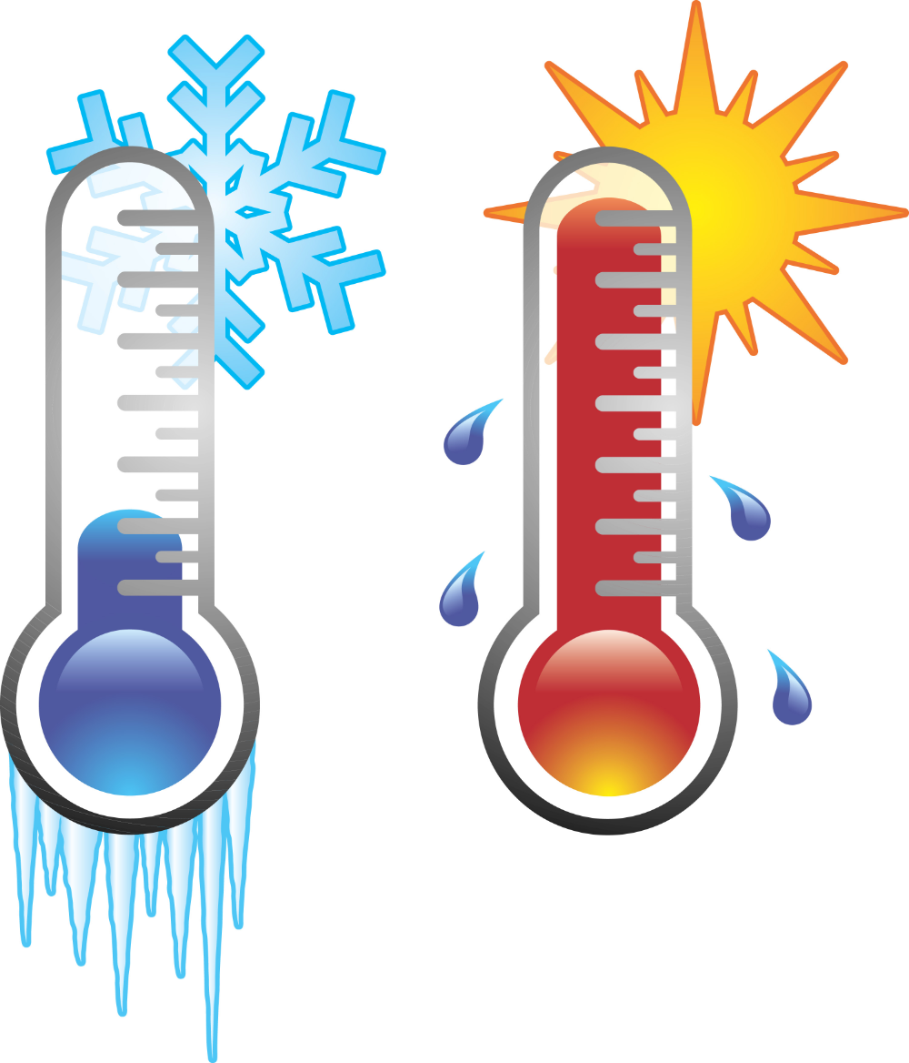
Any Ol' Thermometer Will Do

Slide 2
No questions, please. Just follow the directions.

Slide 3
Directions
Choose a thermometer
Find a place to hang/place the thermometer
Wait 2 more minutes
Record the temperature and time
Come back inside
Share your data on the classroom graph
Wait 2 minutes
Record the temperature and time
Go outside
you have 5 minutes

Slide 4
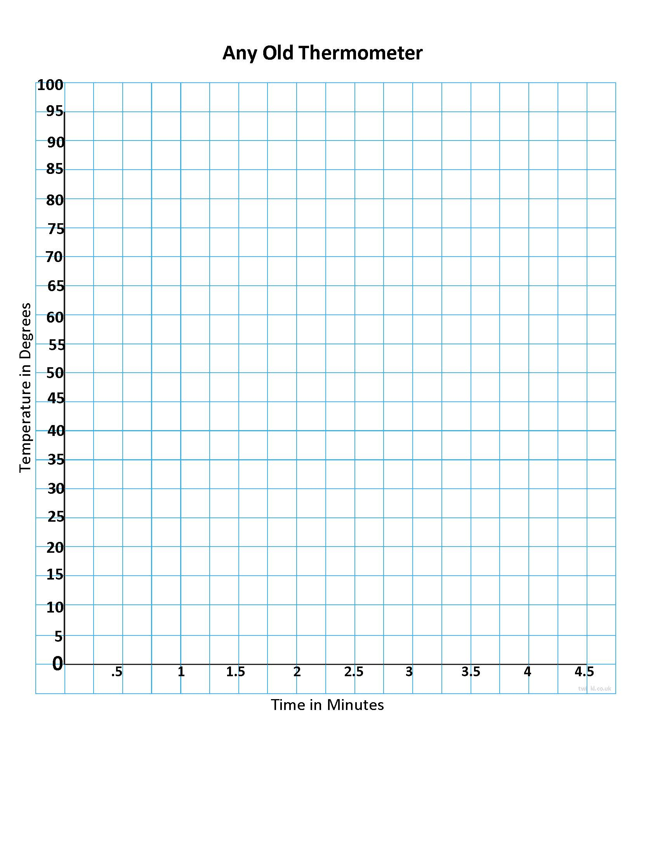
Record Your Data

Slide 5
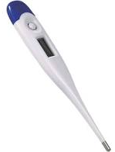
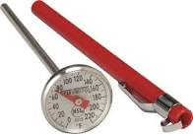
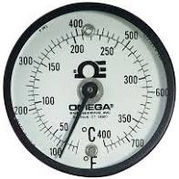
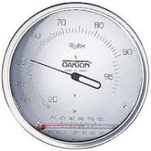
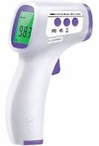
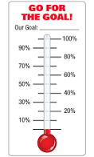
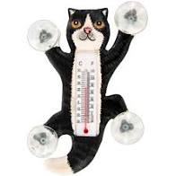
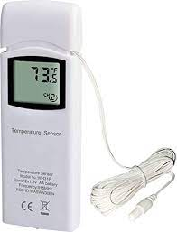
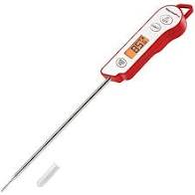
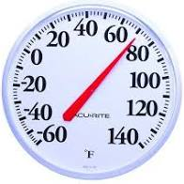
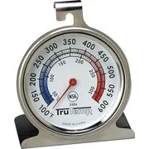
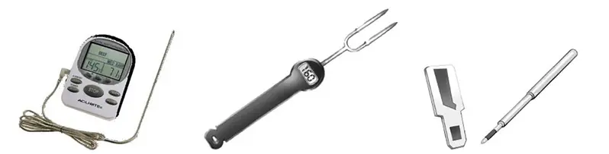
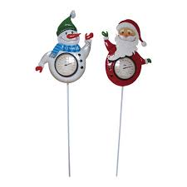
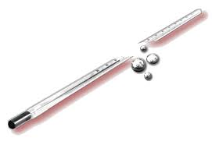
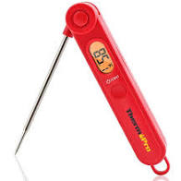
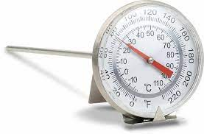
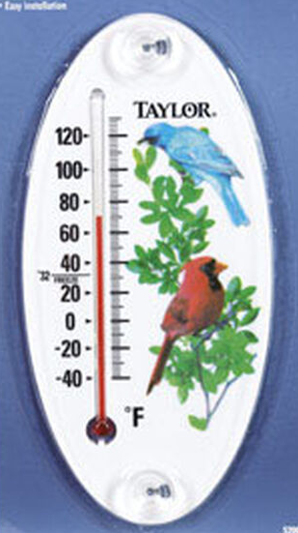
A thermometer’s a thermometer.
RIGHT!?!

Slide 6
Why do we have to do it this way?
Who?
What?
When?
Where?
How?
Experienced in reading scale, know calibration
Same type of instrument, same scale
Same time within set limits
Same place over time or different places, if required
Follow protocols, use metadata when necessary
Data Collection, Data Quality, and Data Assessment

