Slide 1
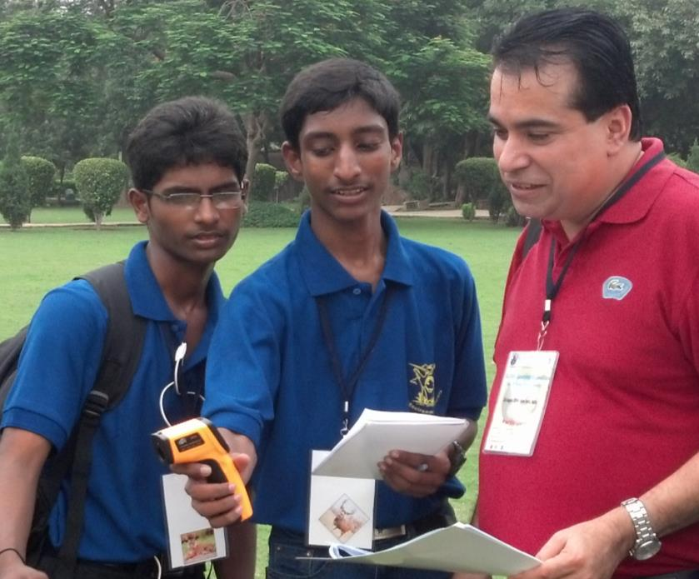
Surface Temperature and Soil Moisture
Kevin Czajkowski
University of Toledo
Photo credit: Kevin Czajkowski

Slide 2
Surface Temperature is at the Heart of the Energy Budget
Incoming sunlight heats the surface
Evapotranspiration
Sensible heat rises from the ground
Emitted energy cools the surface to space
Surface Temperature
Soil Temperature
Heat goes into the ground

Slide 3

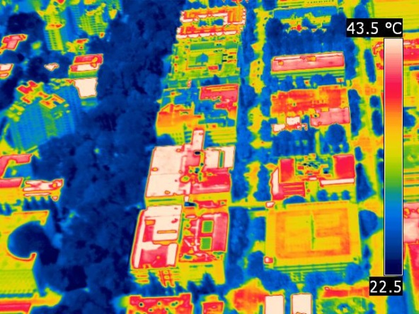
Everything emits electromagnetic energy given their temperature
Not all surfaces have the same temperature!

Slide 4
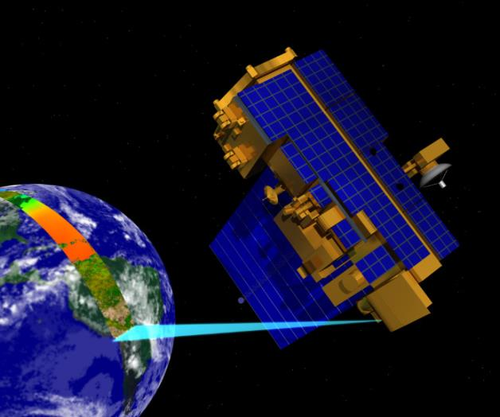

Satellites and students observe surface temperature in similar ways.
Find out more about
NASA’s MODIS Imagery
Photo credit: Kevin Czajkowski

Slide 5
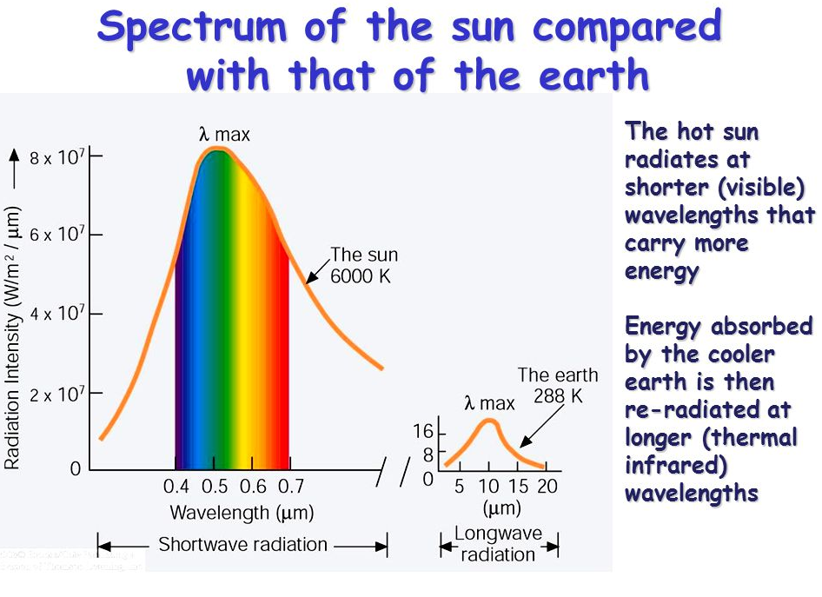

Slide 6
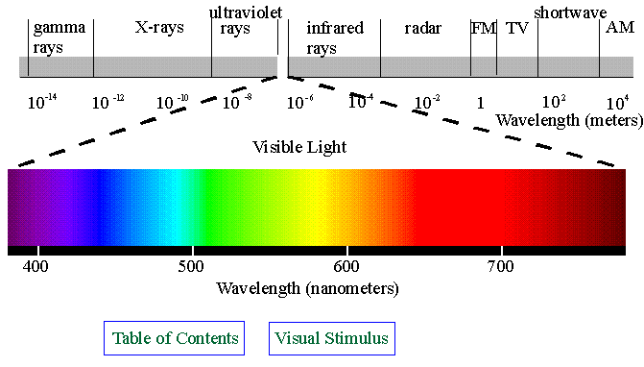
EM Spectrum
Visible light only small part of em spectrum
Thermal IR

Slide 7
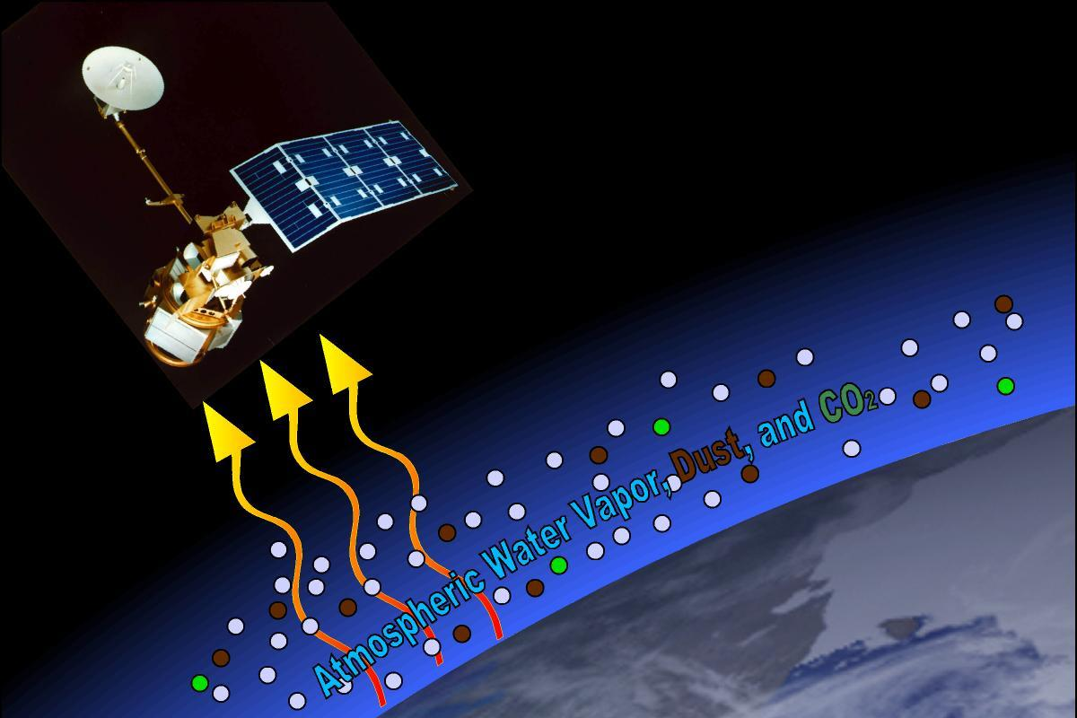
Misconception: surface temperature is observing reflected sunlight
Fact: surface temperature observes energy emitted by the surface

Slide 8
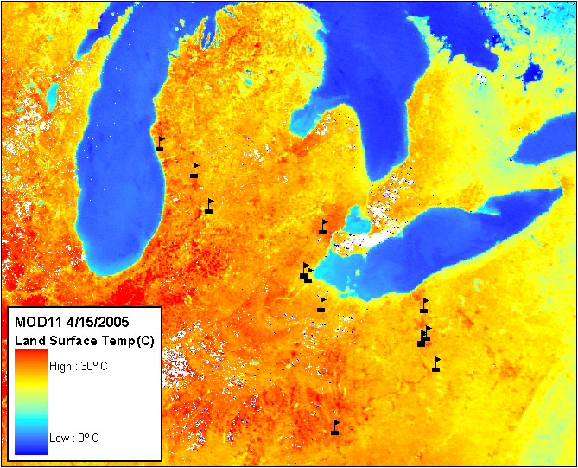
How accurate are estimations of surface temperature from satellites?
MOD11 Surface Temperature Image with GLOBE Ts Schools, April 15, 2005
Image from the Institute for Computational Earth System Science(ICESS), University of California, Santa Barbara, Zhengming Wan, Product PI

Slide 9
40 C
20 C
Lake Erie
A Mall
Lake Erie
Wildwood Park
A Mall
Wildwood Park
Downtown Toledo
Downtown Toledo
Farm Field
Farm Field
Cloud
Maumee River
Cloud
Maumee River

Slide 10
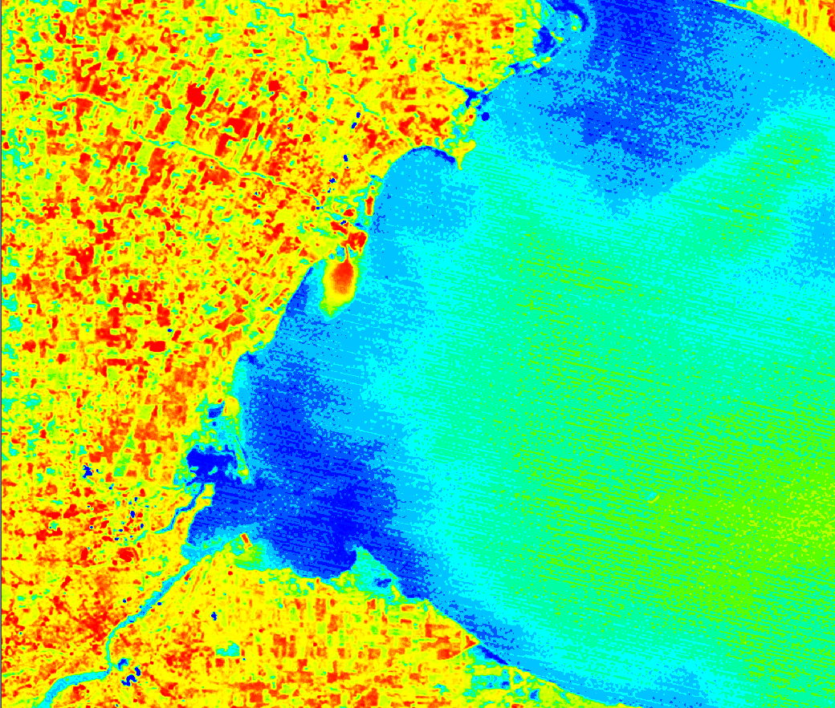
10/19/2003 Landsat Thermal
8/19/2003 Landsat Thermal

Slide 11



La Nina (Cold) 1988
Normal 1990
El Nino (warm) 1997
Courtesy of the National Climatic Data Center

Slide 12
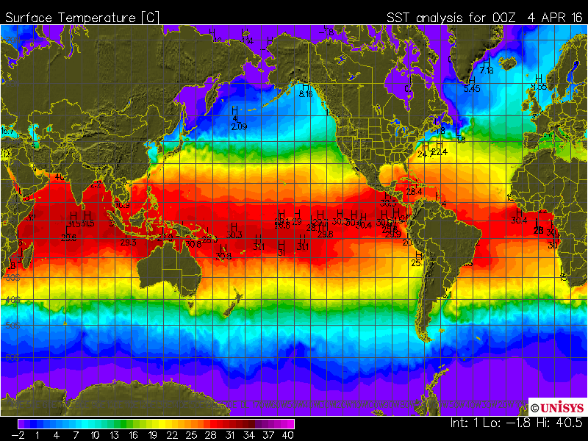

Slide 13
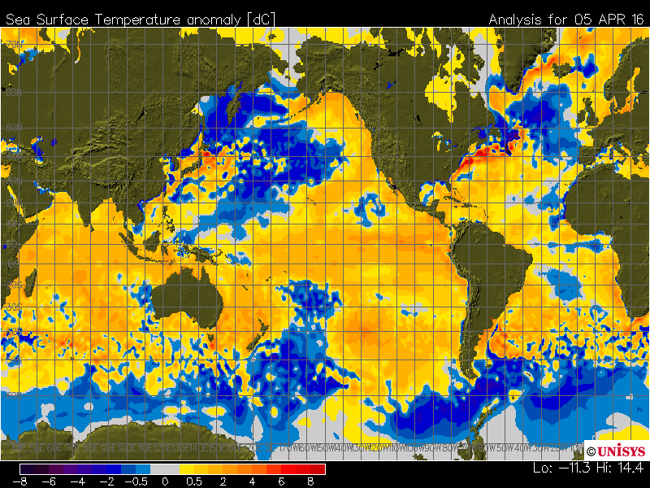

Slide 14
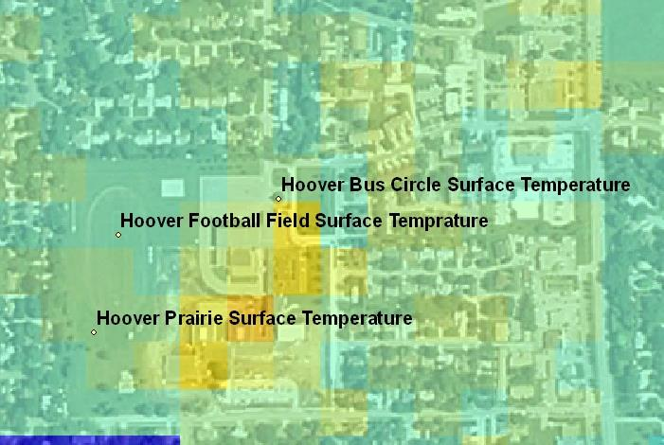
Surface Temperature with the Landsat7 Thermal Image
29.2°C
30.3°C
30.8°C

Slide 15
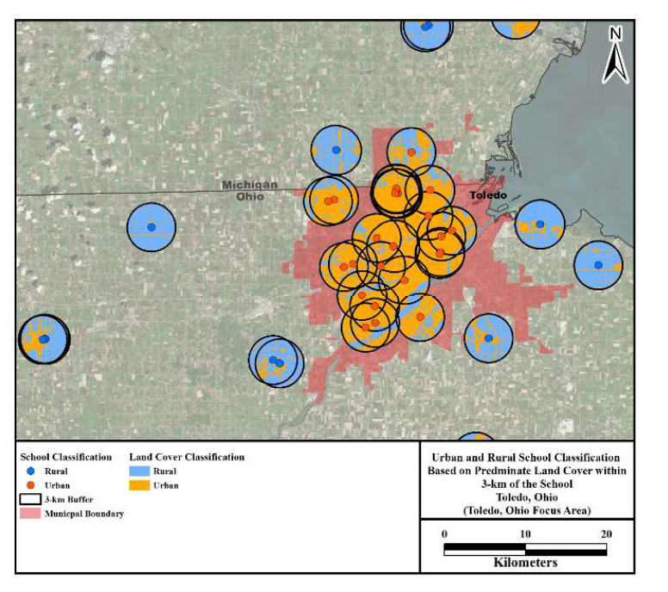
Masters Project: Detection of Urban Heat Islands in the Great Lakes Region with GLOBE Student Surface
Temperature Measurements
Nancy Cochran
Urban schools were warmer than rural schools
Asphalt = 5.9 C warmer
Grass = 3.7 C warmer

Slide 16
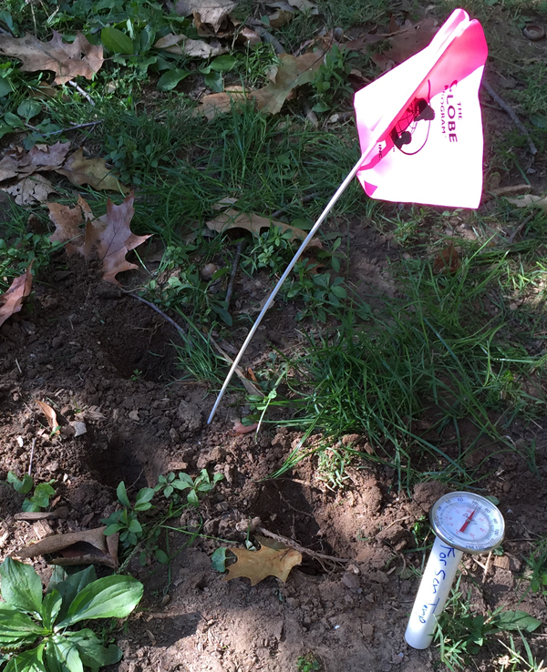
Soil Temperature

Slide 17
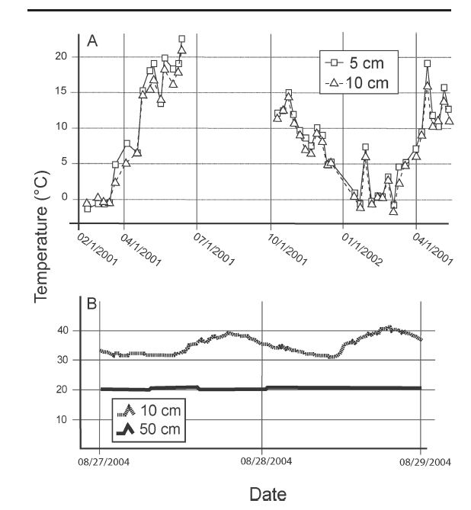
Soil Temperature: how depth affects it

Slide 18
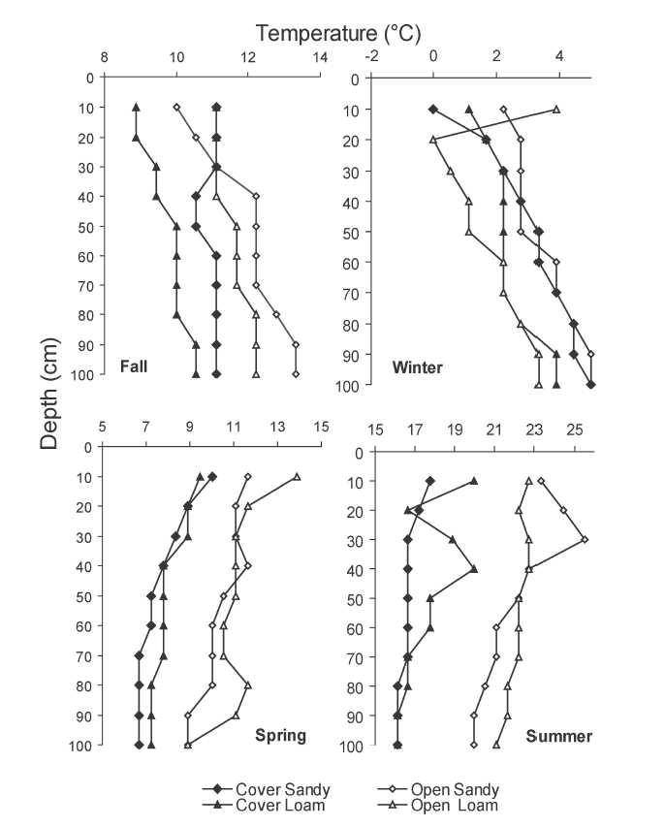
Changes in soil temperature down to 100 cm

