Slide 1
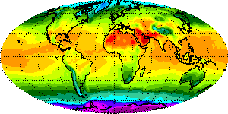
GLOBE Protocols
Surface Temperatures
Soil Temperatures

Slide 2
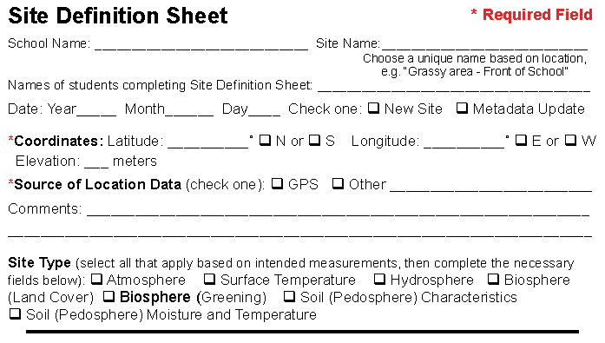
Site Definition
Surface temperature sites must be defined using the site definition form

Slide 3
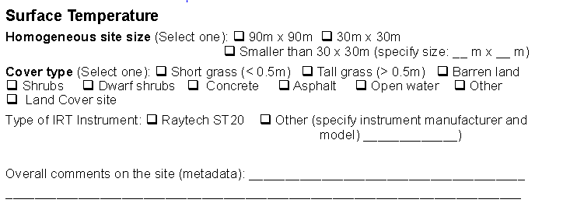
Site Definition
The site is described with information further down the site definition form

Slide 4
Land Cover Sample Site
Data collected is compared to satellite data collected at the same time.
Site must be over 90 m X 90 m with homogeneous cover.
Data collection must be coordinated with satellite overpasses.

Slide 5
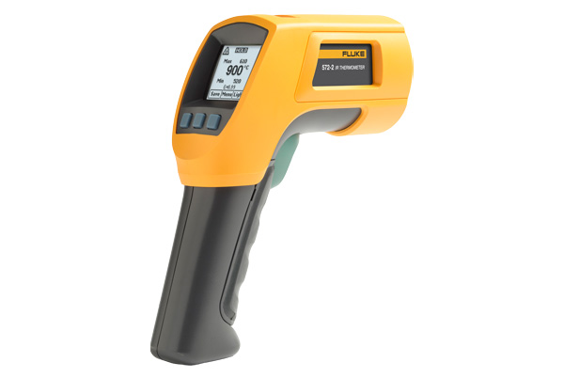
Infrared Thermometers
Must be calibrated once a year using an
ice bath.

Slide 6
Infrared Thermometers
Must be placed outside for 30-60 minutes prior to data collection to prevent thermal shock and incorrect readings.
May also be wrapped in the oven mitt modified as instructed in the Surface Temperature Protocols on the GLOBE website.

Slide 7
Data Collection

Slide 8
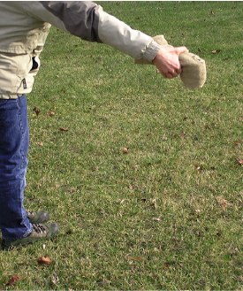
Observations
Nine separate observations are taken using
the method below. Take 5-6 steps between
observations covering the entire site.

Slide 9
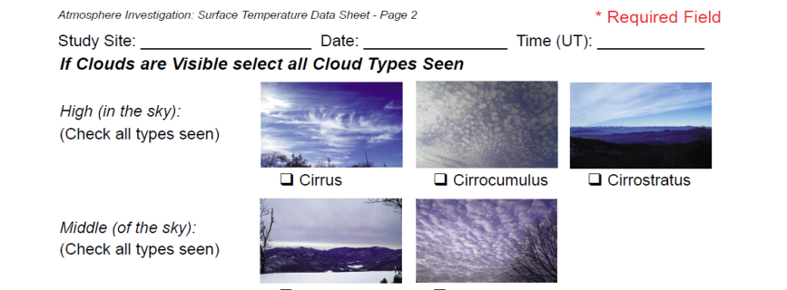
Cloud Coverage

Slide 10
Contrail Coverage

Slide 11
Data Entry App
App enables data to be collected on a tablet and transmitted to the website with WiFi connection.
App is available for Android and Apple devices.

Slide 12
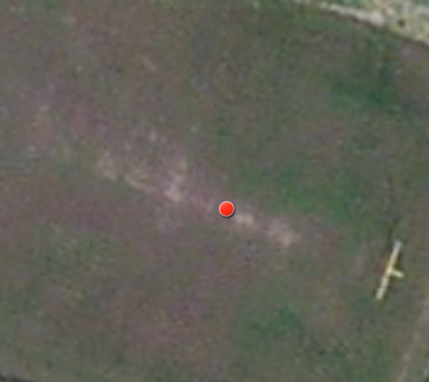
HHS Observation Sites
Atm Site 2
Atm Site 3

Slide 13
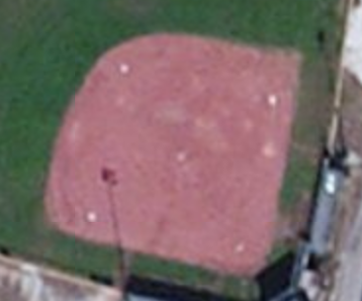
HHS Observation Sites
Atm Site 50
Atm Site 52

Slide 14
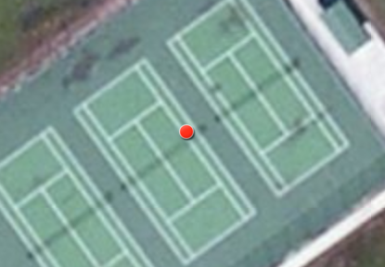
HHS Observation Sites
Atm 407
Atm 93

Slide 15
HHS-Surface Temperature
Participate in Dr. C’s Surface Temperature Field Campaign.
Collect data 6 hours each day school is in session.

Slide 16
HHS- Projects
Ideal protocol for science projects.
- Comparison of surface
temperatures from year to year.
- Comparison of one surface to
another.
- How aerosols affect surface
temperatures.

Slide 17
Elementary GLOBE
Inquiry-based learning.
Project-based learning.
Collaboration between elementary and high school students.

Slide 18
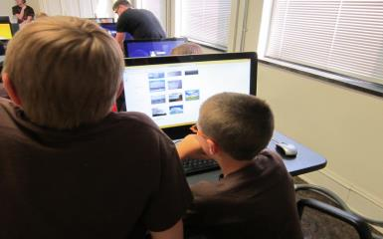
GLOBE Day
High school students work with elementary
students collecting surface temperature data
and entering it in the training data site.

Slide 19
Soil Temperatures
Determine when seeds sprout.
Affect Budbursts
Affect plant growth.
Decomposition of organic waste.
Affect climate.

Slide 20
Data Collection
Temperatures may be collected using digital or dial thermometers.
Data is collected at a defined atmospheric or soil moisture site.
Digital thermometers enable multi-day minimum/maximum observations.

Slide 21
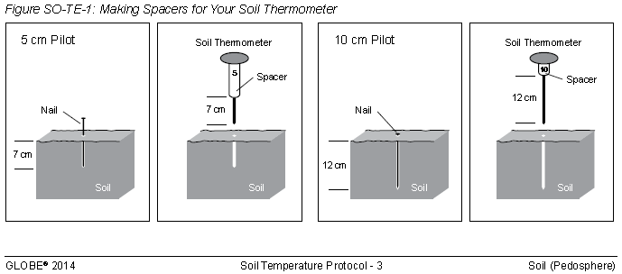
Dial Thermometers
Data is collected at the 5 and 10 centimeter soil depths.
Wooden block spacers are used to ensure correct measurement depth.

Slide 22
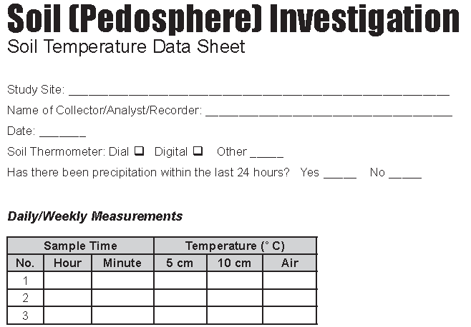
Daily/Weekly Observation
Temperatures may be collected daily or weekly.

Slide 23
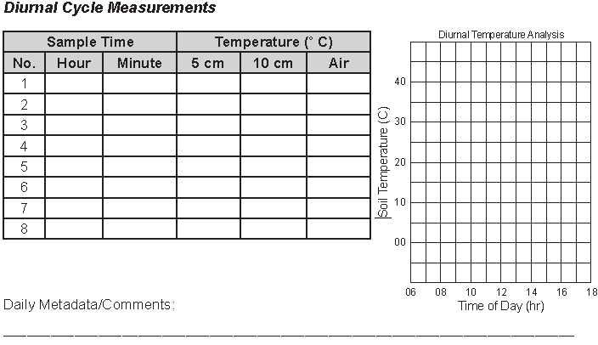
Diurnal Cycle Measurements
Every 3 months, measurements are taken 5 times per day, 1-2 hours apart for 2 days.

Slide 24
Digital Thermometers
Observations are made at the 10 and 50 centimeter depths and reported on a soil investigation sheet
10 centimeter observations are collected and reported in the regular atmosphere data sheet.

Slide 25
Digital Multi-Day Thermometers
A single thermometer measures the minimum/maximum air temperature and soil temperature 10 cm down.
A second thermometer measures soil temperatures at the 5 and 50 cm depth.
Each stores data for up to 6 days.

Slide 26
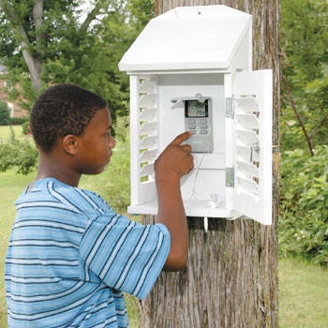
Installation
Thermometers are mounted in the back of the instrument shelter.
The air sensor must
not be in contact with
the shelter in any way.

Slide 27
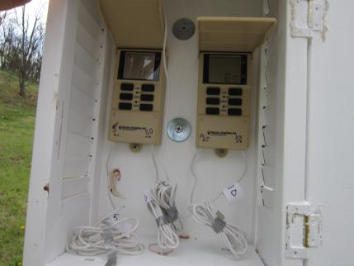
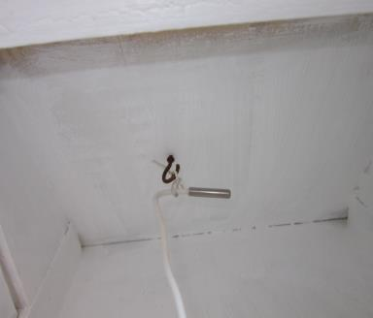
Sensor Placement
The left thermometer measures soil at the 5 and 50 cm depths, and the right one measures air and soil at 10 cm depth.

Slide 28
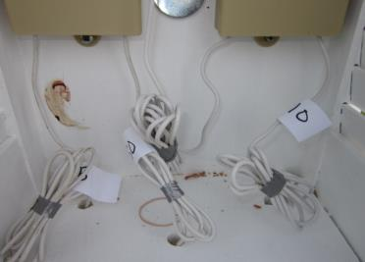
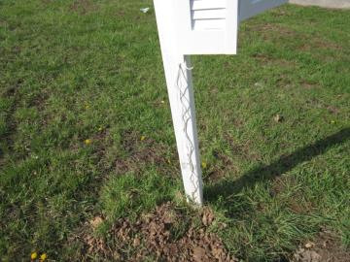
Sensor Placement
Excess cable should be bundled in the shelter and attached to the shelter post to avoid mower and trimmer damage.

Slide 29
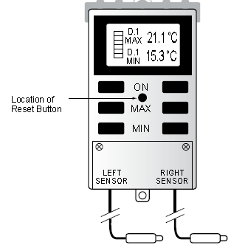
Data Collection
The thermometer must be reset so data collection begins and ends within an hour of local solar noon.
NOAA Solar Calculator

Slide 30
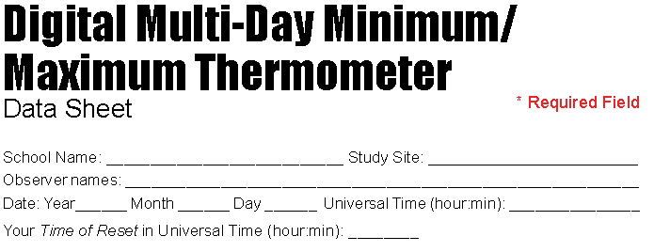
Data Collection
Readings should be taken at least 5 minutes after your time of reset, as noted on the data sheet.

Slide 31
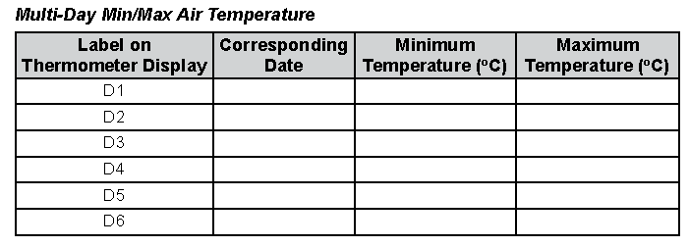
Data Collection
Data is collected by pressing the air MIN and MAX buttons, starting with twice for Day 1 and then once for each day back, beginning with air temperature.

Slide 32
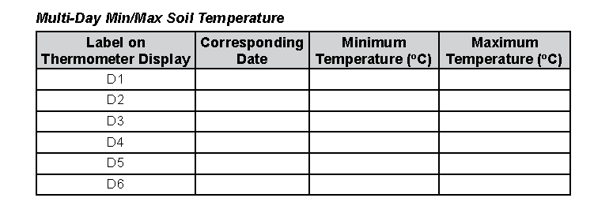
Data Collection
Soil Temperature data at the 10 cm depth is recorded following the same procedure as in the air temperature.

Slide 33
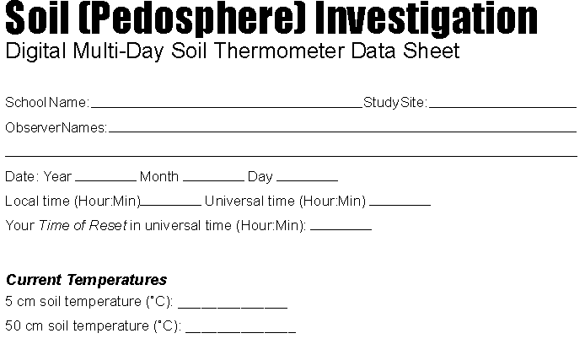
Data Collection
Data collection for the 5 cm and 50 cm depths use the following data sheet.

Slide 34
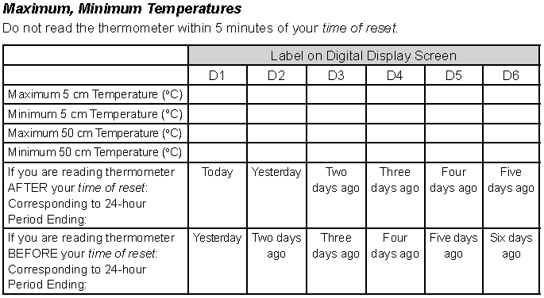
Data Collection
Observations are recorded using the same methods as in air temperature data.

Slide 35
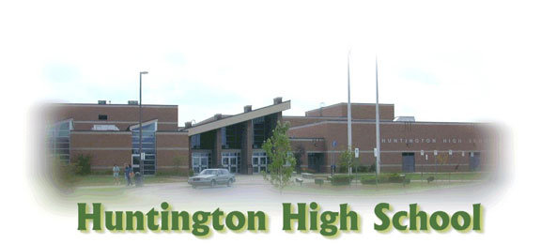
GLOBE Protocols
Rick Sharpe
Huntington High School
Huntington, WV

