Slide 1
NASA GLOBE ENSO Student Research Campaign Phase III: Water in Our Environment!
Webinars
14 November 2017

Slide 2
How the SODA webinars work:
Introduction of featured teacher, students and school (2 minutes)
Presentation by featured teacher and/or students (20-25 minutes)
  Chosen Phase III Guiding Investigative Question(s)
  How the question was explored (dates of data collection)
  Ideas for potential collaboration
Collaboration and discussion time (30 minutes)
What do I do to participate in a SODA event?
Identify the Guiding Investigative Question(s) to explore
Conduct protocol measurements using as many of the GLOBE protocols as desired
Take protocols measurements at least 3 times per week for one month
Report on the data collected at a future GLOBE Water in Our Environment SODA webinar
Begin collaborating with other GLOBE schools
Submit a blog, to the GLOBE web site, highlighting your student research

Slide 3
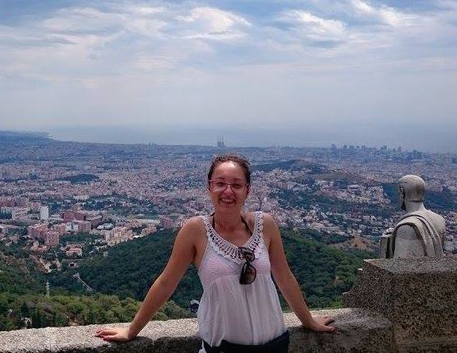
Next SODA Webinar – Monday, December 4, 2017 @ 2:00pm ET (7:00pm UTC)
Featured Speaker:
Marina Balažinec
OSNOVNE ŠKOLE VARAŽDIN – Croatia
SODA Event Data Collection
November 2017

Slide 4
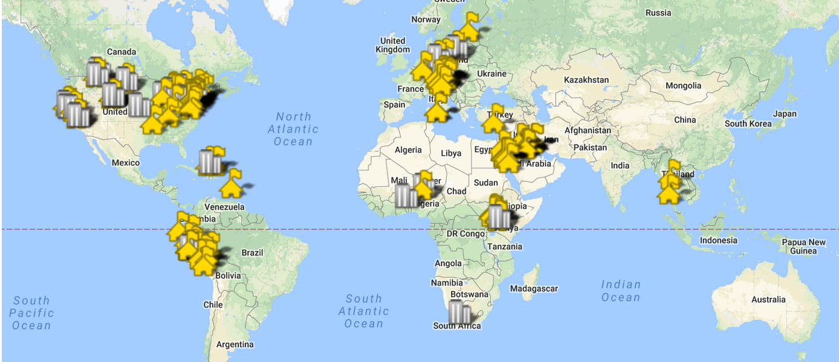
Our next Monthly Science and Research webinar will be Dec. 7th, 8 pm (EST/ 01:00 UST)

