Slide 1
NASA GLOBE ENSO Student Research Campaign Phase III: Water in Our Environment!
GLOBE and NASA Measure Water Quality
14 November 2017

Slide 2
What is “Water Quality”?
Water participates in many important natural chemical reactions and is a good solvent. Changing any part of the Earth system, such as the amount or type of vegetation in a region or from natural land cover to an impervious one, can affect the rest of the system. Rain and snow capture aerosols from the air. Acidic water slowly dissolves rocks, placing dissolved solids in water. Dissolved or suspended impurities determine water's chemical composition.

Slide 3
Water Quality and GLOBE
Current measurement programs in many areas of the world cover only a few water bodies a few times during the year.
GLOBE students provide valuable data to help fill these gaps and improve our understanding of Earth's natural waters.
Please see this page to read more about the importance of water quality and the protocols used to measure water quality.

Slide 4
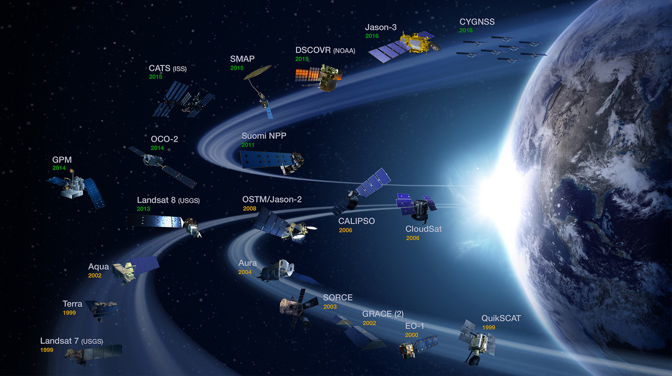
NASA Studies Water Quality in a Variety of Ways

Slide 5
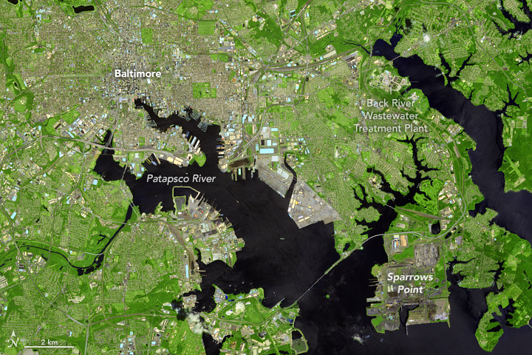
How Cities and Suburbs Affect the Chesapeake Bay

Slide 6
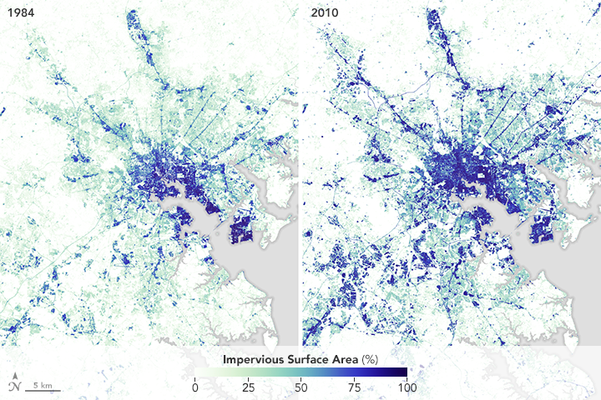
Notes:
The image at the top of this page, captured by the Operational Land Imager (OLI) on Landsat 8, shows ongoing construction at the Back River plant. Notice the brown construction site located between rows of circular clarifiers—special tanks designed to separate out solid particles from wastewater. Other features in the image include the heavily developed areas near the center of Baltimore City (gray), suburban areas to the south and east of the city (light green), and the Patapsco River, the heavily polluted urban river that enters Baltimore Harbor as it flows into Chesapeake Bay.

Slide 7
NASA Monitors Water in Lake Chad in Africa
Scientists Monitor the Rise and Fall of Lake Chad
11/9/17
Nestled in a low spot within a huge basin in west-central Africa is an isolated blue dot: That’s Lake Chad. Its water sustains people, animals, fishing, irrigation, and economic activity in Chad, Cameroon, Nigeria, and Niger.
But in the past half century, Lake Chad has lost most of its water. The once-great lake now spans less than a tenth of the area it covered in the 1960s. Scientists and resource managers are concerned about the dramatic loss of fresh water that is the lifeblood of more than 30 million people.

Slide 8
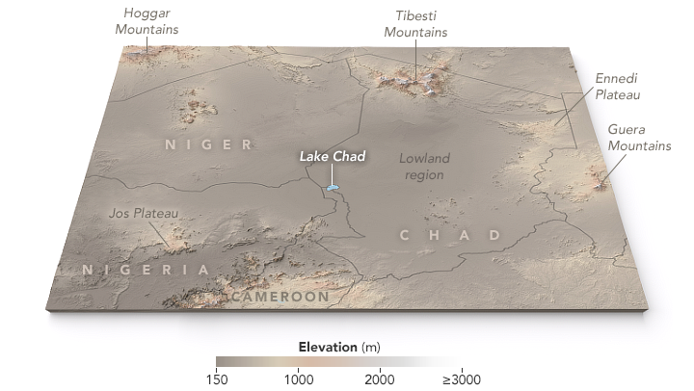
Notes:
NASA Earth Observatory map by Joshua Stevens, using ASTER Global Digital Elevation Model (GDM2) terrain data.

Slide 9
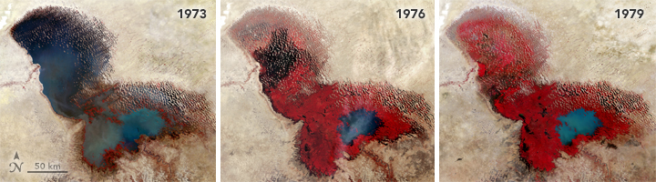
Using Landsat 1, 2, and 3 Multispectral Scanner (MSS) data

Slide 10
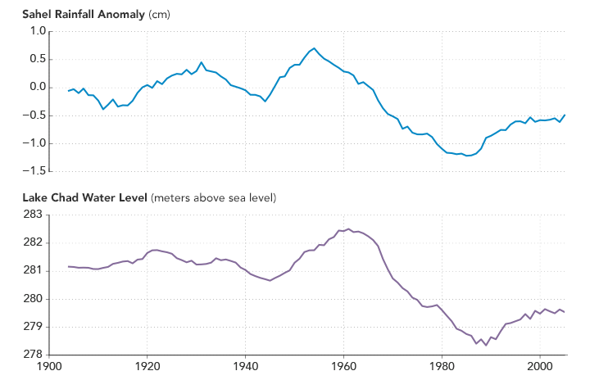

Slide 11
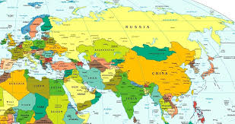
Today’s Program: Water Quality in Europe and Eurasia

Slide 12
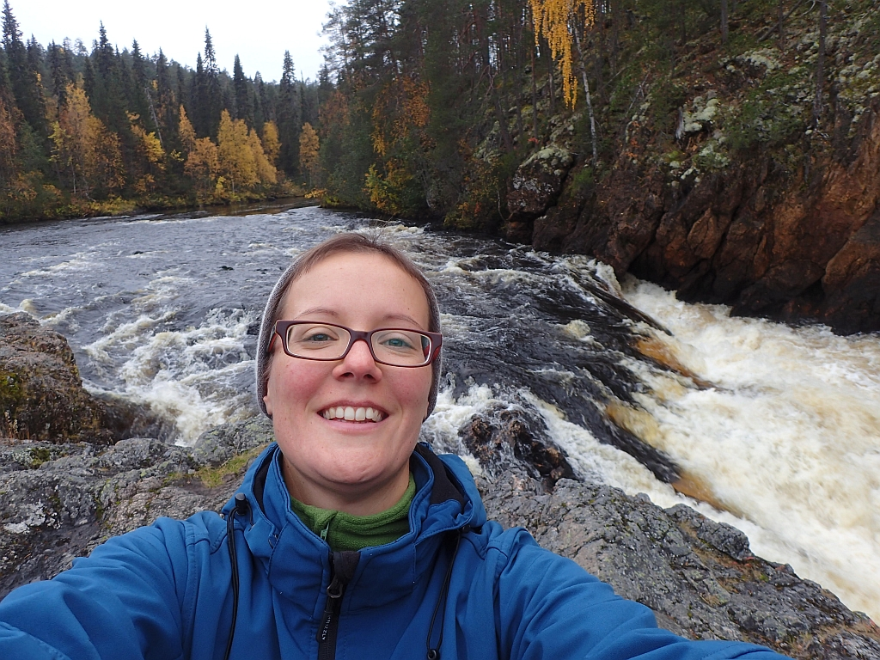
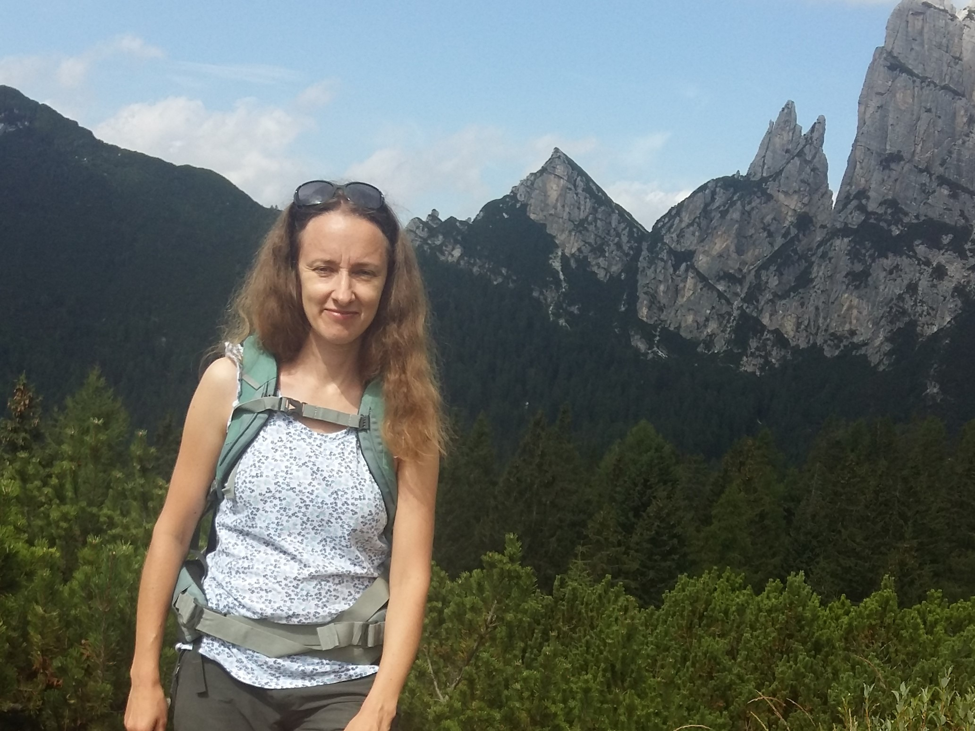
From Poland!
Elżbieta Wołoszyńska-Wiśniewska, GLOBE Country Coordinator, Poland; hydrologist working as the Head of Education Unit at UNEP/GRID-Warsaw Centre will tell us how scientists measure water quality in Poland
Joanna Gawor: GLOBE teacher will describe how her students have measured water quality in her area and share some “Best Practices” for using GLOBE hydrology protocol.

Slide 13
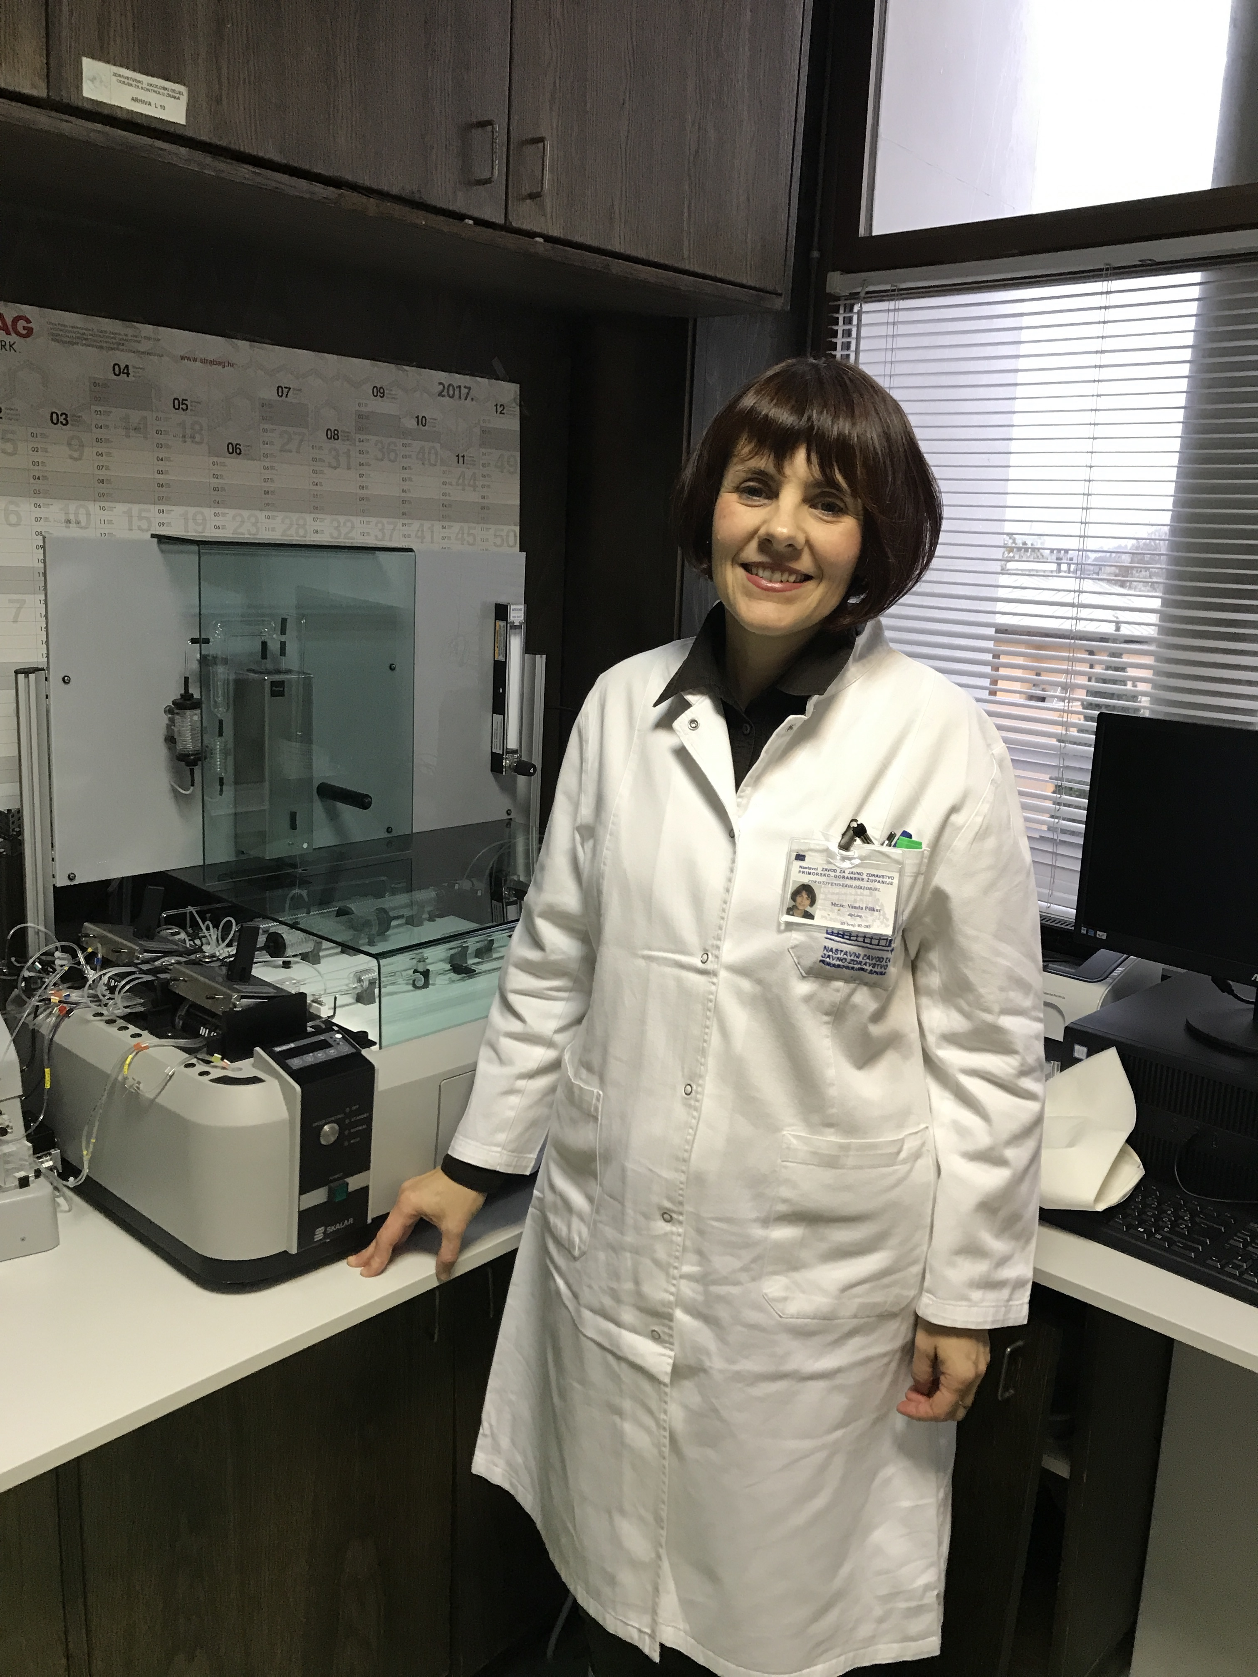

From Croatia!
Vanda Piškur, a water specialist whom Marina Pavlic works with will give some information on the use of water quality data to ensure safe drinking water in Croatia
Fran, a GLOBE students of Marina Pavlic’s will tell how they test water quality on the sea and their freshwater channel, using GLOBE and other protocols

Slide 14
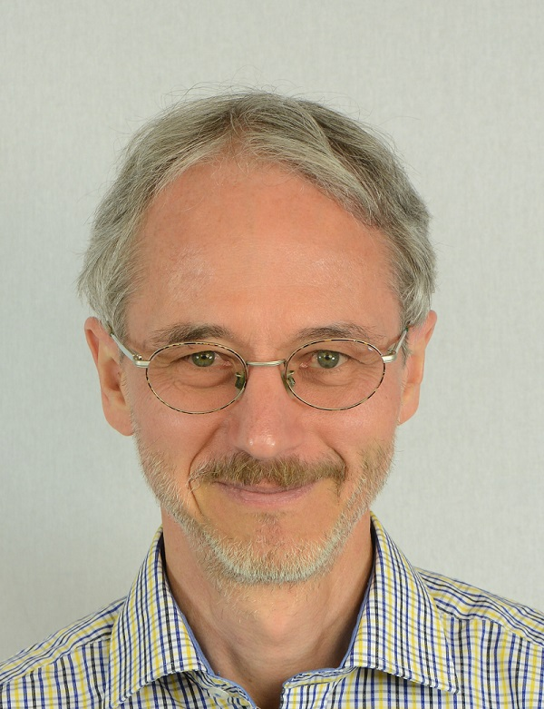
From Switzerland!
Markus Eugster, a GLOBE teacher from Uzwil, will describe how his students learn about and measure water quality in his region.

