Slide 1
NASA GLOBE ENSO Student Research Campaign Phase III: Water in Our Environment!
Webinar #5
9 January 2018

Slide 2
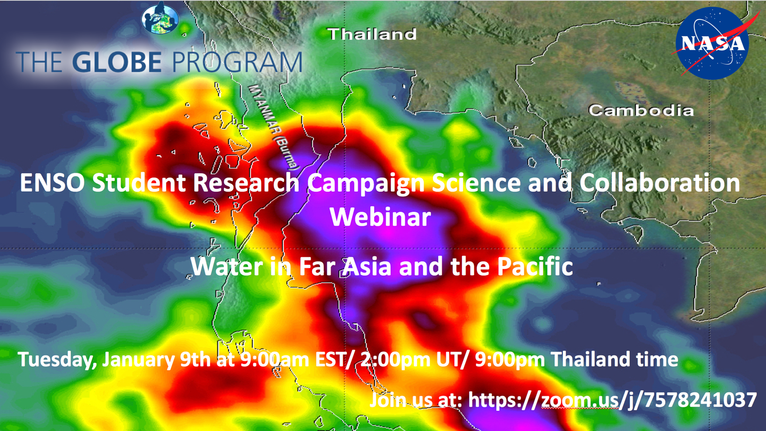

Slide 3
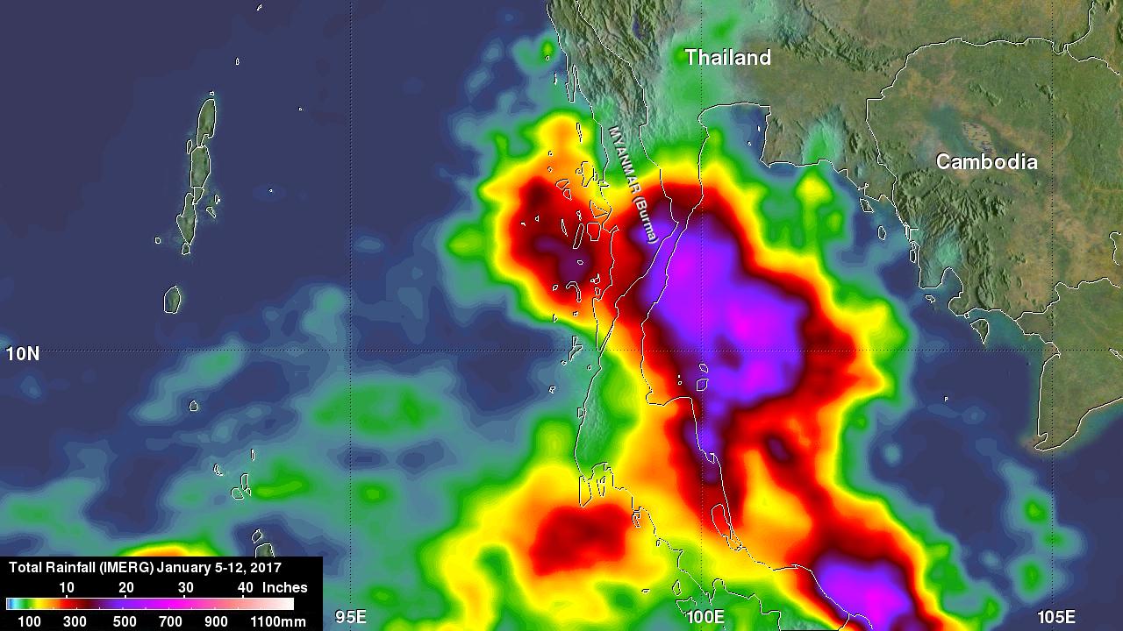
https://www.nasa.gov/feature/goddard/2017/nasa-analyzes-heavy-rainfall-over-southern-thailand

Slide 4
We Need SODA Webinar Presenters for February, March, and April 2018

Slide 5
How the SODA webinars work:
Introduction of featured teacher, students and school (2 minutes)
Presentation by featured teacher and/or students (20-25 minutes)
  Chosen Phase III Guiding Investigative Question(s)
  How the question was explored (dates of data collection)
  Ideas for potential collaboration
Collaboration and discussion time (30 minutes)
What do I do to participate in a SODA event?
Identify the Guiding Investigative Question(s) to explore
Conduct protocol measurements using as many of the GLOBE protocols as desired
Take protocols measurements at least 3 times per week for one month
Report on the data collected at a future GLOBE Water in Our Environment SODA webinar
Begin collaborating with other GLOBE schools
Submit a blog, to the GLOBE web site, highlighting your student research

Slide 6
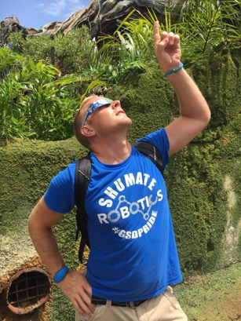
SODA Webinar #1 Featured Presenter
6 November 2017
Mr. Jeff Bouwman
Getting Science Done with Shumate Middle School
SODA Event Data Collection: October 2017
Jeff Bouwman, a science teacher at the Shumate Middle School in Gibraltar, Michigan USA is no stranger to getting his students involved in collecting hands-on data. Jeff also has students monitoring automatic environmental data coming into Shumate's WeatherSTEM weather station. Come and hear all about how Jeff's students are exploring ENSO Phase III’s Guiding Investigative Questions, during this SODA Event. Learn how Shumate Middle School is #GettingScienceDone and how you might be able to collaborate with Jeff and his students.
See the awesomeness HERE: http://bit.ly/2AwWHYY

Slide 7
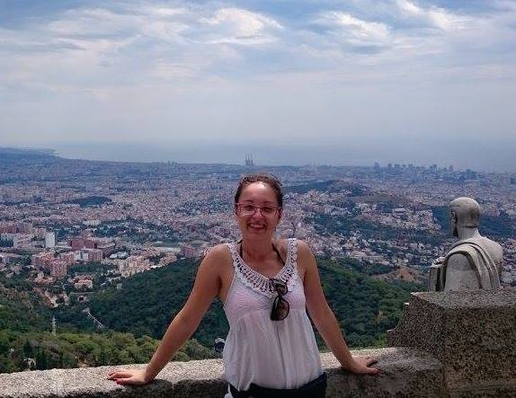
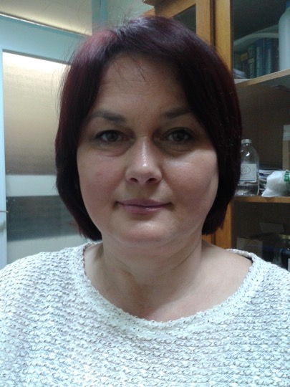
Short Observation &
Data Analysis
(SODA)
Live from Croatia
Monday, December 4, 2017 @ 2:00pm EST (7:00pm UTC)
SODA Event Data Collection Time Period: November 2017
Marina Balažinec (left), a teacher at Osnovne Škole Varaždin in Croatia, and Marija Krajnik (right), a teacher at Medicinska Škola Varaždin in Croatia, have been working with their students for several years to take GLOBE Protocol measurements to better understand Croatia’s environment. Recently, Marina, Marija and their students have been exploring ENSO Phase III’s Guiding Investigative Questions through research of the Plitvica River. Marina’s students have focused on the plant life of the Plitvica River and Marija’s students have focused on the physiochemical properties of the Plitvica River. Join us for some great presentations during this SODA webinar. Learn how you might be able to collaborate with Marina and Marija.
Medicinska Škola Varaždin Student Presenters: Lana Bogović & Jonathan C. Beneš
Osnovne Škole Varaždin Student Presenter: Dora Vitez
See the awesomeness HERE: http://bit.ly/2AwWHYY

Slide 8
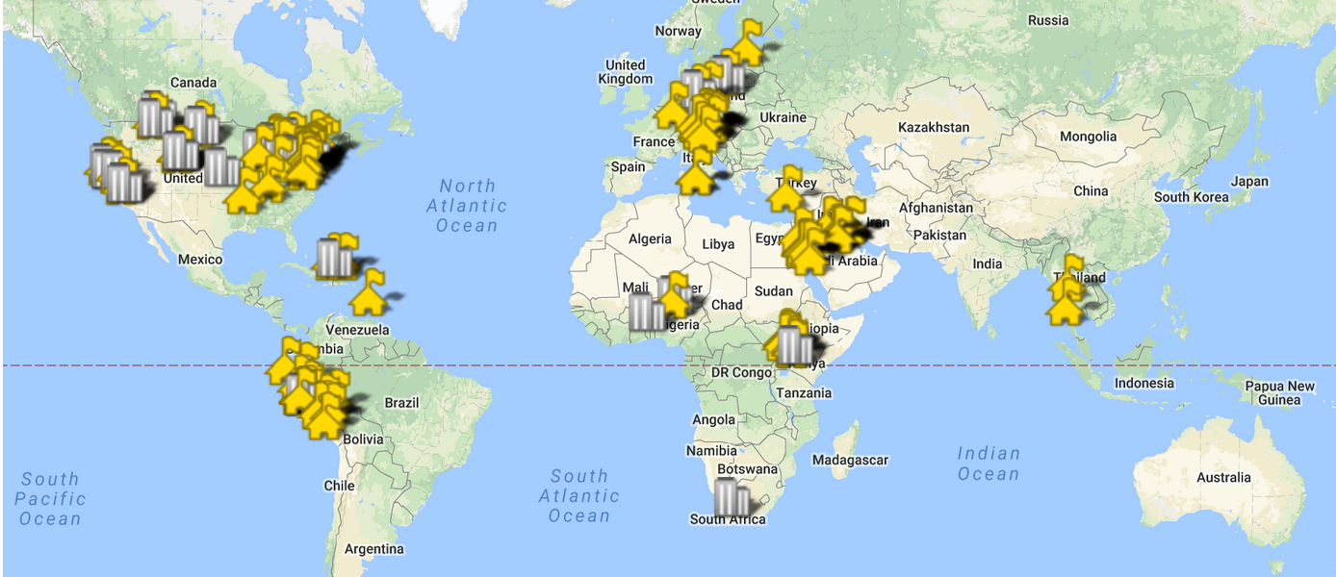
Our Campaign Members

