Slide 1
Measuring water quality in Poland
Ela Wołoszyńska-Wiśniewska (ela@gridw.pl) Head of Education Unit at UNEP/GRID-Warsaw Centre GLOBE Country Coordinator in Poland
ENSO PHASE III “Water in Our Environment” Collaboration Webinar Webinar # 3- WATER QUALITY in Europe and Eurasia Nov. 14th 2017

Slide 2
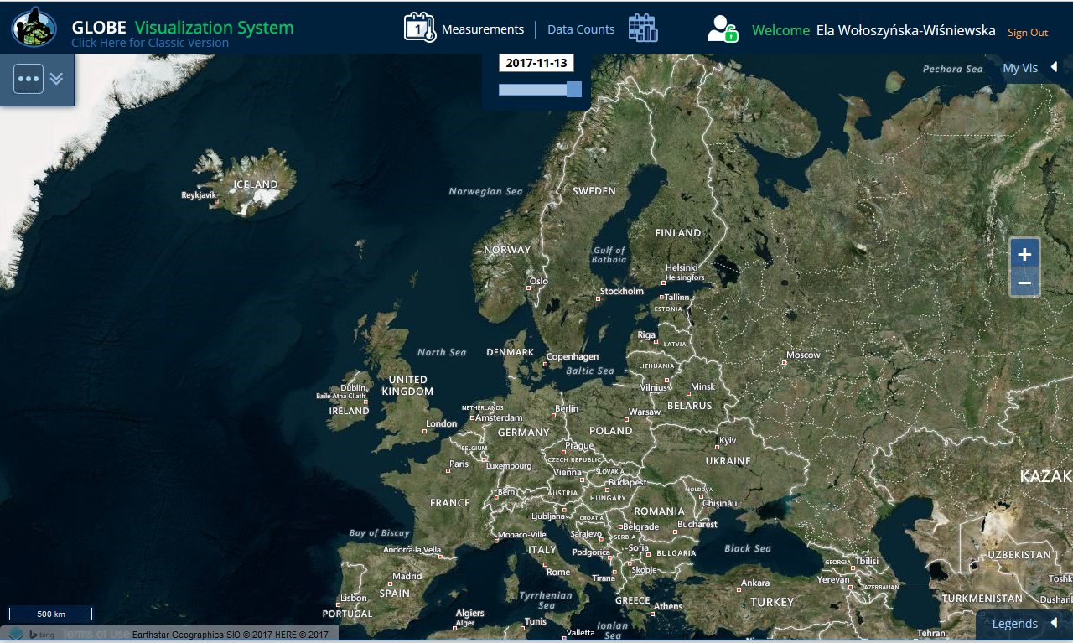
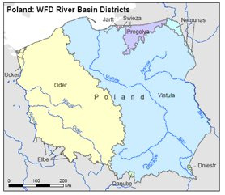
Polish rivers In the geographic centre of Europe
Source: European Commision, WISE – Water Information System for Europe

Slide 3
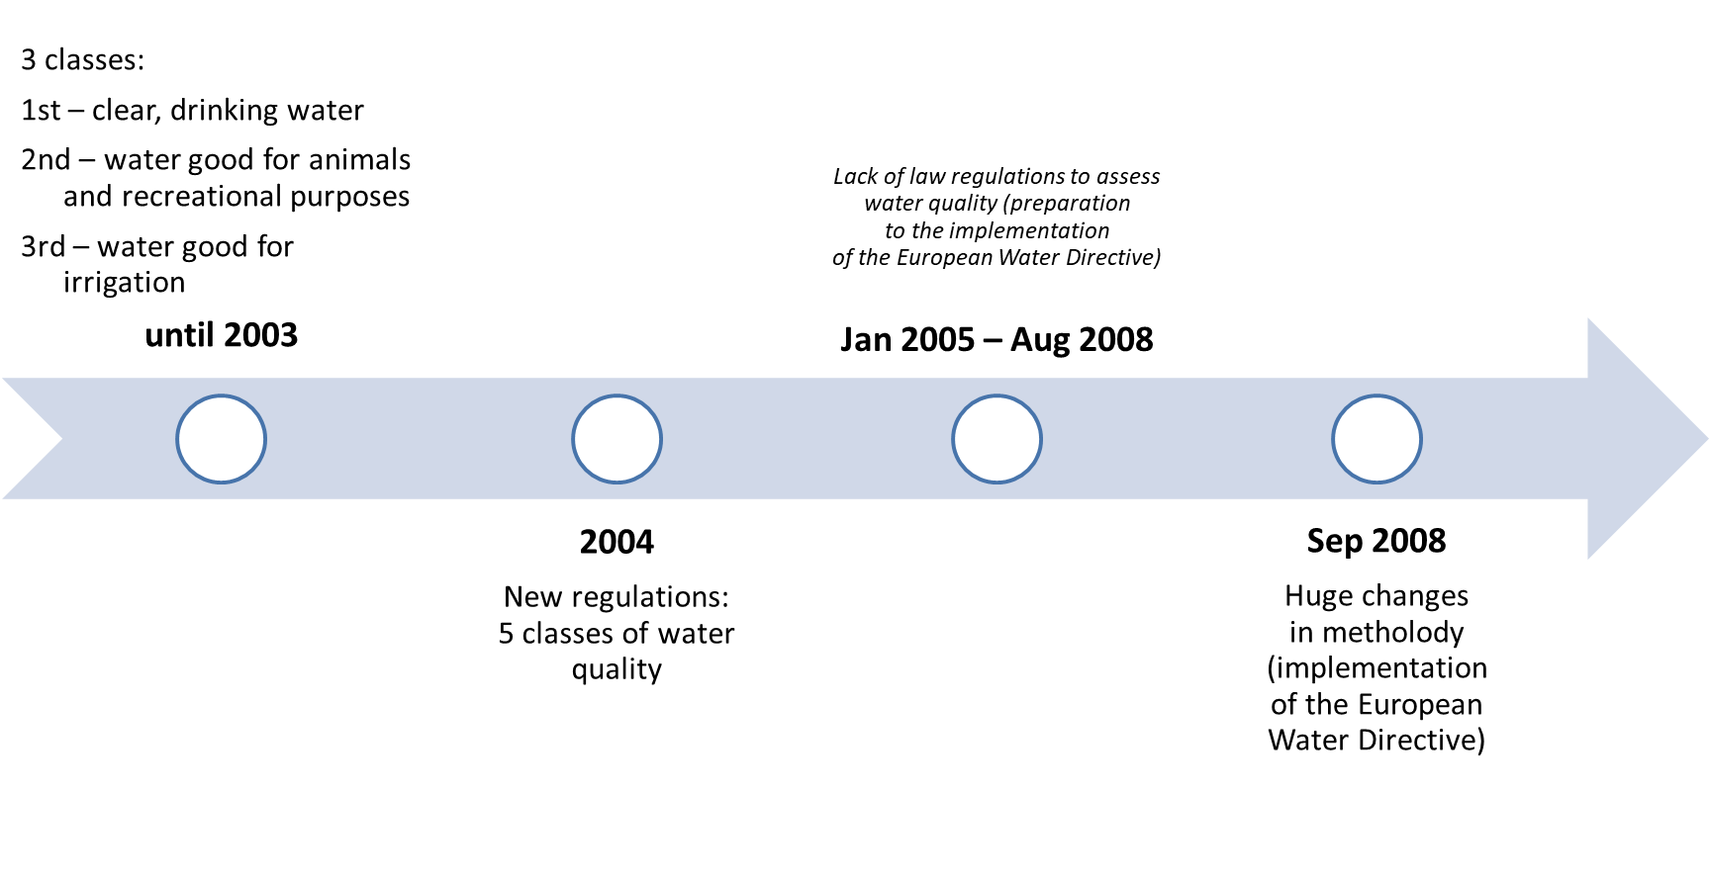
Surface waters classification in Poland: (r)evolution
Source of information: Czaban, S. (2008), Classification of surface water quality in Poland, Infrastructure And Ecology Of Rural Areas., Cracow.

Slide 4
Surface waters quality 2010–2015
The Chief Inspectorate for Environmental Protection and 16 regional inspectorates are responsible for official water monitoring in Poland;
Overal water status = ecological status + chemical status

Slide 5
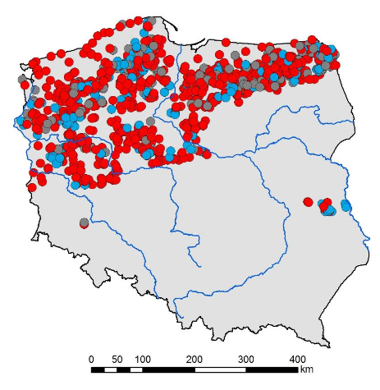
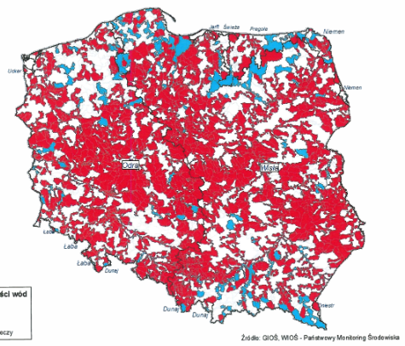
Surface waters quality 2010–2015
The Chief Inspectorate for Environmental Protection and 16 regional inspectorates are responsible for official water monitoring in Poland;
Overal water status = ecological status + chemical status
LAKES
RIVERS AND ARTIFICIAL LAKES
Overal water status:
good
bad
no data
Source: The Chief Inspectorate for Environmental Protection

Slide 6
Surface waters quality Main challenge
Decrease the level of contamination coming from agricultural and communal sources (incl. nitrogen and phosphorus – main cause of eutrophication)
LAKES
RIVERS AND ARTIFICIAL LAKES
Overal water status:
good
bad
no data
Source: The Chief Inspectorate for Environmental Protection

Slide 7
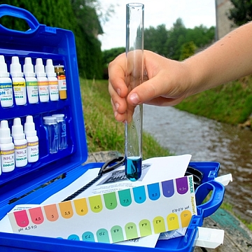
Drinking water quality
Polish law regulations define drinking water parameters, incl.: acceptable level of pH, transparency, alkalinity, nitrates, conductivity – all measurements taken by GLOBE students.
GLOBE community can play significant role in almost real-time water quality monitoring – GLOBE database used as supplement for official resources used by decision makers

Slide 8
Thank you!
Ela Wołoszyńska-Wiśniewska (ela@gridw.pl) Head of Education Unit at UNEP/GRID-Warsaw Centre GLOBE Country Coordinator in Poland
ENSO PHASE III “Water in Our Environment” Collaboration Webinar Webinar # 3- WATER QUALITY in Europe and Eurasia Nov. 14th 2017

