Slide 1
ENSO Phase III SRC
GLOBE El Niño Southern Oscillation campaign:
Water in our environment
Webinar, November 14th, 2017
Markus Eugster, Sek Uzwil

Slide 2
Water quality: How we measure water quality, which methods we use and how we share our findings.

Slide 3
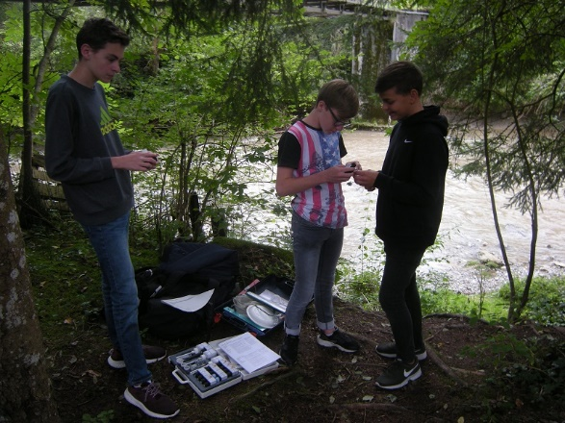
Students with their equipment

Slide 4
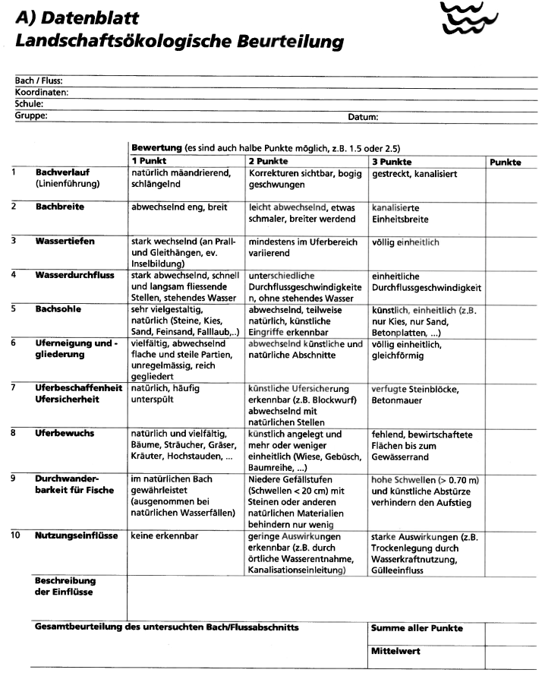
Landscape ecology

Slide 5
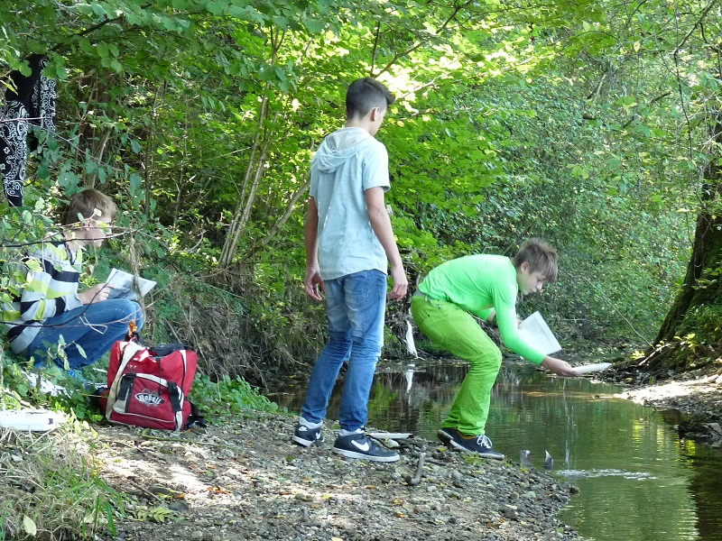
Landscape ecology + bioindication

Slide 6
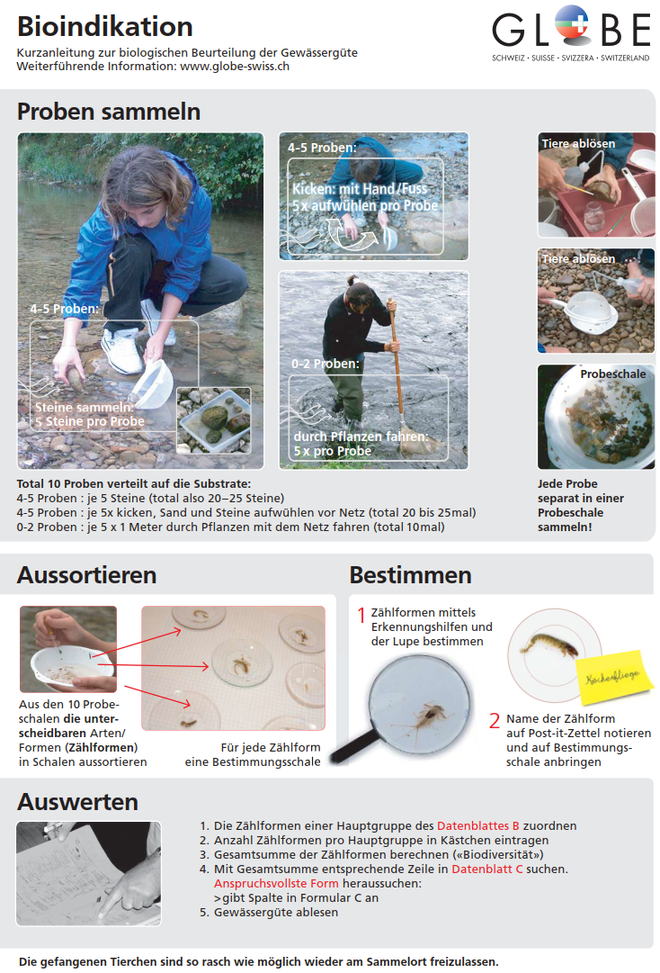
Bioindication: quick reference

Slide 7
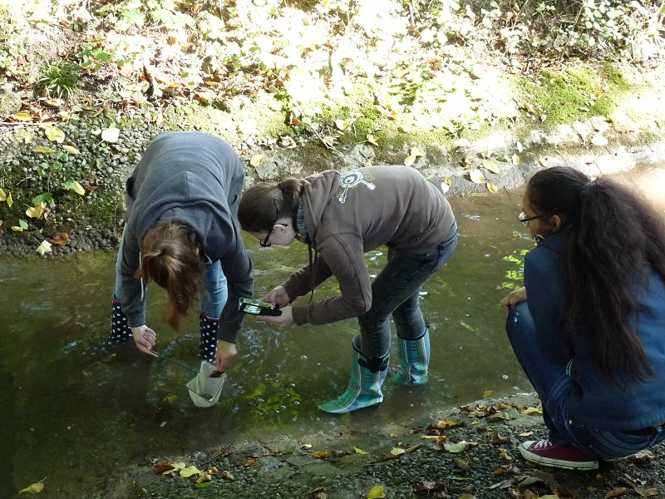
Documenting the methods

Slide 8
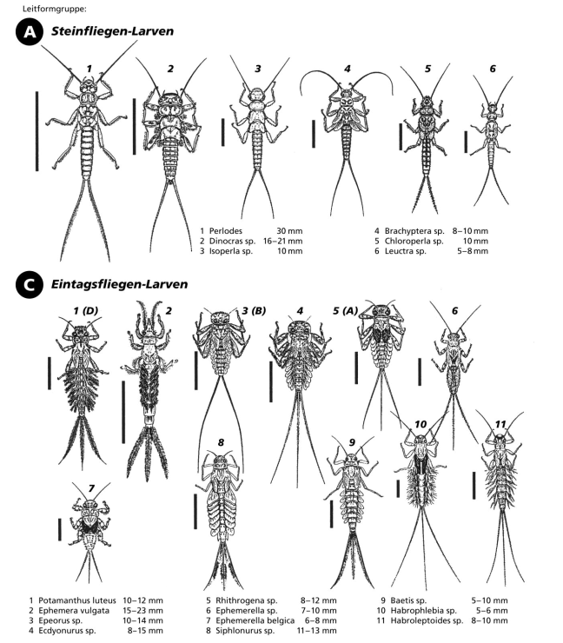
Classification guide

Slide 9
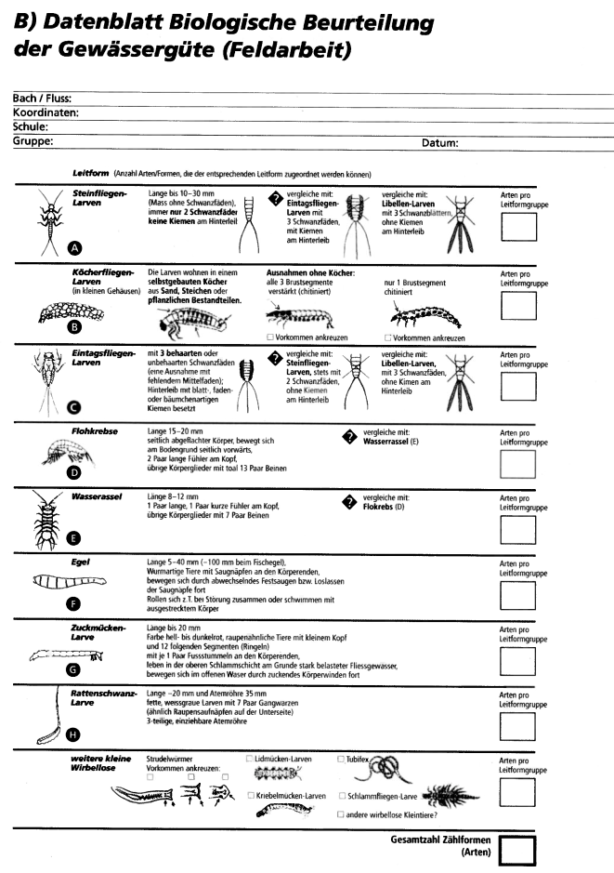
Macroinvertebrates: overview

Slide 10
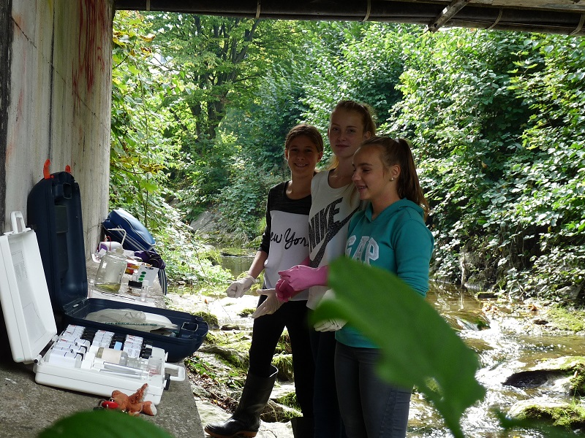
Ready for the chemical field work

Slide 11
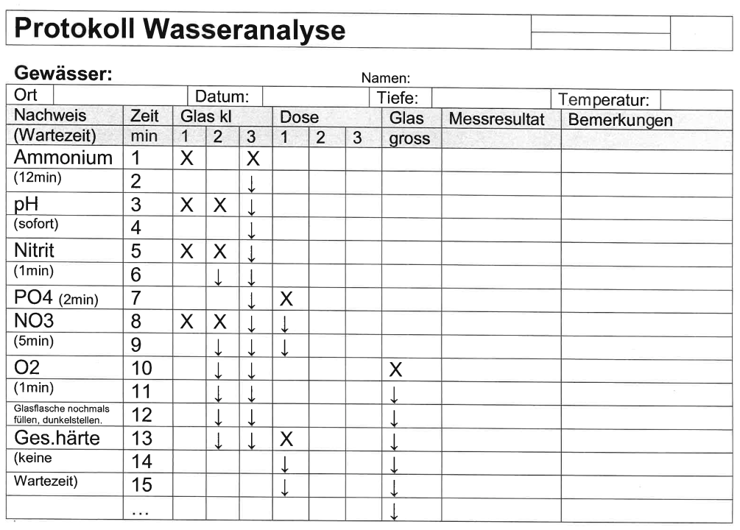
Chemical analysis: procedure

Slide 12
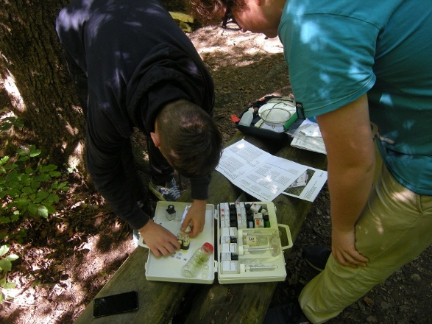
Measuring nitrate

Slide 13
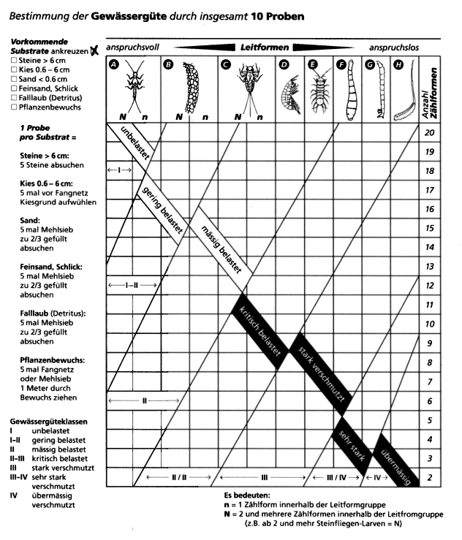
Water quality chart

Slide 14
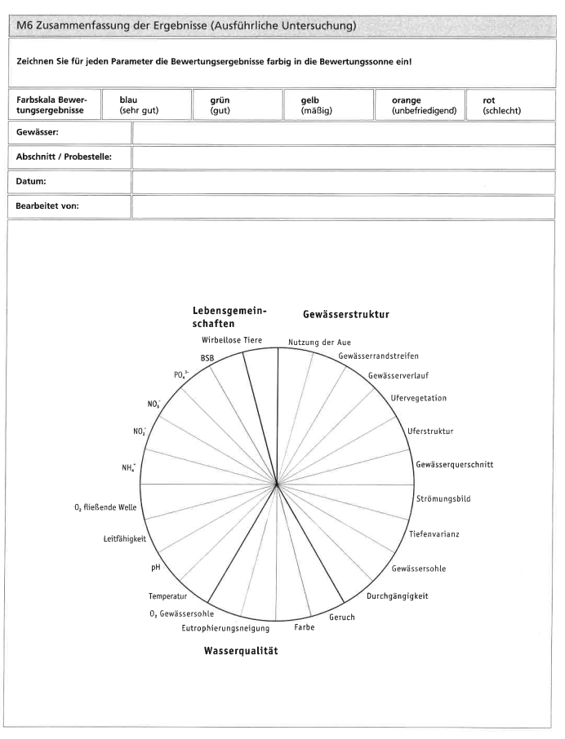
Summary of all the measurements

Slide 15
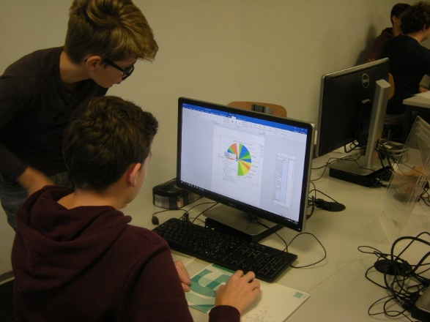
Visualize the results

Slide 16
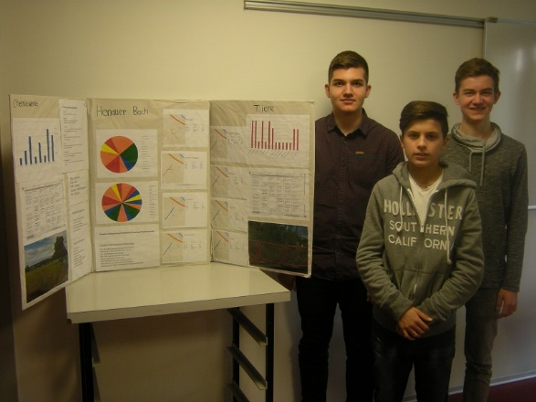
Share your findings

Slide 17
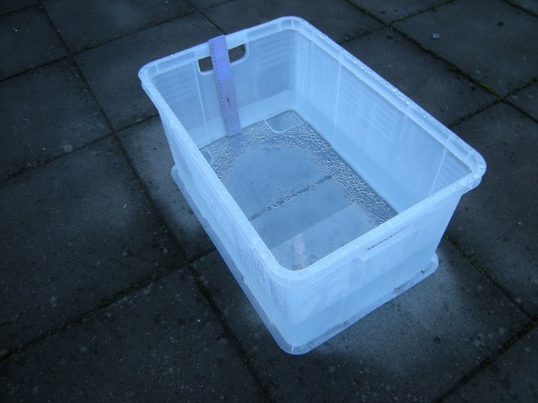
Evapotranspiration box

Slide 18
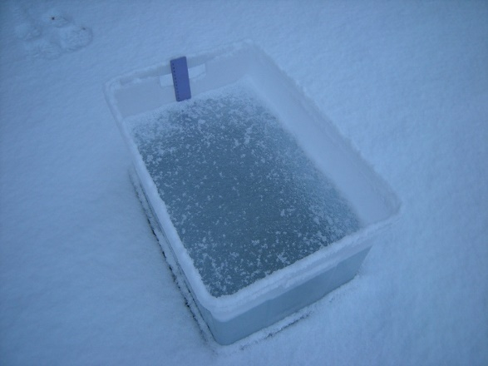
Evapotranspiration box in winter

Slide 19
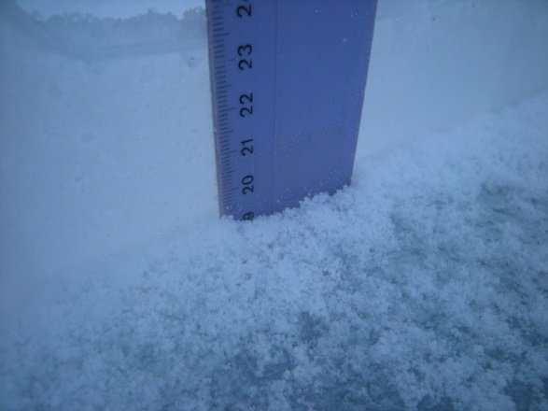
Evapotranspiration box in winter

Slide 20
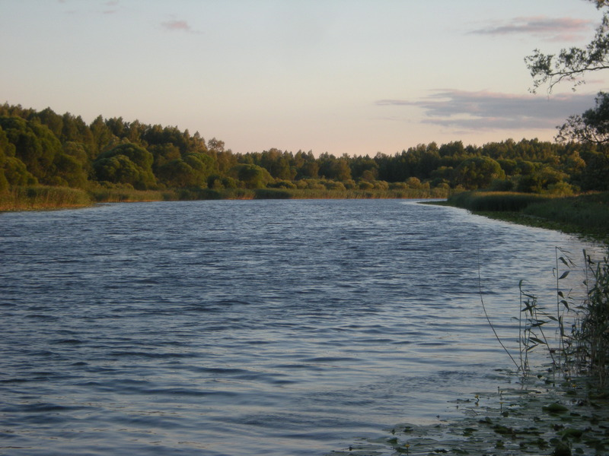
Questions? mk.eugster@gmail.com

Slide 21
GLOBE model for student research

