Slide 1
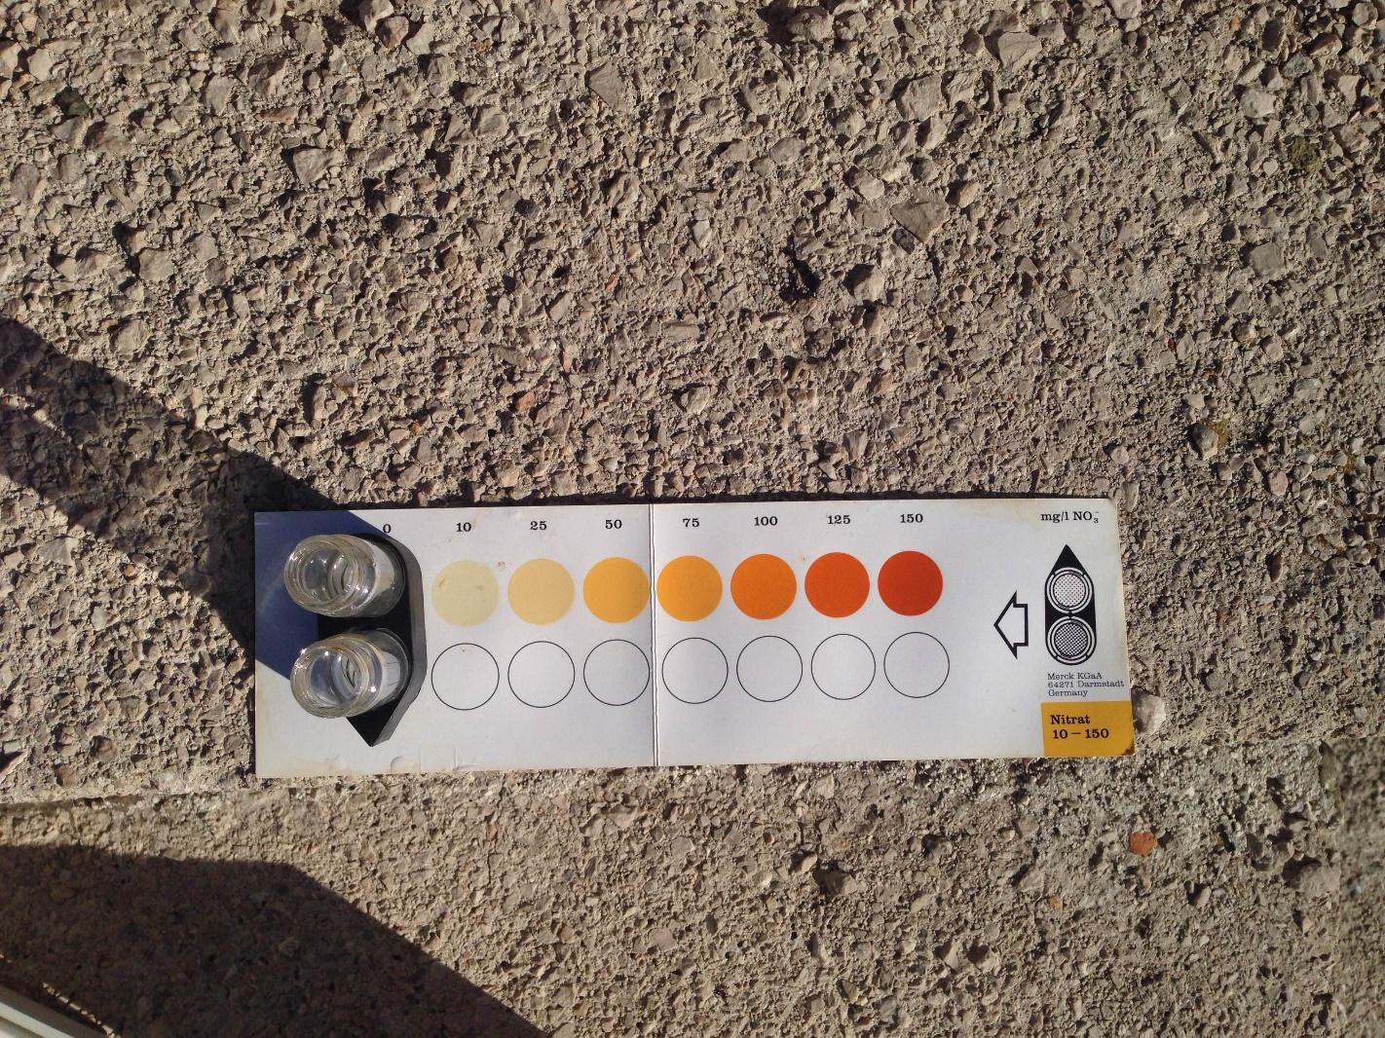
HIDROLOGY GLOBE PROTOCOLS
ON THE SCHOOL'S SEA SITE ON THE ADRIATIC SEA
Latitude 45.2023°Longitude14.232°
Measured November 11th 2017

Slide 2
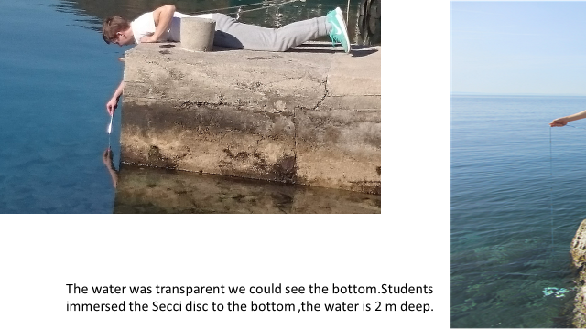
Water temperature was 17,5 C and current air temperature 18,9C

Slide 3
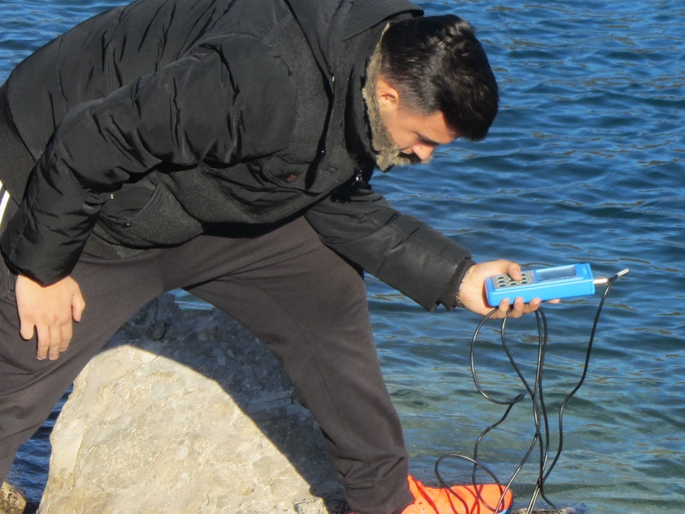
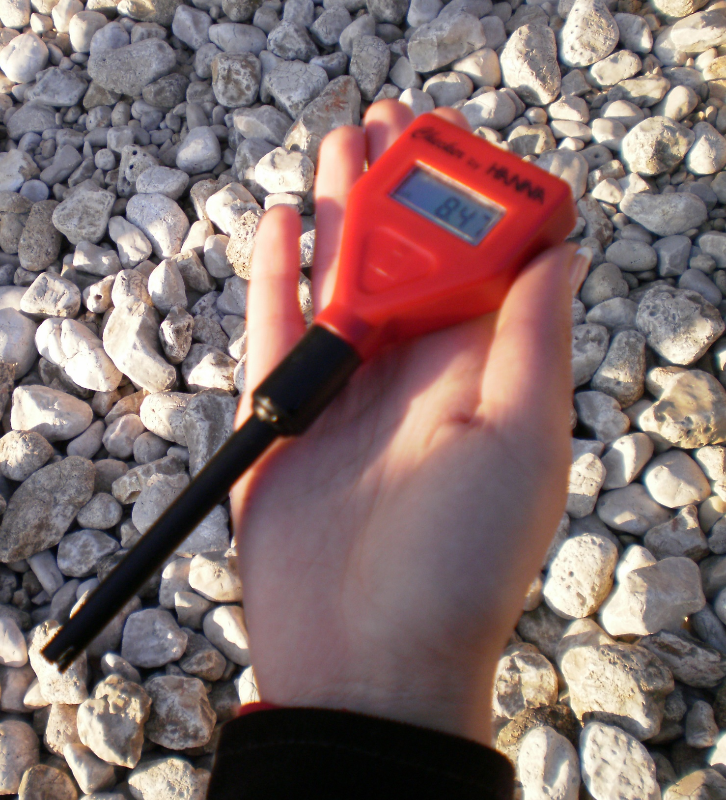
OXIGEN LEVELS
probe 8,9 mg/l
kit 8,8 mg/l
pH 8,1

Slide 4
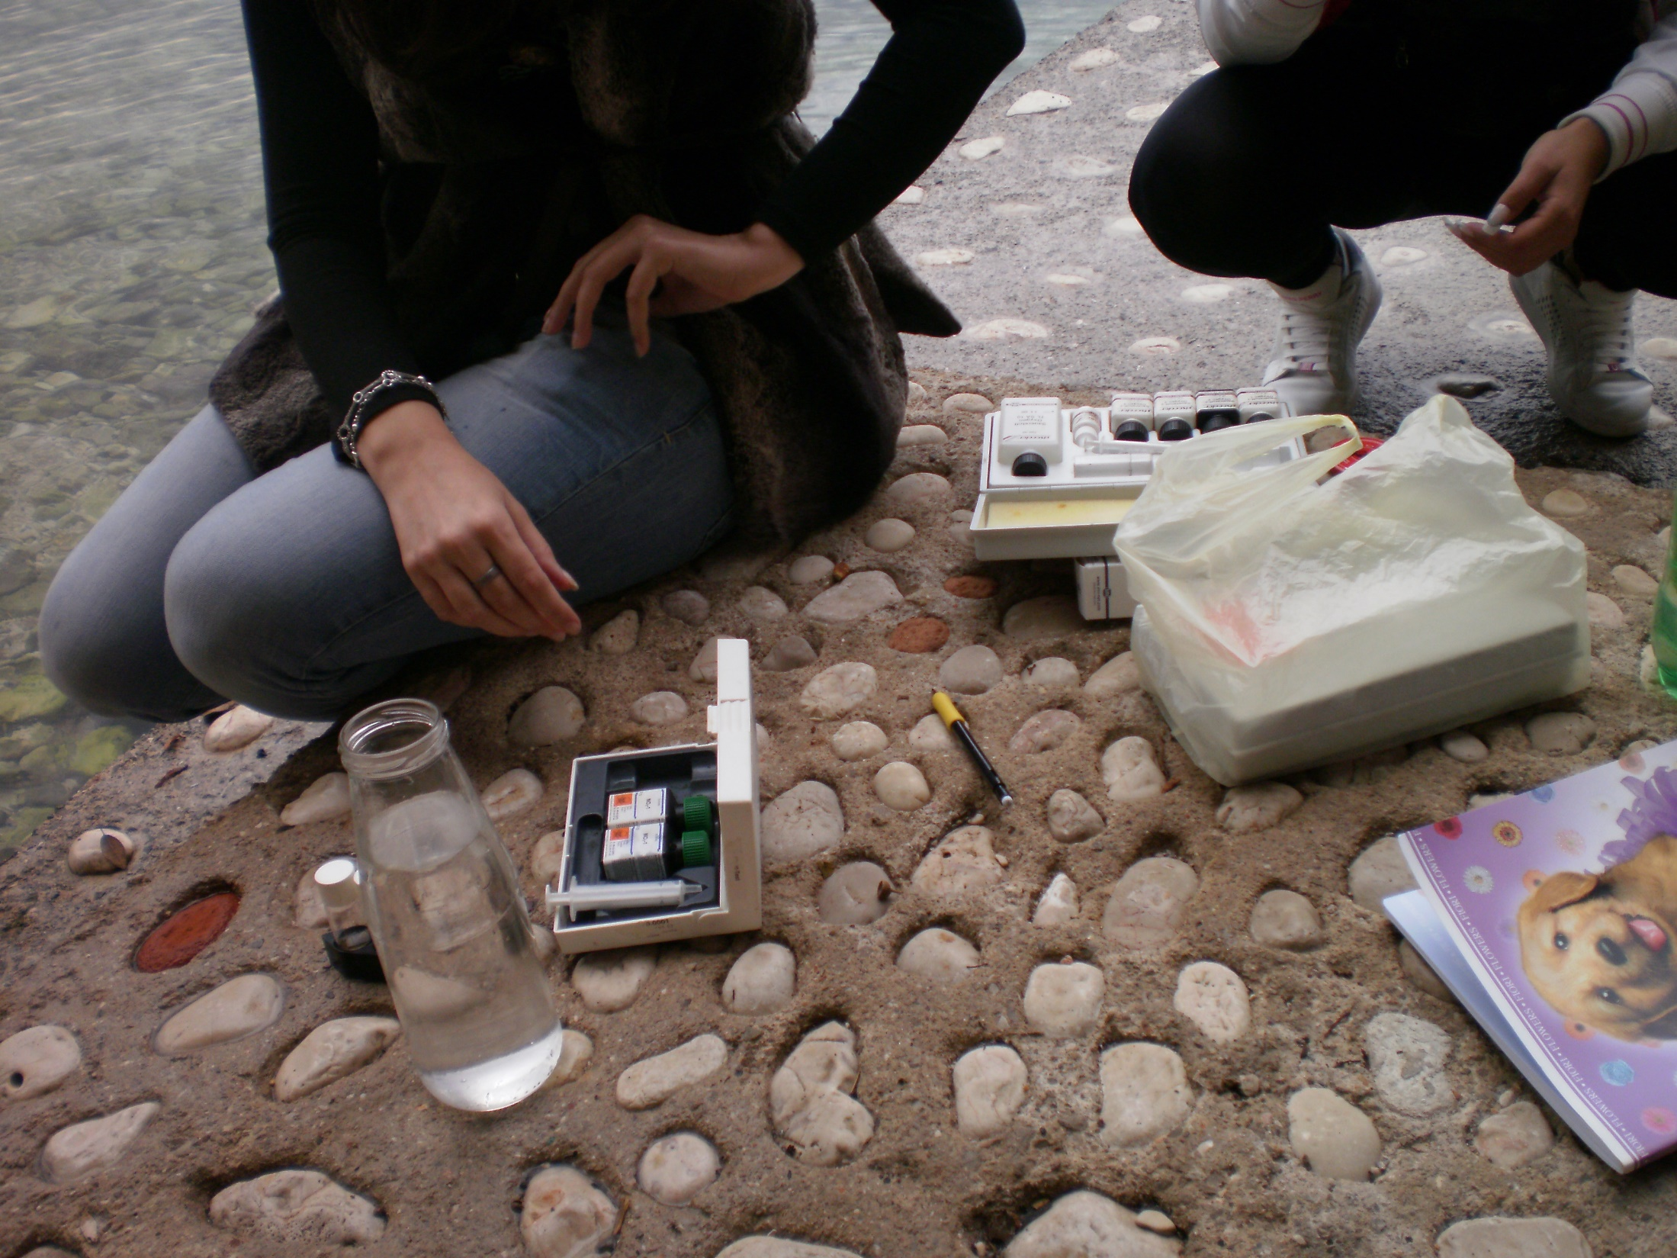
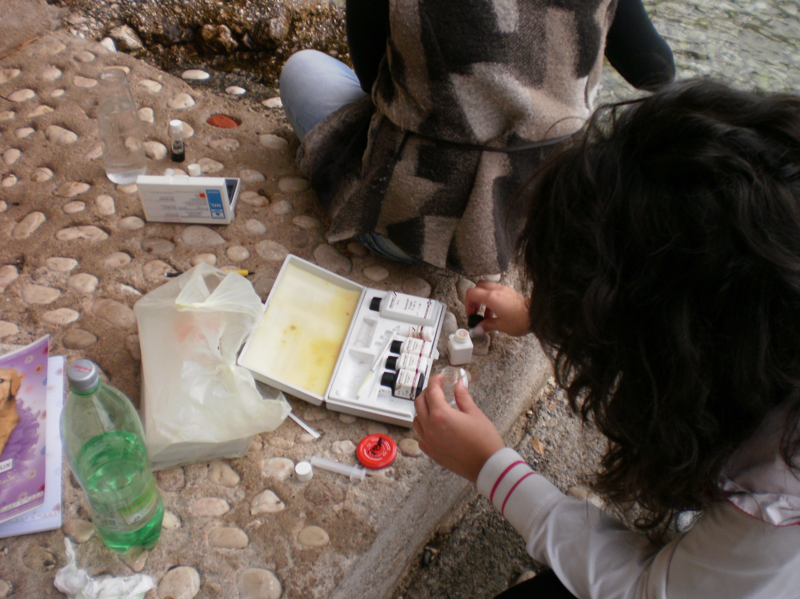
SEA QUALITY
Chlorides19 g /l Salinity 35 ‰(lab)
Sulphates 2 g/l
Carbonates 0,12 g/l Nitrates 0 g/l
Calcium 0,41 g/l Nitrites 0 g/l

Slide 5
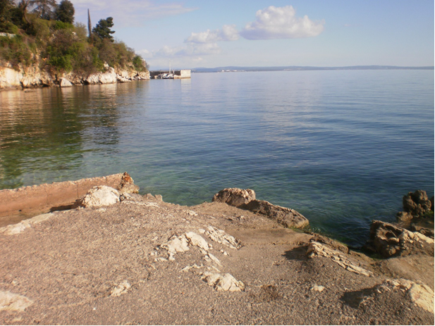
CONCLUSIONS
The seawater on our site is clean, all chemical and phisical
parametars are within range.
The salinity is lower than the standard Adriatic sea salinity
( 39‰)
There are a lot of freshwater springs on the site, we counted
four(we can see them when the water is transparent).
There are no nitrates or nitrites in the water, so bathing will
be safe.
NZZJZ is making microbiological analysis to confirm that
there are no bacteria in the sea

