Slide 1
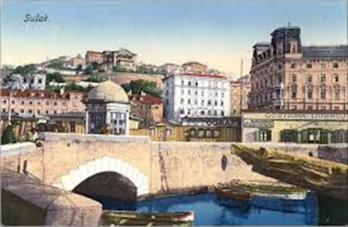
HYDROLOGY GLOBE PROTOCOLS: WATER QUALITY OF THE CHANNEL IN THE RIJEKA'S CENTER
In 19th century
Today
The channel was built in 1891 to prevent the flooding of the town.
The depth of the channel when built was 60 m. Now is about 3-5 m.
Notes:
Pročitaj naslov i dok gledaju :On the left you see a trench that connect channel to the river so it can't flood

Slide 2
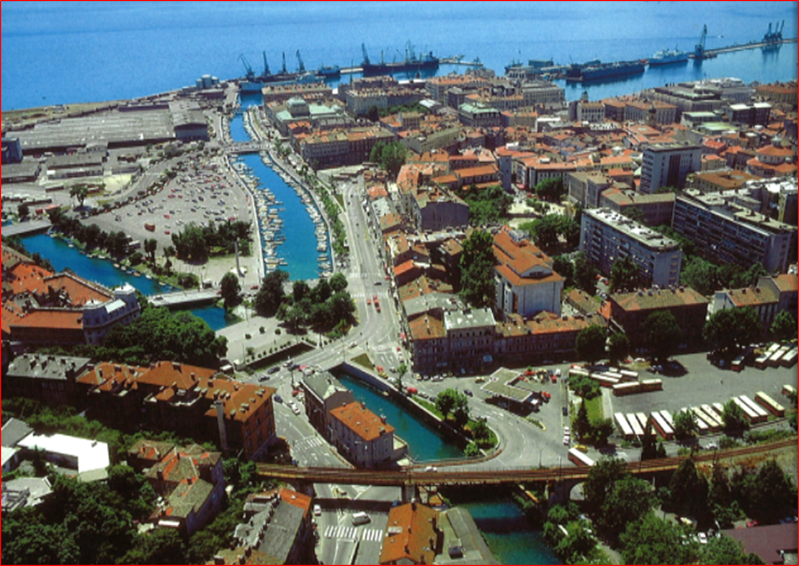
MEASURING
We took all of our measurements in the right fork (channel Mrtvi Kanal-parking place), the left fork is Rijeka's river,Rječina.Both flow into the sea.
Notes:
We measured on the channel, Our channel is on the right, the river on the left

Slide 3
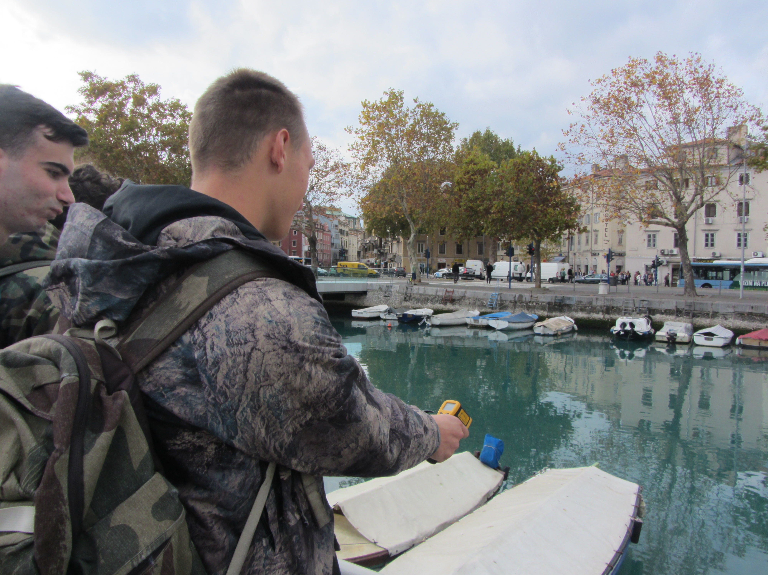
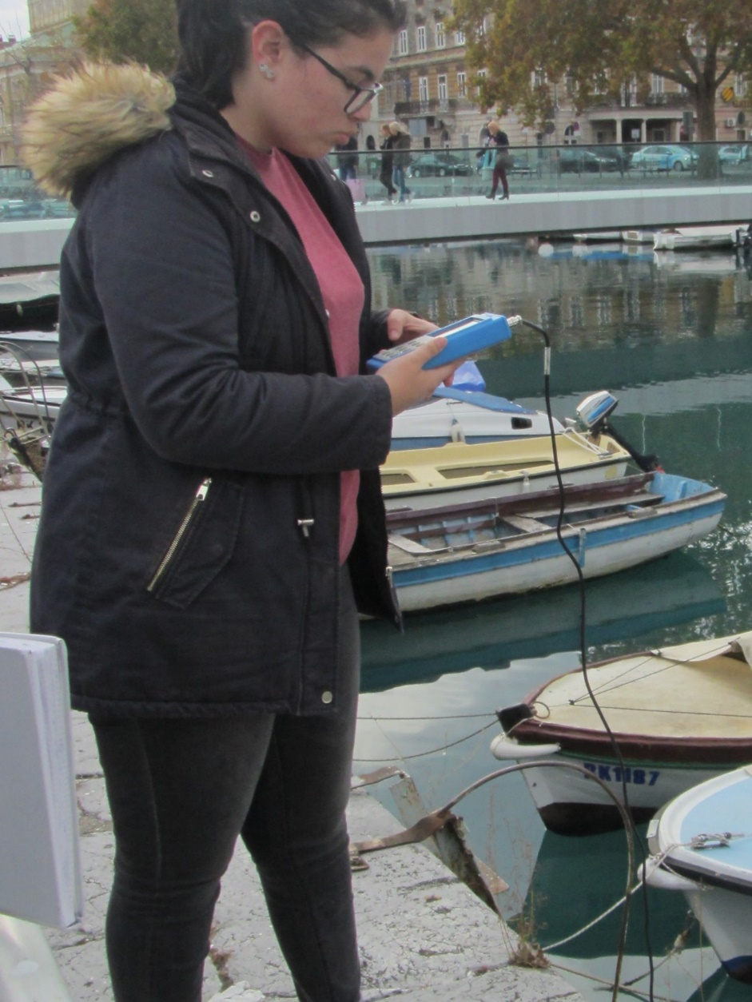
MEASUREMENTS
TEMPERATURE (digital termometer) 11,8ºC
10.3ºC water surface=13,4ºC(IR termometer)
DISSOLVED OXYGEN LEVEL
measured with probe 24,47 ppm(mg/l)
105,6 ppm(mg/l)
Notes:
We measured temperature, dissolved oxygen, red measurings are from January 2016.

Slide 4
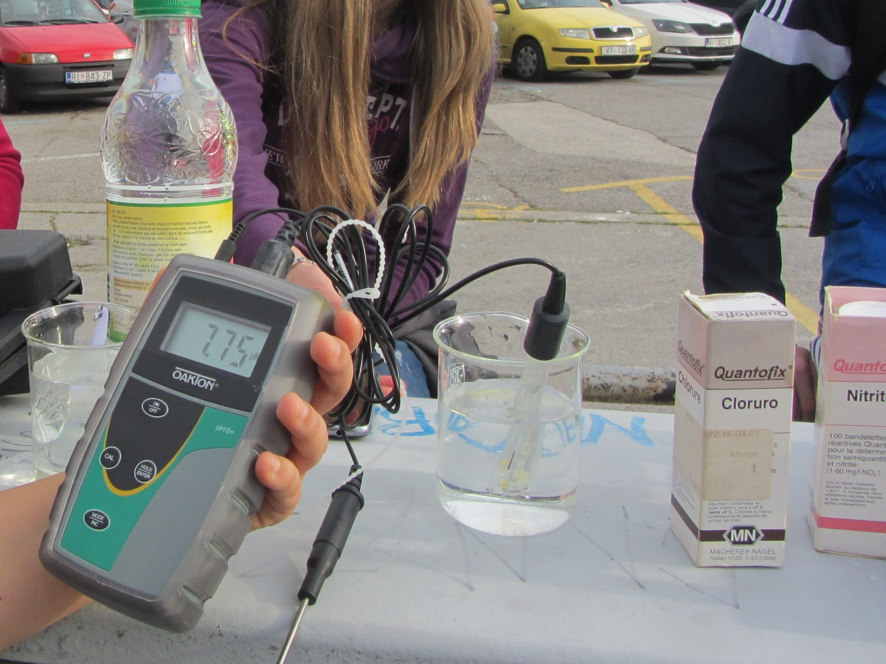
pH & CONDUCTIVITY
7,75(YLACES donation) 8,1
252 µS/cm
106,5 µS/cm
Notes:
pH (Pi eiđ )is lower , conductivity higher our supposition, more acid ions, especially chlorides

Slide 5
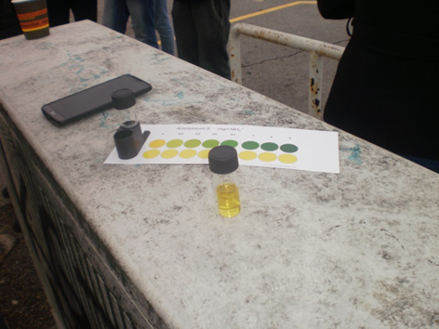
DISSOLVED IONS
SULPHATES (Quantofix test) >200 mg/l
SULPHITES (Quantofix test) 10 mg/l
NITRITES 0 mg/l 0 mg /l
NITRATES
0 mg/l 10 mg/l
CHLORIDES
500 mg/l
Notes:
We think that a lot of chlorides came from the sea-the channel finishes into the sea

Slide 6
CONCLUSIONS
Water in our channel is slightly basic, but less than a year ago
It contains four times less oxygen (temperature is only 1,5 degrees higher)
There are no nitrates or nitrites in the channel
As last year the water is safe, and older citiziens who like to fish in the channel can eat the fish safely.
We took water samples to determine water hardness in our school lab.

Slide 7
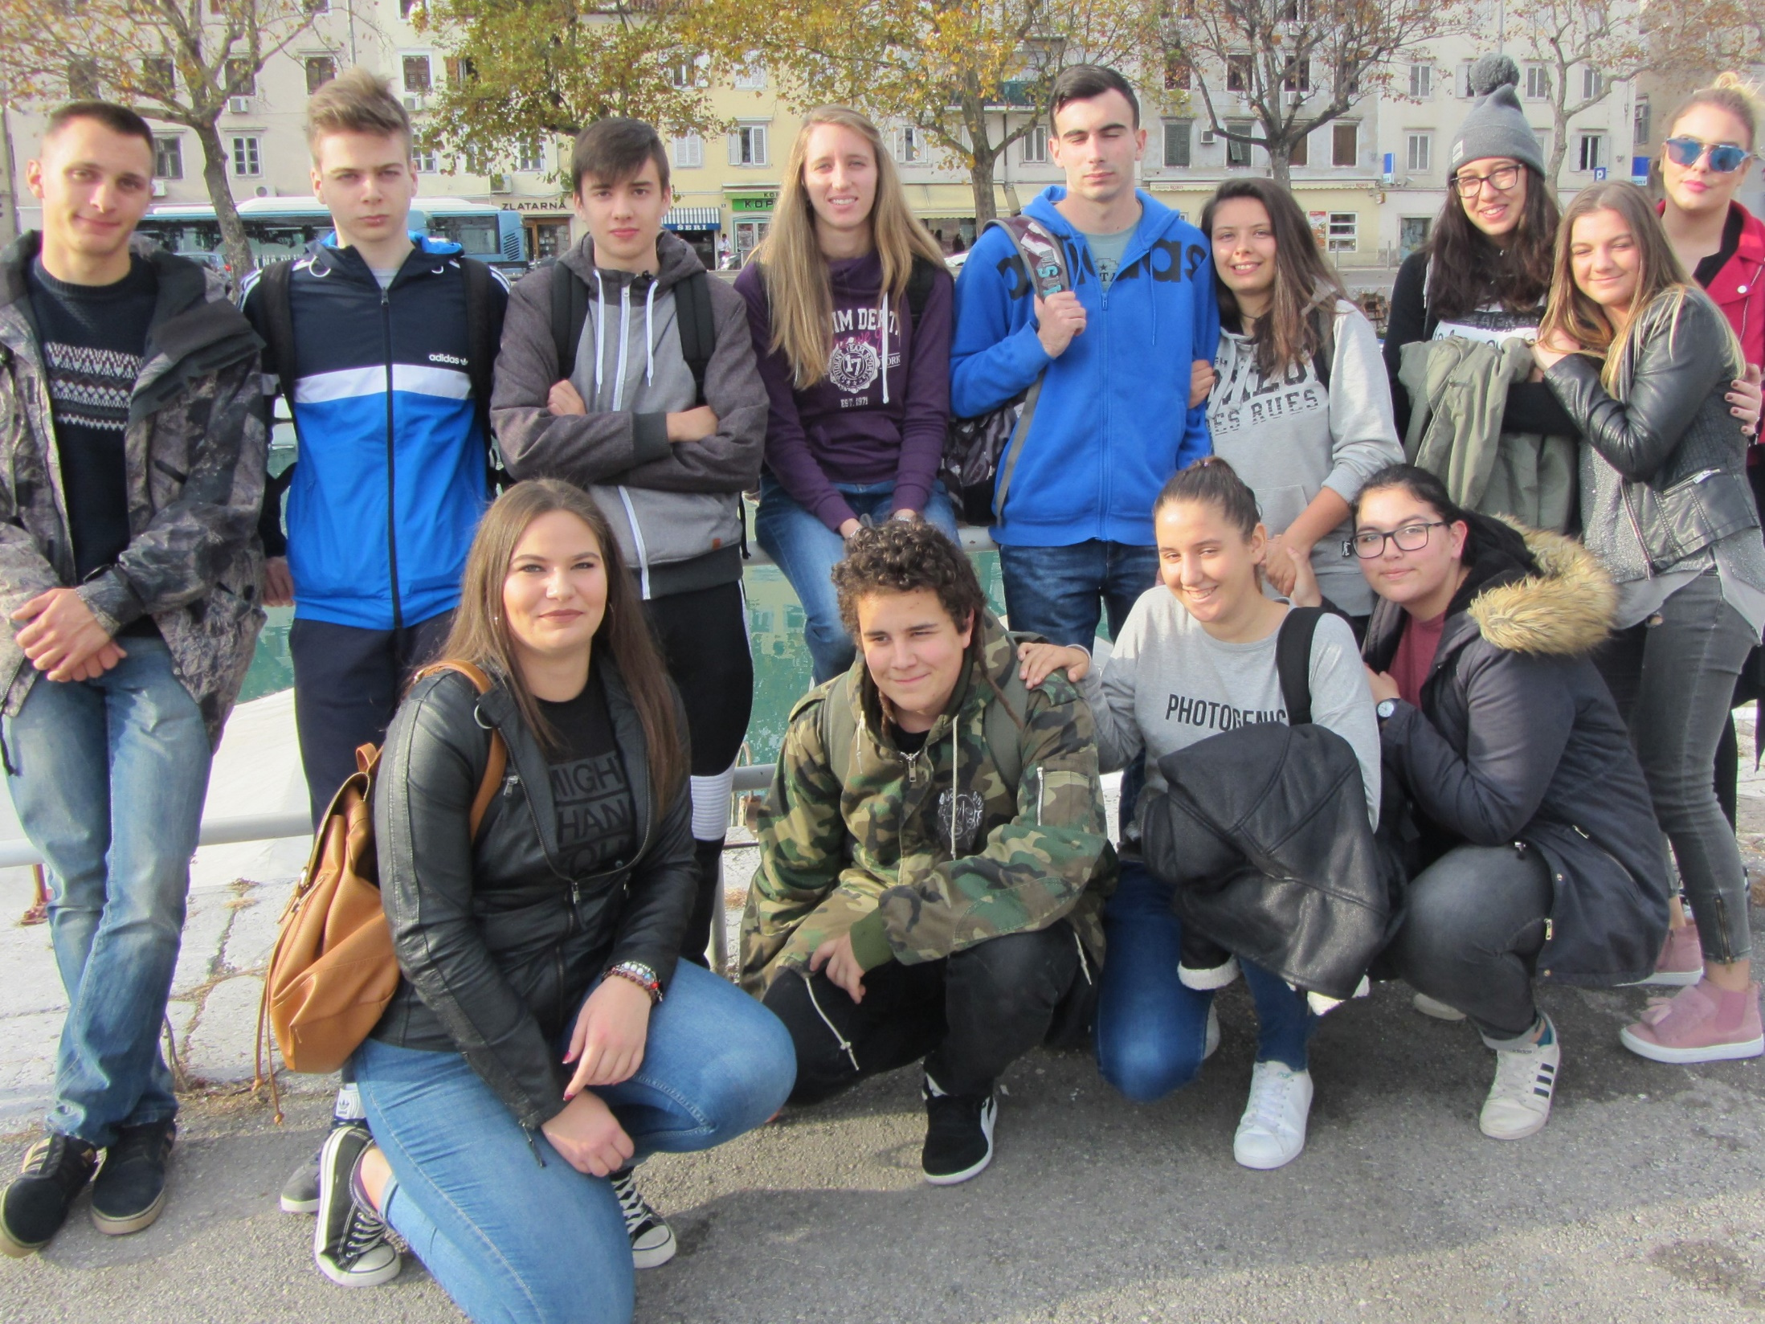
Notes:
The measurements made a 12 th year GLOBE group and thank you for your attention

