Slide 1

The flood project
What did we find out about the quality of THE water in our local environment?
Joanna Gawor, Primary School with Integrated Classes no. 1 in Bieruń, Poland

Slide 2
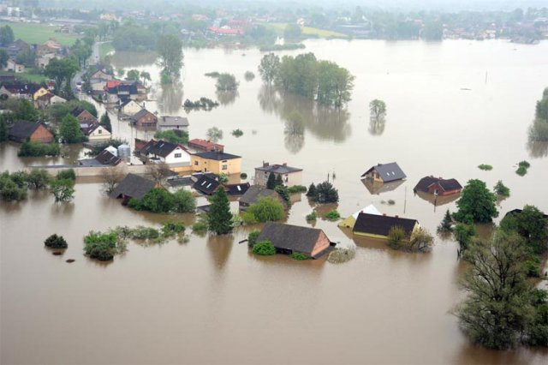
The flood in Bieruń in 2010
http://www.powodzbierun.pl/galeria,lotnicze.html

Slide 3
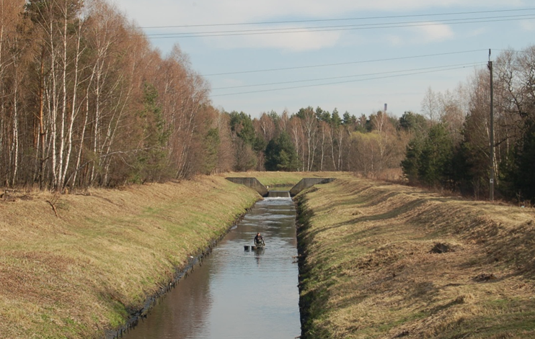
What is the quality of the water
in our environment?

Slide 4
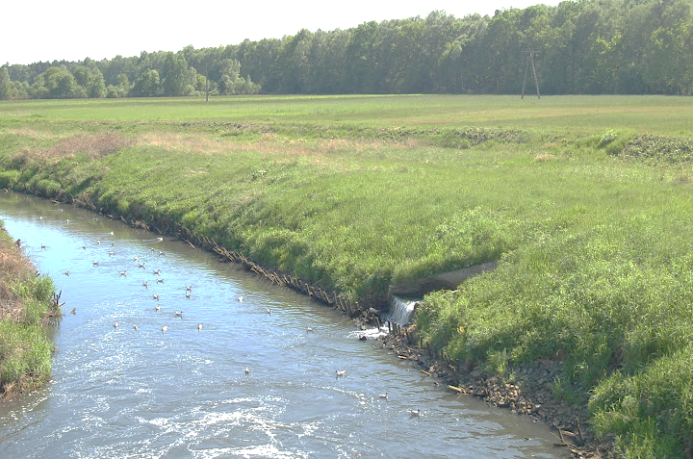
Weather anomalies and floods incidents are more and more common in our country.
During floods variable contaminations can enter the water.
Excess nutrients like phosphates
or nitrates in the water bodies can
lead to eutrophication.

Slide 5
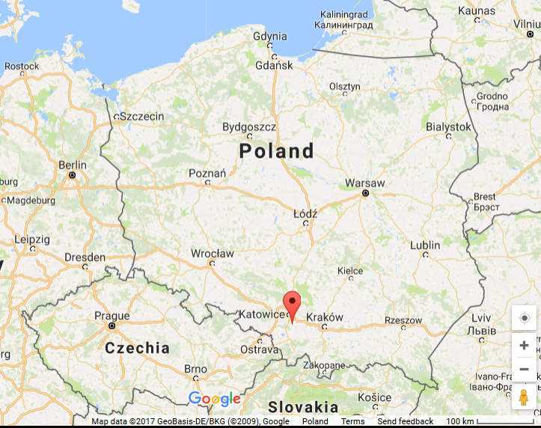
Bieruń

Slide 6
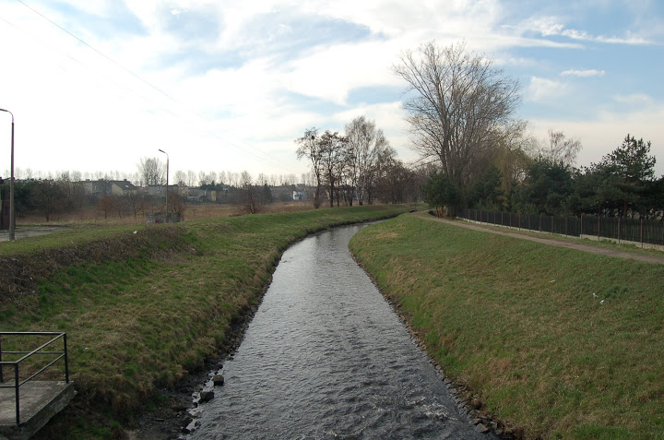
The Mleczna river

Slide 7
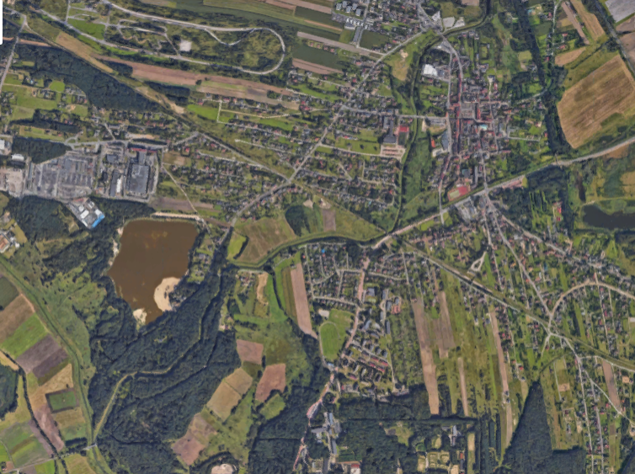

The Mleczna river
Sampling site no. 1
2 km
Sampling site no. 2

Slide 8
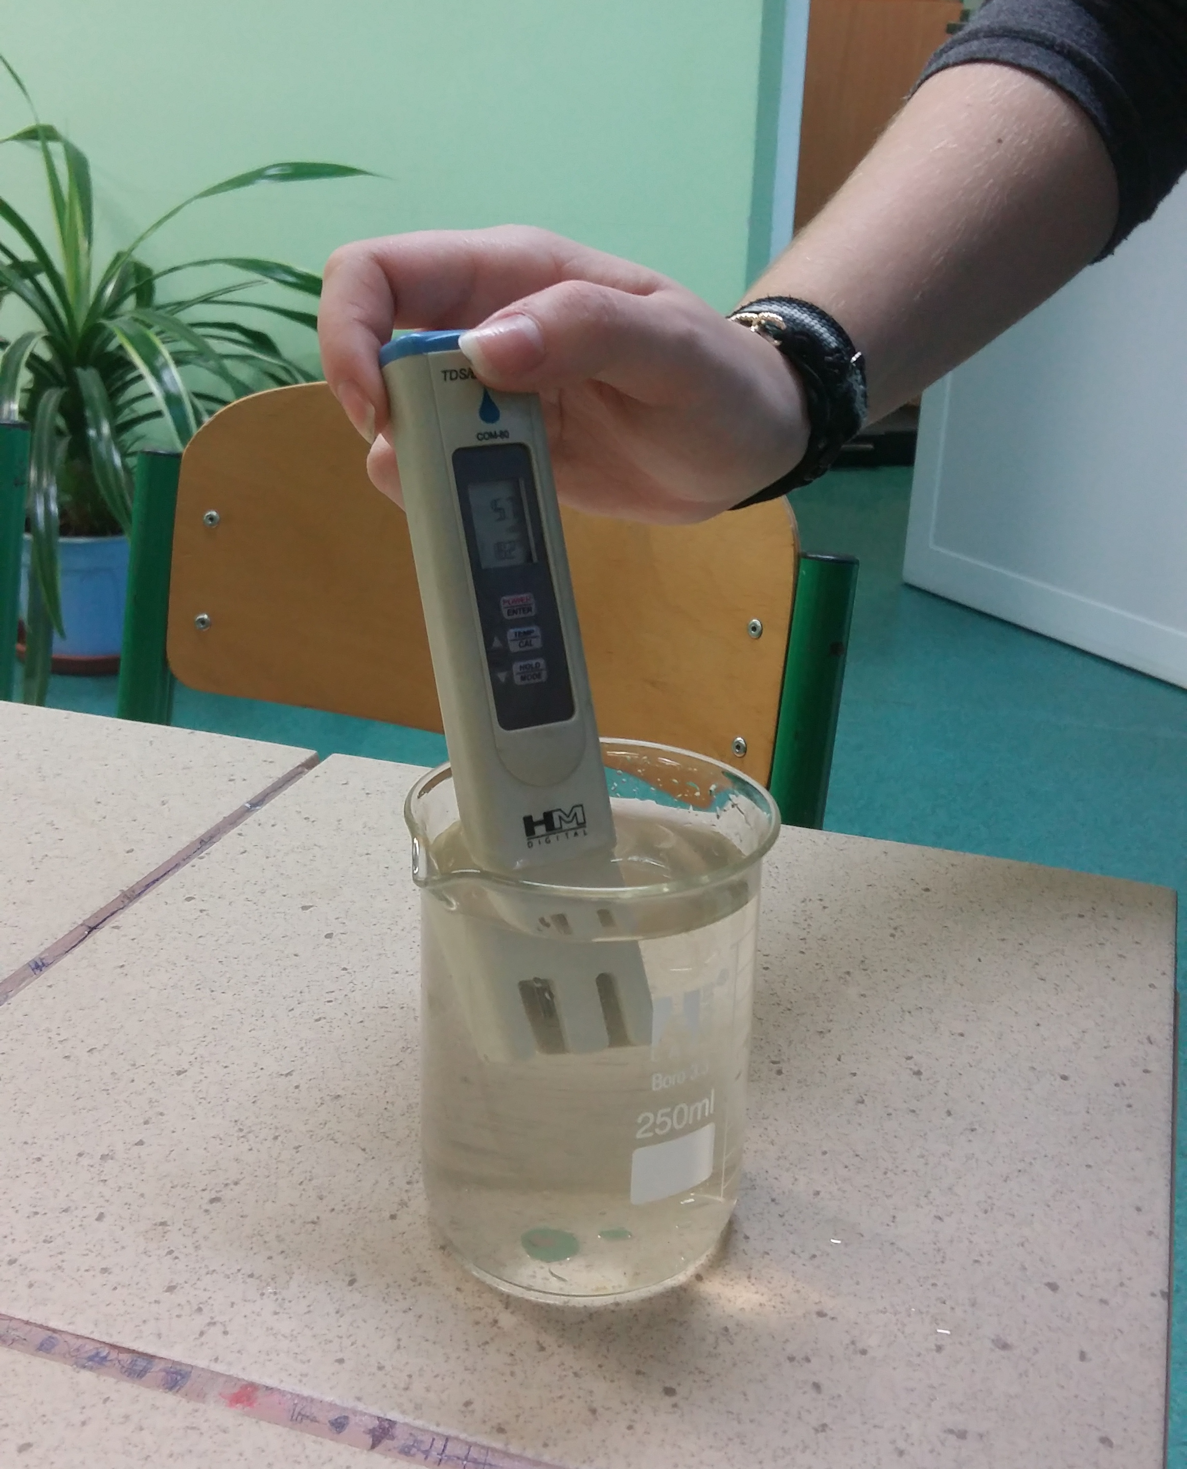
pH
water temperature
dissolved oxygen
nitrates
nitrites
ammonia
phosphates

Slide 9
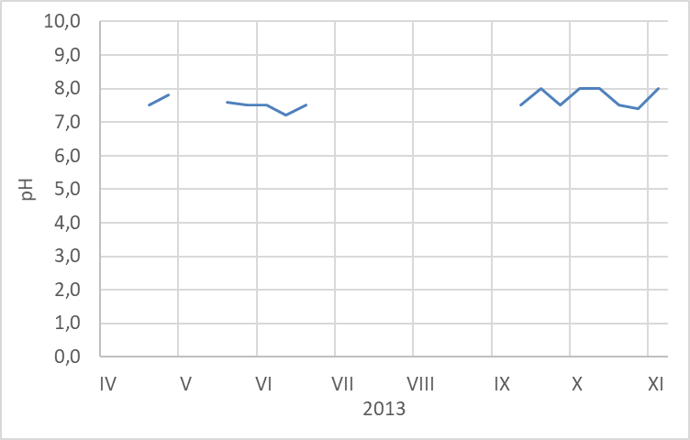
pH of the Mleczna river

Slide 10
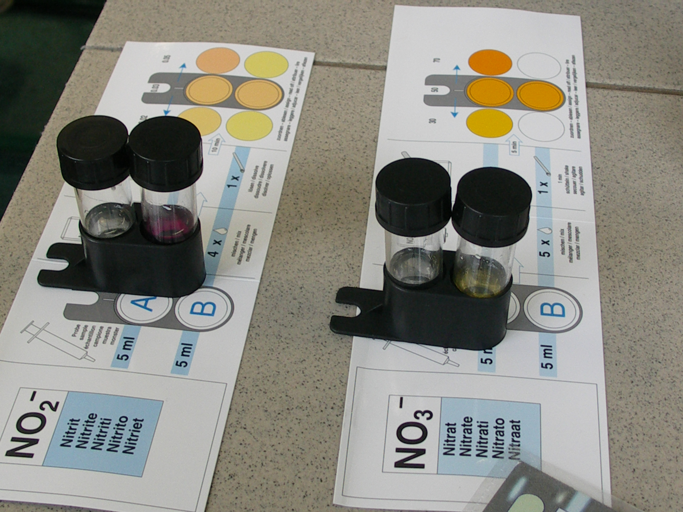

Slide 11
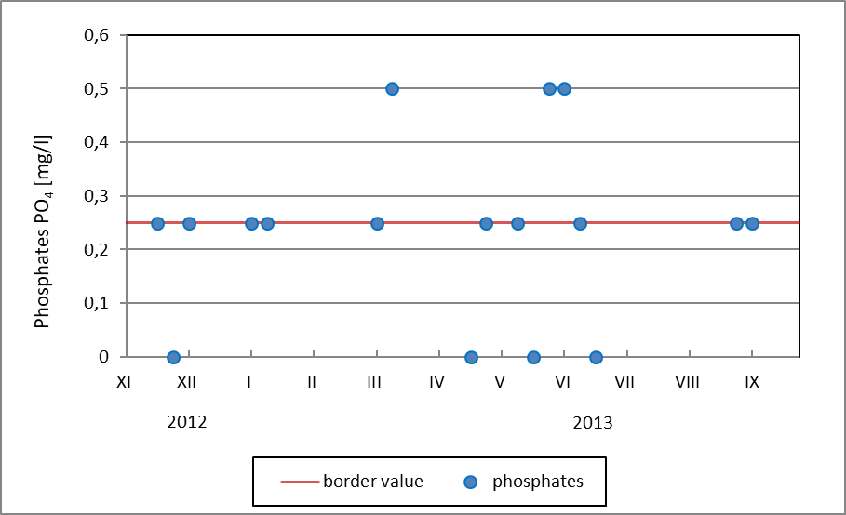
Phosphates in the Mleczna river

Slide 12
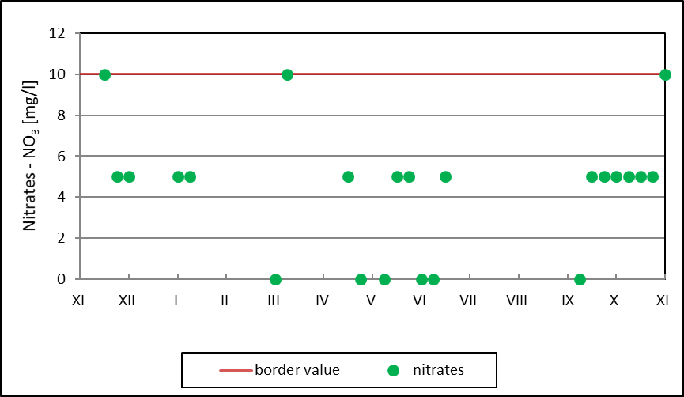
Nitrates in the Mleczna river
2012
2013

Slide 13
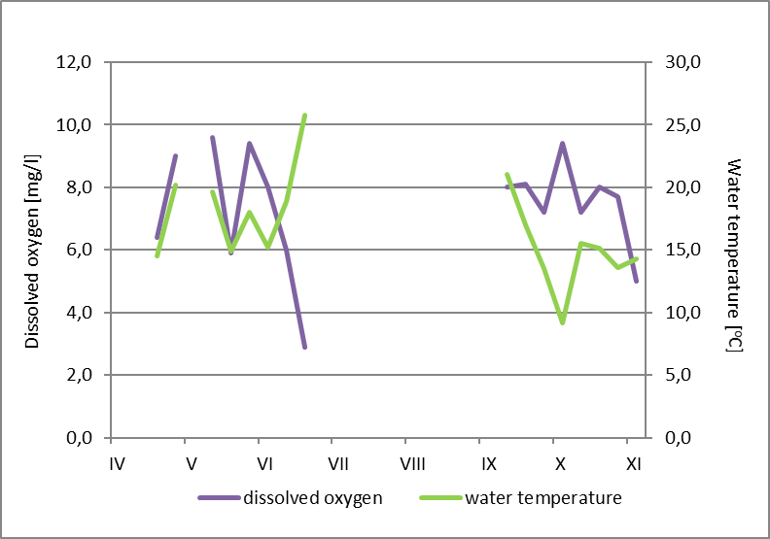
Water temperature and dissolved oxygen in the Mleczna river in 2013

Slide 14
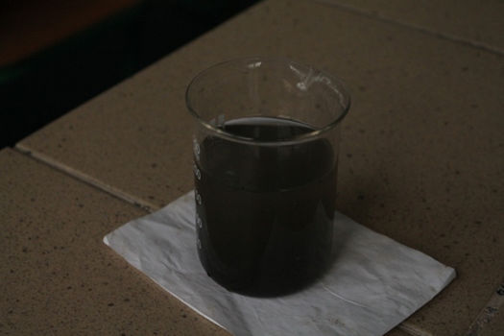

Slide 15
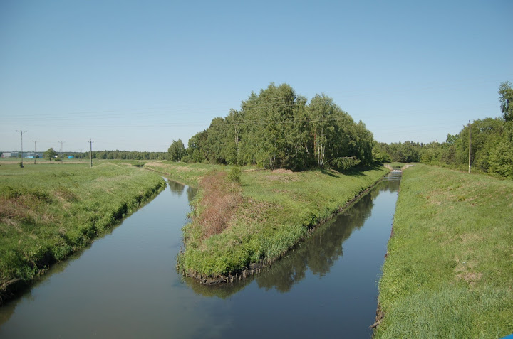

Slide 16
The Mleczna river
Sampling site no. 1
Sampling site no. 2

Slide 17
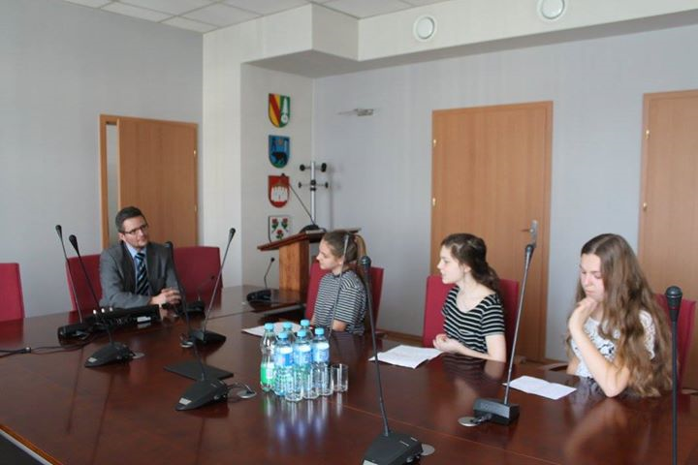

Slide 18
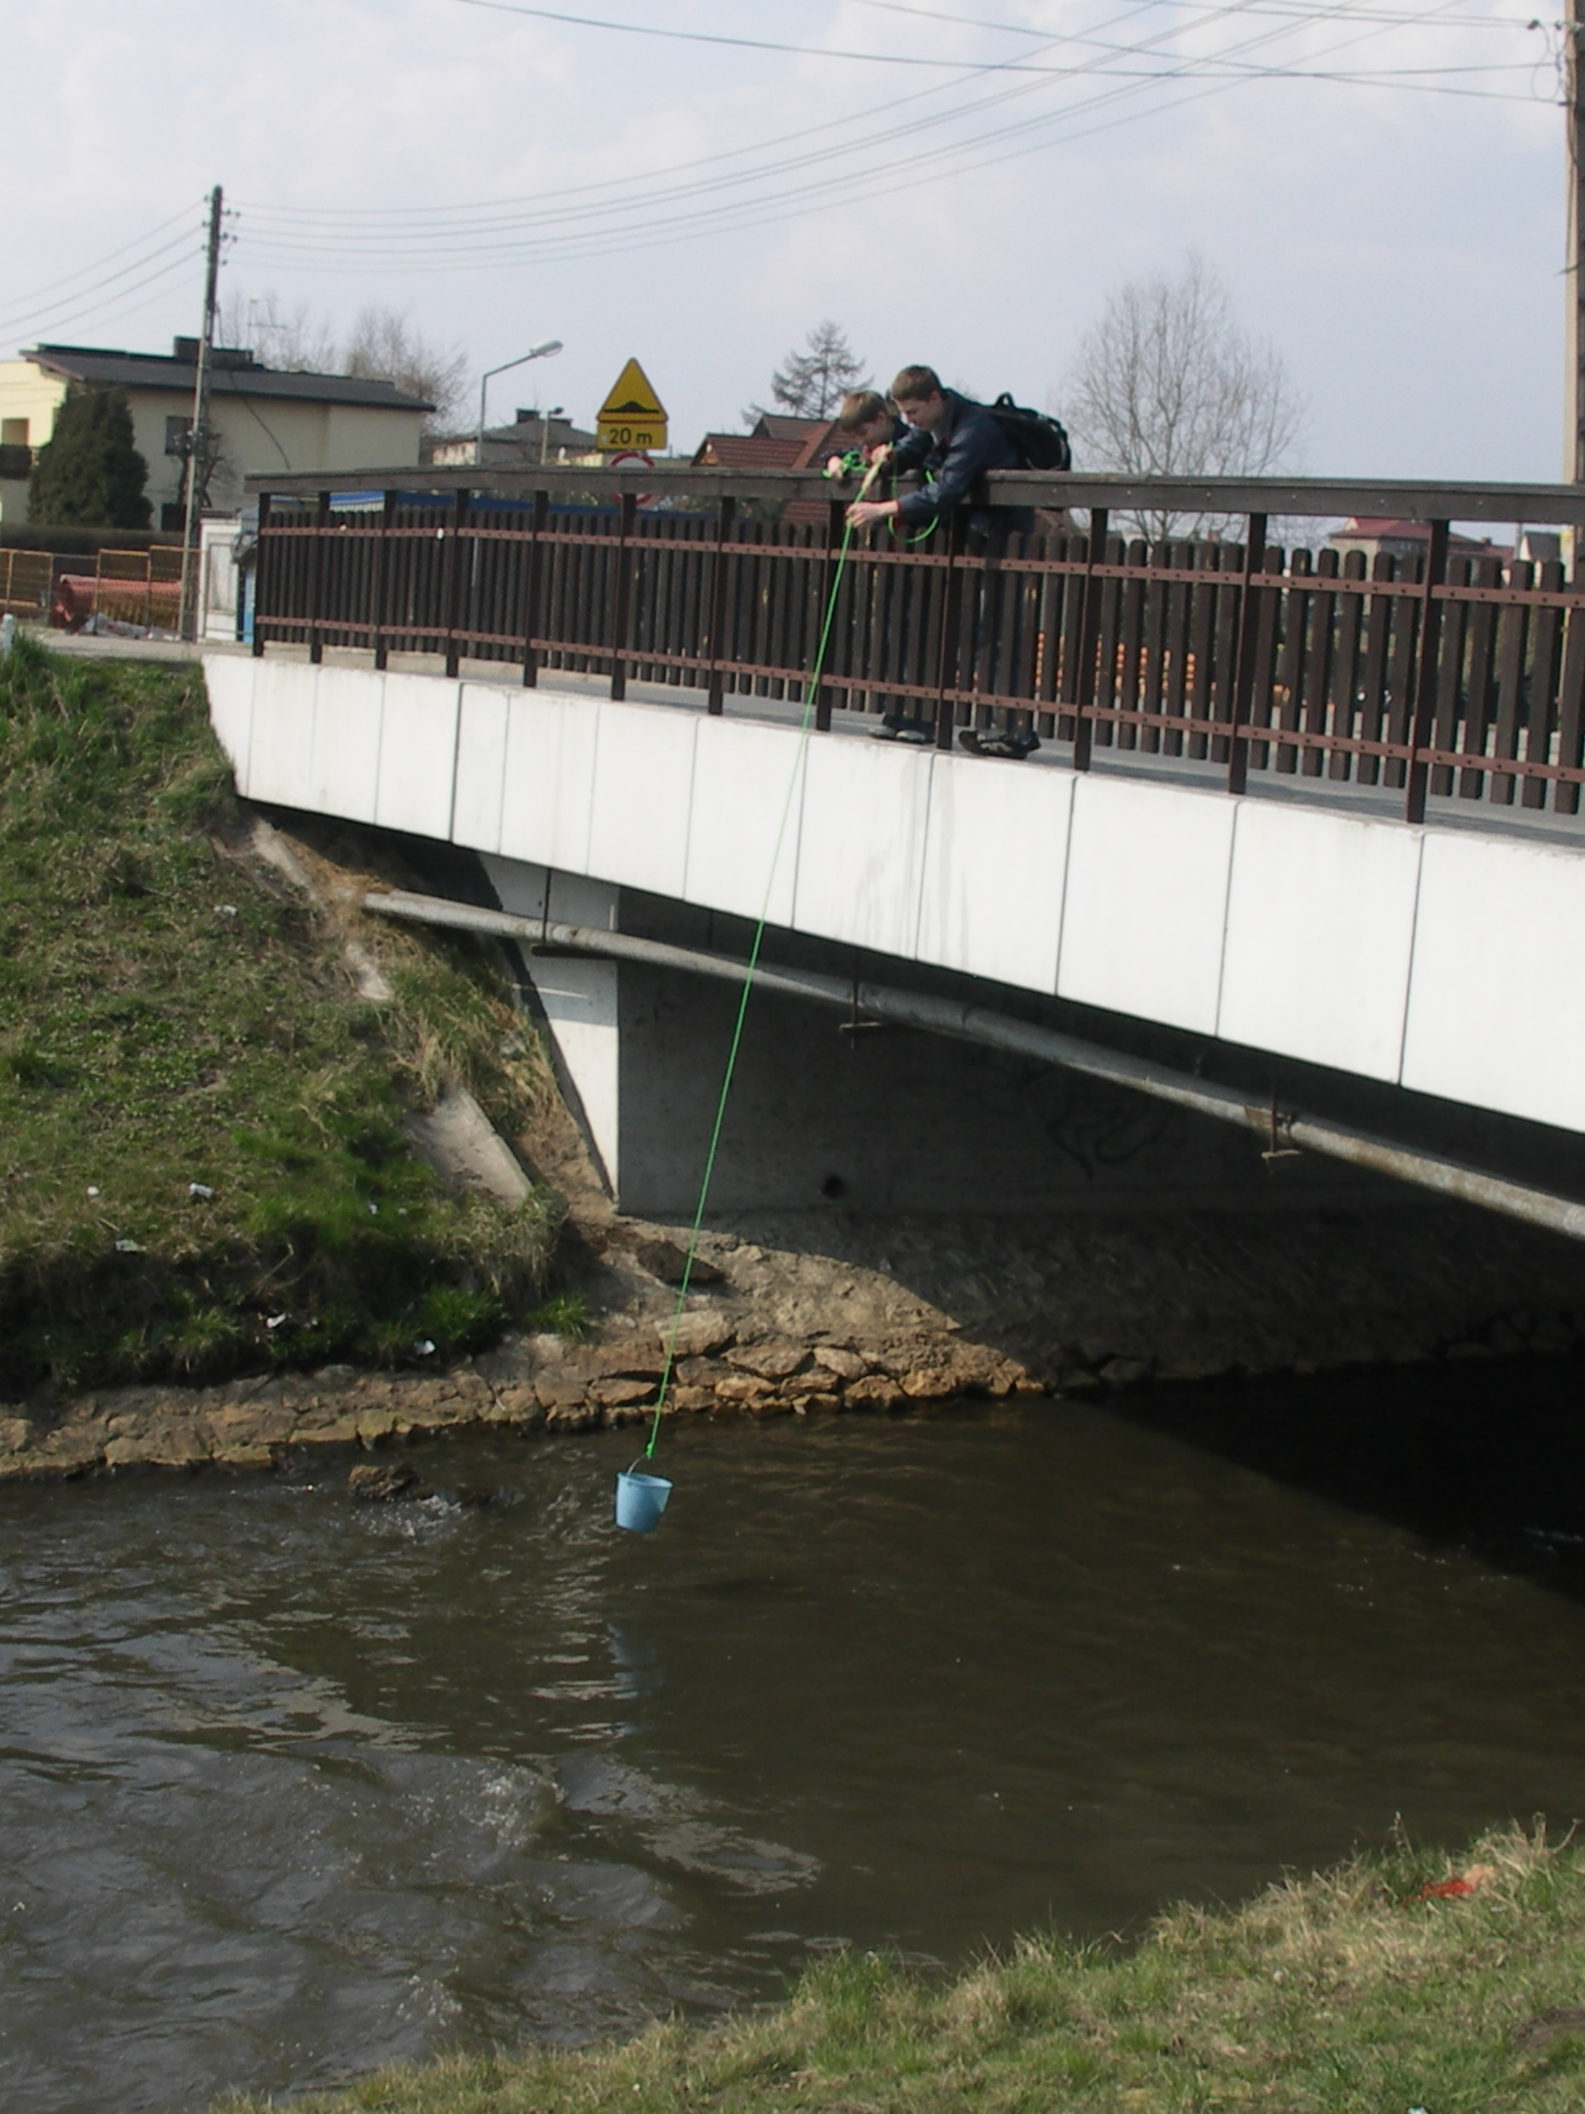

Slide 19
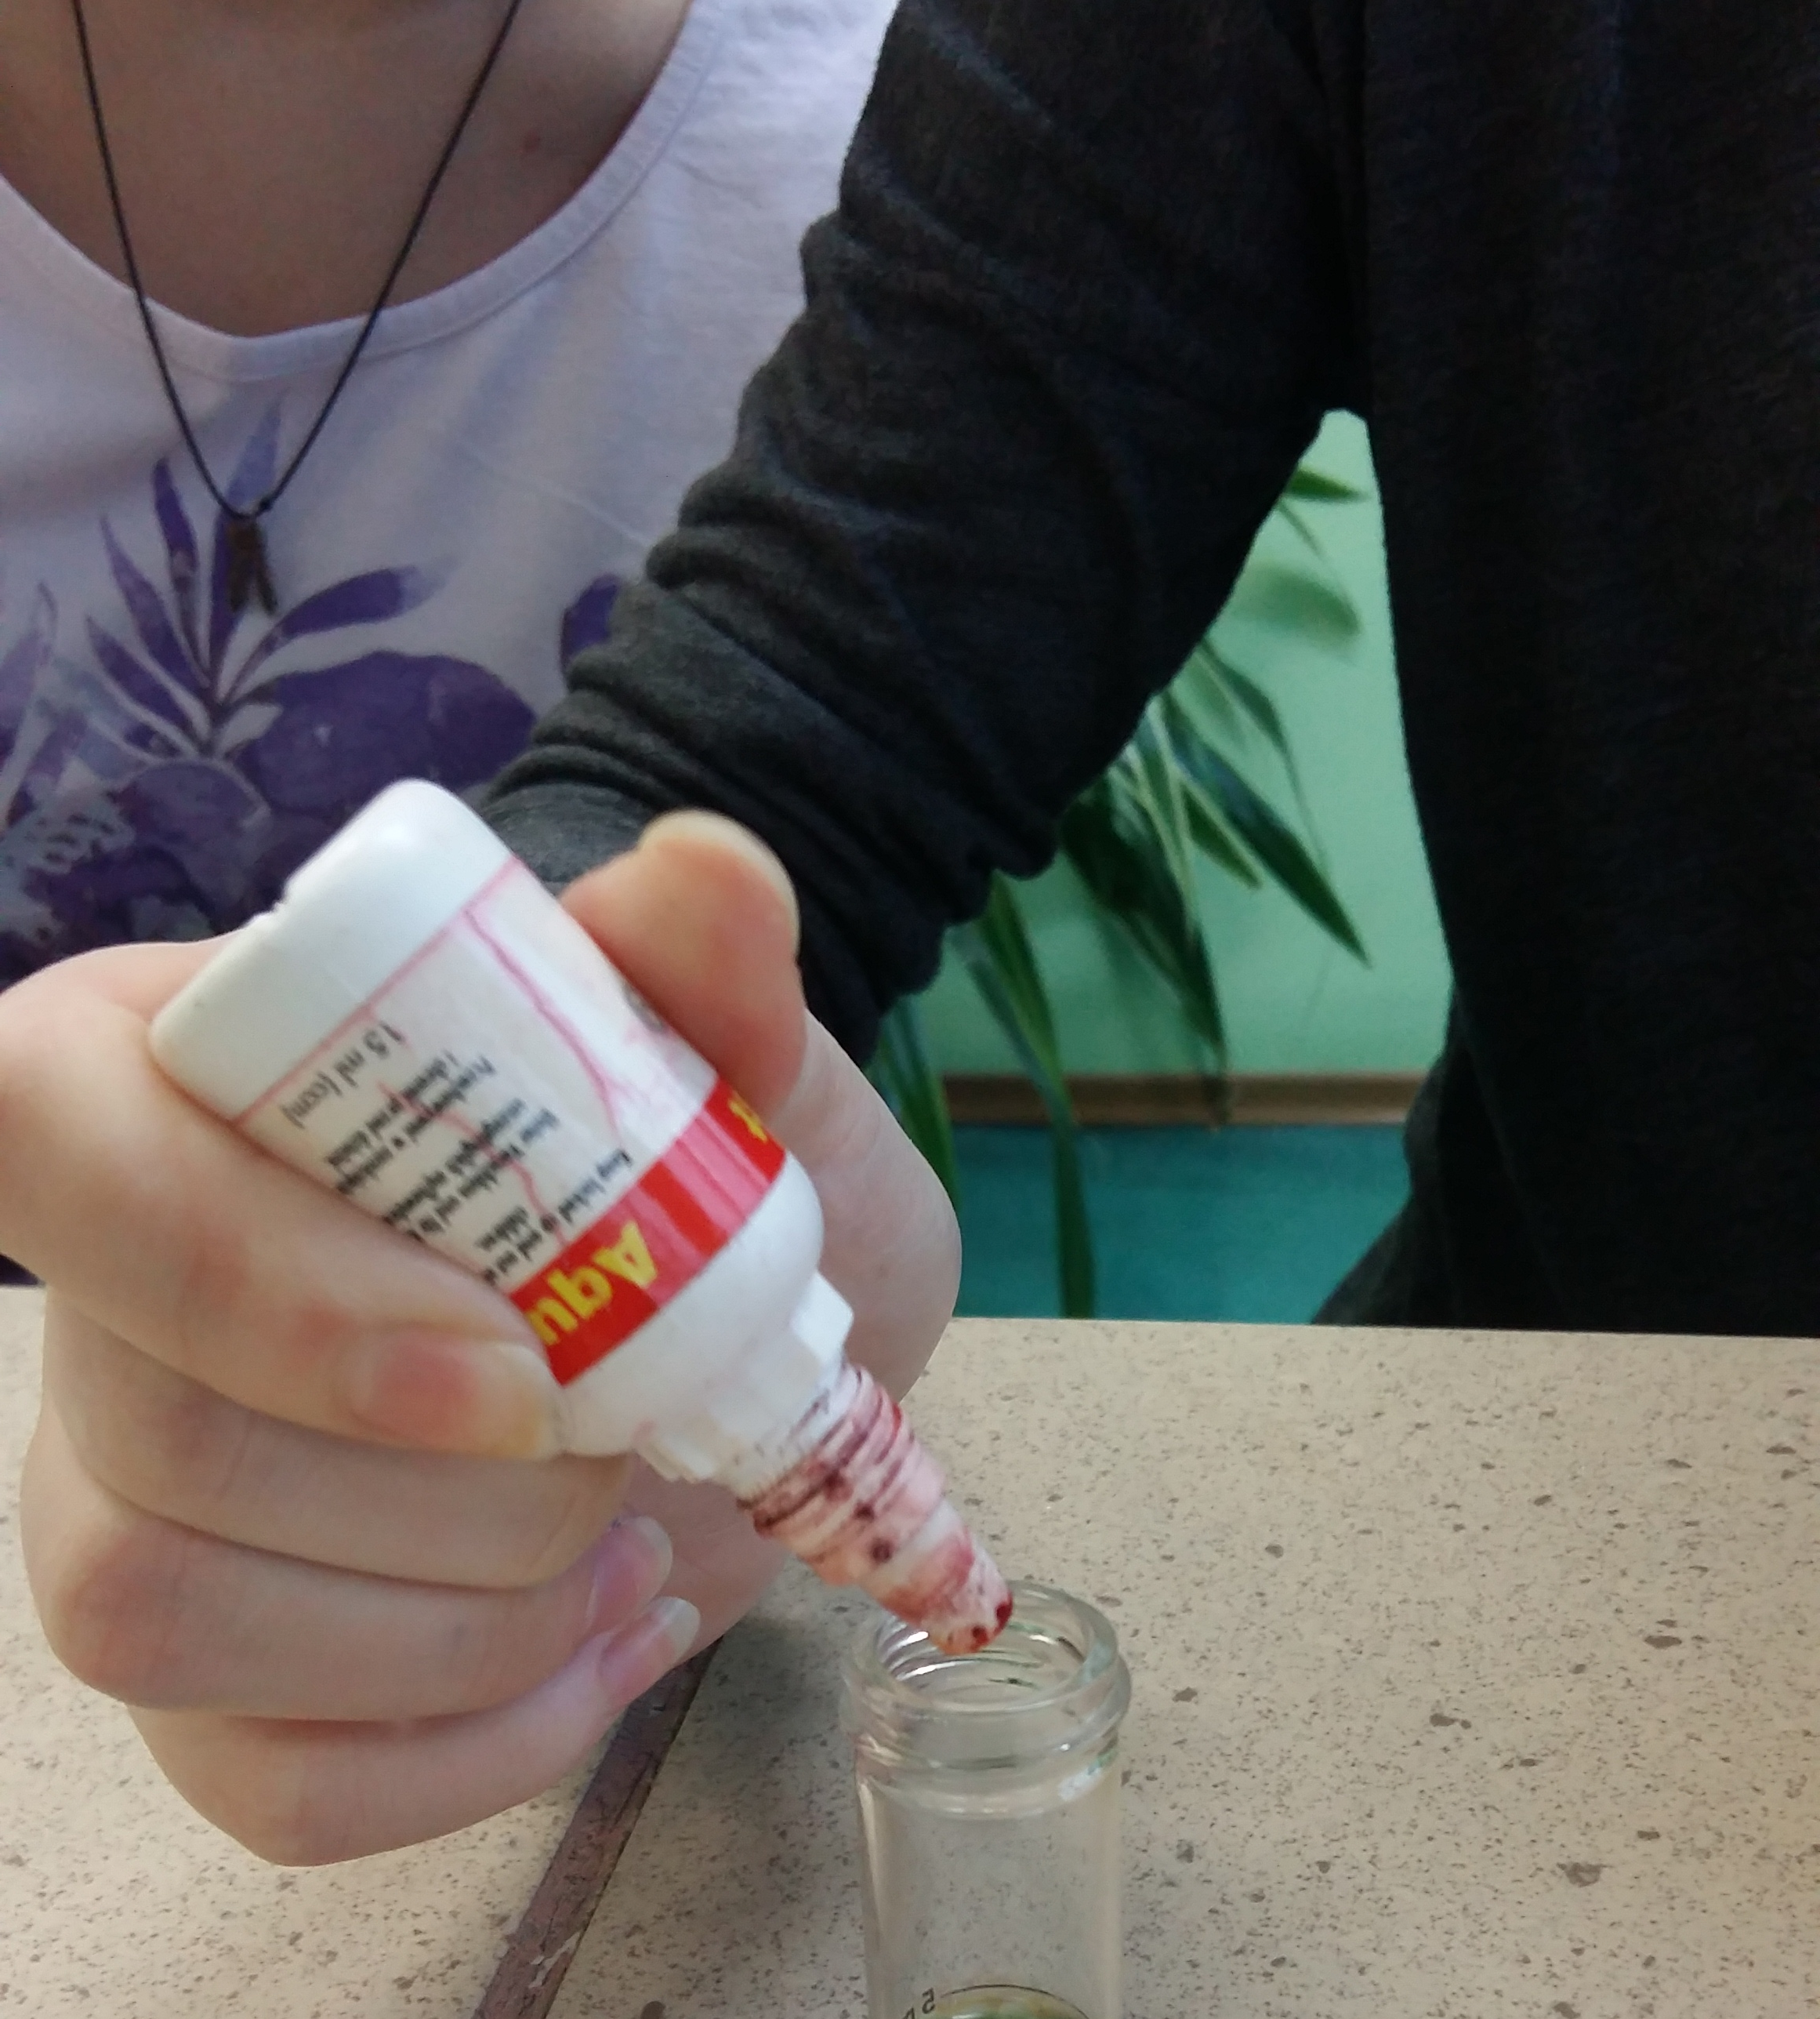
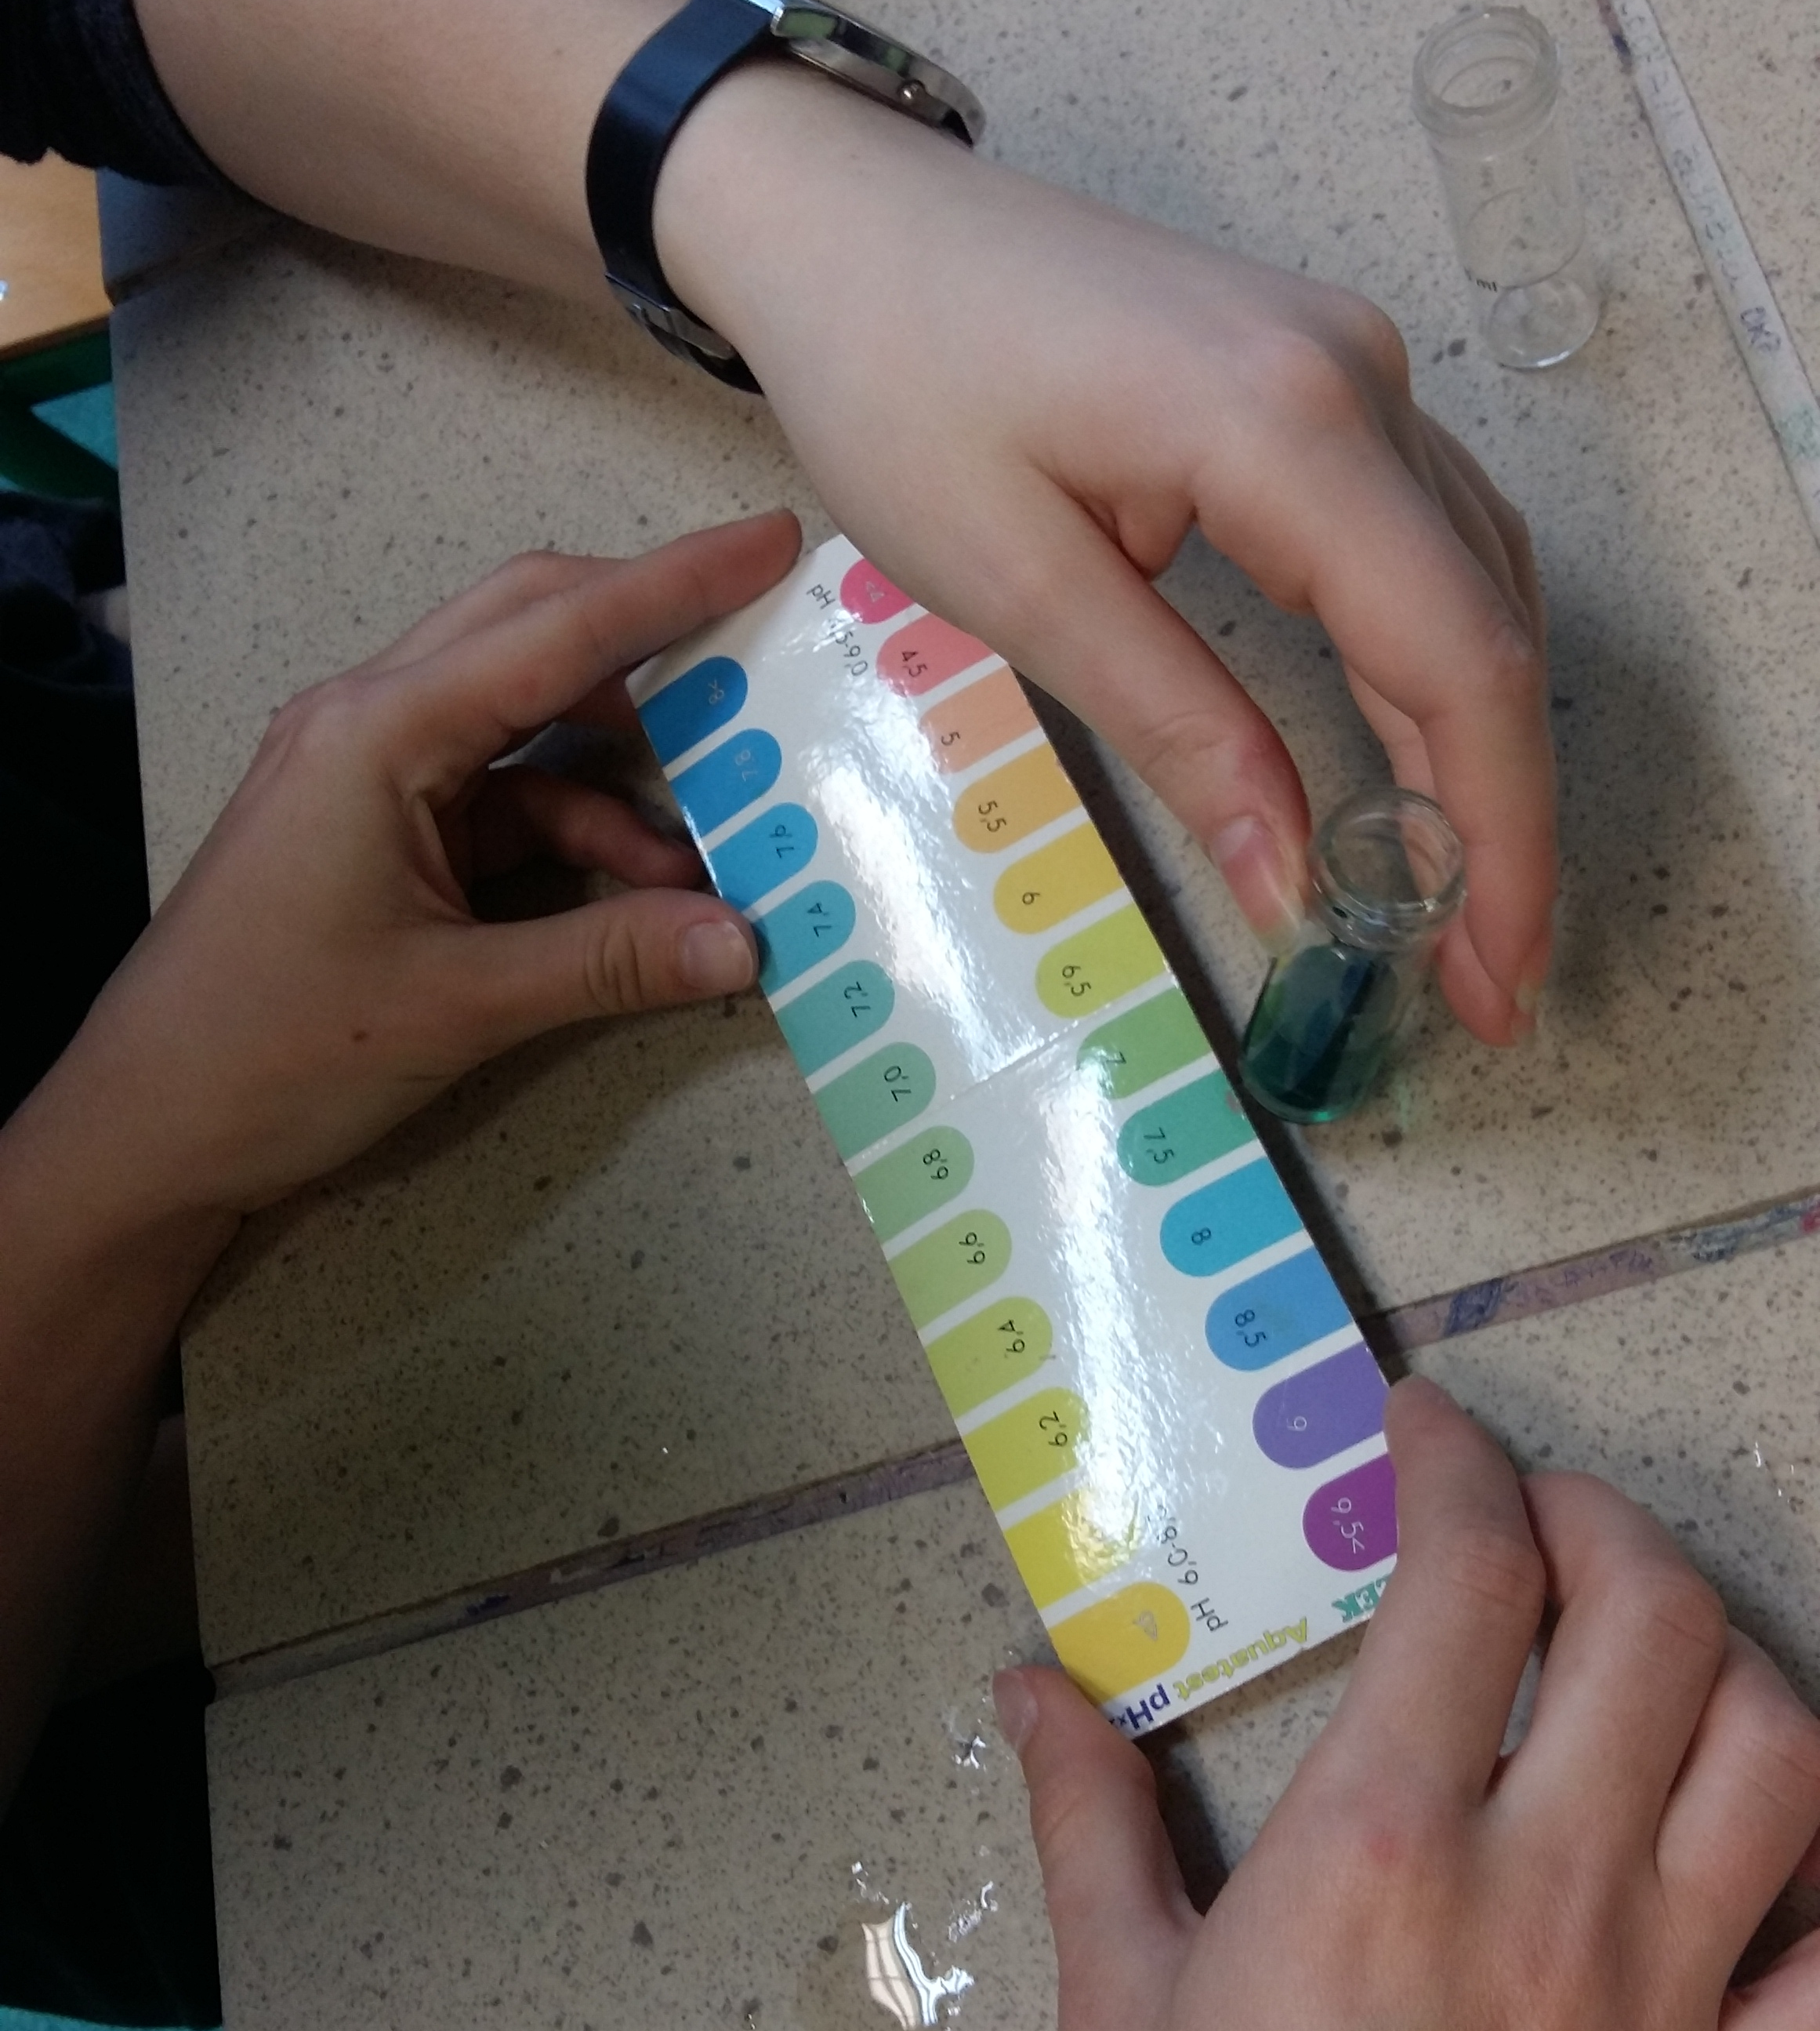
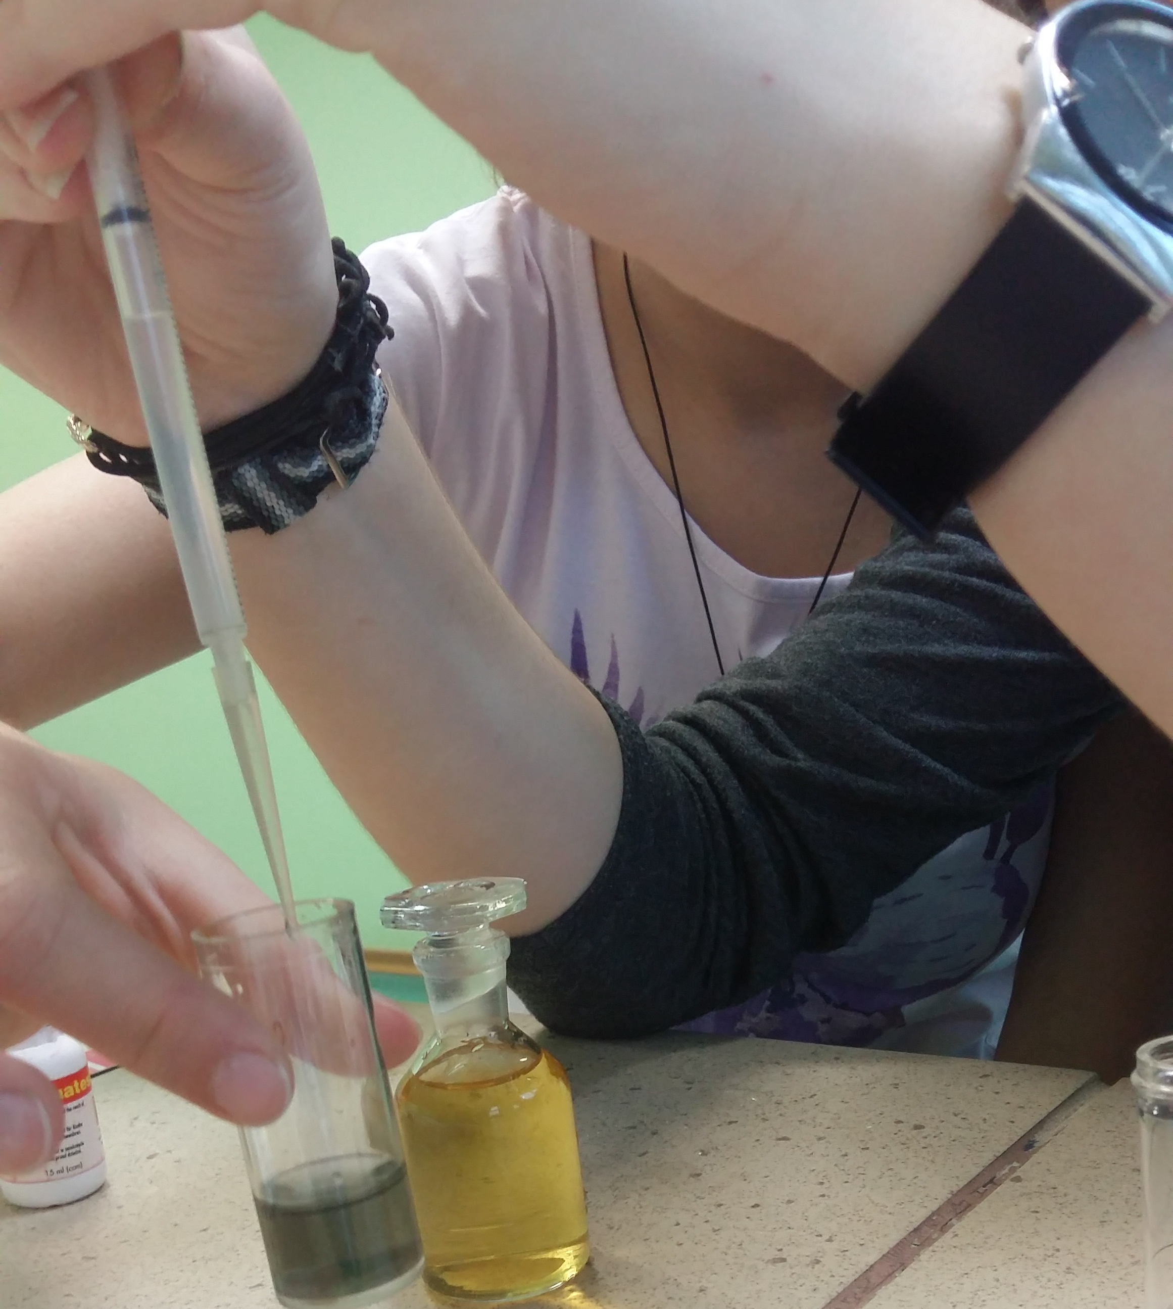
Thanks for your attention

