Slide 1
The ENSO Field Measurement Campaign Phase III: Water in Our Environment WEBINAR #7- March 8th, 2018

Slide 2
Spotlight on Connection and Collaboration
Today we will hear from GLOBE students in Hawkins, Texas and from GLOBE students and scientists in Nigeria.
We are focusing on learning about the different ways that GLOBE scientists, teachers, and students around the world are studying their water!

Slide 3
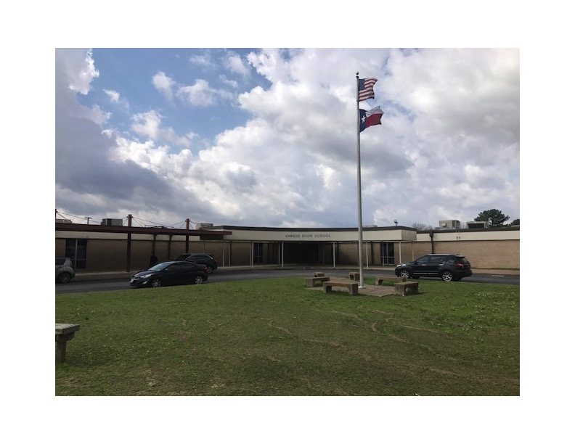
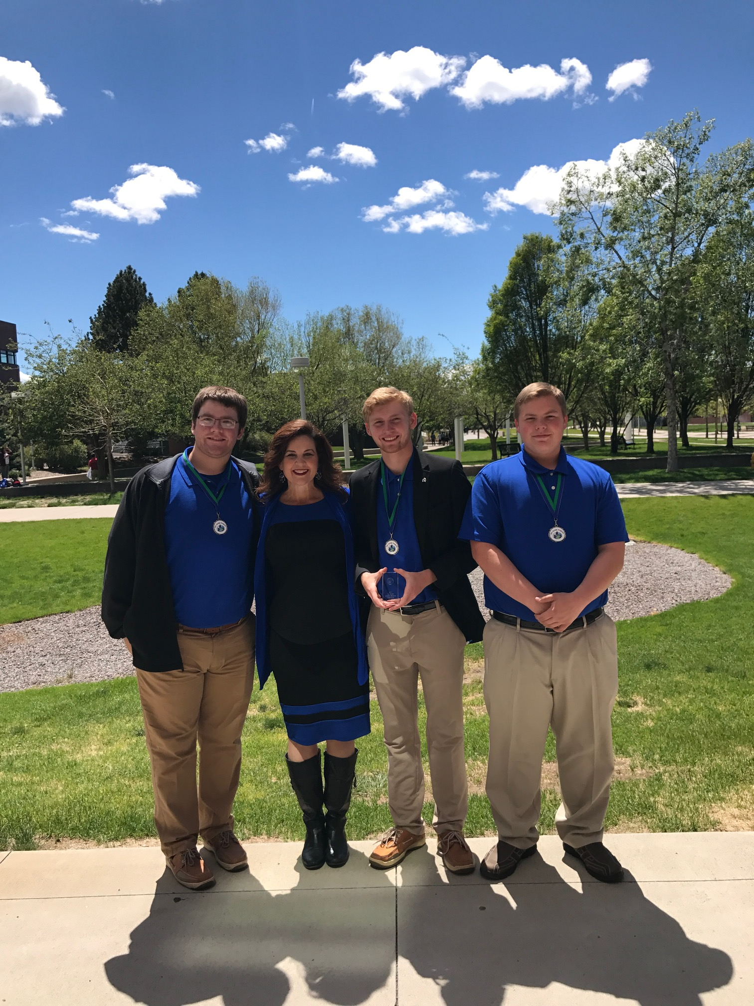
Hawkins High School- Texas, USA

Slide 4
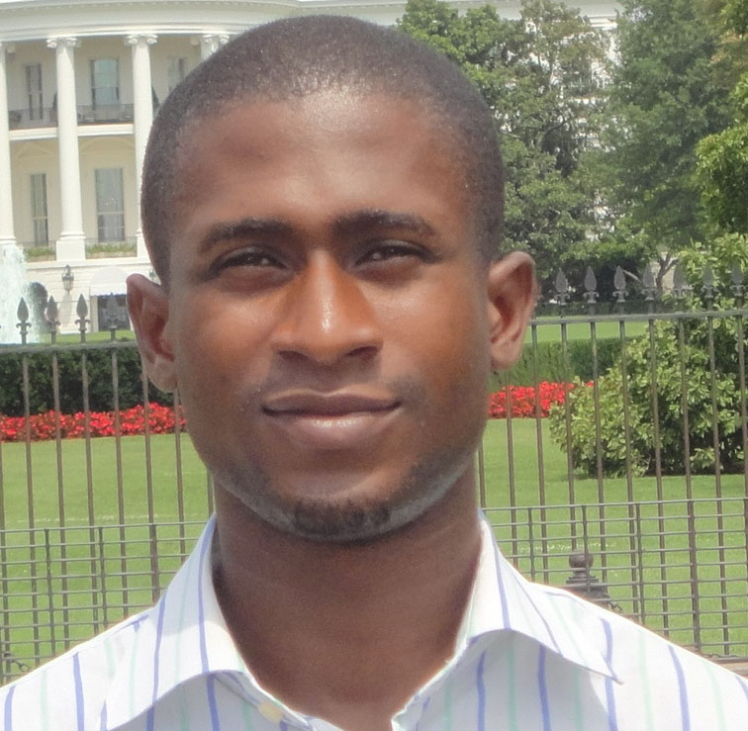
Mr. Olawale Ayodeji Oluwafemi

Slide 5
Is a a Senior Research Officer with Nigerian Space Agency’s Centre for Geodesy and Geodynamics, Toro, Bauchi State, Nigeria.
He got involved in several national projects and research within the West African sub-region. These projects were multidisciplinary cutting across different fields and industry such as health, security, energy, construction, education e.t.c. He received his BSc and M.Sc Degree in Physical Geography and GIS from Obafemi Awolwo University, Ile-Ife, Nigeria.
- He received M.Sc Degree in Remote Sensing and GIS (Environmental Geomorphology) from Nigerian Defence Academy, Nigeria. Femi is engaged in research focusing on the use of satellite data to understand subsidence rate and geomorphologic deformations along the coastal cities of Nigeria.
- Is the President and Coordinator of Students Learning Earth Systems Science (SLEES) in Nigeria and the Secretary, GLOBE Science Working Group.

Slide 6
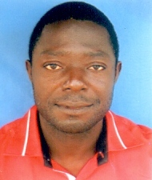
Dr. Akinola Shola Akinwumiju

Slide 7
Is a lecturer in the Department of Remote Sensing and Geoscience Information System, The Federal University of Technology, Akure, Ondo State Nigeria.
has keen interest in the implementation of Globe Protocols in Nigeria. received a B.Sc. degree in Physical Geography of the University of Ilorin, Ilorin Nigeria; a M.Sc. degree in Geography (Climatology Option) of the University of Ibadan, Ibadan Nigeria; a M.Sc. degree in Remote Sensing and GIS of the Obafemi Awolowo University, Ile-Ife Nigeria and a Ph.D. degree in Ecology and Environmental Science (Hydrogeophysics and GIS Option) of the Obafemi Awolowo University, Ile-Ife Nigeria.
actively involved in multiple research endeavours with keen interest in the application of Space Science and GIS in Earth Sciences and software development.
- a member of many scientific research groups and is a Globe Scientist who is determined to expand the influence of Globe Program in Nigeria.

