Slide 1
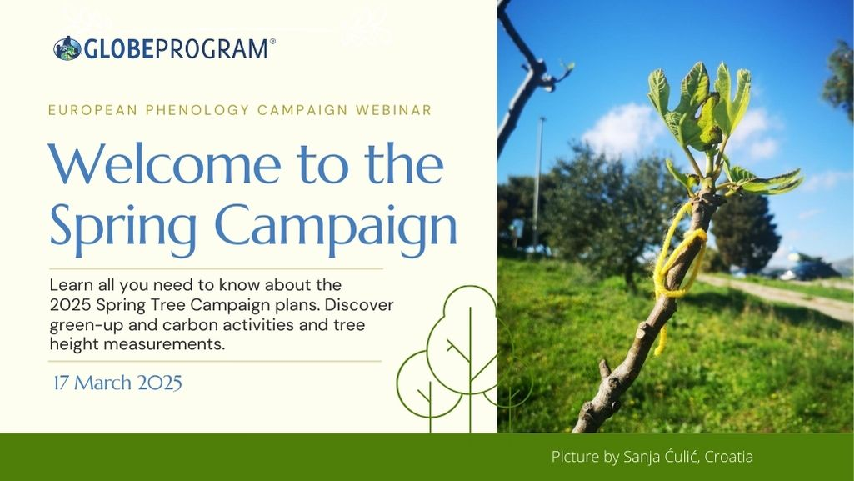
Lenka Kleger, Europe and Eurasia Region Coordination Office

Slide 2

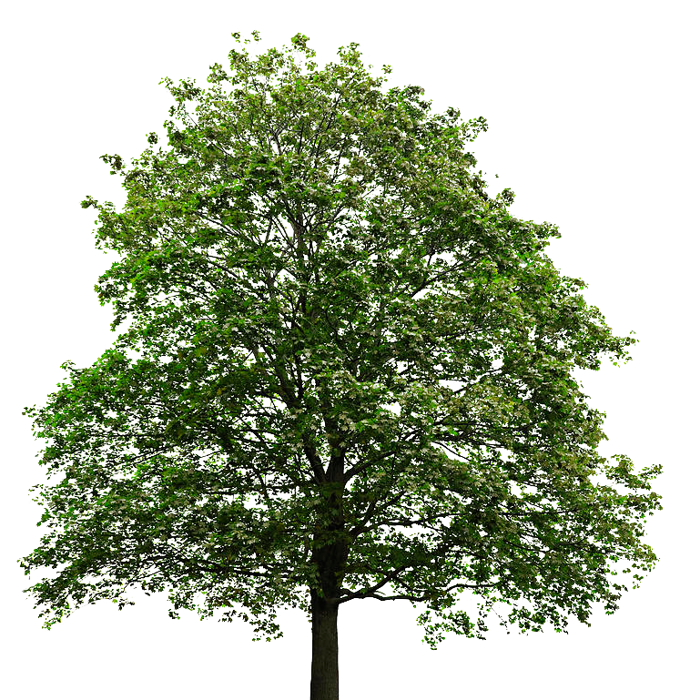
2025 Spring Tree/Phenology Campaign
March June
Campaign aims
Exploring trees and their change over spring
Learning about the place, where they grow
Meaningful time outdoors
Sharing and cooperation

Slide 3
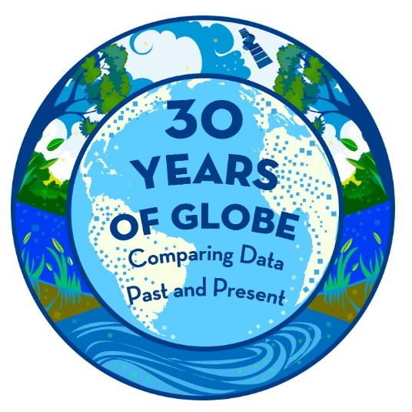
2025 Spring Phenology Campaign
Activities
Green-up (4)
Carbon cycle (4)
Tree height (1)
Trees and urban heat island (1)
Communication
Newsletter, Discussion forum, Webinars
Award for active participation
Certificate
„30 Years of GLOBE“ badge for data entry
All activities are voluntary.
Let us know, how it goes!

Slide 4
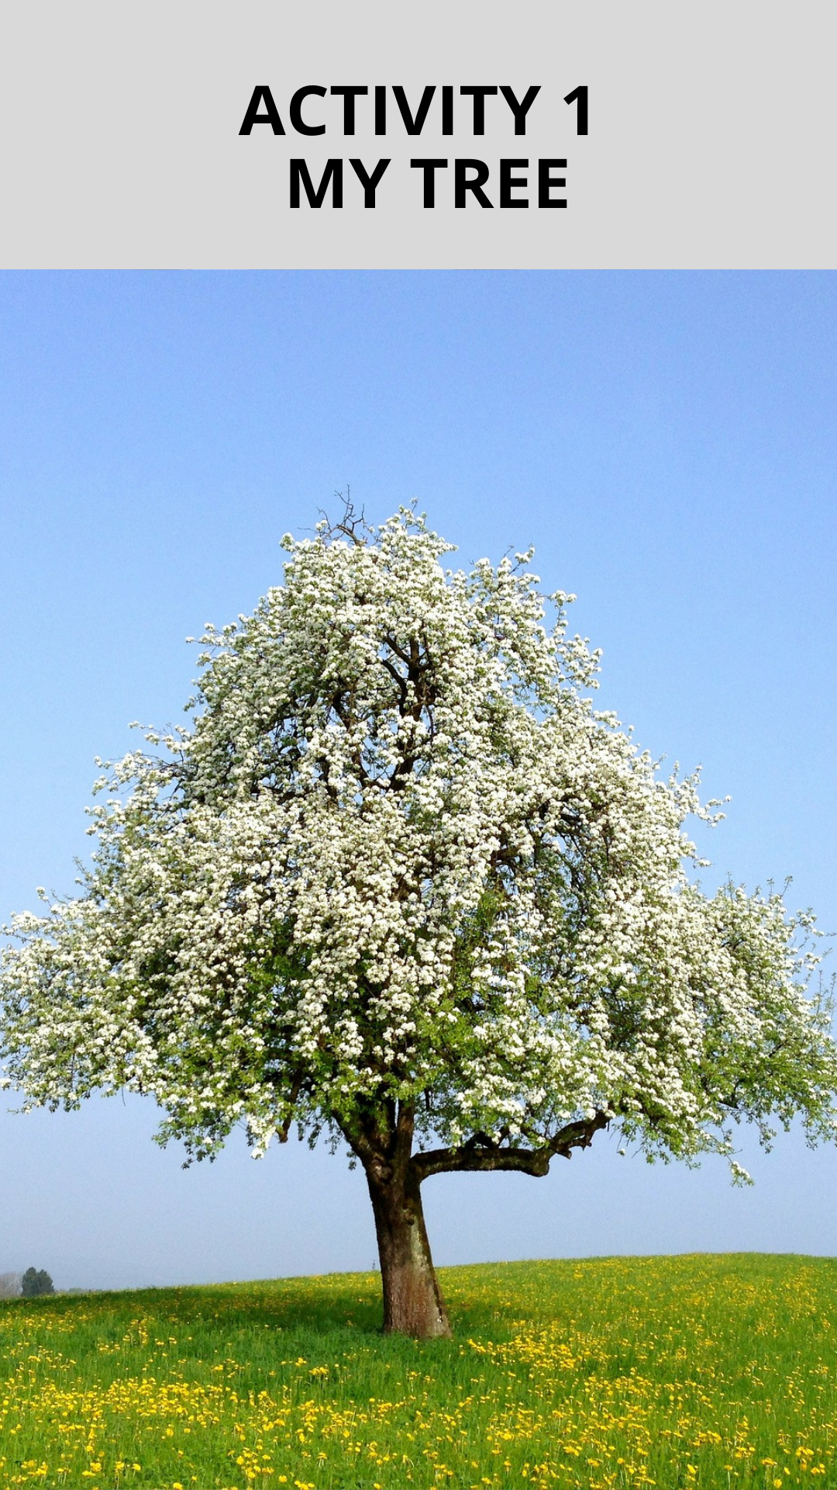
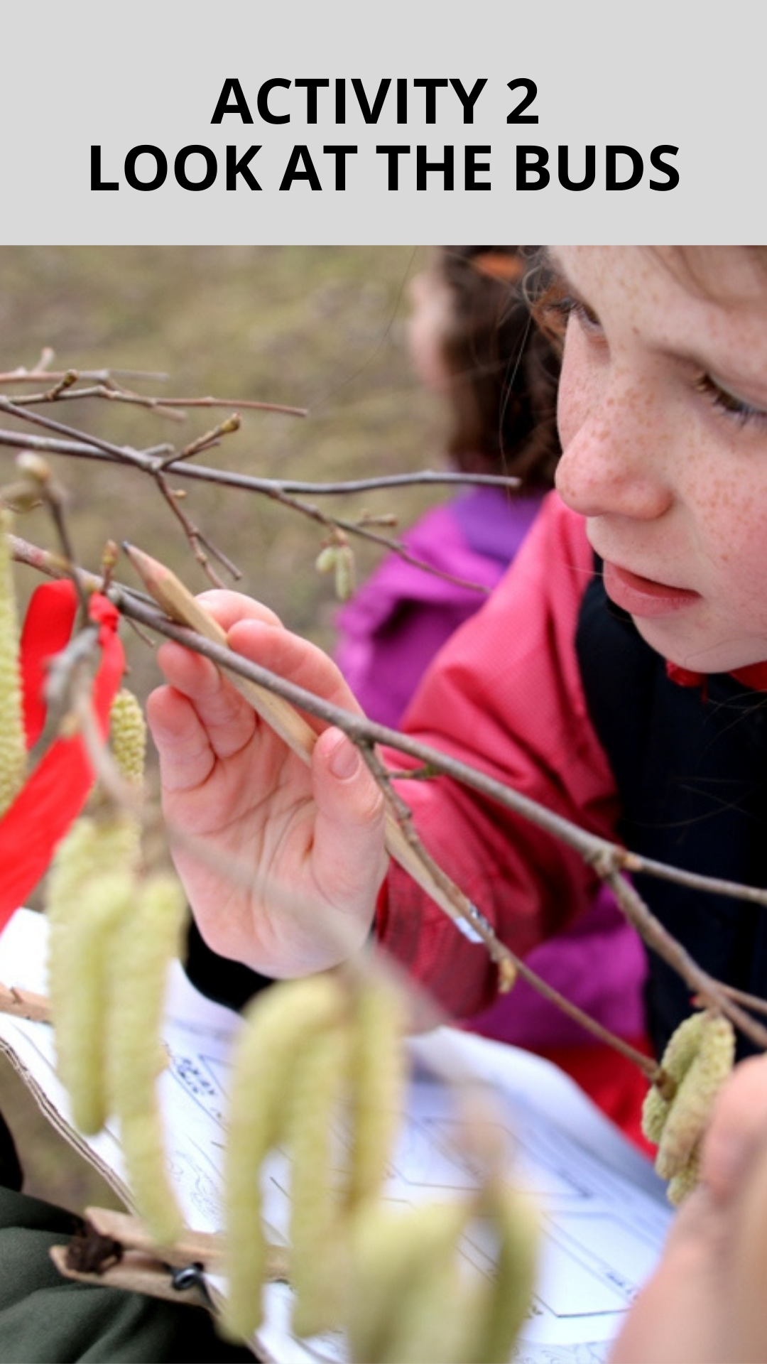
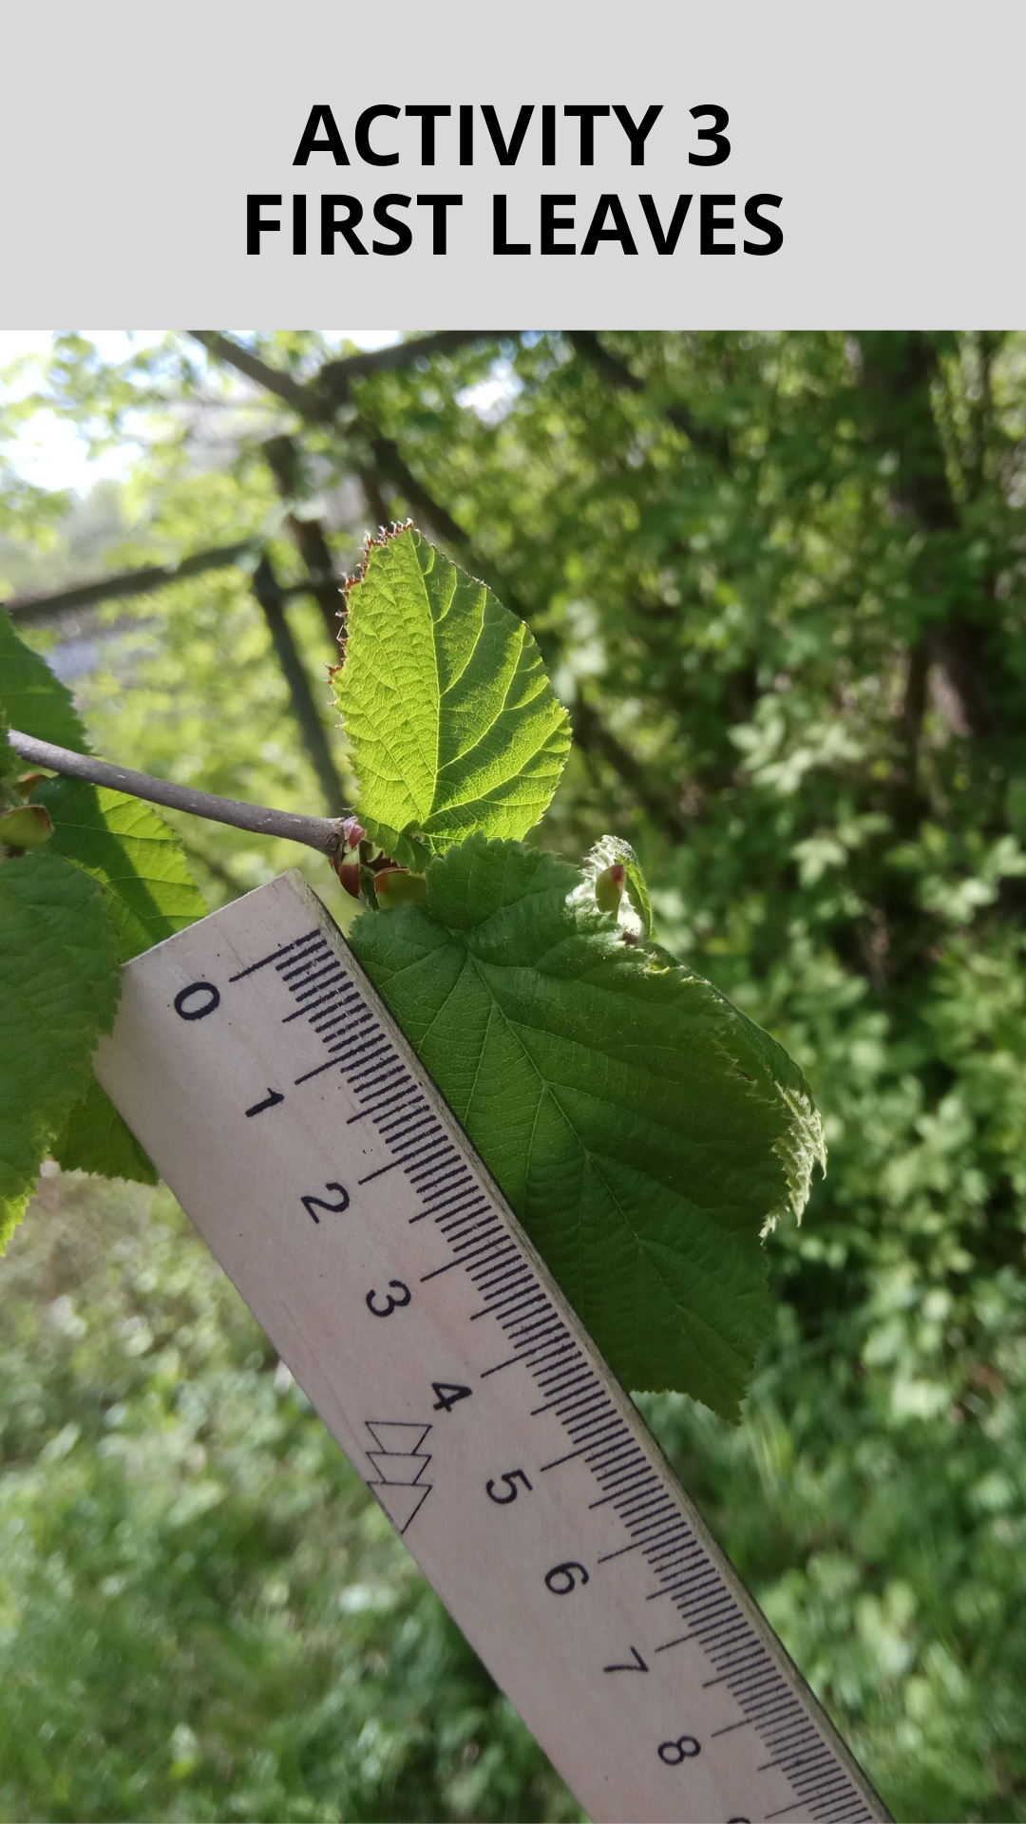
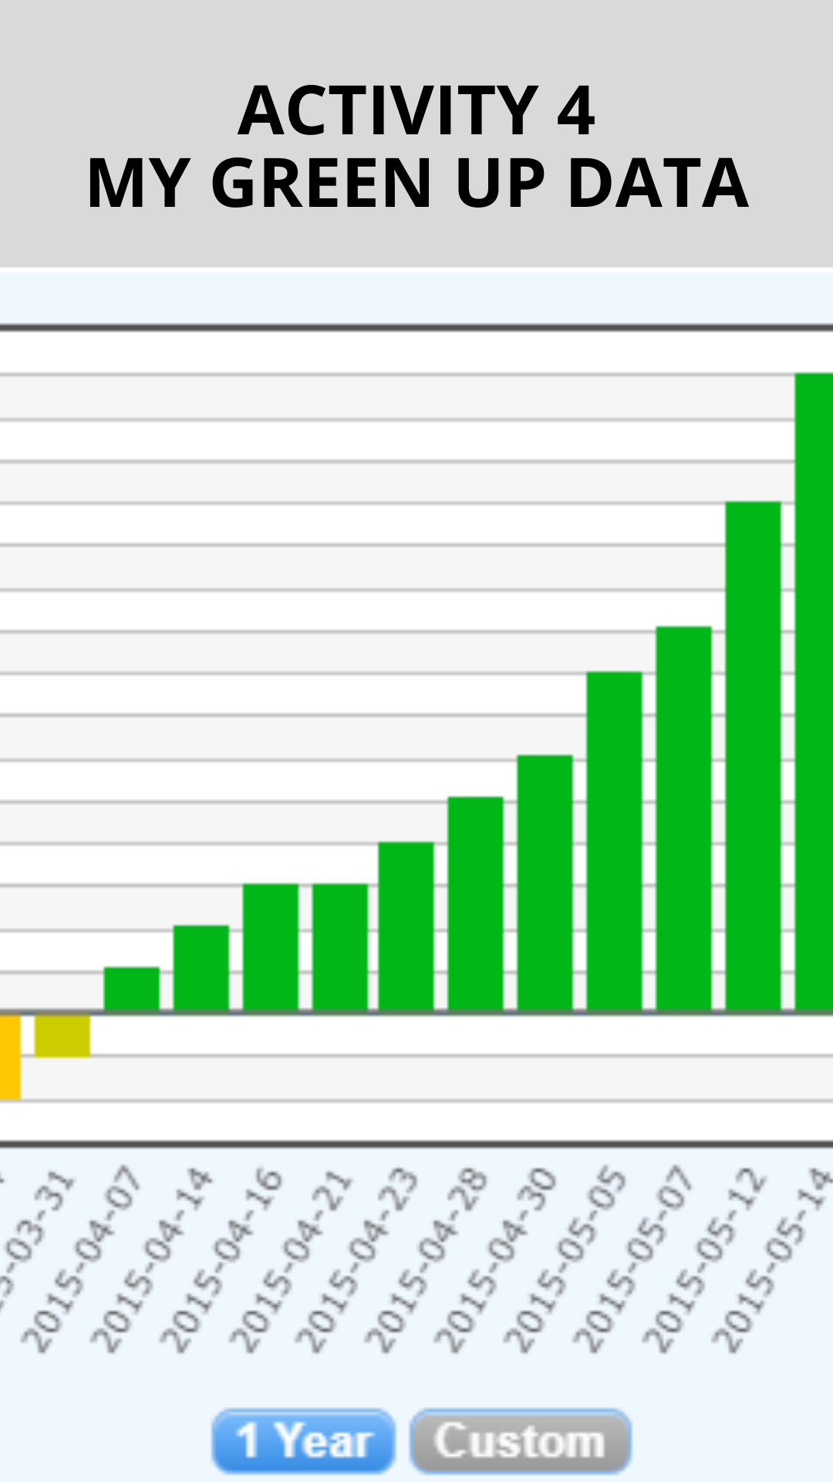
Green-up activities
All activities are voluntary.
Let us know, how it goes!

Slide 5
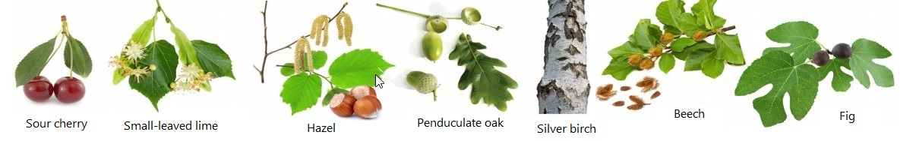
Activity 1 – My Tree
Find a suitable tree
  Close
  Low south-facing branch
  Not shaded, watered, fertilized
Describe the tree and the site where it grows
Take pictures with GrowApp
Share pictures of your tree without leaves at the discussion forum

Slide 6
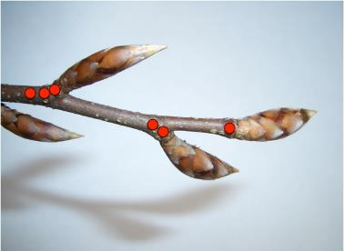
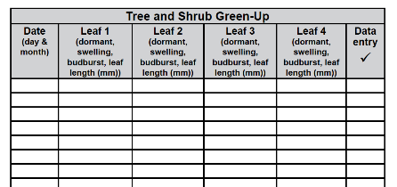
Activity 2 – Look at the Buds
Select and sign a branch and 4 buds
Observe them 2 times a week
Record the observations into the Tree and Shrub Green-Up Data Sheet
If you have an Atmosphere site nearby, keep recording temperature and precipitation data
Share date of budburst

Slide 7
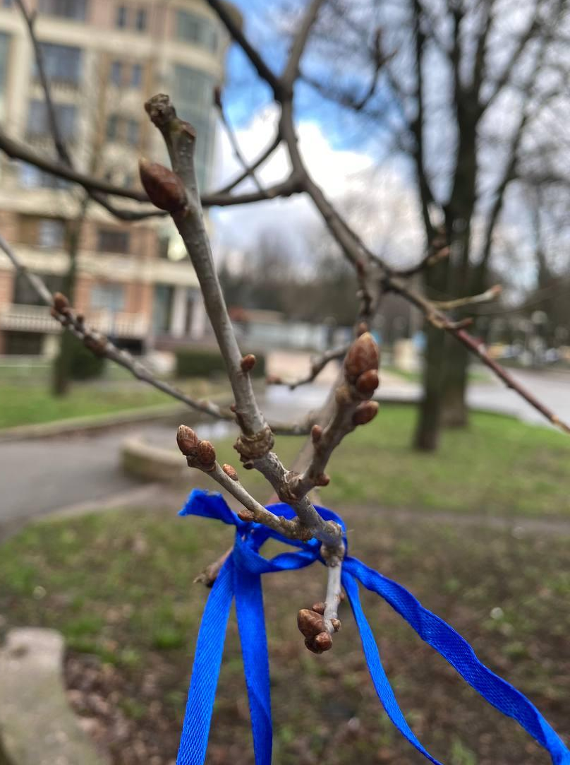
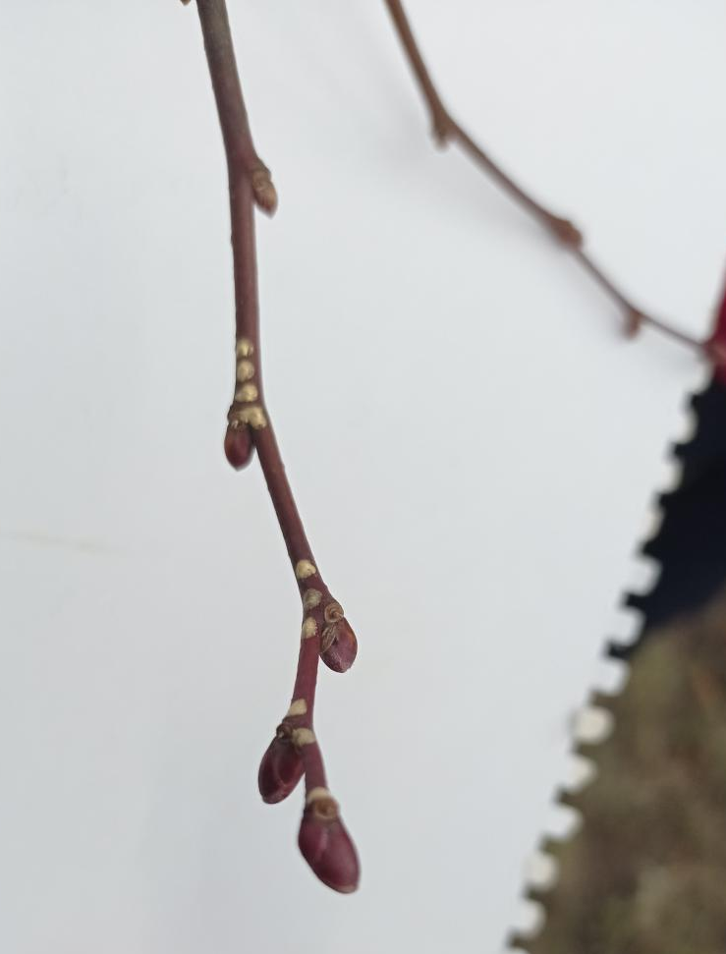
Credis: Poltava School, Ukraine
Credis: Natalia Maisak, Ukraine

Slide 8
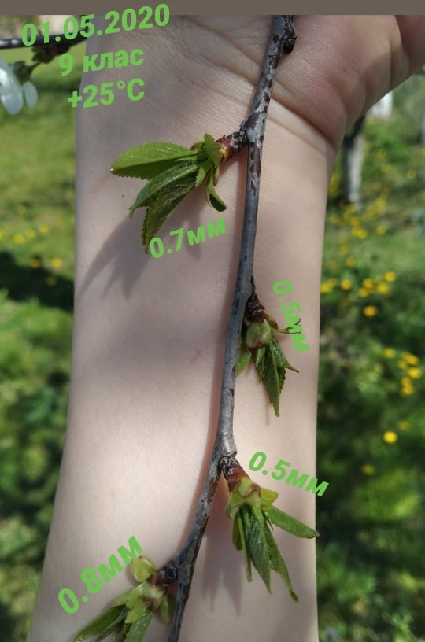
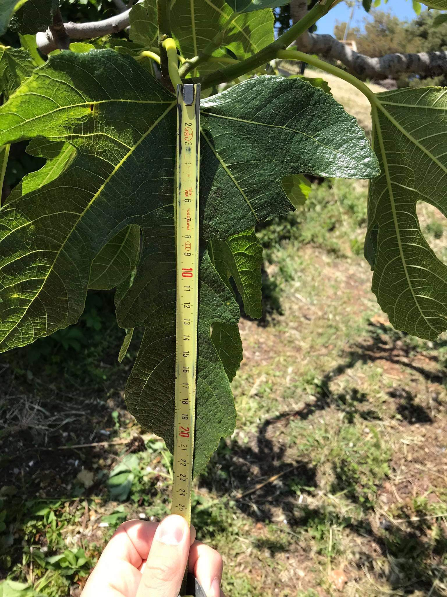
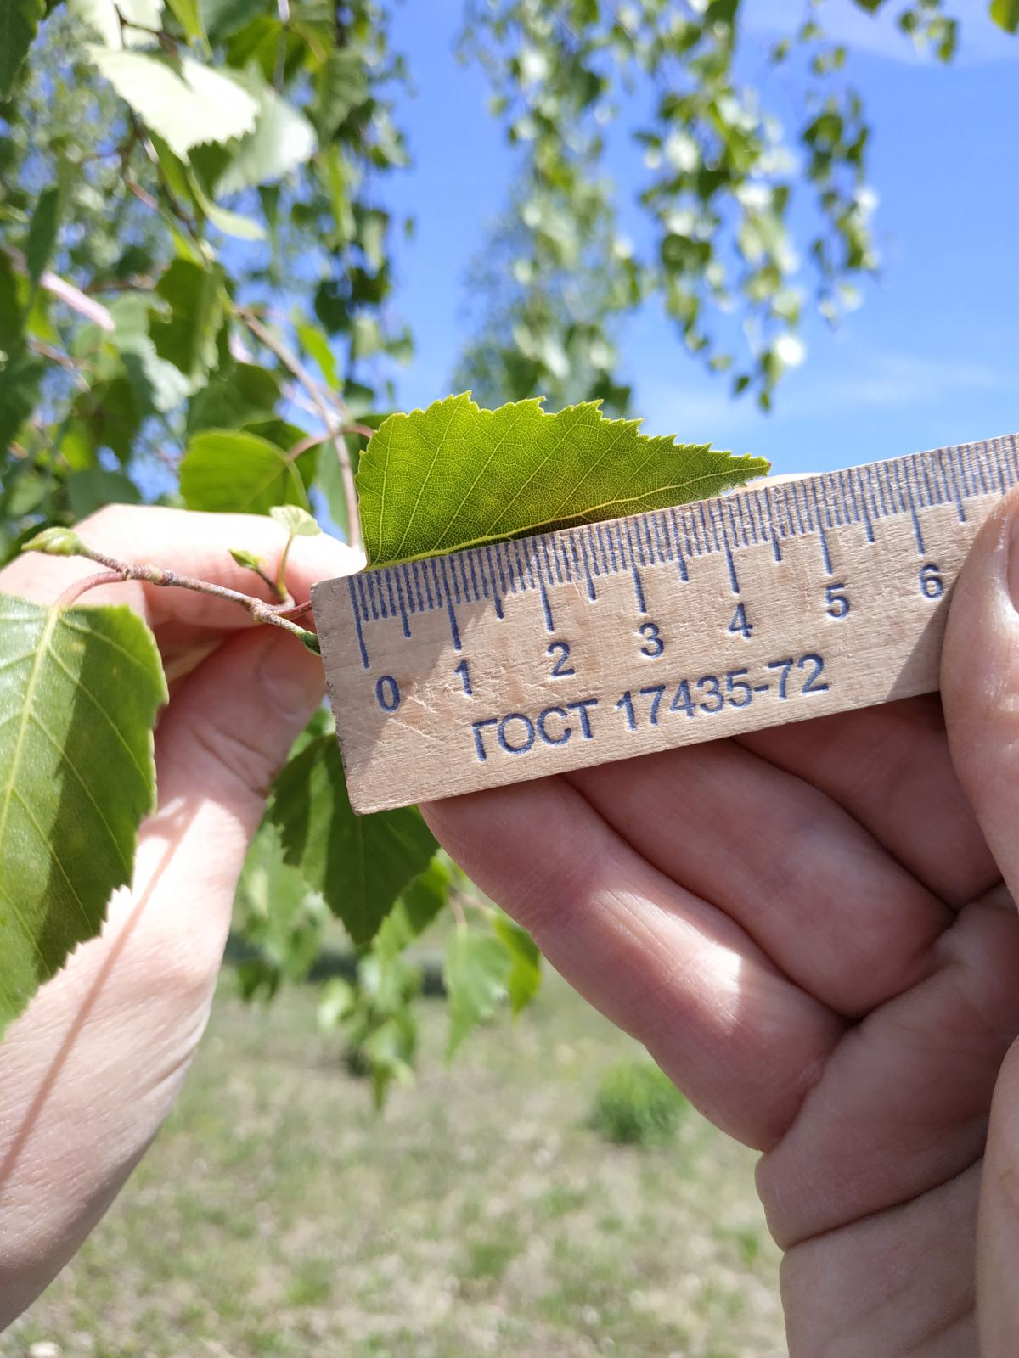
Activity 3 – First Leaves
Budburst (= you can see the tip of green leaf) - record to your data sheet
Measure the length of a leaf that grows from the bud
Measure the leaf without the stem
Continue twice a week until your leaves stops growing
Credits: Ekonomska skola Dubrovnik, Croatia
Credits: Rivne Young Naturalists Station,Ukraine
Credits: Piatyhirska Secondary School,Ukraine

Slide 9
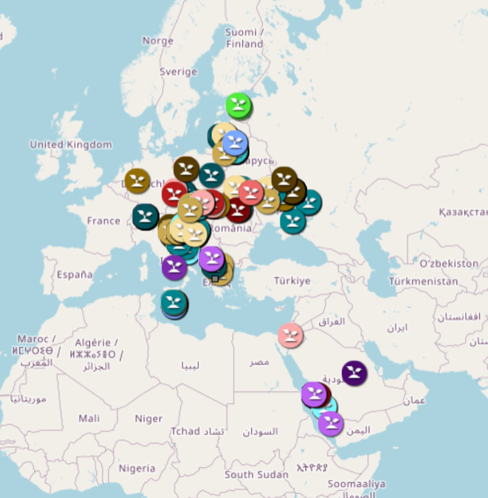
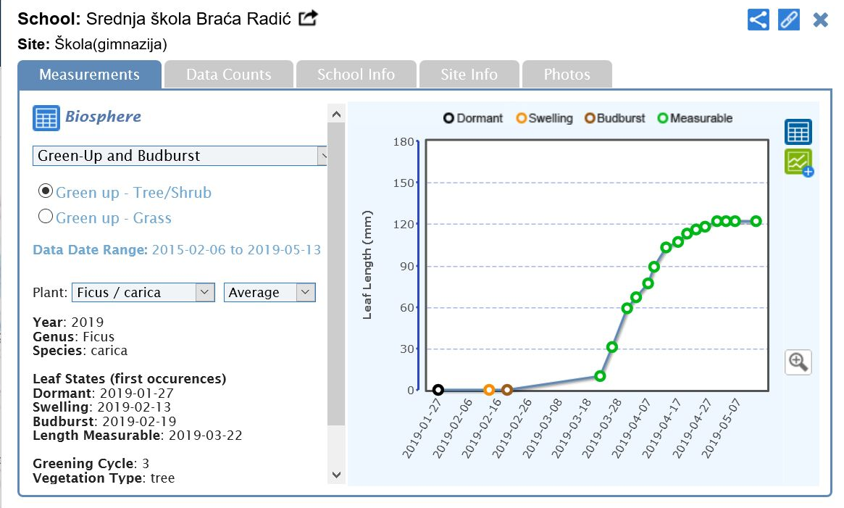
Activity 4 – My Green Up Data
Upload your green up data to globe.gov website
  Login to your GLOBE account
  Data collected at Activities 1, 2 and 3.
Try GLOBE Visualization tool
  - See the data on world map
  - Draw and share a graph with your data
Compare your data
  with another school
  to your data from previous years

Slide 10
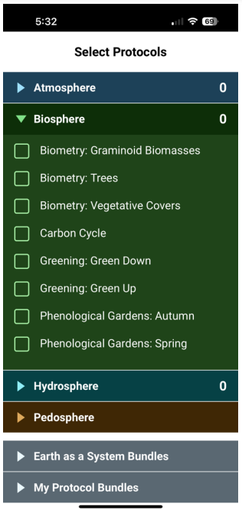
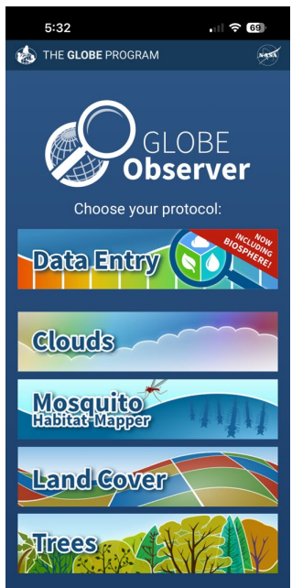
Entering Green Up Data
Now also on GLOBE Observer Data entry App
  observer.globe.gov
Data guide included in the Activity 4

Slide 11
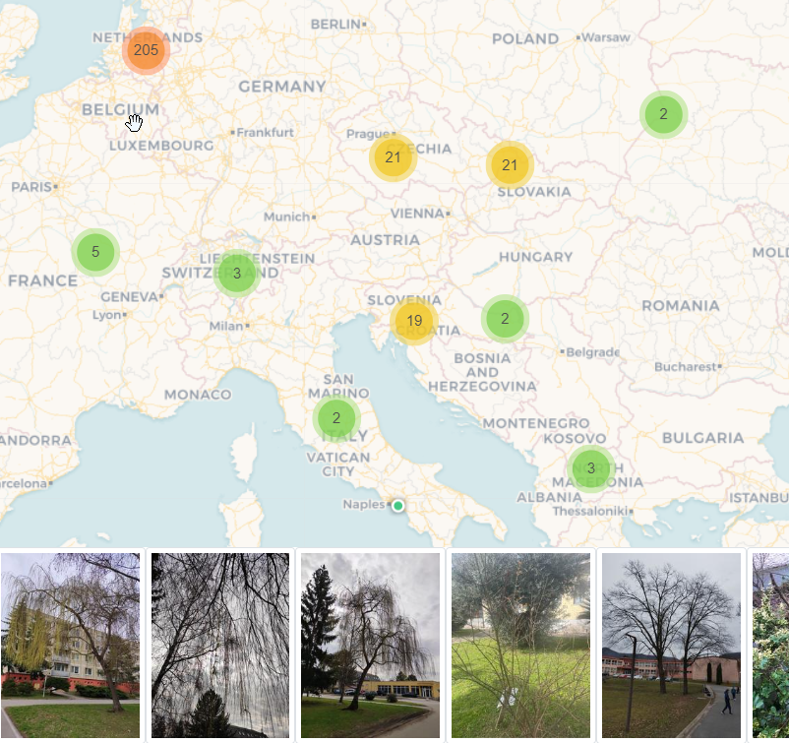
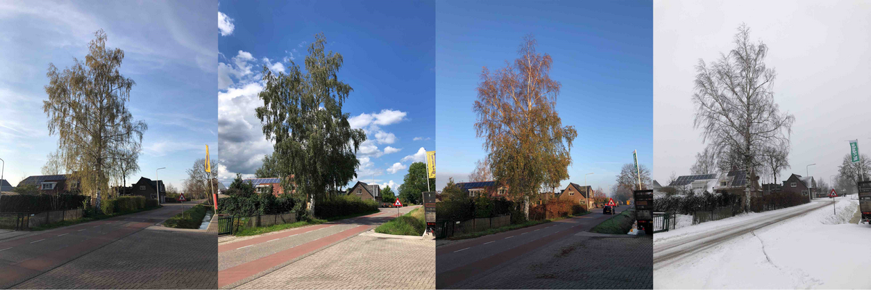
GrowApp
Easy and free mobile application
for Android / for iPhone
Time lapse videos
Pictures and videos in the map
Use # to describe tree species and your school
https://www.globe.gov/web/european-phenology-campaign/overview/growapp

Slide 12
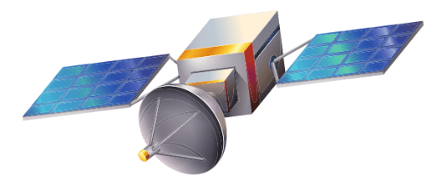
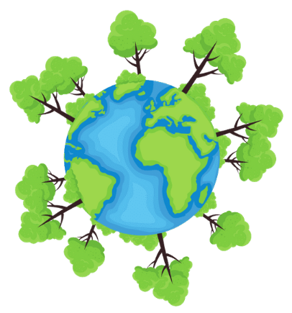
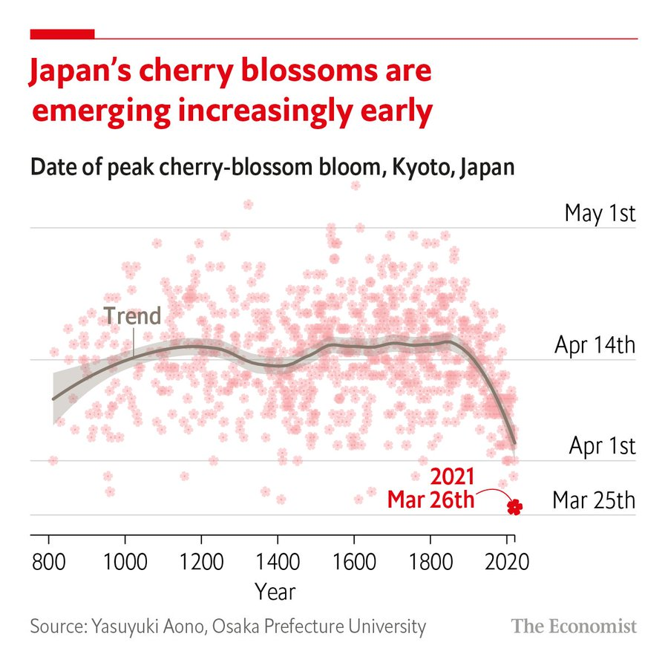

What is phenology? Why trees?
?

Slide 13
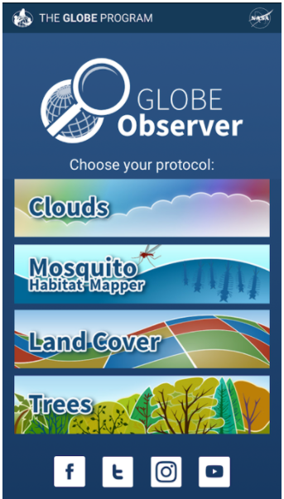
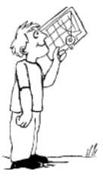
Activity: How tall is my tree?
Get to know your tree better - measure its height using
a hand-made clinometer – easy to do using attached worksheet
GLOBE Observer App: https://observer.globe.gov/

Slide 14

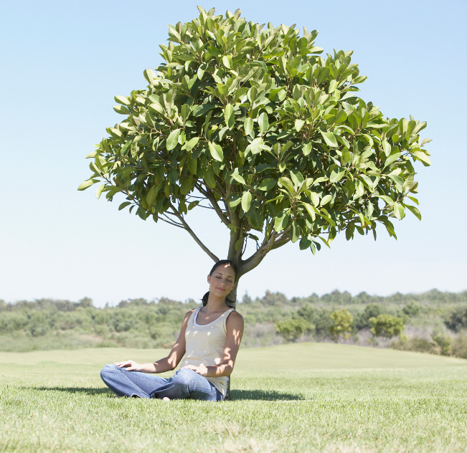
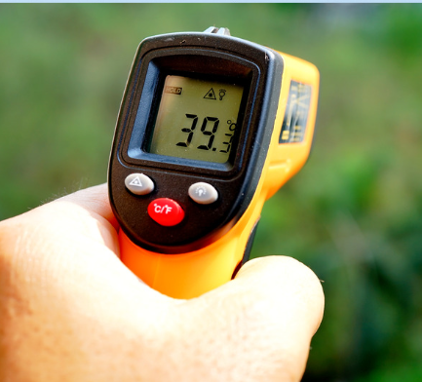
Activity: Air Conditioned by Trees
Explore, how your tree affects the microclimate in its surroundings and how trees help us to cool the urban environment.

Slide 15
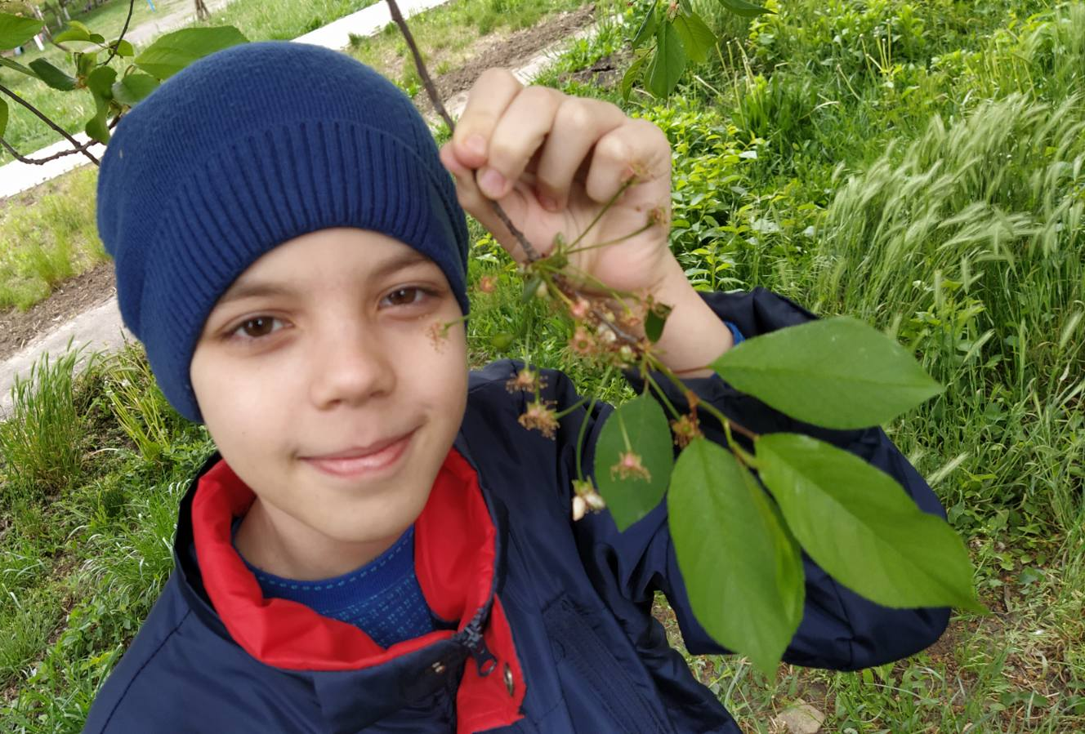

Find a Collaboration Partner
  Exchange of data and pictures by e-mail
  Communication via ZOOM / Skype…
  Student research projects
  Practicing language skills
Let us know, how your
cooperation is going!
  To find a collaboration partner,
  introduce your team on the Discussion Forum
Credits: Lutsk City Ecology and Nature Center, Ukraine

Slide 16
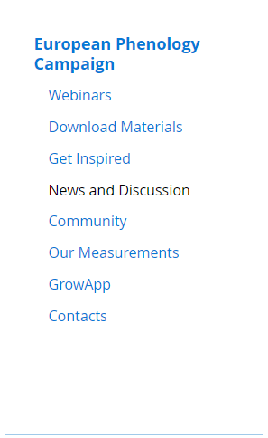
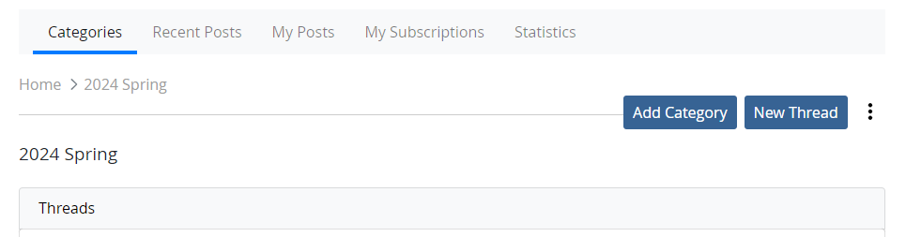
Discussion Forum
Share your pictures and results
How to do it?
  Sign in to GLOBE account
  European Phenology Campaign > News and discussion
  Choose „2025 Spring“
  Publish your post
  Add pictures

Slide 17
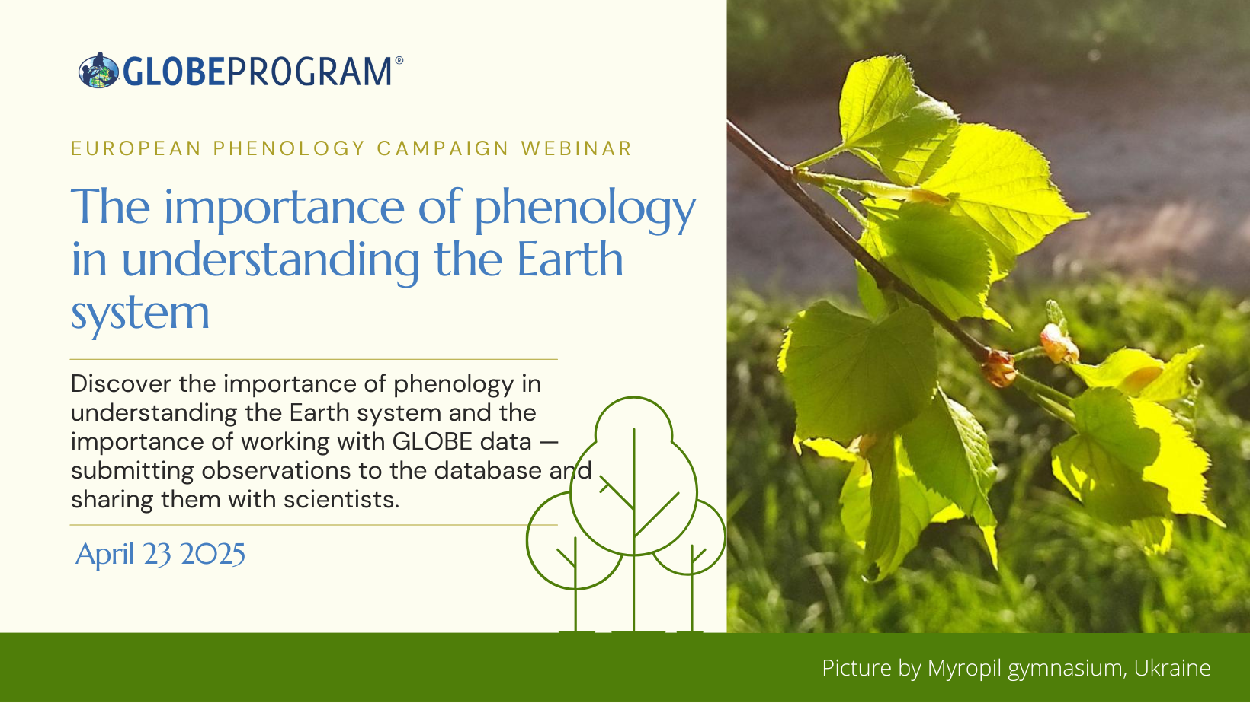
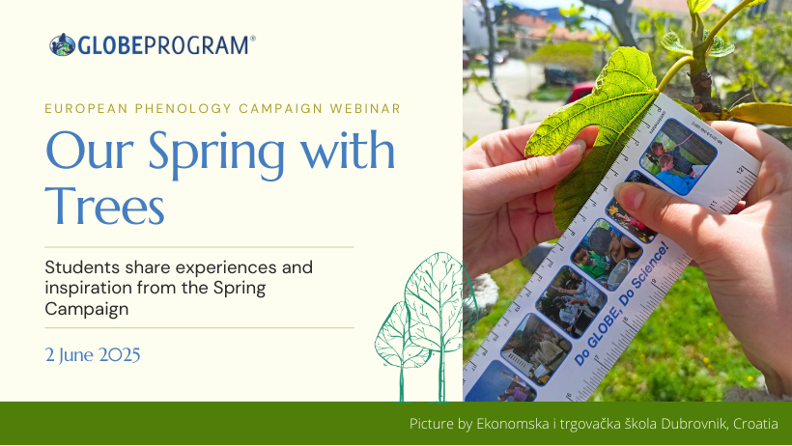
Webinars
April 23 2025
2 June 2025
Also invitations to other tree-related webinars
https://www.globe.gov/web/trees-around-the-globe/overview/webinars

Slide 18
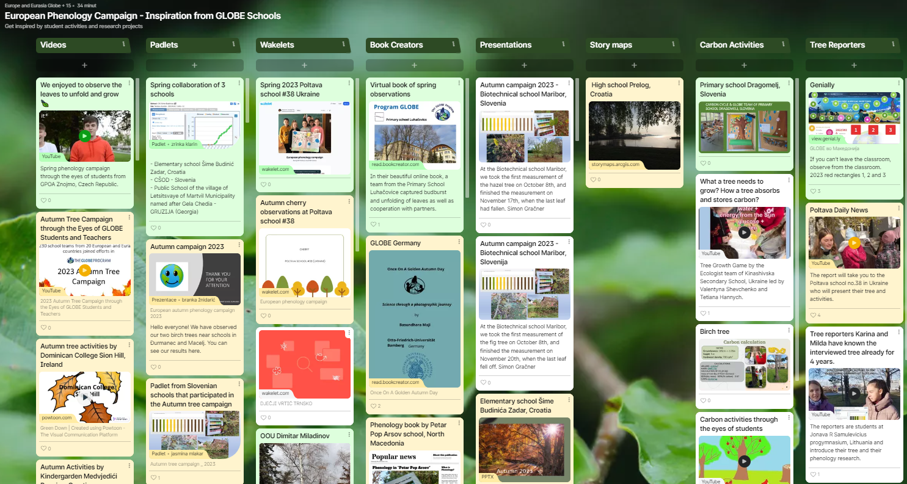
Padlet - inspiration from schools
See school project, videos, collaboration and a lot more…

Slide 19
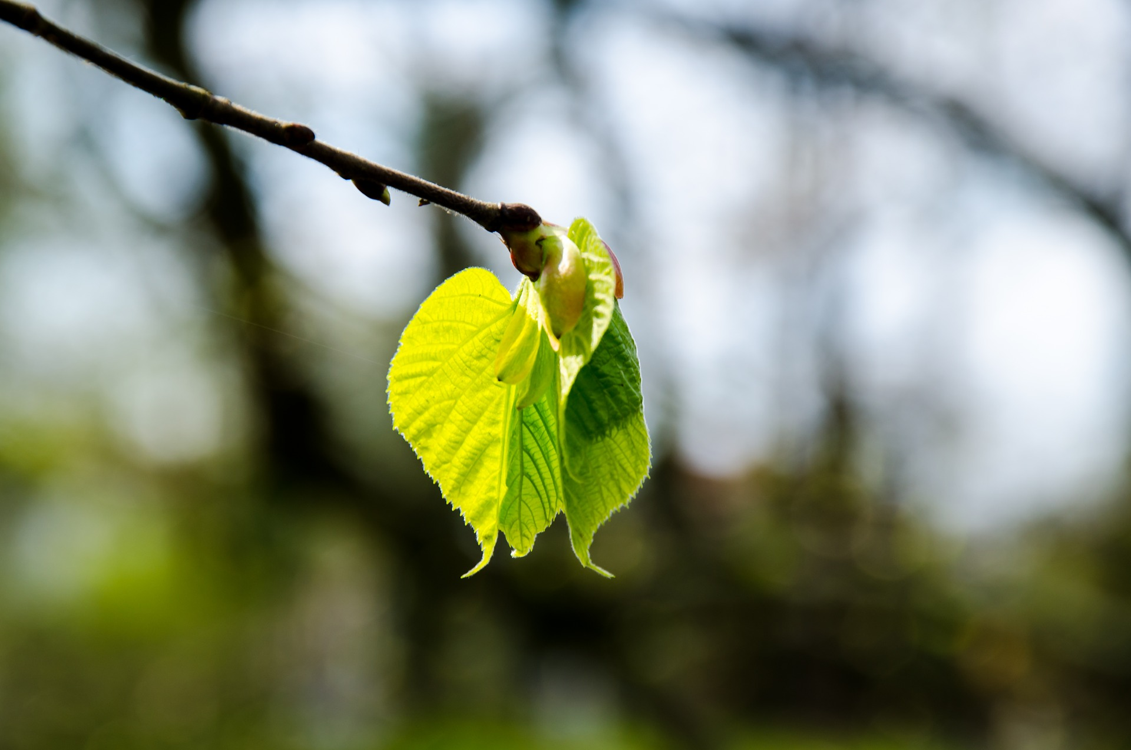


Thank you!
Csilla Barkász, csilla.barkasz@terezanet.cz
www.globe.gov/web/european-phenology-campaign
Notes:
Na závěr – máme vědkyni, která by mohla udělat prezentaci pro pokročilejší – mají o to zájem? Bylo to složité nebo jednoduché

