Slide 1
International collaboration MALTA – ISRAEL
The way forward
Online meeting
2nd April 2020

Slide 2
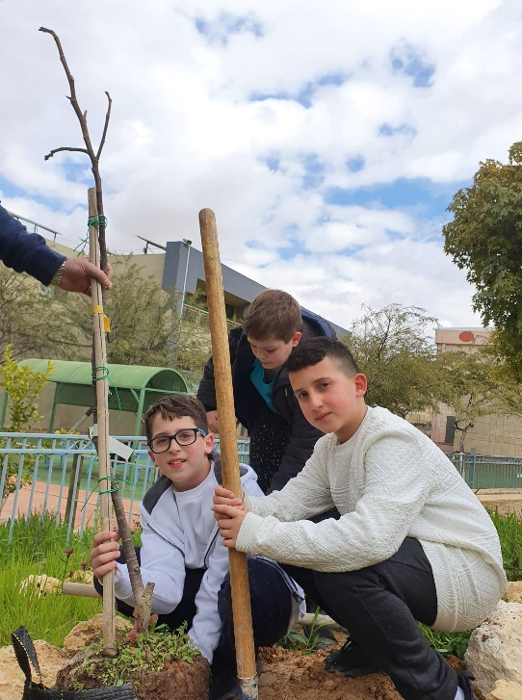
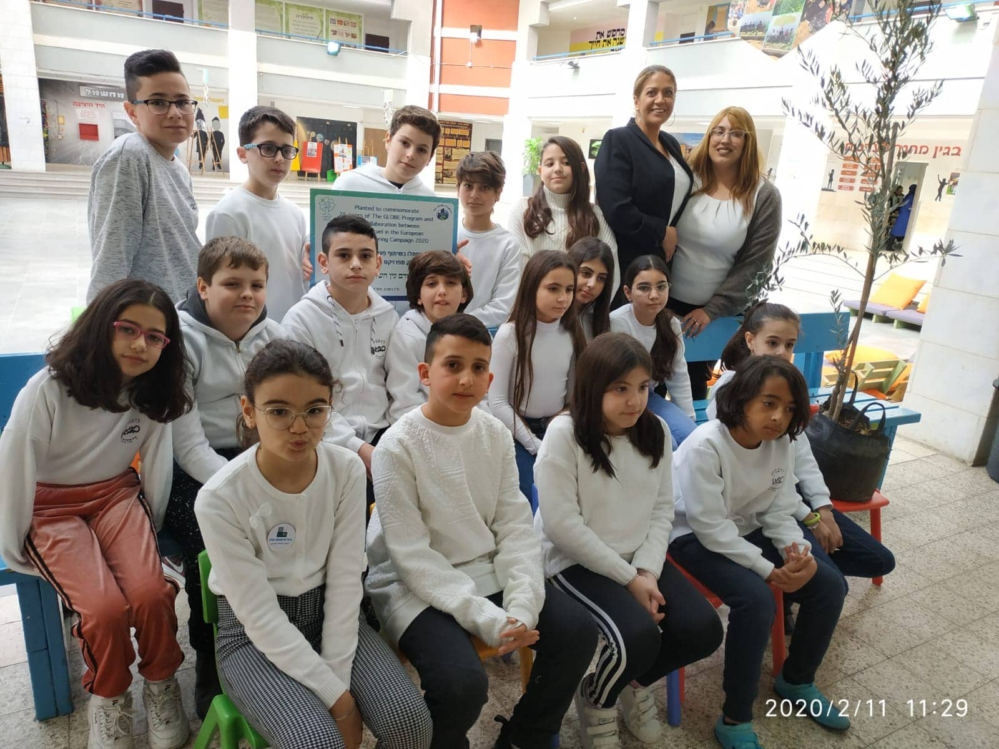
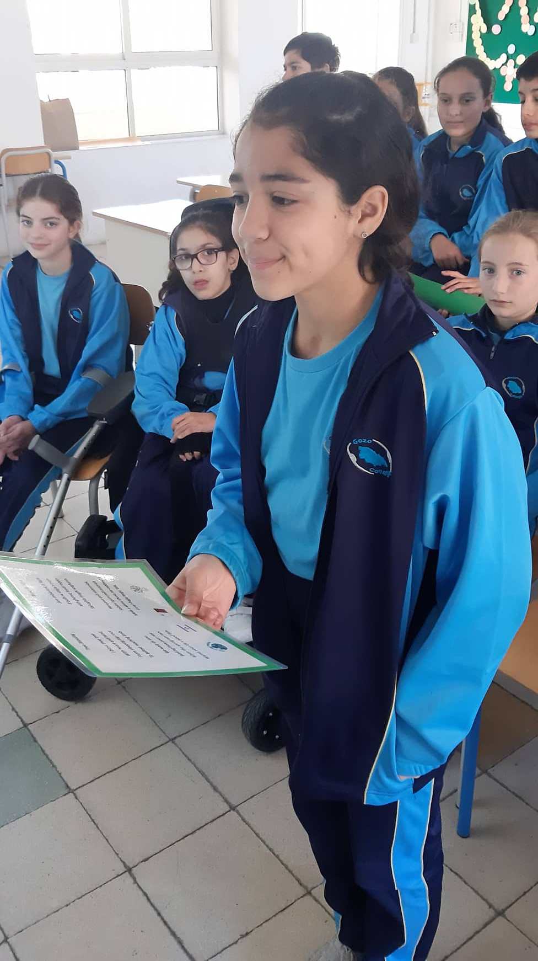
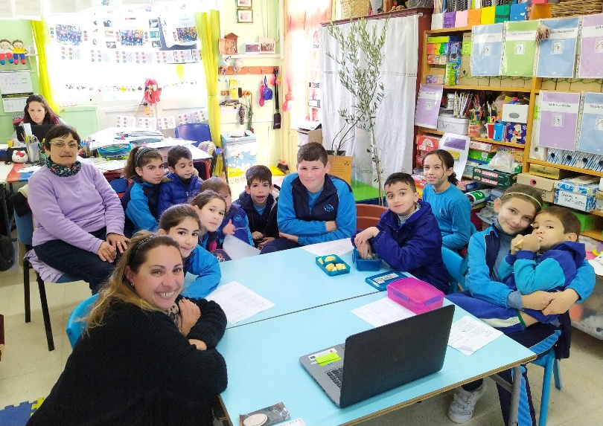
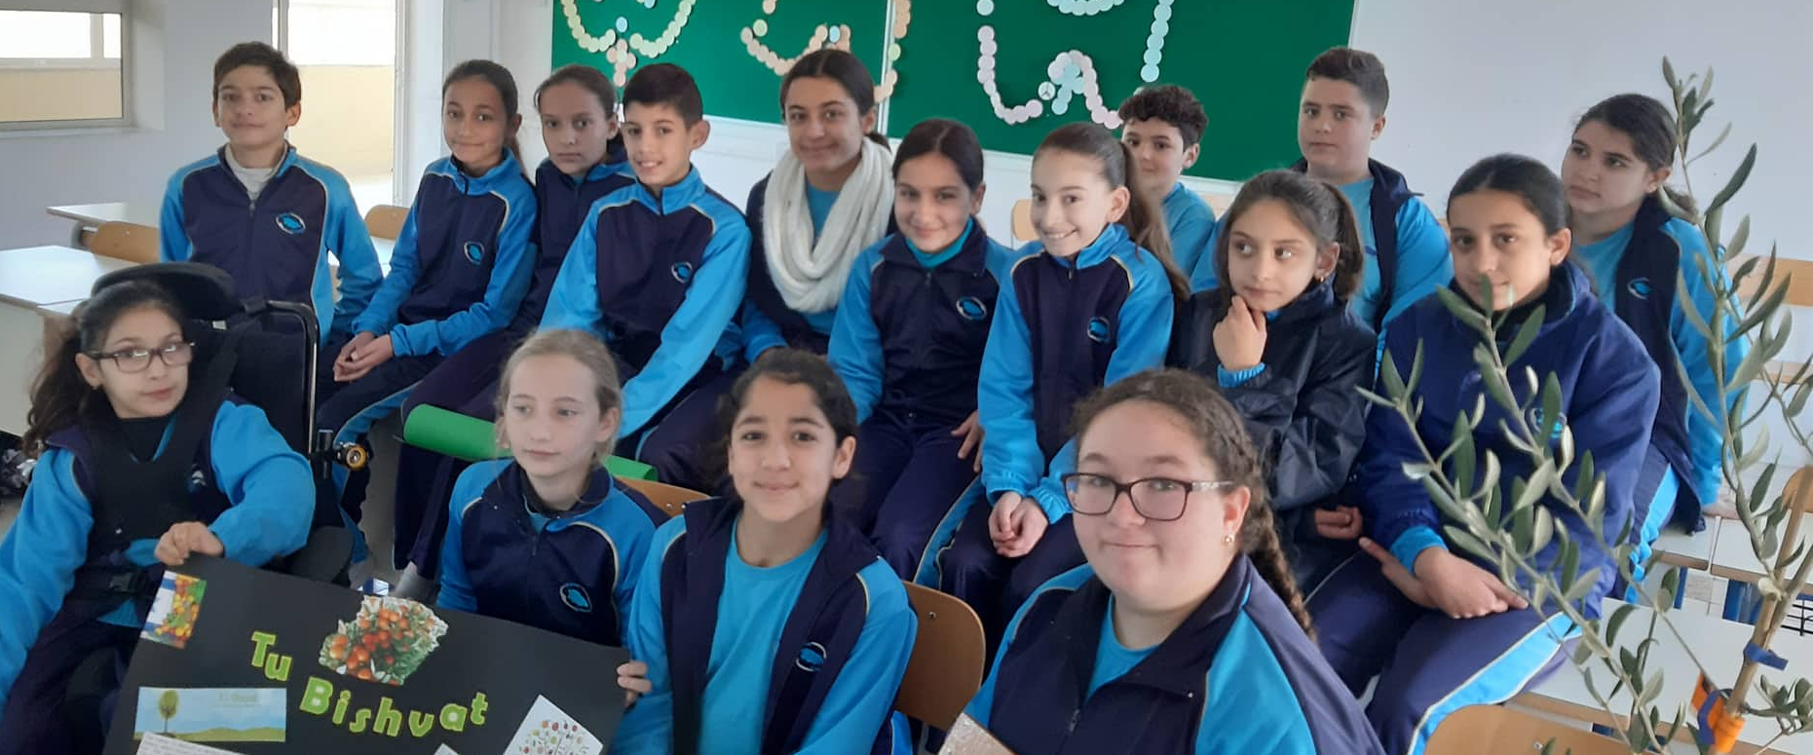
International Collaboration between Gozo and Israel

Slide 3
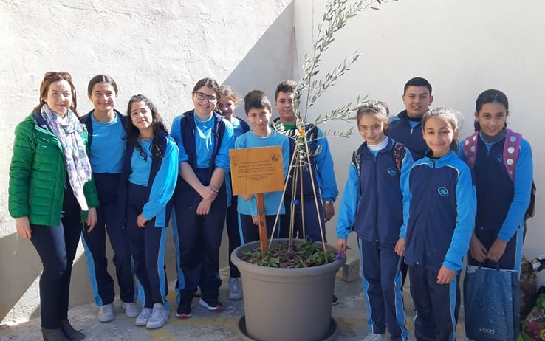
What has been done so far …..
Successful international call on 11th February 2020
Planting of trees
Dissemination of event on social media and news portals
GLOBE Star Story ☺

Slide 4
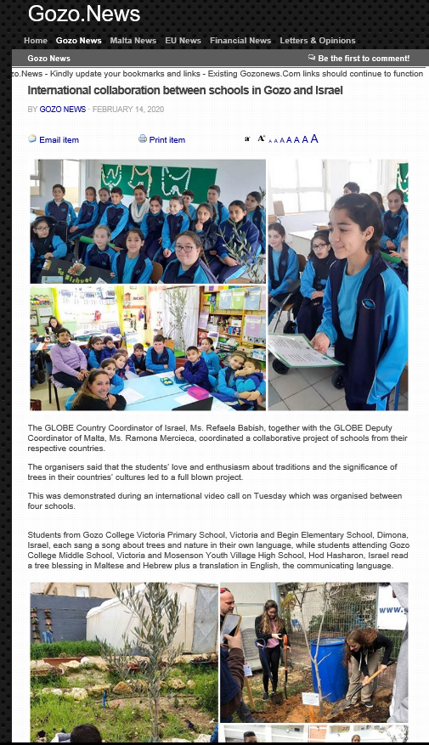
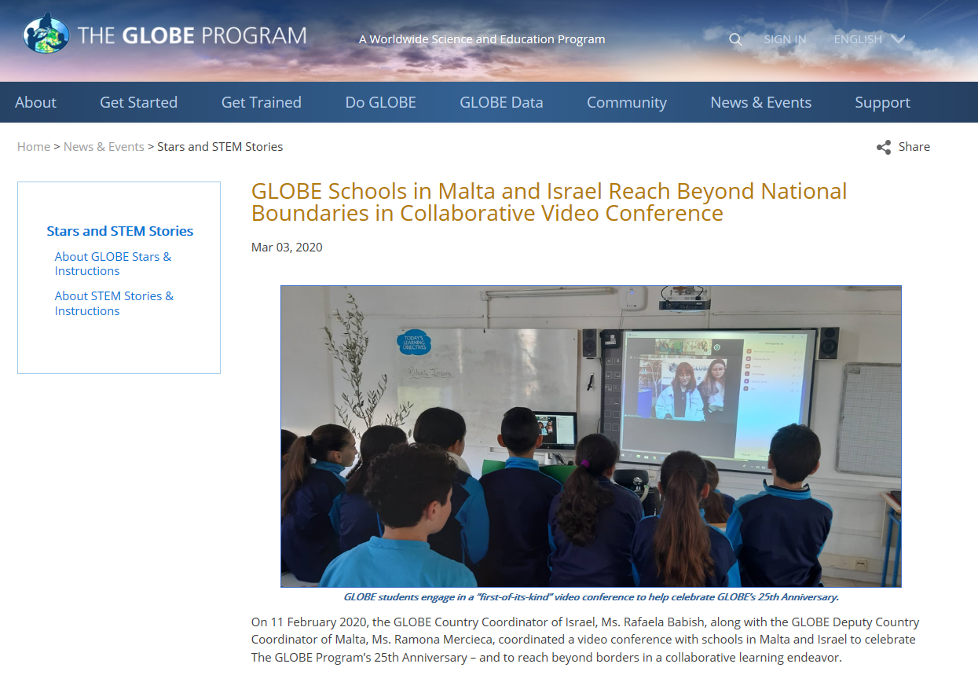

Slide 5
Updates on current situation
Schools in Malta will re-open in September
Fig Tree at GC Middle School cannot be observed since it was planted in the school garden
Fig Tree at GC Rabat Primary still being observed by Ms Jesse since she took pot at home
In Israel Fig Trees have been planted at school so cannot be observed. However, GLOBE teachers will observe another Fig Tree nearby their house and share news with their students.

Slide 6
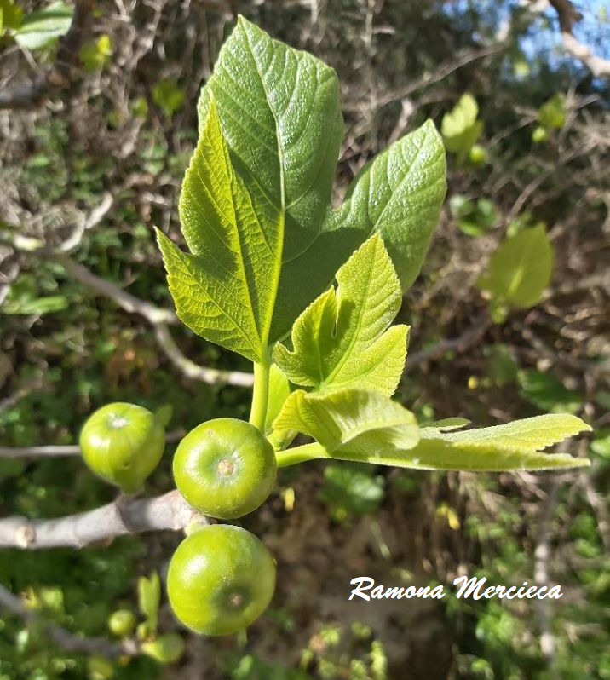
GLOBE keeps rolling from closed schools to safe home
Way forward …..
Teachers can observe a new Fig Tree growing close to their home
Keep in touch with students; live videos, zoom calls and group chats
Students can;
- do research on the fig tree
prepare posters and label parts of the Fig Tree in Maltese, English and Hebrew
find recipes and prepare food using the fruit of the Fig Tree
be creative maybe try some leaf printing
Have Zoom call, in May, where students can present their work.

Slide 7
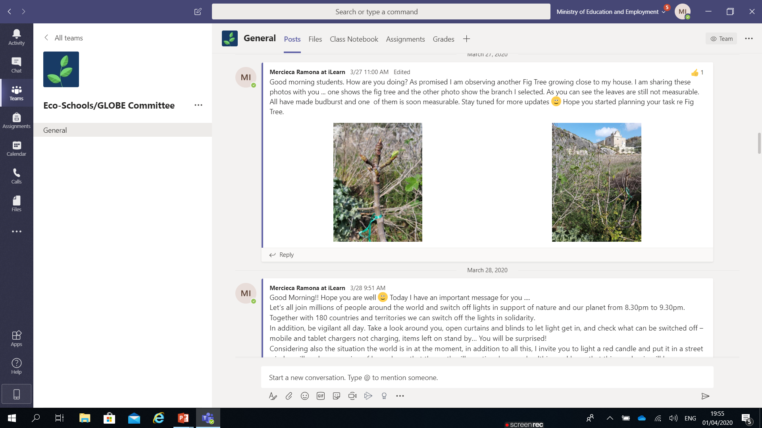
Communication between teacher and students through Microsoft Teams

Slide 8
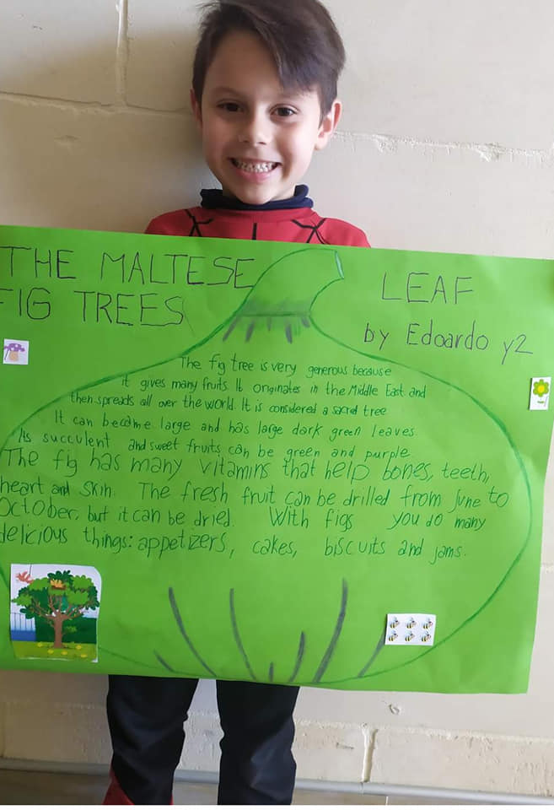
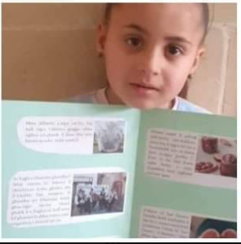
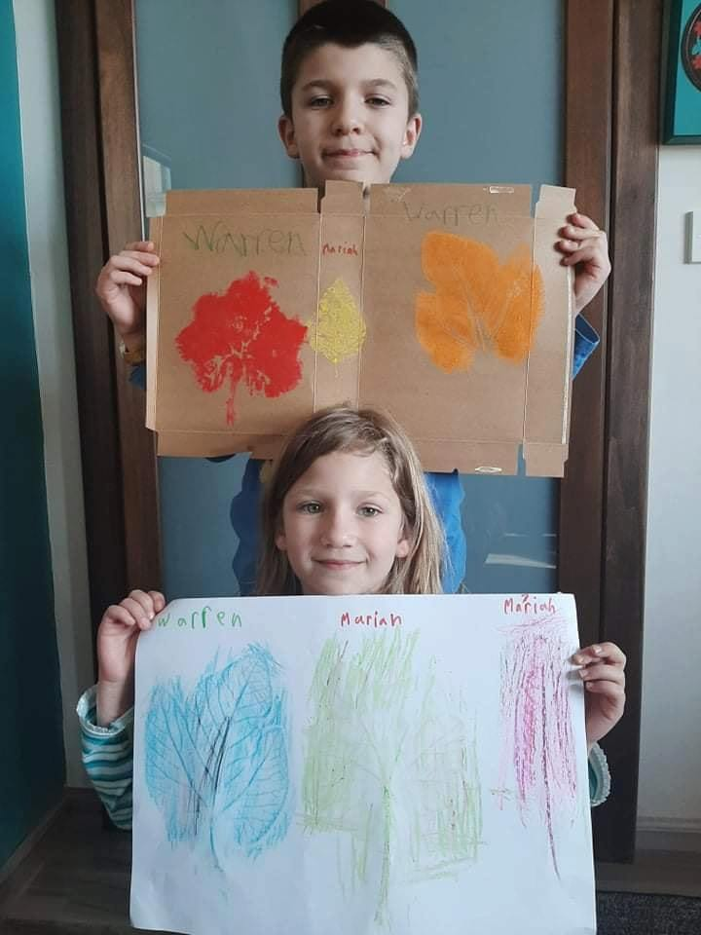
Students showcasing work done at home

Slide 9
Upcoming event

Slide 10
Thank You
Ms Ramona Mercieca
GLOBE Deputy Coordinator for Malta

