Slide 1


مدرسة الملك عبد الله الثاني للتمّيز – إربد
2023

Slide 2
SOIL (Pedosphere) Investigations.
Students: Rama Bani Yassin, Heba Altaweel, Sarah Hamadneh, Ameera Alghawi, Nada Altaweel.
Teacher : WEJDAN MELHEM
School:
King Abdullah the second school for excellence - IRBID

Slide 3
Research Questions :
What are the soils’ characteristics (such as the soil’s moisture, soil’s pH, the amount of roots and rocks, soil’s structure and soil’s consistence) roles in causing cracks in buildings’ walls, ceilings and floors ?
What factors should be studied to indicate wether the land is suitable to build on or not ?

Slide 4
Terms :
Soil moisture
SMAP
pH
Soil structure
Soil consistence

Slide 5
Introduction :
Our main priority was to identify why do the buildings start to crack after several years of existing and the need to diagnose the reasons behind the cracks and how effective it is to study the soils’ nature before building in order to have safe buildings that can remain constant for several years, so we began our researches contacting some engineers that insured us that the soils’ nature plays a big role in the wellbeing of the buildings and informed us of the main characteristics that matters, and depending on the soil protocols we had studied from the GLOBE website we gathered information from a specific site that had buildings with cracks and investigated wether the soil was the problem there or not.

Slide 6
Investigation plan :
We brought samples from different locations around the site we’re working on.
We observed the soil’s structure and consistence while gathering the samples
We determined the geographical location of the building we took the samples from or nearby it.

Slide 7
Investigation plan :
Laboratory work :
We observed the amount of rocks and roots that the soil contained.
We cleared the soil samples from all impurities such as rocks and roots.
We used vinegar and sprayed it on parts of our samples and observed the formation of bubbles to figure if the soil had carbonites.

Slide 8
Investigation plan :
Soil Moisture Data Sheet – SMAP Block Pattern
1- We cleared the samples from all impurities such as roots and rocks.
2- We measured the weight of four containers and divided our samples equally in the containers.
3- We measured the weight of our samples that are in containers before heating and we recorded the results.
4- We heated our samples sequentially for 15 minutes each.
5- We weighed the samples after the heating and recorded the results.
6- We calculated the difference between our records before and after heating to indicate the water weight which shows the rate of soil’s moisture.

Slide 9
Investigation plan :
Soil pH Data Sheet.
1- We measured the pH of 3 Buffer solutions (pH = 4,7,10) to make sure that the pH meter is working correctly.
2- We measured the pH of the water.
3- We mixed the water with the first sample and measured the pH we repeated the measurements 3 times every 3 minutes for the same sample, we did the same for to more samples and wrote the results.

Slide 10
Variables :
Soil samples weights
Soil sample sites
The time (season, time of the day, etc.) by which the soil samples were taken

Slide 11
Research results :
Sample | Mass of wet soil and container (A) | Mass of dry soil and container (B) | Water weight (C) | Mass of empty container (D) | Mass of dry soil (E) (B-D)
1 | 87 | 82 | 5 | 49 | 33
2 | 87 | 79 | 8 | 49 | 30
3 | 89 | 84 | 5 | 51 | 33
4 | 89 | 82 | 7 | 51 | 31

Slide 12
Research results
Soil moisture observations:
We found that the difference between our measurements before heating and after varies scientifically which indicates that the water moisture is high in the site of investigation, and according to our researches that’s the main reason that causes the cracks in buildings and the one of the reasons behind the high water humidity is that the soil is clayey which has materials and that absorb large amount of water and that leads to soil expansions and that causes landslides and rises that and that explains why cracks in the building were found.

Slide 13
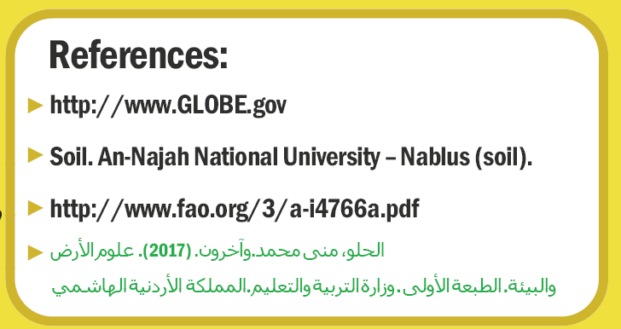

Slide 14
شكر خاص للمهندس قاسم أبو كسّاب، ومجموعة من طلبة كلية الهندسة في جامعة العلوم والتكنولوجيا الأردنية، لما قدموه من مساعدة لإنجاز هذا البحث...

