Slide 1
Citizen Scientists Needed! for the
GLOBE Urban Heat Island Effect Campaign
Dr. Kevin Czajkowski
Janet Struble
Sara Mierzwiak
GLOBE Mission EARTH
The University of Toledo
https://www.globe.gov/web/mission-earth/overview
The material in this document is based upon work supported by NASA under grant award No. NNX16AC54A. Any opinions, findings, and conclusions or recommendations expressed in this material are those of author(s) and do not necessarily reflect the views of the National Aeronautics and Space Administration.

Slide 2
Introductions
Dr. Kevin Czajkowski, University of Toledo
Lead Scientist – GLOBE Urban Heat Island/Surface Temperature Field Research Campaign
Wants YOU to collect Surface Temperature Observations in October, December, & March
Janet Struble
20 years science teacher
Program Manager
GLOBE Master Trainer
Sara Mierzwiak
20+ years work in the environmental field
GLOBE Master Trainer
Research Assistant for GLOBE Mission EARTH
PhD Student in Education at the University of Toledo
💫 Your Turn

Slide 3

What is GLOBE Mission EARTH?
Funded by NASA
Develop vertically-integrated activities and materials to support implementation of GLOBE and NASA into schools
Provide K-12 professional development (PD)
Enhance STEM Experience for Undergraduate Students, using MyNASA DATA and citizen science initiatives.
Collaborate and build capacity with district and state agencies
Engage the public by supporting and enhancing GLOBE (www.globe.gov)
Infuse Teacher Preparation with NASA & GLOBE learning and teaching assets

Slide 4
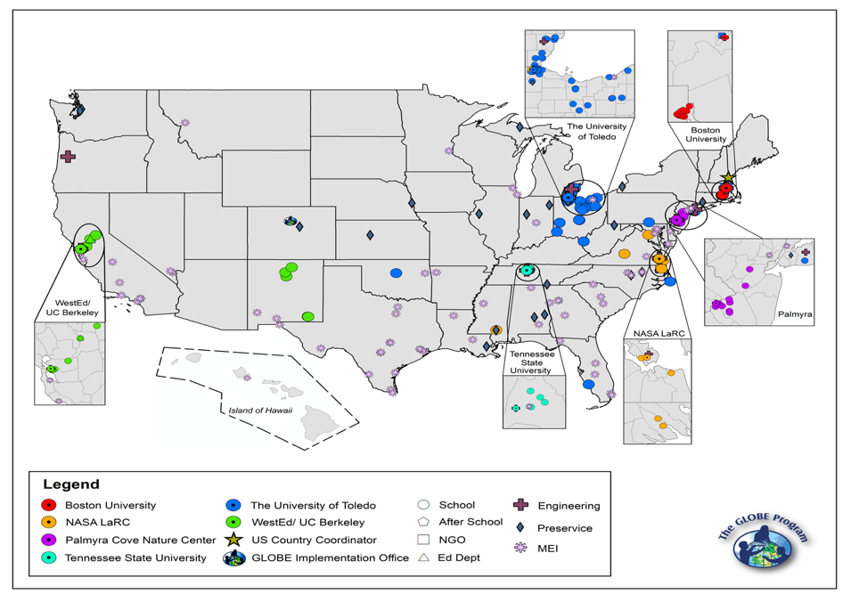
GLOBE Mission EARTH
Reach Map

Slide 5

GLOBE (http://www.globe.gov)
International Program involving teachers, students and citizen scientists from around the world!
Provides standardized protocols for collecting data from our planet in its four spheres:
  Atmosphere
  Hydrosphere
  Pedosphere
  Biosphere
  Provides a cloud-based GIS database for uploading, viewing and sharing data.

Slide 6
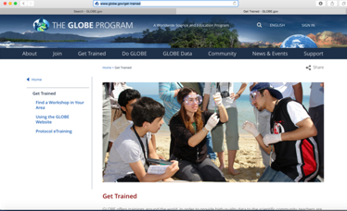
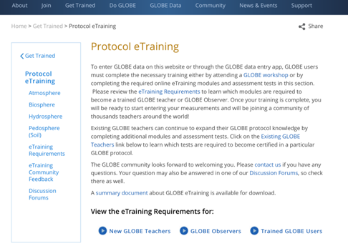
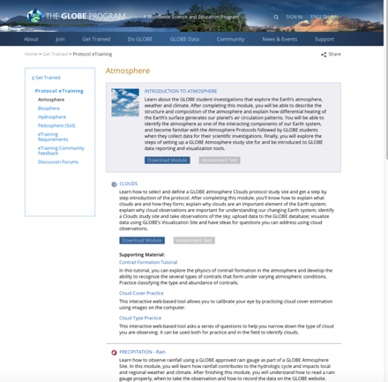
GLOBE E-Training/Atmosphere/Surface Temperature
https://www.globe.gov/get-trained/protocol-etraining/etraining-modules/16867642/12267
http://www.globe.gov/get-trained
https://www.globe.gov/get-trained/protocol-etraining

Slide 7
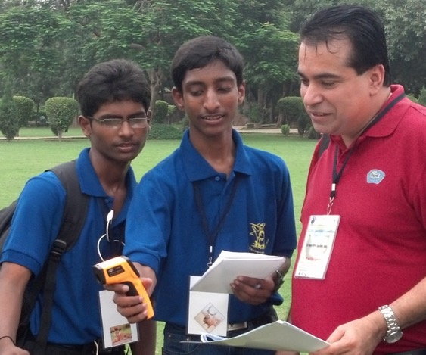
Protocol Training Slides for
Surface Temperature
Photo credit: Kevin Czajkowski

Slide 8
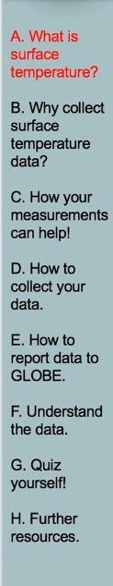
Overview and Learning Objectives
Overview
This module:
Describes how to take surface temperature measurements
Provides instructions on how to enter your data on the GLOBE website
Learning Objectives
After completing this module, you will be able to:
Describe and define surface temperature
List reasons why it is important to collect surface temperature data
Determine the correct locations to take surface temperature readings
Upload data to the GLOBE website
Visualize data using GLOBE and formulate your own questions about weather
Estimated time needed for completion of this module: 1.5 hours

Slide 9
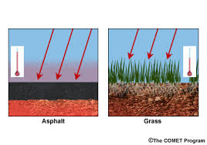
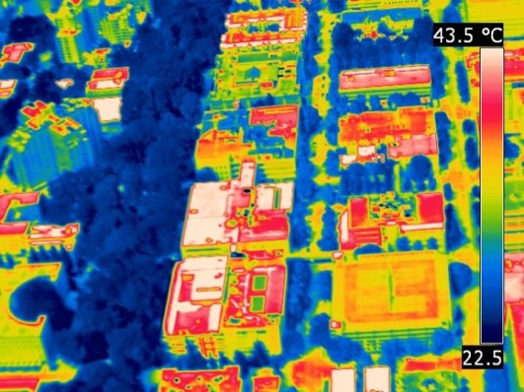
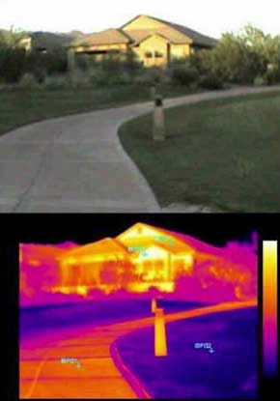
Surface temperature is the temperature at the Earth’s surface, including the land, water and structures
Not all surfaces have the same temperature!

Slide 10
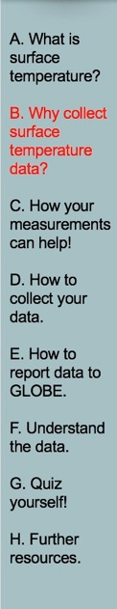
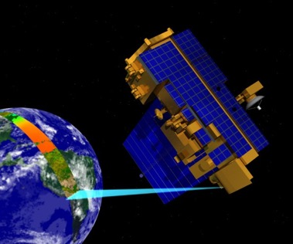
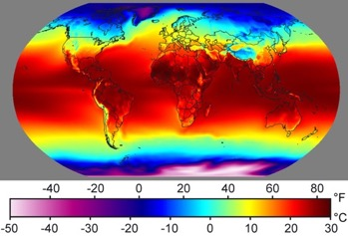
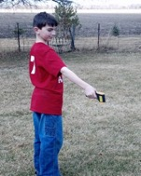
Recording surface temperature is important
To help verify surface temperature readings collected by NASA satellites.
Image: Windows to the Universe
Find out more about
NASA’s MODIS Imagery
Image: NASA
Image: Kevn Czajkowski

Slide 11
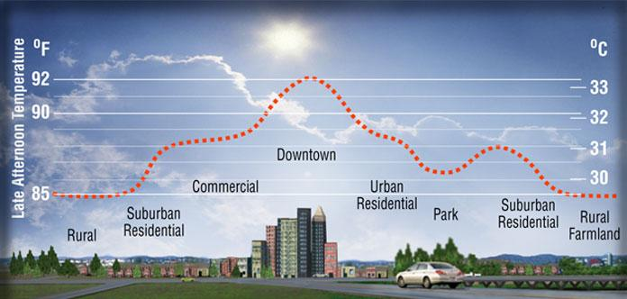
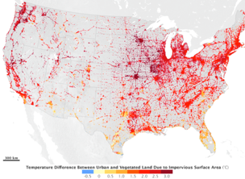
Recording surface temperature is important
To assist in urban planning and to help understand the Urban Heat Island Effect.

Slide 12
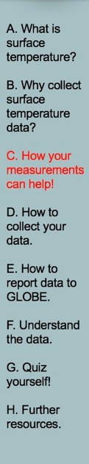
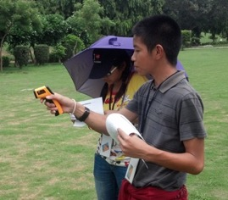
YOUR measurements can help NASA scientists to understand and predict:
How do urban areas affect the temperature around them?
What is the contribution of changing land use and land cover on local energy budgets?
How are land surface temperatures
changing over the long-term?
How accurate are data from NASA
satellites?

Slide 13
Surface Temperature is at the Heart of the Energy Budget
Incoming sunlight heats the surface
Evapotranspiration cools the surface
Sensible heat rises from the ground
Emitted energy cools the surface to space
Surface Temperature
Heat goes into the ground

Slide 14
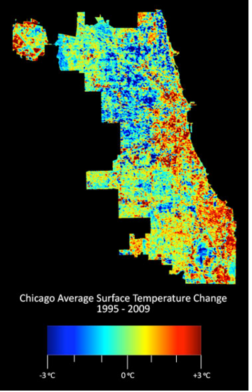
Chicago surface temperature
http://mackeyarchitecture.com/urban_cooling/index.html

Slide 15
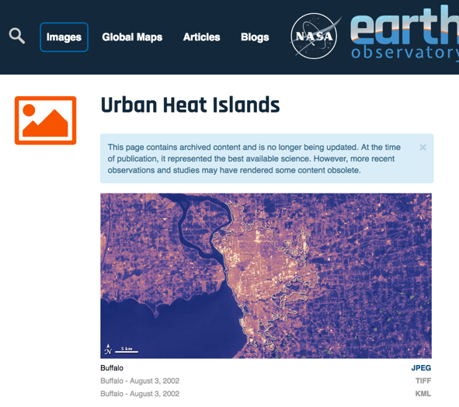

Urban Heat Island Impacts
Increased energy consumption
Elevated emissions of air pollutants and greenhouse gases – ozone
Compromised human health – increased death rate

Slide 16
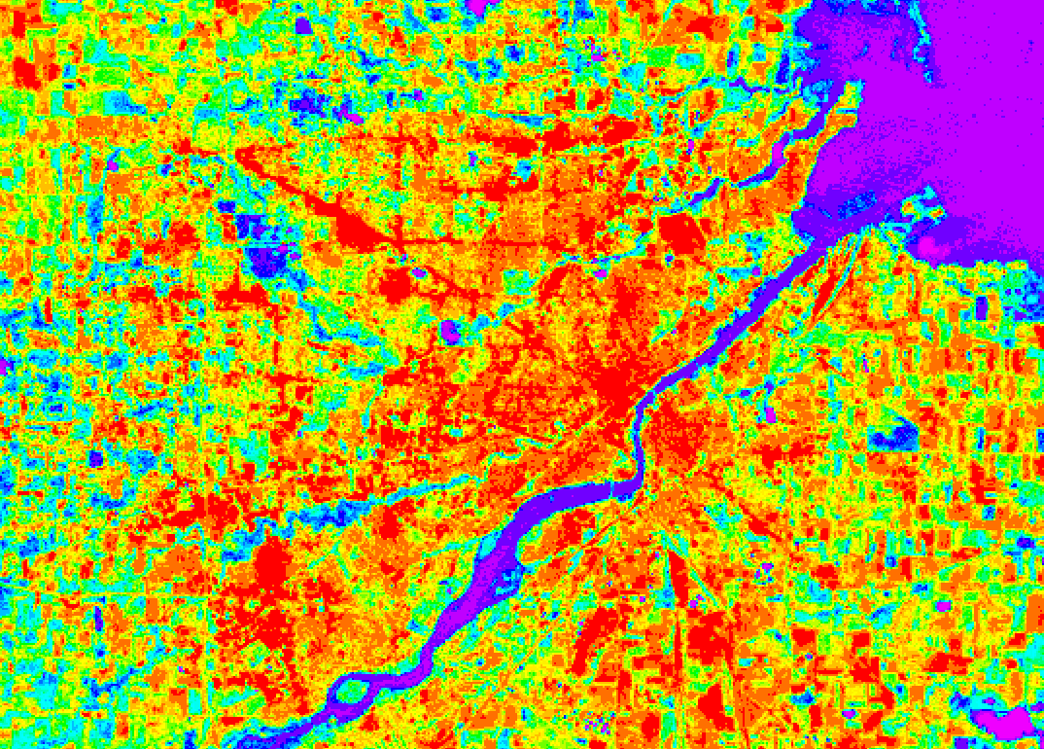
Thermal Landsat Image - Toledo
40 C
20 C

Slide 17
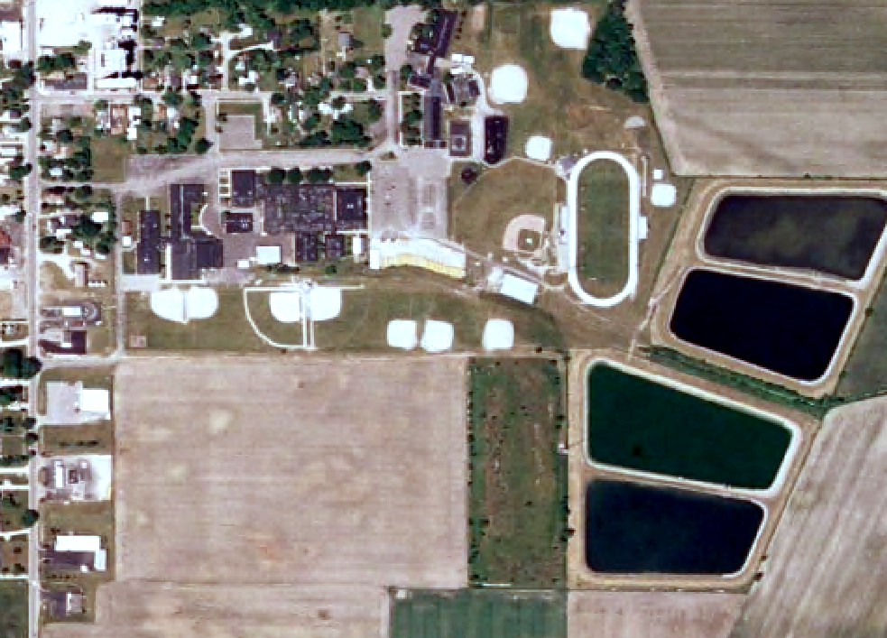
Ida, Michigan Schools

Slide 18
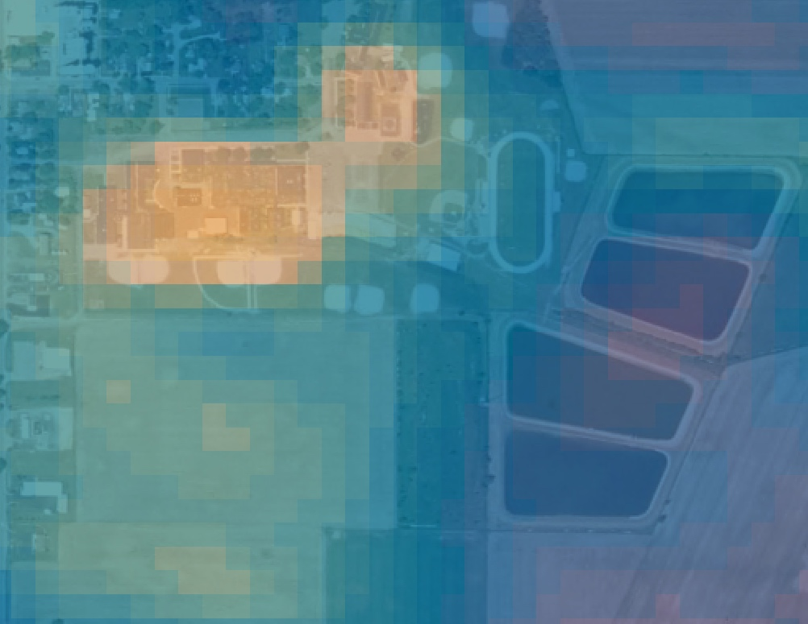
Ida, Michigan Schools – Overlaid with Landsat Thermal Image
warmer
cooler

Slide 19
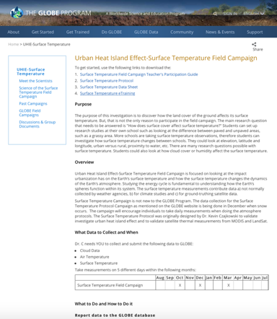
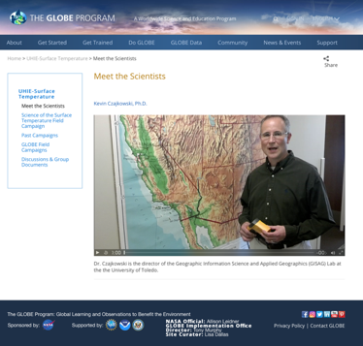
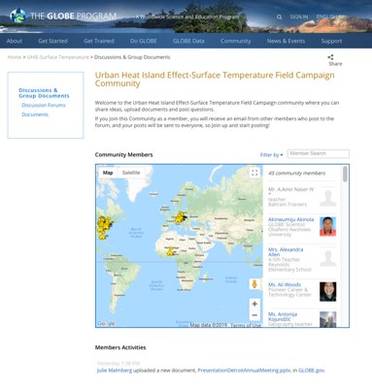
GLOBE Urban Heat Island Effect-
Surface Temperature Field Campaign
https://www.globe.gov/web/surface-temperature-field-campaign

Slide 20
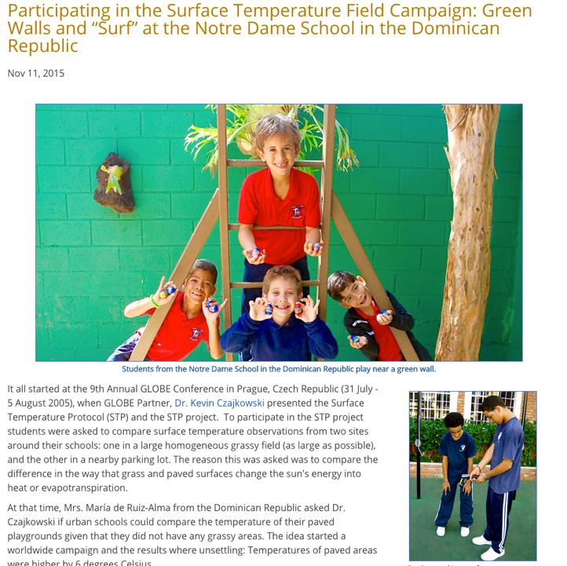

Slide 21
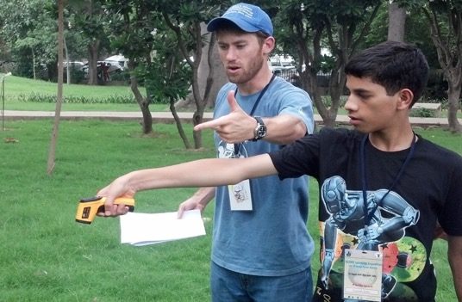
Urban Heat Island Effect-
Surface Temperature Field Campaign
October, December and March
Need both urban and rural schools so we can compare.
5 different days each month.
Take observations of a grassy area and a parking lot

Slide 22
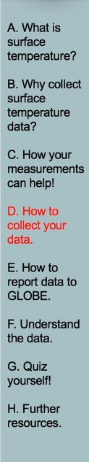
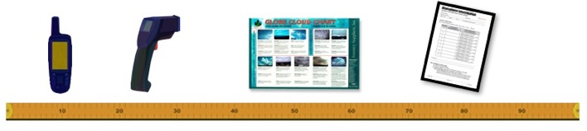
What you need to collect data:
Instruments | Your eyes, GPS unit, Infrared Thermometer, Meter Stick
References | GLOBE cloud chart
When | Good: Any time Better: Within one hour of local solar noon Best: Within +/- 15 minutes of a satellite overpass
Where | A good observation site (See Documenting your atmosphere study site)
Form | Surface Temperature Data Sheet

Slide 23
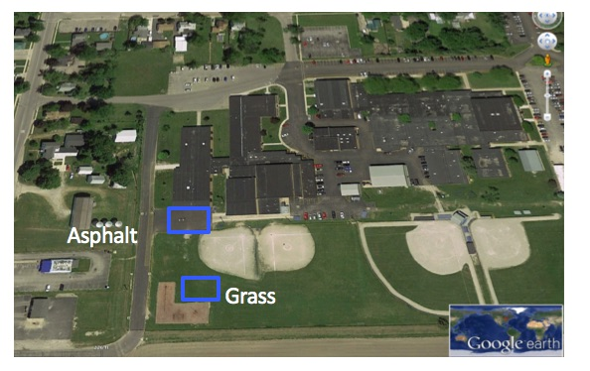
Choose homogenous study areas.
Choose study areas that are as large as possible and that have homogeneous cover. If the only area you have is smaller, take observations there and measure the size of the area. At this school, students took surface temperature observations on the asphalt and the nearby grassy outfield of a softball field.
Notes:
Calibrate with bucket of ice water
-point IRT perpendicular to water surface about 5 cm away
-reading should be within –2° C to +2° C
The IRT sensor is susceptible to large differences in air temperature. If you enclose the IRT in the adapted oven mitt (thermal glove), this will ensure the IRT stays insulated and will provide accurate readings.
Some IRT units are equipped with a laser that will shine from the front of the thermometer along the approximate line of sight, causing a red dot to appear where the surface temperature is measured. Make sure students do not aim this laser beam directly at eyes or off surfaces that could reflect in someone’s eyes.
Wrap your IRT in the Thermal Glove when the air temperature at your study site varies more than 5 degrees Celsius from the air temperature of where the IRT has been stored. The IRT with the thermal glove has been tested to work for 30 minutes. The thermal glove is made from a standard oven mitt. The oven mitt used to make the thermal glove MUST be constructed of 100% terry cloth; inside and outside. An actual-size pattern of the thermal glove with hole designations for the IRT’s sensing eye and digital display screen is shown in the Surface Temperature Protocol section of the 2003 Teacher’s Guide.

Slide 24
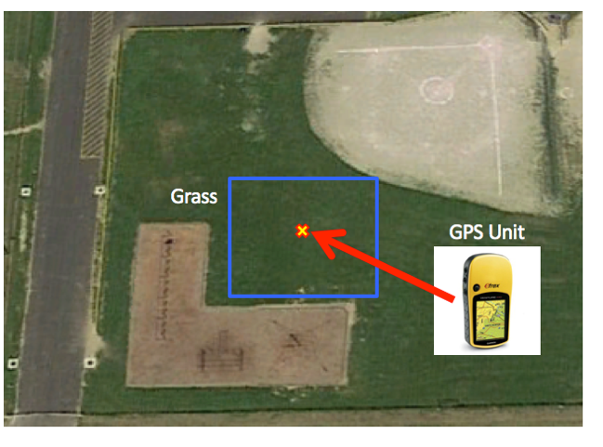
2. Collect GPS data of the center of each study area.
Record latitude, longitude and elevation.
Notes:
Calibrate with bucket of ice water
-point IRT perpendicular to water surface about 5 cm away
-reading should be within –2° C to +2° C
The IRT sensor is susceptible to large differences in air temperature. If you enclose the IRT in the adapted oven mitt (thermal glove), this will ensure the IRT stays insulated and will provide accurate readings.
Some IRT units are equipped with a laser that will shine from the front of the thermometer along the approximate line of sight, causing a red dot to appear where the surface temperature is measured. Make sure students do not aim this laser beam directly at eyes or off surfaces that could reflect in someone’s eyes.
Wrap your IRT in the Thermal Glove when the air temperature at your study site varies more than 5 degrees Celsius from the air temperature of where the IRT has been stored. The IRT with the thermal glove has been tested to work for 30 minutes. The thermal glove is made from a standard oven mitt. The oven mitt used to make the thermal glove MUST be constructed of 100% terry cloth; inside and outside. An actual-size pattern of the thermal glove with hole designations for the IRT’s sensing eye and digital display screen is shown in the Surface Temperature Protocol section of the 2003 Teacher’s Guide.

Slide 25
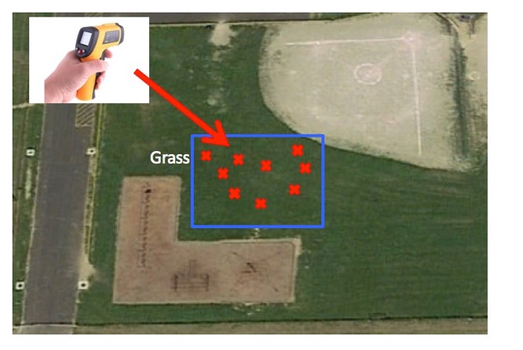
3. Take 9 random surface temperature readings
Take 9 random surface temperature readings within each study area. The 9 random observations ensure a good average for the site is observed.
Notes:
Calibrate with bucket of ice water
-point IRT perpendicular to water surface about 5 cm away
-reading should be within –2° C to +2° C
The IRT sensor is susceptible to large differences in air temperature. If you enclose the IRT in the adapted oven mitt (thermal glove), this will ensure the IRT stays insulated and will provide accurate readings.
Some IRT units are equipped with a laser that will shine from the front of the thermometer along the approximate line of sight, causing a red dot to appear where the surface temperature is measured. Make sure students do not aim this laser beam directly at eyes or off surfaces that could reflect in someone’s eyes.
Wrap your IRT in the Thermal Glove when the air temperature at your study site varies more than 5 degrees Celsius from the air temperature of where the IRT has been stored. The IRT with the thermal glove has been tested to work for 30 minutes. The thermal glove is made from a standard oven mitt. The oven mitt used to make the thermal glove MUST be constructed of 100% terry cloth; inside and outside. An actual-size pattern of the thermal glove with hole designations for the IRT’s sensing eye and digital display screen is shown in the Surface Temperature Protocol section of the 2003 Teacher’s Guide.

Slide 26
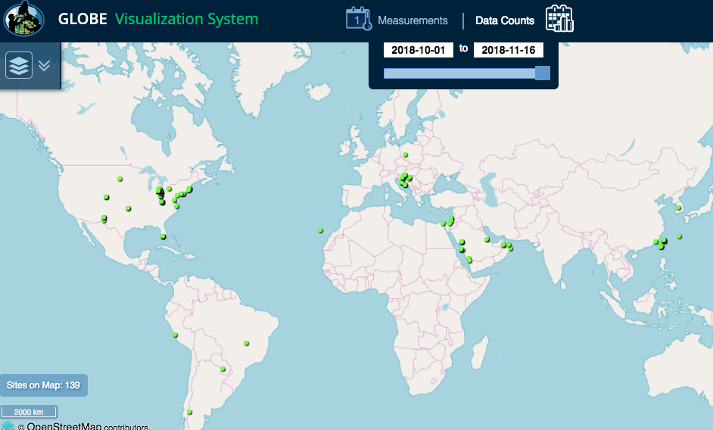
Participating GLOBE Schools in Urban Heat Island Campaign

Slide 27
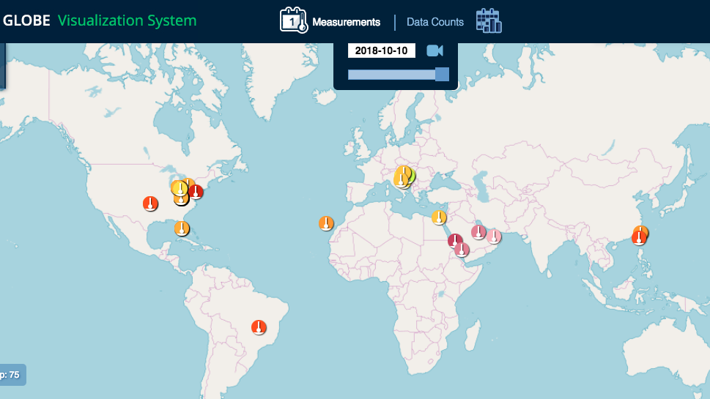
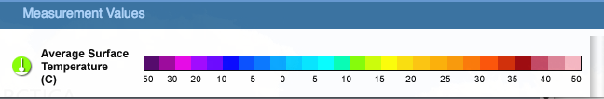
Visualize your data with the GLOBE Vis System!
https://www.globe.gov/globe-data/visualize-and-retrieve-data

Slide 28
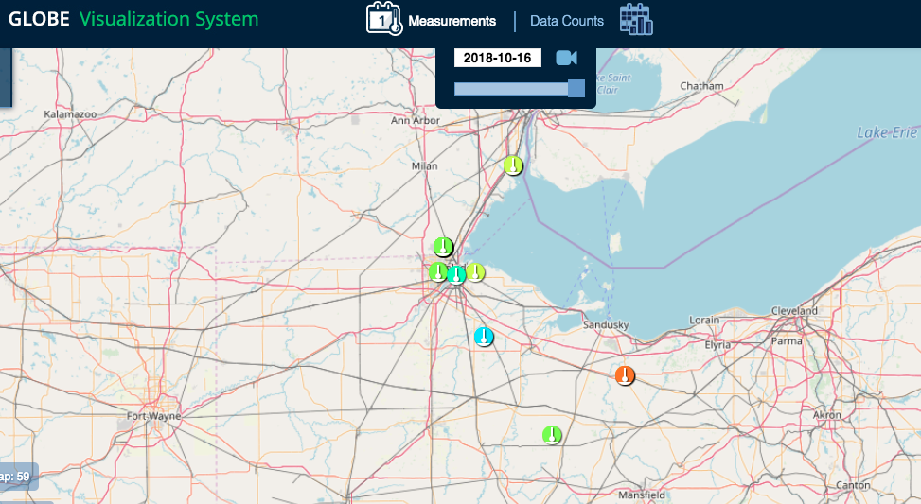
Participating GLOBE Schools in Urban Heat Island Campaign

Slide 29
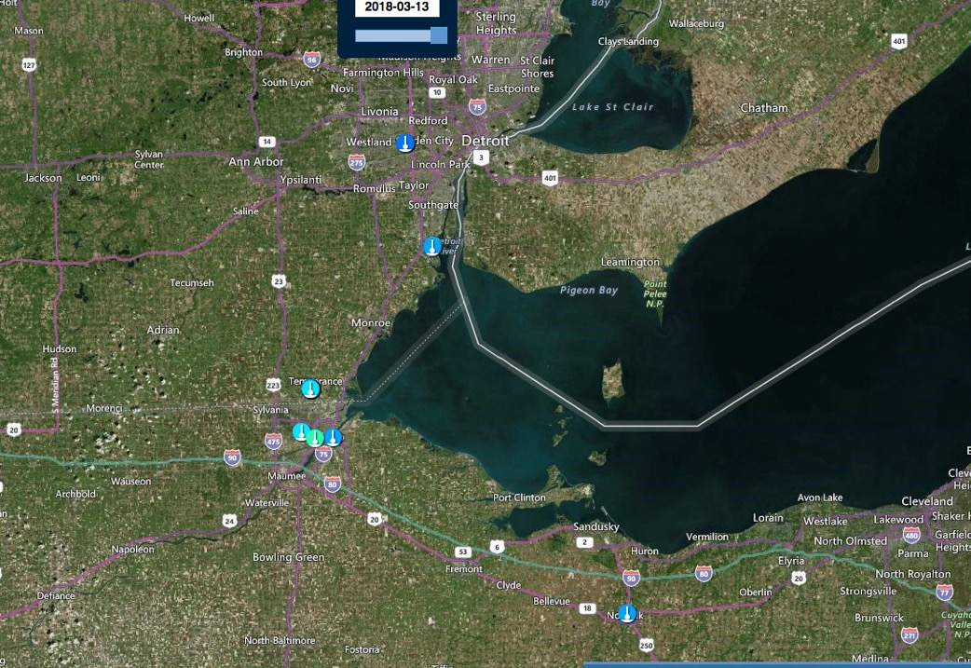

Slide 30
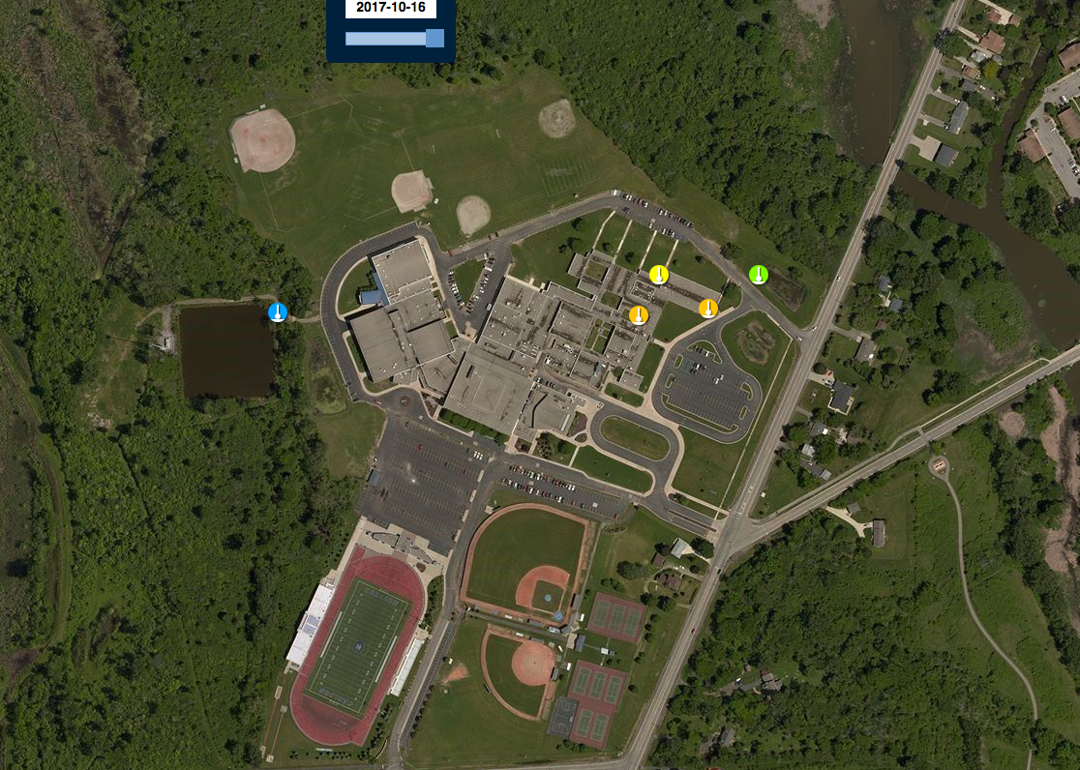
Shumate Middle School

Slide 31
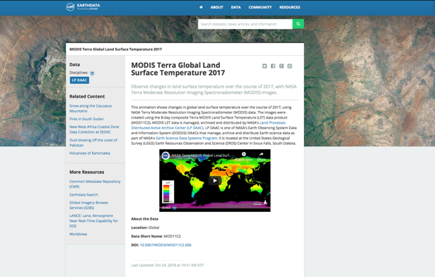
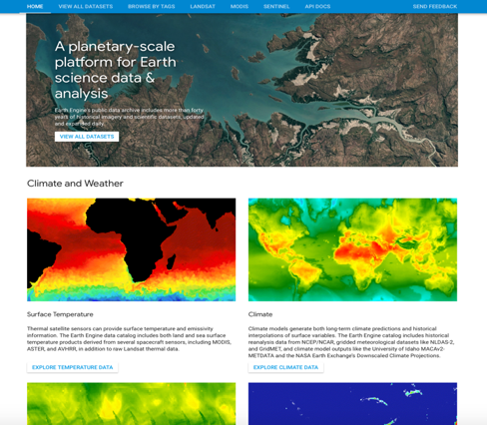
Datasets from NASA Satellites
https://earthdata.nasa.gov/special-feature-modis-global-land-surface-temperature
https://developers.google.com/earth-engine/datasets/
Help Guide Under the AREN Project: https://www.globe.gov/documents/23174792/24151782/AREN+GLOBE+Program+Quick+Guide+for+Accessing+Satellite+Data.pdf/7cf42c4a-c7bc-44f1-8e2c-252a26ef0c8b

Slide 32
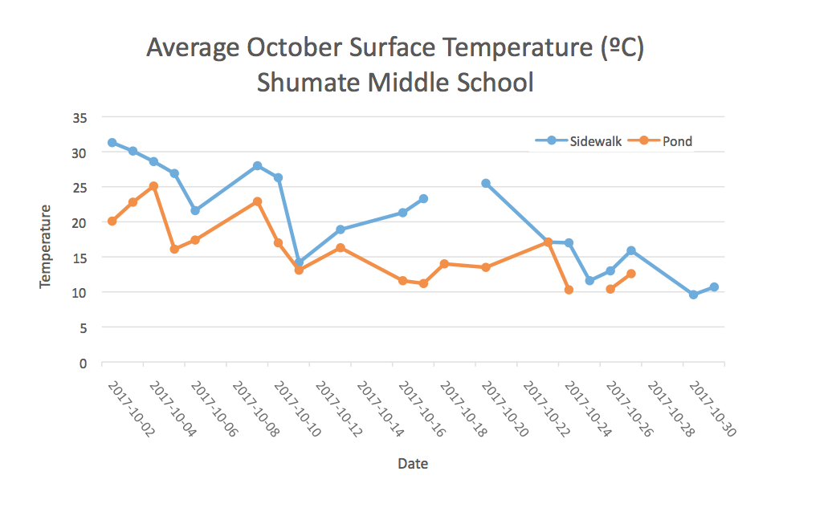
Pond vs. Sidewalk

Slide 33
Guiding Questions
Which surfaces have warmer or cooler surface temperature?
How do local weather conditions affect surface temperatures of different materials over time?
What is the Urban Heat Island Effect?
How do surface temperatures at my school compare with another school in a different environment (ex. Urban vs. Rural)?

Slide 34
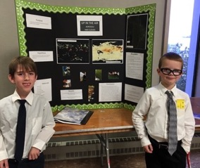
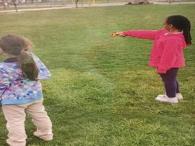
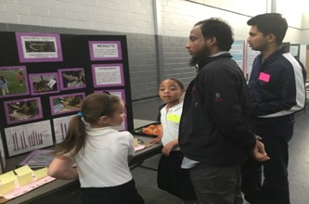
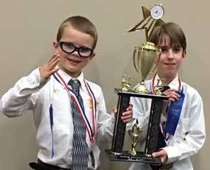
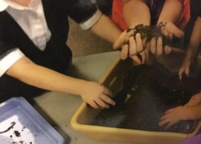
Young Scientists
Once a week 2 kindergarten students at a time would measure surface temperature and collect soil for the class to sift through and look for worms. The class also wanted to know if worms really help plants grow better.
Students would record their data in a journal.
Two students presented their science project at the GME SATELLITES Science Fair.
Grade 1 students studied Aerosols along with NASA Satellite Data and took First Place.
Notes:
Start telling your story here. What did you do?

Slide 35
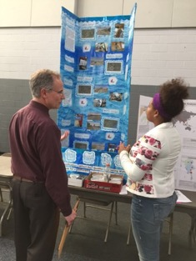
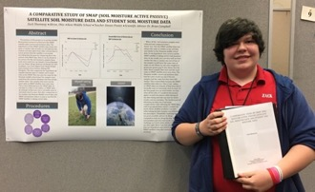
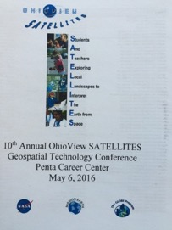
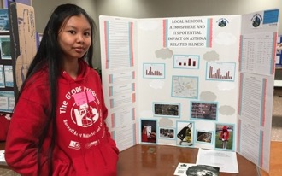





GME SATELLITES & Midwest Student Conferences (K-16)
.
Notes:
Need to update

Slide 36
GLOBE Science Symposia
Virtual - International Virtual Symposium – Reports accepted Jan 1 – April 10, 2019
http://www.globe.gov/news-events/globe-events/virtual-conferences
Face to Face – GME SATELLITES Student Conference – May 1 at The University of Toledo
Face to Face - Midwest GLOBE Student Research Symposium – April 4-7, 2019 at University of Northern Iowa, Cedar Falls, IA (Funding application deadline is February 1, 2019)
https://www.globe.gov/web/united-states-of-america/home/student-research-symposia/calendar

Slide 37


Slide 38

Elementary GLOBE
http://www.globe.gov/web/elementary-globe/overview
Classroom Activities
http://www.globe.gov/do-globe/for-students/games

Slide 39

Alignment to Ohio Standards
https://www.globe.gov/documents/10157/16204287/Ohio+Science+Standards/76788d59-3b81-42d1-8f91-ade57ad7a6fd

Slide 40
https://www.globe.gov/web/mission-earth/overview/nsta-sessions-baltimore
Notes:
Other learning progressions are available for Hydrosphere and Biosphere.

Slide 41


NASA Badging
https://www.nasa.gov/audience/foreducators/best/badging.html
Urban Heat Island Effect Badge is in the process of being uploaded to the server.
https://www.nasa.gov/audience/foreducators/best/index.html

Slide 42

Contact Information
Dr. Kevin Czajkowski Janet Struble
GEPL Professor and PI Project Manager
Kevin.czajkowski@utoledo.edu Janet.struble2@utoledo.edu
Website: http://www.globe.gov/web/mission-earth
Email: http://globe.mission.earth@gmail.com
Twitter: @globemissionear
Facebook: https://www.facebook.com/globemissionearth/
YouTube channel: http:tinyurl.com/globemissionearth
webinars
The material in this document is based upon work supported by NASA under grant award No. NNX16AC54A. Any opinions, findings, and conclusions or recommendations expressed in this material are those of author(s) and do not necessarily reflect the views of the National Aeronautics and Space Administration.

