Slide 1




Science and Plant Project
Emma Gertrudes, Gelen Mercado Castro, Carter Nguyen, Becket Deshaw, Ida Cronin
Mrs. Nugent
6th grade
Nathan Bishop Middle School
This project connects to GLOBE Hydrology and Phenology Protocols and to Earth as a System

Slide 2
Contributors
We all helped to create and complete this project:
Ida
Becket
Gelen
Carter

Slide 3
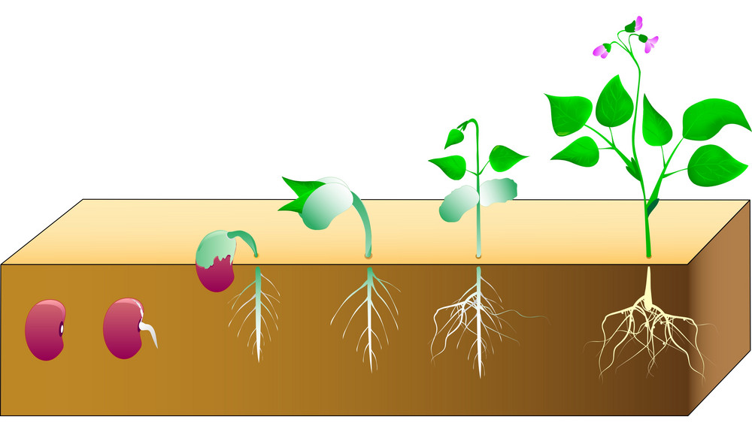
Research Questions
How much do different kinds of water affect plant growth?

Slide 4
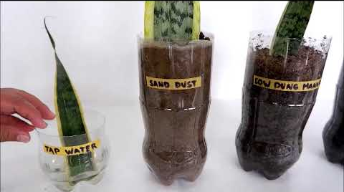
Introduction
We are interested in exploring this question because we want to know how much the different types of water can affect the plant growth.

Slide 5
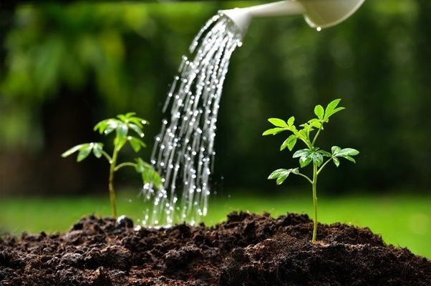
Predictions
We thought the water that had animal droppings would make the plants grow the most.

Slide 6

Methods of Data Collection
We didn’t get a chance to do our investigation because we had to move to distance learning.

Slide 7

Conclusions and Future Work
We are still wondering how much different kinds of water affect plant growth. Maybe we can do this investigation in the future.

