Slide 1




How does dissolved oxygen affect the temperature of pond water in Mashapaug Pond?
Jolade Oshinkanlu
Ms. Goewey
11th Grade
Dr. Jorge Alvarez High School
This project connects to GLOBE hydrosphere in the protocol/s water quality
How does dissolved oxygen affect the temperature of pond water in Mashapaug Pond?
By Jolade Oshinkanlu
Ms. Goewey
Dr. Jorge Alvarez High School

Slide 2
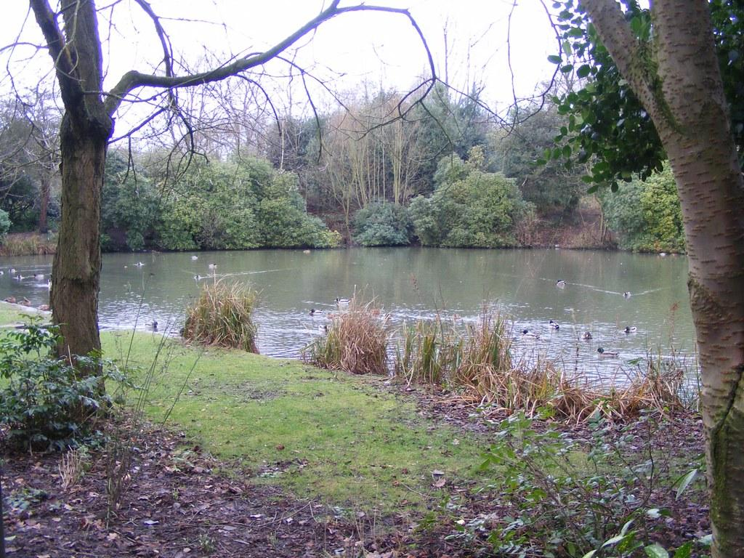
Mashapaug Pond

Slide 3
Background
What do you know about the Mashapaug pond site?
The Mashapaug pond was once healthy and clean until people started dumping waste, garbage, industrial chemicals, animal waste and other pollutants which went into the soil and water and caused the pond to be very harmful and dirty. Because of this, not only human health were endangered but also animal health too. The Mashapaug Pond was not looked at until last century because people thought what they were doing won’t affect or cause harm. Now they are taking actions in filtering the air, building school, and making sure the conditions at the pond don't get worse.
How does your variable affect the quality of the pond?
My variable affects the quality of the pond and plays a big role in many ways for example, if the temperature is low, the dissolved oxygen is low which suffocates and kills animals in the pond like fish. Another example is that, when water temperature is cold, it holds more dissolved oxygen which leads to more oxygen and aquatic life needs less oxygen at this time.

Slide 4
Materials and Procedures
Procedure:
First the dissolved oxygen meter was turned on and faced upside down until me and my group came back from the pond
Second we went to the pond, filled the pond water in the three bottles, and made sure the water was at the top so no air would escape.
After that, we went back to the lab and wrote down the time we left to the pond and if the pond was floody, or dry e.t.c
Then each of the group members would put the dissolved oxygen meter in each of the bottles while the others record when the number is stable/remains the same for a while.
Lastly, we added up the three numbers that was taken and divided by 3 to get the average.
Materials:
3 Bottles
Dissolved Oxygen Meter
Lab book
Pen
calculator

Slide 5
Data
1 | 7.56
2 | 7.7
5 | 5.1
5 | 6.13
5 | 7.23
5 | 9.23
6.3 | 7.8
7 | 9.5
7.7 | 6.5
8.5 | 10.3
11 | 5.1
12.3 | 4.6
13 | 4.73
13 | 5
15 | 4.3
21 | 4.23
Water Temp | DO

Slide 6
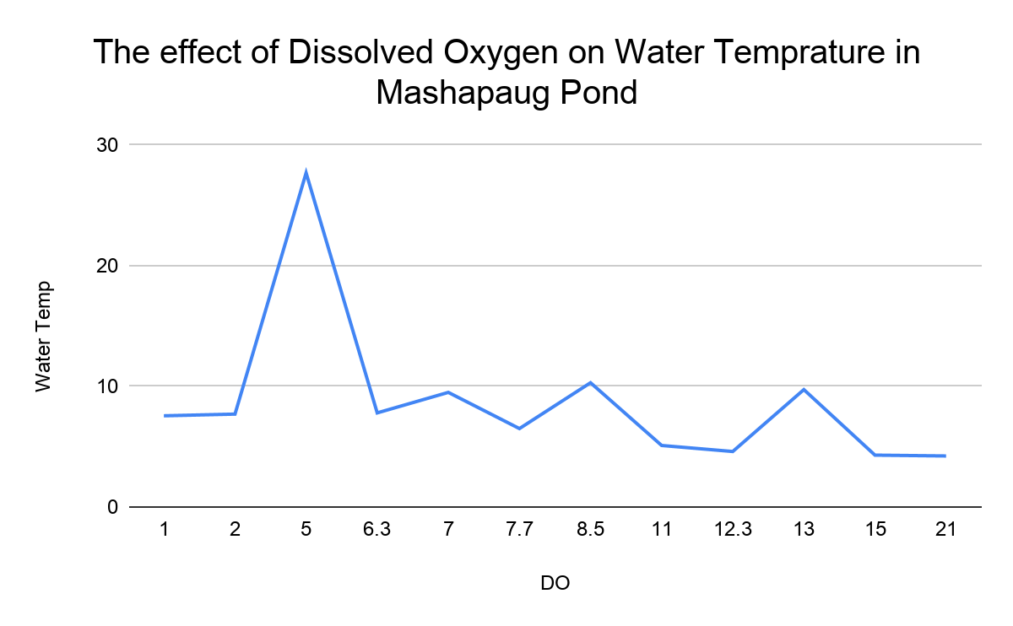
Graph

Slide 7
Analysis
Summary of what the data shows as it relates to the research question:
The graph shows the effect of dissolved oxygen on water temperature by telling us that when the temperature is low, the dissolved oxygen is low but when it is high, the dissolved oxygen rises which is how it affects the Mashapaug Pond.
Any unexpected data points:
My graph was going up for a while in a constant way but it suddenly went up high when the water temperature increased. This shows that when the temperature of the water increases, the dissolved oxygen increases too.

Slide 8
Conclusion
What does the result tell us about the pond? The results tell us that only when temperature increase, dissolved oxygen increase which causes pond fish to be more active from my research and when they use up all the oxygen, it causes the fish to die. Also, when the dissolved oxygen is low the fishes will die/animals from lack of dissolved oxygen.
What can be done as a community to improve the quality of the pond?
From my research, we can reduce nutrients in the pond to remove the virus in the pond called, Cyanobacteria so it doesn’t cause toxic conditions for humans, animals, and plants. The form of Cyanobacteria was caused by Stormwater runoff which causes algal blooms in urban, fresh water ponds by picking up pet waste and fertilizers from lawns and landscaping and carrying them into storm drains that empty in urban ponds. If we can also take actions by cleaning wastes like garbage and animal waste from going into the pond, filtering the air and maintaining good hygiene in our surroundings, it can remove Cyanobacteria and make the pond healthy once again..

