Slide 1

Atmosphere
By- Isiah, Chris, Alex, Jadrian

Slide 2
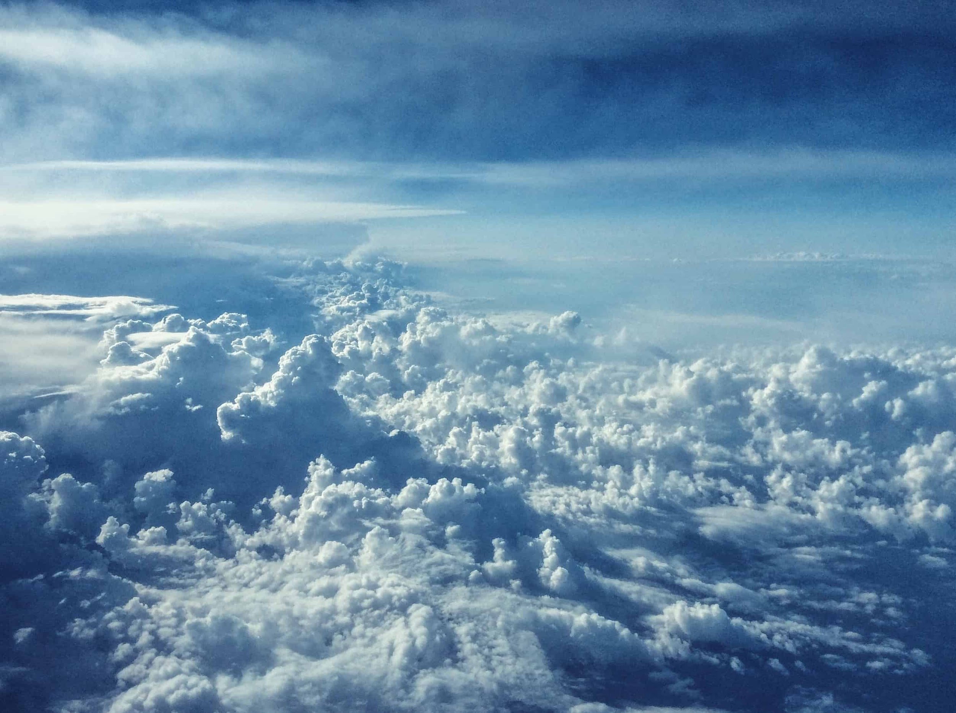
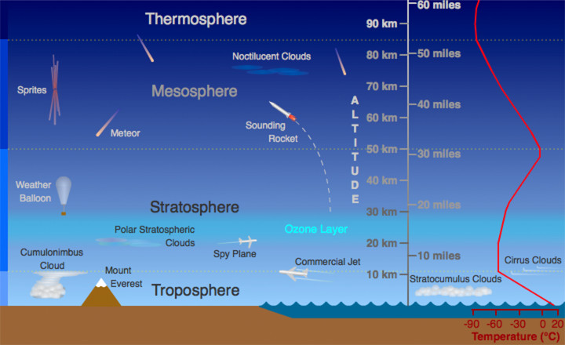
What is the atmosphere?
The Atmosphere is a gas that helps us survive by breathing in its oxygen and it can blow stuff around with its winds. It surrounds Earth with its gases.

Slide 3
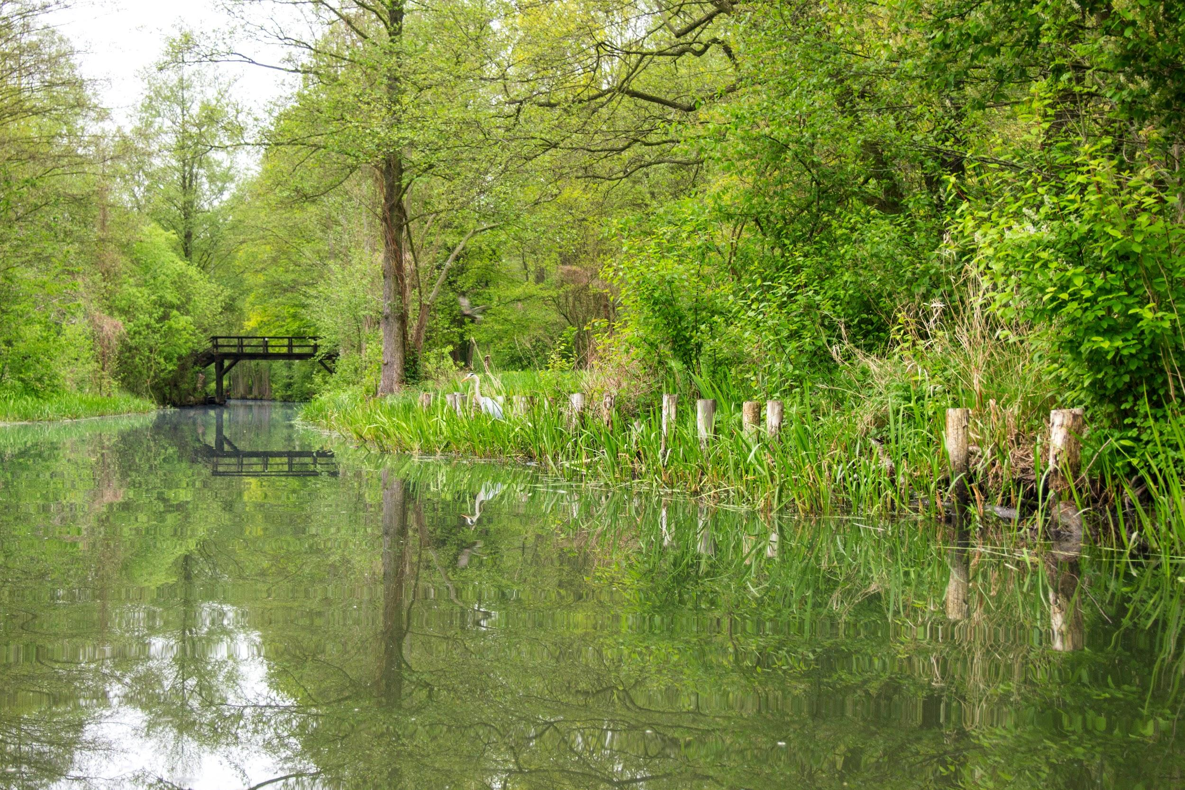
How does the Atmosphere interact with the Biosphere?
The Biosphere interacts with the Atmosphere because it allows living things to survive by providing them with oxygen. Living plants can take the carbon dioxide out of the Atmosphere and put in more oxygen.

Slide 4
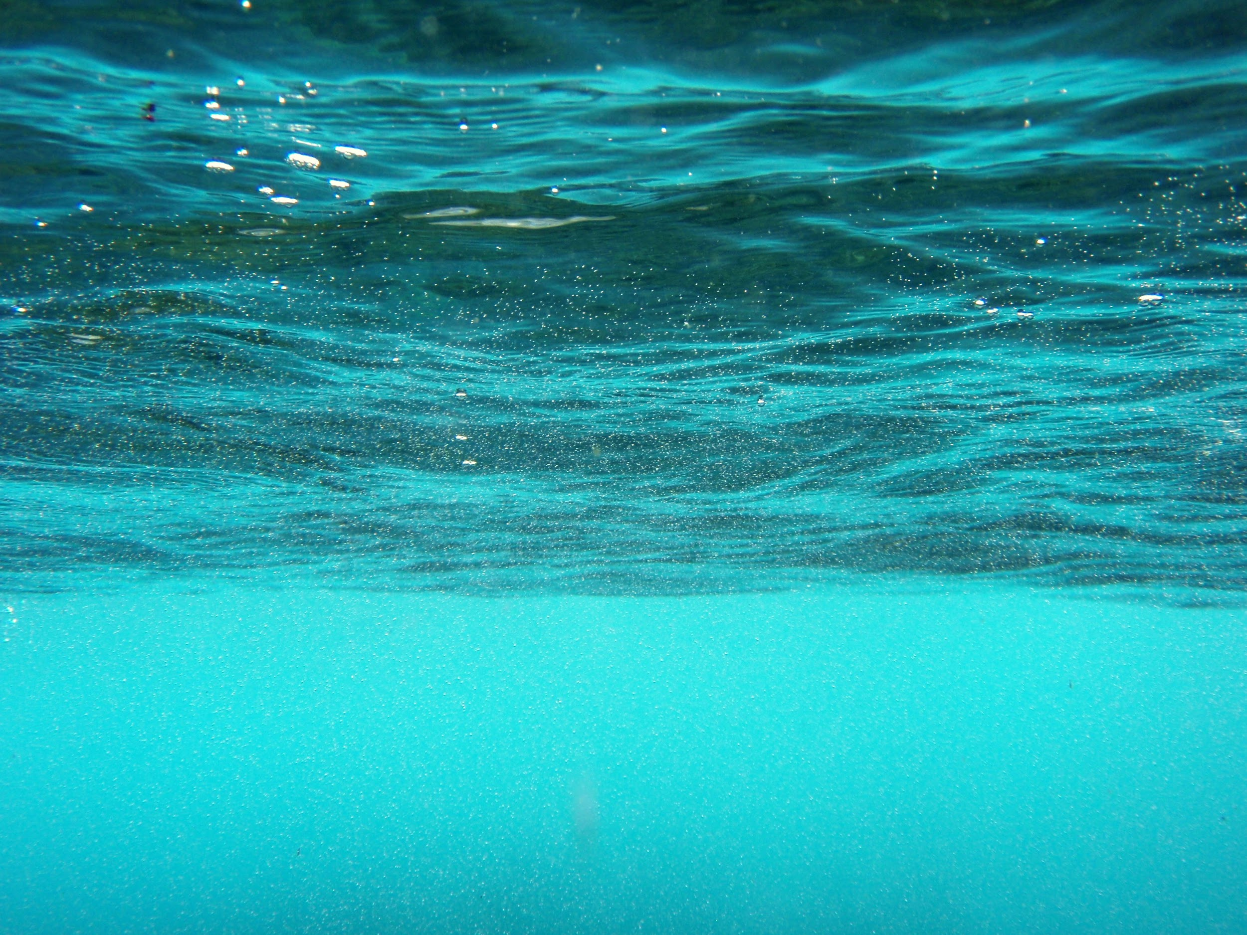
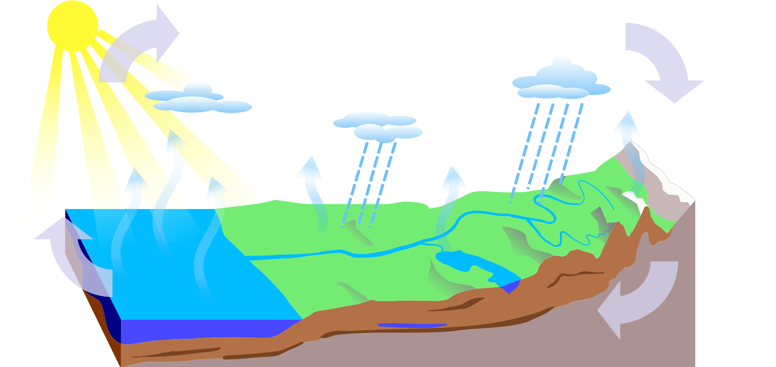
How does the Atmosphere affect the Hydrosphere
The Hydrosphere interacts with the Atmosphere by it influences the climate,and it can trigger logical geological processes.

Slide 5
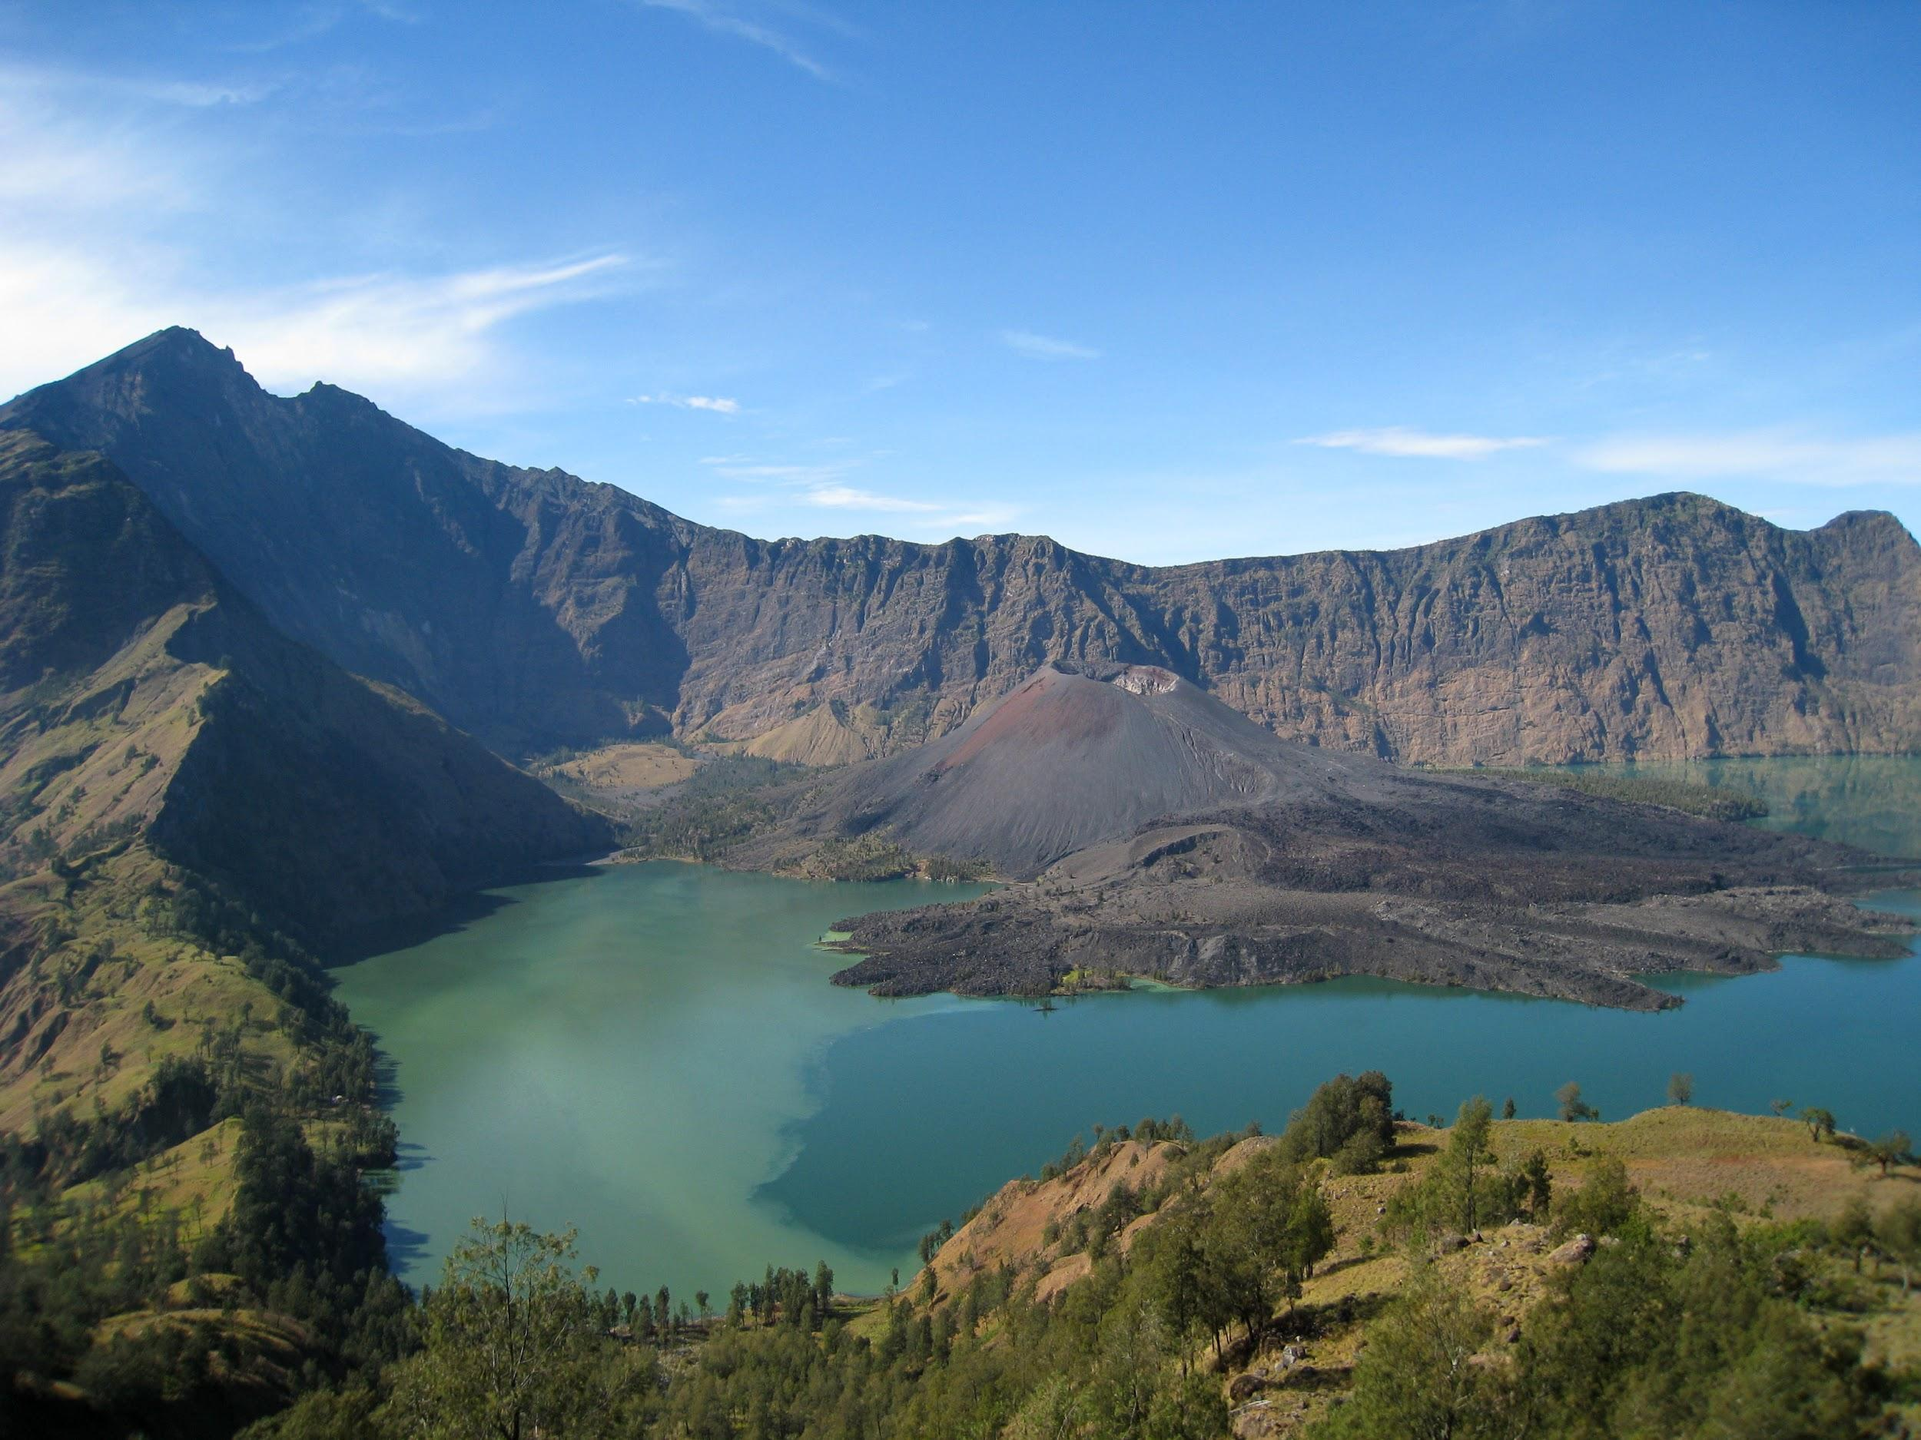
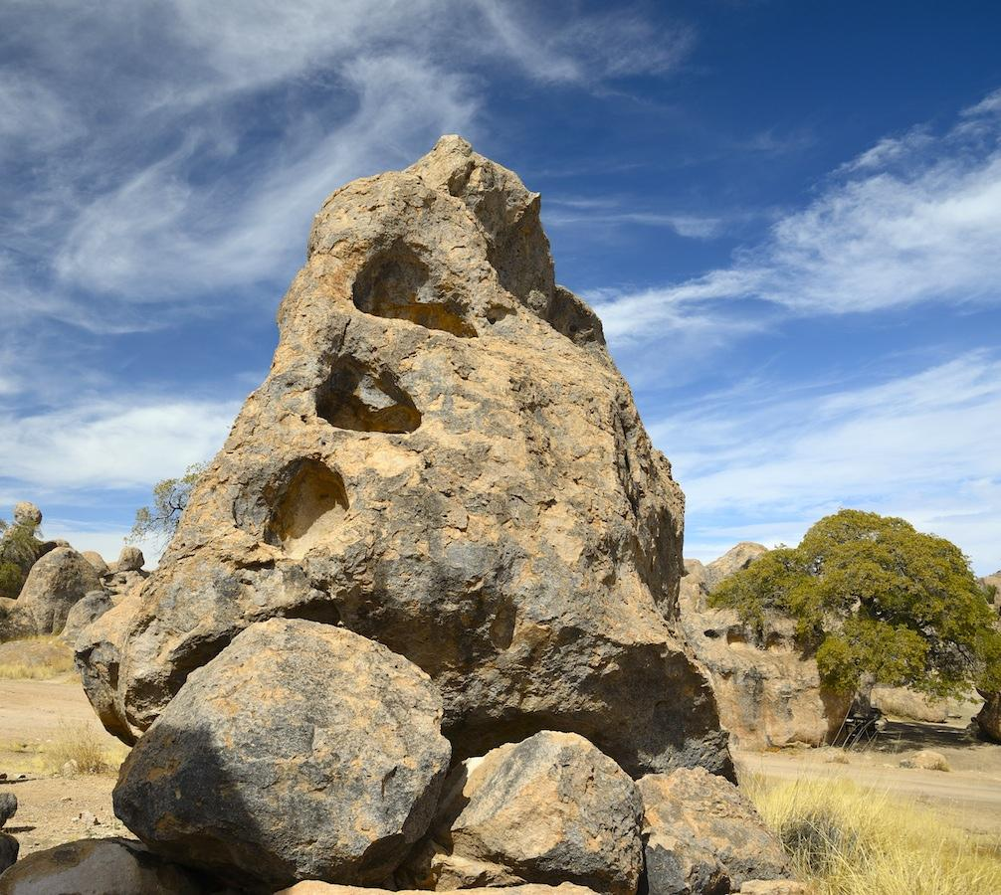
How the Atmosphere affects the Geosphere
The Atmosphere above the desert can push the sand around and cause erosion through wind and rain. It can receive poisonous gases and ash clouds from exploding volcanoes or forest fires caused by lightning.

Slide 6
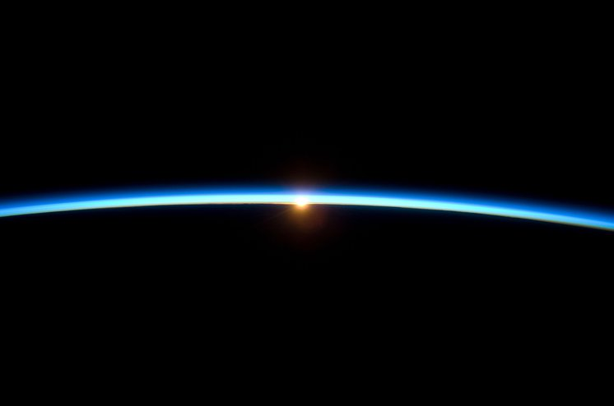
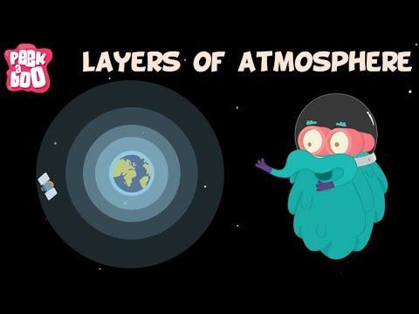
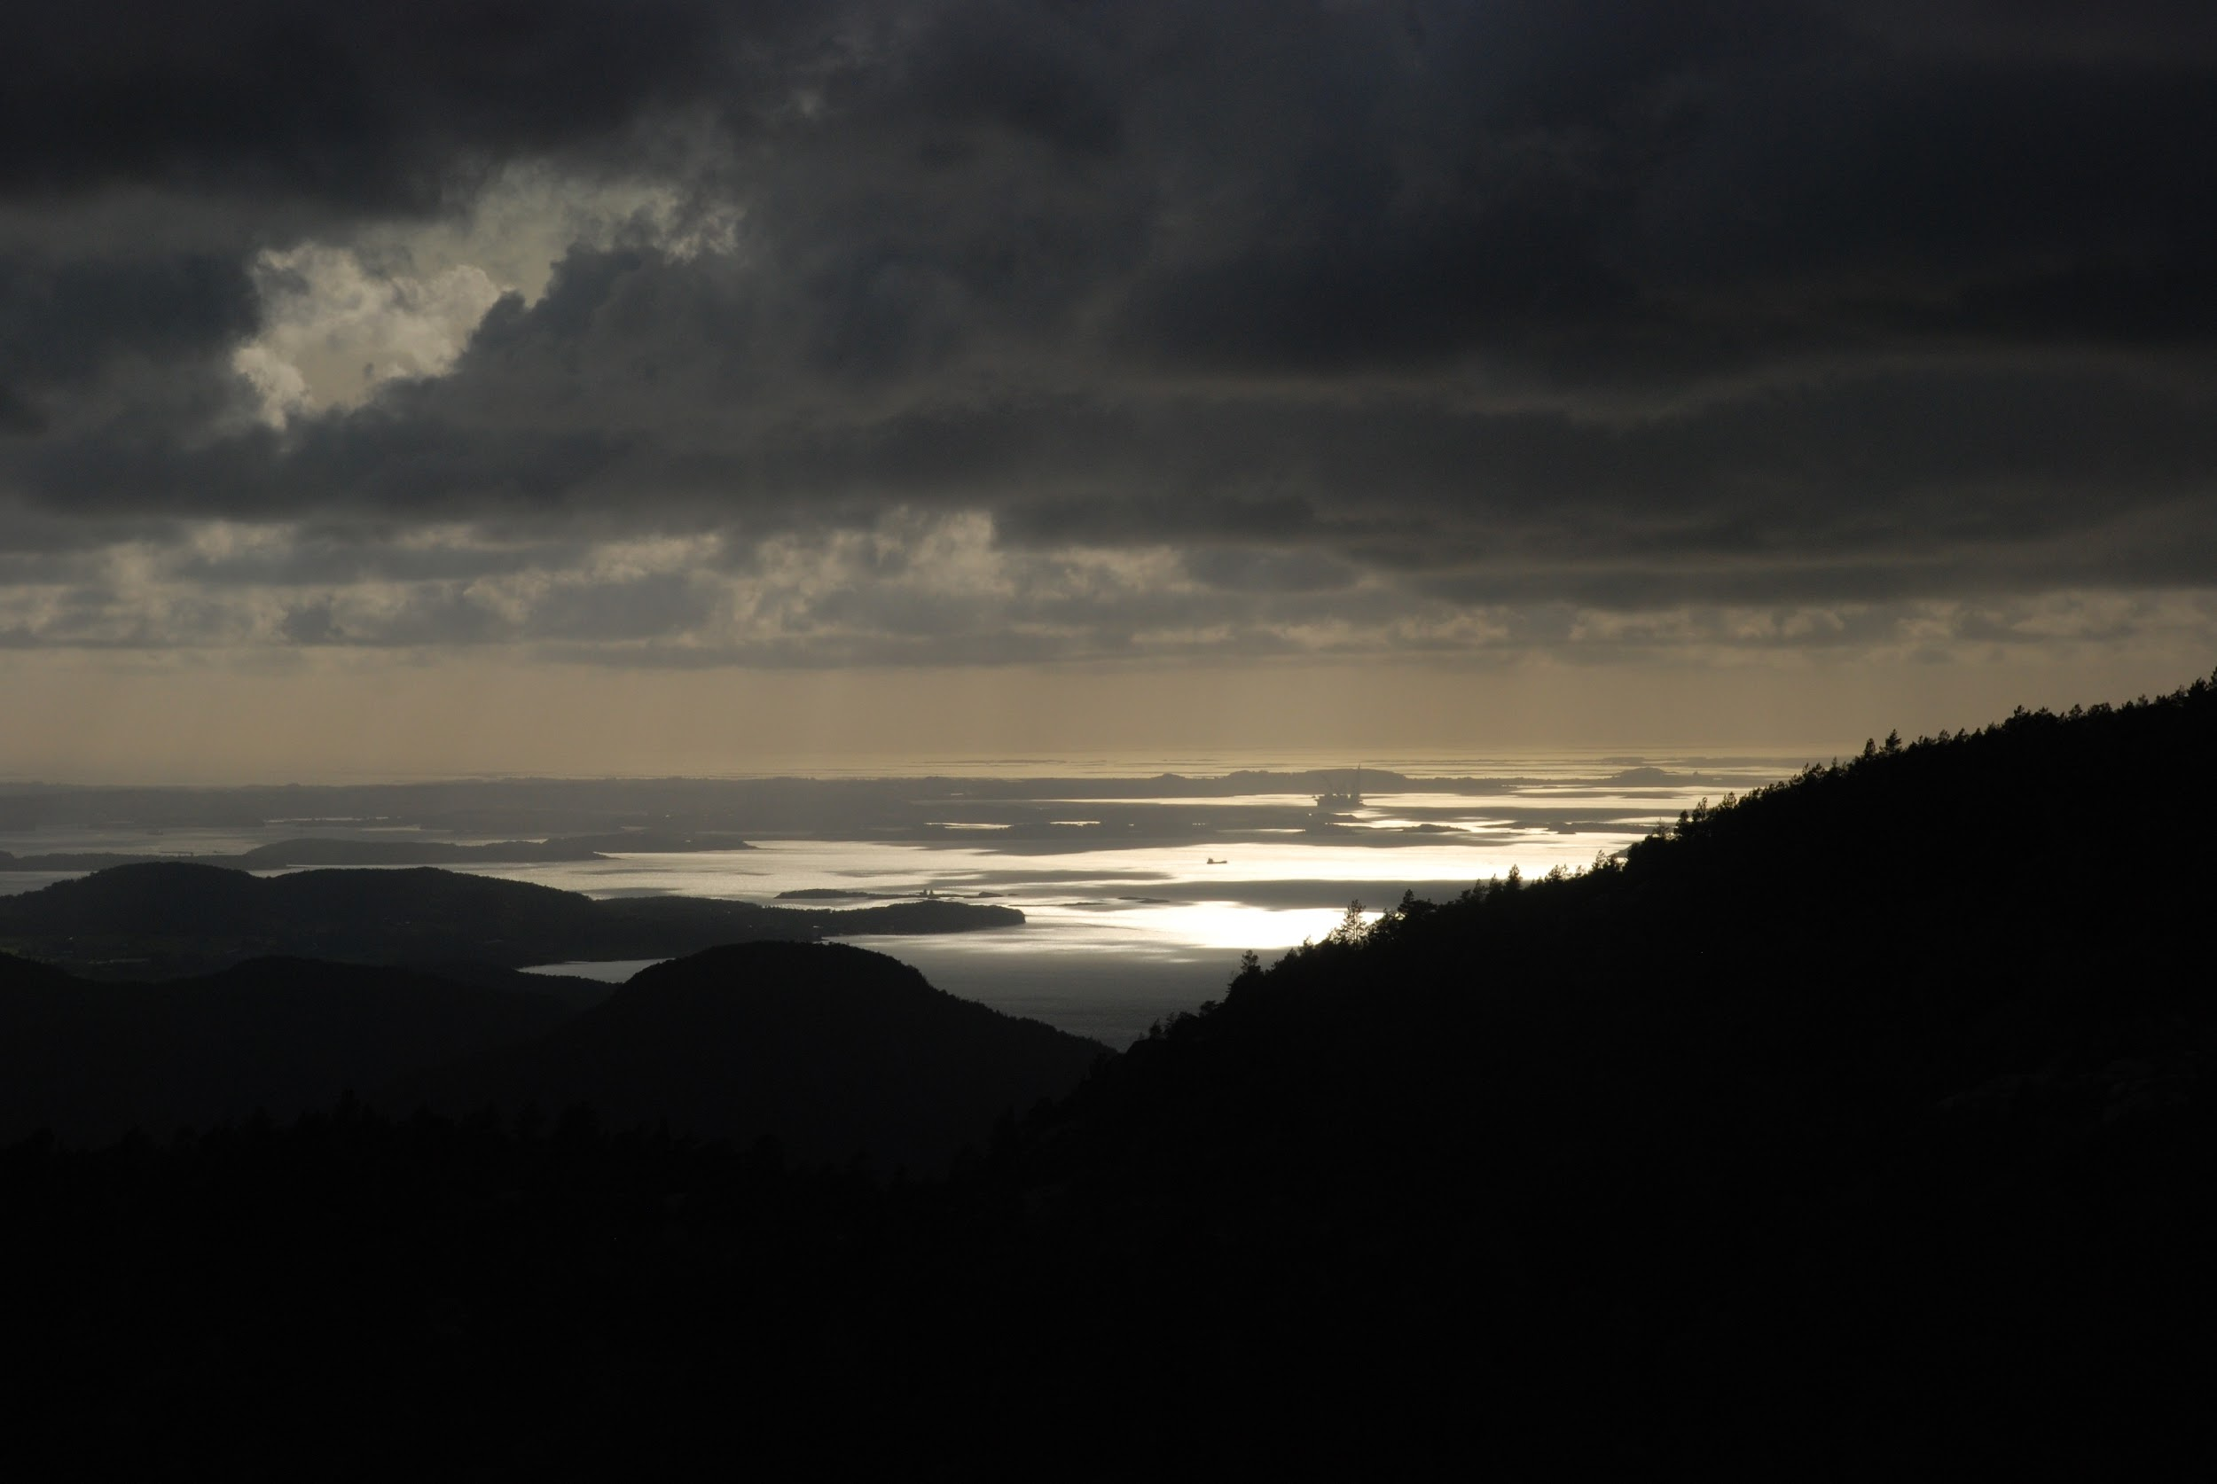
End credits:
Jaydrian
Christopher
Isiah
Alexander

