Slide 1
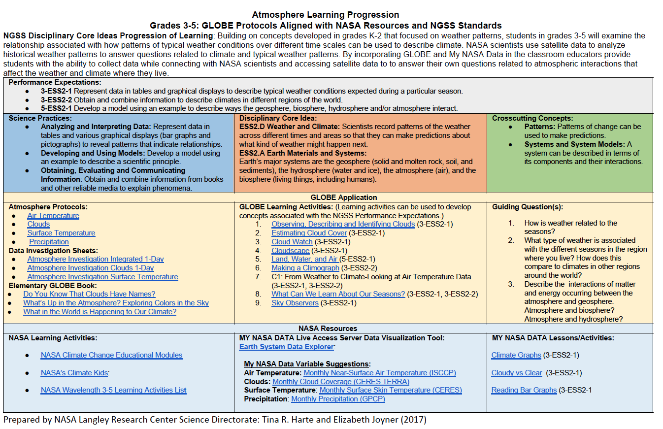
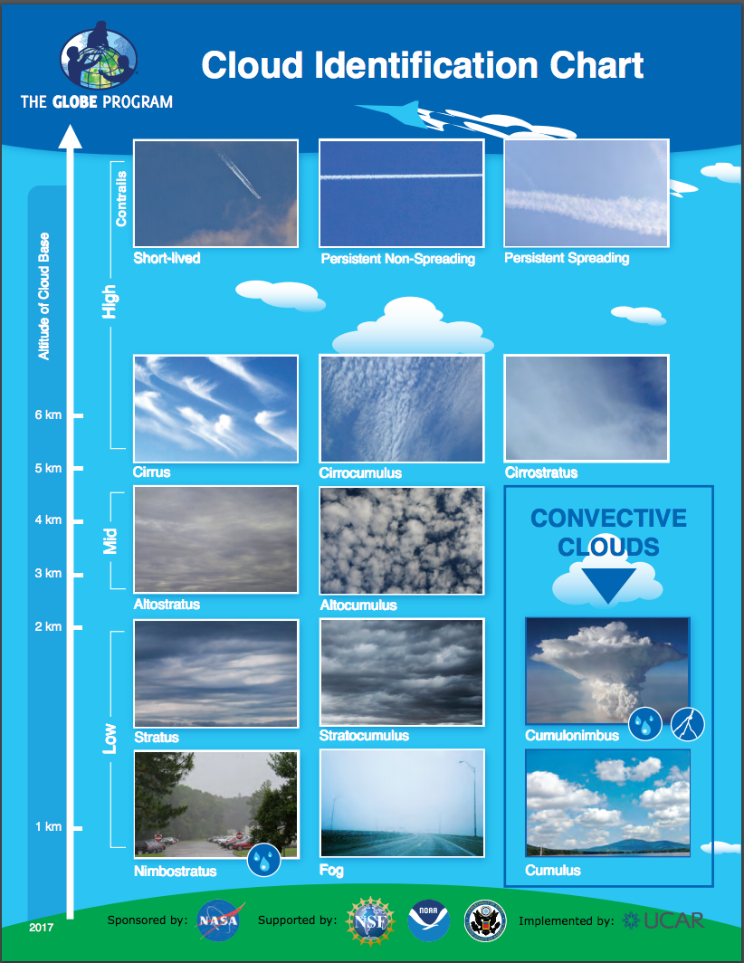
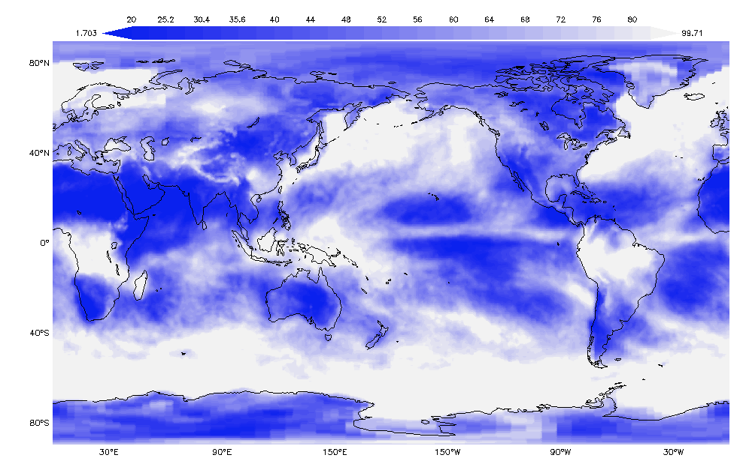
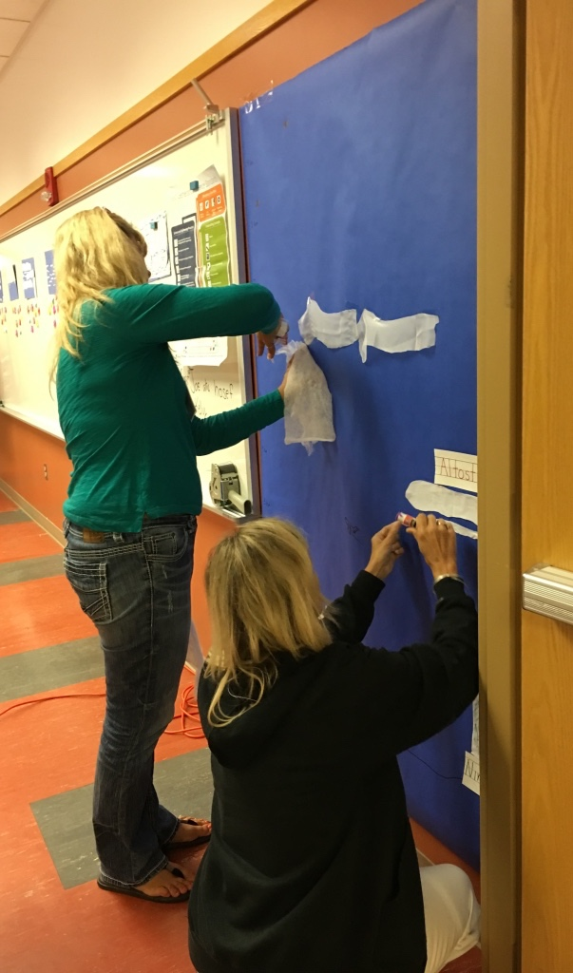
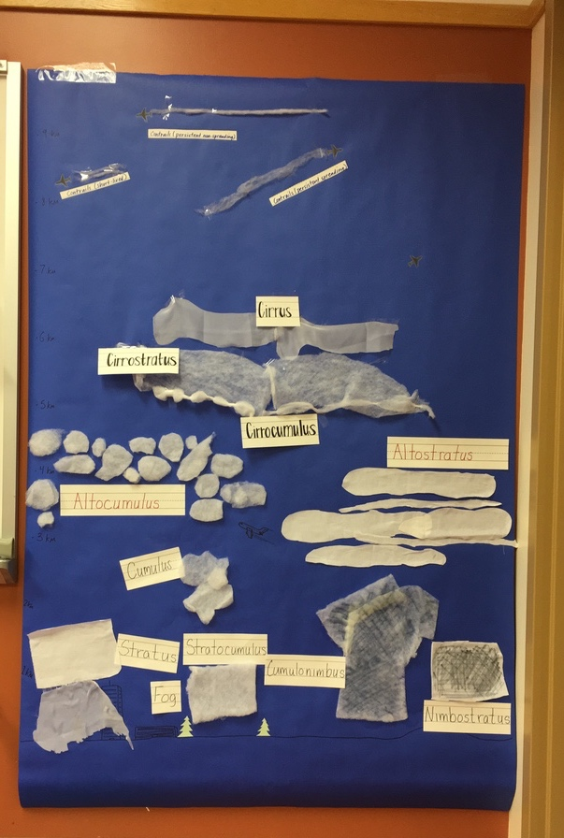
Implementing 3DLearning with NASA/GLOBE Earth System Learning Progressions
Mission Earth Partners with NASA
Janet Struble (janet.struble2@UToledo.Edu)
Tina R Harte (tina.r.harte@nasa.gov)

Slide 2
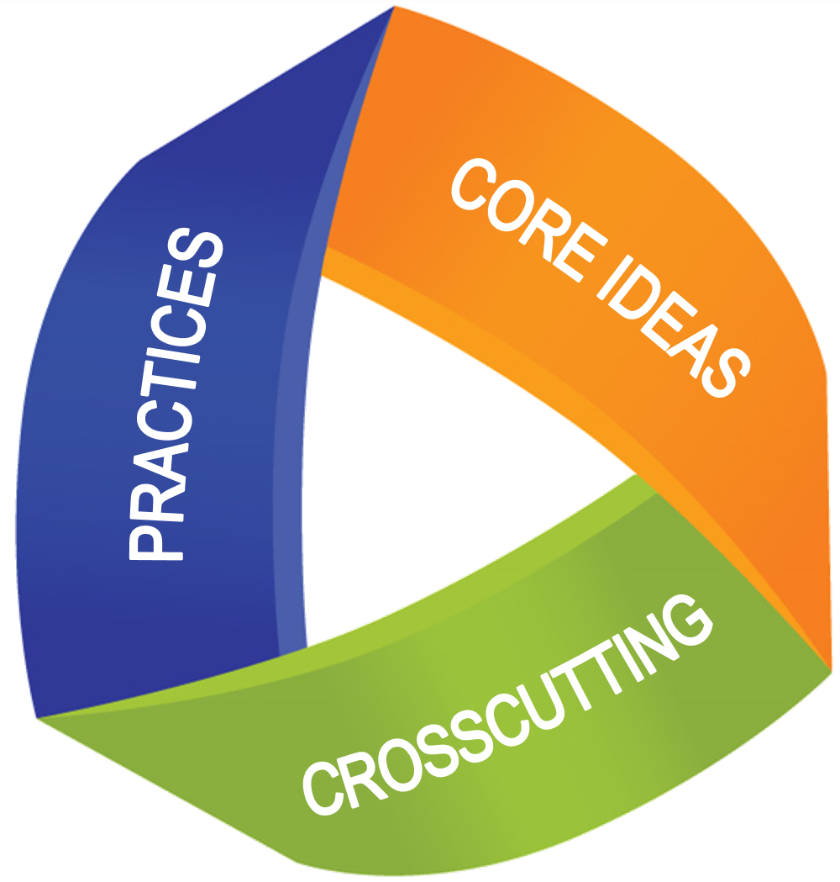
3D Learning
Dimension 1: Practices
The practices are the behaviors that scientists engage in as they conduct their investigations and explore real world problems. The practices are the actions involved in “doing” science.
Dimension 2: Cross-cutting concepts
The cross-cutting concepts are the linking of science content across topics, that help students make connections.
Dimension 3: Disciplinary Core ideas
The disciplinary core ideas guide the curriculum by focusing on what is the most important in each of the four domains of science, the “big” ideas of science.
Notes:
Janet

Slide 3
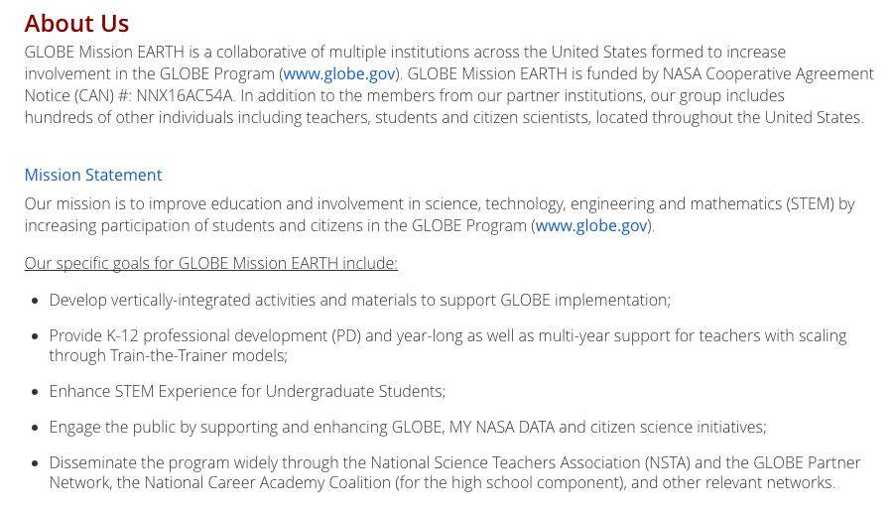
Notes:
Janet

Slide 4
The Components of the Learning Progressions
Notes:
(Tina)

Slide 5
Atmosphere Learning Progression
1
2
3
Components of the Learning Progression:
Disciplinary Core Ideas Progression of Learning
Performance Expectations
3D Perspective: Science Practices, Disciplinary Core Ideas, and Crosscutting Concepts
Notes:
(Tina) The alignment began by looking at the Disciplinary Core Ideas progression of learning, identifying the performance expectations and then looking at the 3Dimensions of learning. Once we identified these components we worked to develop guiding questions aligning them with GLOBE Protocols and Learning Activities. We then identified NASA Educational resources that would further the develop learning opportunities.

Slide 6
Atmosphere Progression of Learning:
Students in K-2 explore weather as the combination of sunlight, wind, snow or rain, and temperature in a particular region and time. They learn to record weather patterns to learn more about the interactions that occur within our Earth system. (Elements of weather)
Students in grades 3-5 will examine the relationship associated with how patterns of typical weather conditions over different time scales can be used to describe climate. (Patterns of Typical Weather)
Students in grades 6-8 will examine how complex interactions determine local weather patterns and influence climate including the role of the ocean. (Patterns Associated with Climate)
Students in 9-12 will examine the relationship between the Sun’s radiation and tis interactions with the Earth system, in particular the atmosphere, recognizing the ocean and land as the foundation of the global system. (Interactions of Earth systems)
Notes:
How does the content develop as students progress from each grade level? Tina

Slide 7
Notes:
Tina

Slide 8
GLOBE Alignment:
Notes:
Janet

Slide 9
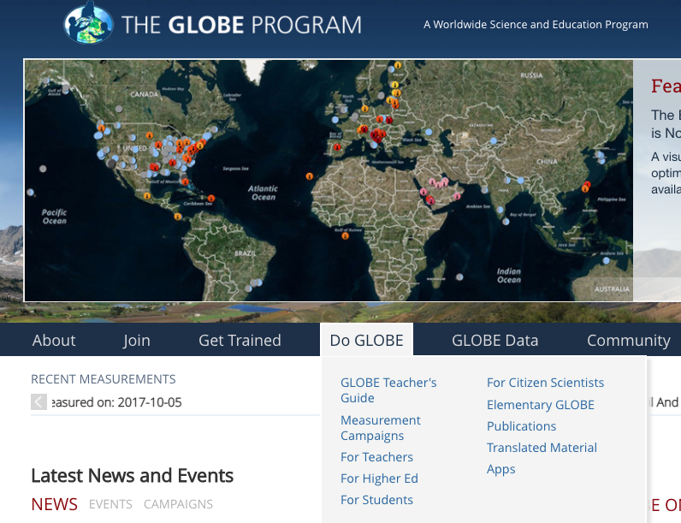
Notes:
Janet

Slide 10
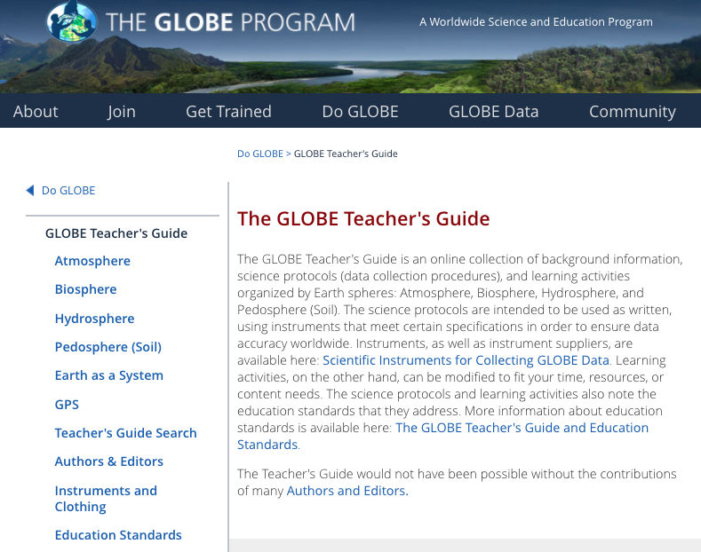
GLOBE Website
Notes:
Website/Sphere (Janet)

Slide 11
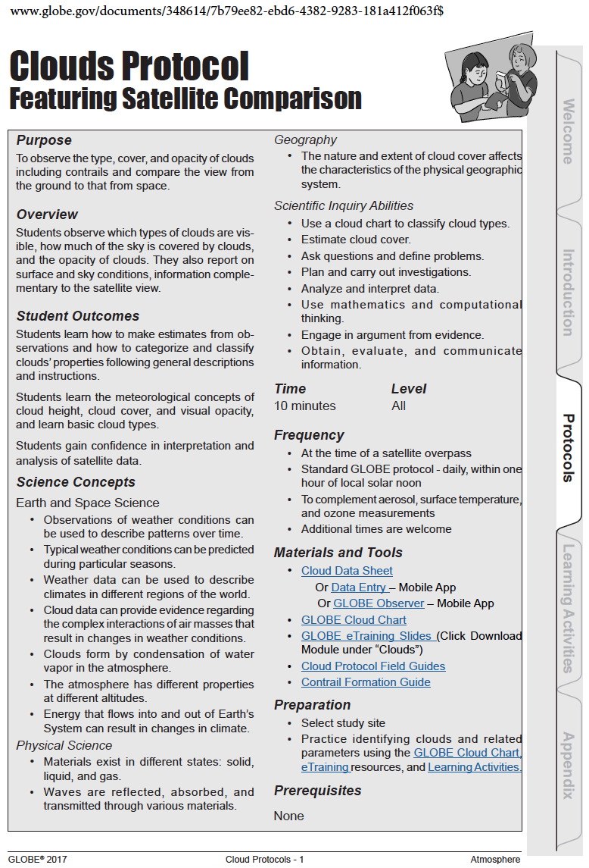
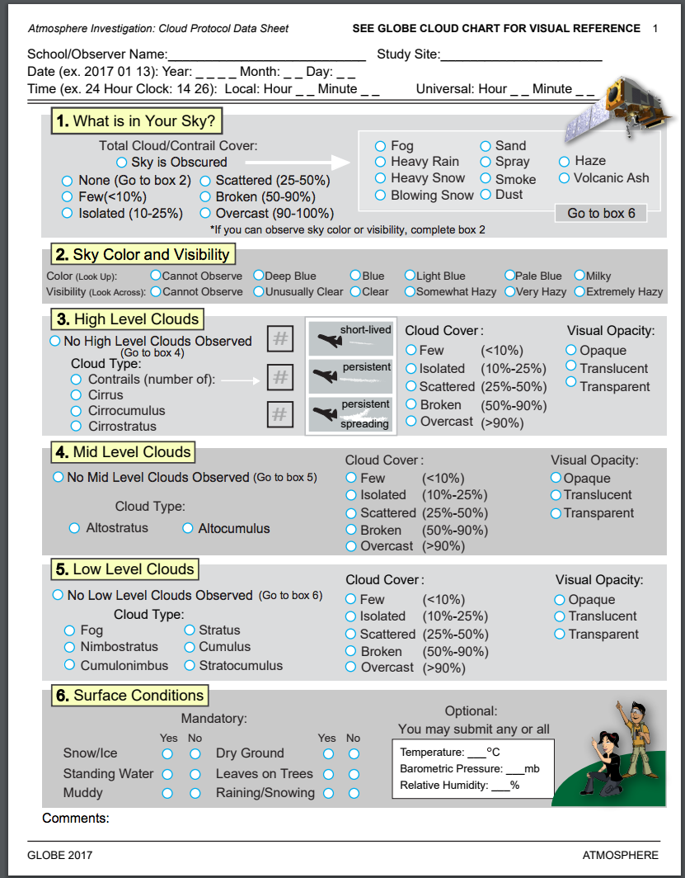
GLOBE Cloud Protocol and Data Collection
GLOBE Cloud Protocol and Cloud Observation
Notes:
Example of Protocol and data collection sheet (Janet)

Slide 12
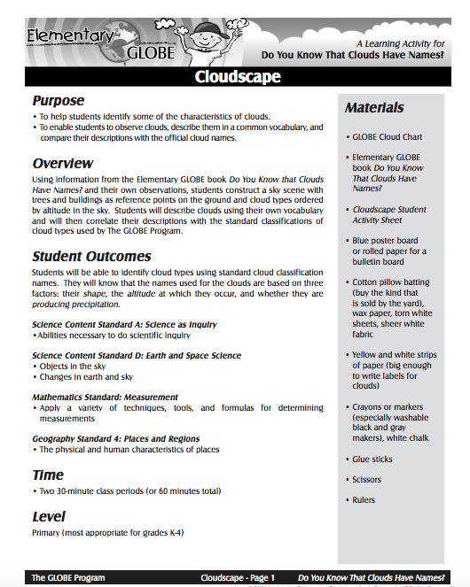
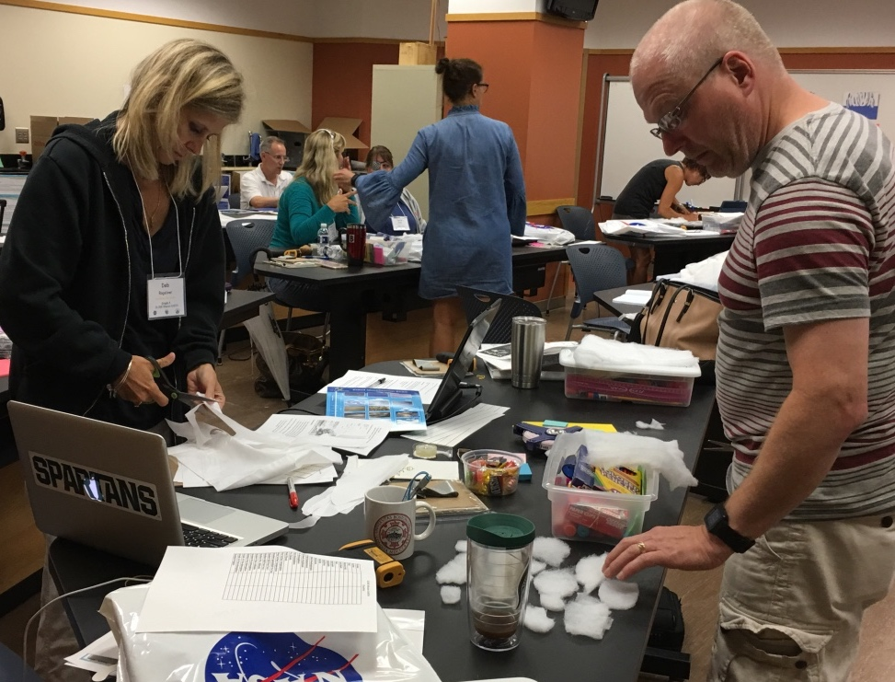
Cloudscape Learning Activity:
Notes:
(Janet)

Slide 13
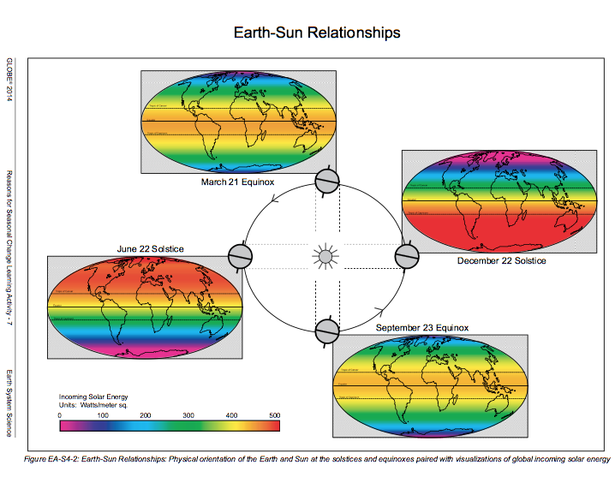
Notes:
Taken from the Reason for the Seasonal Change GLOBE Learning Activity (Grades 6-8) (Janet)

Slide 14
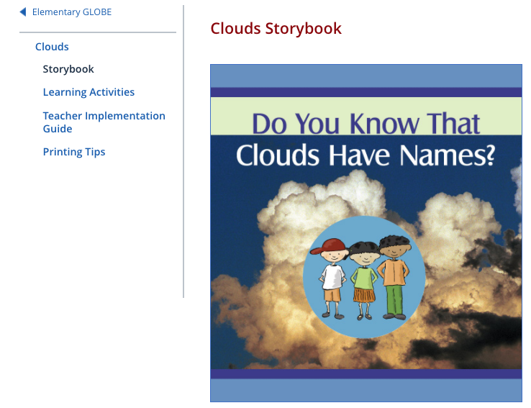
Notes:
(Janet)

Slide 15
Guiding Questions
How is weather related to the seasons?
What type of weather is associated with the different seasons in the region where you live? How does this compare to climates in other regions around the world?
Describe the interactions of matter and energy occurring between the atmosphere and geosphere. Atmosphere and biosphere? Atmosphere and hydrosphere?
Notes:
Guiding questions are based on the NGSS Performance Expectations (Janet)

Slide 16
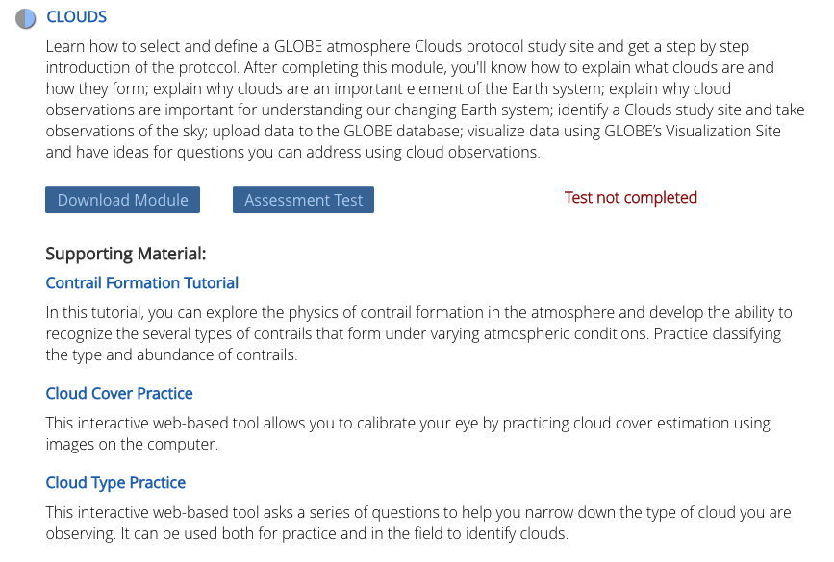
eTraining:
https://www.globe.gov/get-trained/protocol-etraining/etraining-modules/16867642/12267
Notes:
There are also resources available to develop content background and to become certified in the GLOBE Protocols. In order to enter data online, teachers need to become certified in the protocols that they wish to implement. In the past, this was only done through face-to-face training; but now it is possible through eTraining. (Janet)

Slide 17
Aligned with NASA Resources:
Notes:
(Tina)

Slide 18
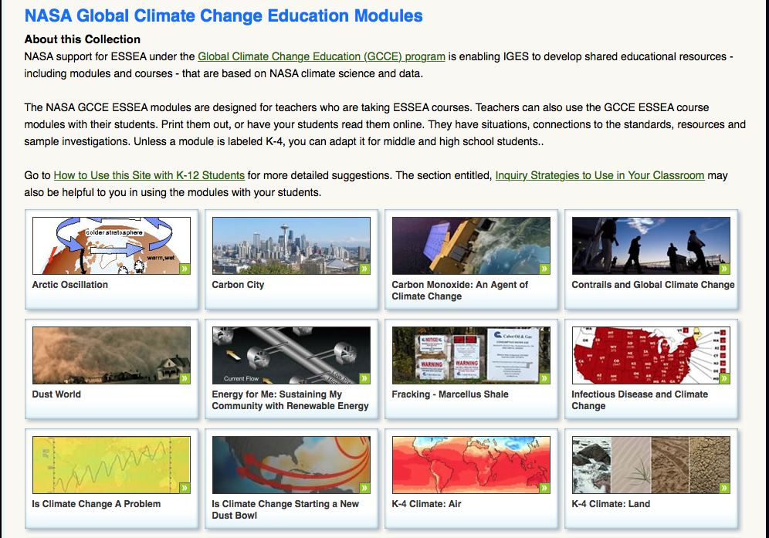
http://esseacourses.strategies.org/module.nasa.html
Notes:
(Tina)

Slide 19
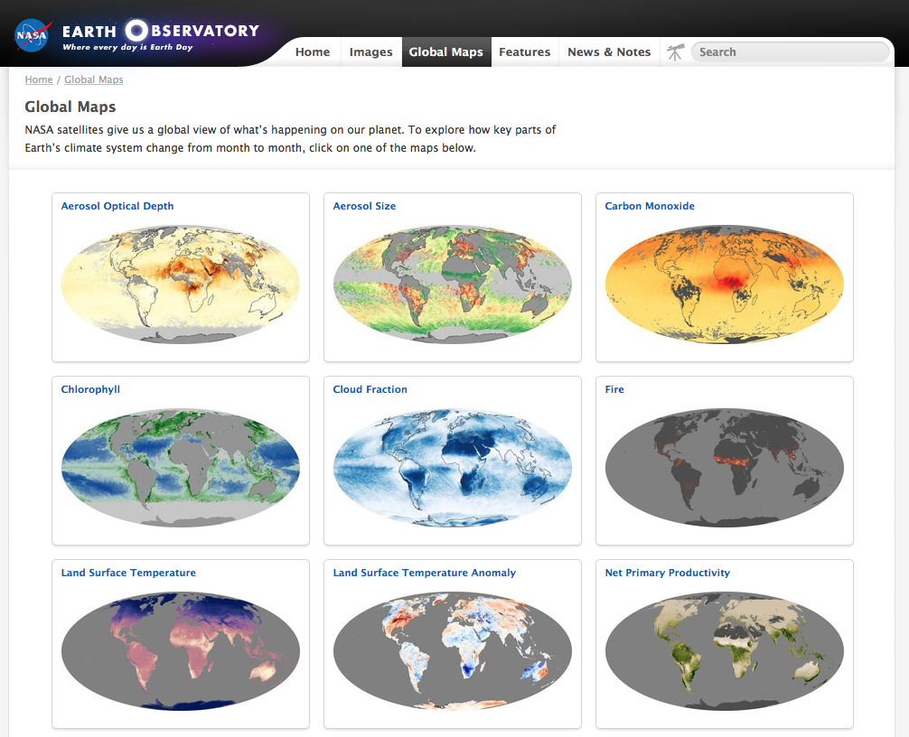
https://earthobservatory.nasa.gov/GlobalMaps/?eocn=topnav&eoci=globalmaps
Notes:
(Tina)

Slide 20
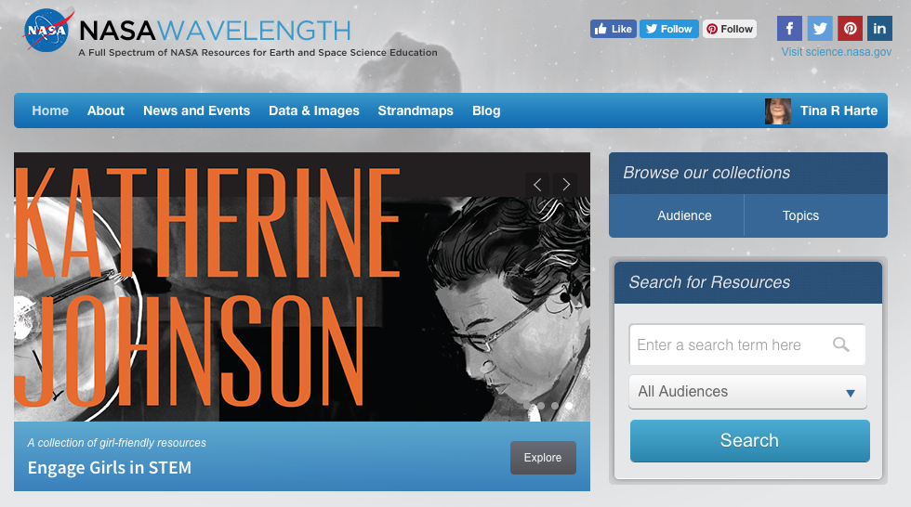
NASA Wavelength Lists:
Notes:
There is a NASA Wavelength list that has been created for each grade band. These lists include a variety of grade appropriate resources that have been aligned with the GLOBE Atmosphere Protocols and NGSS Performance Expectations. (Tina)

Slide 21
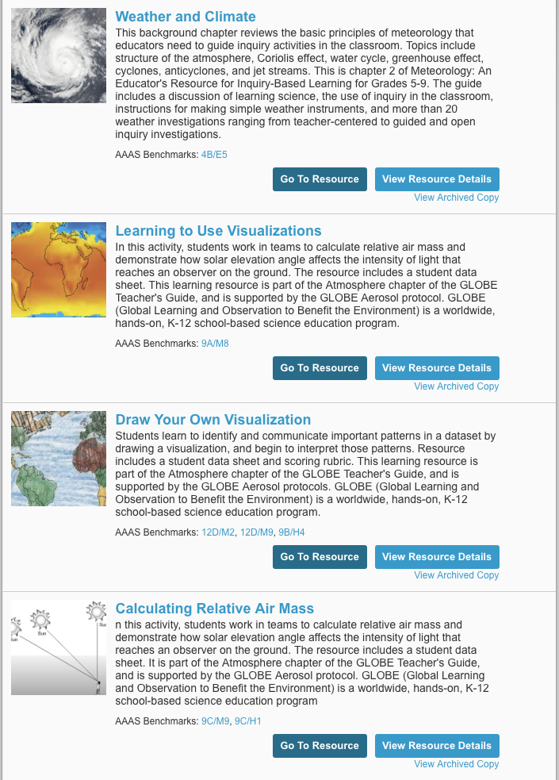
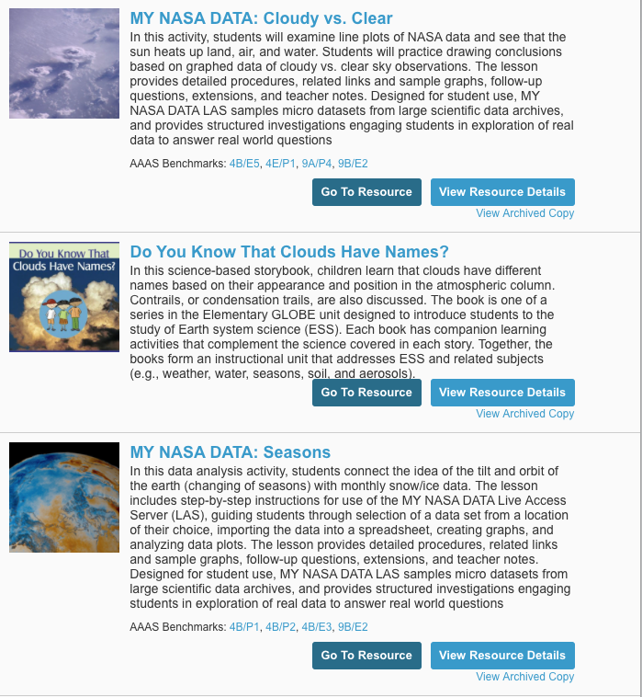
NASA Wavelength
Notes:
Section of NASA Wavelength list on the left (3-5) and the section on the right (6-8) (Tina)

Slide 22
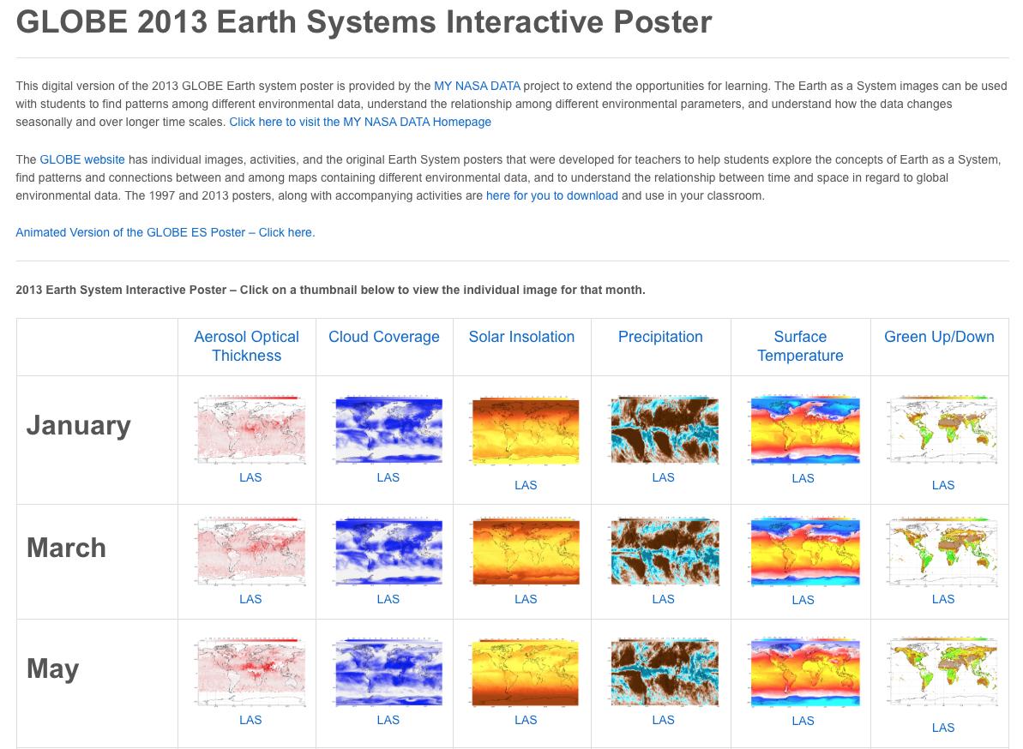
https://mynasadata.larc.nasa.gov/globe/globe-2013-earth-systems-interactive-poster/
Notes:
(Tina) The goal and purpose behind the interactive poster . . . Provide teachers and students with a resource to begin the process of data analysis and acquisition of data analysis skills, in addition to the animations of data from 2013 there is a card set option for teachers with limited internet capabilities in their classroom. We will have demos of these at the NESTA share-a-thon tomorrow from 12:30 to 1:30 in Hilton Baltimore (Holiday 6)

Slide 23
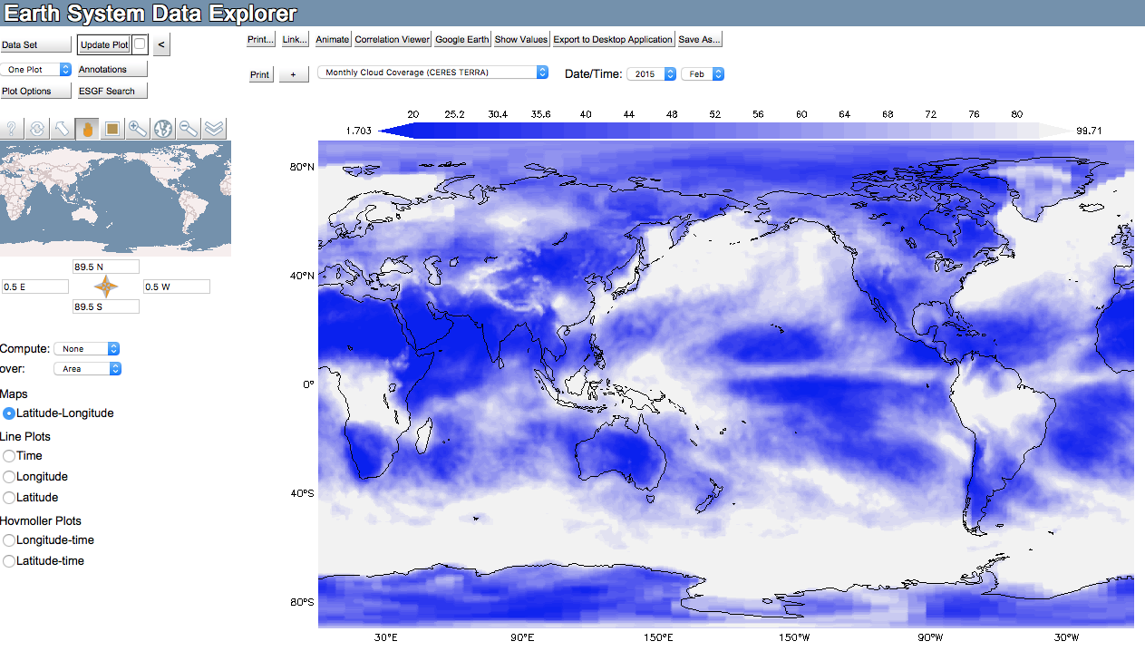
Accessing NASA Data Using My NASA Data
https://mynasadata.larc.nasa.gov/EarthSystemLAS/UI.vm
Notes:
(Tina) Three main items for selecting data sets using My NASA Data

Slide 24
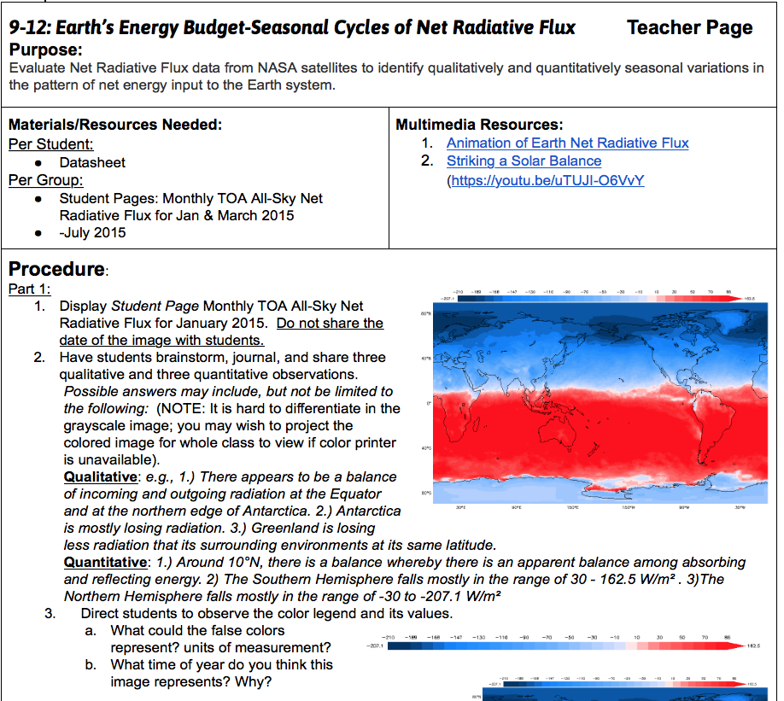
Notes:
(Elizabeth) The process of lesson revisions

Slide 25
Notes:
The Hydrosphere Learning progression has been developed, it is going through edits at this point. (Tina)

Slide 26
Hydrosphere Progression of Learning:
Students in K-2 explore how wind and water change the shape of land, water is found in many types of places and in different forms on Earth, and that living things need water resources from the land which influences where they live.
Students in grades 3-5 will examine how rainfall helps to shape the land, affects the types of living things found in a region, the role that water plays in breaking rocks, soil and sediments into smaller pieces, and discover that most of Earth’s water is in the ocean, while much of Earth’s freshwater is found underground and in glaciers.
Students in grades 6-8 will examine how water cycles among land, ocean, and atmosphere and is propelled by sunlight and gravity. They will explore the density variations of seawater that drive interconnected ocean currents and how the movement of water causes weathering and erosion resulting in changes to landscape.
Students in 9-12 will explore how the planet’s dynamics are greatly influenced by water’s unique chemical and physical properties, how resource availability has guided the development of human society, how the use of natural resources has associated costs, risks, and benefits and how natural hazards and other geological events have shaped the course of human history at local, regional and global scales.
Notes:
The Hydrosphere learning progression . . .

Slide 27
Mission Earth
Dr. Kevin Czajkowski
GEPL Professor and PI
Kevin.czajkowski@utoledo.edu
Janet Struble
Project Manager
Janet.struble2@utoledo.edu
Website: http://www.globe.gov/web/mission-earth
Email: http://globe.mission.earth@gmail.com
Facebook: www.facebook.com/globemissionearth
Twitter: @globemissionear
YouTube: http:tinyurl.com/globemissionearth

Slide 28
NASA Connection
GLOBE Website: http://www.globe.gov/
NASA Langley Education:
https://www.nasa.gov/langley/education
NASA Langley Research Center: https://www.nasa.gov/langley
Jessica Taylor: jessica.e.taylor@nasa.gov
NASA Langley Science Directorate
GLOBE Partnership
Tina Harte: tina.r.harte@nasa.gov
NASA Langley Science Directorate
Education/Outreach Task Lead

