Slide 1
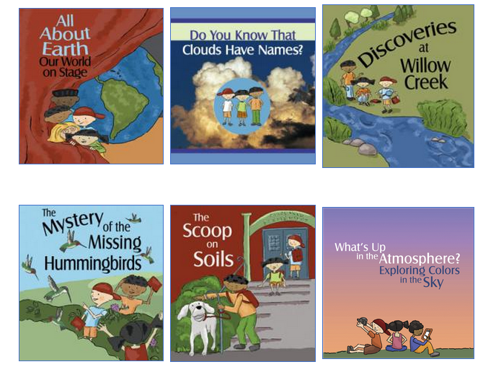
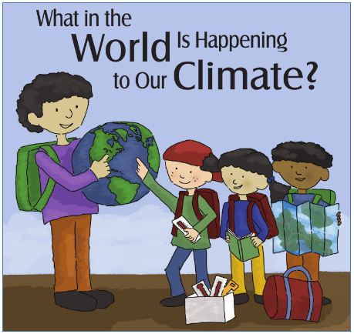
Engaging Students in a
3D Science Literacy Learning Experience
Tina R Harte
Task Lead
NASA Senior Education Specialist
GLOBE Training POC
tina.r.harte@nasa.gov
Elizabeth Joyner
NASA Education Specialist
MY NASA DATA POC
elizabeth.r.joyner@nasa.gov

Slide 2
3D Science Literacy
To be proficient in science students must engage in learning experiences that foster the development of three dimensional (3D) learning.
This can be accomplished by providing them with the “practice” of doing science, the opportunity to make “connections” by linking concepts across the sciences, and by providing them with experiences through which they can make “applications of what they are learning whereby increasing the depth of their scientific understanding.

Slide 3
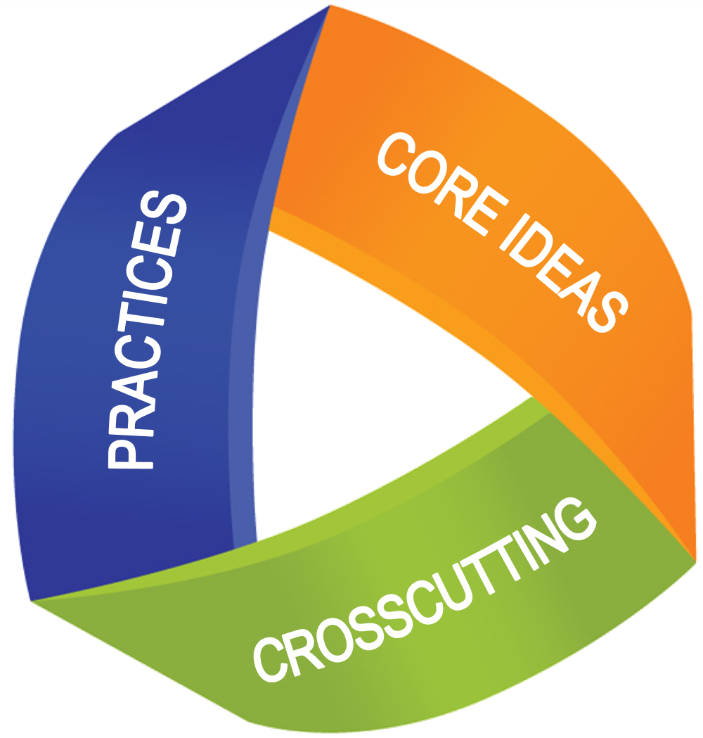
The Specifics of 3D Learning
Dimension 1: Practices
The practices are the behaviors that scientists engage in as they conduct their investigations and explore real world problems. The practices are the actions involved in “doing” science.
Dimension 2: Cross-cutting concepts
The cross-cutting concepts are the linking of science content across topics, that help students make connections.
Dimension 3: Disciplinary Core ideas
The disciplinary core ideas guide the curriculum by focusing on what is the most important in each of the four domains of science, the “big” ideas of science.

Slide 4
How does
Elementary GLOBE engage students in a
3D science literacy experience?

Slide 5
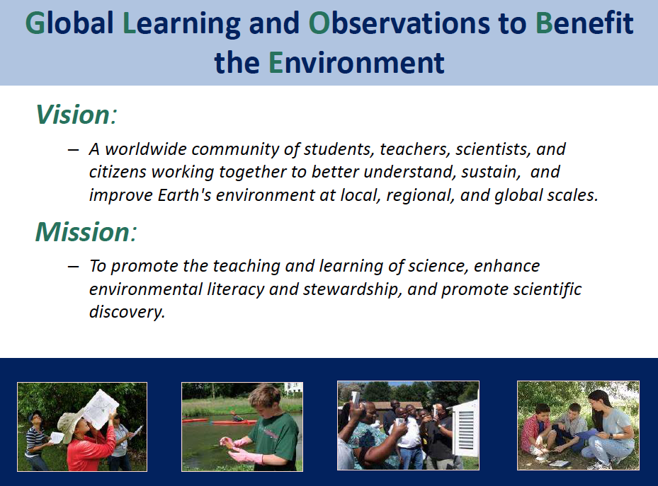
Notes:
Let’s begin by first discussing “What is GLOBE?”

Slide 6
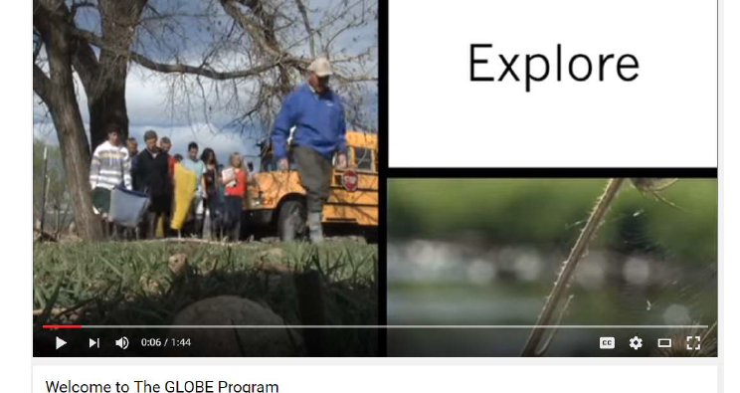
Introduction to GLOBE www.youtube.com/watch?v=bEzdkvwSDn8

Slide 7
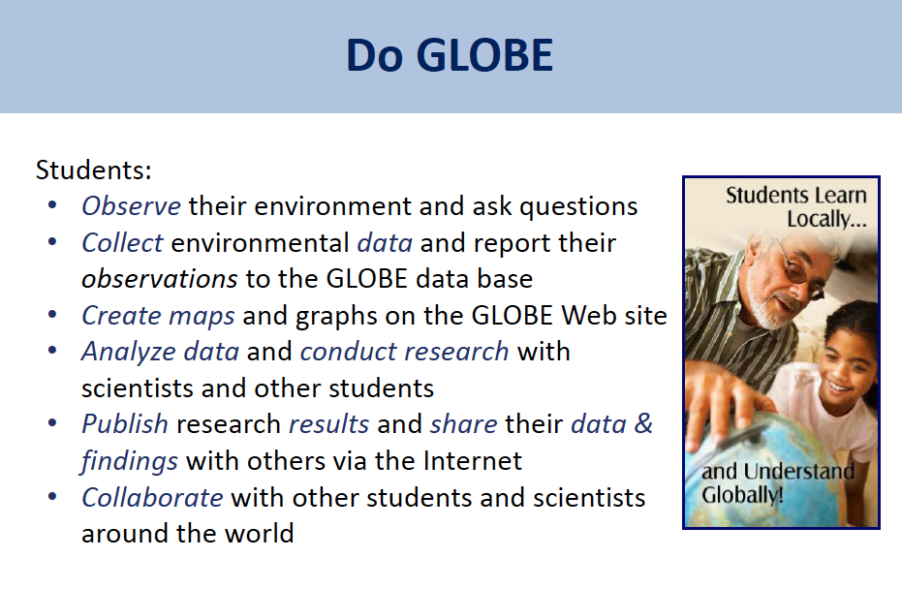

Slide 8
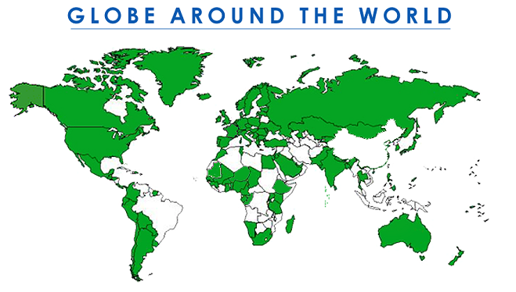
GLOBE
Global Learning and Observations to Benefit the Environment
Began 1995
112 Countries
54,000 Teachers
24,000 Schools
1.5 M Students
22 M Measurements
www.globe.gov
Notes:
Supported by: NASA, NOAA, NSF, and the Dept of State
Announced in 1994, GLOBE began operations on Earth Day 1995. Today, the international GLOBE network has grown to include representatives from 111 participating countries coordinating GLOBE activities that are integrated into their local and regional communities. Due to their efforts, there are more than 54,000 GLOBE-trained teachers representing over 24,000 schools around the world. Over 1.5 million students have participated in GLOBE, contributing more than 22 million measurements to the GLOBE database for use in their inquiry-based science projects.

Slide 9
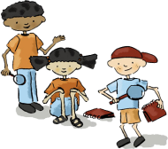
Elementary GLOBE
Elementary GLOBE is designed to enable K-5 teachers to integrate Earth science into their curriculum as they teach students to read and write. It can be used to enhance literacy skills while encouraging scientific exploration and inquiry based learning.
The books
are not intended to
be used as leveled readers,
as they are written at a
5th – 6th grade
reading level.
Join the GLOBE Kids as they explore and investigate the natural world!

Slide 10
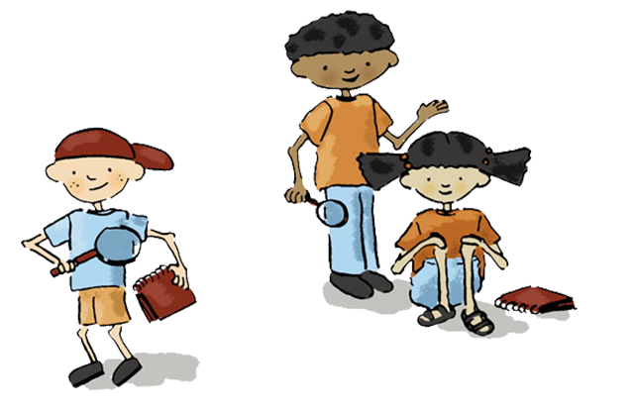
Topics: Elementary GLOBE Storybooks
Climate
Earth Systems
Clouds
Soils
Seasons
Water
Aerosols

Slide 11
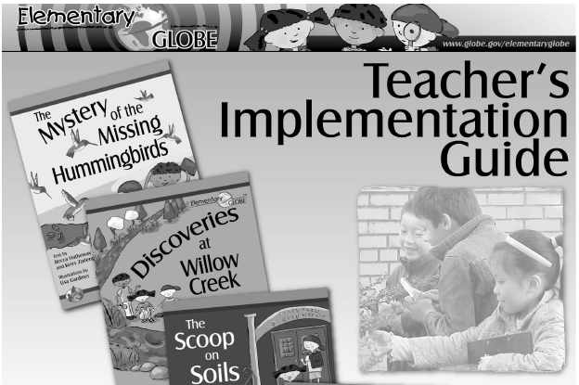
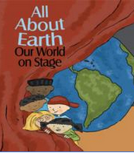
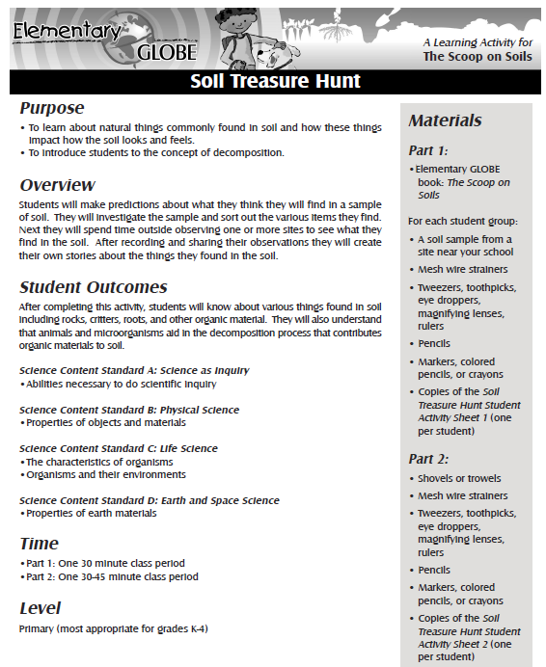
Elementary GLOBE Resources
Teacher Implementation Guide
Storybooks
Learning Activities
All are FREE online – View or Print
Notes:
Materials were piloted in classrooms in the US. Now we say K-6, and even that has a wide range. Implementation will look different for a kindergarten classroom than a 4th grade classroom. Many teachers have told me they use the storybooks into early middle school and particularly with ELL. One thing to keep in mind is that these stories contain quite a bit of scientific information and terms. These are not designed to be read by students in isolation of the teacher…
Going through the teachers guide will help give you some idea for some of the adjustments to make for younger or older students. We’re going to highlight some of the Teachers Guide content.

Slide 12
Available Languages
Elementary GLOBE Books, Activities, and the Teacher’s Guide available in:
Arabic
English
French
German
and Spanish
★ Family Engagement:
Use the Translated Books with ELL Families

Slide 13
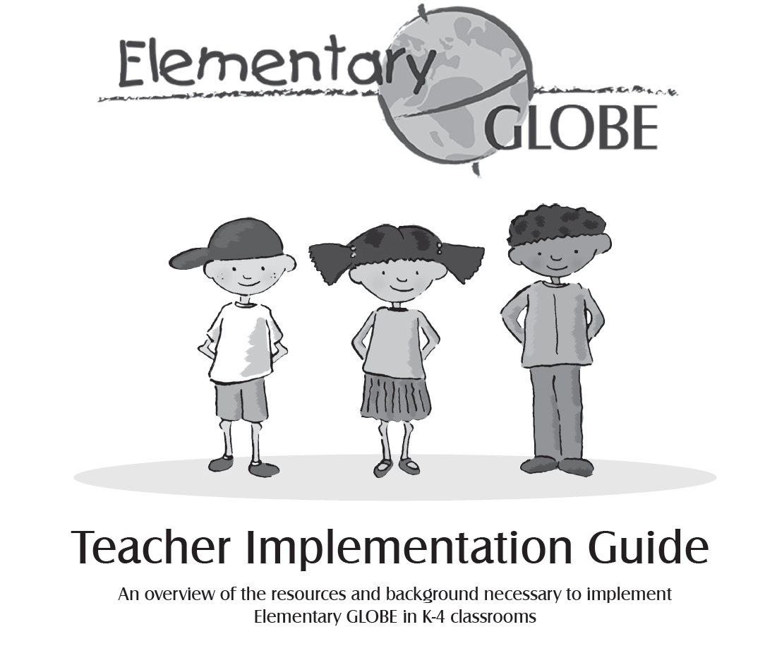

Slide 14
Characters
Each storybook features the “GLOBE Kids” as they explore and investigate the natural world.
These characters, Anita, Simon, and Dennis, have traits that students can relate to when they are reading the books in the Elementary GLOBE series.
The three GLOBE kids have different personalities and strengths, and each brings diverse and valuable skills to their science investigations.

Slide 15
Book Settings
The stories are set in North American ecosystems.
Most of the books aren’t set in a specific location.
The Mystery of the Missing Hummingbirds - Pennsylvania, providing an accurate location for the ruby-throated hummingbird habitat.
What in the World is Happening to Our Climate? Is set in the Boston area before the characters depart on their worldwide adventure.
The soil types in The Scoop on Soils is representative of those found in pine forests, meadows and gardens in the Mid-Atlantic states.

Slide 16
Correlation to Education Standards
The Elementary GLOBE materials have been correlated to:
  Next Generation Science Standards
  National Geography Standards
  Common Core Mathematics
  Common Core English Language Arts.
  Appendix B in the Implementation Guide lists these correlations.

Slide 17
Science and Literacy
Science and literacy in the K-4 classroom complement each other well. The skills that students utilize in an inquiry-based science experience and the skills that students utilize for literacy activities are remarkably similar.
Note details
Compare and Contrast
Predict
Sequence Events
Link cause and effect
Make inferences
Draw conclusions
Distinguish fact/opinions
Link words with precise meanings

Slide 18
Instructional Read-Aloud
Pre-read the book
Highlight vocabulary chosen for instruction
Determine the big idea(s) to emphasize for deeper meaning
Select illustrations for more observation time to enhance the understanding of concepts
Develop open-ended questions that will support discussion toward the understanding of big ideas.
Decide when to engage students in “turn and talk” to support thoughtful discussion
Model your thoughts. For example, using sentences that begin with:
“This part reminds me of when . . .”
“I noticed that . . . “
“I was wondering about _______, but now I understand ________.”
After reading the story, support deeper conversations in the direction of the big ideas by using the learning activities provided.

Slide 19
Literacy Skills: Word Wall
Before reading the Elementary GLOBE Storybooks or working through one of the learning activities with your students, list key vocabulary words on the board, on a piece of chart paper or construct a word wall. As you read the storybooks or learning activities, continue to add to the word wall as you and your students encounter new vocabulary words. Encourage your students to refer to the word wall when they write in their journals.

Slide 20
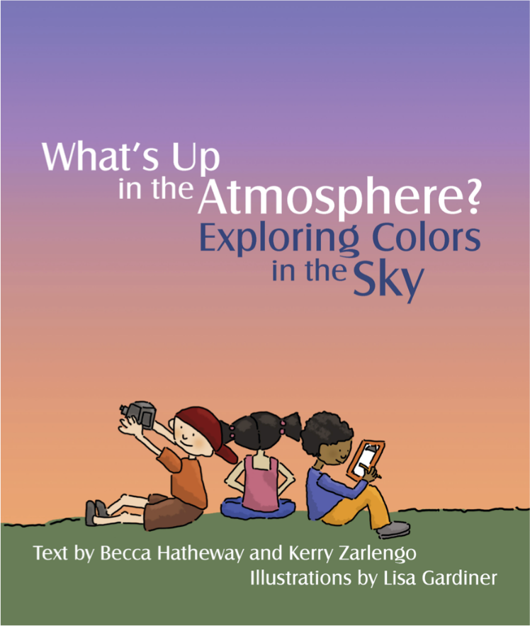
New Sky Color (Aerosols) Storybook
What color is the sky today?
Anita, Simon, and Dennis want to know why the sky isn't always blue. They learn that there's a lot more than air in the atmosphere, which can affect the colors we see in the sky.

Slide 21
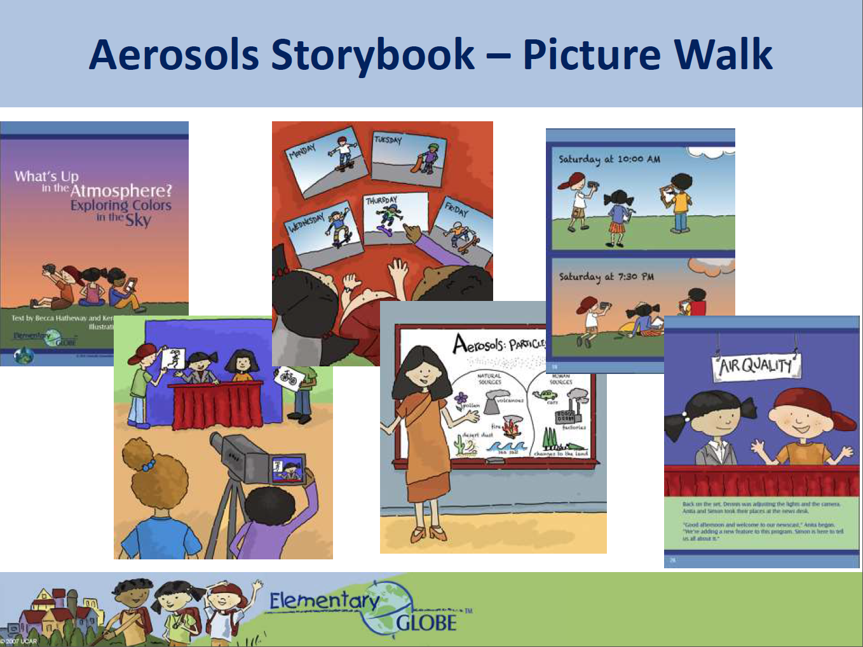

Slide 22
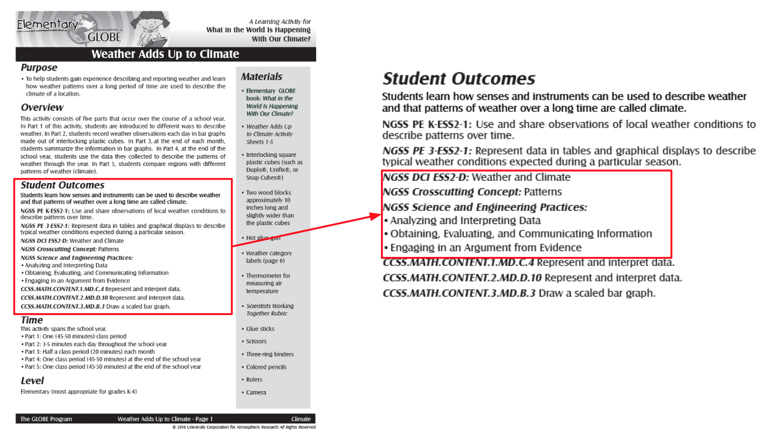
3D Learning Connections

Slide 23
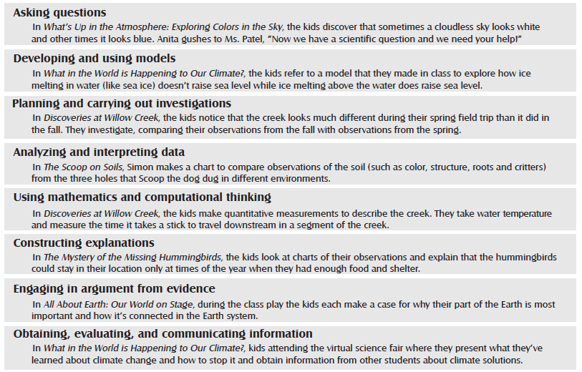
Notes:
Science Practices within the Storybooks

Slide 24
Science Journaling
The GLOBE Kids make frequent use of their science journals in the story books. They write and draw in their journals as they investigate the world around them.
Keeping a science journal provides a place for students to record information and helps them focus their observations.
Student science journals allow for literacy connections in your classroom by encouraging students to write and communicate their thoughts.
Notes:
-

Slide 25
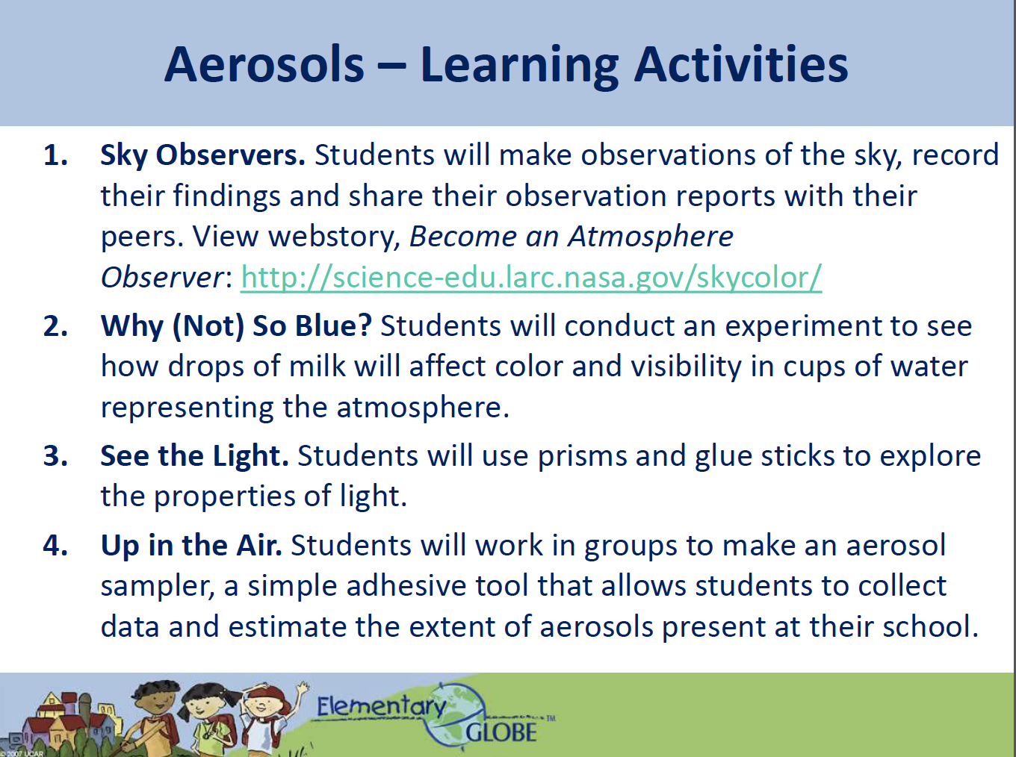

Slide 26
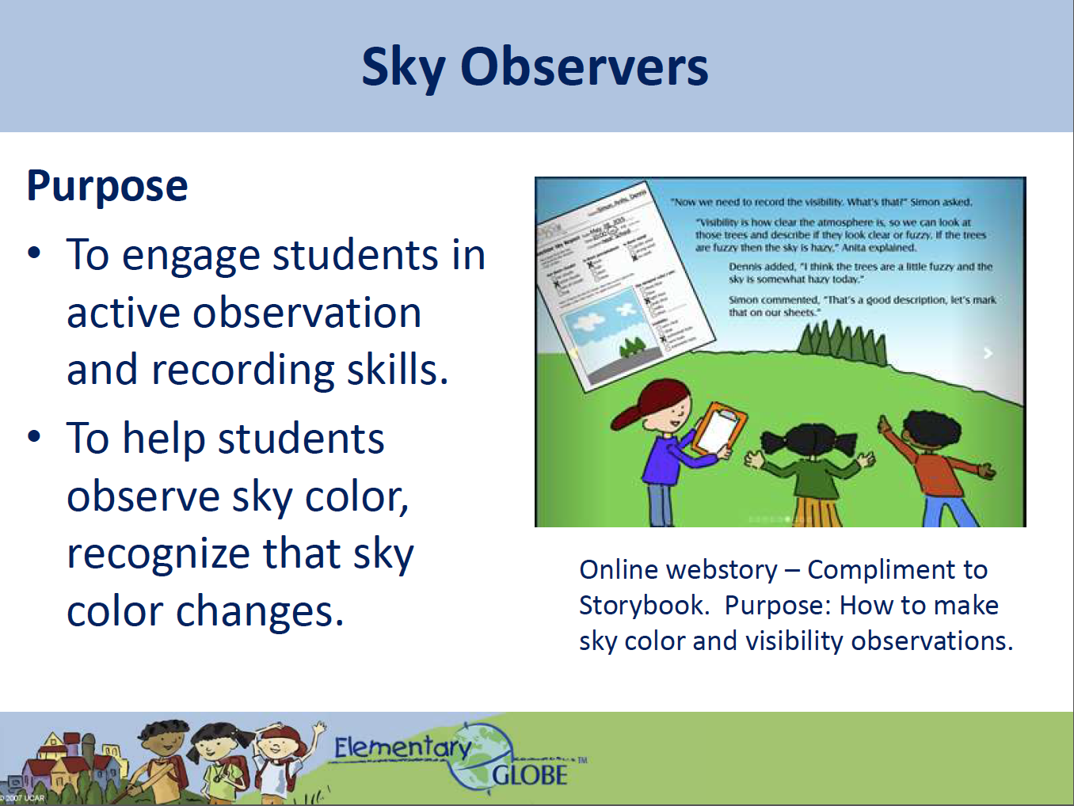

Slide 27
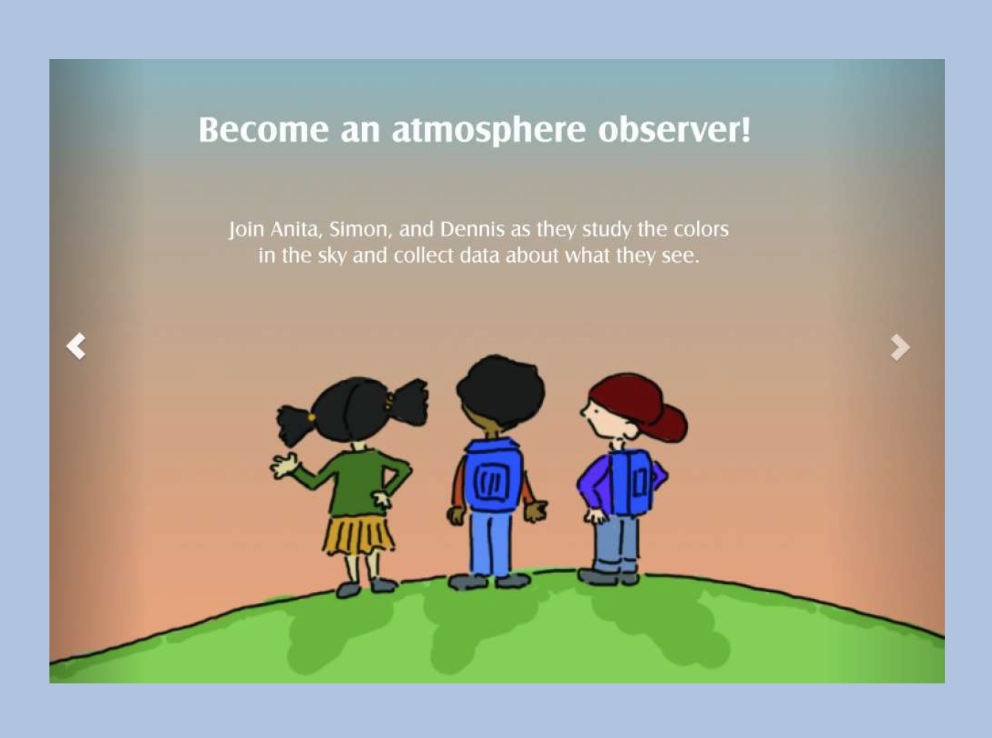

Slide 28
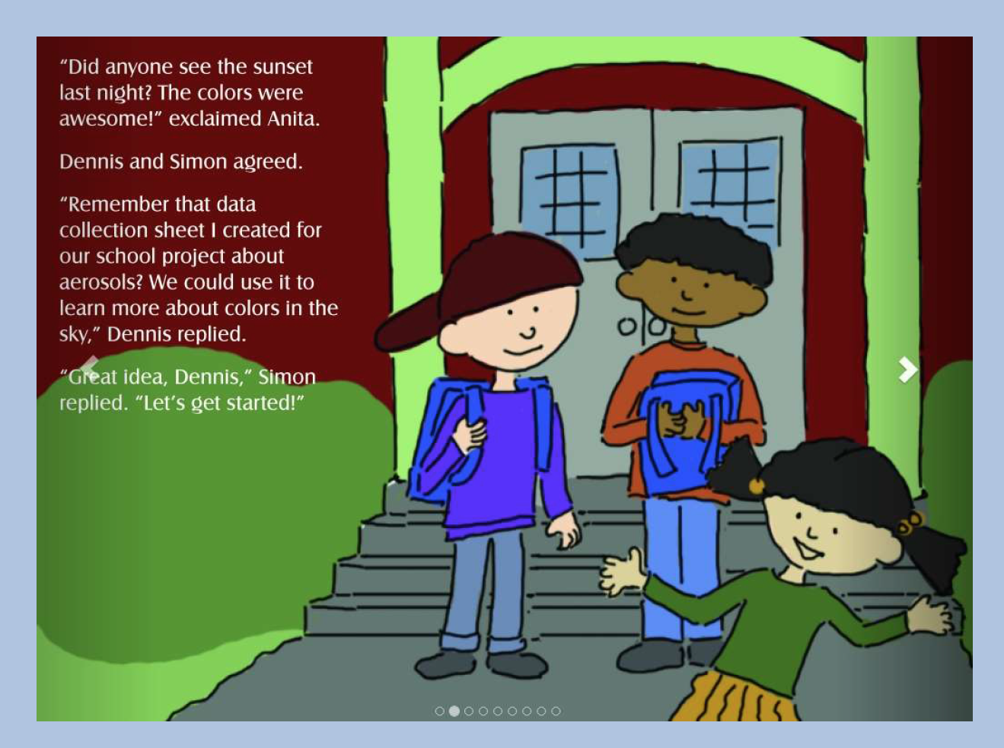

Slide 29
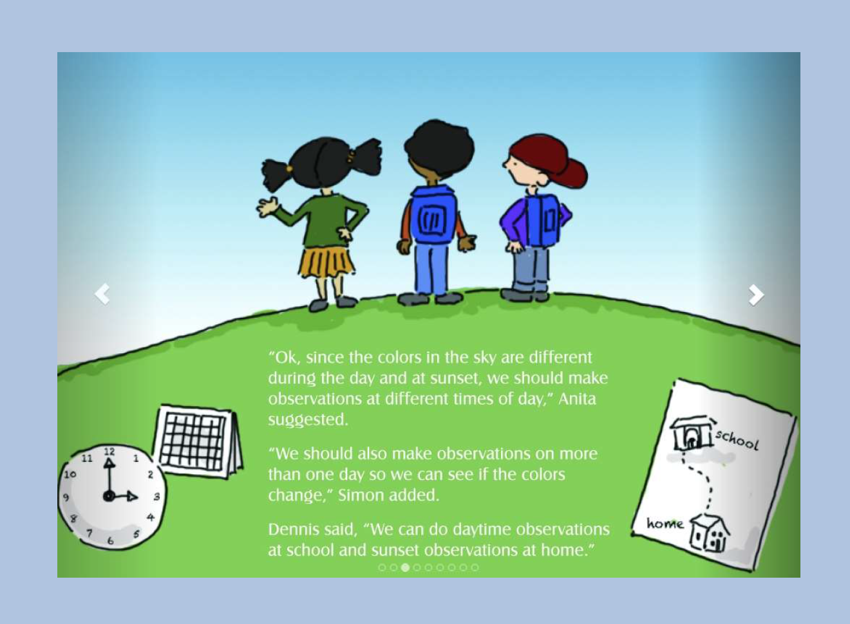

Slide 30
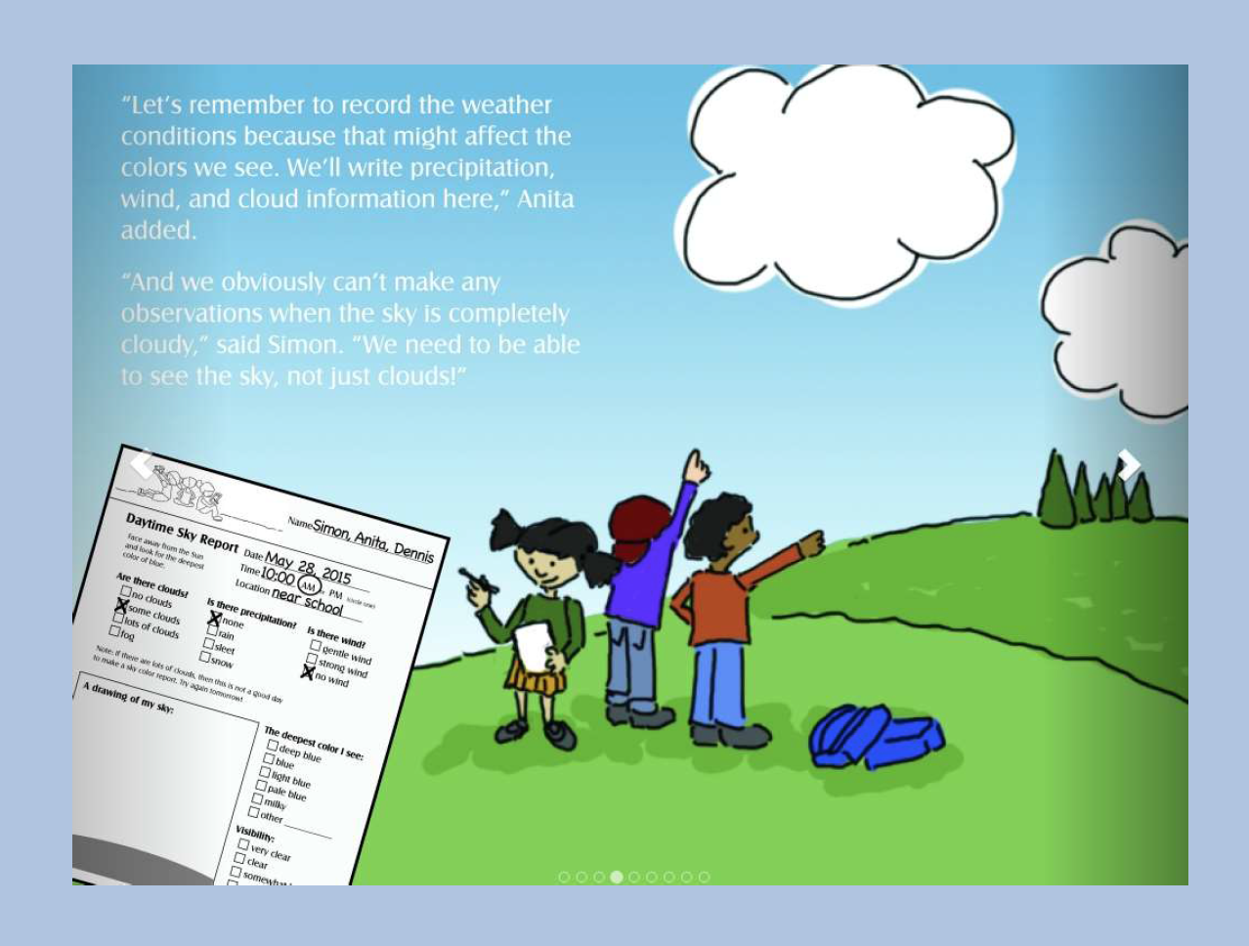

Slide 31
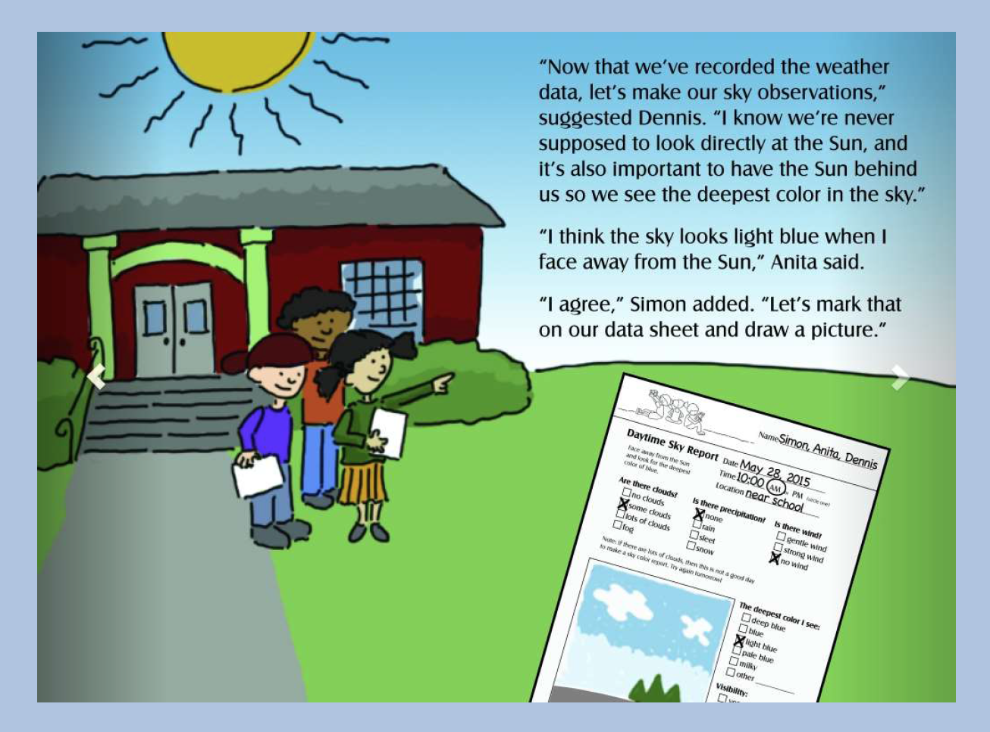

Slide 32
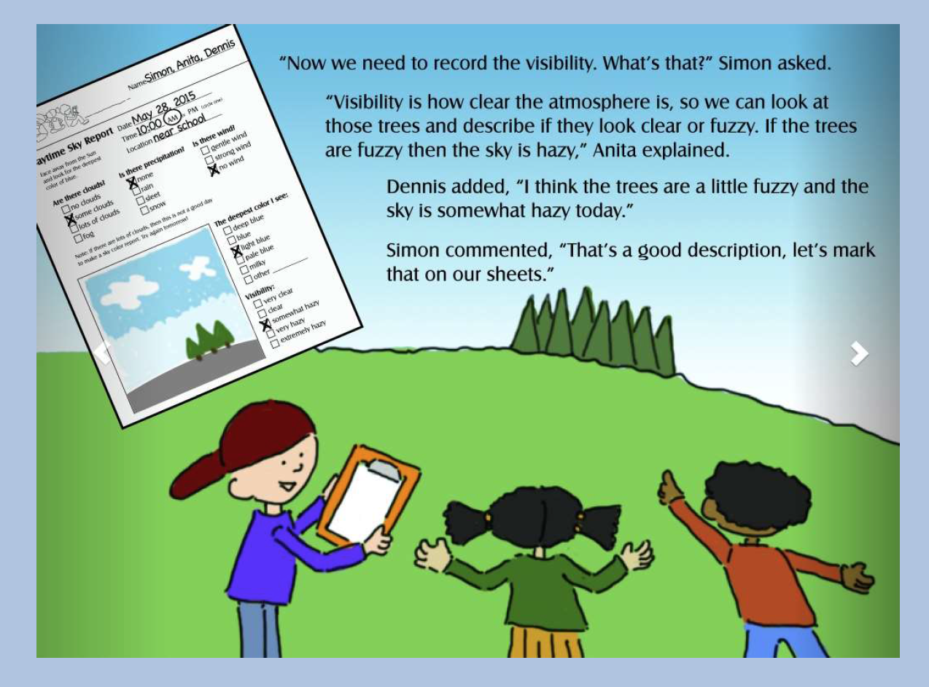

Slide 33
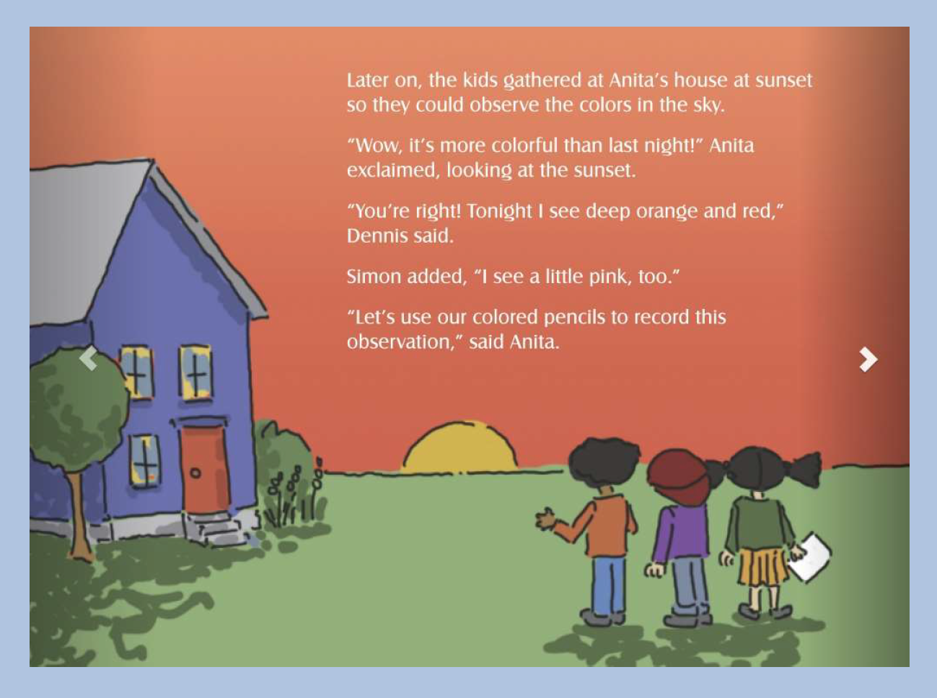

Slide 34
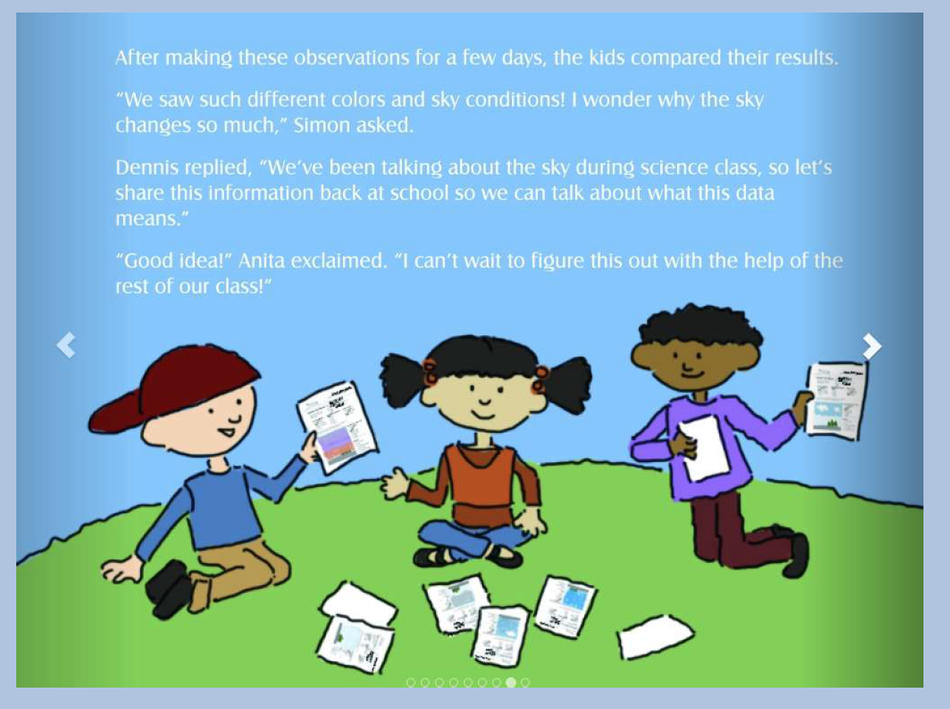

Slide 35
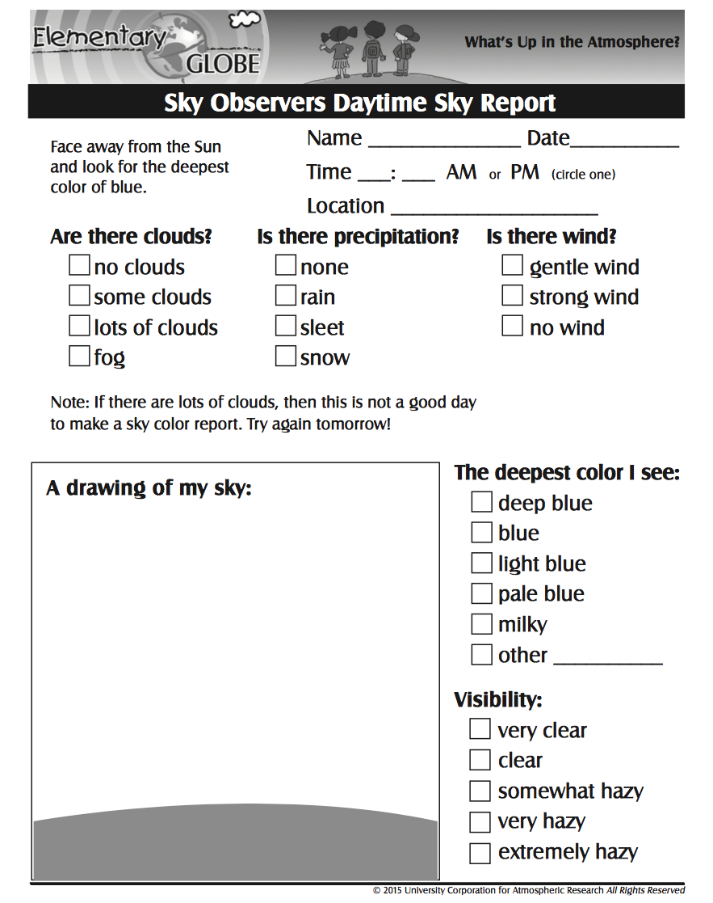
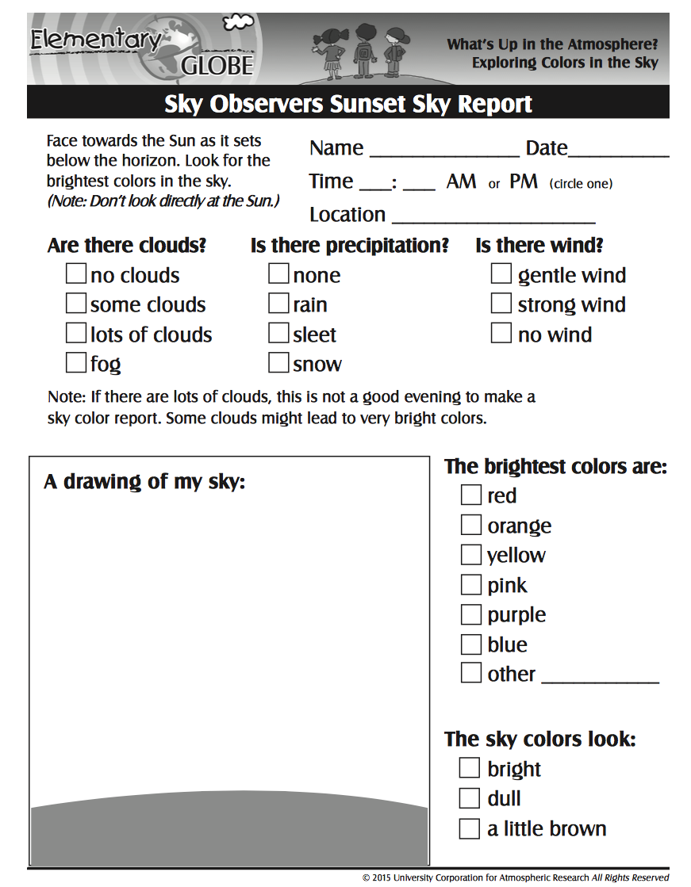
Sky Observers: Teaching the Skill of Data Collection
Notes:
Grab a clip-board, colored pencils and a partner . . .

Slide 36
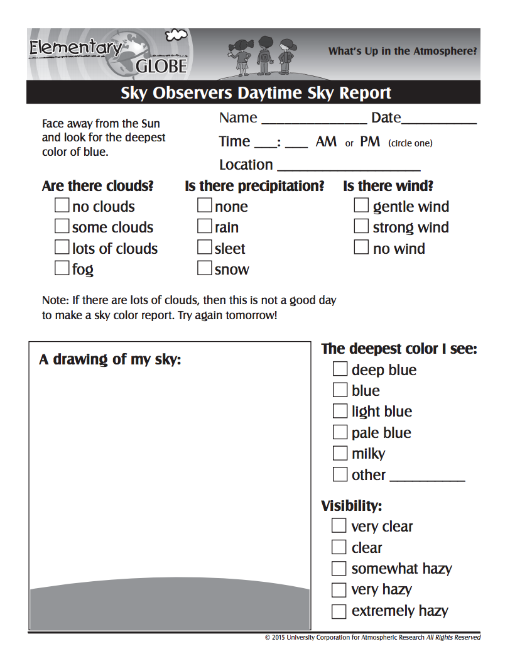
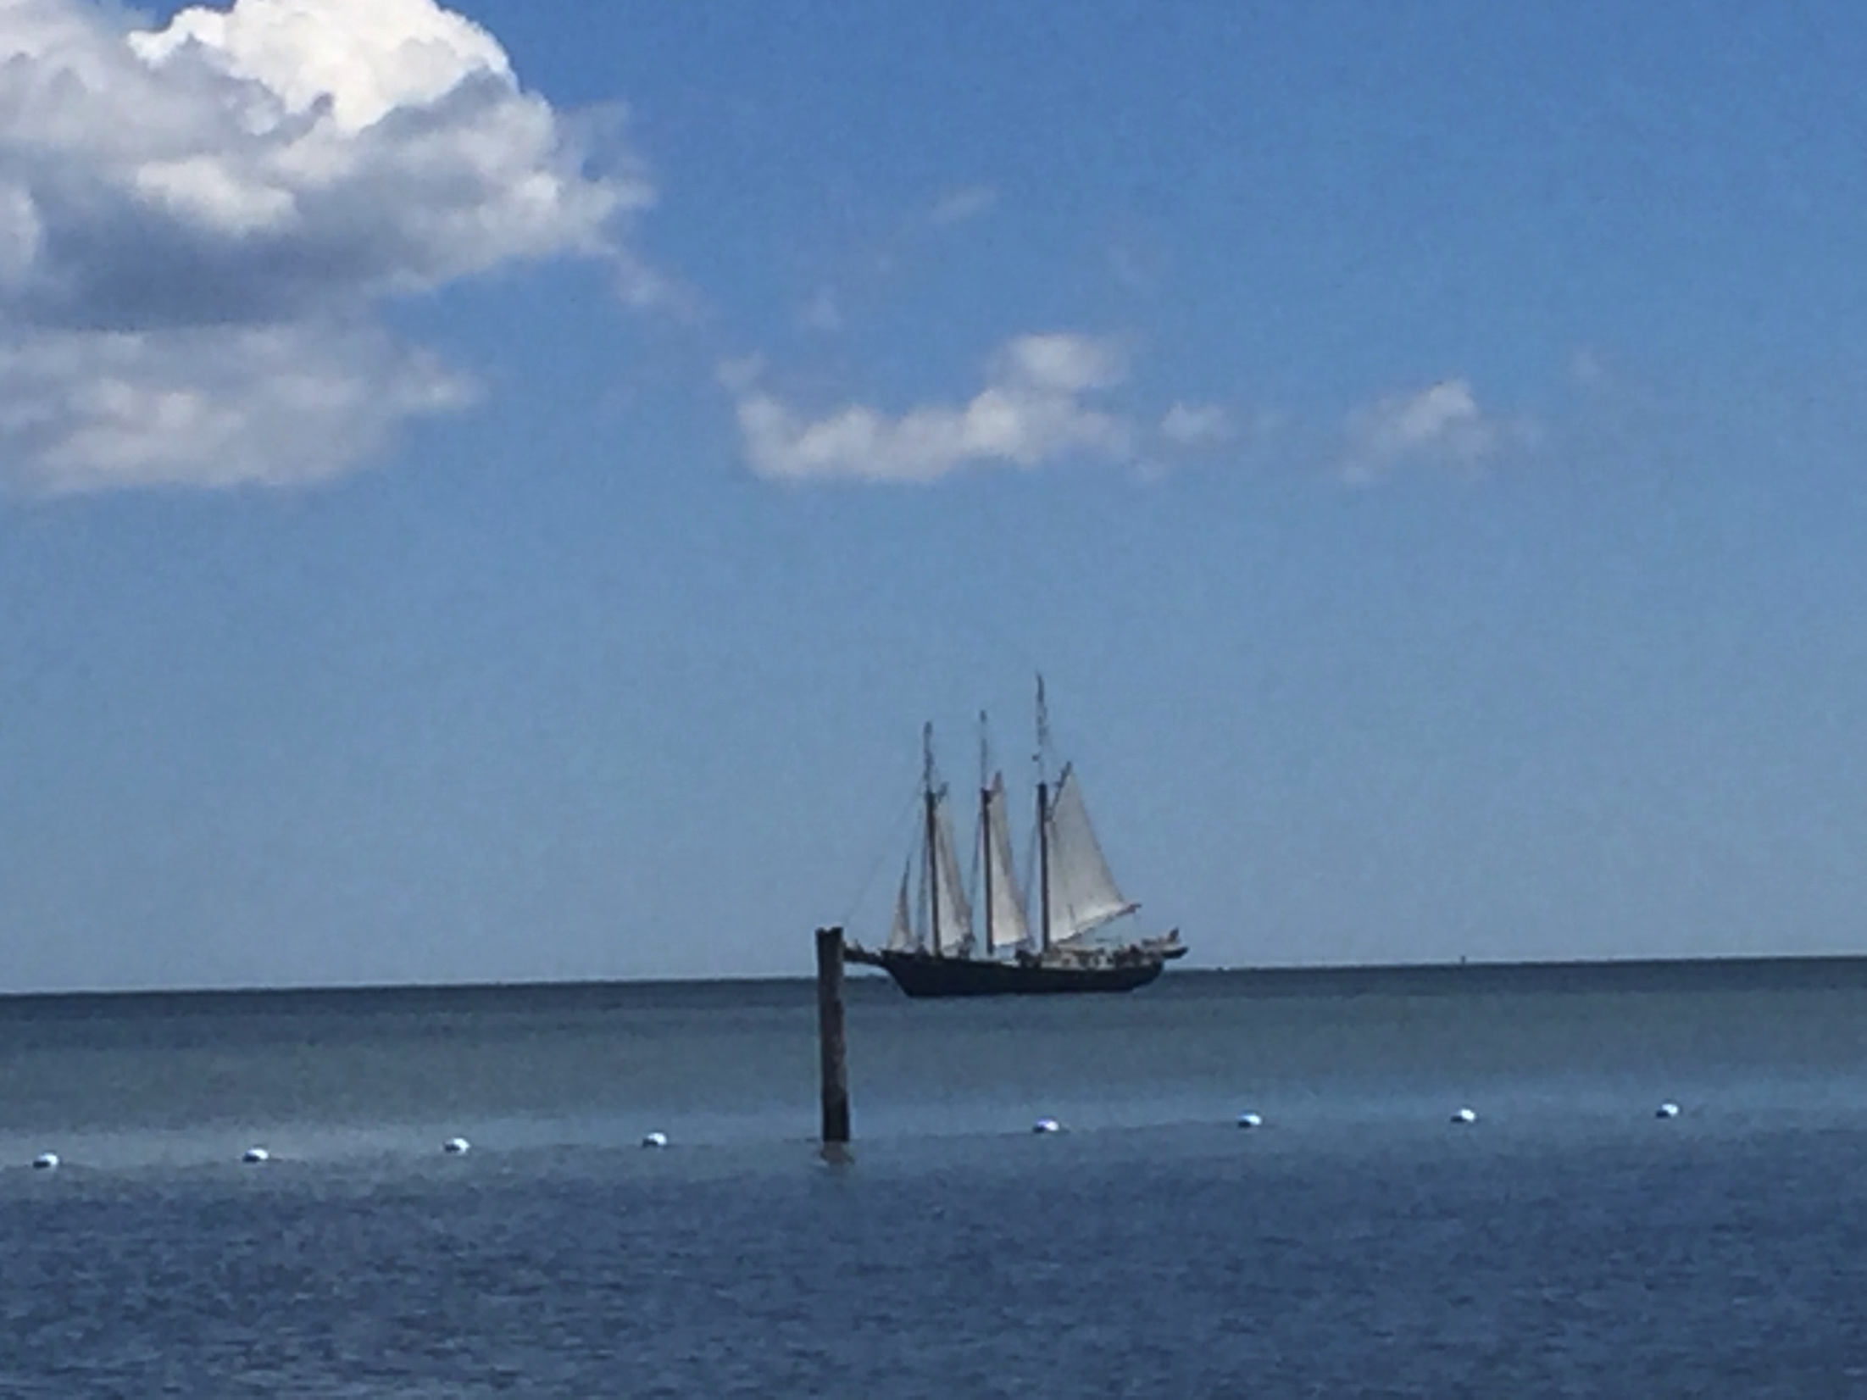
Sky Color: Daytime Observation

Slide 37
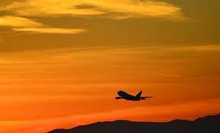
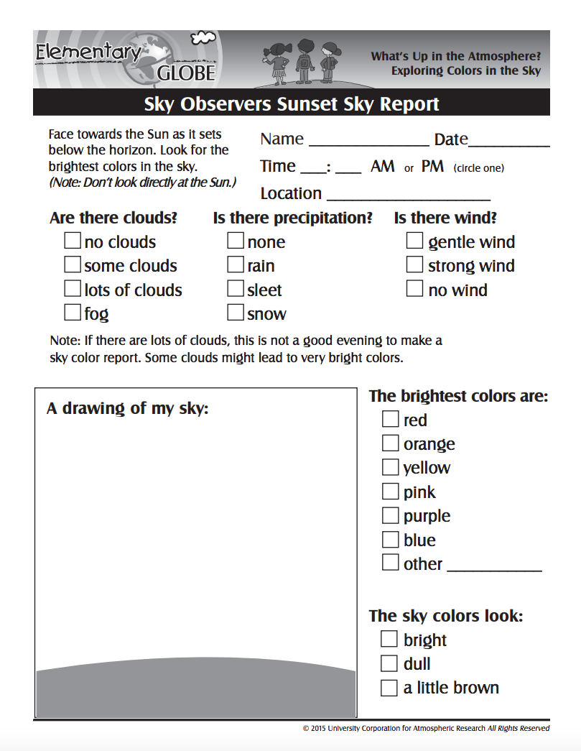
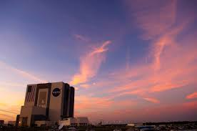
Sky Color: Sunset Observation

Slide 38
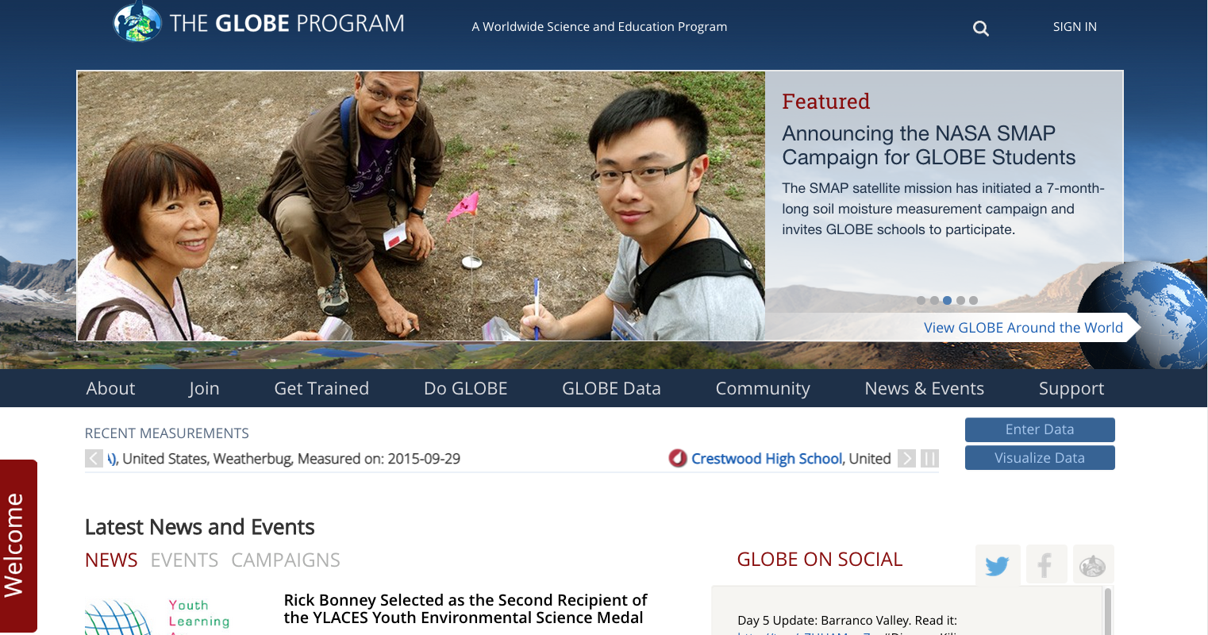

Slide 39
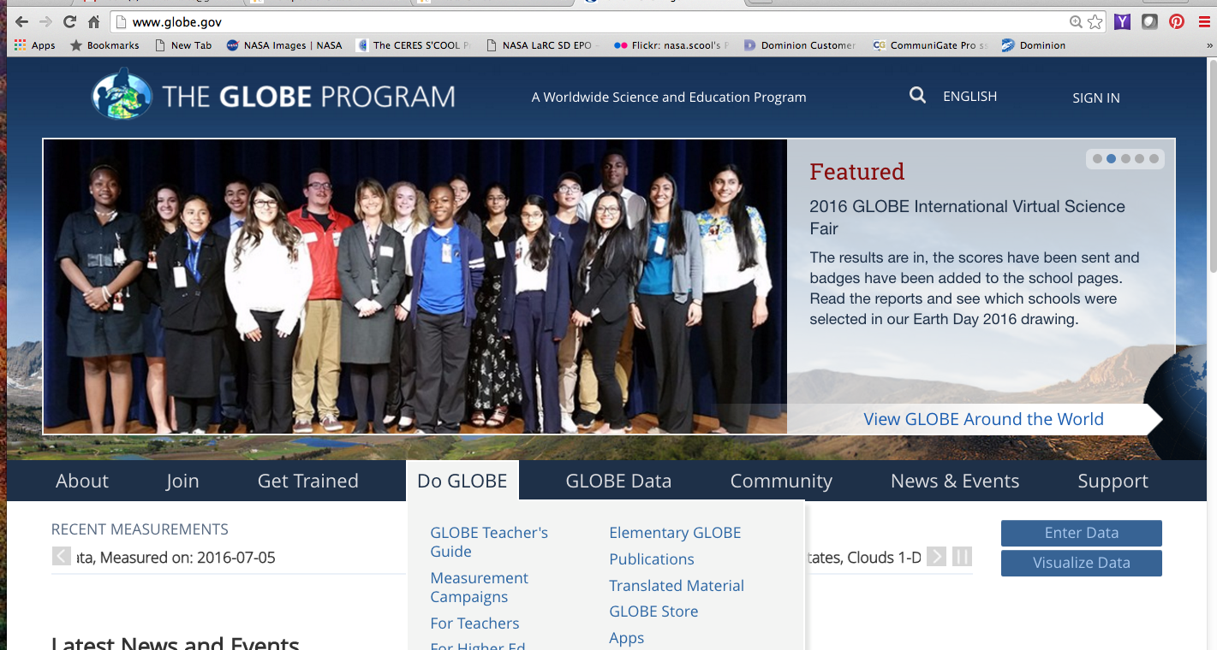

Slide 40
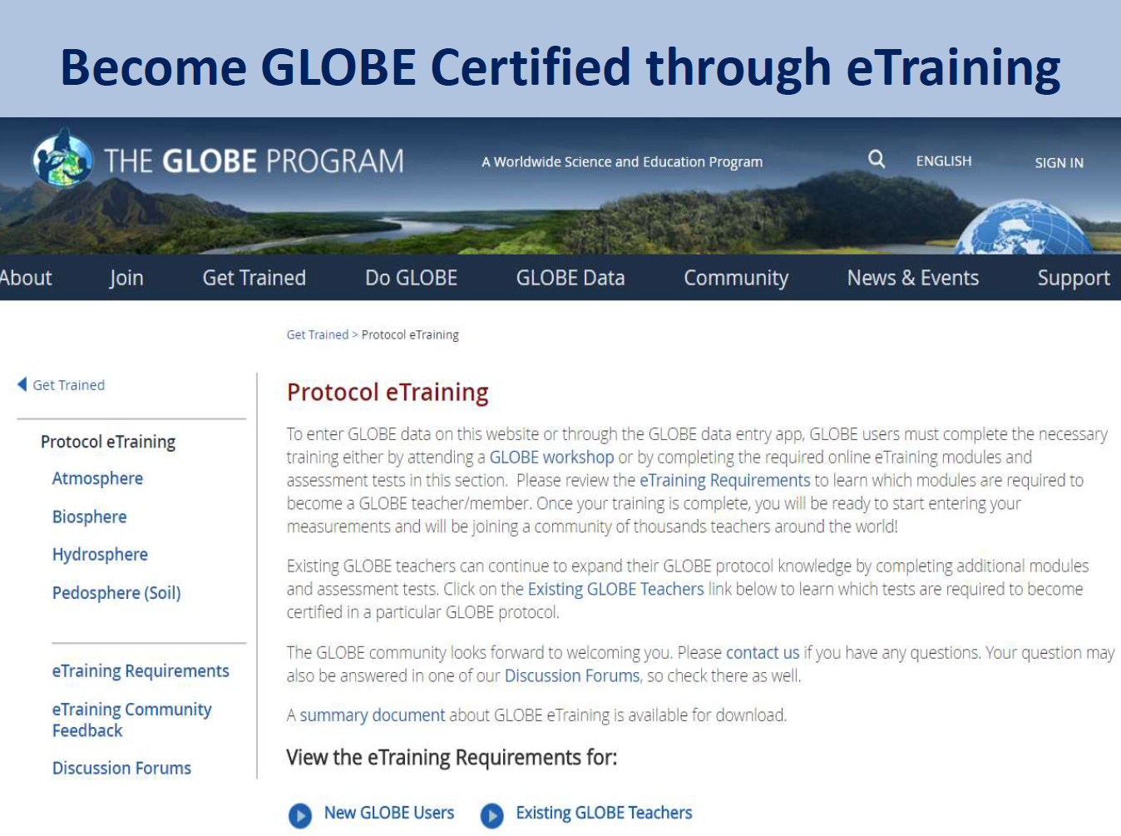

Slide 41
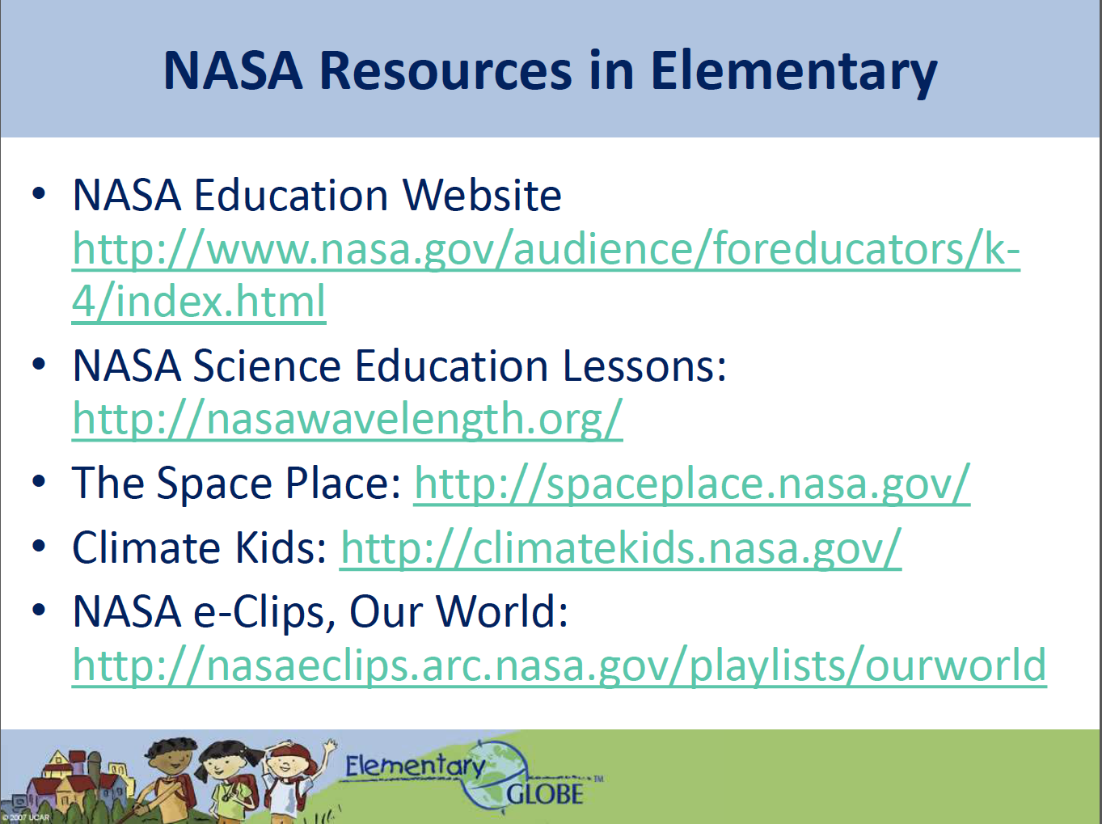

Slide 42
Elementary GLOBE
Tina R Harte
Task Lead
NASA Senior Education Specialist
GLOBE Training POC
tina.r.harte@nasa.gov
Elizabeth Joyner
NASA Education Specialist
MY NASA DATA POC
elizabeth.r.joyner@nasa.gov

