Slide 1
Save the Dogs!
Water Quality of the Maumee River from 2019-2020
McKinley STEMM Academy 7th grade class
teacher Cynthia Madanski

Slide 2
Abstract
The Toledo area is notorious for having harmful algal blooms in the summer months. We read articles about toxic algae, including an article highlighting a current algal bloom happening in the summer of 2020 in Toledo. With this relevance to our own lives, we asked the question “Is the water in Toledo safe enough for Mohawk and other dogs to swim in?” Last year, students found the water was safe. We wanted to see if it is safe again this year, or if anything has changed in the Maumee River at Sidecut Metropark.
The GLOBE protocols used to answer this research question were water temperature, fecal coliform bacteria, Biochemical Oxygen Demand, phosphate, nitrate, turbidity, total solids, water transparency, pH, dissolved oxygen, and macroinvertebrates. We collected data once for all protocols, between 9:07-10:57am on October 8, 2020. We used past results from October 2019 to compare. The results showed that the water quality was worse in 2020.

Slide 3
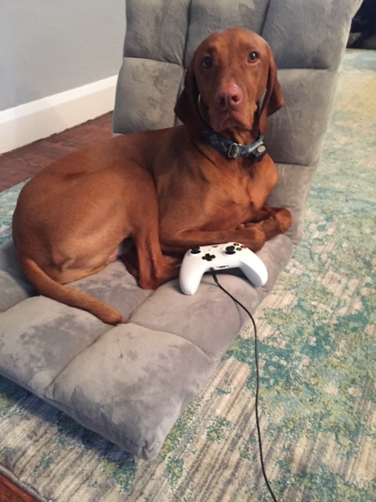
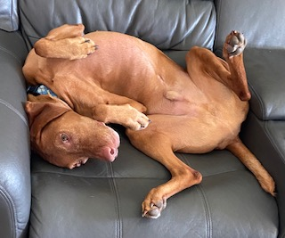
Our teacher Mrs. Madanski showed us her dog Mohawk in a Google Meet.

Slide 4
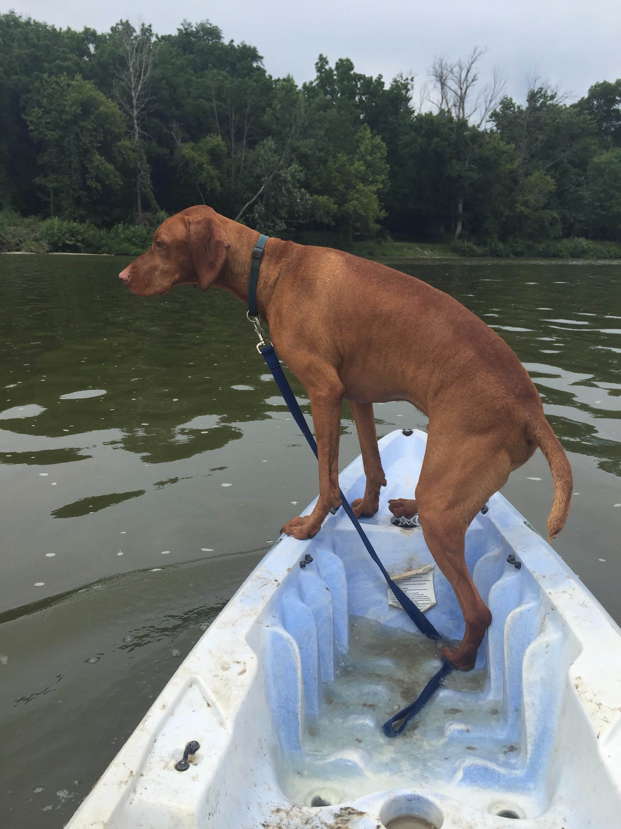
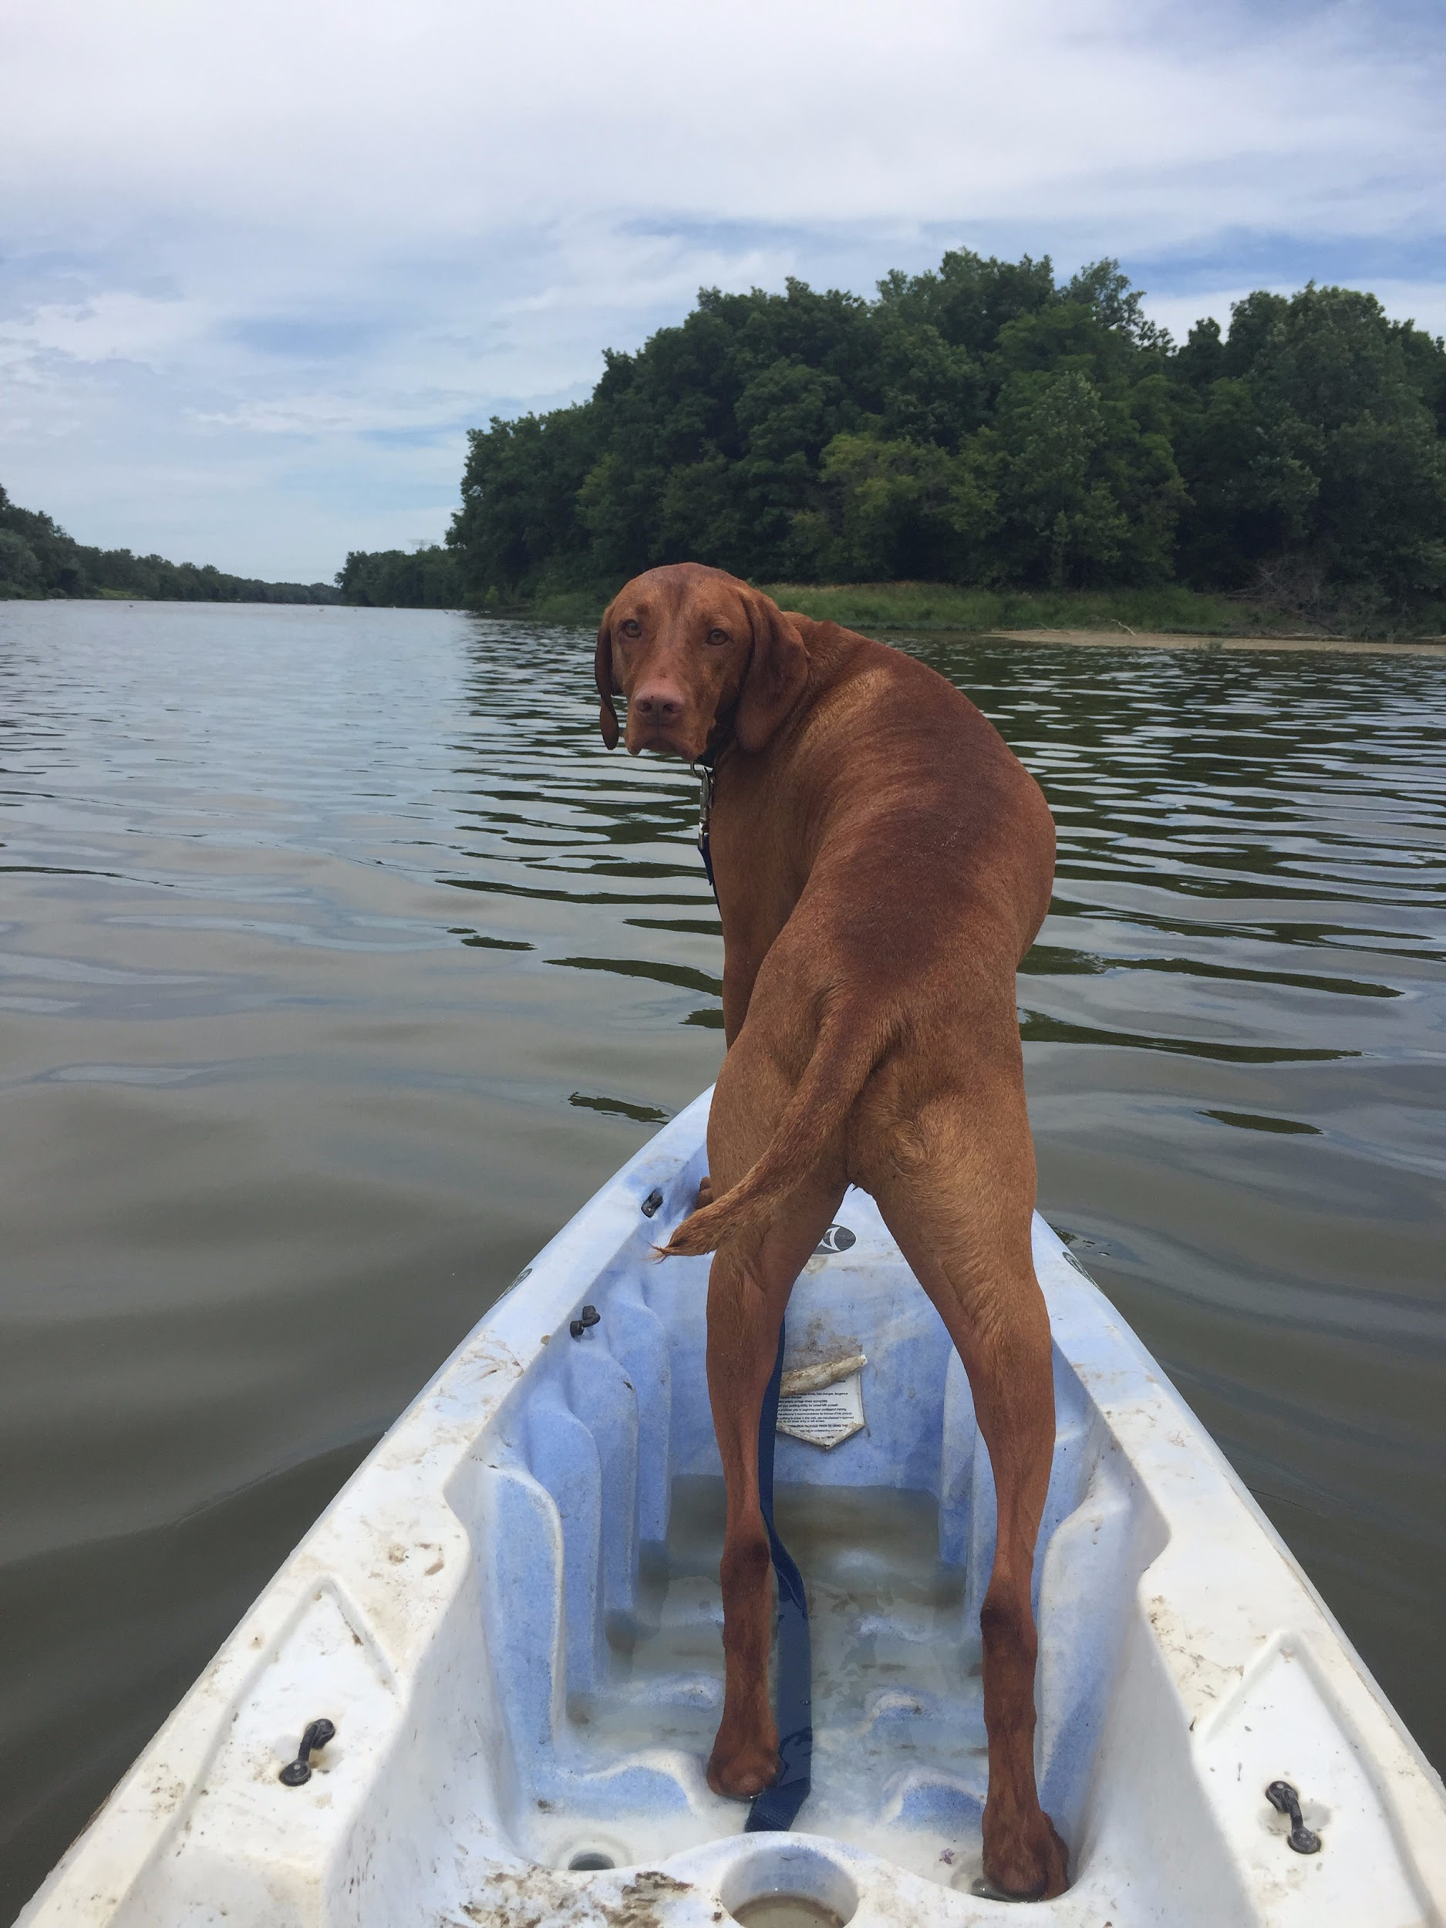
Mrs. Madanski and Mohawk love the go kayaking a lot around Toledo. He will jump in the water and swim around when they are kayaking.

Slide 5
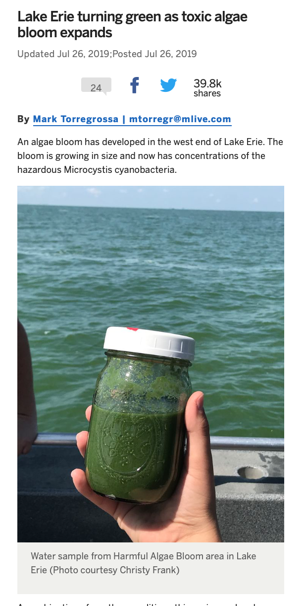
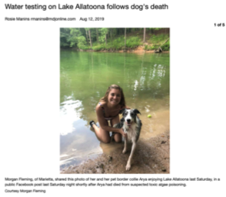
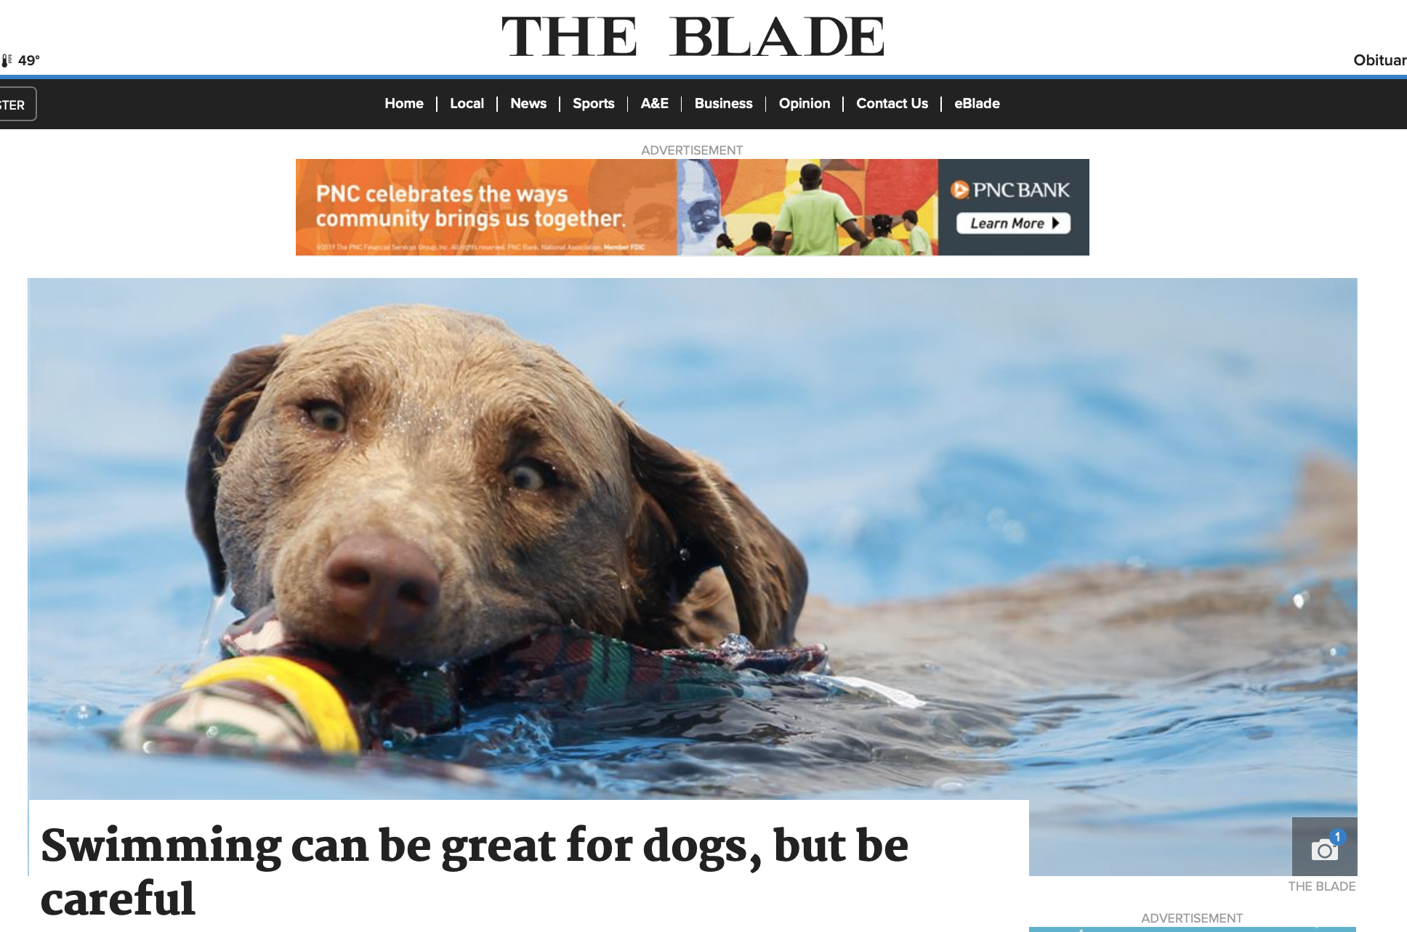
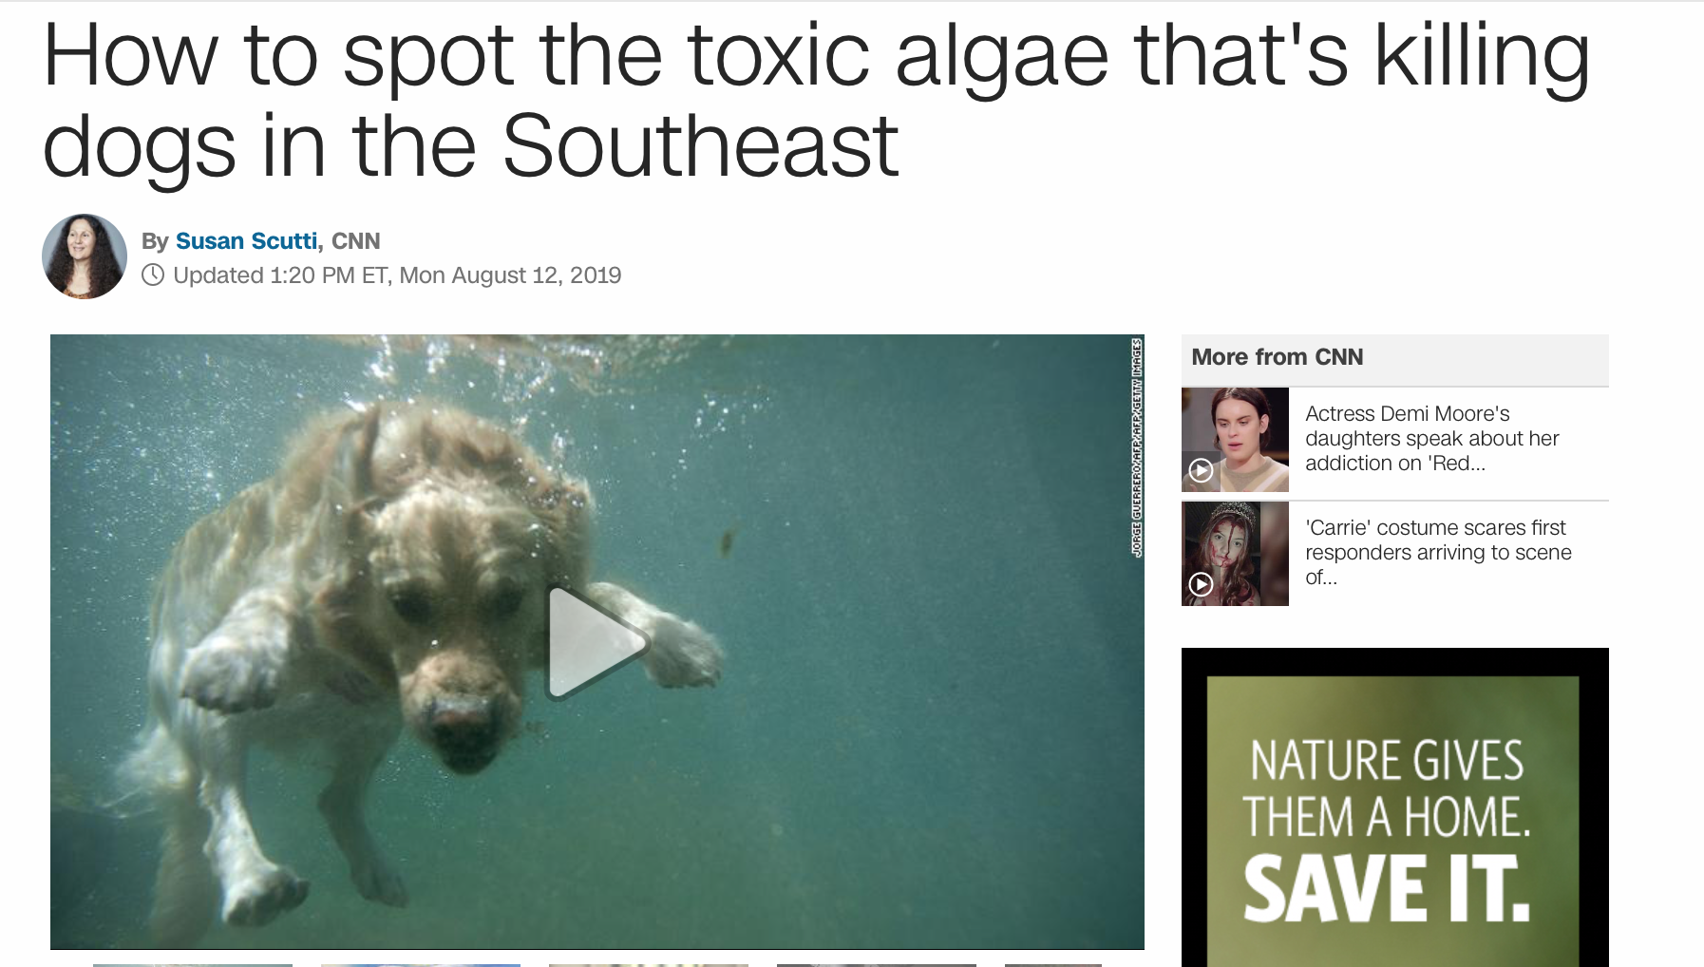
But we researched some headlines in the news this year and a lot of bad things popped up about how dogs were sick and dead because of the toxic water.

Slide 6
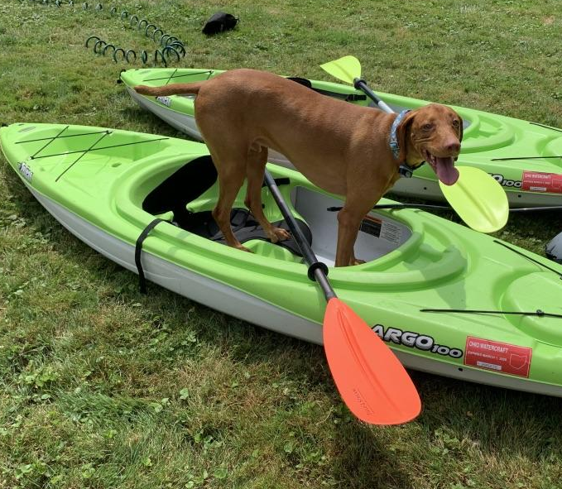
Is the water in Toledo safe enough for Mohawk and other dogs to swim in?
So that made us wonder...

Slide 7
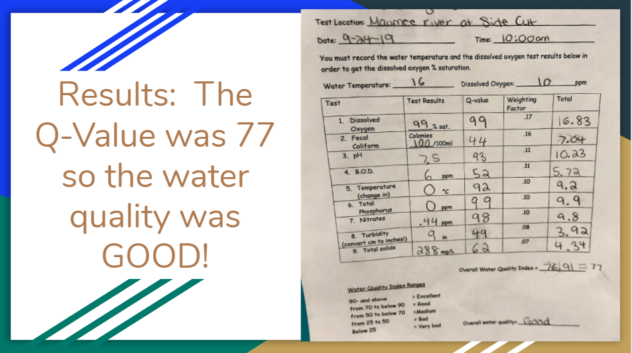
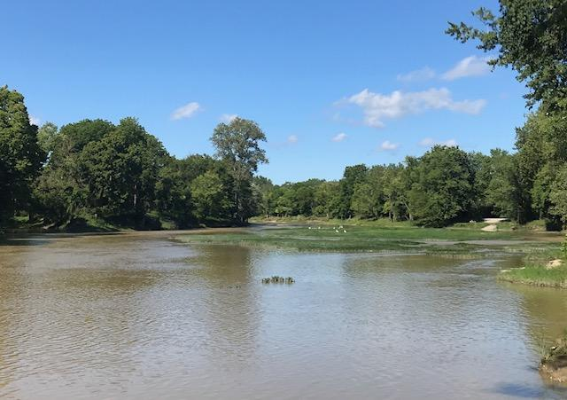
2019 Data from the Maumee River at Sidecut Metropark:
Students from our school last year did the project as well. They wanted to see if the water was safe then. Here are their results: Overall, the water quality was good in October of 2019, with an overall Q-Value of 77..

Slide 8
2019 Data
areas of concern: fecal coliform, turbidity
excellent range tests: dissolved oxygen, pH, phosphate, nitrate

Slide 9
2019 Data
With a Q-Value in the good range, the water in the Maumee River at Sidecut Metropark was safe for Mohawk and other dogs to swim!

Slide 10
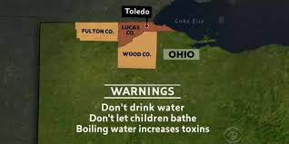
How did the water quality in the Maumee River in 2019 compare to 2020?
Even though the water was safe last year, is it still safe in 2020?
In August of 2014, there was a water crisis where Harmful Algal Blooms deemed the drinking water unsafe. Students researched this water being harmful to people and pets. Could it be that unsafe again?

Slide 11
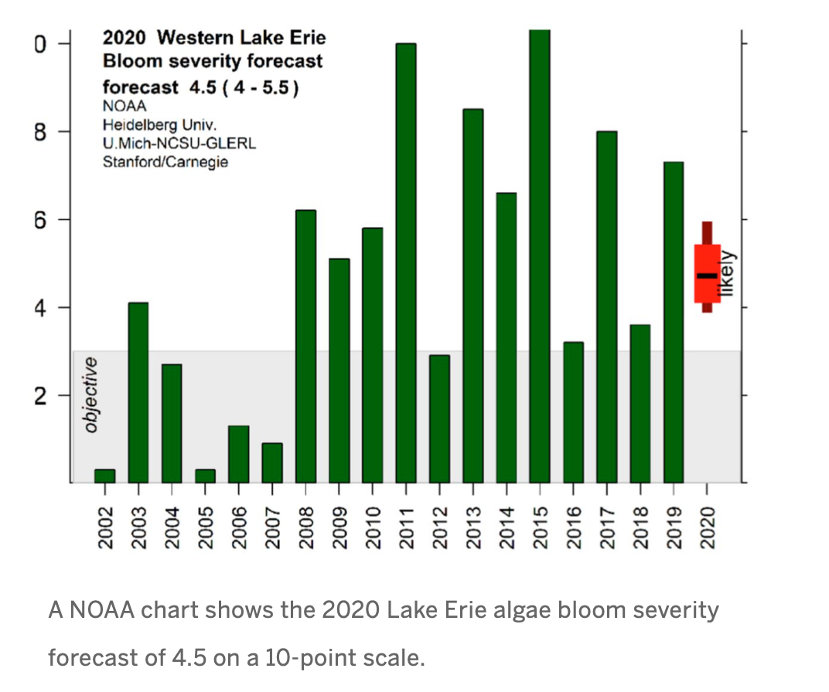
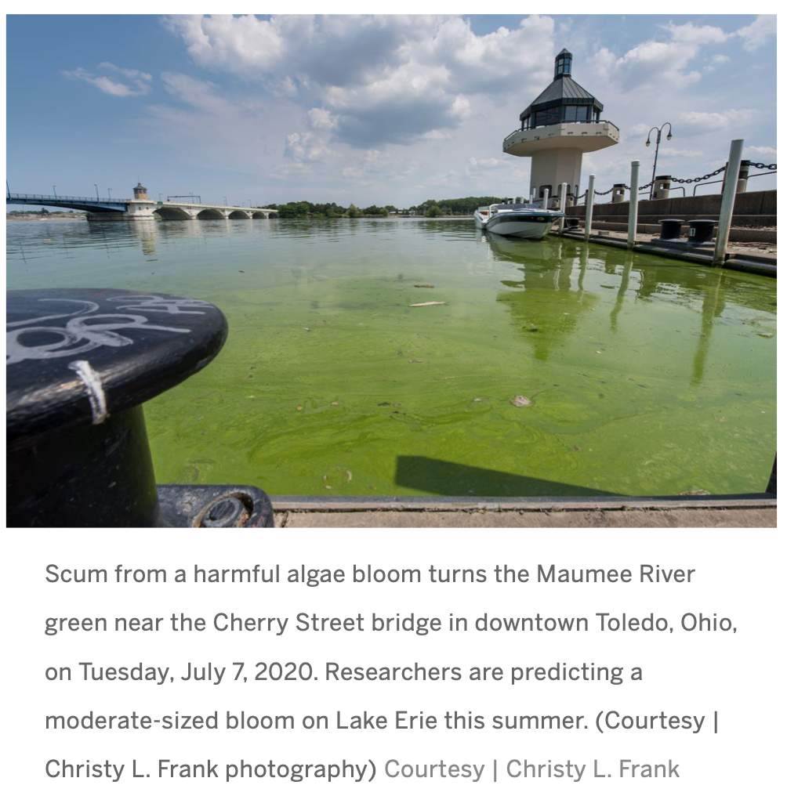
Current Algal Bloom in Toledo 2020

Slide 12
Research Methods: Describing The Planning Process (Planning Investigations)
For this project, we decided to compare the water quality of the Maumee River at Side Cut Park in Maumee, Ohio in 2019 and again in 2020. Both years the testing was done in October, with clear skies and no precipitation. We used the exact same location on the Maumee River both years.
For our study on water quality, we decided to use the following GLOBE protocols and the instruments: transparency (turbidity tube), water temperature (liquid), dissolved oxygen (CHEMets Kit), macroinvertebrates (using net and picking rocks), and pH (paper), fecal coliform bacteria (coliform plates), Biochemical Oxygen Demand (CHEMets Kit), phosphate (CHEMets Kit), nitrate (CHEMets Kit), total solids (Labquest with probe).
We collected our samples between 9:07-10:57 on October 8,2020. Mrs. Madanski collected samples in person, while students participated remotely via a Google Meet due to COVID-19 restrictions.

Slide 13
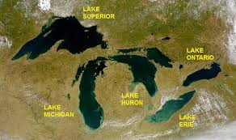
Map of Study Site

Slide 14
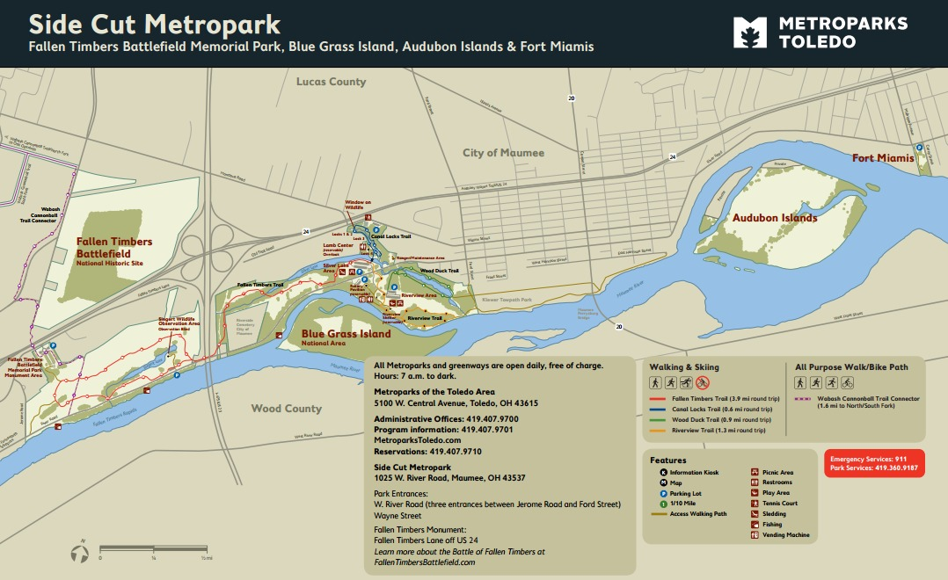
testing site

Slide 15
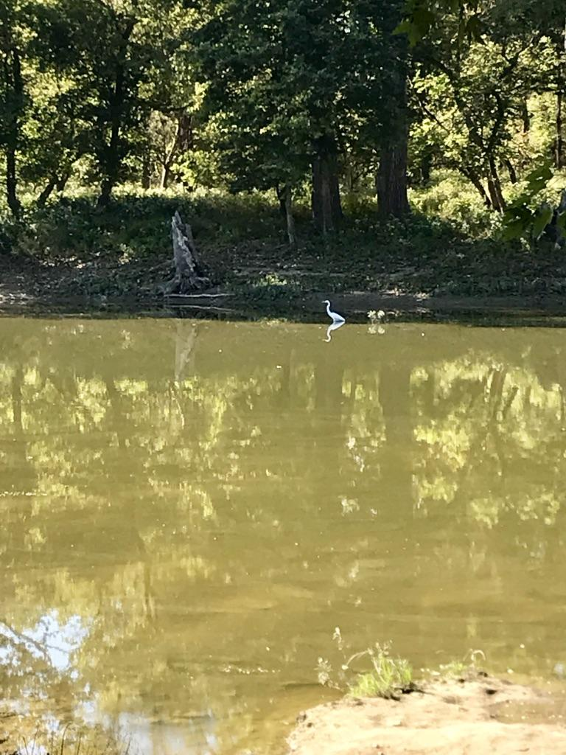
Photo of testing site in 2019

Slide 16
Photo of site in 2020

Slide 17
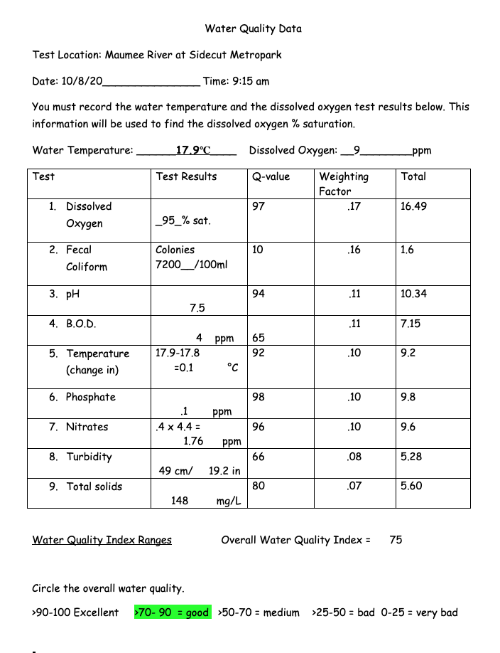
Overall Water Quality Results in 2020
75 = good

Slide 18
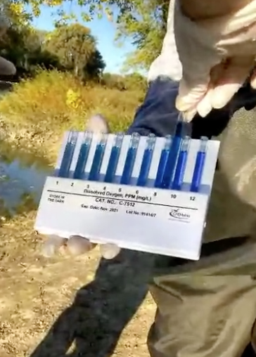
Dissolved Oxygen Protocol
Dissolved Oxygen is a measure of how much oxygen is dissolved in water. This is the oxygen that is available to living organisms in the water. The dissolved oxygen is breathed by fish and other organisms, and is needed by them to survive.
Rapidly moving water tends to contain a lot of dissolved oxygen, and still water contains less. Periods in the summer with hot, calm weather can result in very low dissolved oxygen, and will result in fish kills.

Slide 19
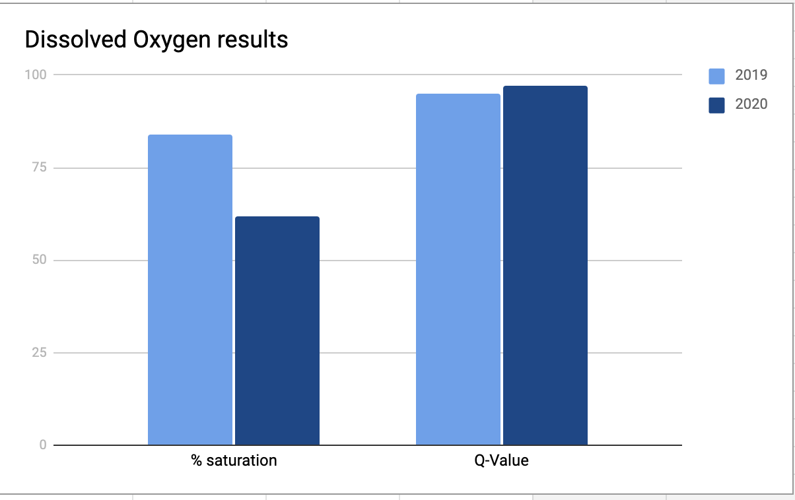
Dissolved Oxygen Results
year | % saturation | Q-Value
2019 | 84% | 62
2020 | 95% | 97

Slide 20
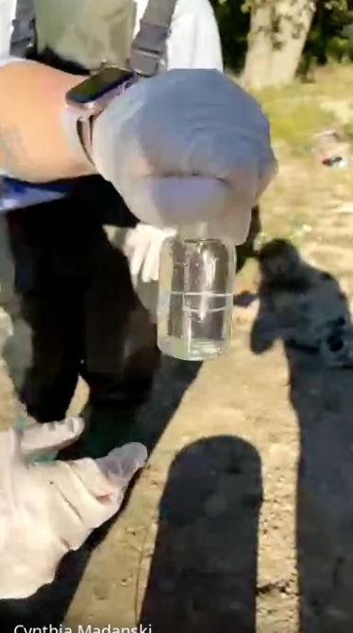
Biochemical Oxygen Demand (BOD) protocol
Measures the amount of oxygen used by the microorganisms in the stream.
Mainly bacteria which are decomposers.
If BOD is high there will be less oxygen in the water.
Testing Directions BOD
1.Fill bottle with water. (NO air bubbles!)
2.Put in dark place for 5 days.
3. Run a DO test. Subtract the results from your original DO to see what the organisms used.

Slide 21
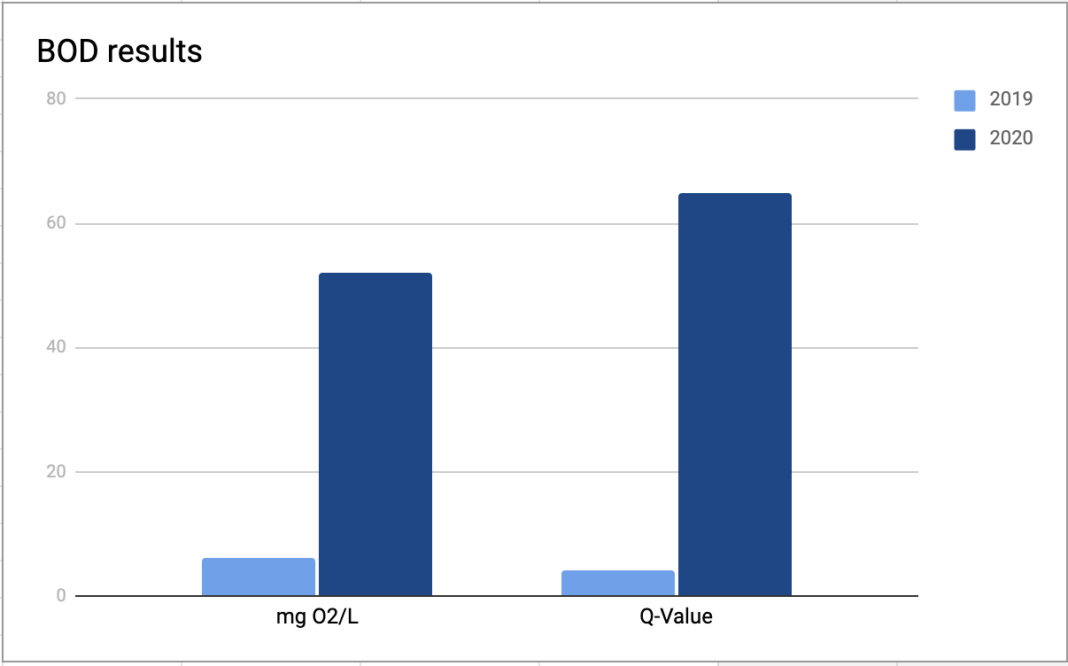
Biochemical Oxygen Demand Results
year | mg O2/L | Q-Value
2019 | 6 | 52
2020 | 4 | 65

Slide 22
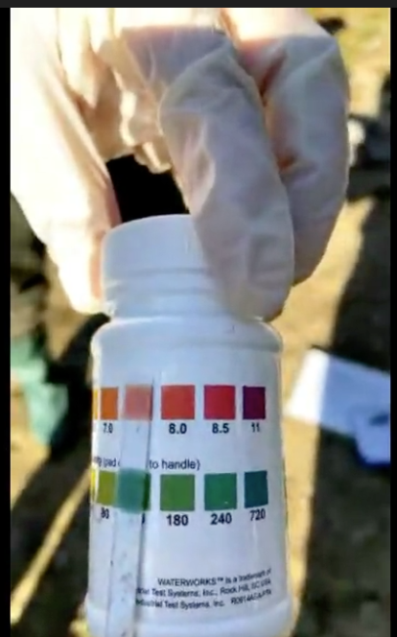
pH Protocol
pH is a measure of how acidic or basic water is. 7 is normal. pHs of less than 7 indicate acidity, and a pH greater than 7 indicates a base.
pH is an important indicator of water quality. The pH of a river can affect organisms living in the water, and can be an indicator of increasing pollution.

Slide 23
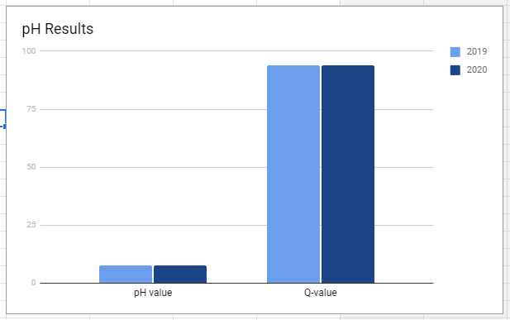
pH Data
year | pH value | Q-Value
2019 | 7.5 | 94
2020 | 7.5 | 94

Slide 24
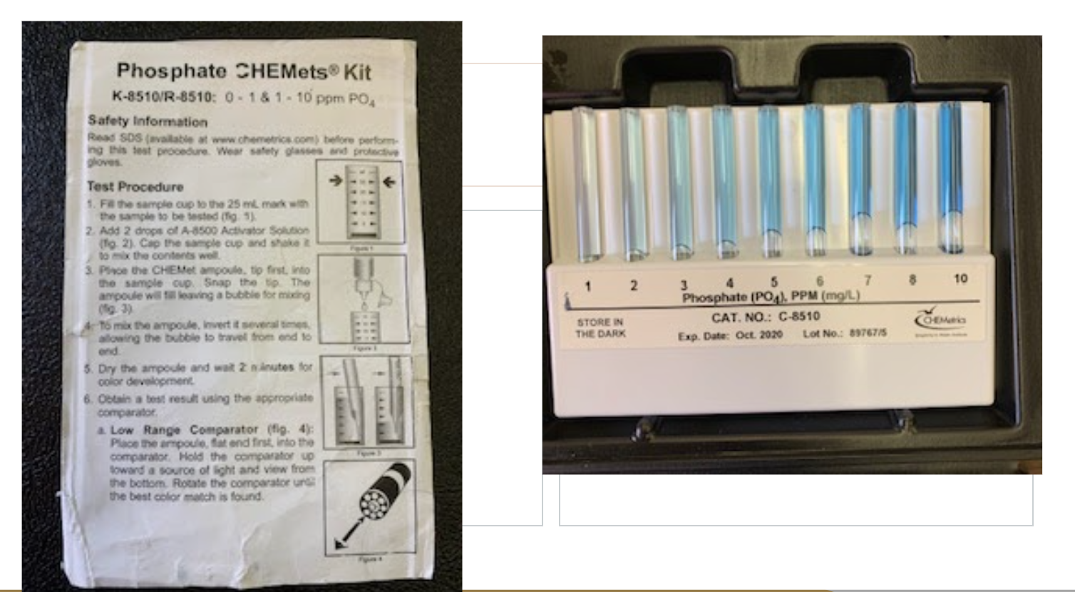
Phosphate Protocol

Slide 25
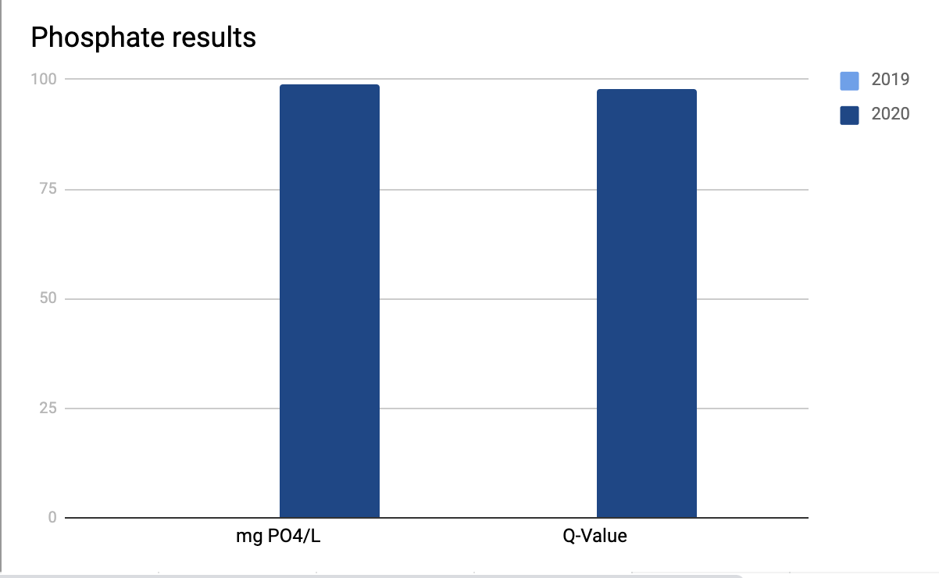
Phosphate Results
year | mg PO4/L | Q-Value
2019 | 0 | 99
2020 | .1 | 98

Slide 26
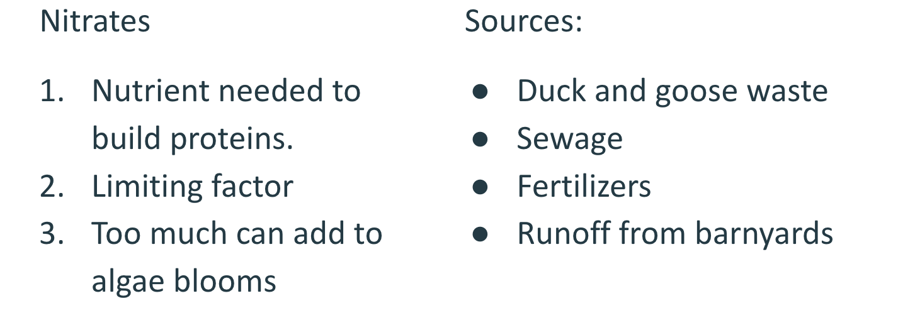
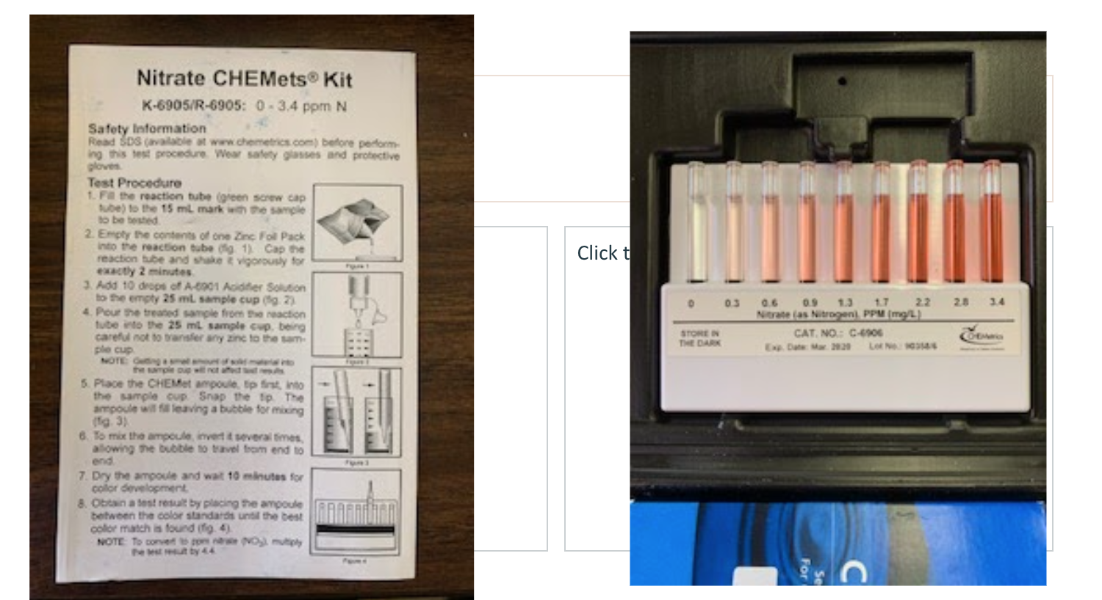
Nitrate Protocol

Slide 27
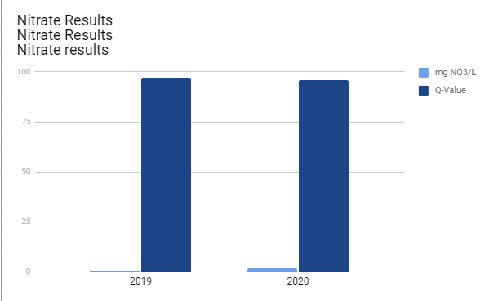
Nitrate Results
year | mg NO3/L | Q-Value
2019 | .44 | 97
2020 | 1.76 | 96

Slide 28
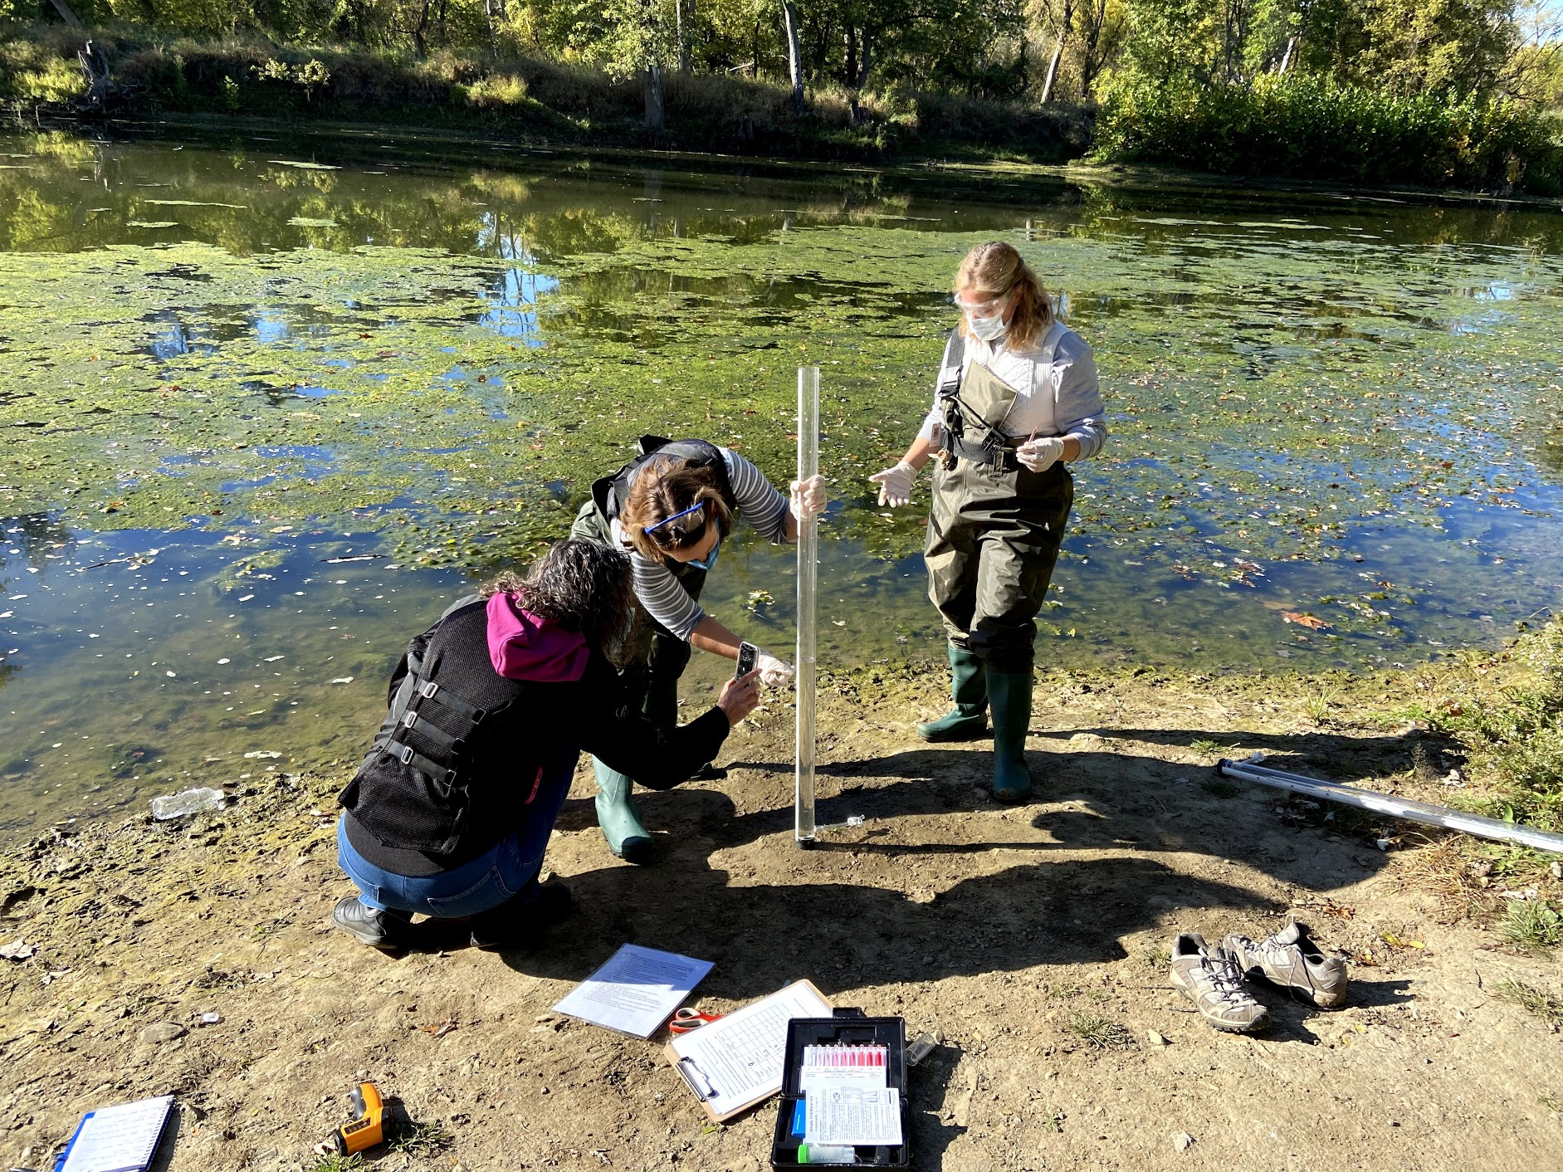
Water Transparency (Turbidity) Protocol
Water transparency, also referred to as turbidity, is a measure of the relative clarity of a liquid. It is a measurement of the amount of light that is scattered by material in the water when light goes through the sample. Material that causes high turbidity include clay, silt, organic matter, algae, and microscopic organisms.
USGS states excessive turbidity causes the water to be cloudy and can represent a health concern. Turbid conditions provide shelter for pathogens, specifically protozoa. The lower the turbidity, the better the water quality.

Slide 29
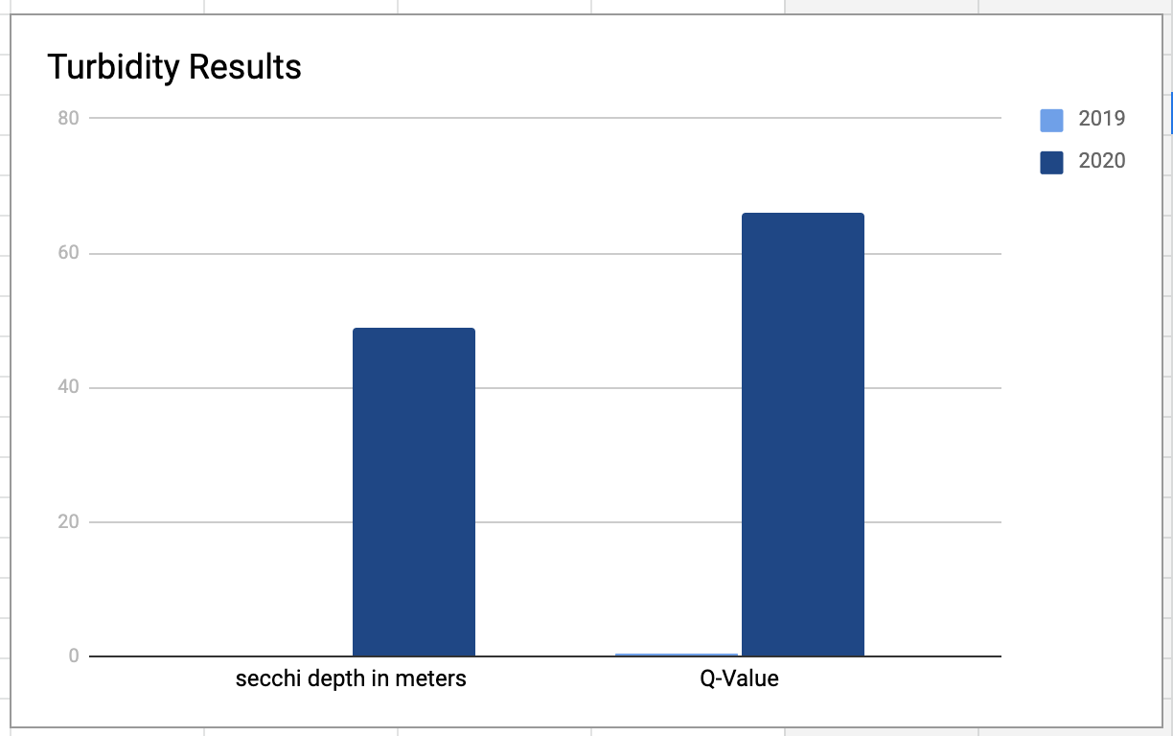
TURBIDITY RESULTS
year | secchi depth in meters | Q-Value
2019 | .23 | 49
2020 | .49 | 66

Slide 30
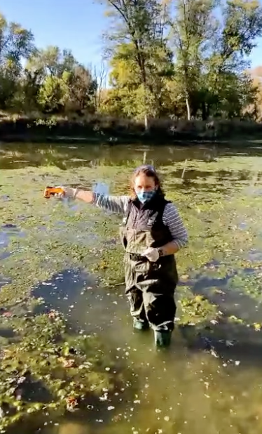
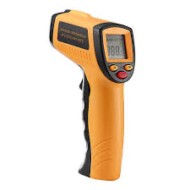
Water Temperature Protocol
Water temperature influences the kinds of organisms that live in bodies of water. Fish, insects, zooplankton, and other aquatic species have a preferred temperature range. When temperatures get too far above or below the preferred ranges, the number of organisms decreases until eventually there are none present.
USGS states warm water holds less dissolved oxygen than cool water, which affects the survival of different species of aquatic life.

Slide 31
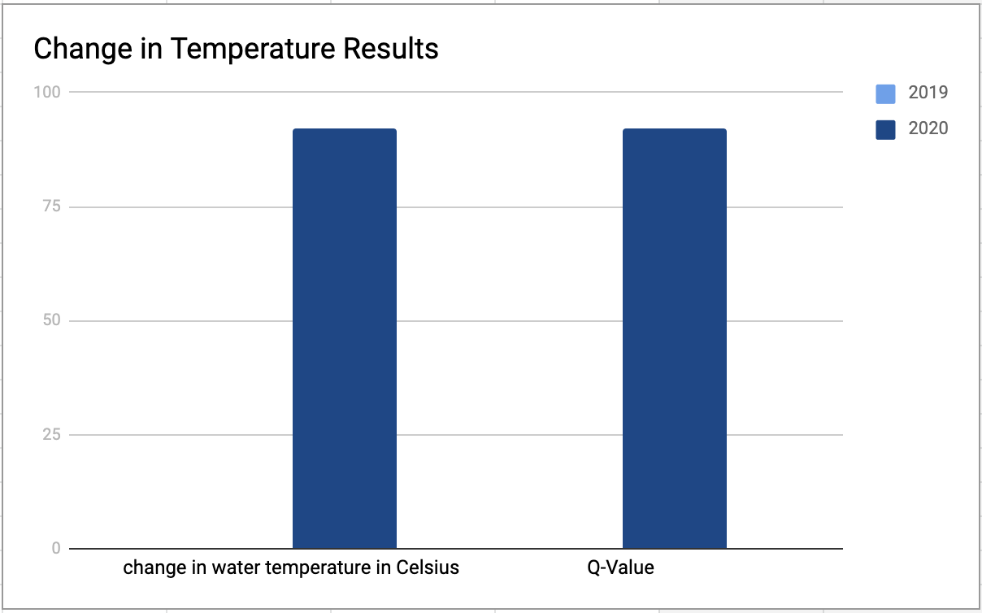
Water Temperature Data
year | change in water temperature in Celsius | Q-Value
2019 | 0 | 92
2020 | .01 | 92

Slide 32
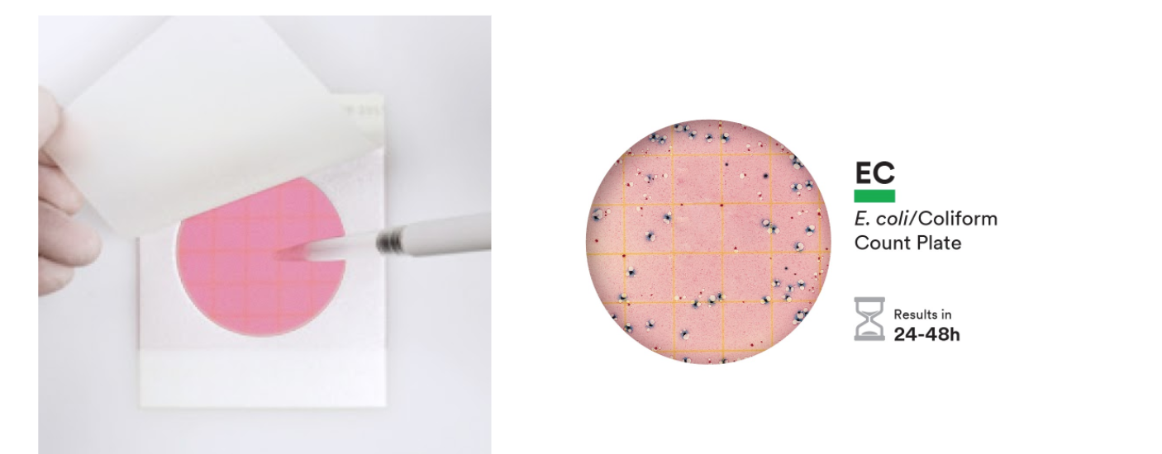
Fecal Coliform Bacteria Protocol

Slide 33
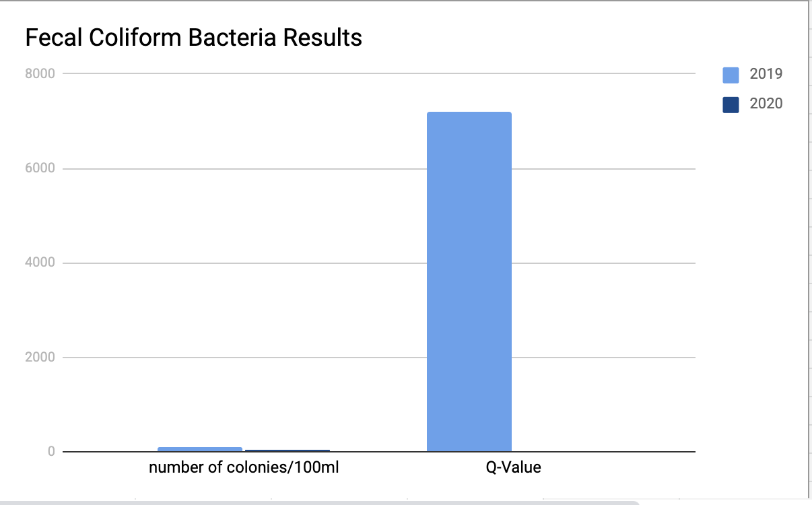
Fecal Coliform Bacteria Results
year | #/100ml | Q-Value
2019 | 100 | 44
2020 | 7,200 | 10

Slide 34
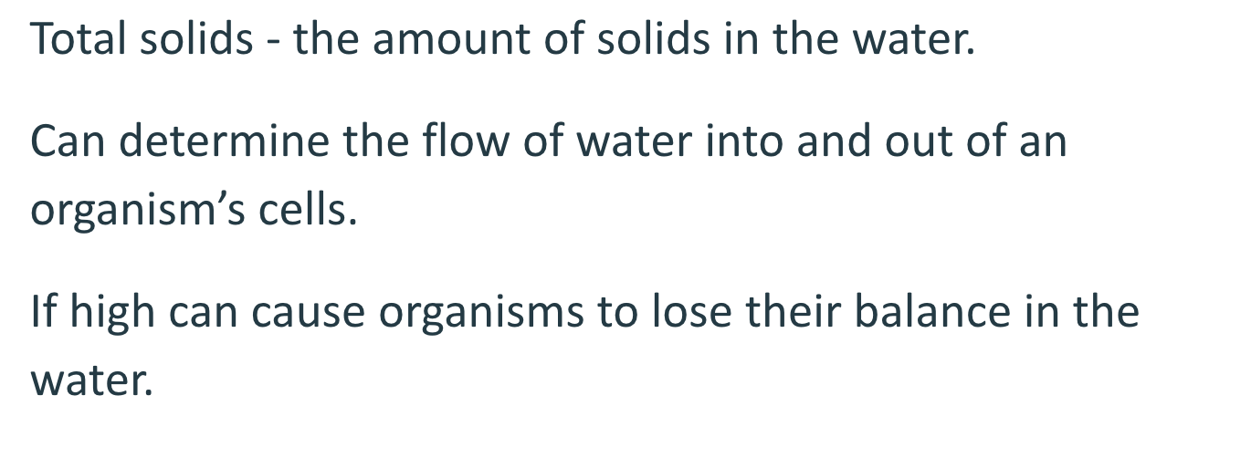
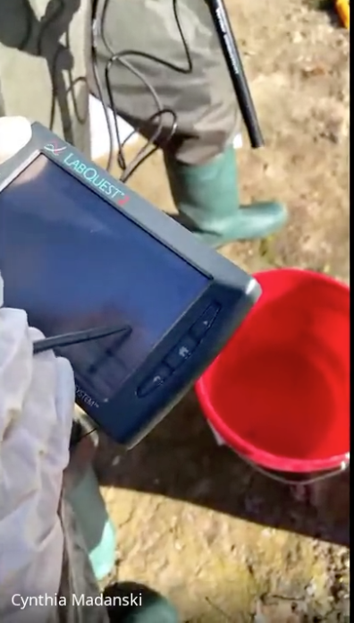
Total Solids Protocol
Total solids, TS, is a measure of all the suspended, colloidal, and dissolved solids in a sample of water. This includes dissolved salts such as sodium chloride, NaCl, and solid particles such as silt and plankton. An excess of total solids in rivers and streams is a very common problem.

Slide 35
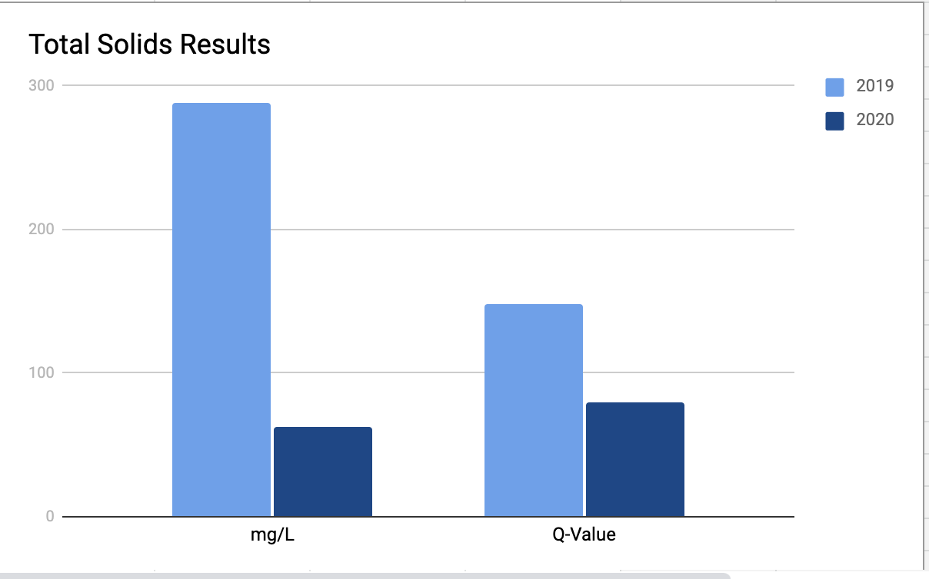
Total Solids Data
year | mg/L | Q-Value
2019 | 288 | 62
2020 | 148 | 80

Slide 36
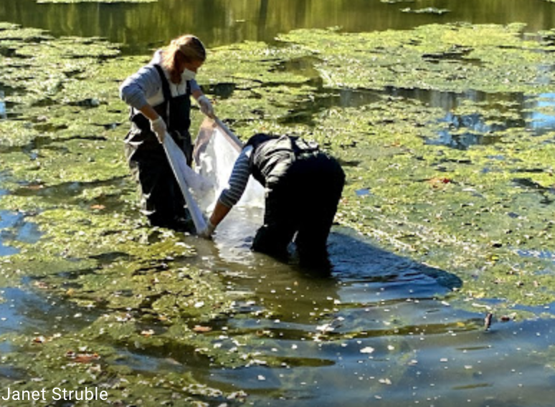
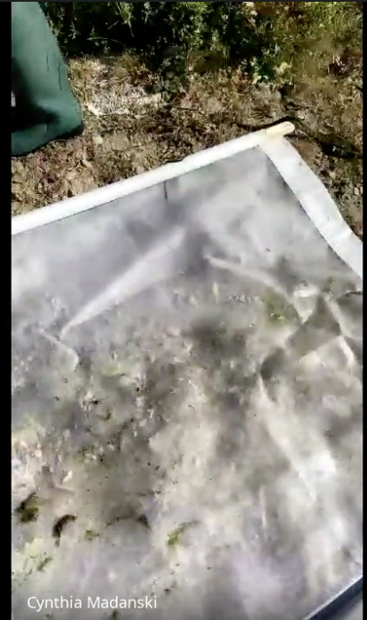
Macroinvertebrates Protocol
Macroinvertebrates are small animals without a backbone that can be seen without a microscope. They are an important part of the food chain. Macroinvertebrates can tell us a lot about the conditions within a water body. Many macroinvertebrates are sensitive to changes in pH, dissolved oxygen, temperature, salinity, turbidity and other changes in their habitat.

Slide 37
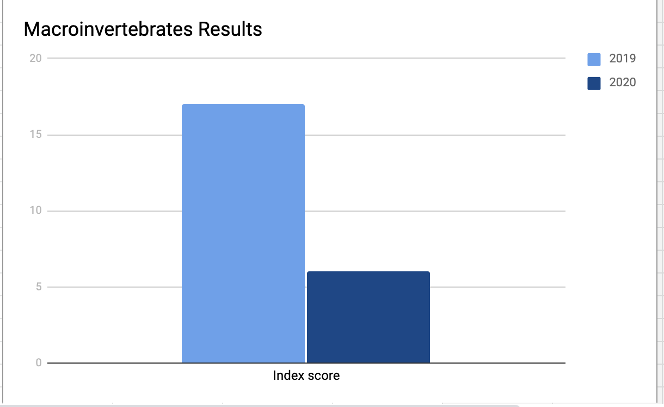
Macroinvertebrates Results
year | index score | Q-Value
2019 | 17 | good
2020 | 6 | poor

Slide 38
Discussion (Interpreting Data)
protocol | best water quality index year
change in water temperature | tie
pH | tie
dissolved oxygen | 2020
water transparency (turbidity) | 2020
BOD | 2020
phosphate | 2019
nitrate | 2019
fecal coliform bacteria | 2019
total solids | 2020
macroinvertebrates | 2019
Overall water quality index score | 2019
2019 had 4 tests with a better water quality index score
2020 had 4 tests with a better water quality score
2 tests had the same water quality index score in both years.
Overall water quality score in 2019 = 77
Overall water quality score in 2020 = 75

Slide 39
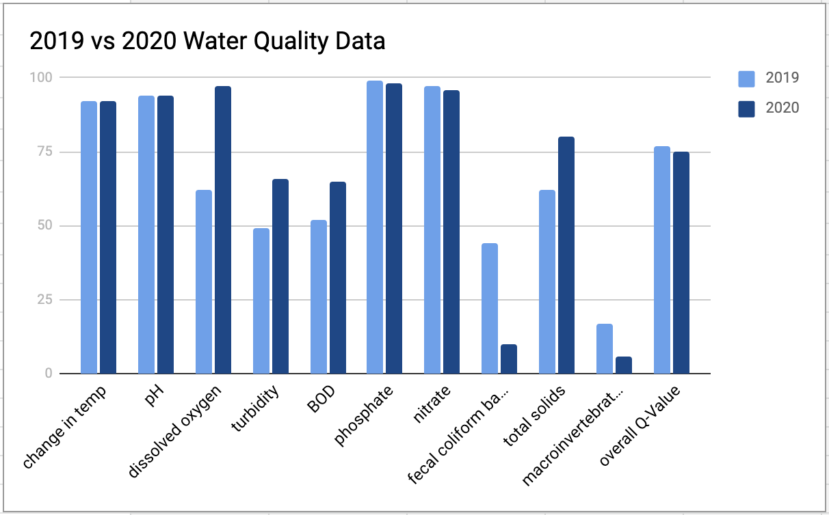
Graph of all water quality tests in 2019 and 2020

Slide 40
Conclusions (Drawing Conclusions)
We found 2019 had better water quality than 2020. The overall water quality score in 2019 was 77 and the overall water quality score in 2020 was 75.
The biggest difference between years was the fecal coliform bacteria. In 2019 we only found 100 colonies of bacteria per 100mL of river water, and that was a Q-Value of 44. However in 2020 we found 7,200 colonies of bacteria on the coliform plate, which calculates to a Q-Value of only 10. 10 is a very low score, and a big concern for our water.
The amount of macroinvertebrates found in 2020 was also an area of concern. We only found leeches, scuds, and gilled snails.

Slide 41
Conclusions (Next Steps)
The fecal coliform bacteria scores were very alarming. We learned that fecal coliform bacteria is bacteria found in the feces of animals. Some, but not all, can cause disease. It would be interesting to dig deeper and learn how to identify if the bacteria we found is disease causing. With such a high amount of fecal coliform bacteria, we are hypothesizing that some of it could be E.Coli or other disease causing bacteria. Due to the fecal coliform bacteria findings, we determined that the river is NOT safe for Mohawk and other dogs to swim in.

Slide 42
Bibliography
Blue, Circle of. “Toxic Algae Bloom Leaves 500,000 Without Drinking Water in Ohio.” EcoWatch, EcoWatch, 28 July 2017, www.ecowatch.com/toxic-algae-bloom-leaves-500-000-without-drinking-water-in-ohio-1881940537.html.
gellison@mlive.com, Garret Ellison |. “It Begins. A Moderate Toxic Algae Bloom Is Forming in
Lake Erie.” Mlive, 10 July 2020,
www.mlive.com/public-interest/2020/07/it-begins-a-moderate-toxic-algae-bloom-is-forming-in-lake-erie.html.
“GLOBE Science Data Visualization.” GLOBE Visualization, vis.globe.gov/GLOBE/.
National Oceanic and Atmospheric Administration, noaa.gov/.
Turbidity and Water, www.usgs.gov/special-topic/water-science-school/science/turbidity-and-water?qt-science_center_objects=0#qt-science_center_objects.

