Slide 1
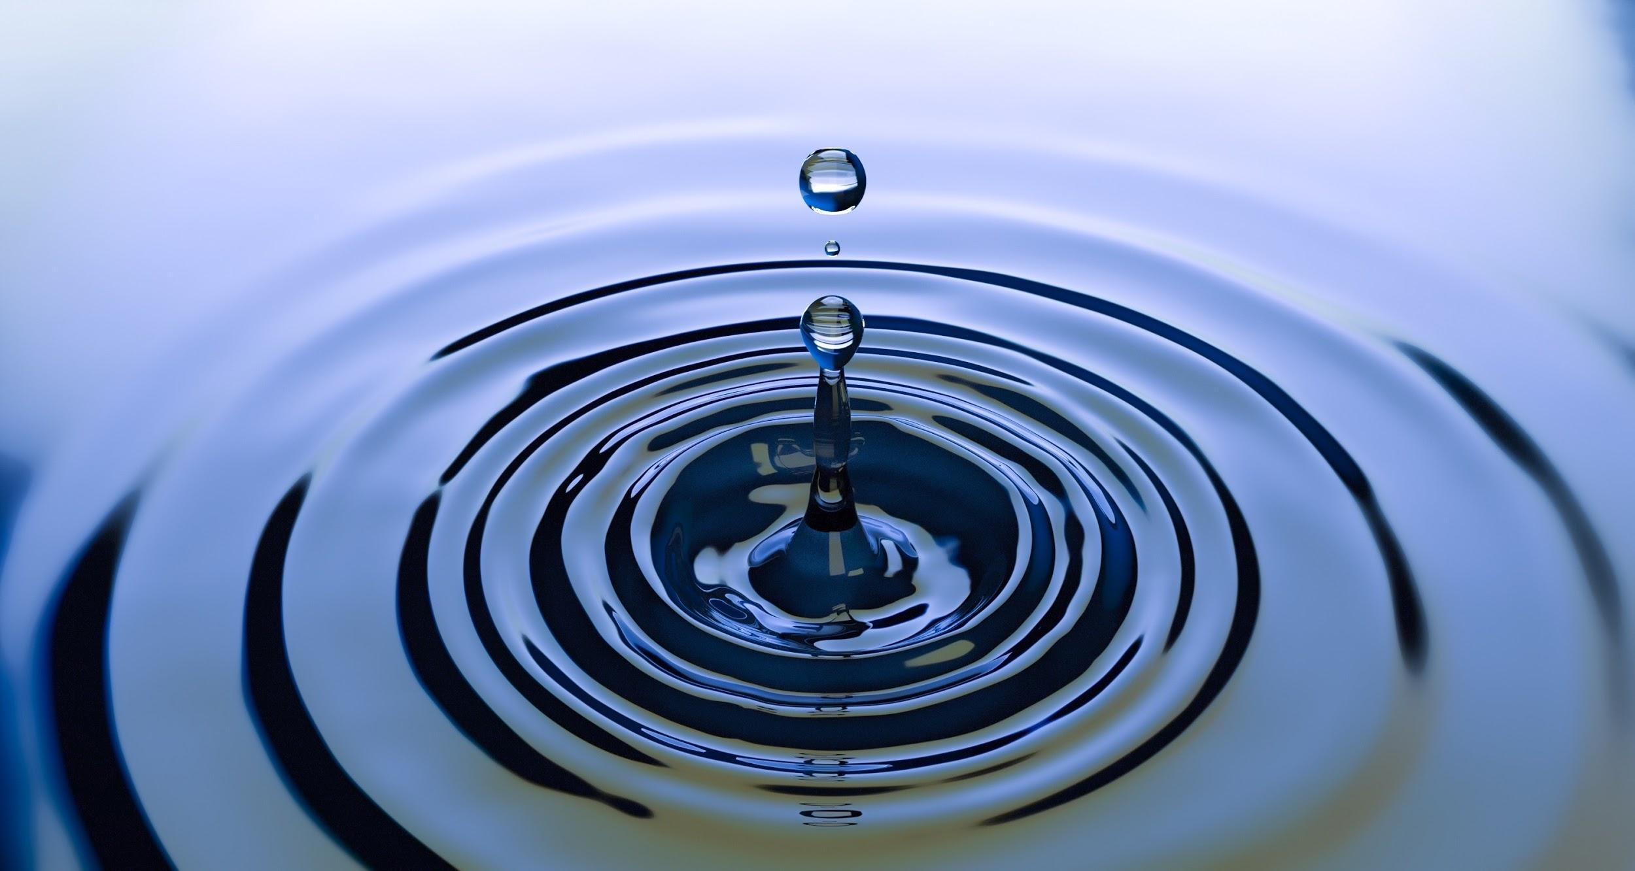
Hydrosphere
The Water on the Earth
By: Tiahna, Aajanae, Amanda and Yasmin

Slide 2





The Hydrosphere
r
r
The hydrosphere is all about the water on the Earth. The hydrosphere interacts with the other spheres by giving lots of water to one sphere and then the next. This process affects each sphere in many different ways They all interact to make life happen on earth by giving water.

Slide 3
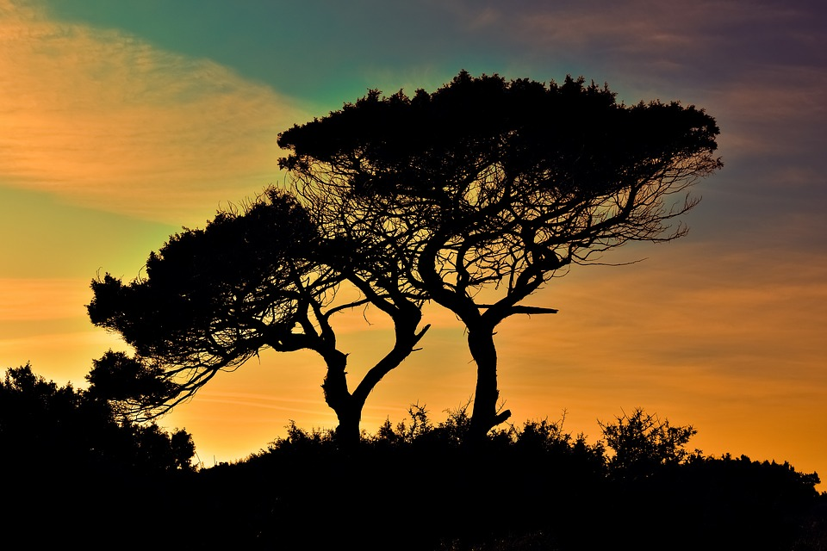
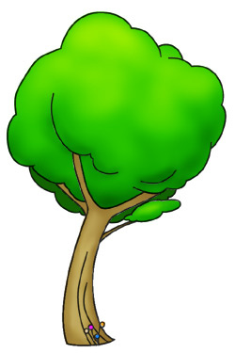
How the Hydrosphere interacts with Biosphere
The hydrosphere interacts with the biosphere by giving water to humans, plants and all other living creatures.By giving water to plants that helps us humans and animals by growing food so we can eat. Giving water to us humans, to help us not become thirsty.

Slide 4
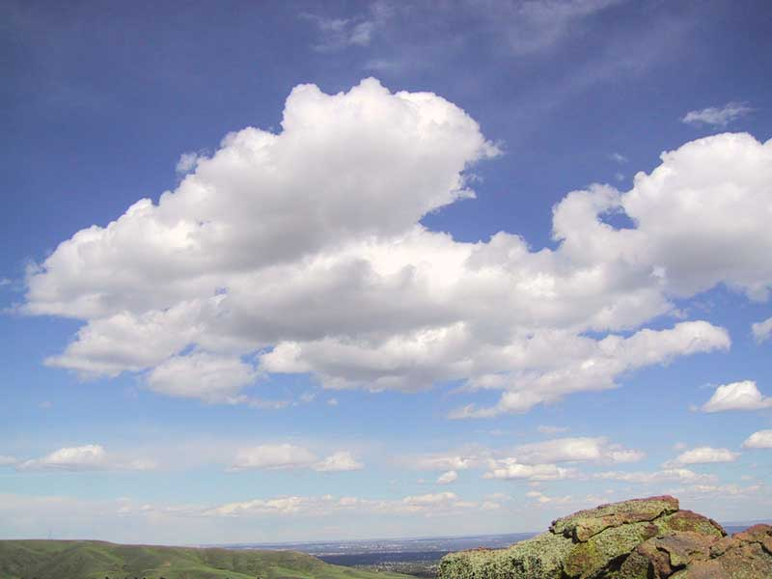


How Hydrosphere interacts with Atmosphere
Hydrosphere interacts with Atmosphere from evaporation, when the water is on the ground the water evaporates with all the dust particles with the gases as well and when they are both near the sky they combine with heat and they make a cloud together.
Notes:
the hydrosphere interacts with the Atmosphere by giving it water

Slide 5


How hydrosphere interacts with Geosphere
Hydrosphere interacts with the Geosphere by making new land.How this works is that on a beach the water is going back and forth, the sand is slowly going to the bottom of the ocean. that is called erosion.

Slide 6
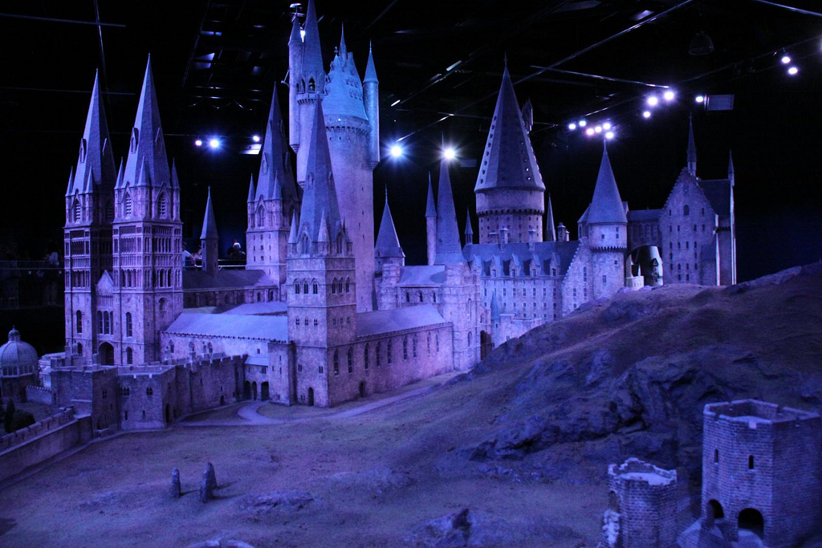





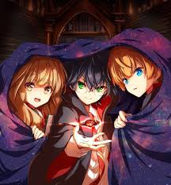
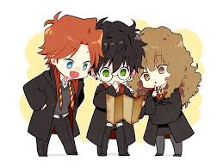
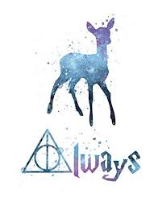
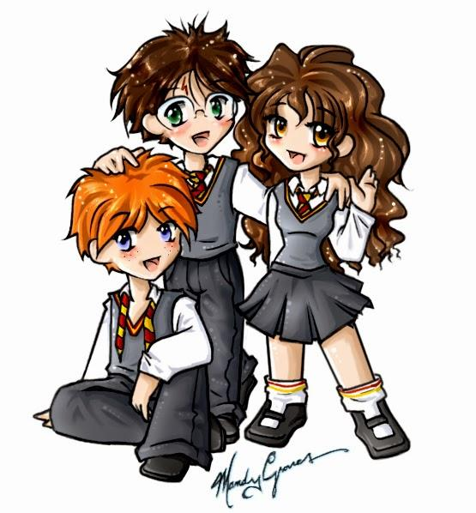
artist
Tiahna

Slide 7
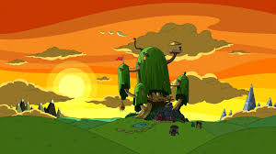
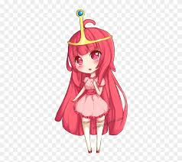


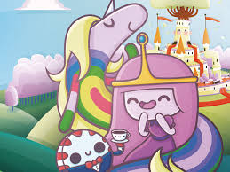


Designer
Aajanae

Slide 8


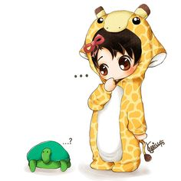
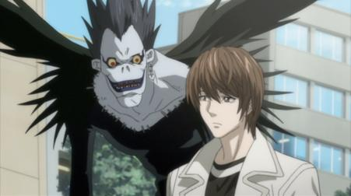
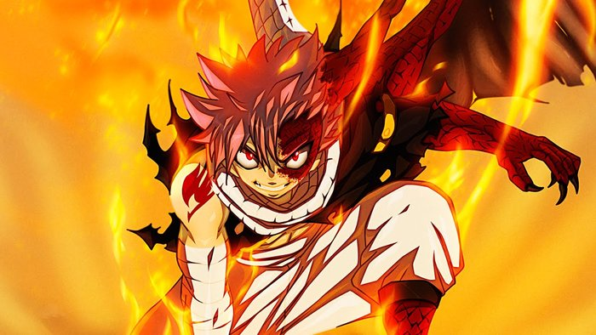



researcher
Yasmin

