Slide 1



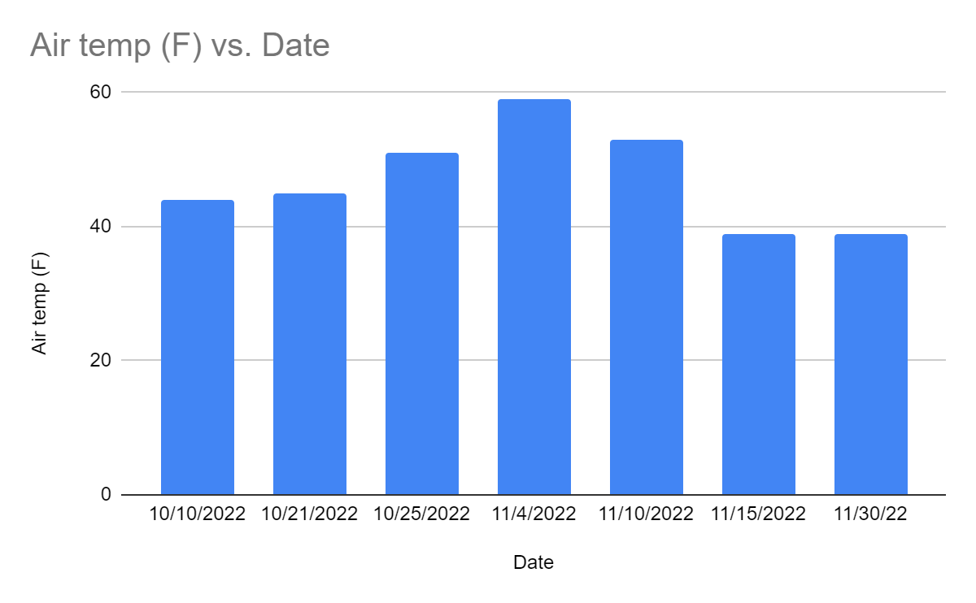
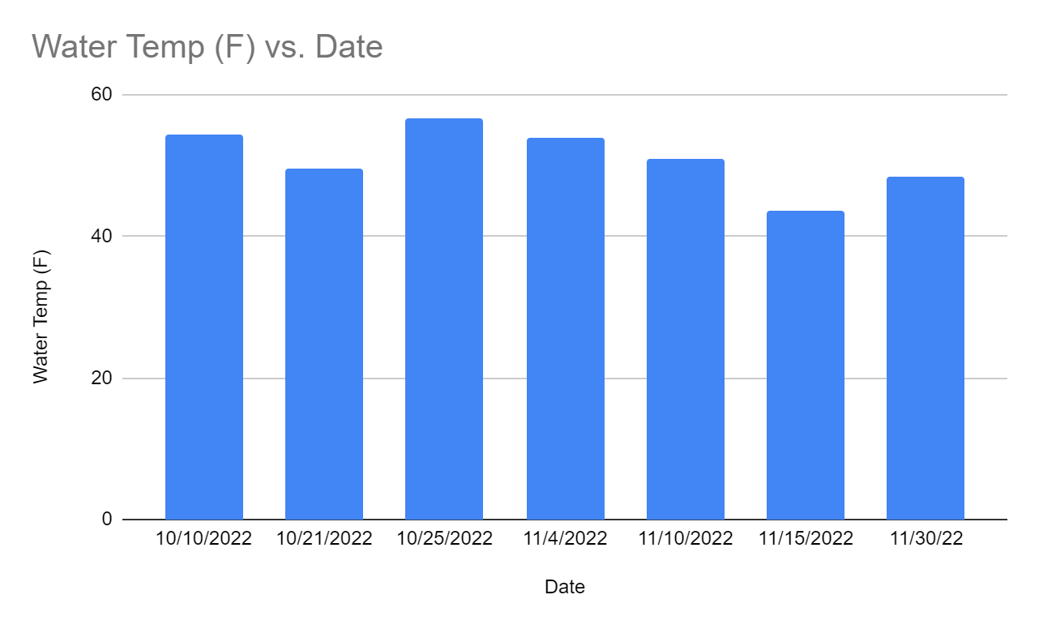
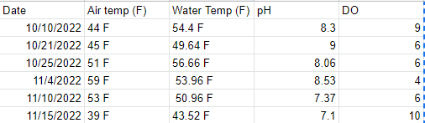
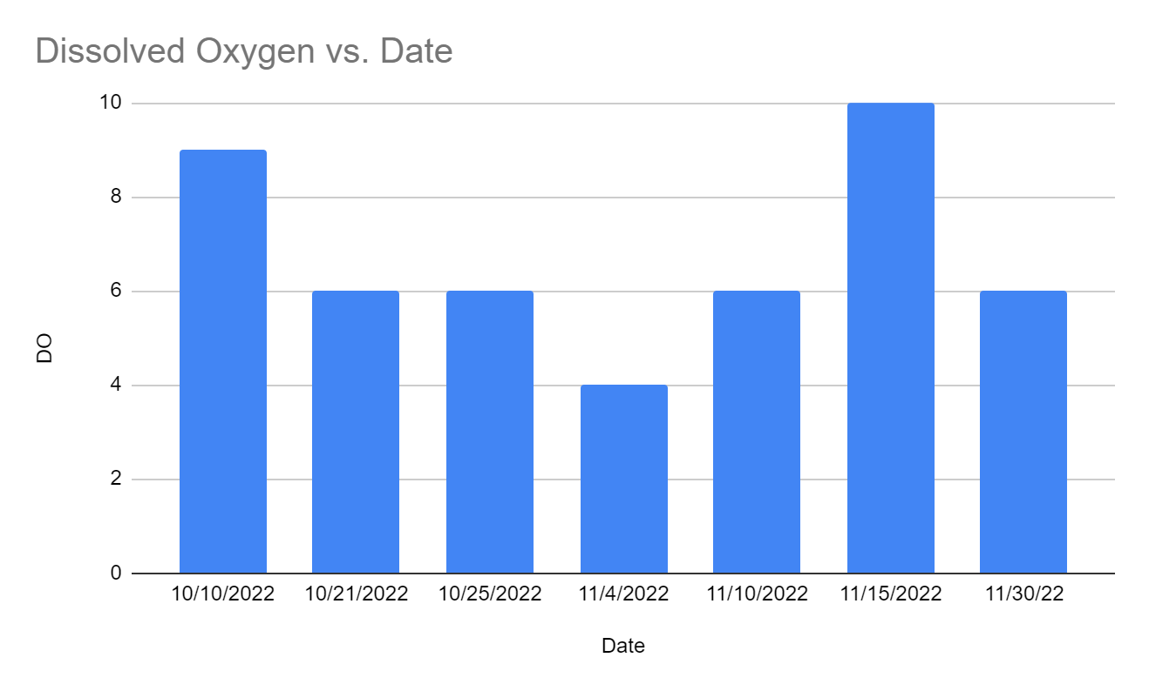
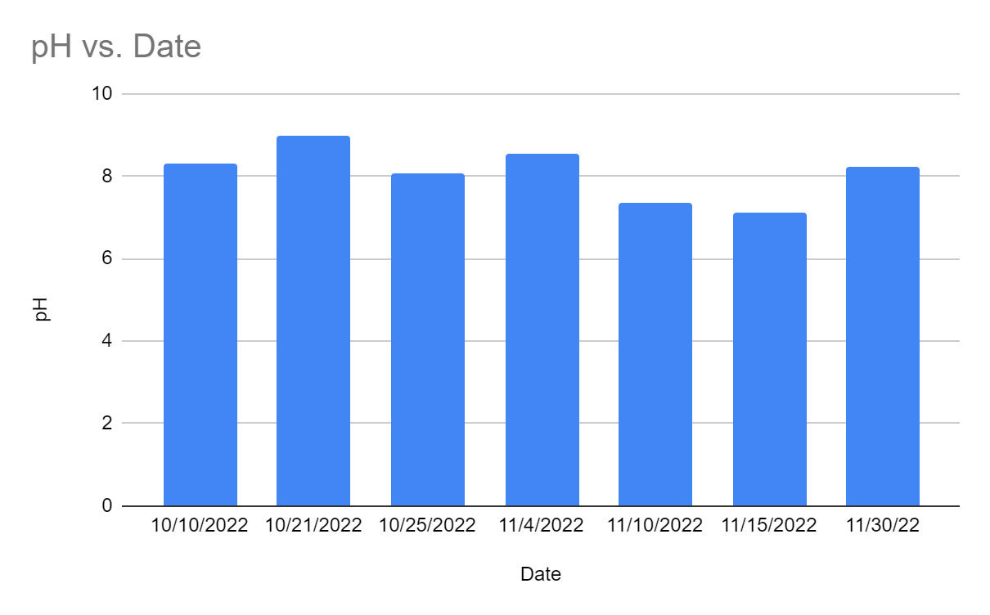
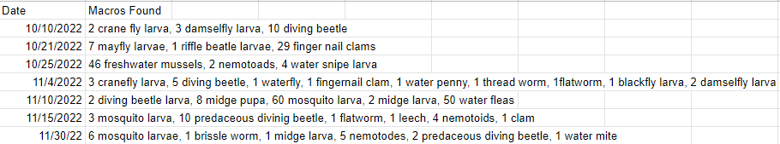

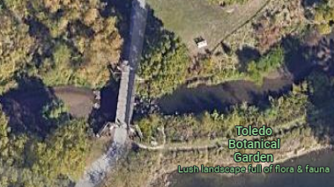
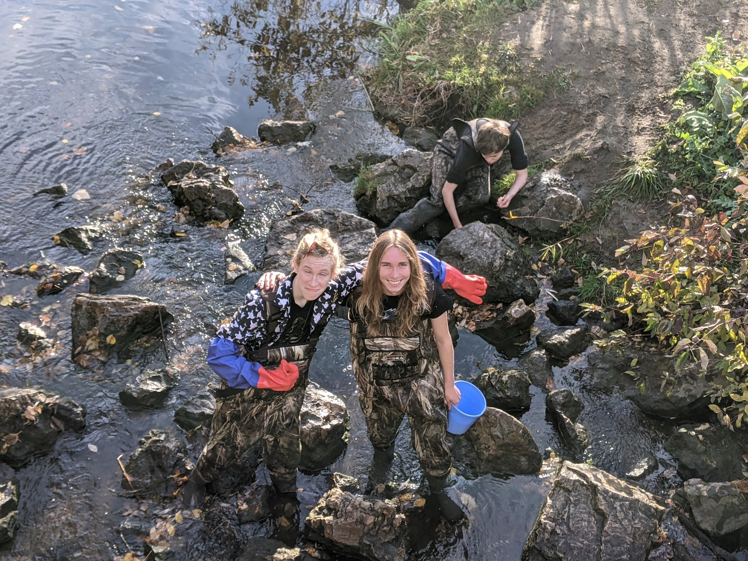
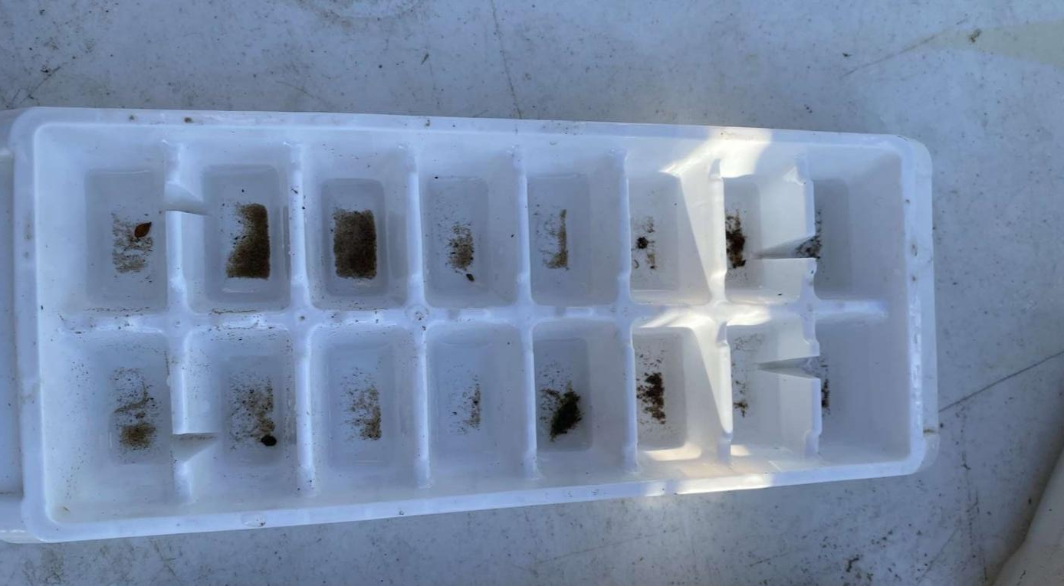
Macroinvertebrate Creek Data
Billy Orth, þora Behnfeldt
Toledo Natural Science Technology Center
Introduction
Abstract
How does macroinvertebrate population change from fall to winter in Toledo Botanical Garden's creek? Do some populations die out?
Macroinvertebrates are important to our environment because they can be indicators of stream health and stream species’ health.
Macroinvertebrates can be utilized to find negative aspects that are affecting our water. Examples of this would include stressors in the water that are attacking aquatic life, and pollutants in the water. On the positive side, macroinvertebrates can also indicate improvement in water quality. (Melissa A. Kenney, Ariana E. Sutton-Grier, Robert F. Smith, and Susan E. Gresens, 2009)
Macroinvertebrates have a very important role in the translocation of materials, nutrient cycles, decomposition, and primary productivity. (J. Bruce Wallace and Jackson R. Webster, 1994)
In this article, the authors talk about how threatened freshwater rivers and ecosystems are. In Argentina they have set up protected areas for these freshwater ecosystems to keep the organisms and plant life safe (Carolina Nieto, Ximena M.C. Ovando, Rafeal Loyla, Andrea Izquierdo, Fatima Romero , Carlos Molineri, Jose Radriguez, Paola Rueda Martin, Hugo Fernandez, Veronica Manzo, and Maria Jose Miranda, 2009)
Hoosier Riverwatch, the Isaak Walton League, save our streams program, and the kentucky watershed watch talk about the benefits to using macroinvertebrates to check the quality of the water, (Hoosier Riverwatch, 2016)
In this research project, the objective was to find out how temperature affects how abundant macroinvertebrate species will be. All data was collected from TBG’s (Toledo Botanical Garden) creek. The hypothesis of this project was that with colder weather there will be less macroinvertebrates in the creek, the data that was collected proves this correct.
Macroinvertebrate population abundance is affected by seasonal change.
Results
The chart above is data that we collected in our field of research. This data shows the dates that data was collected as well as information about the temperature of both water and the air, pH of the water, and dissolved oxygen of the water.
Hypothesis
When the season changes from fall to winter and the temperature drops then we will find less macroinvertebrate populations. This is because the macroinvertebrates will not survive as well in the cold.
This data shows the macroinvertebrates that were found for each day that we went out to collect research.
Objective
The purpose of this research project is to find out if the temperature has an effect on macroinvertebrate population.
The data above are CIV (Cumulative Index Value) scores that came from Ohio Department of Natural Resources SQMA (Stream Quality Monitoring Assessment) forms. These forms are used to monitor stream quality based on the macroinvertebrates found. This collection of information was stopped after three days of research. The reason behind this is that these forms did not include seven of the species that we collected. Due to the lack of presence of these species on these sheets, our data was inconclusive.
Conclusion
Methods
In conclusion, our hypothesis was correct. We hypothesized that as the season changed and the weather got colder, we would find less macroinvertebrates in TBG’s creek. As the temperature dropped, our data showed that we found less species of macroinvertebrates. There were some parts of this research project that did not go through how we intended. One of these things include how we originally thought and expected for the water temperature to be much colder as the season continued on. Water temperature did get colder but not nearly as much as anticipated. Additionally, we had planned to use Ohio Department of Natural Resources SQMA CIV scores to measure the water quality rating. However, there were complications that prevented us from doing so. These complications were that there were seven different species that we found that were not included in the SQMA forms. Due to that, we were unable to fully use these sheets without having incomplete data.
In the field:
Collect our materials and go to TBG
Take air temperature, water temperature, pH, and dissolved oxygen of creek water
Collect rocks and bring them to a table where we will pick off macros with tweezers
Use a d-net and kick-net to collect macroinvertebrates
Separate all macros by species into ice tray compartments
Identify and record macros found
Return macros to creek
In the lab:
Organize our collected data onto a Google Sheet
Use Ohio Department of Natural Resources SQMA (Stream Quality Monitoring Assessment) forms to record information collected.
Looking at the data that has been collected, determine if our hypothesis is accurate and true.
Map of Hill Ditch, our research field, at Toledo Botanical
Researchers Behnfeldt (left) and Orth (right) collecting research at Hill Ditch, Toledo Botanical Gardens
Acknowledgments
QR Code
Individuals who we would like to thank for assisting us with this project would include our classmates, Autumn Moore, Mrs. Kubiak, Mrs. Friar, and Mr. Steele.
References
Kenney, M. A., Sutton-Grier, A. E., Smith, R. F., & Gresens, S. E. (2009). Benthic macroinvertebrates as indicators of water quality: The intersection of science and policy. Terrestrial Arthropod Reviews 2 (2009) 99–128. https://doi.org/10.1163/187498209X12525675906077
Wallace, J. B., & Webster, J. R. (1994). THE ROLE OF MACROINVERTEBRATES IN STREAM ECOSYSTEM FUNCTION. Annu. Rev. Entomol. https://www.faculty.biol.vt.edu/webster%20publications%20pdfs/wallace%20and%20webster%201996.pdf
Nieto, C., Ovando, X. M., Loyola, R., Izquierdo, A., Romero, F., Molineri, C., Rodríguez, J., Rueda Martín, P., Fernández, H., Manzo, V., & Miranda, M. J. (2017). The role of macroinvertebrates for conservation of freshwater systems. Ecology and Evolution, 7(14), 5502–5513. https://doi.org/10.1002/ece3.3101
Riverwatch & Isaak Walton League. (2016). Making the Most of Your Monitoring Monitoring Using Macroinvertebrates! http://www.orsanco.org/wp-content/uploads/2016/11/makingthemostofyourmacros.pdf

