Slide 1
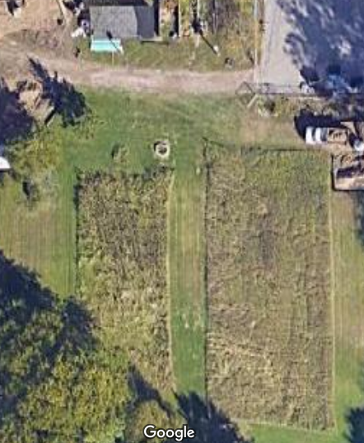
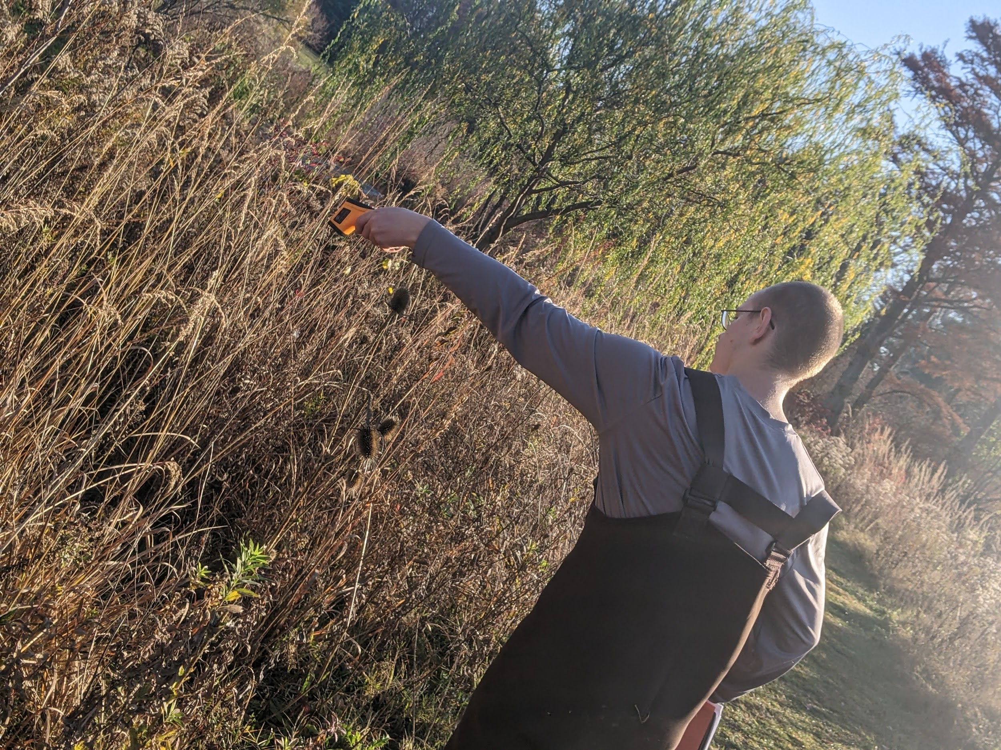
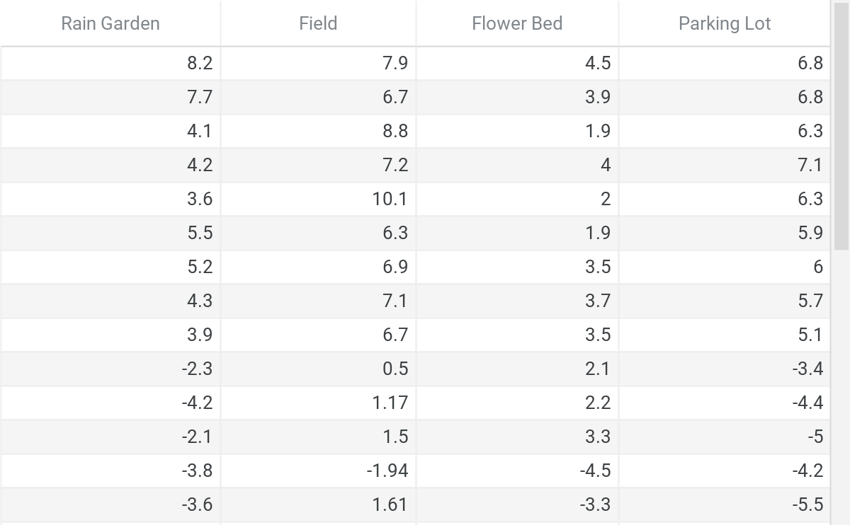
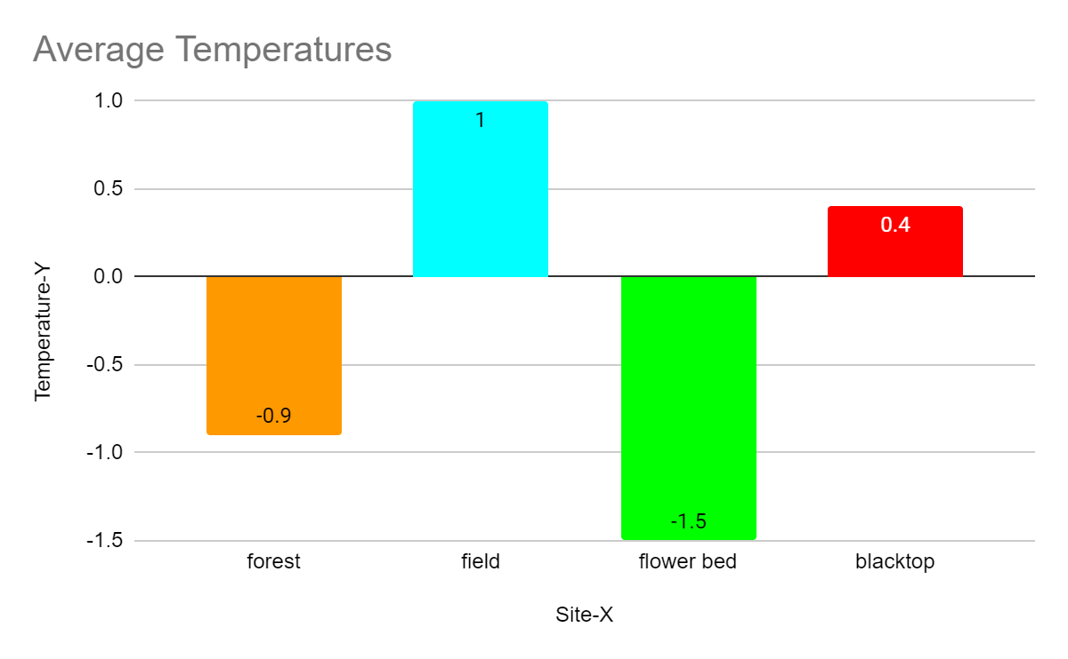
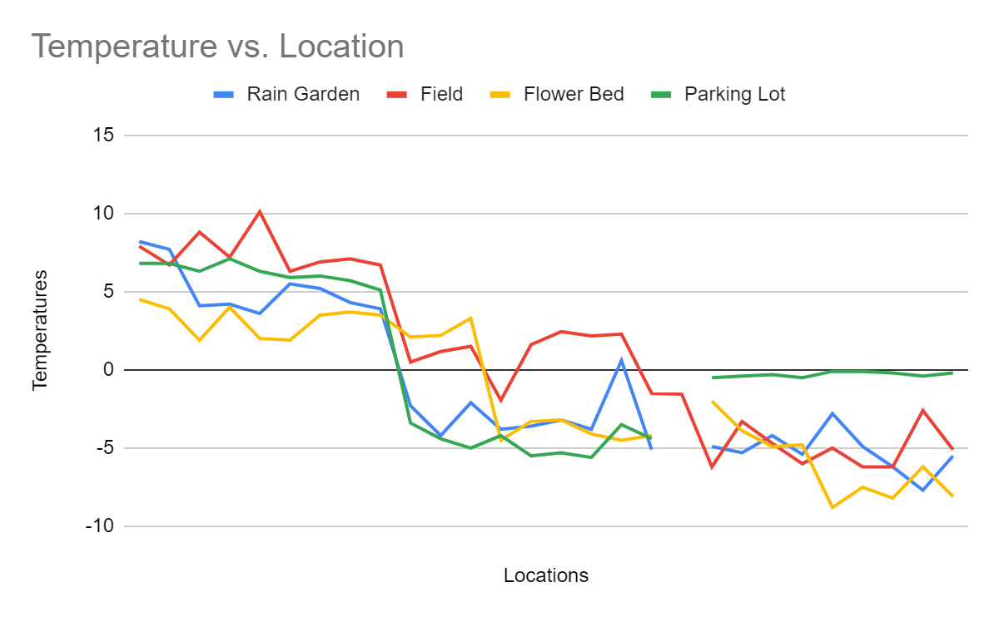
Garden Surface Temperatures
Sean Irelan
Natural Science Technology Center
Introduction
Abstract
Will the temperature of 4 different landscapes be around the same temperature.
I’m interested in how different landscapes affect the way temperature is held inside of them, how it cools off, and how human-made environments affect the temperature, compared to the wildernesses temperature. Surface air temperature deals with surface temperature because of how the air temperature affects the land’s temperature on the very top of the surface. I want to understand how air temperature affects the temperature of the land, how it increases it, how it decreases it, and how it leaves it at a standstill. Surface air temperature is affecting the land because of how the surface absorbs the temperature that the air and sun share with it, but it still gets cold at times. The surface can trap heat more efficiently because of the many materials that are in the soil. I want to find out what makes it so important that the land traps the heat, but also let’s go of the heat. (L. Mahrt)
The hypothesis is the forest will be the lowest temperature compared to the parking lot, field, and the flower bed.To understand why warm years tend to be dry, we have to examine how the sun’s energy interacts with water that is in or on the ground. When there is above-average precipitation, the ground holds more water. When the sun’s energy hits wet ground, a portion of it evaporates the water instead of warming the ground and the air, keeping temperatures lower. Also, above-average precipitation usually means more clouds, which prevents the sun’s energy from even reaching the ground, and that also keeps temperatures cooler.(NOAA, JAKE CROUCH)
I’m interested in how different landscapes affect the way temperature is held inside of them, how it cools off, and how human-made environments affect the temperature, compared to the wildernesses temperature. the forest will be the lowest temperature compared to the parking lot, field, and the flower bed. The hypothesis is the forest will be the lowest temperature compared to the parking lot, field, and the flower bed. Flower bed has the lowest temperature average than the rest of the locations that have been chosen. My results that the four finishing averages for temperature for each landscape are: -0.9(rain Garden), 1(Field), -1.5(Flower bed), and 0.4(Blacktop). I believe that the different landscapes store different heat, so the blacktop absorbed more heat, while the grass fed it into the ground, but the water cooled the ground off, so the more water there is, the cooler the landscape is.
Research about gardens and temperatures
Gather infrared thermometers, notebook, pencil, and people to help
Select field, flower garden, forest, and blacktop
Gather information about the locations and temperature intake
Put information into graph
Put graph onto poster
Insert GLOBE observer app information
Flower bed has the lowest temperature average than the rest of the locations that have been chosen.
-0.9(rain Garden), 1(Field), -1.5(Flower bed), and 0.4(Blacktop).
Results
My results that the four finishing averages for temperature for each landscape are: -0.9(rain Garden), 1(Field), -1.5(Flower bed), and 0.4(Blacktop).
Kosi River:
GRACE missed steep drop in AOD correlating to extreme flooding
Affected 2.3 million people in Bihar in North India
Embankments broke and the river changed course
Hypothesis
The hypothesis is the forest will be the lowest temperature compared to the parking lot, field, and the flower bed.
Objective
My objective is to collect temperature and look over them to see if there’s a consistent temperature in 4 different types of environments.
Conclusion
Methods
Rain Garden | Field | Flower Bed | Parking Lot
8.2 | 7.9 | 4.5 | 6.8
7.7 | 6.7 | 3.9 | 6.8
4.1 | 8.8 | 1.9 | 6.3
4.2 | 7.2 | 4 | 7.1
3.6 | 10.1 | 2 | 6.3
5.5 | 6.3 | 1.9 | 5.9
5.2 | 6.9 | 3.5 | 6
4.3 | 7.1 | 3.7 | 5.7
3.9 | 6.7 | 3.5 | 5.1
-2.3 | 0.5 | 2.1 | -3.4
-4.2 | 1.17 | 2.2 | -4.4
-2.1 | 1.5 | 3.3 | -5
-3.8 | -1.94 | -4.5 | -4.2
-3.6 | 1.61 | -3.3 | -5.5
-3.2 | 2.44 | -3.2 | -5.3
-3.8 | 2.17 | -4.1 | -5.6
0.6 | 2.28 | -4.5 | -3.5
-5.1 | -1.5 | -4.2 | -4.4
 | -1.56
-4.9 | -6.2 | -2 | -0.5
-5.3 | -3.3 | -3.9 | -0.4
-4.2 | -4.7 | -4.9 | -0.3
-5.4 | -6 | -4.8 | -0.5
-2.8 | -5 | -8.8 | -0.1
-4.9 | -6.2 | -7.5 | -0.1
-6.2 | -6.2 | -8.2 | -0.2
-7.7 | -2.6 | -6.2 | -0.4
-5.5 | -5.1 | -8.1 | -0.2
I believe that the different landscapes store different heat, so the blacktop absorbed more heat, while the grass fed it into the ground, but the water cooled the ground off, so the more water there is, the cooler the landscape is.
Research about gardens and temperatures
Gather infrared thermometers, notebook, pencil, and people to help
Select field, flower garden, forest, and blacktop
Gather information about the locations and temperature intake
Put information into graph
Put graph onto poster
Insert GLOBE observer app information
Acknowledgments
QR Code
I would like to thank my classmates for helping, Dr. Kevin Czajkowski for helping on my poster and giving me ideas for what to put on my poster and what to do for my data, my best friend for helping me get through when I almost gave up, and Mrs. Kubiak, Mr. Oswanski,and Mr. Steele for giving me ideas.
References
L, Mahrt, 2002
NOAA, Jake Crouch, 2017

