Slide 1
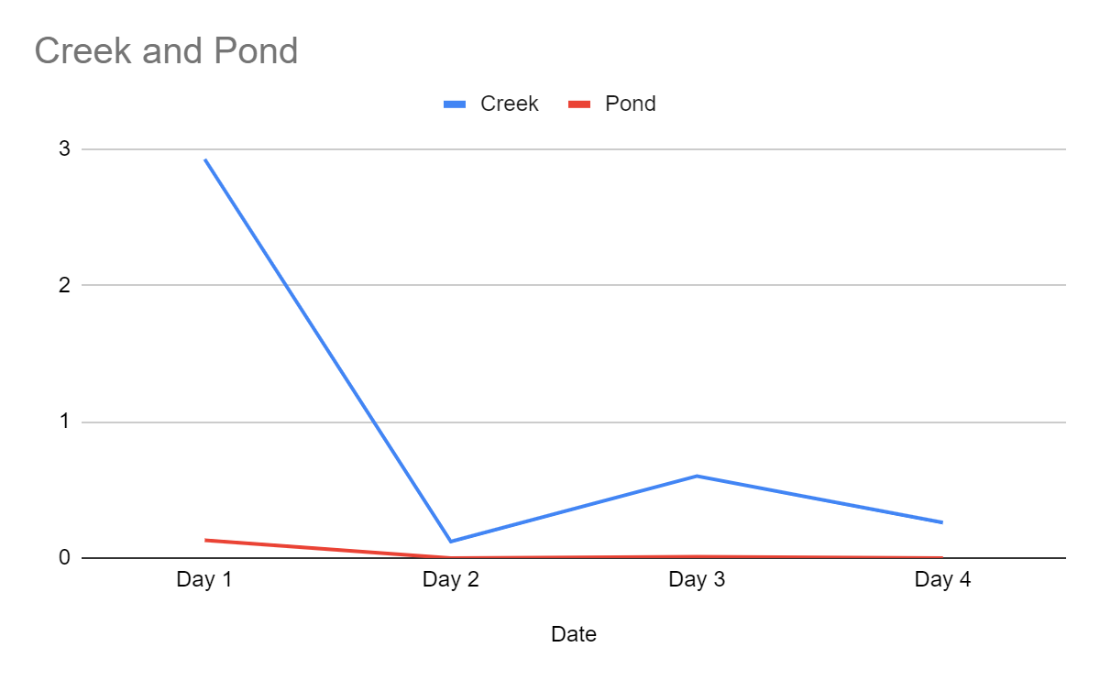
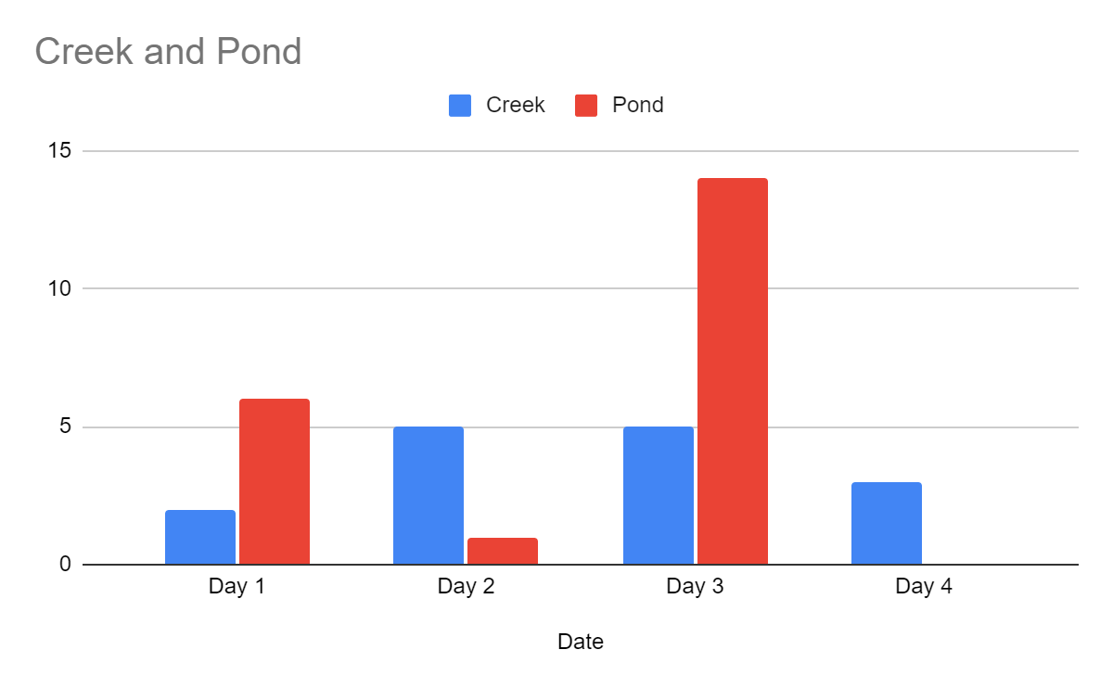
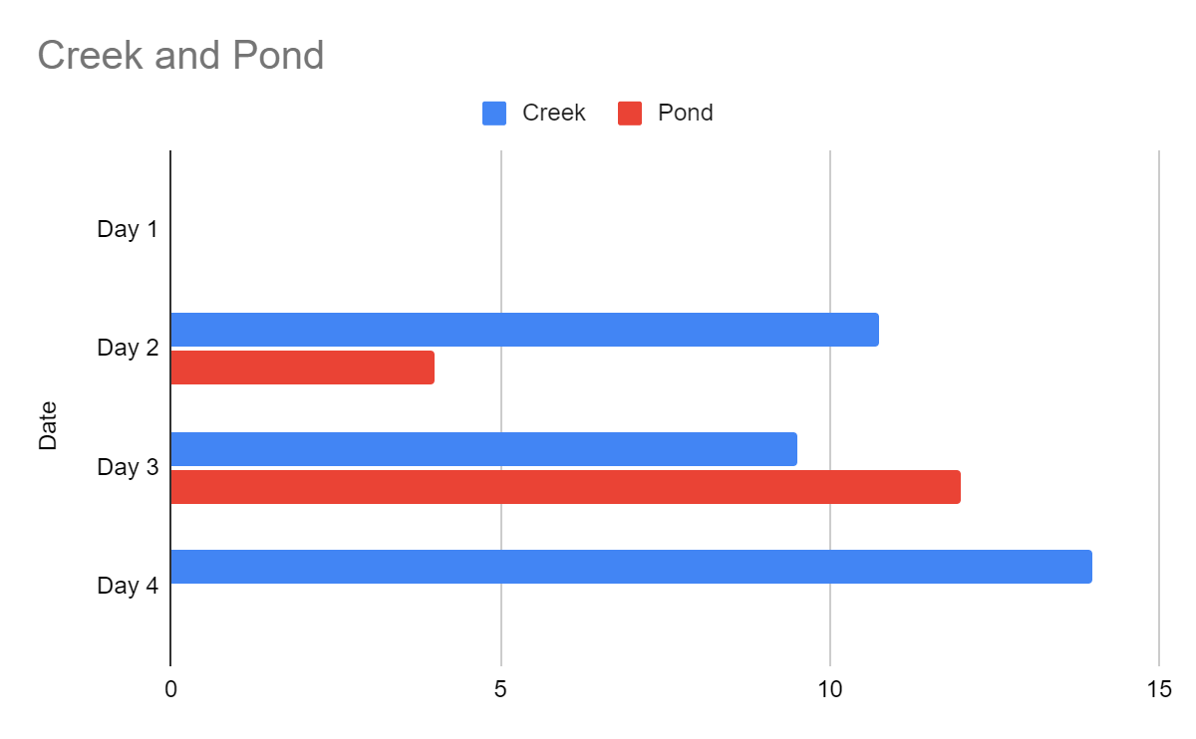
Creek V Pond At TBG
Natural Science Technology Center
Devon Hartford,Logan Zolciak
Introduction
Our project shows how the health of fish can indicate the quality of the water.
Our hypothesis is that the creek will produce more fish because it has a better flow of water.
This article (EPA 2022)talks about how fish will sense pollutants and even start relocating themselves to avoid poor water quality. So with that being said, the easiest way to identify the poor water quality is to evaluate fish assemblage.
The next article explains the purpose and difference between the different indicator species. They can be an important factor in determining the quality of the water because, they can die off or relocate themselves too find better water quality. Which is why we think the creek will produce more and healthier fish and determined the water health through fish size and weight (FDACS,2021).
Abstract
Due to flowing water the creek is the better habitat for fish according to results of abundance,size and weight.
Does the creek or pond have a higher abundance of fish and which is healthier? The creek is what we thought would produce more fish. After the traps were set, check the traps, measure the fish weight and length. We found the pond has a higher amount of fish but the creek had healthier ones.
Results
The creek had a higher relative abundance of fish than the pond. We came to this conclusion, because the fish were generally larger in the creek but the fish were caught more consistently than in the pond.
Fish size
Number of fish
Kosi River:
GRACE missed steep drop in AOD correlating to extreme flooding
Affected 2.3 million people in Bihar in North India
Embankments broke and the river changed course
Hypothesis
The creek will produce more fish because it has a better flow of water.
Objective
stream/creek 1
The objective is to determine whether the creek or pond has better water quality.
Creek 2
Conclusion
The conclusion is that the creek is healthier than the pond, because the creek has good health due to fish coloration and size. Even though the abundance of fish was higher in the pond
•The hypothesis was supported by the average size and weight but, not abundance of fish.
Methods
Go to creek and stream one
Head to creek 2, collect data
Head to pond 2 collect data
Reset traps or take them out
Measure the fishes weight and length
Measure the ph and turbidity of the water at each site and enter results into the globe database
Pond 2
Fish weight
Acknowledgments
QR Code
A thanks to Autumn Moore for her expertise in fish and indicator species knowledge.Also to Mr Steel for donating his time to come work in the field with us. Finally, a special thanks to Mrs. Kubiak for her assistance with getting in contact with professionals and setting things up to go as smooth as possible.
References
Fish Assemblage. (2022, June 16). US EPA. https://www.epa.gov/national-aquatic-resource-surveys/indicators-fish-assemblage
Aquarium Water Quality: pH. (2021). fdacs.gov. Freid https://fdacs.gov/Consumer-Resources/Recreation-and-Leisure/Aquarium-Fish/Aquarium-Water-Quality-pH

