Slide 1




Wind Tunnel Effect
Ben C.
Ms. Nugent
Grade 6
Nathan Bishop Middle School
This project connects to GLOBE Wind Protocols

Slide 2
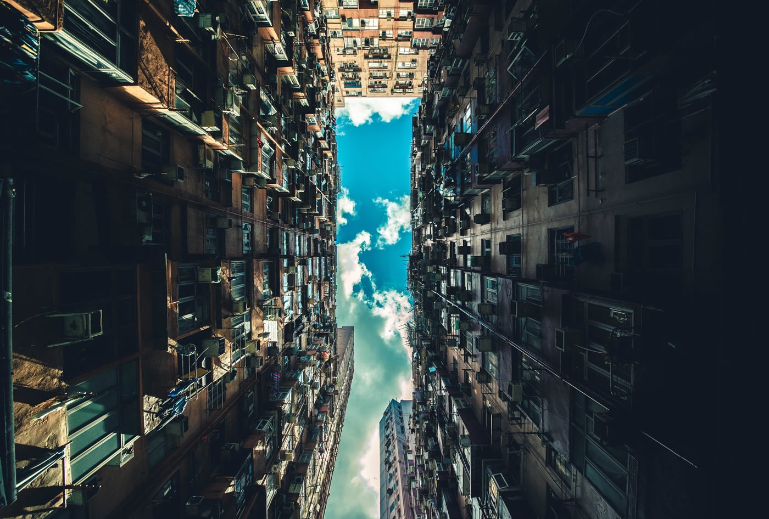
Research Questions OR What I Like About GLOBE
I will be researching why wind gets stronger in between buildings.

Slide 3
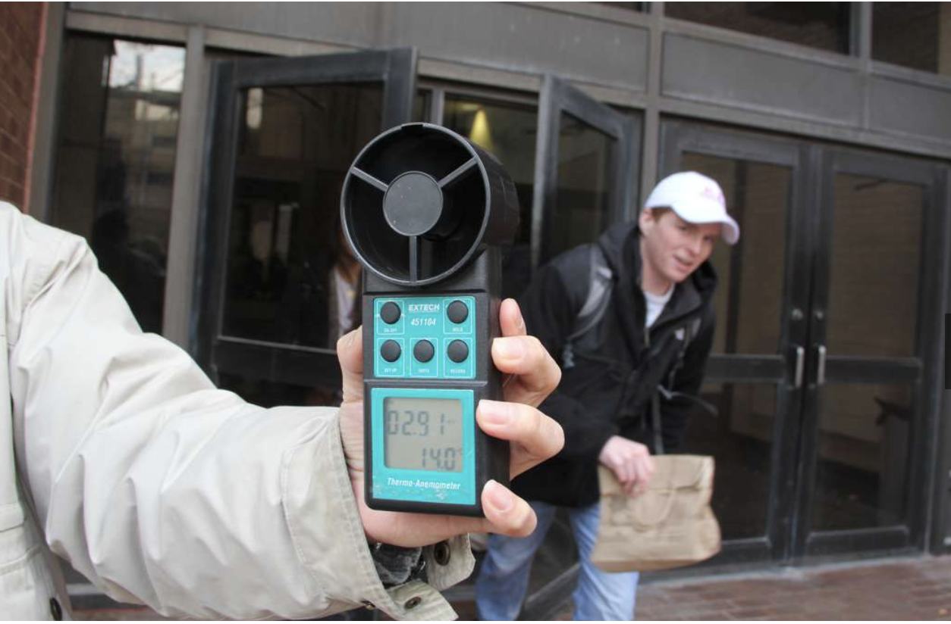
Predictions
I predict that wind will get stronger in between buildings.

Slide 4
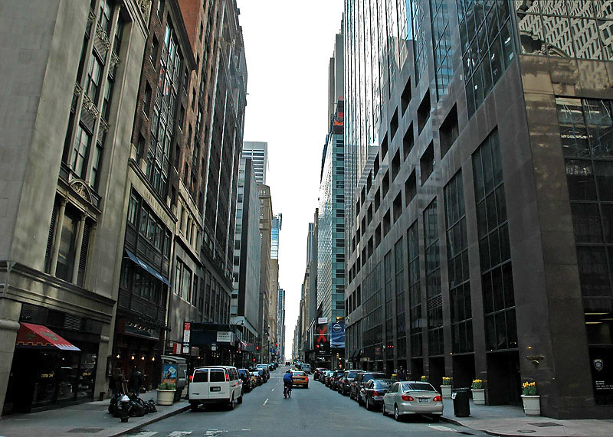
Methods of Data Collection
I will be researching online why wind gets stronger in between buildings.

Slide 5
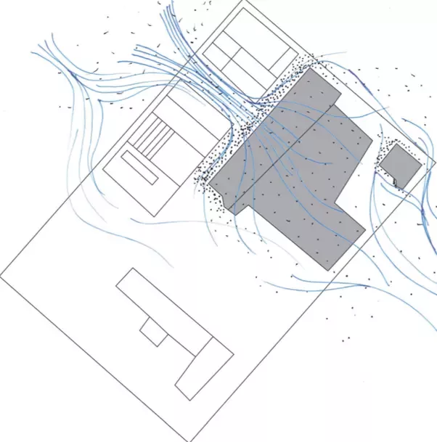
Results
The wind tunnel effect is when wind gets stronger in between buildings, because buildings are close together the air pressure drops, causing the wind to move faster and circle between the two buildings. There are a couple parts to a wind tunnel The Settling Chamber, the Contraction Cone, the Test Section, the Drive Section, and the Diffuser.
https://www.quora.com/Aerodynamics-What-is-a-wind-tunnel-effect

Slide 6
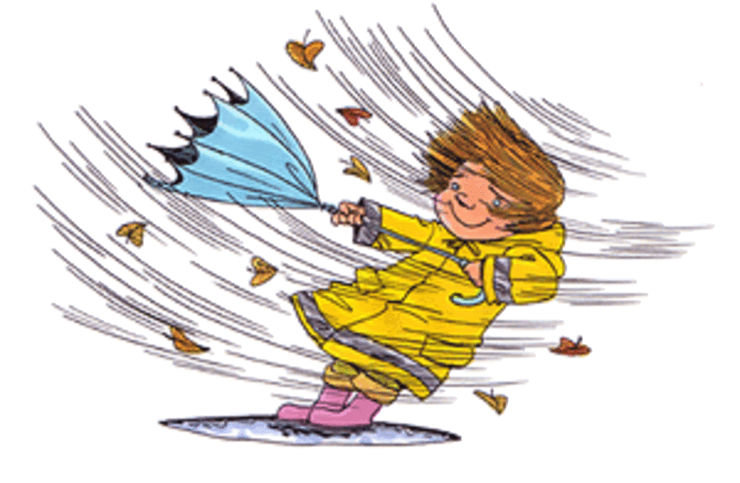
Conclusions and Future Work OR Something I would like do with GLOBE and NASA
It was fun to research the wind tunnel effect, I will do research like this next year if I have the chance.

Slide 7
References
https://whyy.org/segments/the-science-of-wind-tunnels-where-and-why-those-harsh-winds-strike/ - PBS

