Slide 1
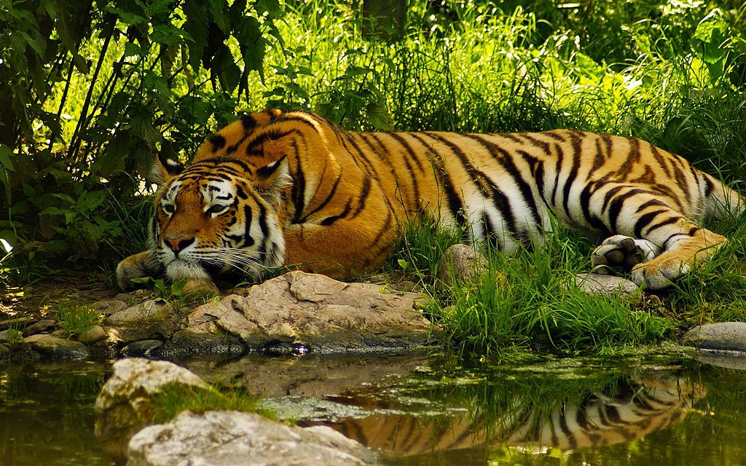
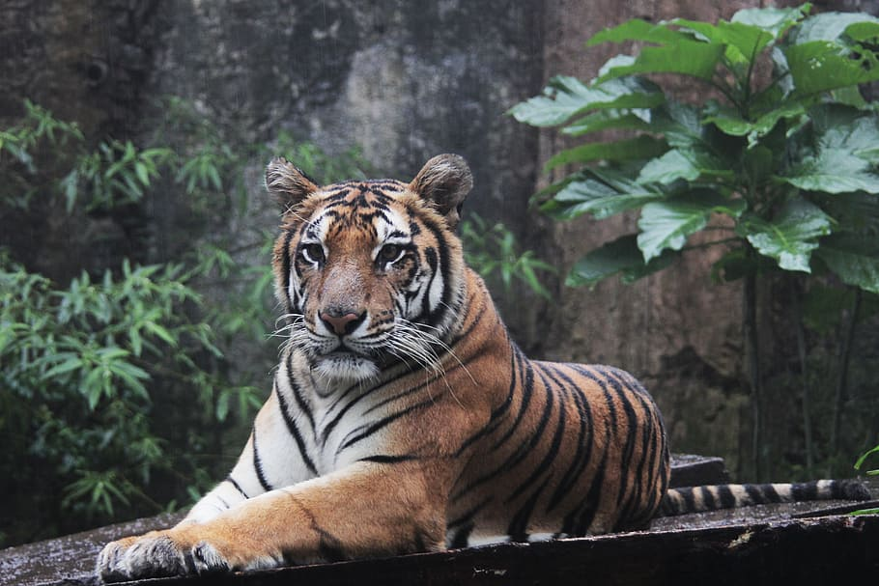
LETS SAVE TIGERS!!
Endangered Habitat Project
4/15/2020
By Yazmin

Slide 2
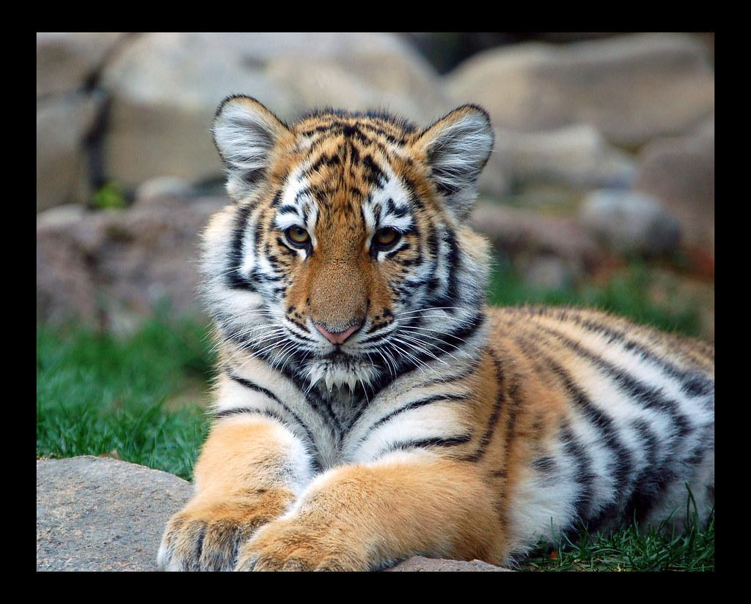
Why are Tigers Endangered?
The main reasons tigers are endangered:
1-illegal hunting for their pelts, meat and body parts used in human medicines
2-habitat loss that results from forest destruction and other forms of habitat loss.

Slide 3
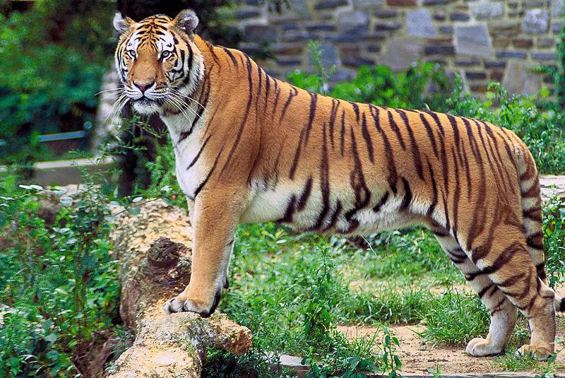
How will our Ecosystem be Without Tigers?
Our Ecosystem without tigers will not be good because Tigers are at the top of the food chain and without them deer, wild boar and all the animals they eat will expand too much!
Tigers keep these animals in check!! When One species goes extinct then the whole Ecosystem collapses!

Slide 4
How do we save Tigers?
We have to protect the tigers from their habitat so they can be safe. We have to reduce human-tiger killing because everybody knows the tiger will end up dying because humans always have guns with them when they are dealing with tigers. We have to promote Tiger-Friendly Policies or for short T.F.P. Last but not least we have to Monitor Tiger numbers, Popular trends, And threats to their Tiger habitat.
We have to stop taking tigers to the Zoo’s even though we love to see them there but that is also making the tiger numbers decrease. People Caging Tigers and selling them needs to stop! Take tigers out of the circus this is not good for them! They may seem happy in the show but behind the show they are being caged up and tortured. If you want to see tigers just go to India or Siberia and drive around to see them in their natural habitat. Save Tigers!

Slide 5
What is the Tiger population?
The tiger Population is………………………………………………………………………………………….
3,800 Tigers
are left in the whole world

Slide 6
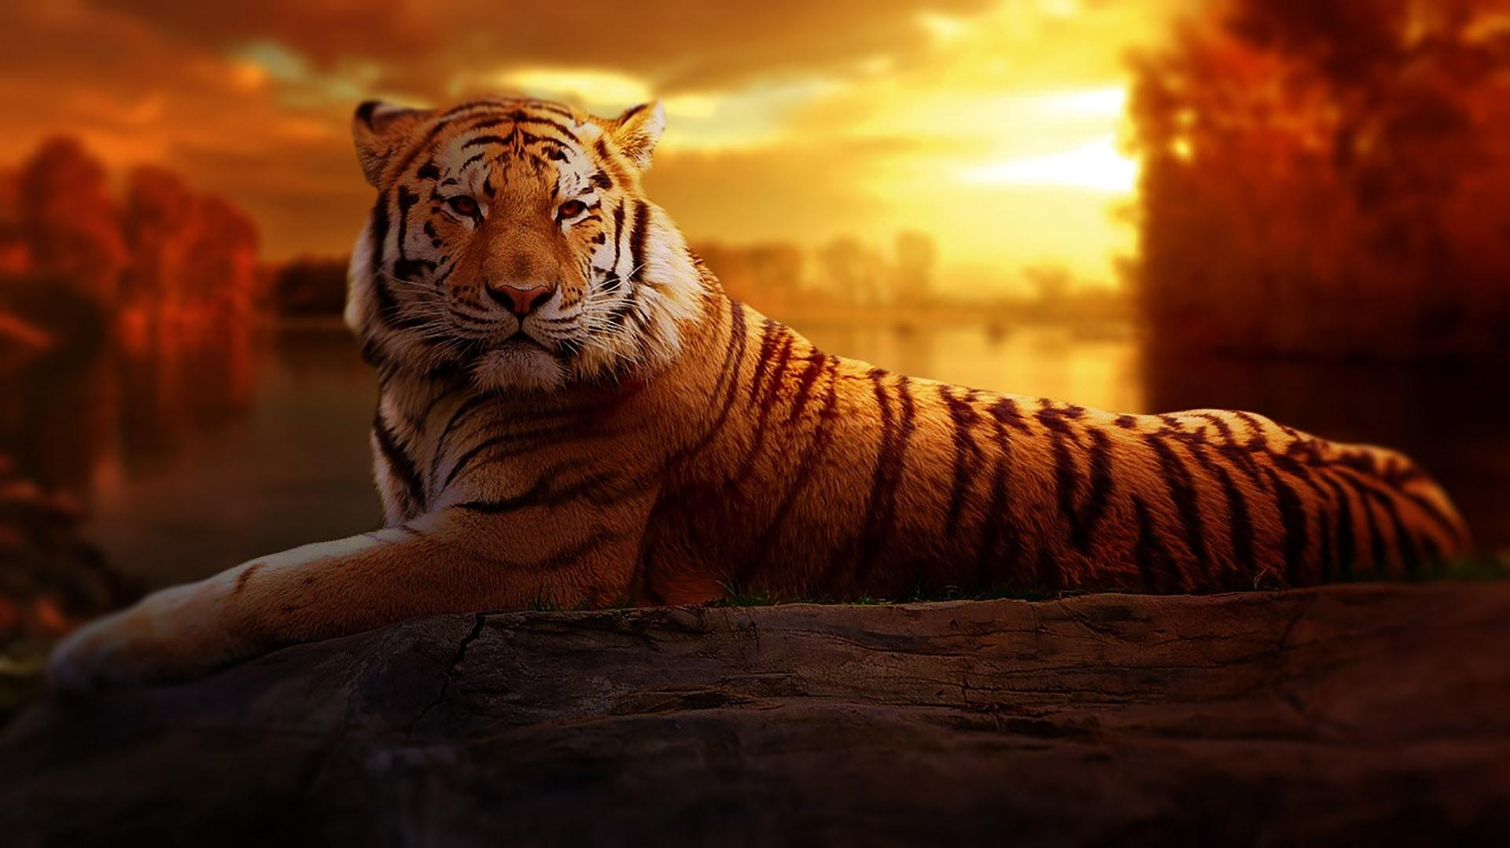
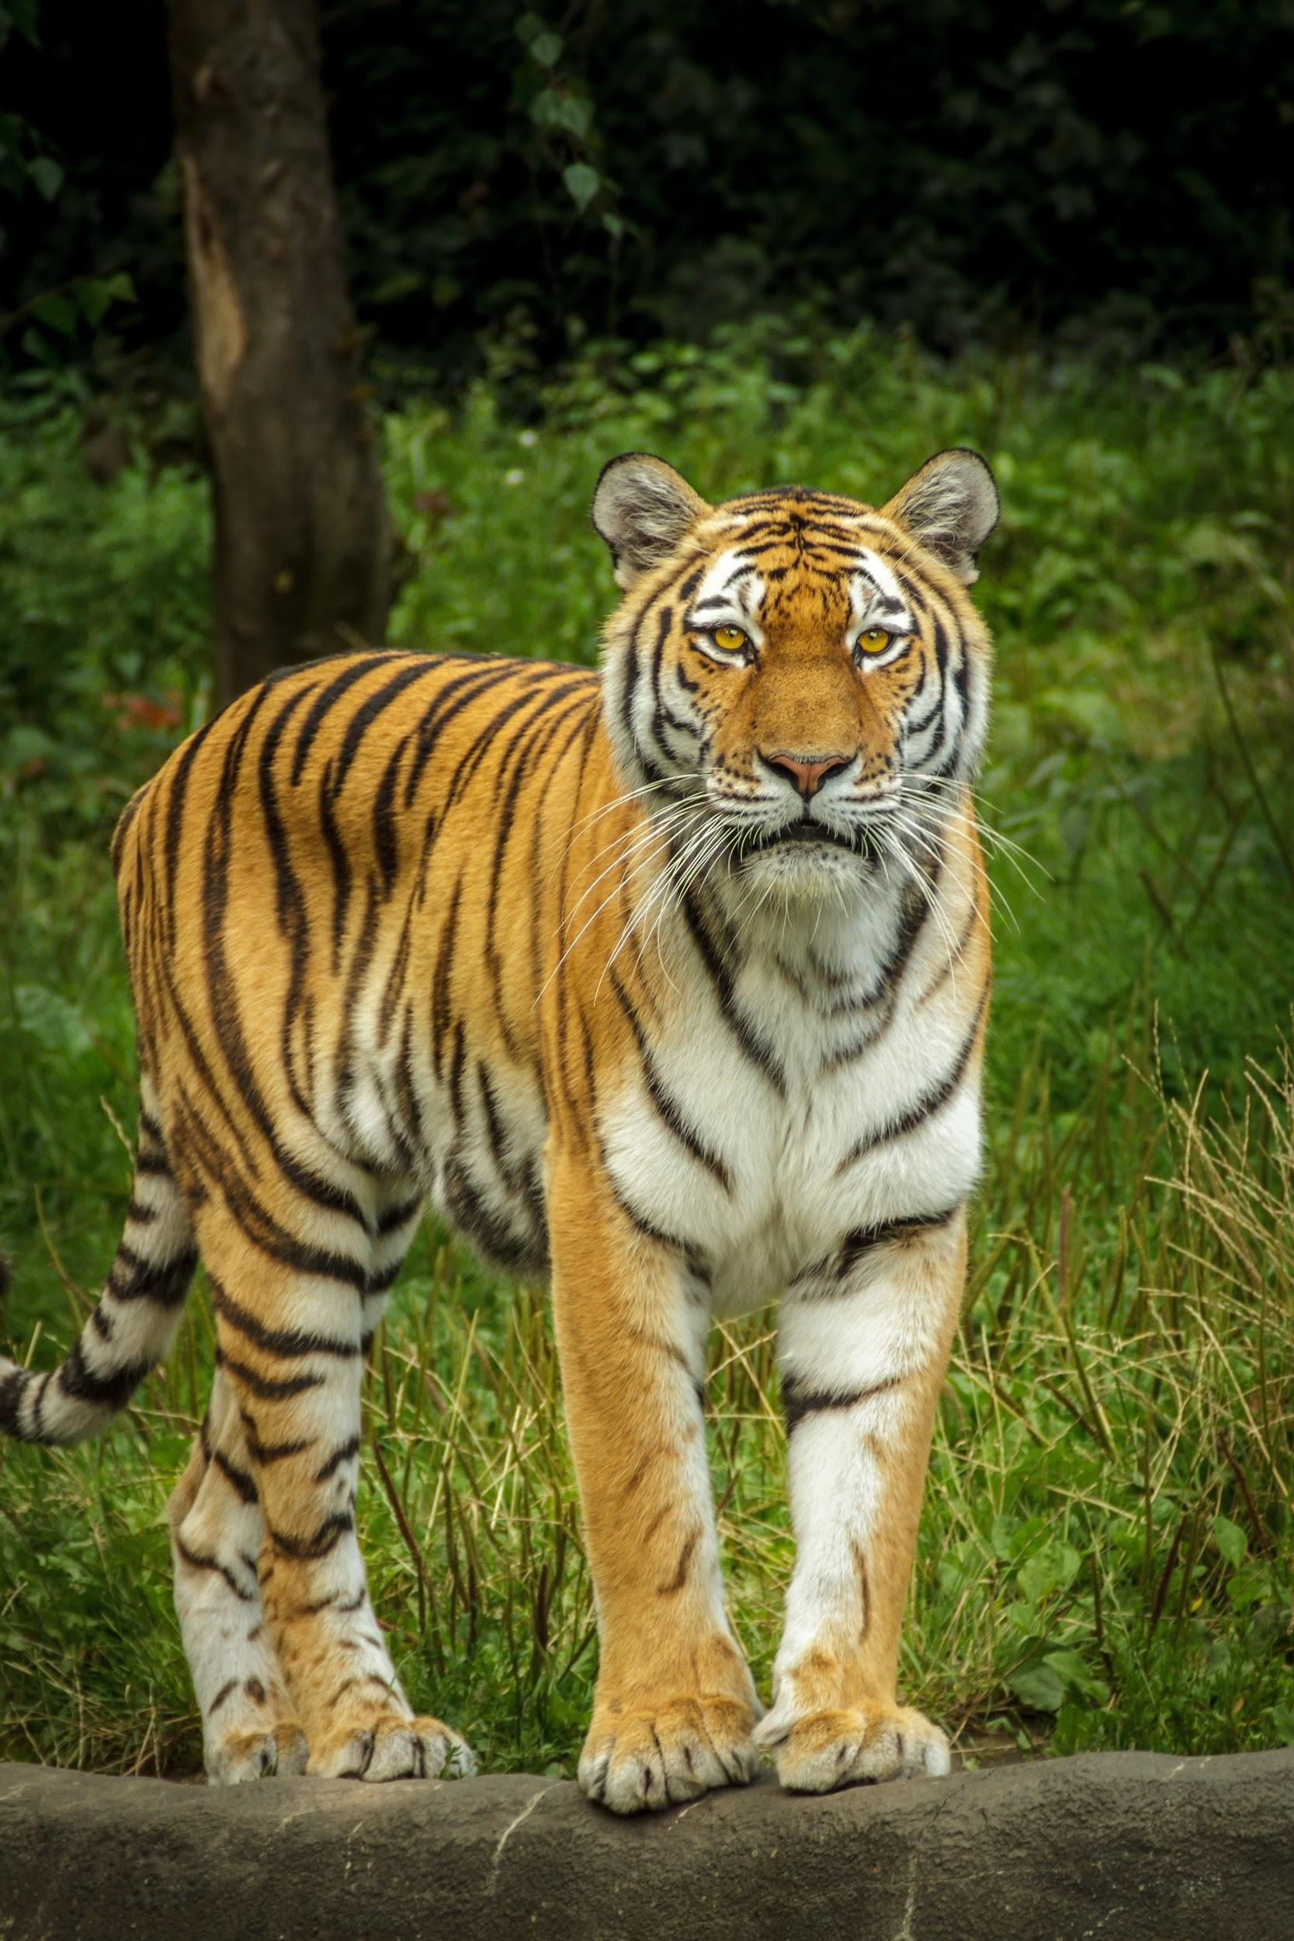
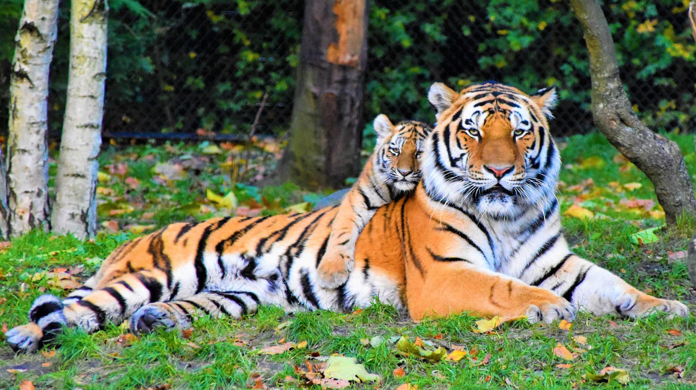
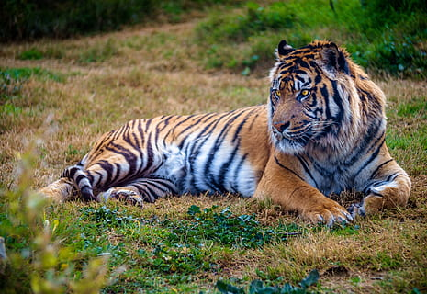
Look at these cute tiger pictures.
Will these convince you to save them?

