Slide 1




How does temperature affect the water quality in Mashapaug Pond? (Water temp and DO)
Yackelin Pinto
Ms. Goewey
11th Grade
Dr. Jorge Alvarez High School
This project connects to GLOBE hydrology water quality testing

Slide 2
Background
The Mashapaug Pond is in Providence Rhode Island. It is surrounded by Alvarez High School and houses. There used to be a factory near the pond. Throughout the past centuries the pond was contaminated with dangerous chemicals, metals and disgusting things floating. It was unsafe for humans to be around and nobody could swim. This made the pond unsafe to be around. It was unhealthy for the environment and for the organisms living around it or in it. After a lot of years of people trying to get it clean and healthy for the environment it is better than how it used to be. There are no chemicals or any type of dangerous things floating or chemicals in the pond. It is safe for the humans to be around the Mashapaug Pond. The water temperature of the pond can affect the quality of the pond by holding less dissolved oxygen or holding a lot more oxygen than normal. This can cause the fishes and other living organisms in the pond to not survive a long time.

Slide 3
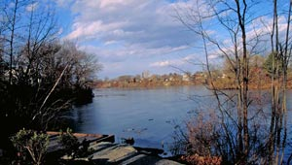
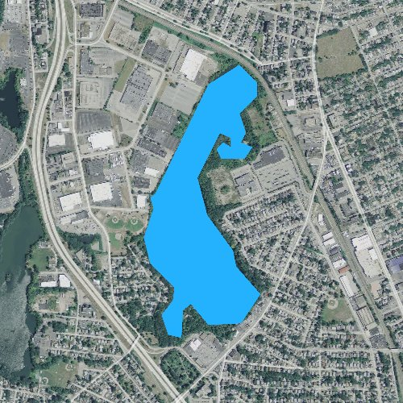
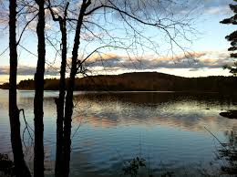

Slide 4
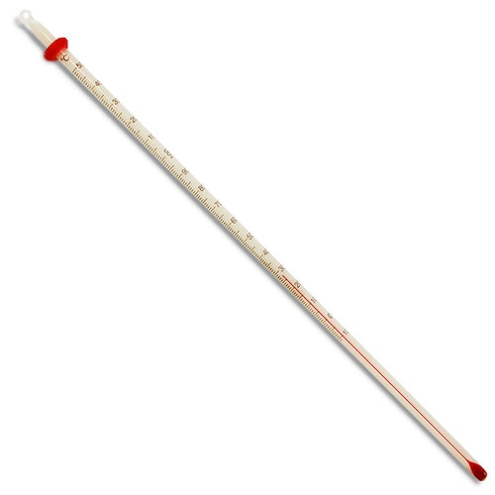


Materials and procedures
Water Temperature (procedure)
When we are down at the pond we need to first take the air temp. And write it down on the paper
Then get your 3 thermometers and put it under the pond water 10cm.
Wait 3 minutes till taking the pond water temperature
Write the 3 temperatures on the paper
Add all 3 temperatures to get your average of the water temperature
Water temperature (Materials)
3 thermometers
Pencil or pen
Clipboard with the paper to mark down temperatures
Calculator

Slide 5
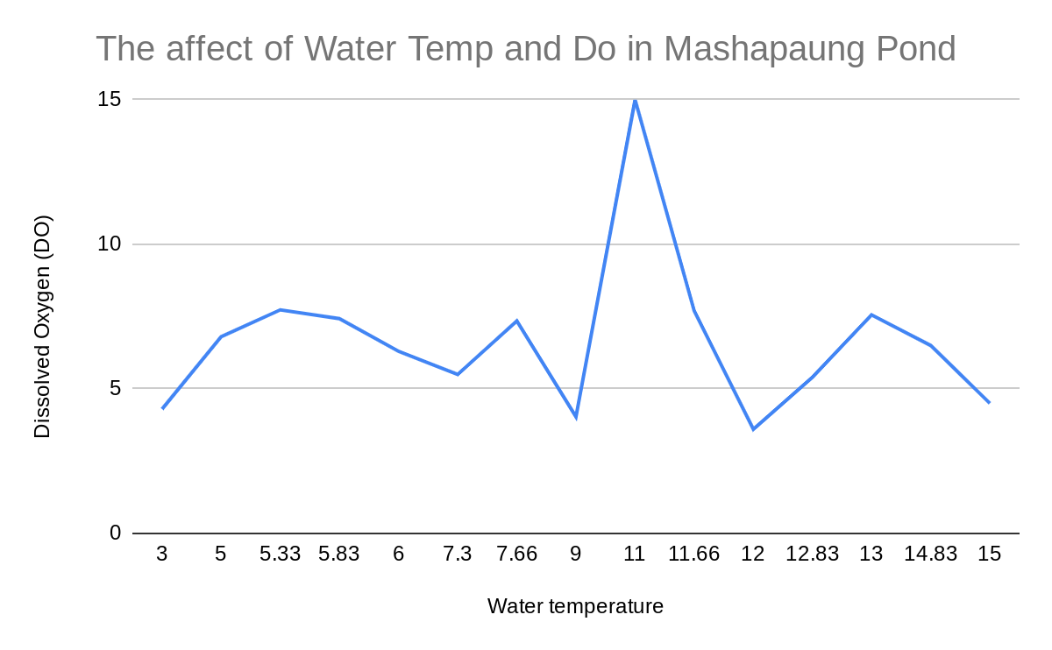
Data and Graph
Water Temp | DO
-1 | 4.2
3 | 4.3
5 | 6.8
5.33 | 7.73
5.83 | 7.43
6 | 6.3
7.3 | 5.5
7.66 | 7.35
9 | 4.03
11 | 7.8
11 | 7.2
11.66 | 7.7
12 | 3.6
12.83 | 5.4
13 | 7.56
14.83 | 6.5
15 | 4.5

Slide 6
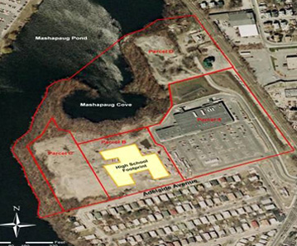
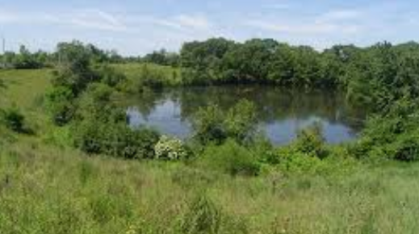
Analysis
The data on the graph shows the effect between the water temperature and the Dissolved Oxygen affecting the quality of the water in Mashapaug Pond. It shows that the quality of the pond water is affected. The dissolved oxygen is one of the most important qualities in water. It shows that the temp is increasing with the dissolved oxygen. When the water temperature was 11 degrees celsius the dissolved oxygen was 15. That showed that the DO was higher than any other water temp day. I think that the dissolved oxygen was increasing with the water temp. There was a lot of DO in the pond water.

Slide 7
Conclusion
Overall, the water temperature and the dissolved oxygen affects the quality of Mashapaug Pond. The water temperature affects the water quality in Mashapaug Pond because the Dissolved Oxygen is increasing with the water temp. If there isn’t a lot of DO in the pond then it could kill the fish or any other organisms that live in the pond. Water Temperature and Dissolved Oxygen both have an affect on the quality of the water. As a community we should improve the quality of the pond by picking up after their pets and disposing of chemicals properly. People should start to stop dumping their trash wherever they want. Also stop using plastic, if you do you should recycle to not let it end up in the ocean or the pond. And as a community we should all work together to keep Mashapaug Pond in good quality conditions and make it healthy for the environment.

