Slide 1
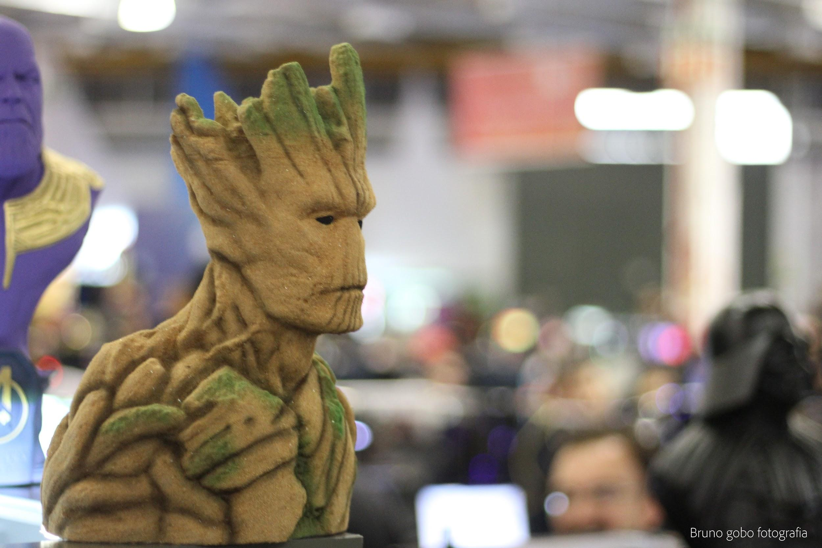
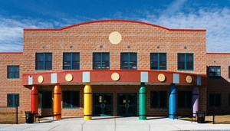
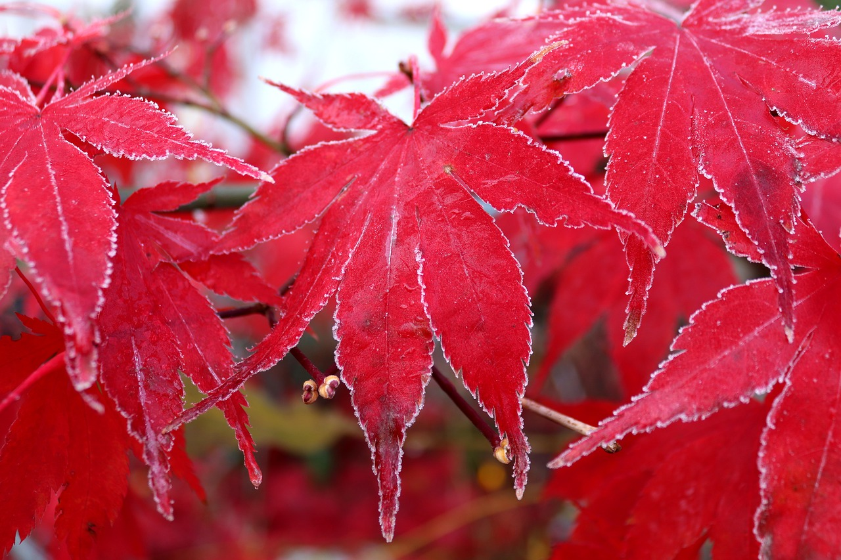
Green Up/Green Down at Anthony Carnevale!
Our GLOBE Science Inquiry
Anthony Carnevale Elementary School
Providence, Rhode Island
Grade 2, Inclusion, Room 201
Mr. Tramonti/Mrs. Tavares, Classroom Teachers

Slide 2
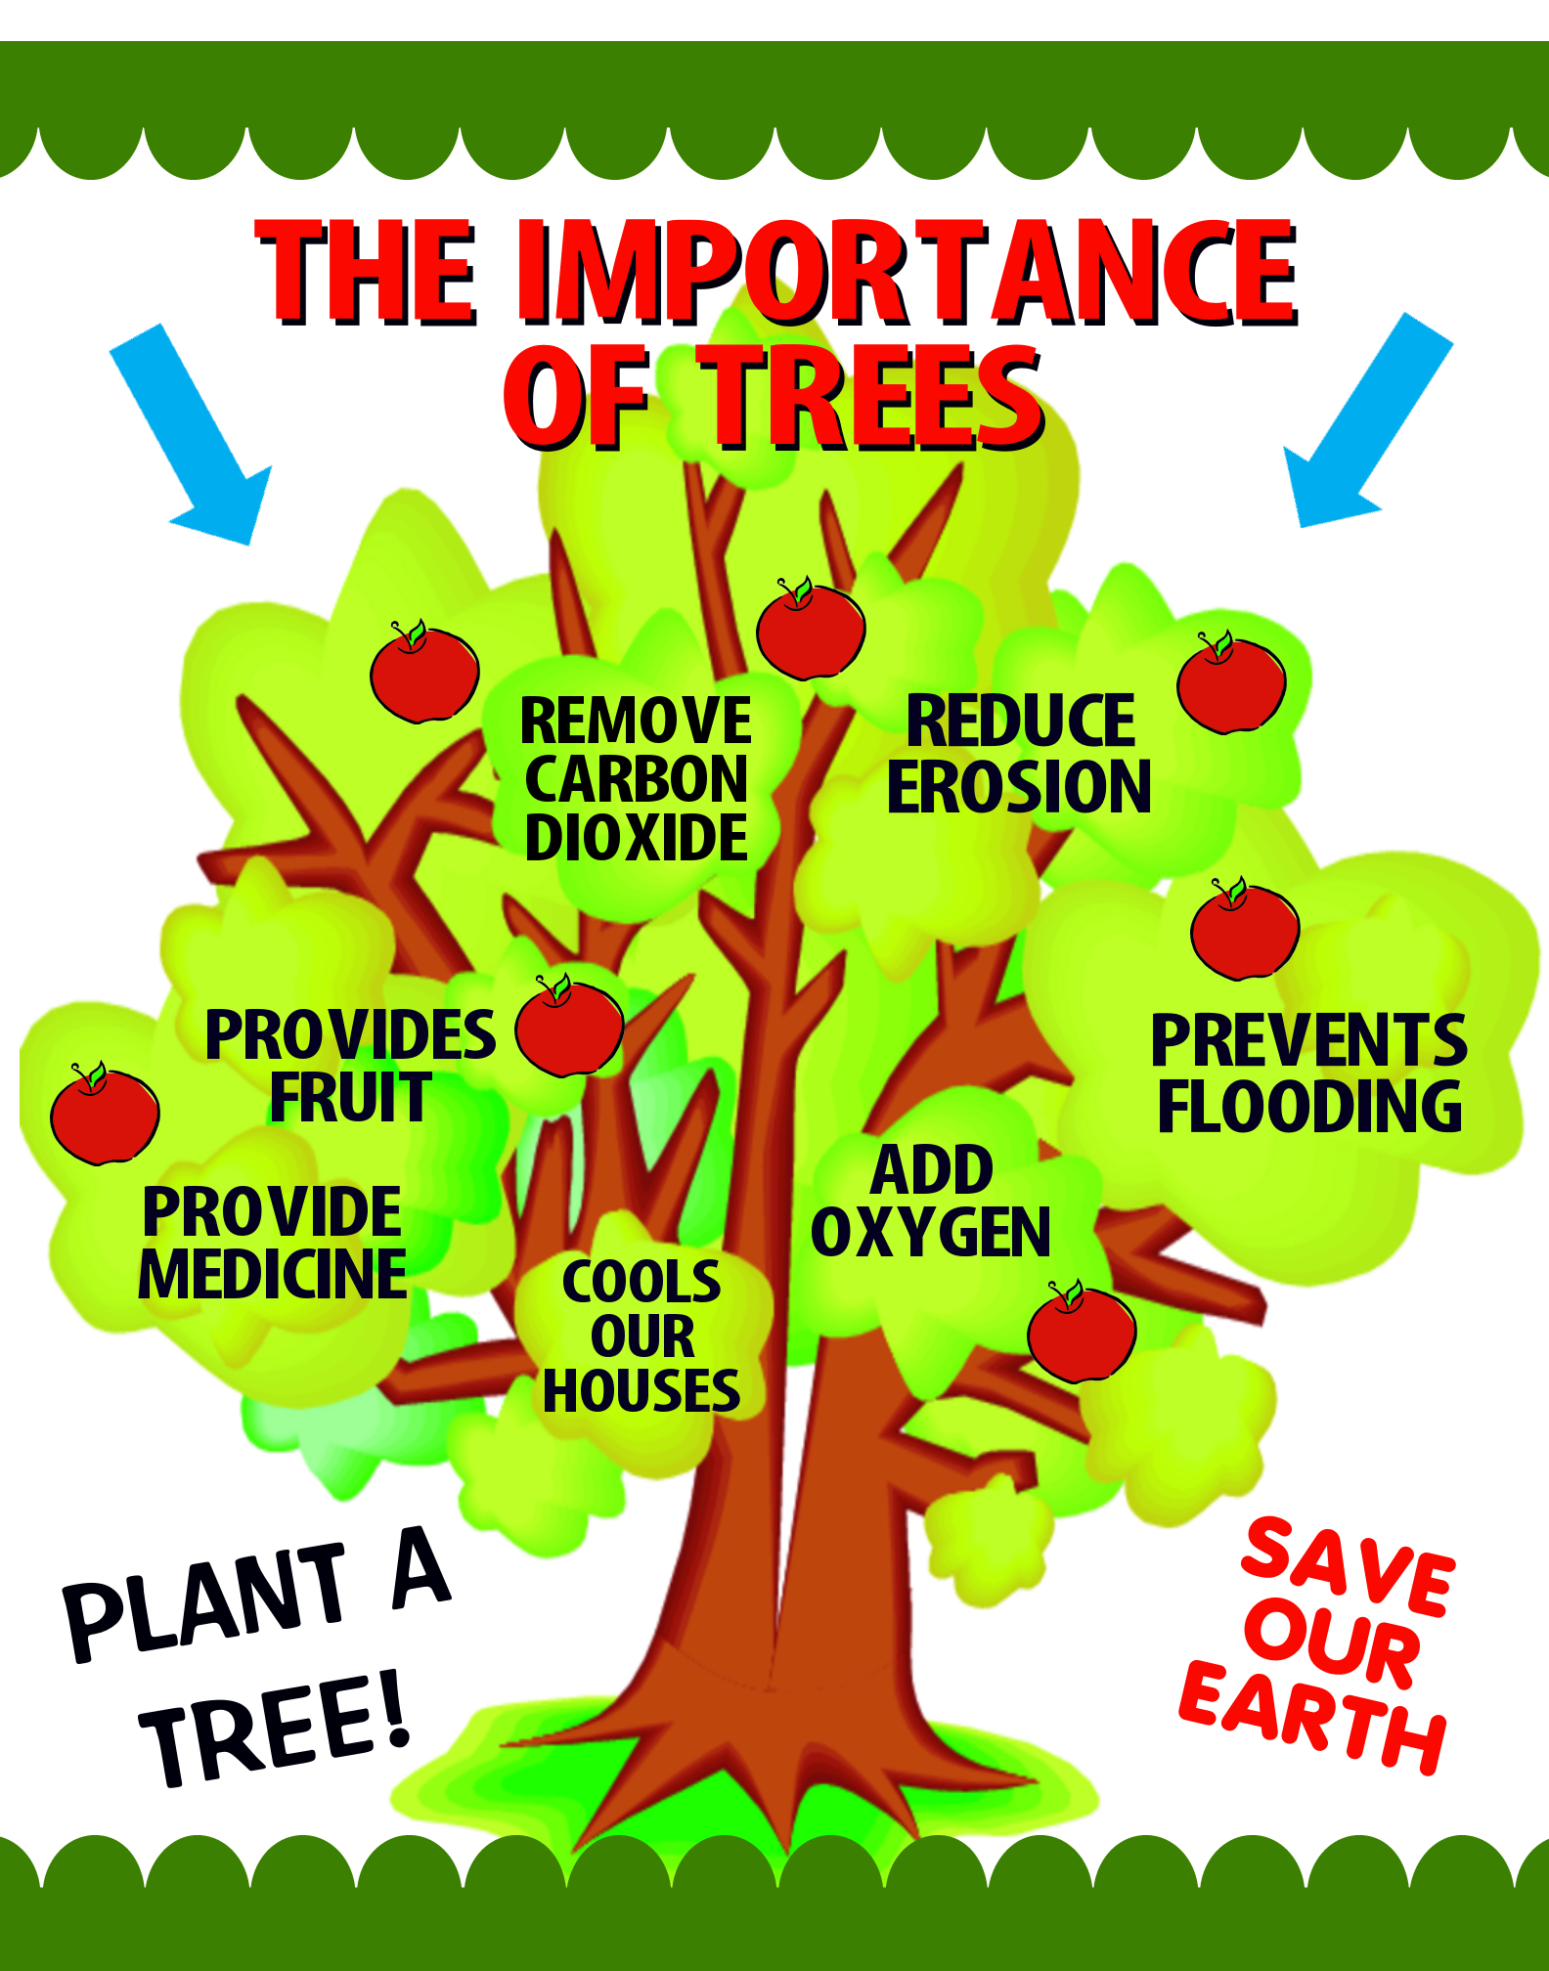
Adopting Our Trees...
Three Teams of students explored the school grounds. Each team adopted a different tree species that are located in our school yard that they could study throughout the school year. An Adoption sign with the team names and student pictures were placed on each tree.

Slide 3
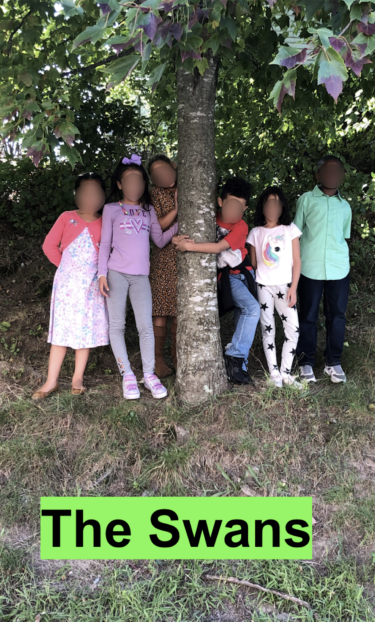
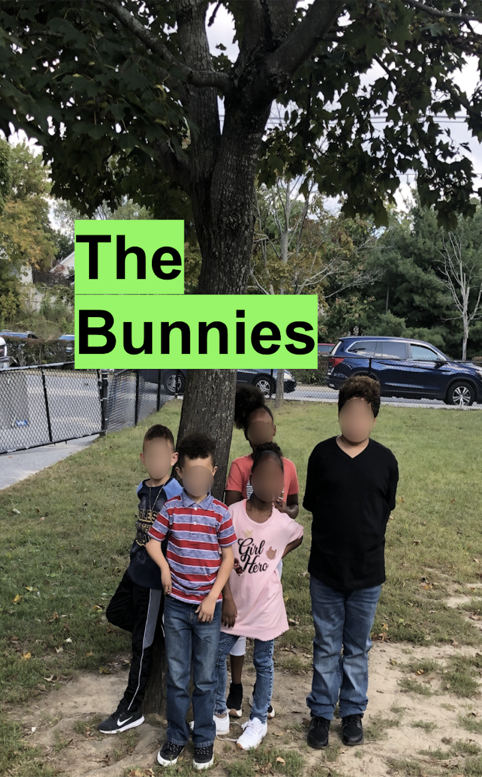
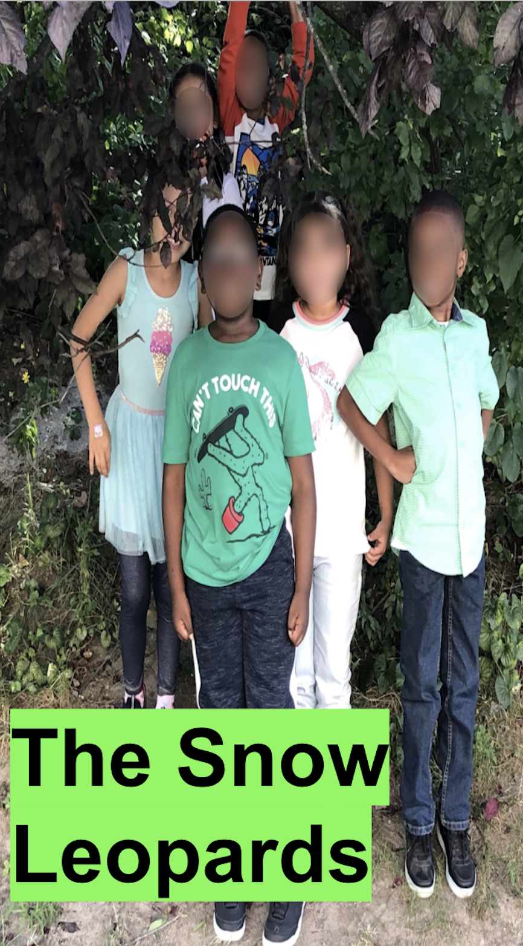

Slide 4
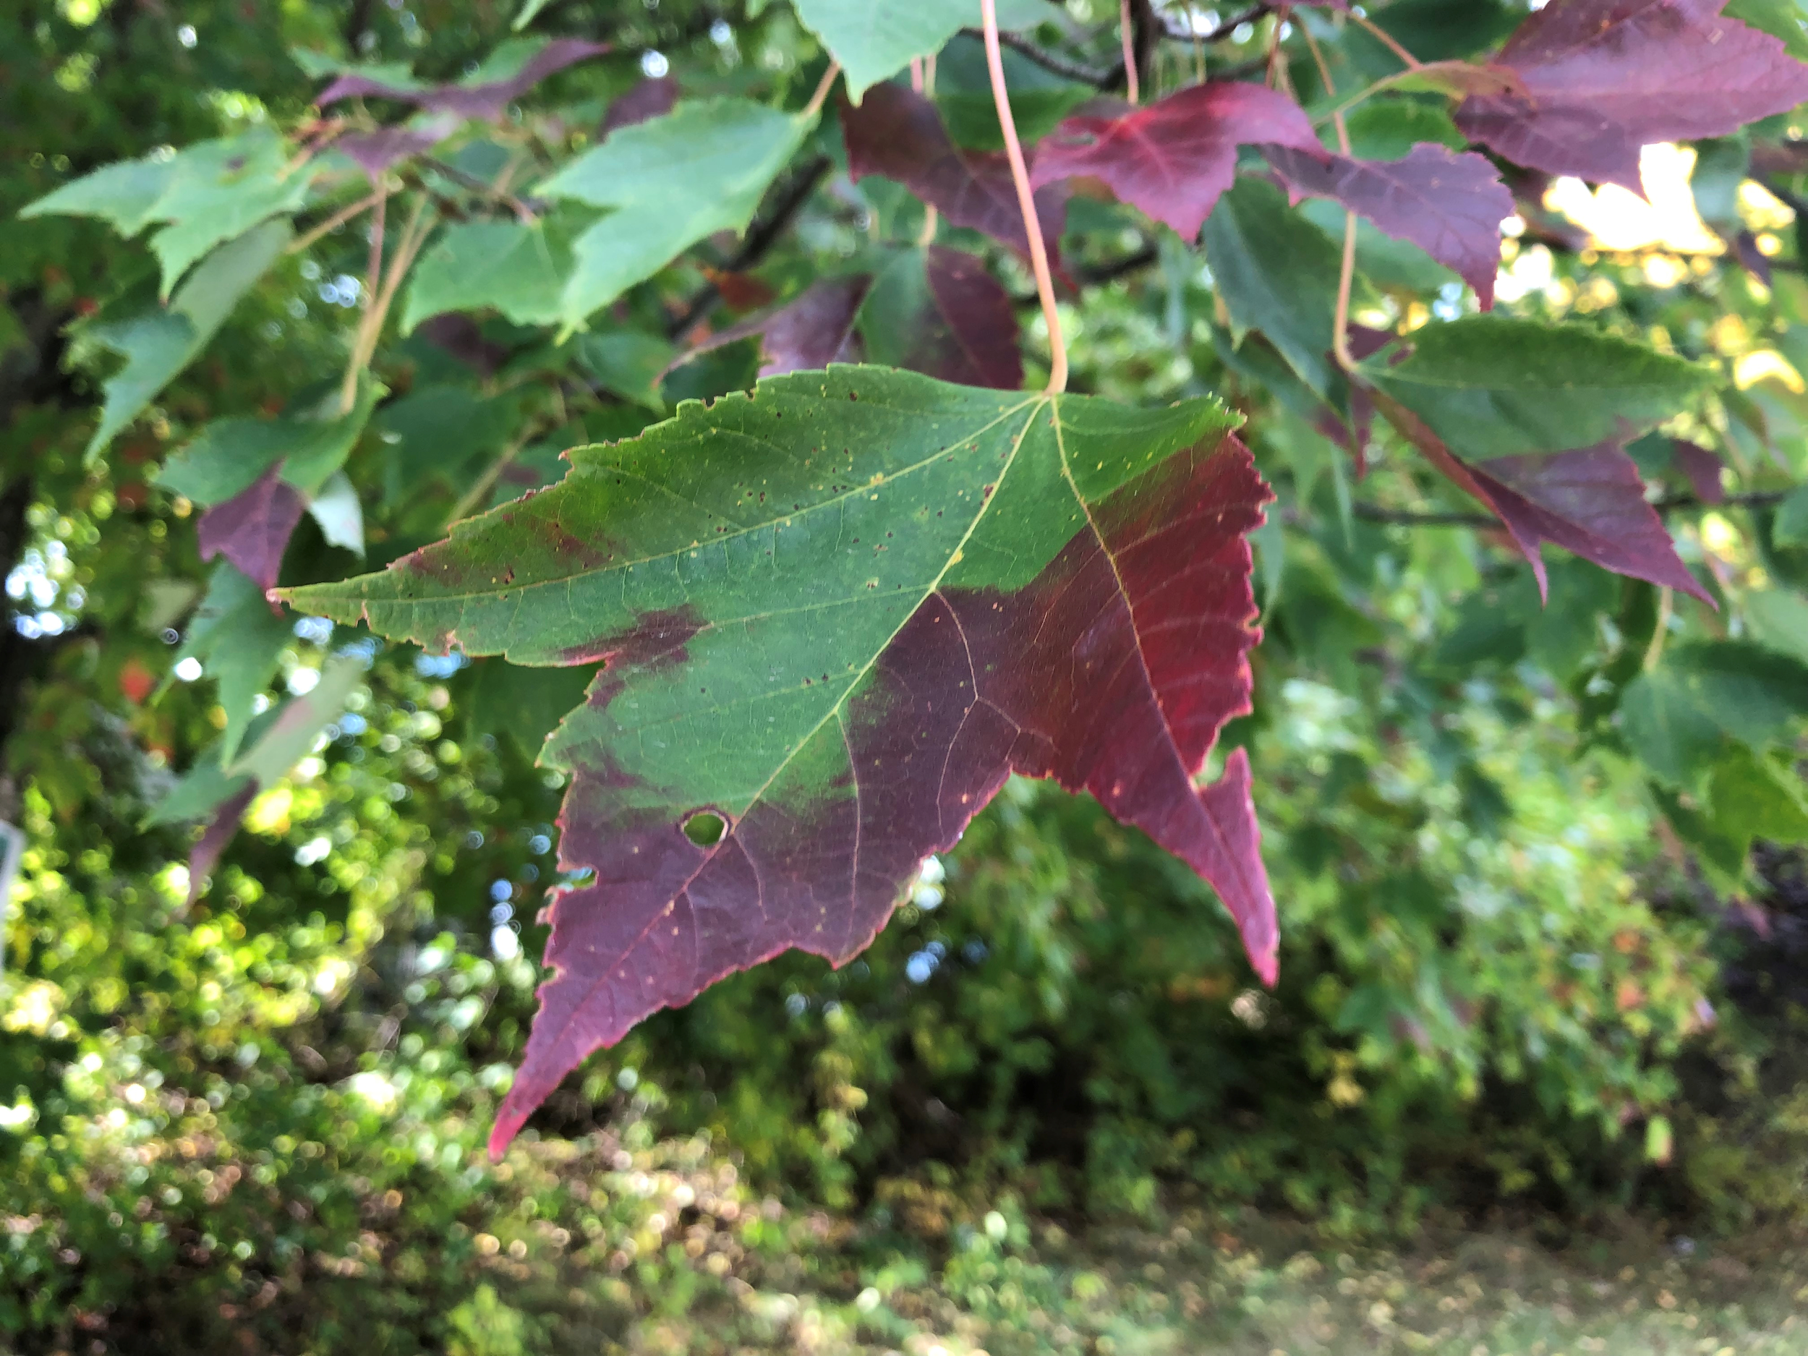
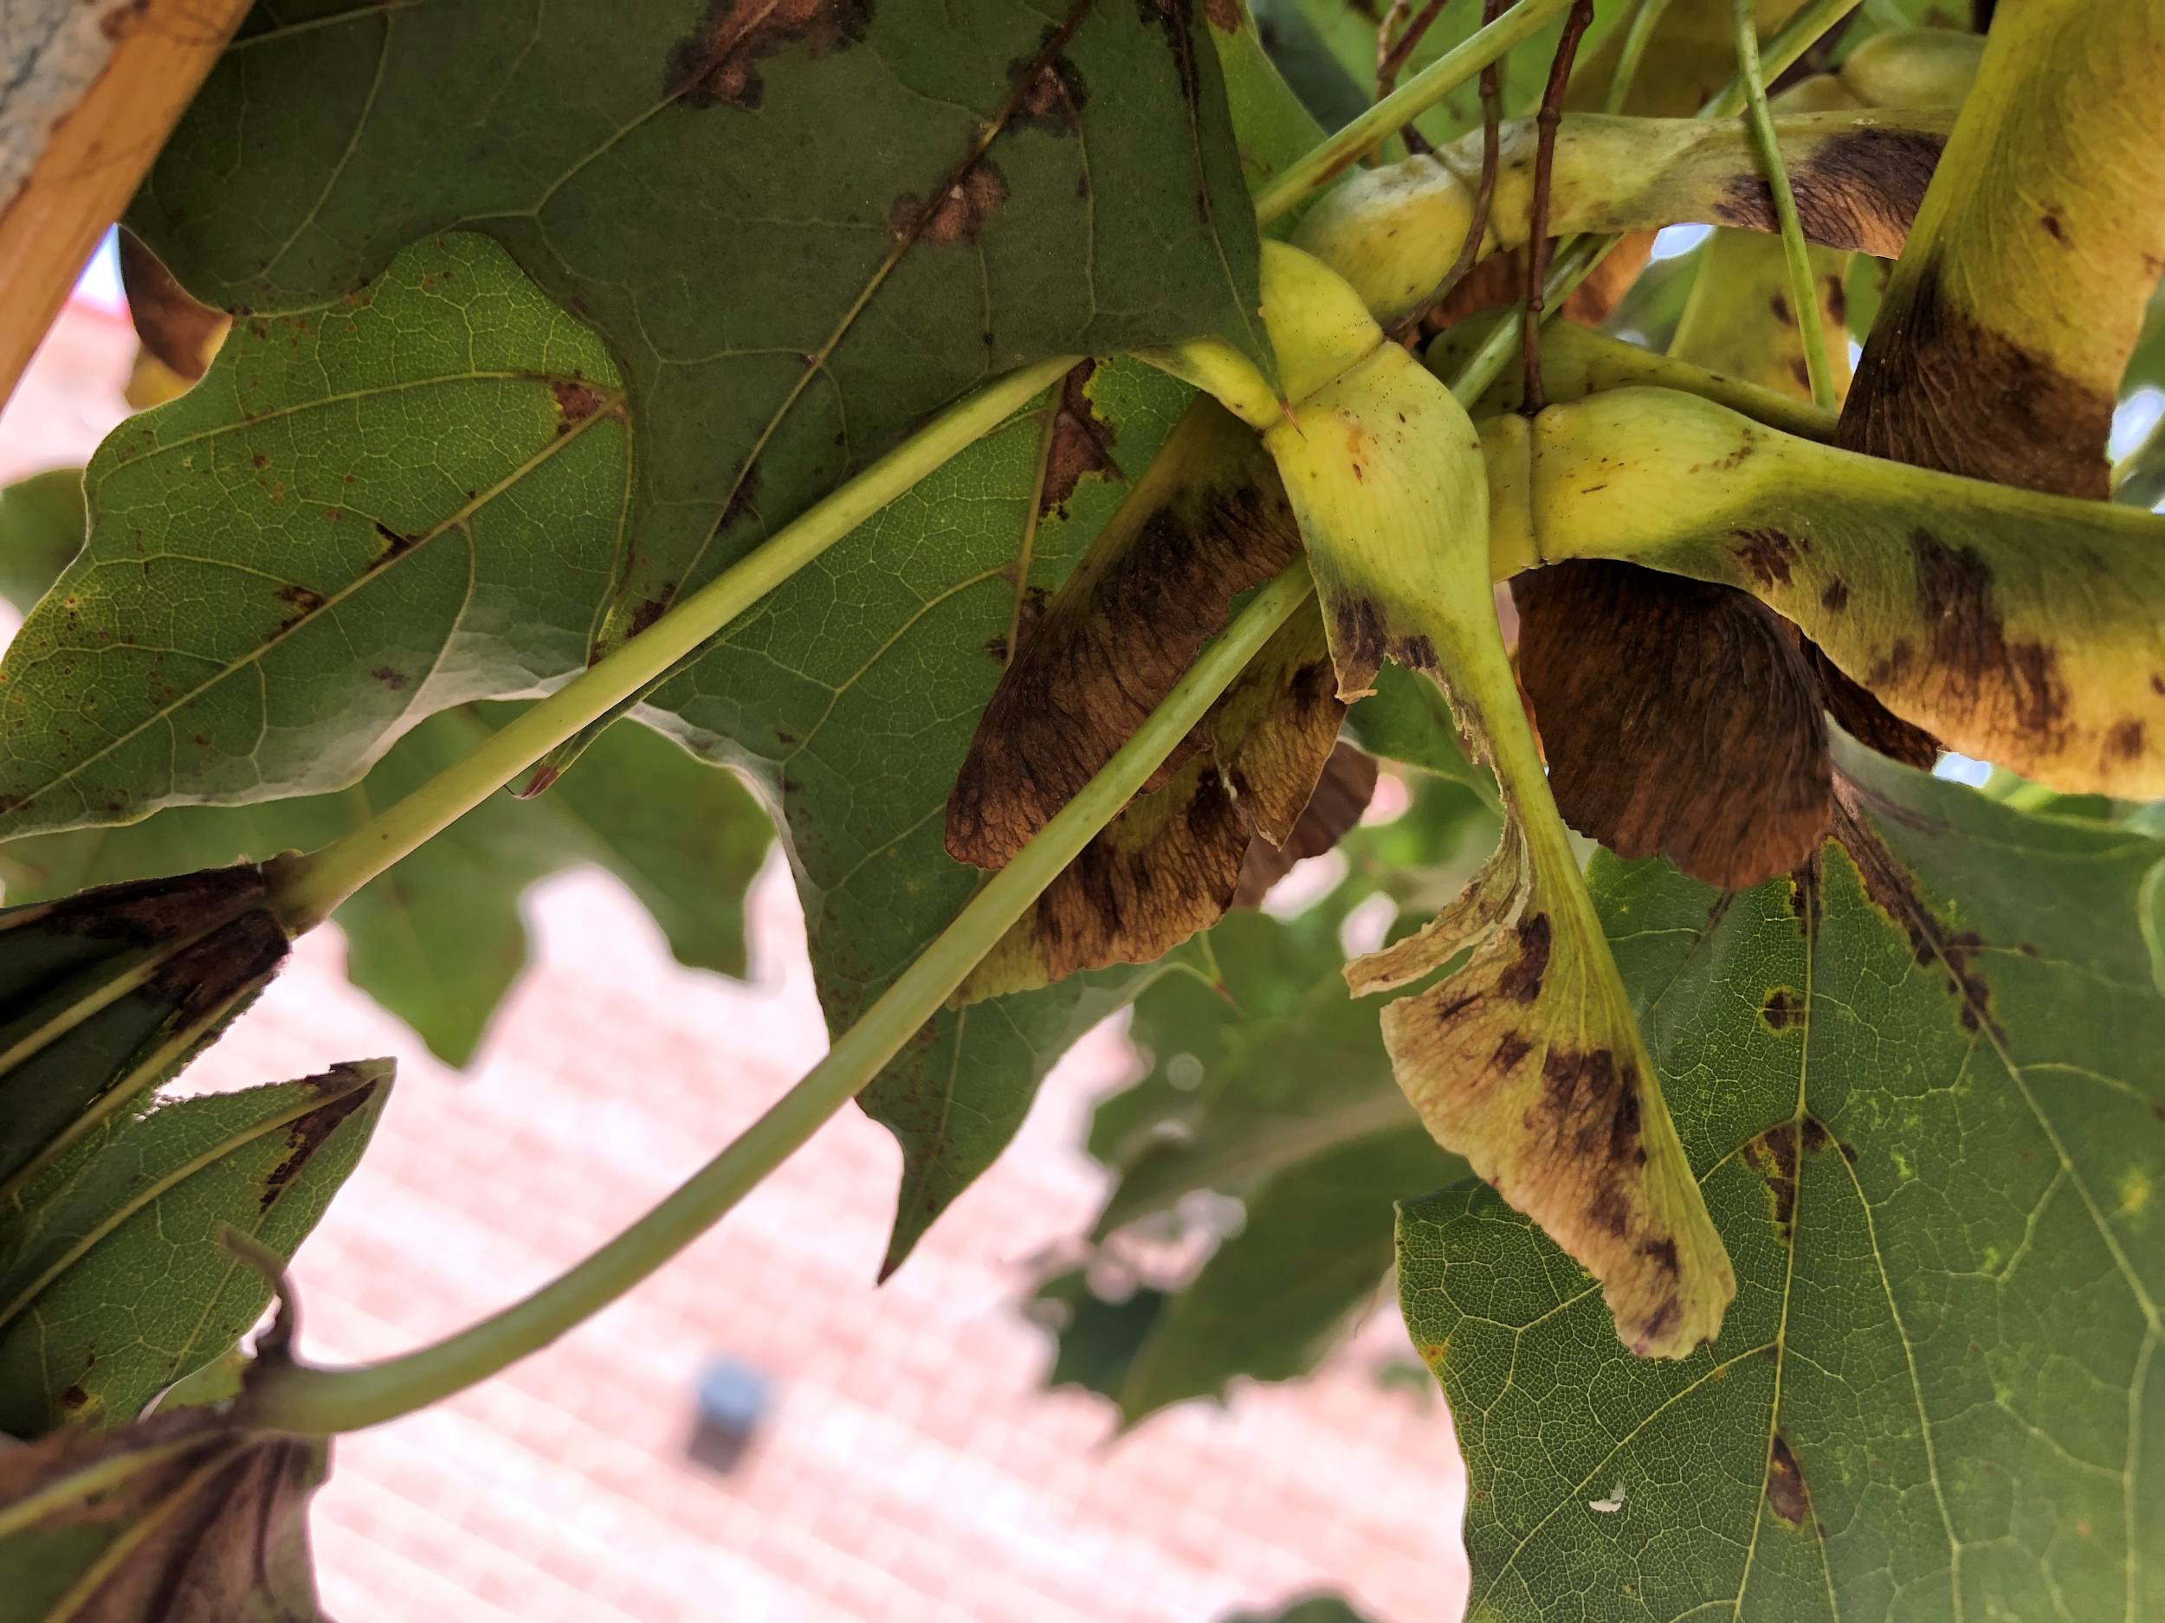
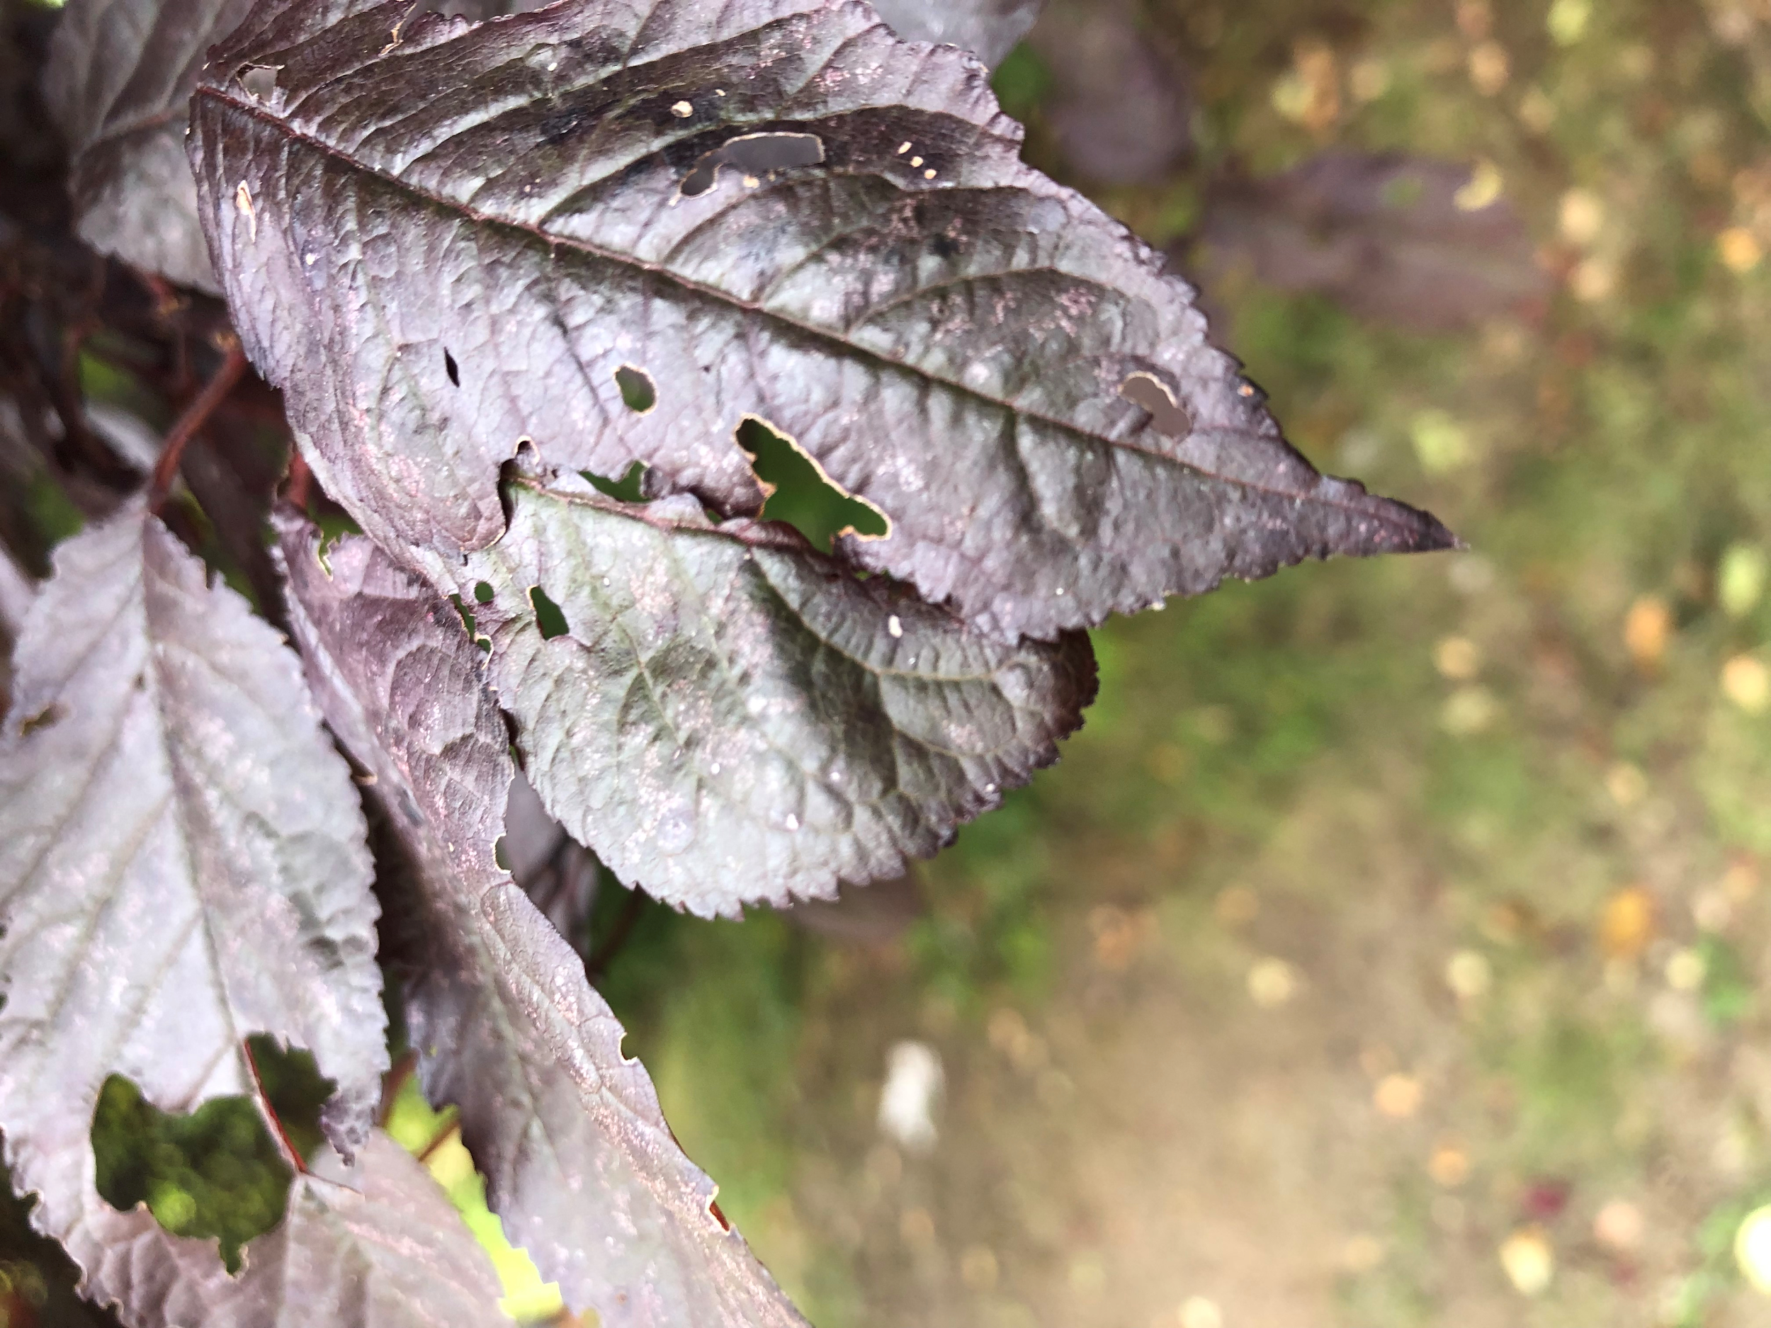
Fall Observations...

Slide 5
Stick vs.Twig or in Other Words, Dead vs. Dormancy
Investigation #1
“Are trees dead in the winter, Mr. Tramonti?”
One inquiry question from a student prompted an investigation that spanned a few months.
So, to learn about misconceptions that our students may have, I took an informal survey of their thoughts about this question...

Slide 6
Common Misconceptions About Trees in the Winter
Student Responses were as follows:
Most students believed trees died in the winter and came alive again in spring.
Some thought they were just asleep.
Some thought they were frozen.
Some had no idea.

Slide 7
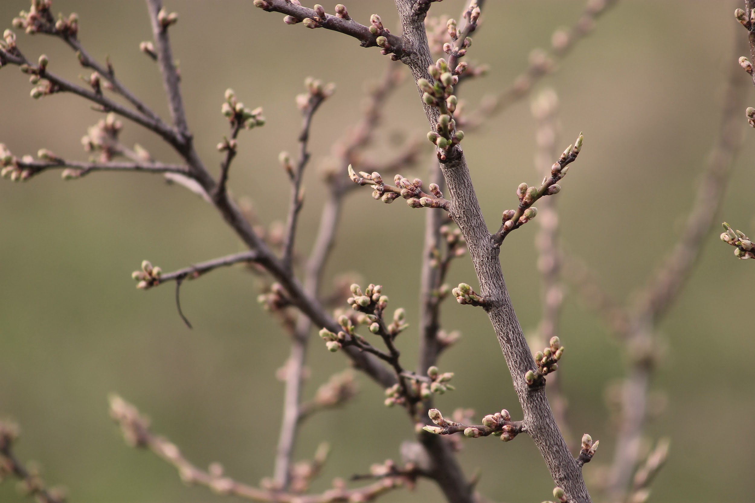
Investigation #2
How Does Air Temperature Effect Bud Bursts?

Slide 8
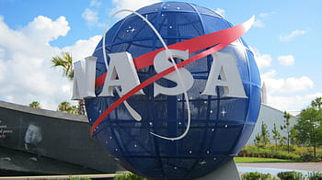

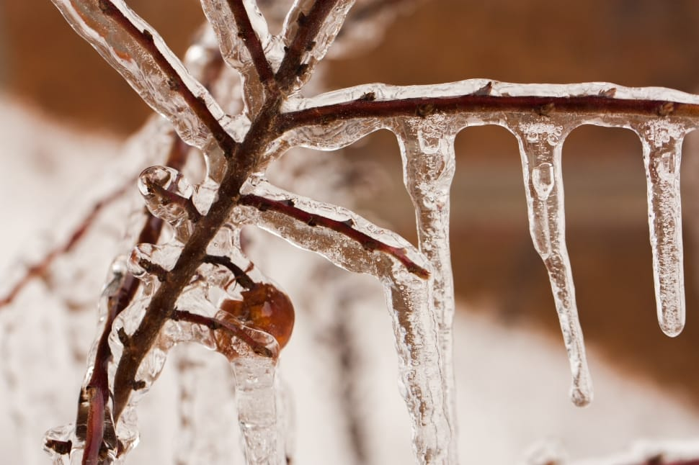
How can we change these student misconceptions?
The Mystery of the Winter Twig
As a class decided that an expert was needed!
We decided we wanted GLOBE help and I reached out to our BU Superhero, Ms. Kathleen! She swooped in to save the day, and had us knee deep in twigs to investigate in a top secret twig mission called Operation: Winter Twig!

Slide 9
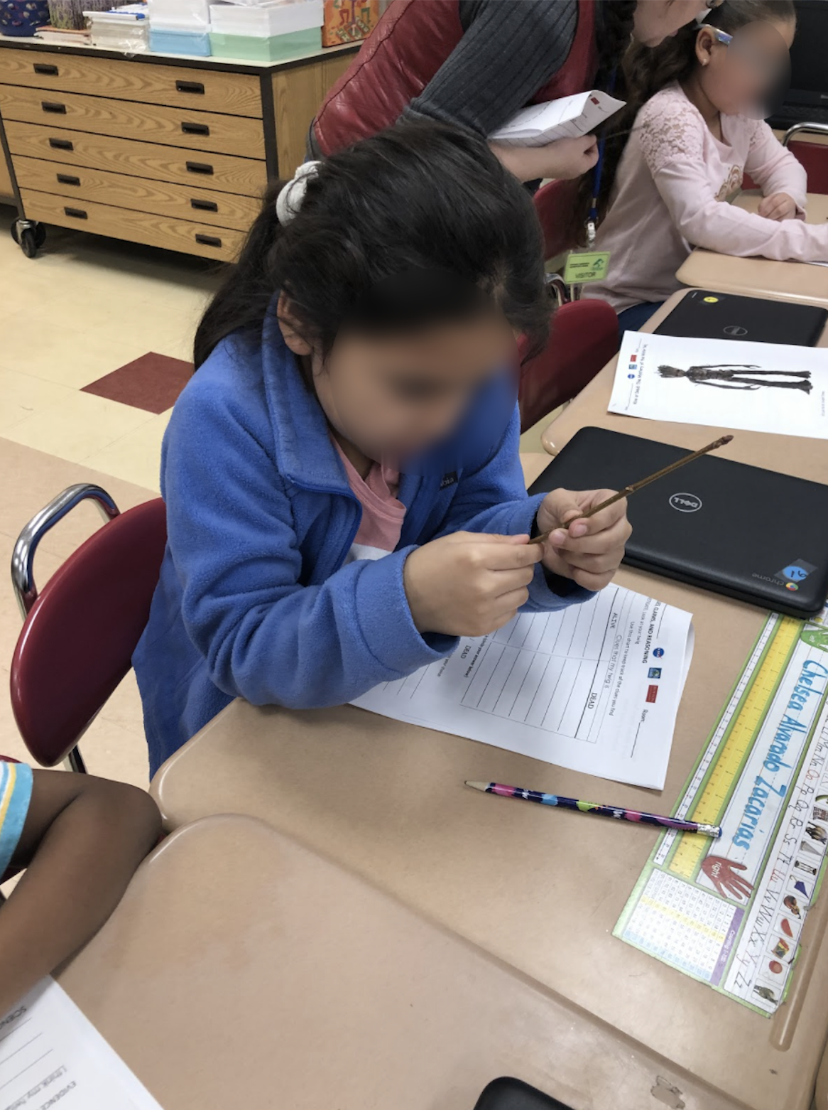
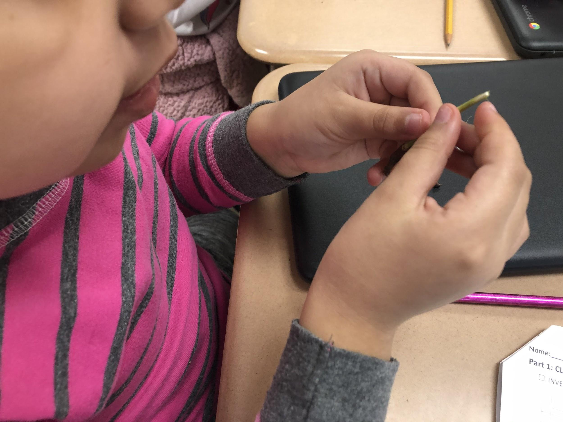
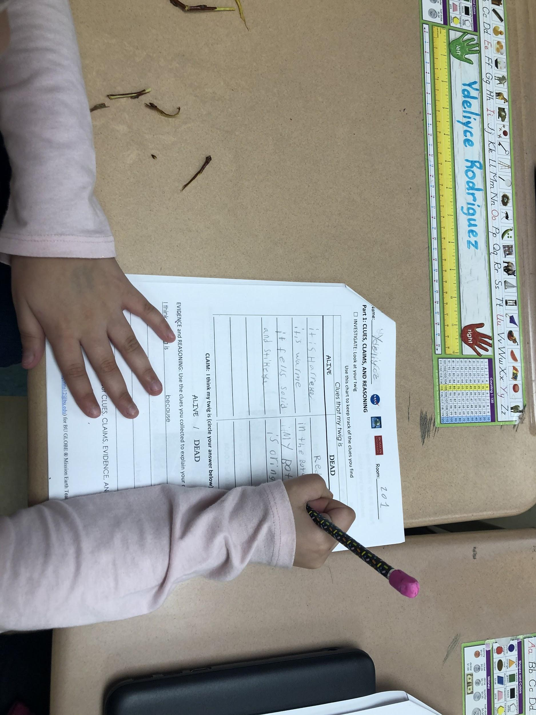
Room-201 Inquiry Investigation!

Slide 10
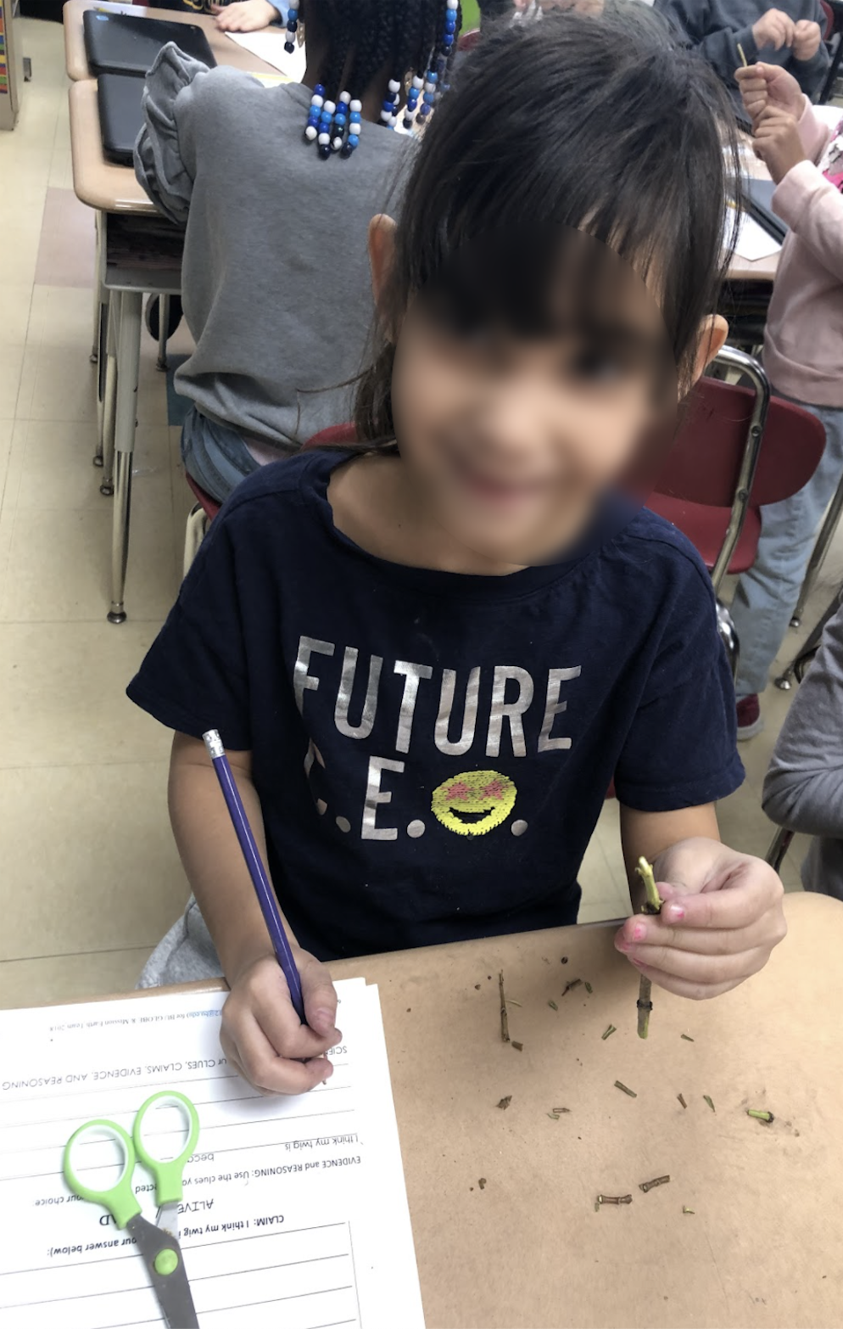
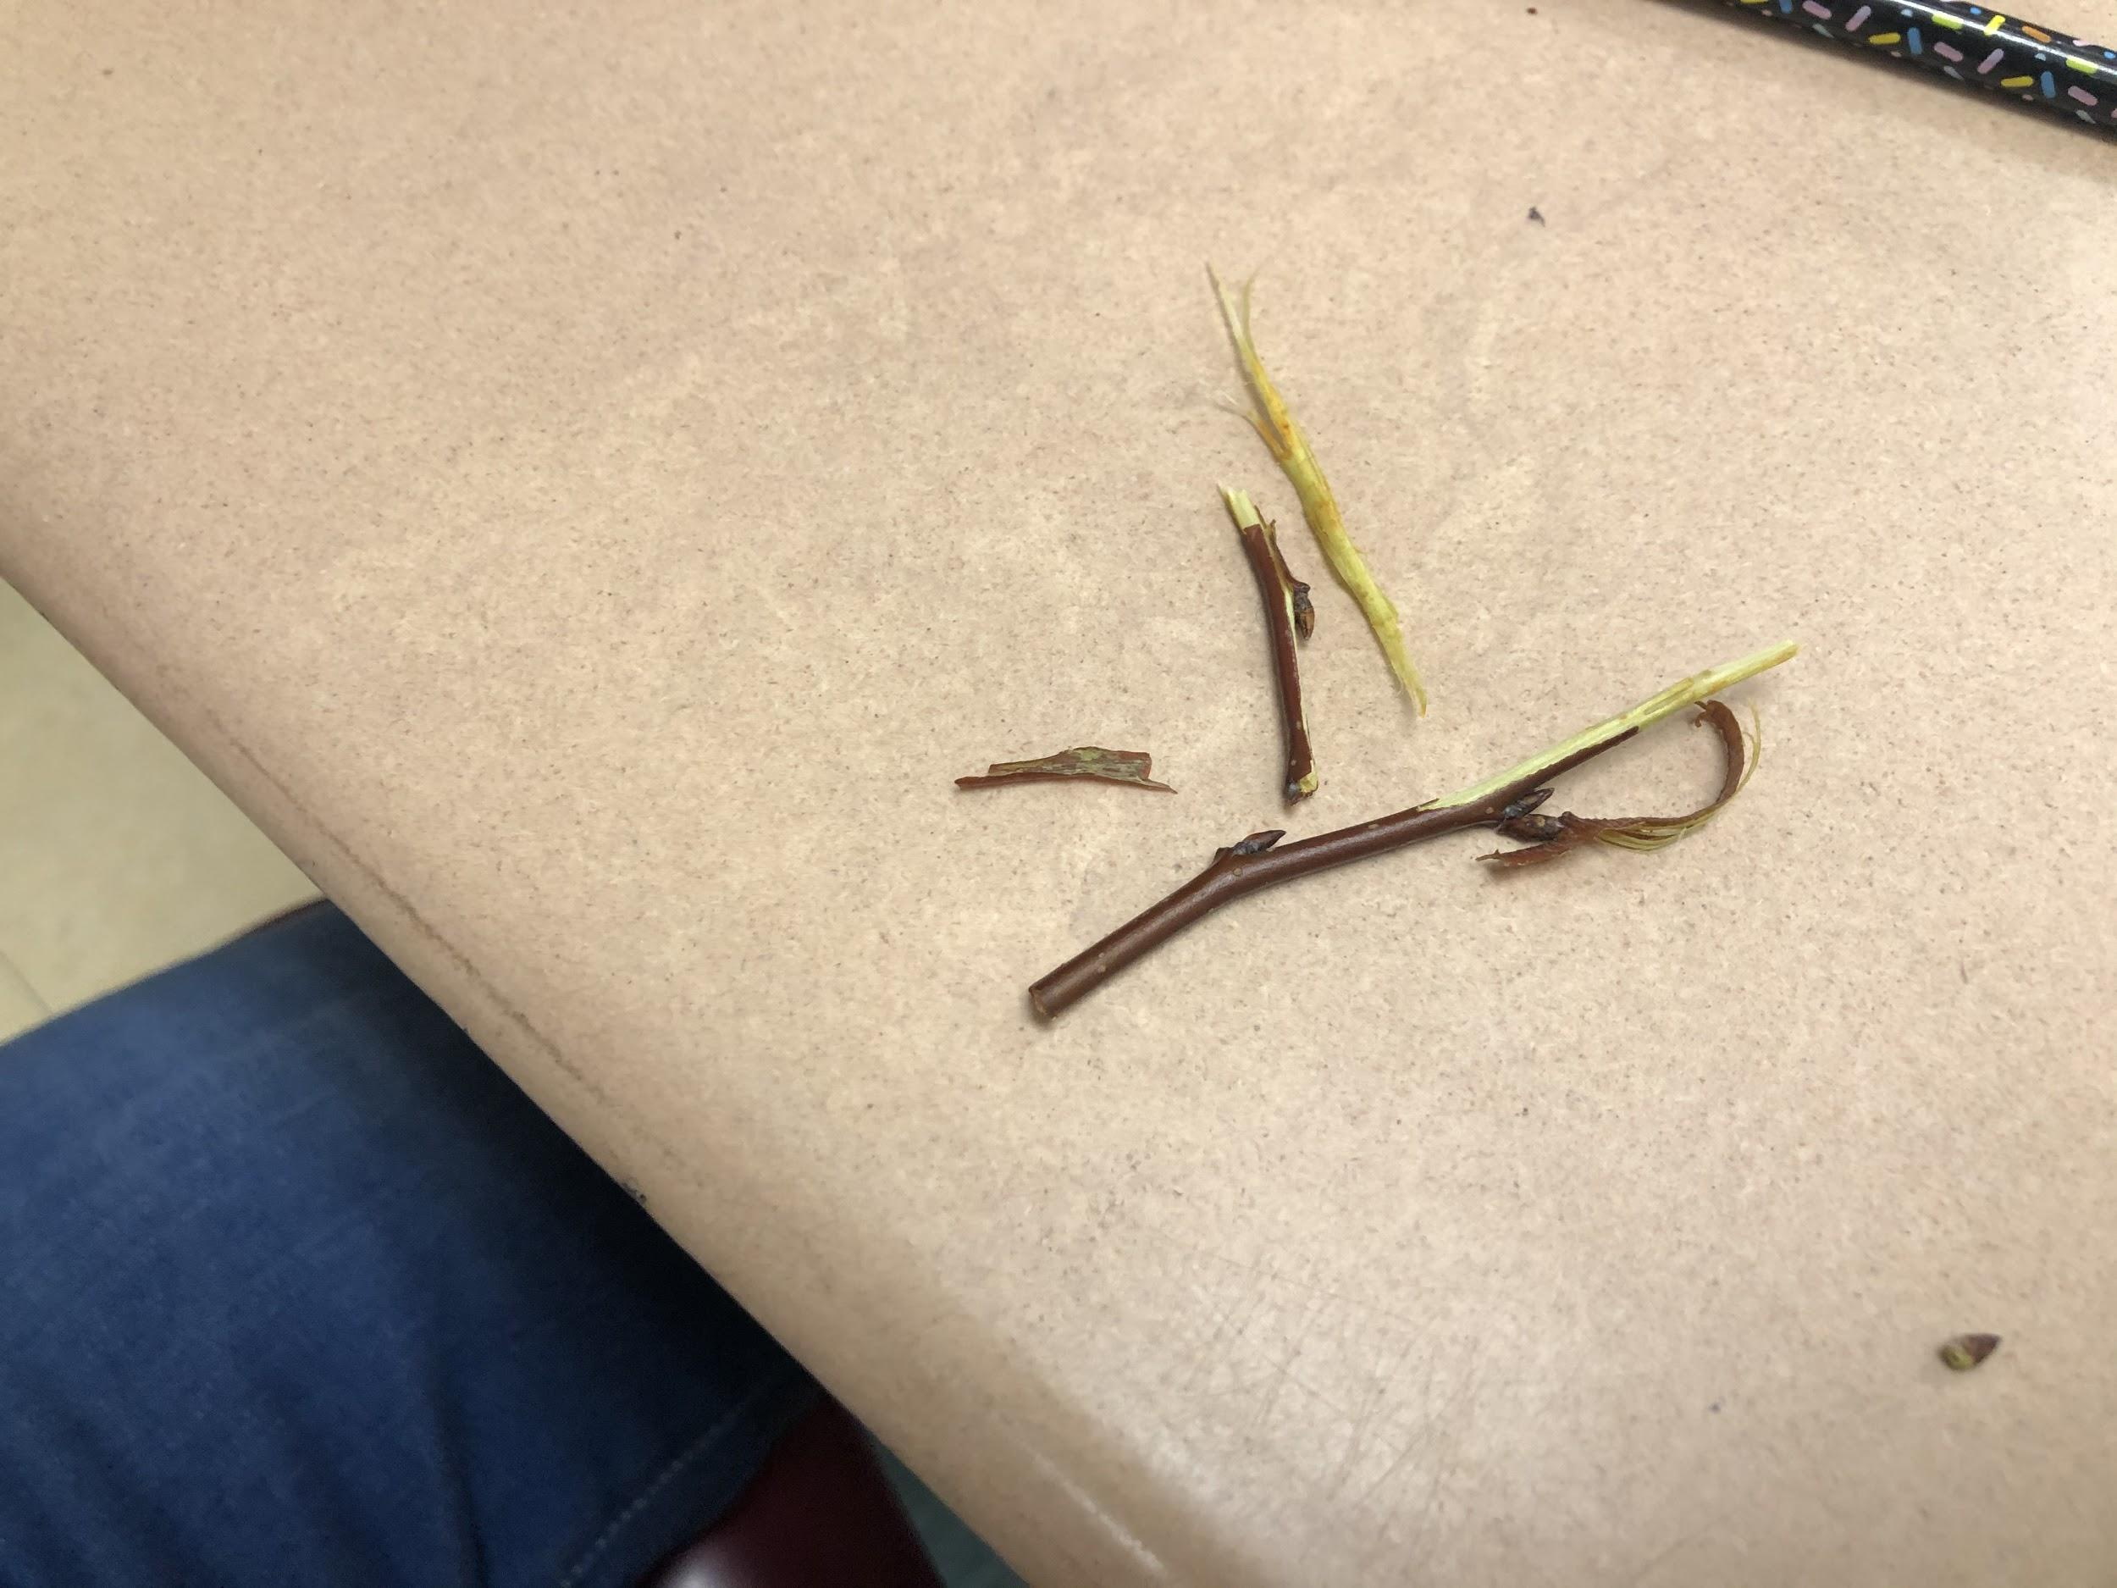
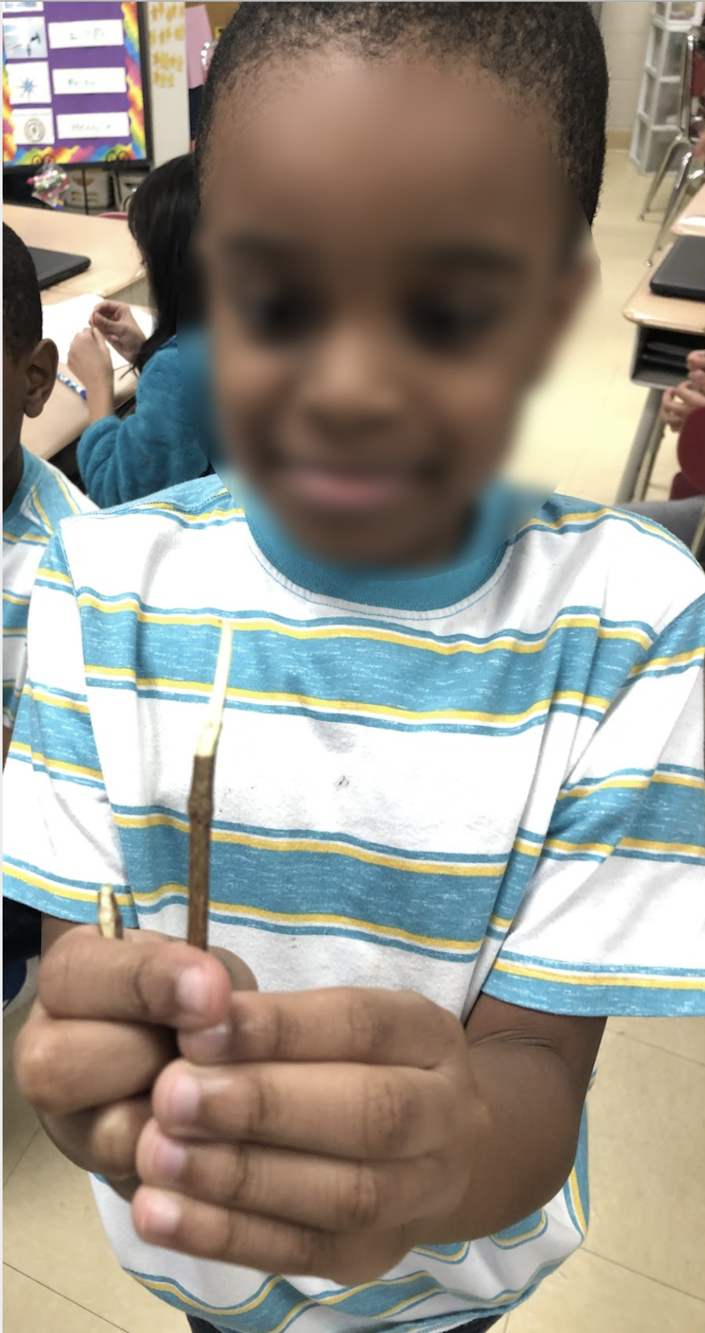

Slide 11
Continuing Our Investigation...Bud Bursts!
The students continued the investigation by doing the following:
Each team kept twigs in a cup with water and they were placed in front of a window with plenty of sunlight. Each team marked their cups.
In addition to the twigs brought in by Kathleen, each team went outside to their adopted tree, clipped their twigs and they were placed in their respective cups.
“Twig Monitors” were assigned to monitor water levels, record air temperature and mark any changes they noticed in the twigs.
All students monitored twigs weekly and recorded their noticings and presented their noticings to the entire class.

Slide 12
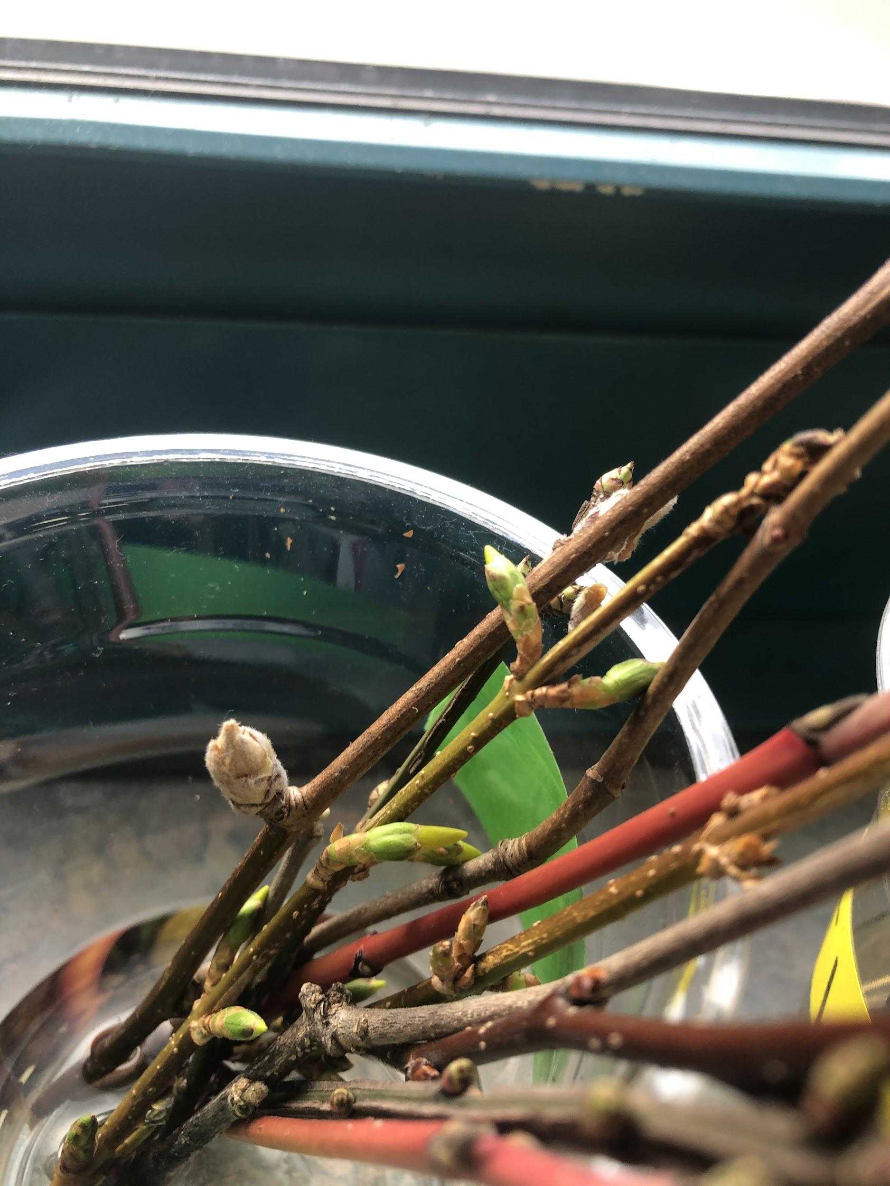
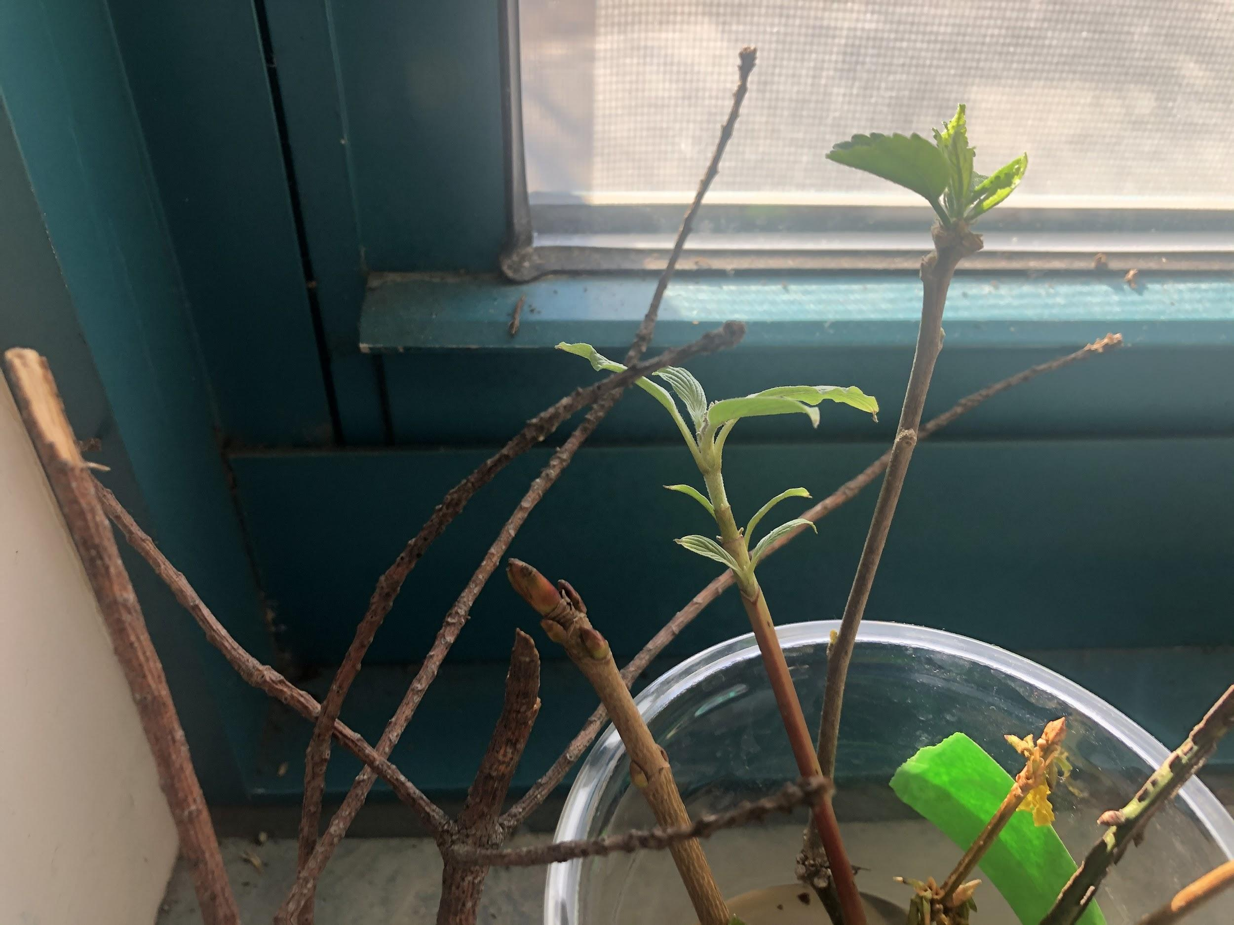

Slide 13
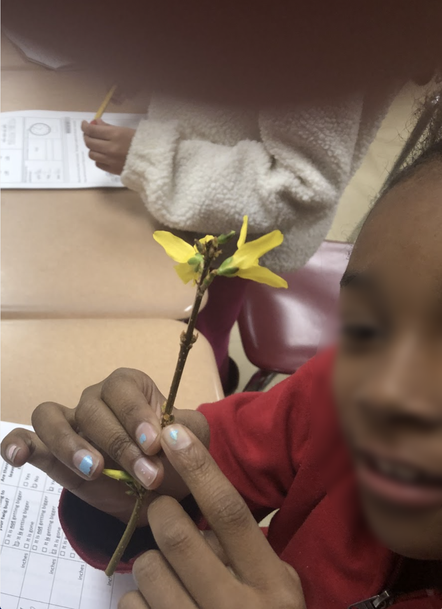
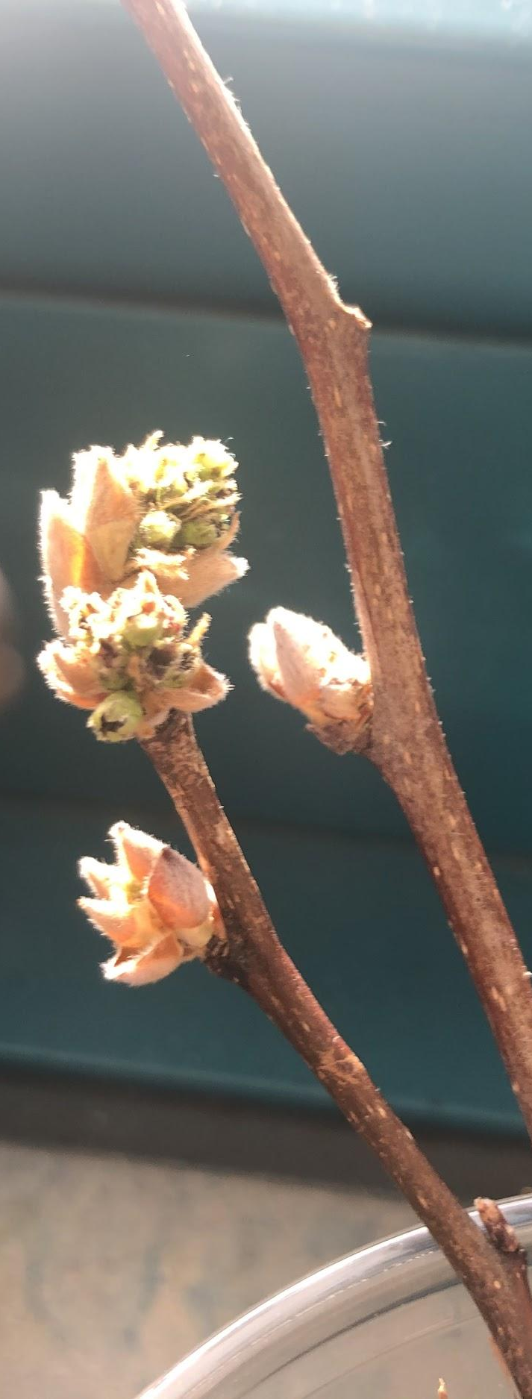
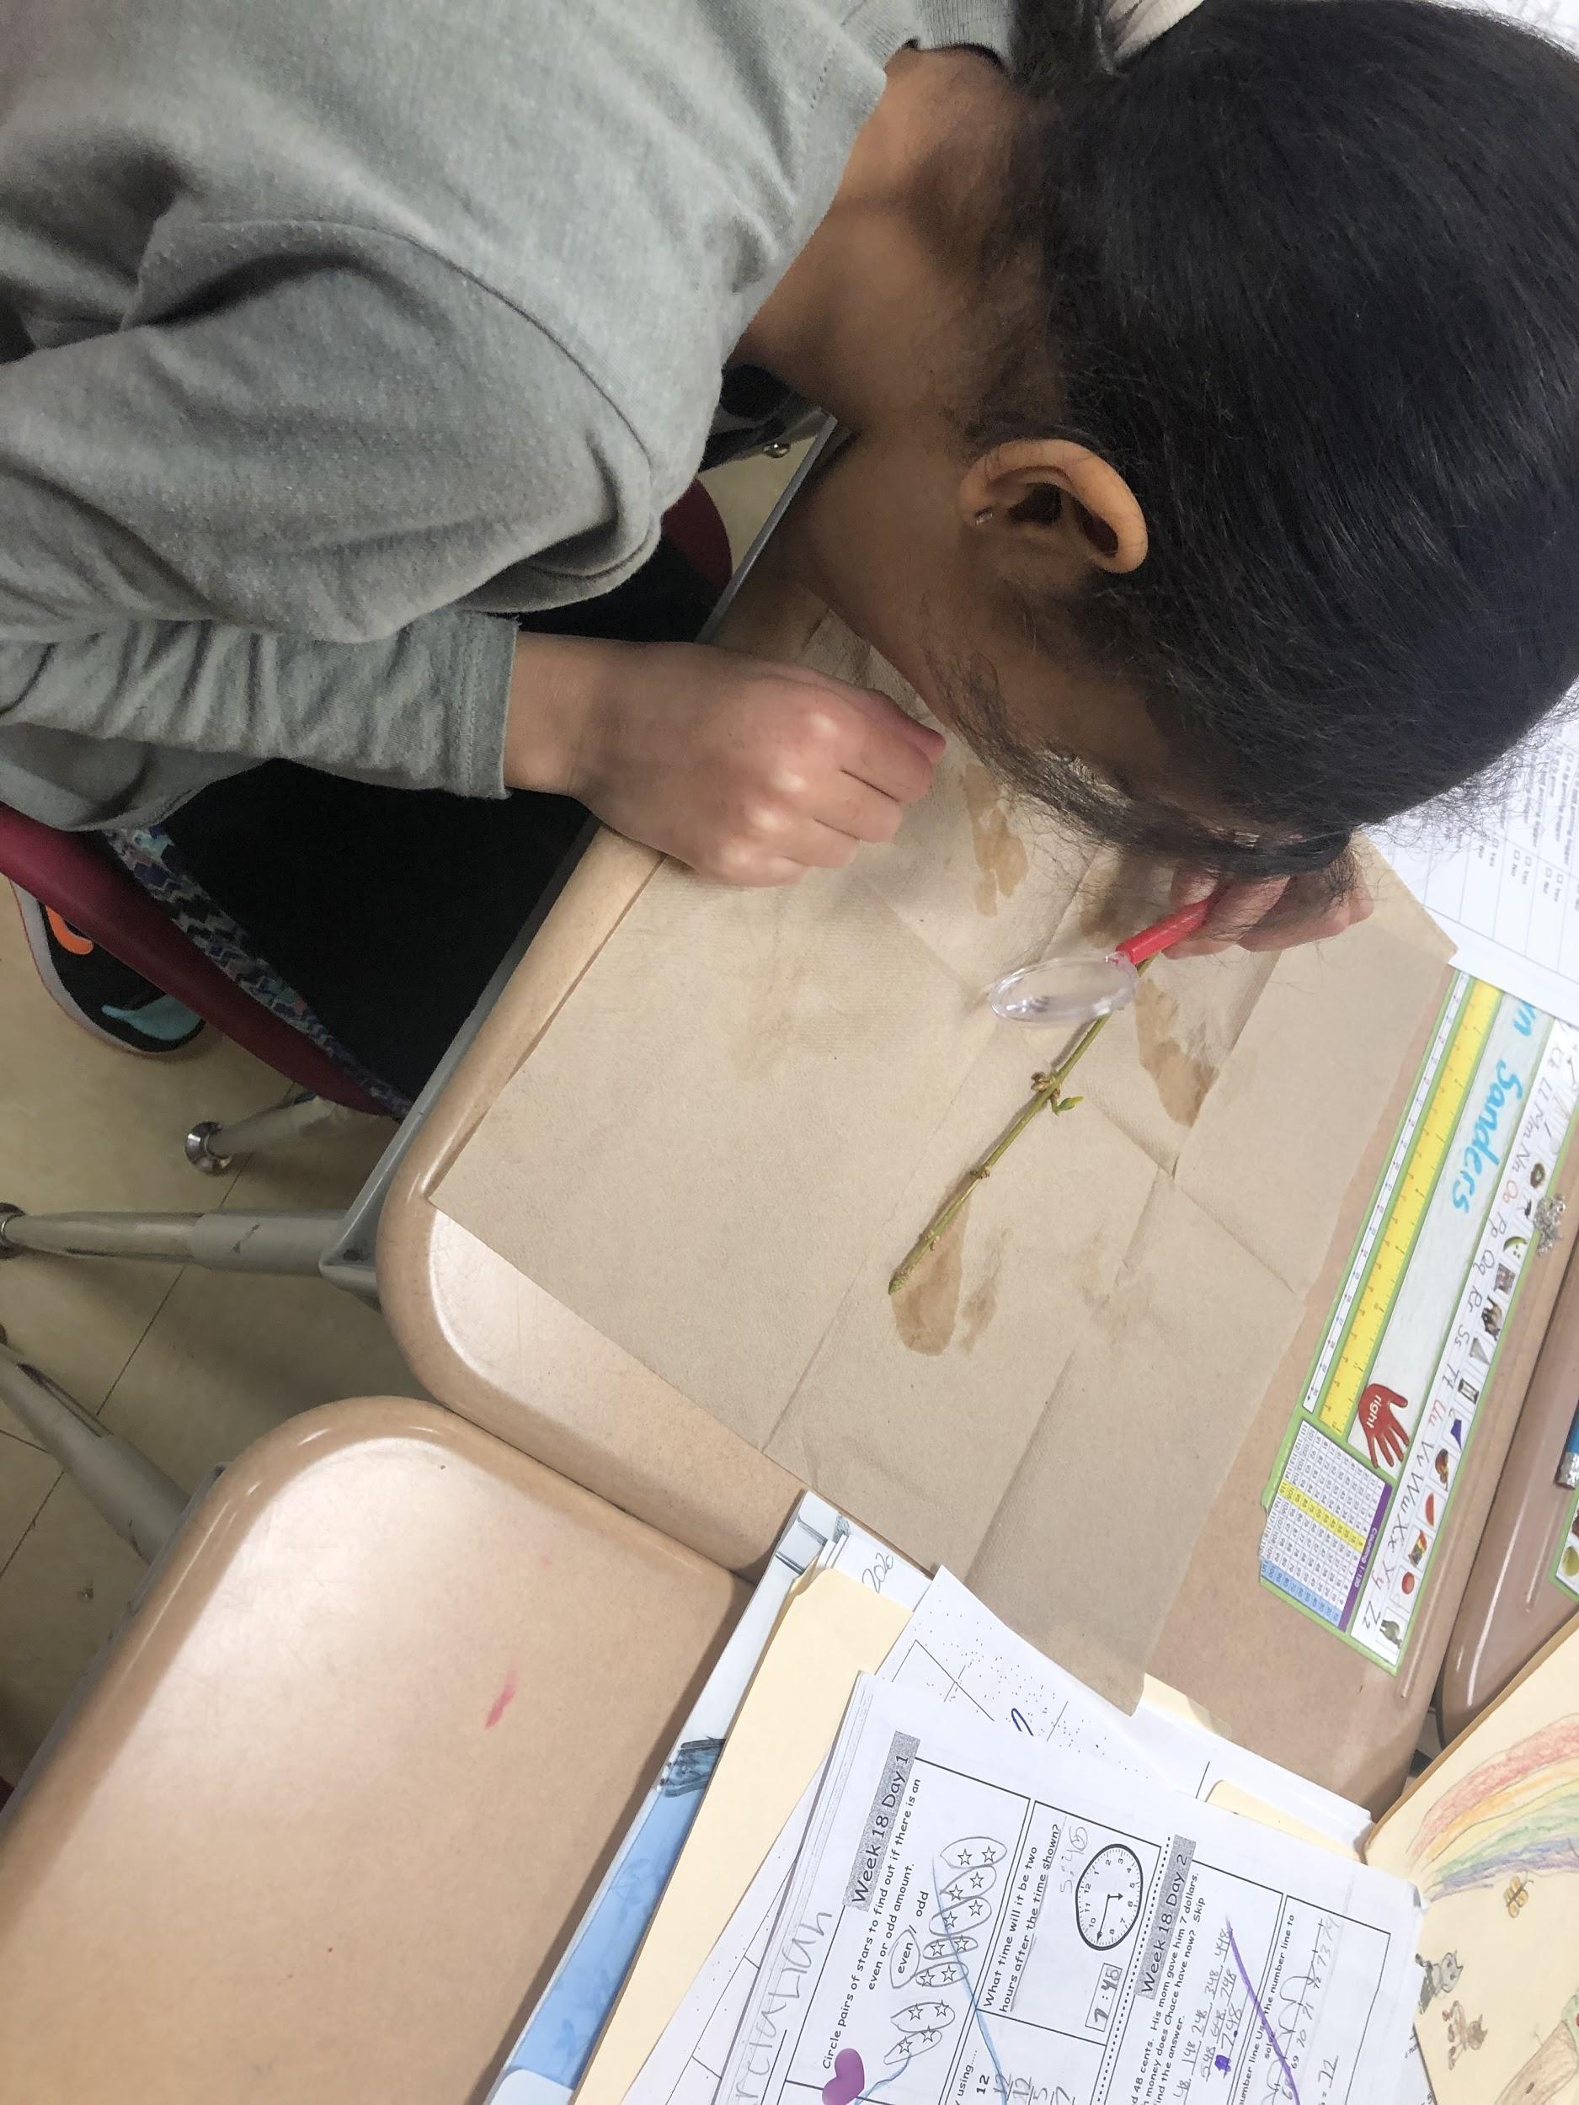

Slide 14
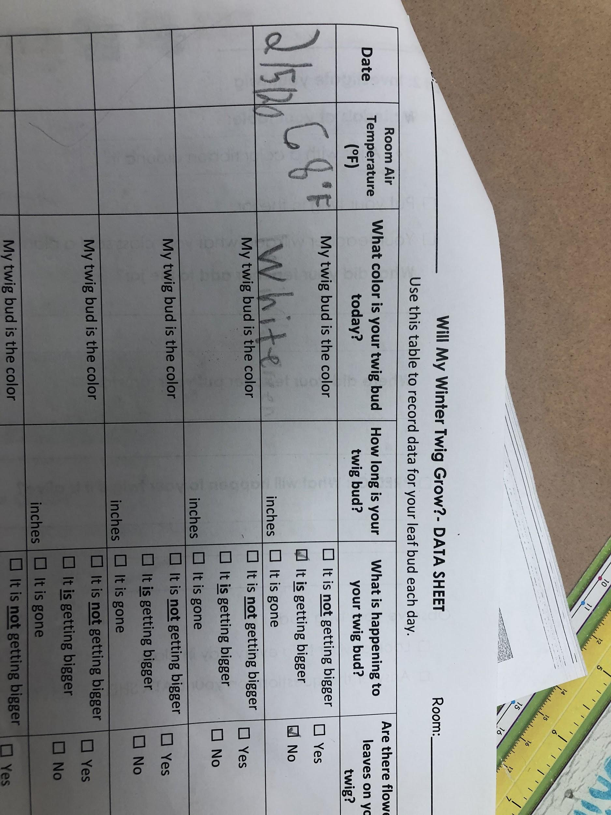
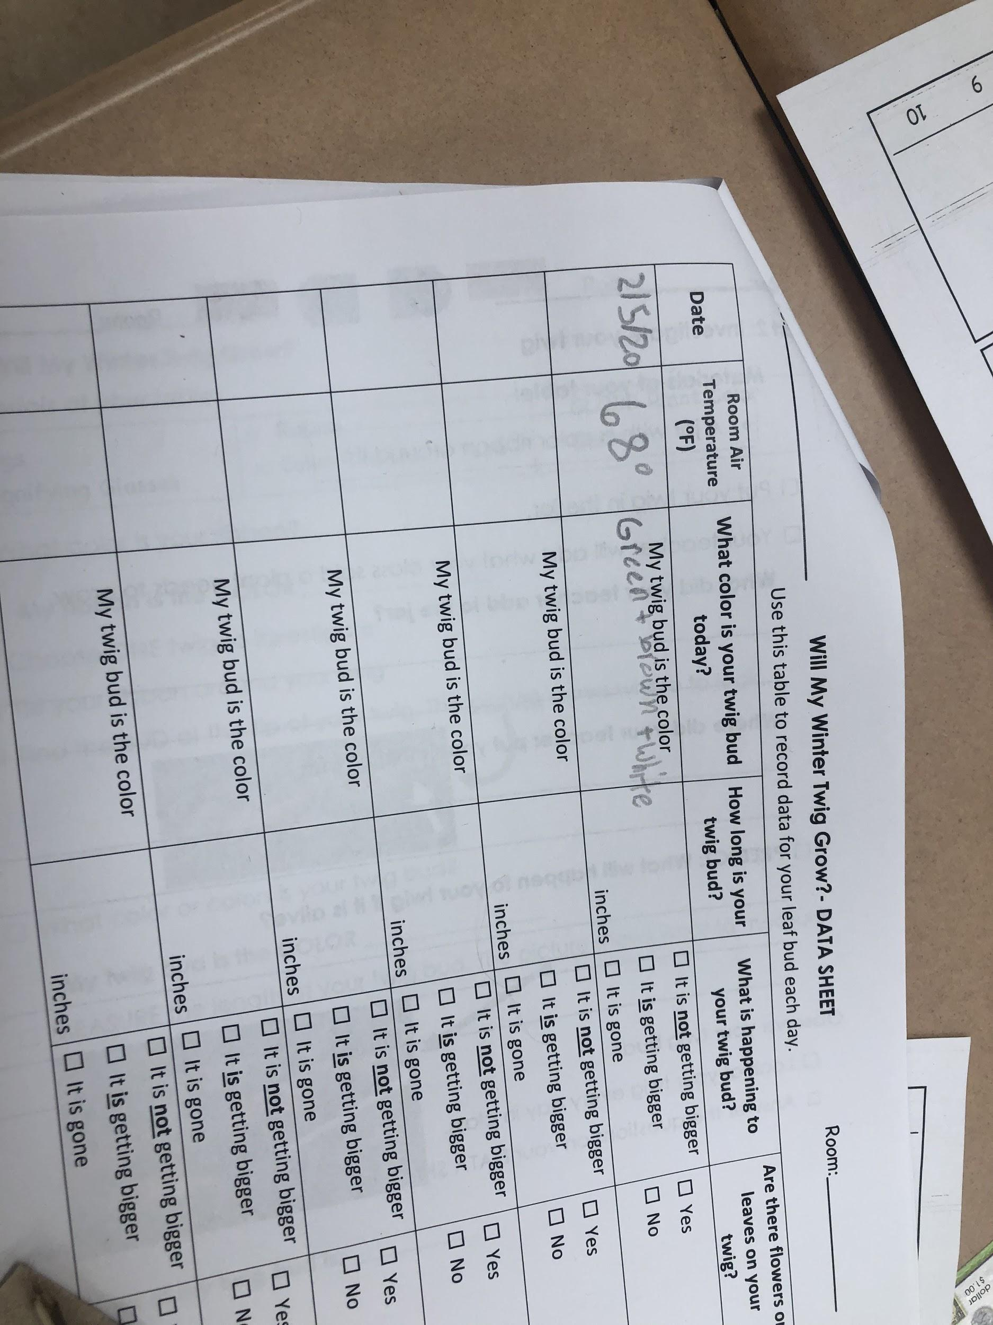

Slide 15
Room 201 Meterologist Protocols
A meteorologist is a scientist who studies weather. Some meteorologists report the weather to many people!
Scroll down on the assignment page to the section marked GLOBE.
Open up the link to the Carnevale Weather Station.
Look at the information.
Click on to the Weather board and fill in the information.
DO NOT submit!
Click on the April Weather Data Chart
Complete the chart by adding the temperature and sky conditions
Report out information to the class! Remember to be an awesome superstar speaker!

Slide 16
Weather Collection Tools
Virtual Weather Board
Weather Board (Google Doc)
Fill in the information on the Virtual Weather Board below. Be prepared to share your data with the class.
* Required
The temperature is... *
The sky conditions are... *sunny, partly cloudy, cloudy

Slide 17
The precipitation is…
rain, snow, freezing rain, drizzle, none
What kind of clouds are in the sky? *
Cumulus, Cirrus, Stratus, No clouds...the sky is clear.
The wind speed is... *

Slide 18
The wind direction is... *
The barometer is... *
steady (the weather is staying the same with no changes)
falling (there is going to be a change in our weather...like rain, snow or a storm)
rising (our weather is going to improve).

Slide 19
Student Air Temperature/Sky Condition
Data Collection Sheet
Student meteorologists logged on to the Davis Weather Center daily during the solar noon time.
Students recorded their data on the sheet.
The data collected focused only on school days.
The information on the collection sheet was turned into a bar graph and the data was then analyzed.

Slide 20
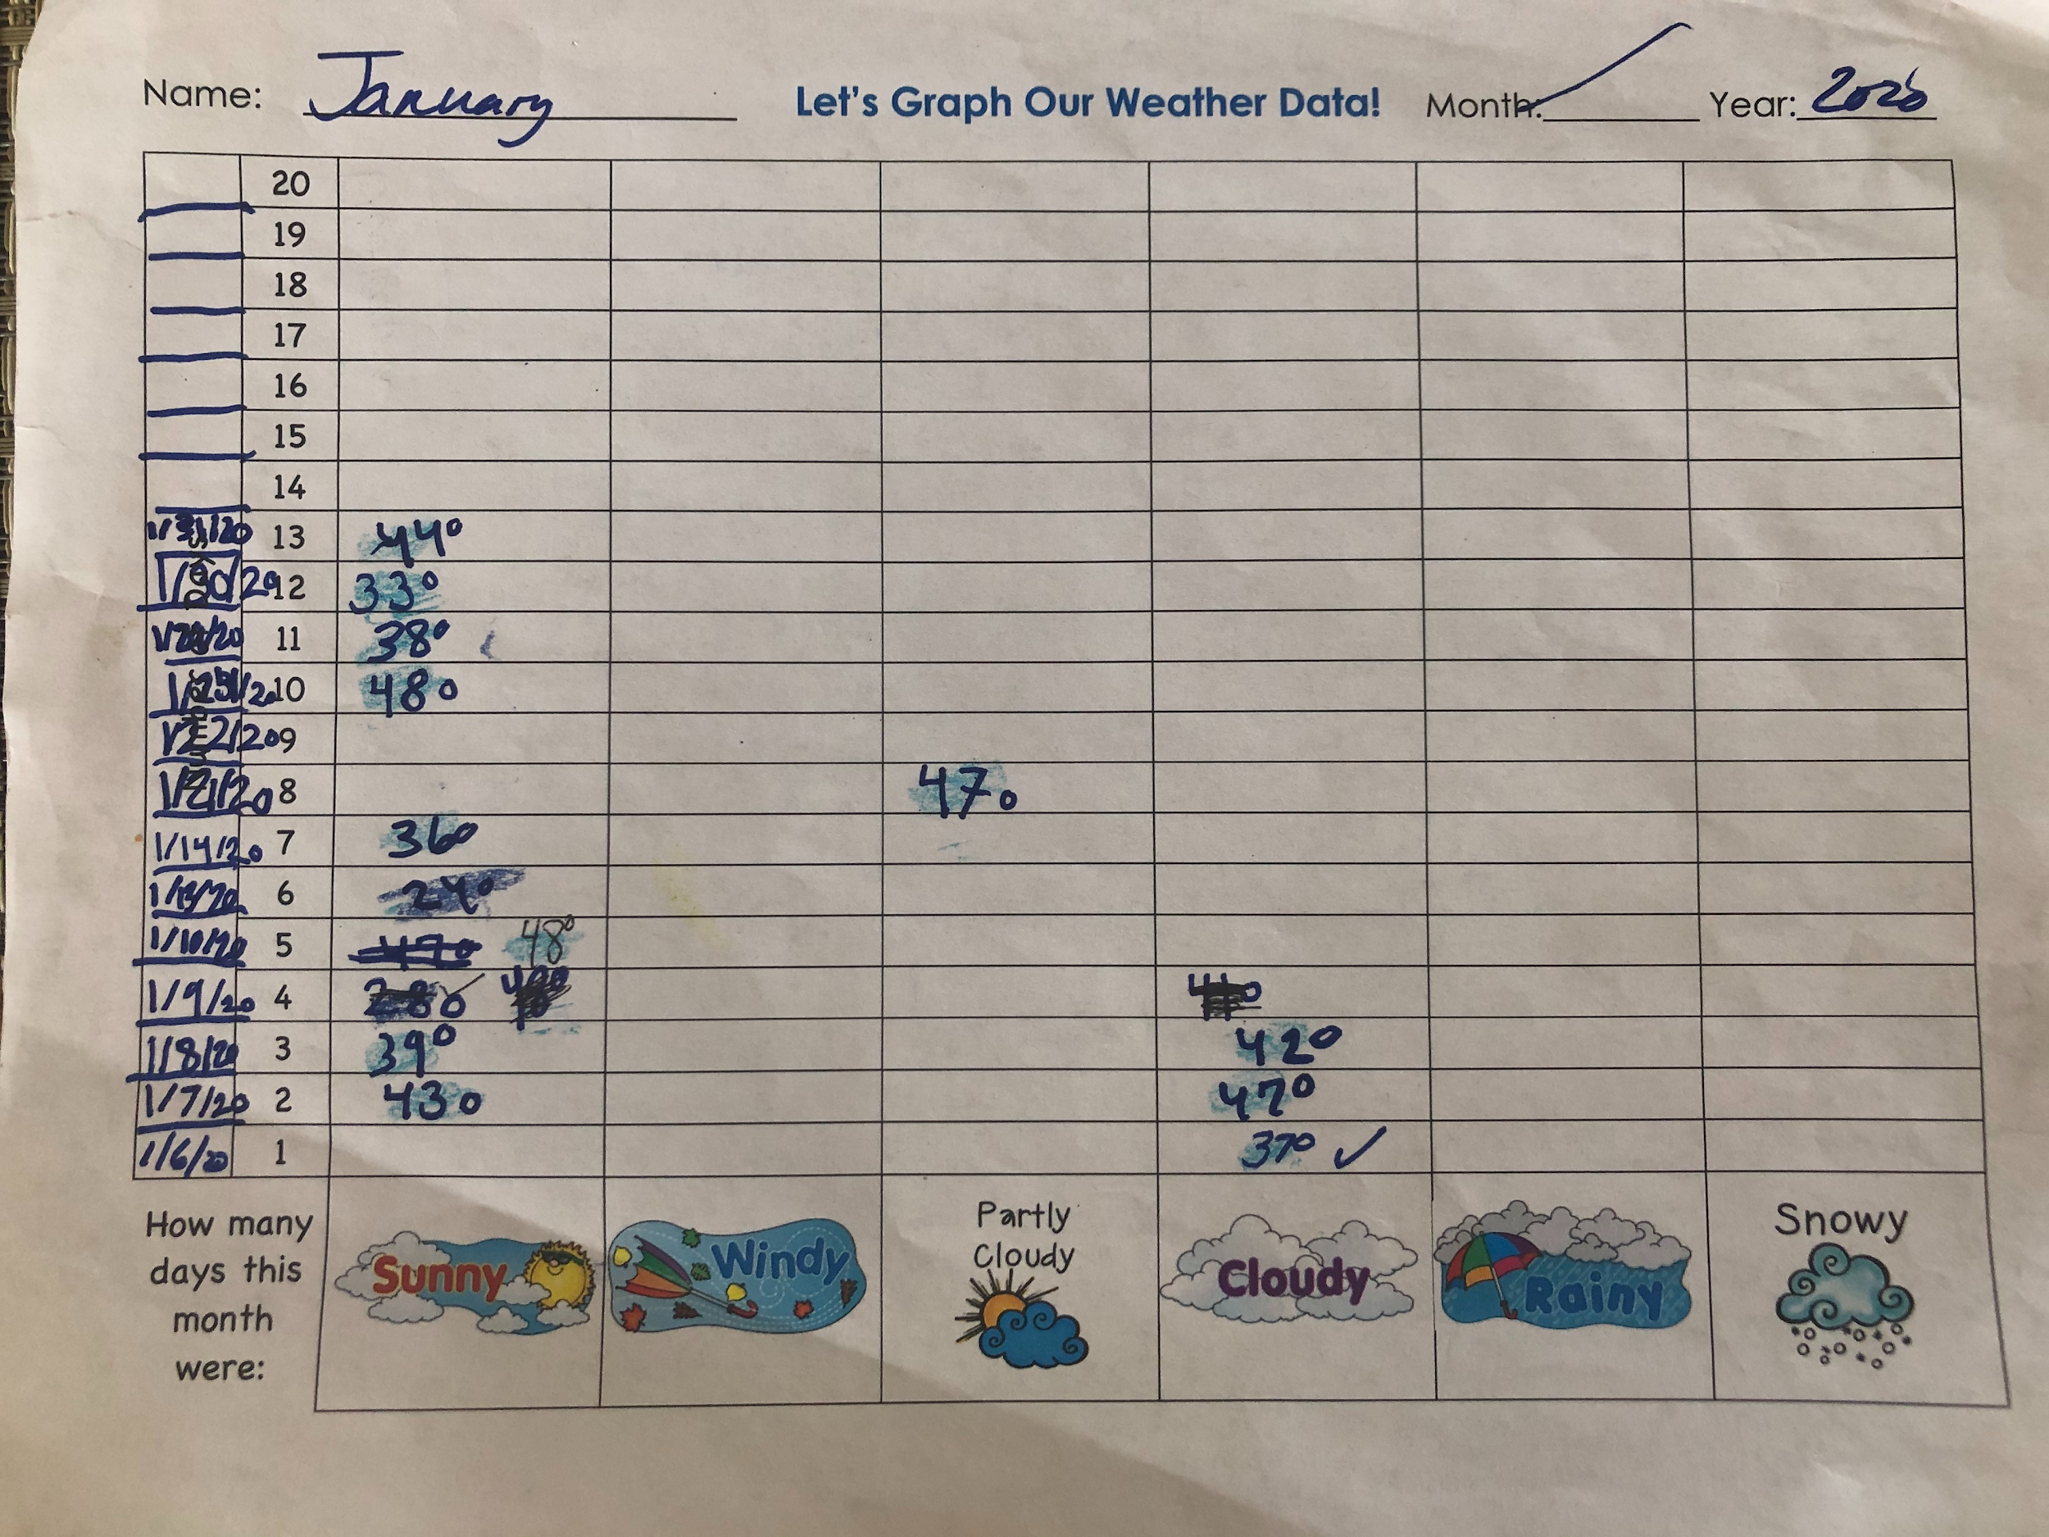
Student Air Temperature and Sky Condition Data Collection...January, 2020

Slide 21
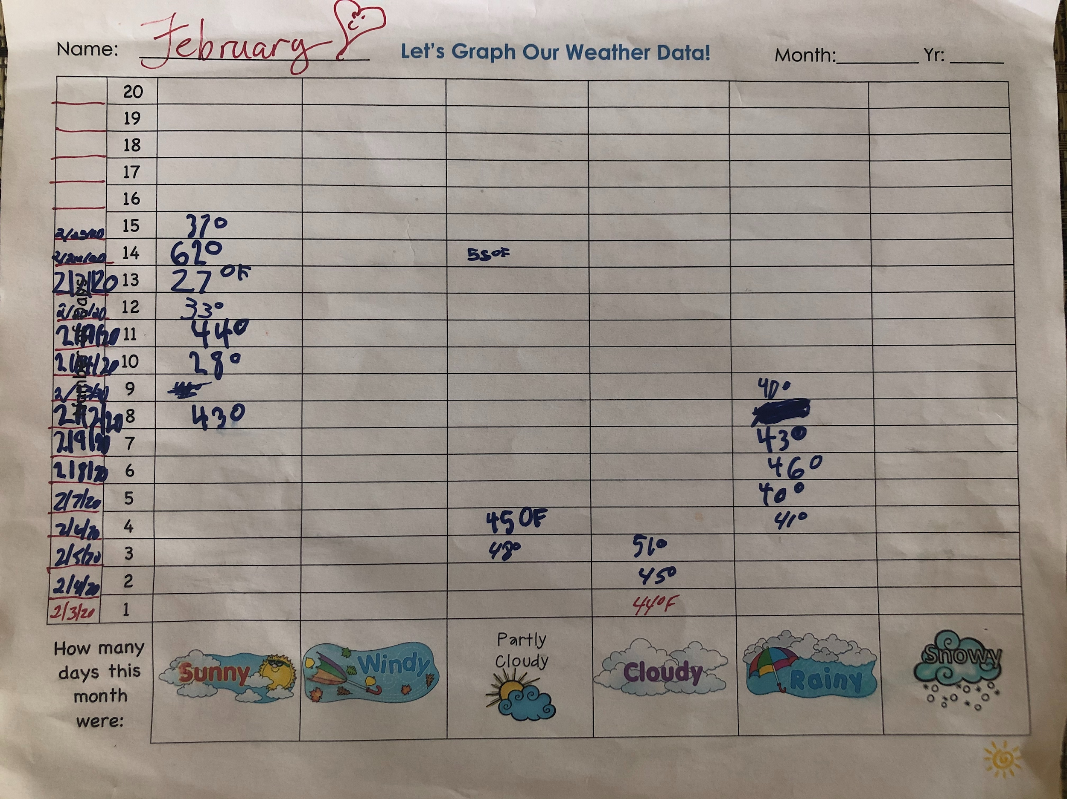
Student Air Temperature and Sky Condition Data Collection...February,2020

Slide 22
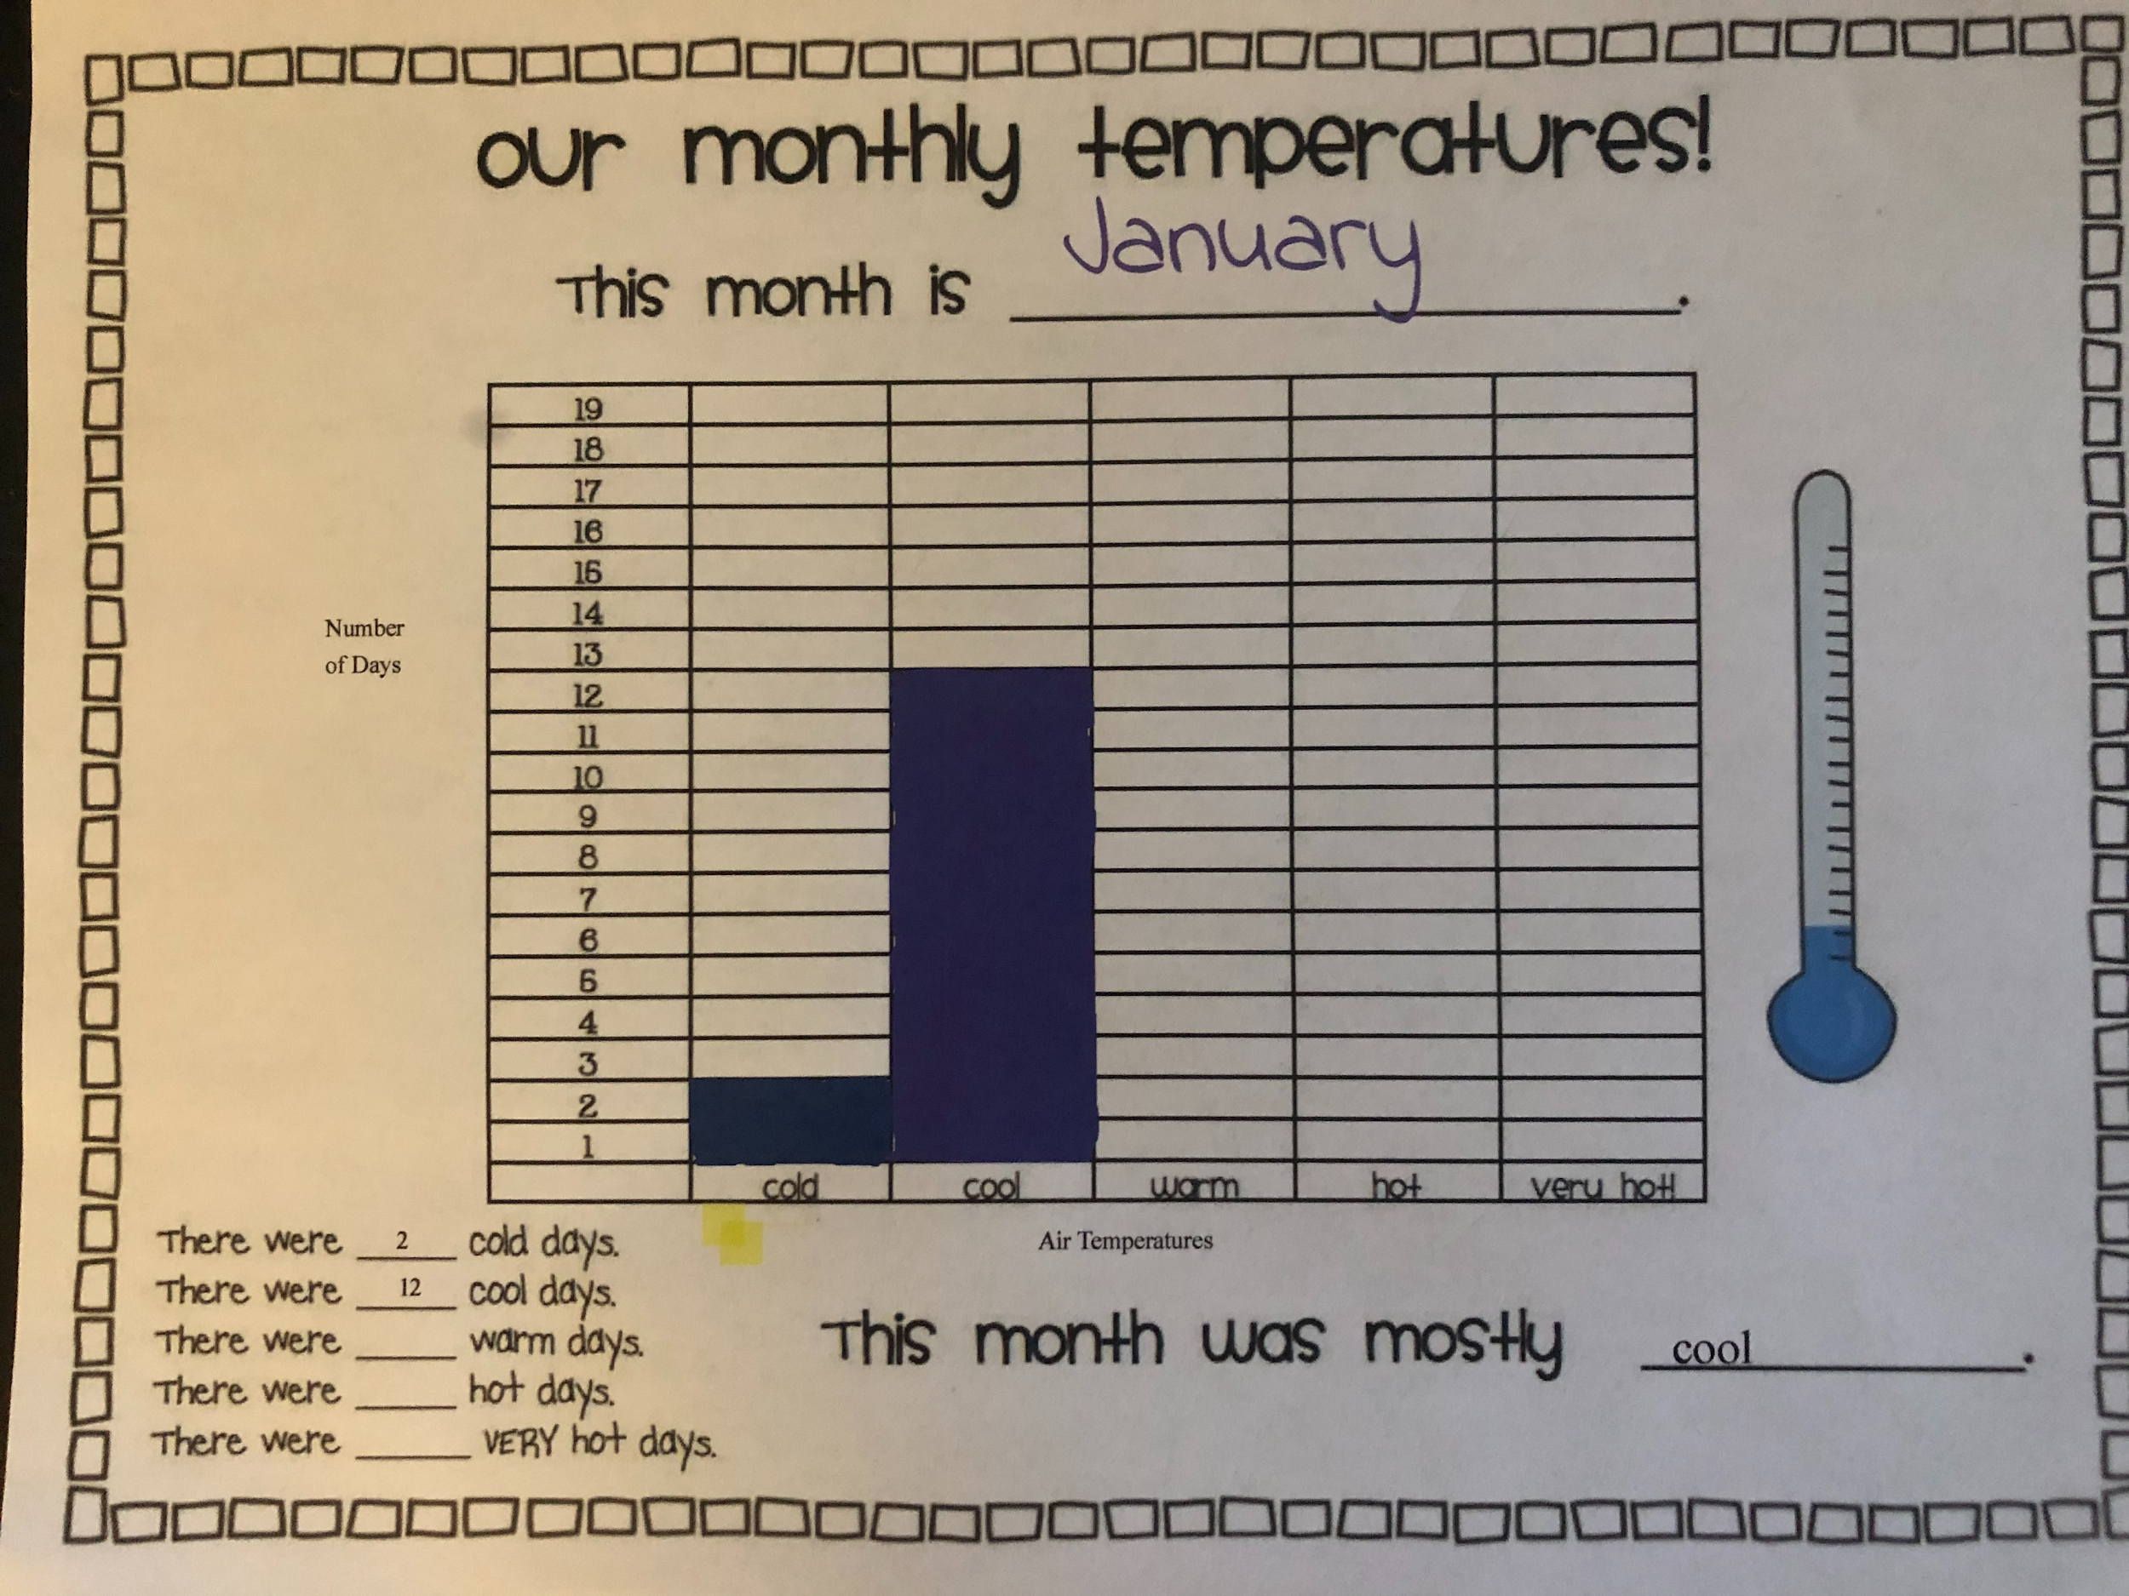
Data Analysis
January, 2020

Slide 23
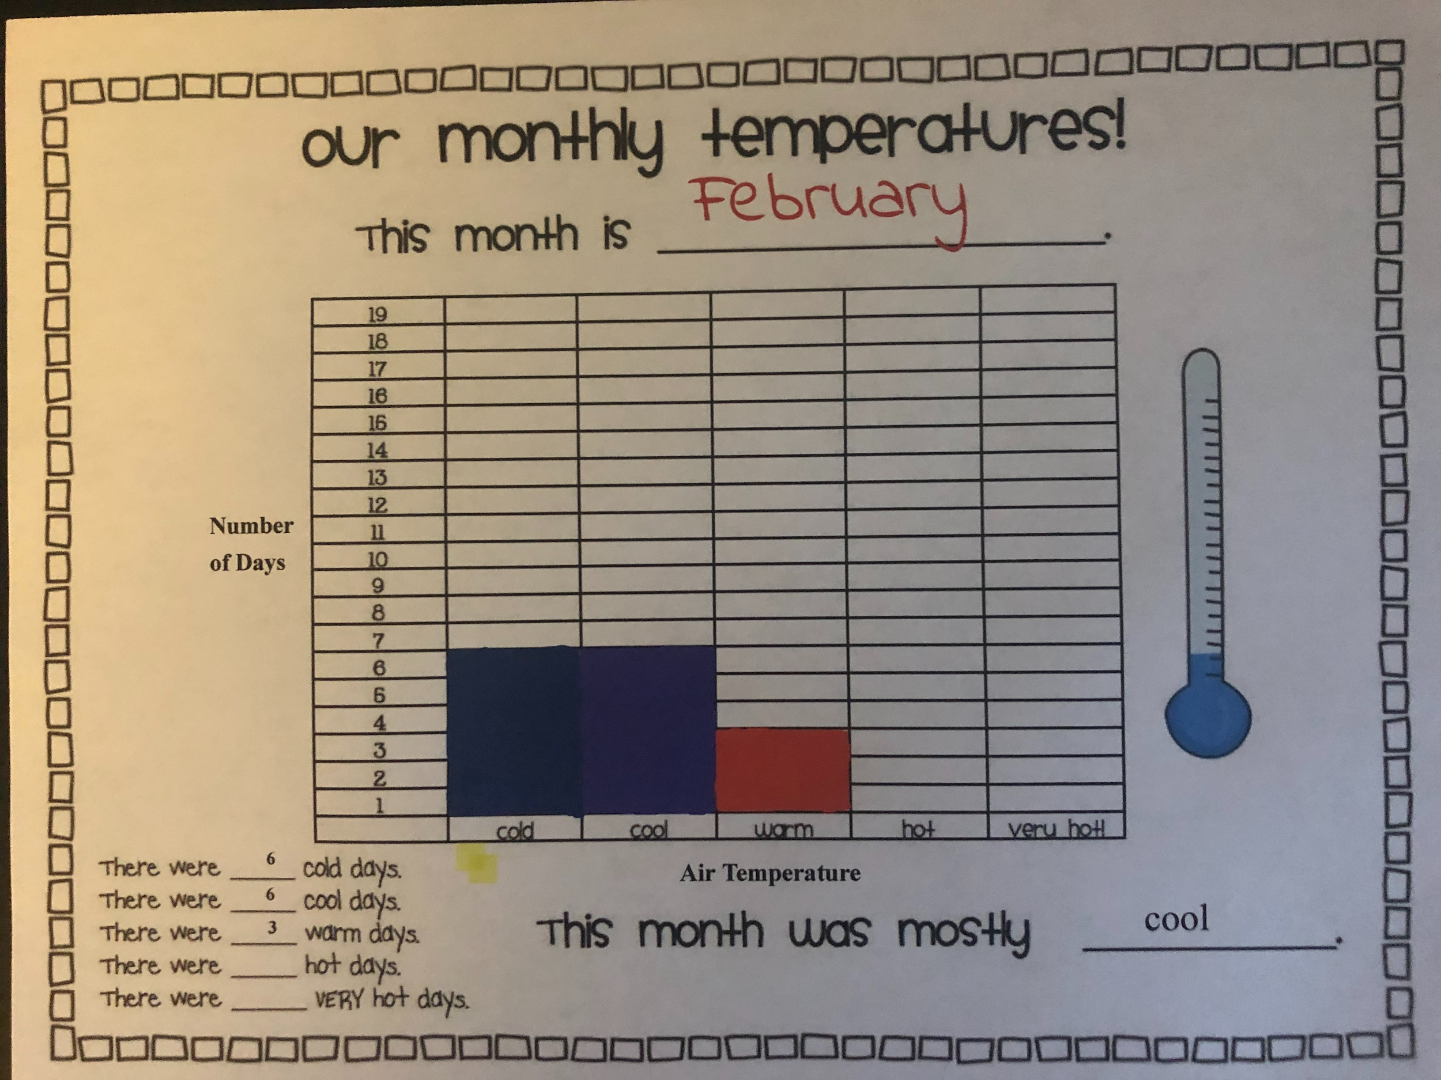
Data Analysis
February, 2020

Slide 24
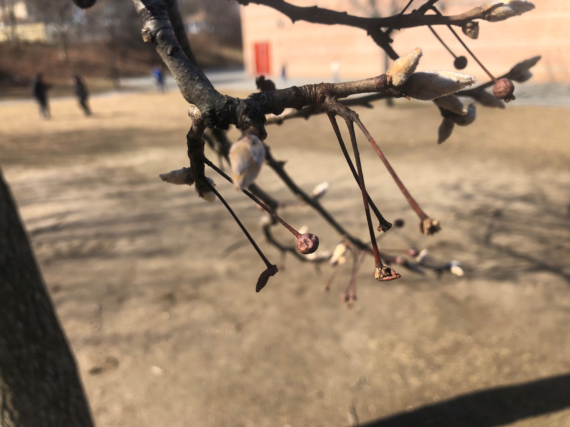
Bud Bursts, Winter, 2020
Anthony Carnevale School, Providence, R.I.

Slide 25
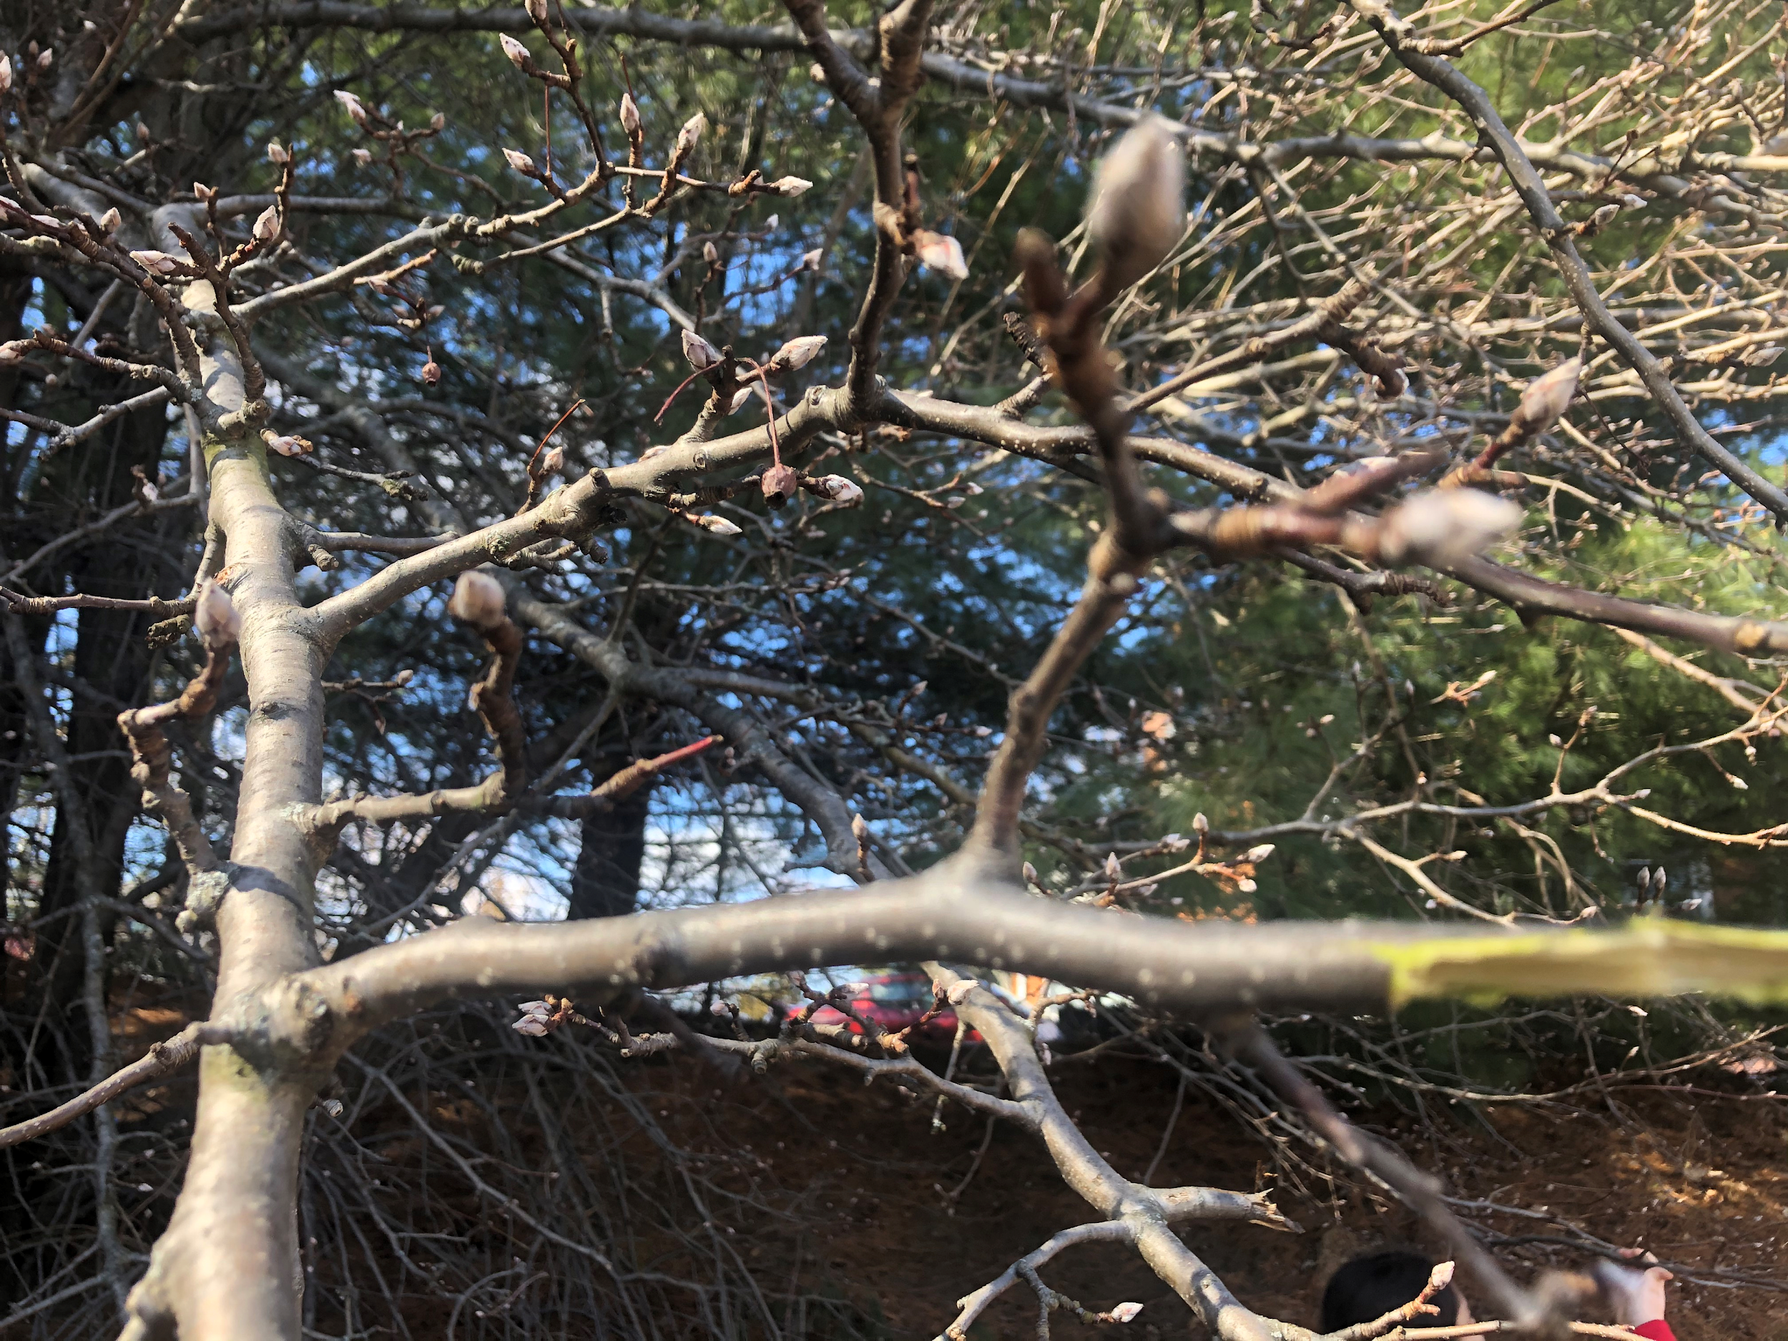
More Bud Bursts, Winter, 2020
Anthony Carnevale School, Providence, R.I.

Slide 26
Our Conclusions...
All students had to make a claim and support it with evidence they recorded on their data collection sheets.
The evidence from the 8 weeks of data collected as well as student observations helped us understand that trees and bushes are dormant during the winter. The air temperature in the classroom was consistently between 68*F-72*F, the twigs were kept in water and had plenty of sunlight.
Students also based their observations based on the evidence collected on warmer than normal winter air temperatures that were recorded in the months of January and February as well as the start of very early bud bursts observed by students during this time of year, which they noticed was unusual.

Slide 27
After analyzing air temperature data along with the data collected on bud bursts both inside and outside the classroom, students had enough evidence to make a claim...that air temperature does have an effect on bud bursts and can cause buds to burst.
This evidence also proved that trees and bushes are NOT dead during the winter but remain dormant during these months. Both The Mystery of the Winter Twig activity and the students’ own research, observations and data collection answered both questions about temperature and dormancy.
A final survey showed that 100% of the students agreed trees/bushes were not dead or frozen during the winter but were alive but dormant based on the evidence collected during the collection period.

Slide 28
Differentiation...those students who have an IEP had their data collection modified and worked with our Teacher Assistant...they could draw what they saw,our TA would scribe for them, they were assigned a peer model and they could simply pull a twig from their team cup and share what they learned.

Slide 29
What was your favorite GLOBE activity? (You can choose more than one!) Graphing data is based on 10 student responses.
Using theDavis Weather Center
Collecting /Presenting Weather Data/Sky Conditions.Clouds
Adopting a Tree/Observing Changes
Studying Dormancy/Bud Bursts
Dissecting Bud Bursts
Outdoor nature Scavenger Hunt
Pollinators/Pollination

Slide 30
Student Response Question...
Choose one of your choices. Why was that your favorite activity? Make Sure you tell us WHY you liked that activity and what you LEARNED! Use the sentence starter below to write your answer. l liked the activity ___________________________________ because I learned____________________________________...
Student Responses...
I liked the activity that we did pollination because we did the experiment that we could look inside the flower.
I liked the activity of the outdoor nature scavenger hunt because I got to go outside and I learned about leaves
I liked the activity adopting a tree because I learned that in winter there not dead there alive and I learned the word dormant it means it’s asleep.

Slide 31
Student Comments Continued...
I like the outdoor nature scavenger hunt because i learned about what small seeds look like and branches look more closer and more nature stuff and it was so much fun.
I liked the weather center because I could learn how to look at the weather.
I liked Adopting a tree and watching its changes because l learned all about how they go dormant and how the levels fall off in the fall.
I liked the activity outdoor nature scavenger hunt because I learned about different flowers and pinecones.
I liked the Pollination and pollinators activity because the flowers are pretty
and animals eat pollen.

Slide 32
A Big Thank you to…
The Providence Public Schools
The GLOBE Educators from Boston University
NASA
For all of the materials for us to use, your fun learning activities, and your kindness to all of us!
We appreciate all that you do!
Love,
The Second Grade Students, Room 201 Inclusion
Anthony Carnevale Elementary School
Providence, Rhode Island

