Slide 1
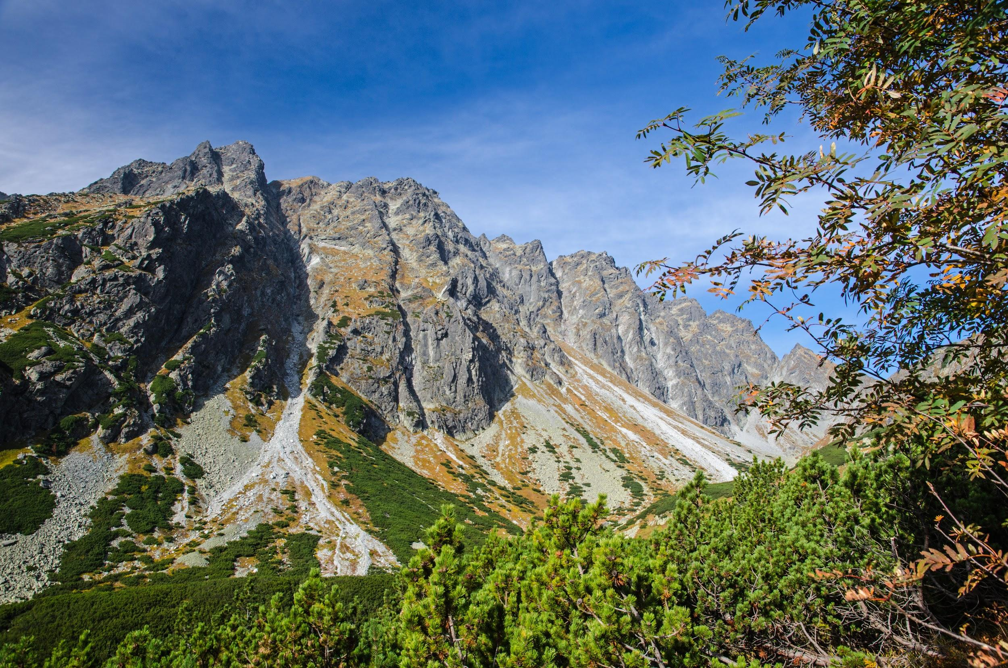
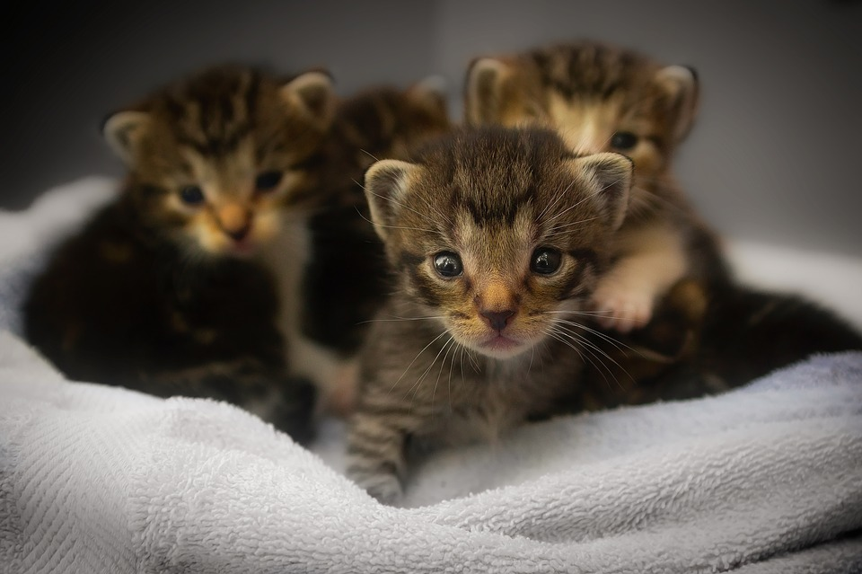
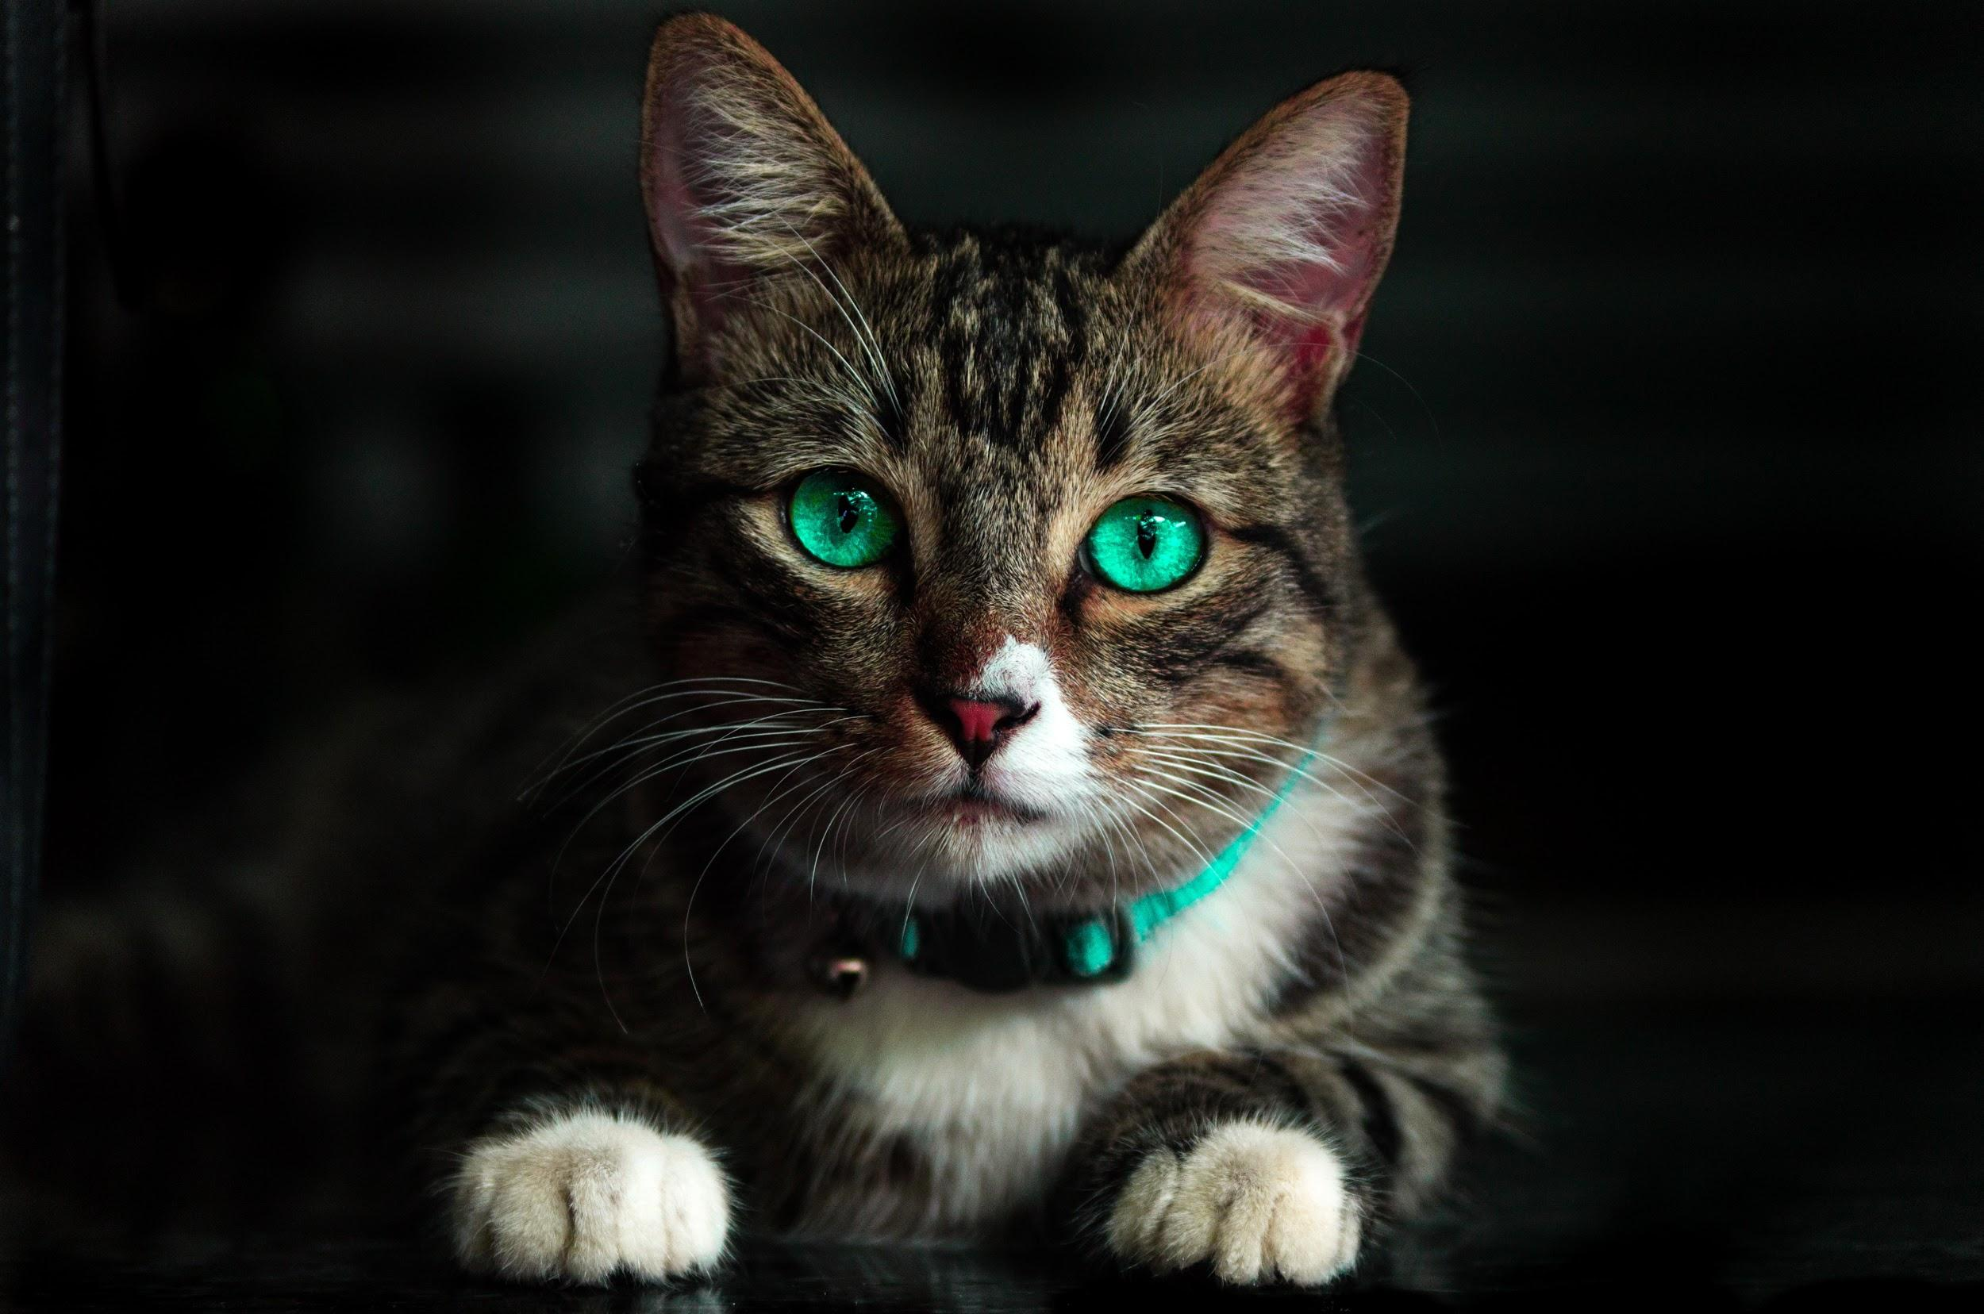
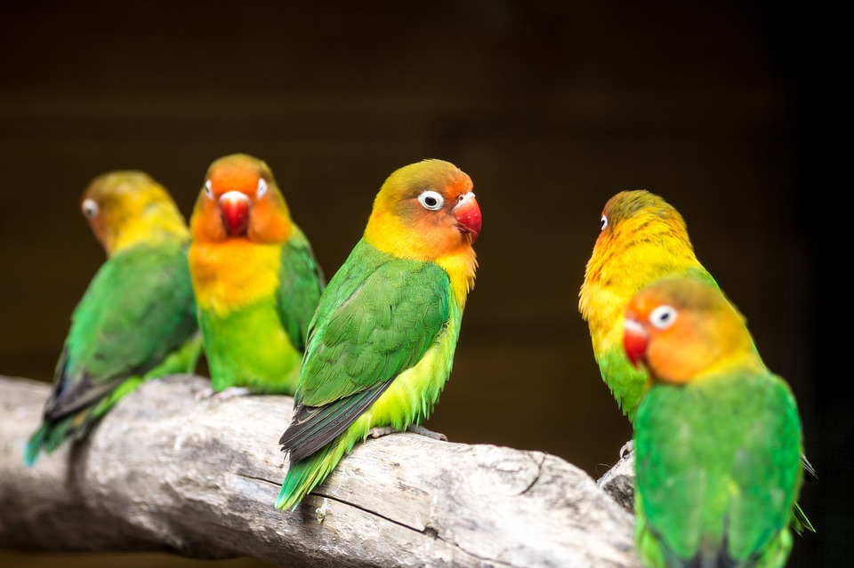
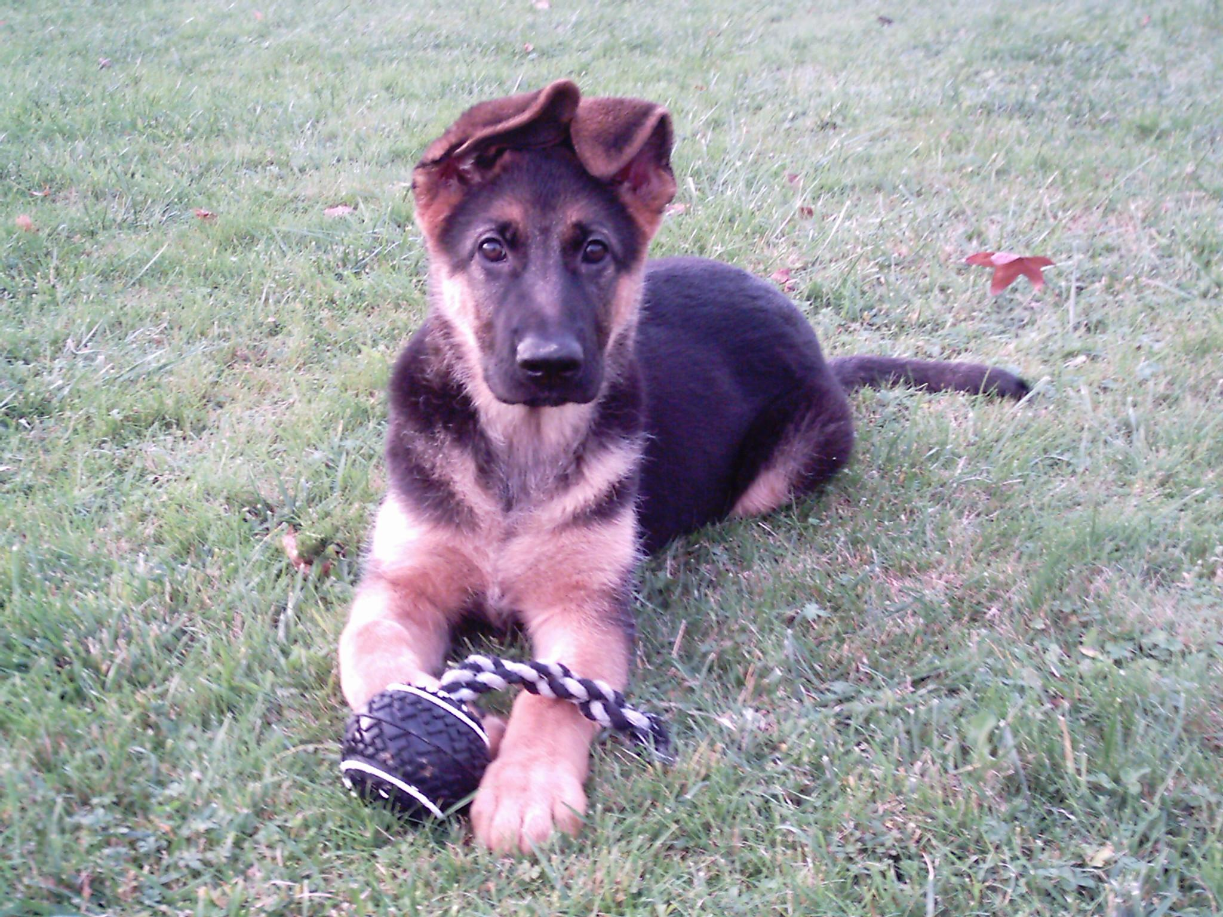
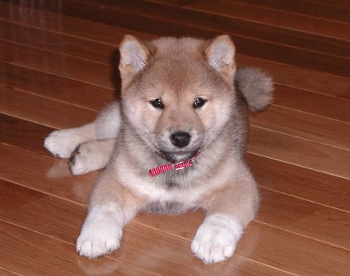
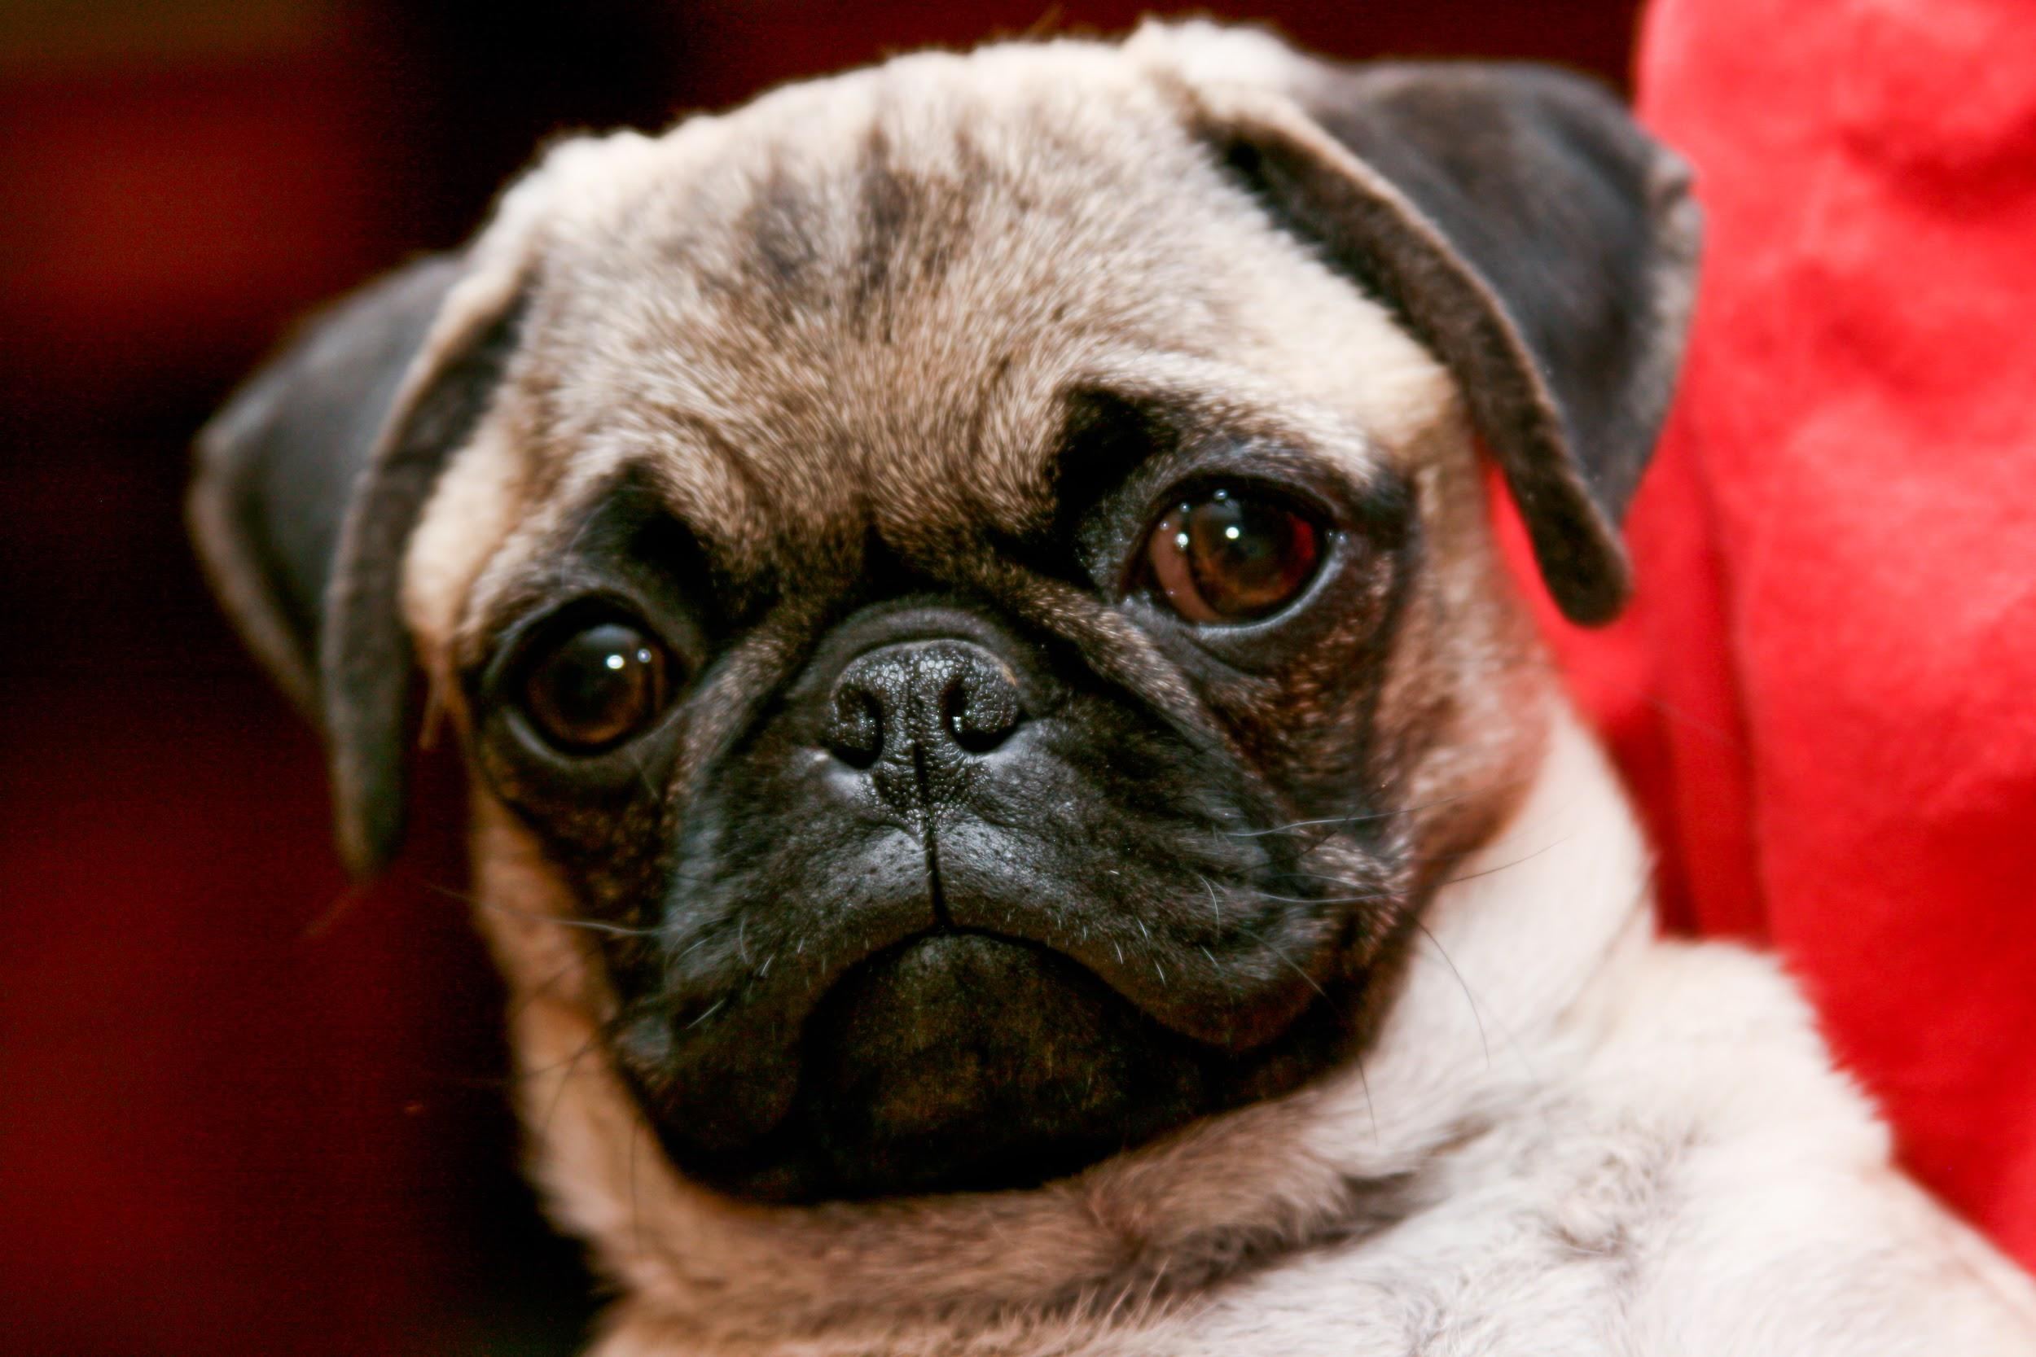
Presenting:The Biosphere
By: Rithea,David, Albin & Jayson - Enjoy!

Slide 2
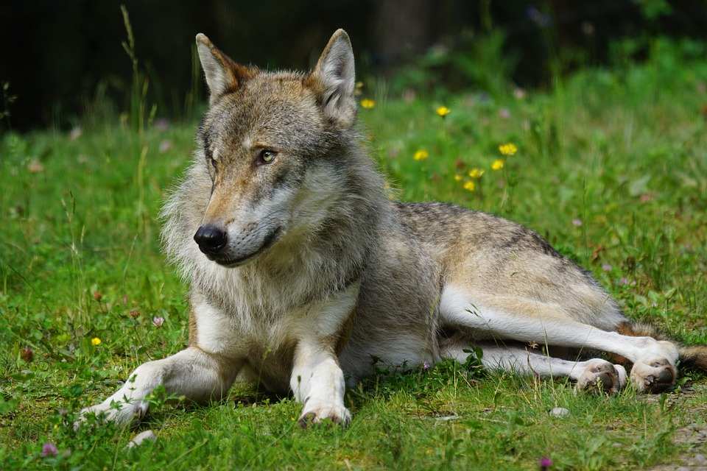

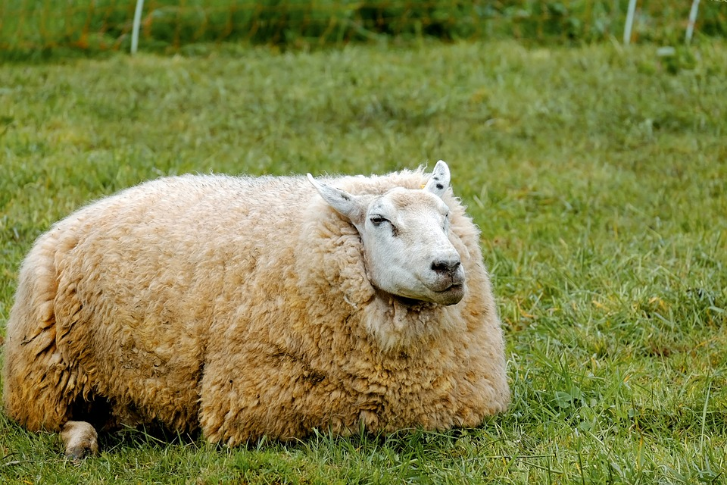
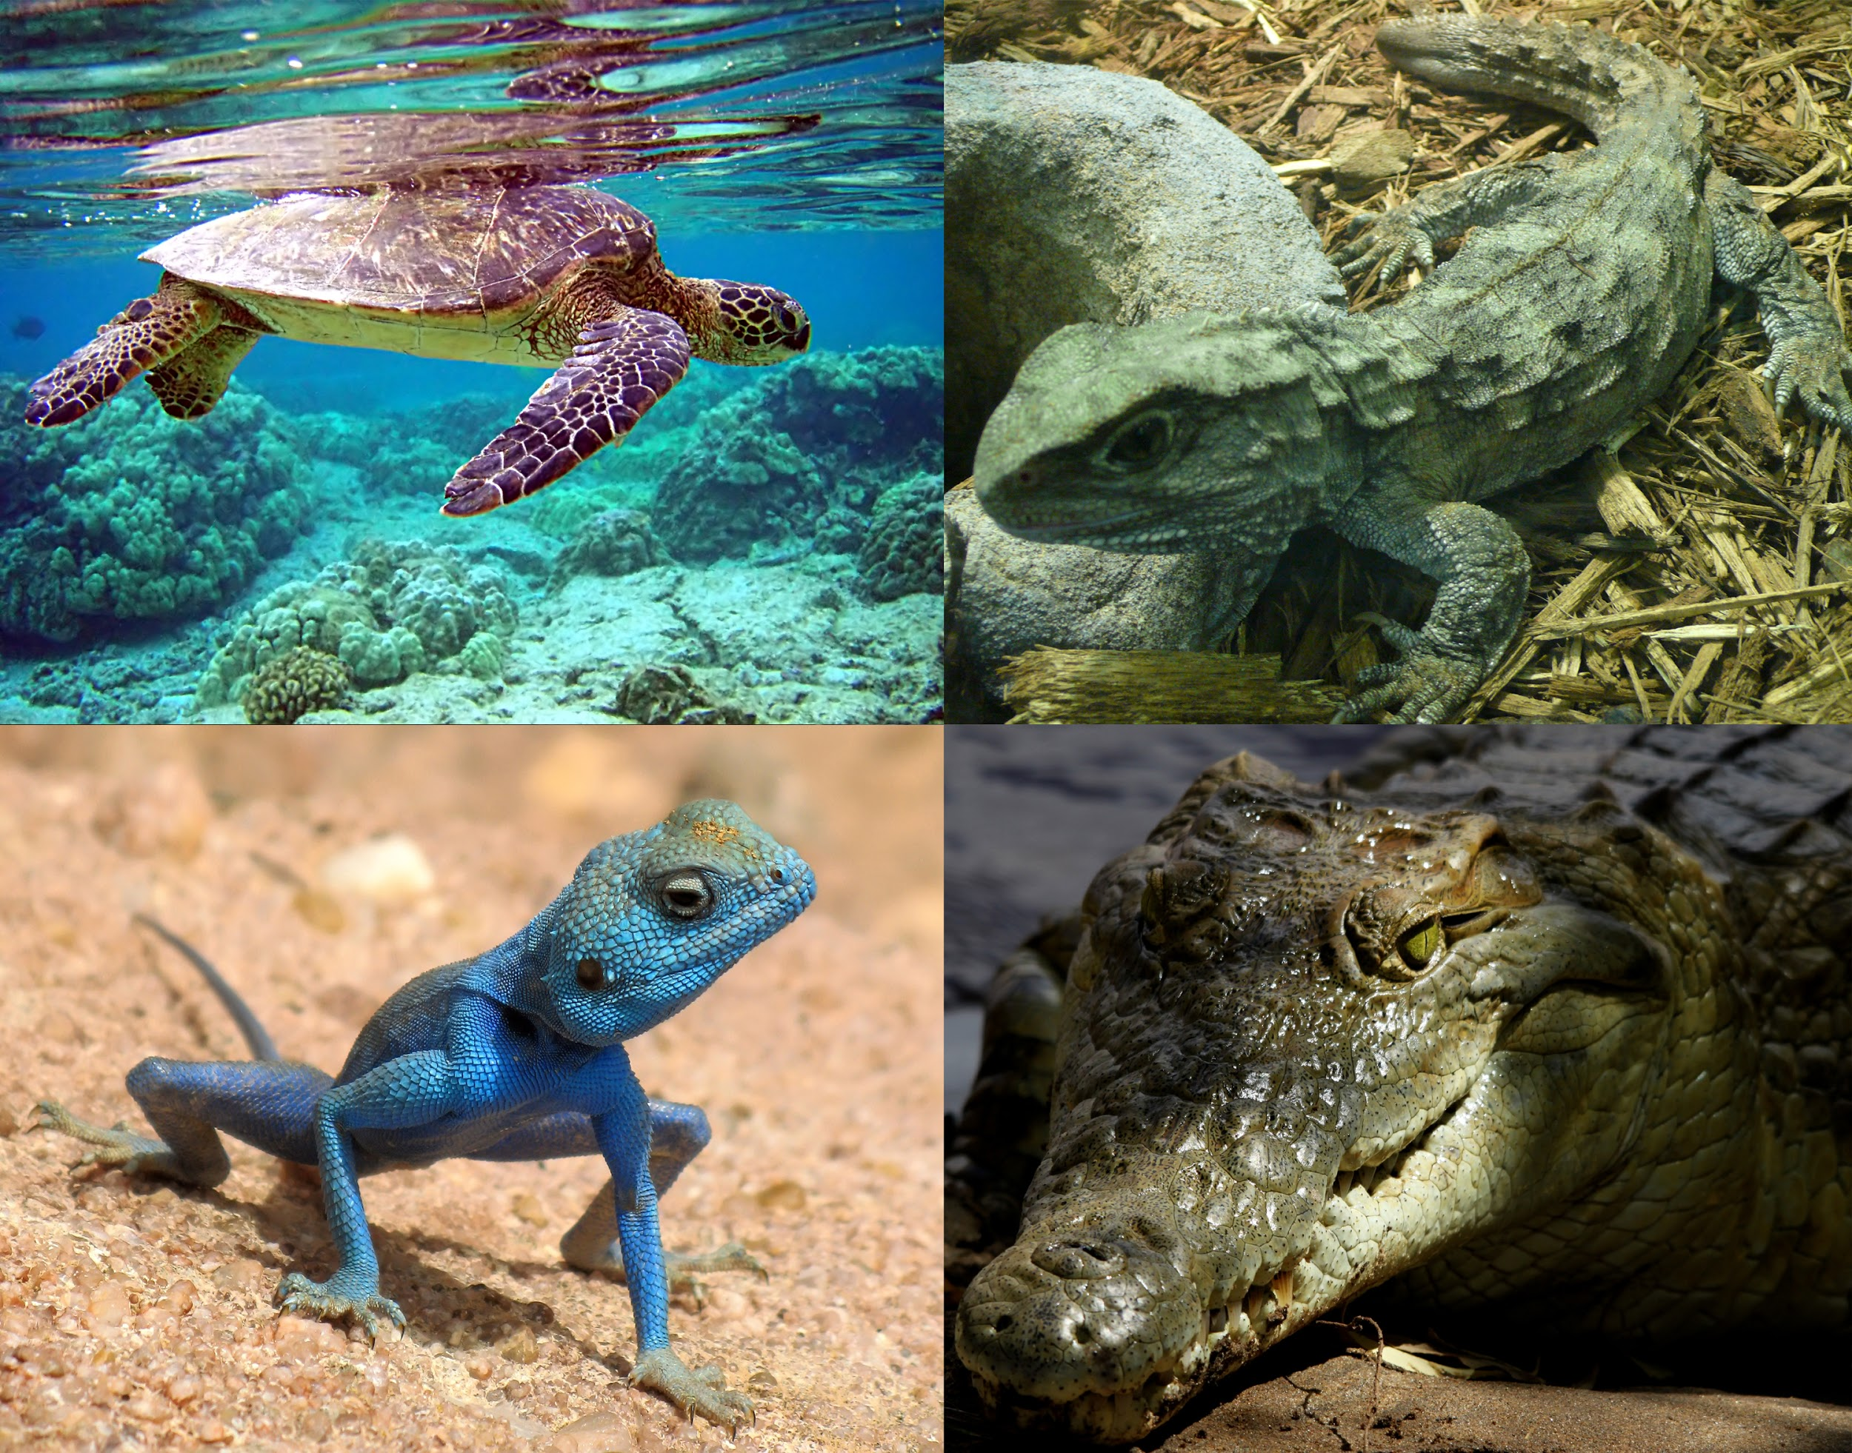
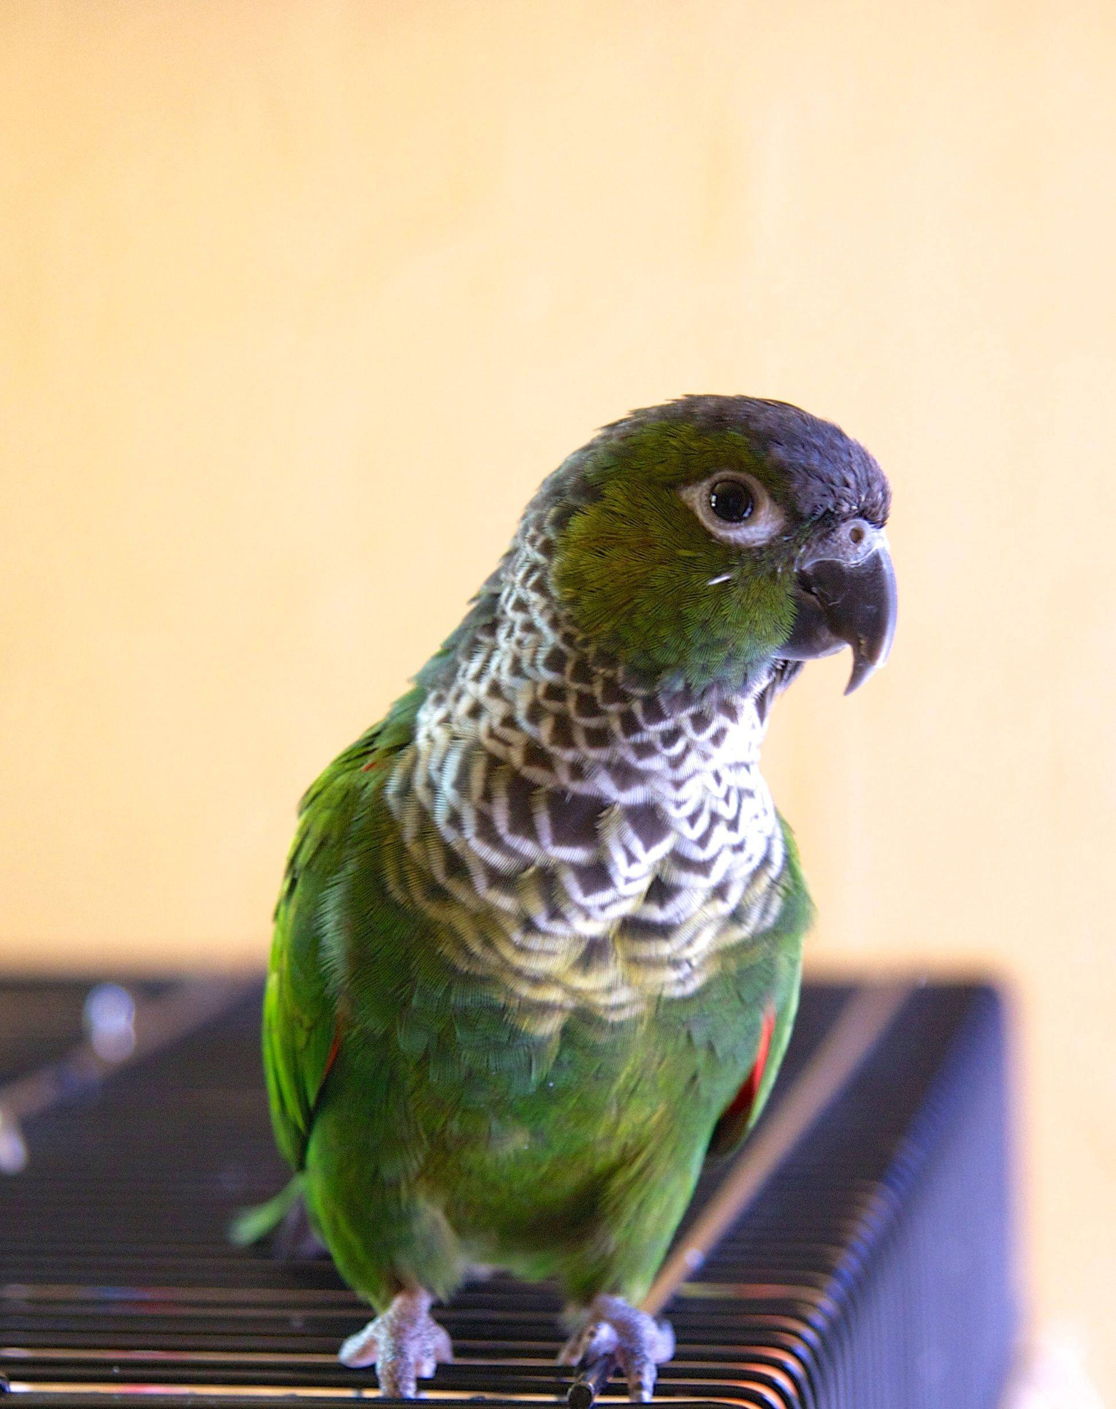
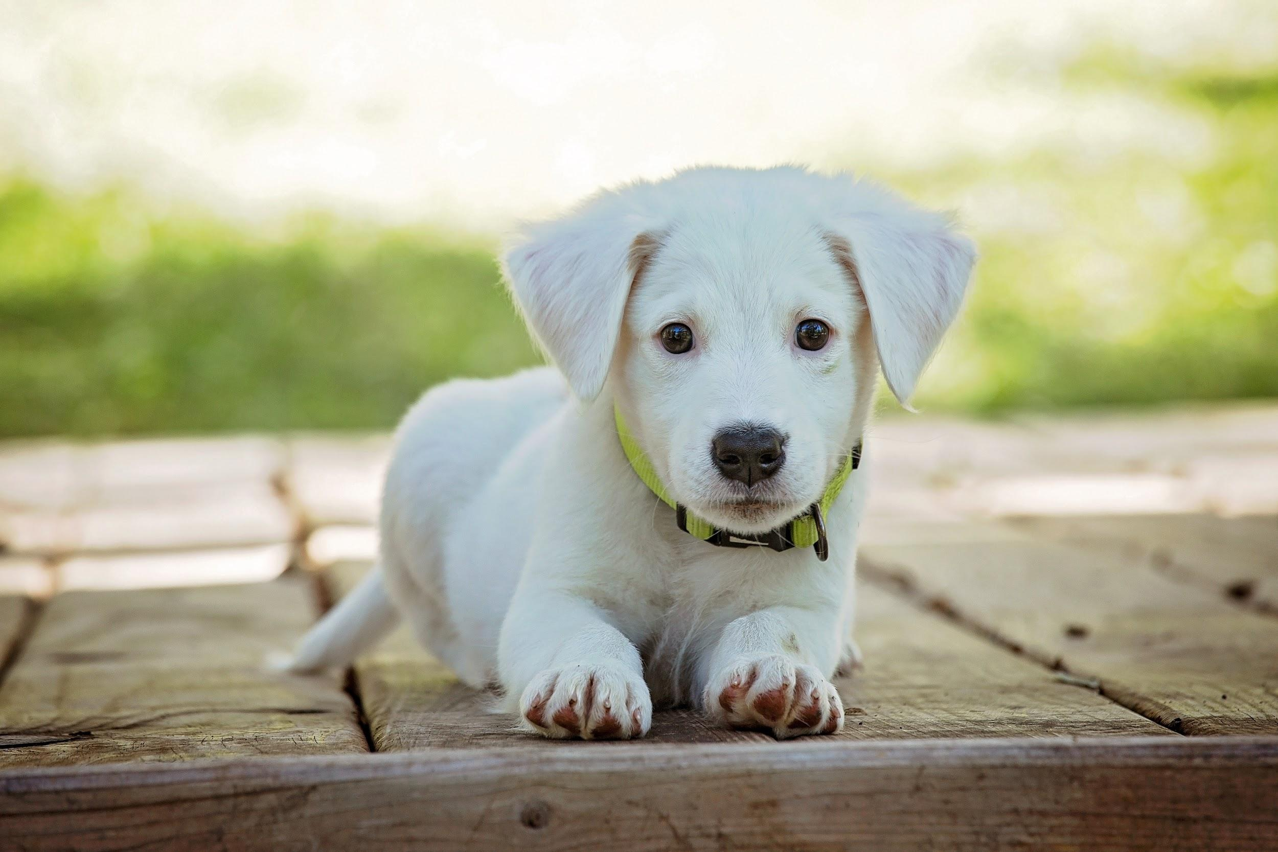
The Biosphere contain all of the living creatures on Earth!

Slide 3
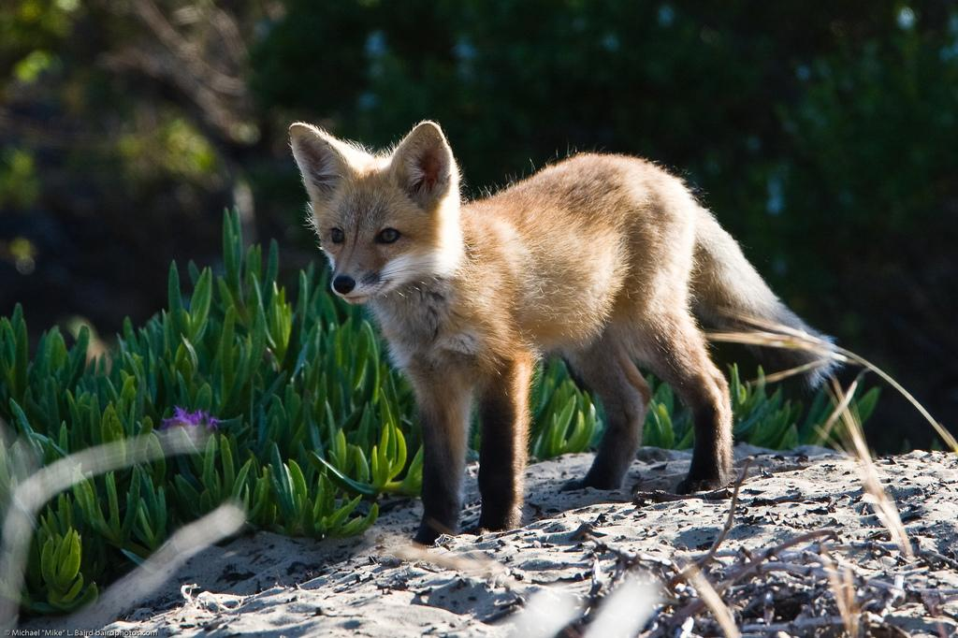
Why do carnivores matter
They keep the population of animals low by hunting so they do not keep spreading ex) mice,deer,bunnies,etc

Slide 4
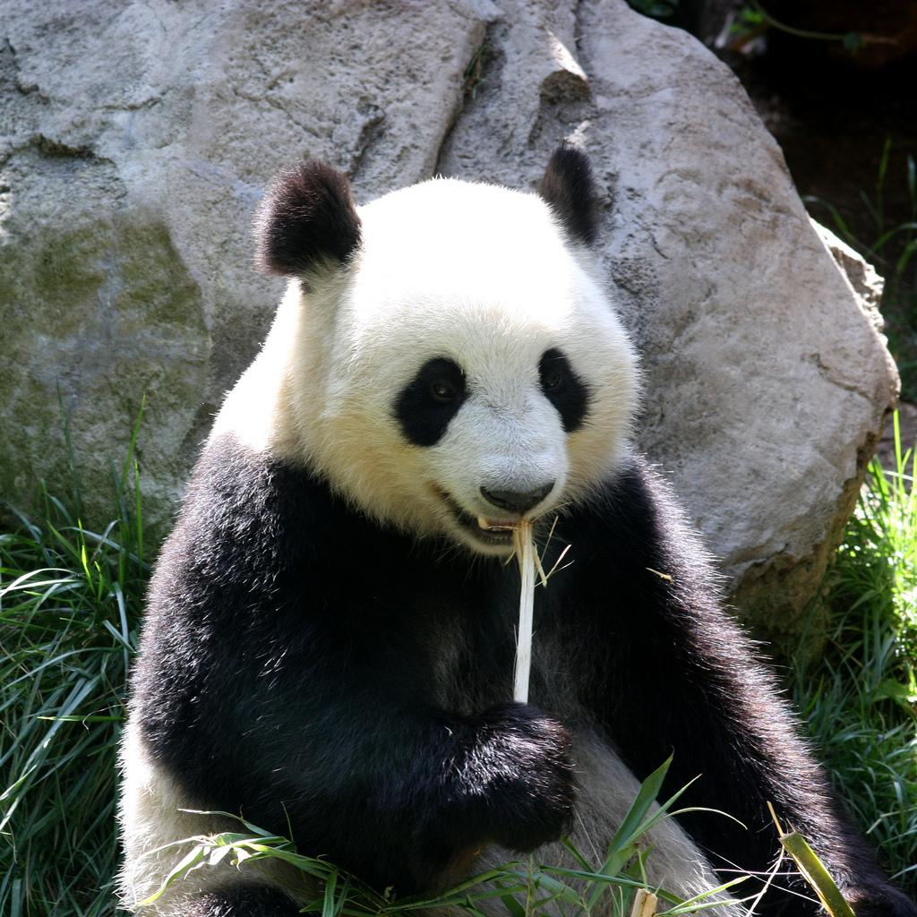
Why do herbivores matter?
Herbivores matter because they eat plants so they don’t spread everywhere. They also help to spread plant seeds in their feces.

Slide 5
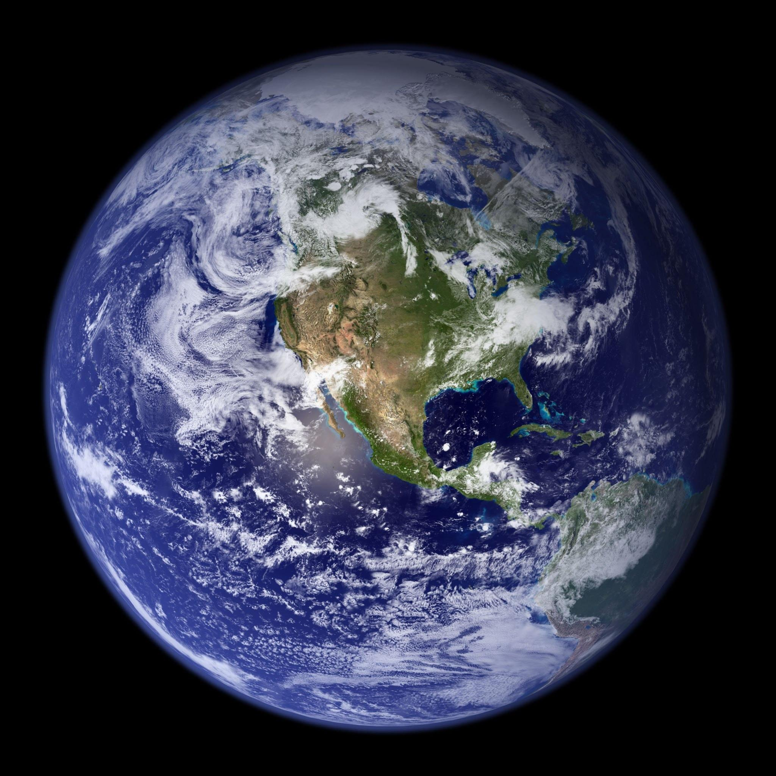
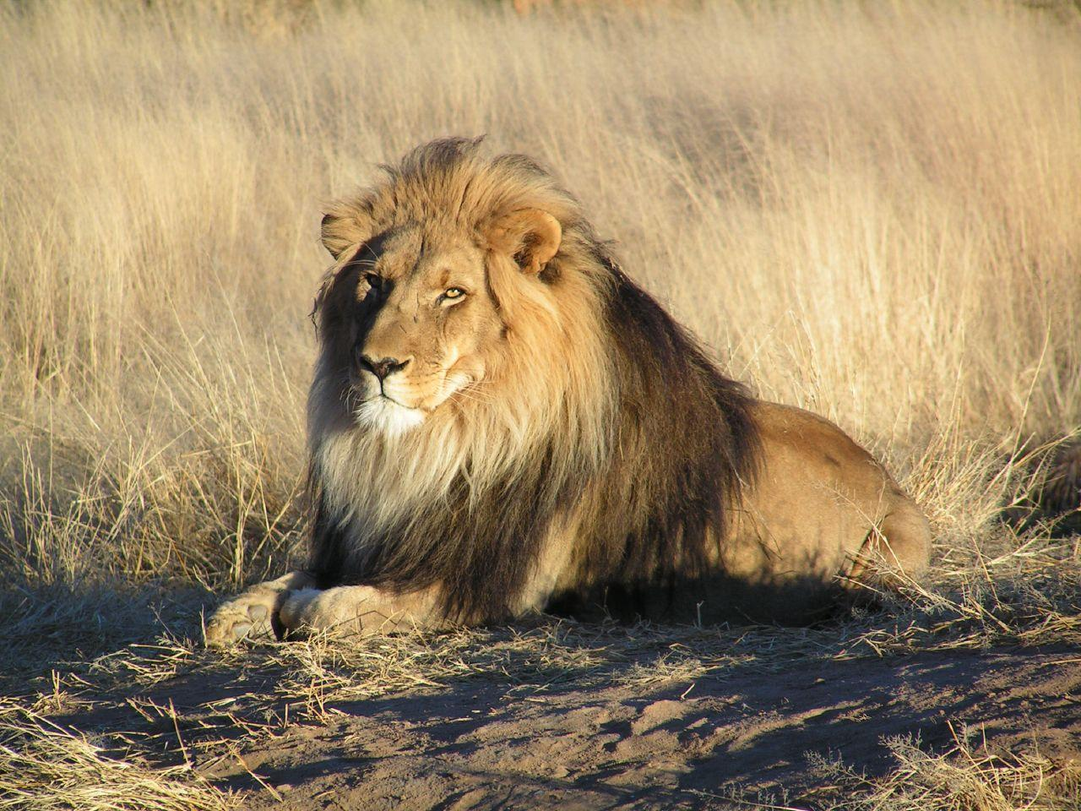
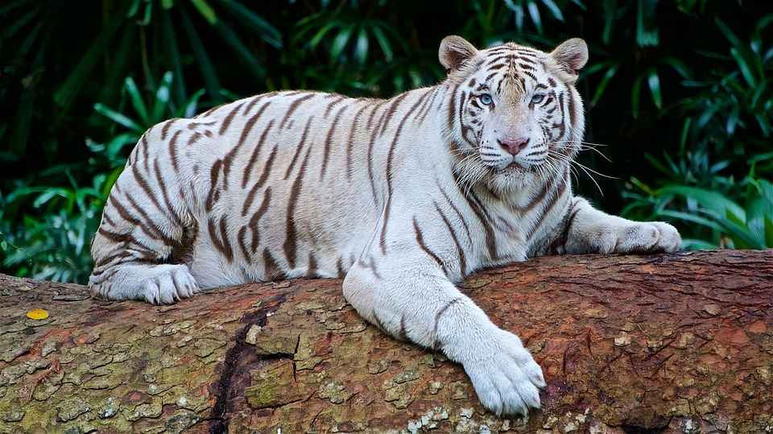
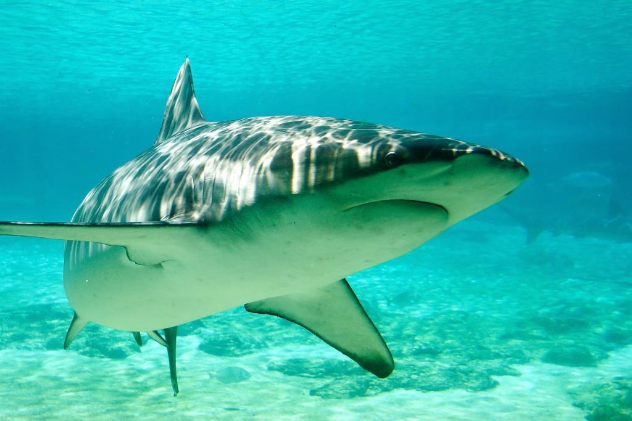
Carnivores!
Carnivores eat meat and hunt in packs or hunt solo Examples: lions, tigers ,sharks, etc.

Slide 6
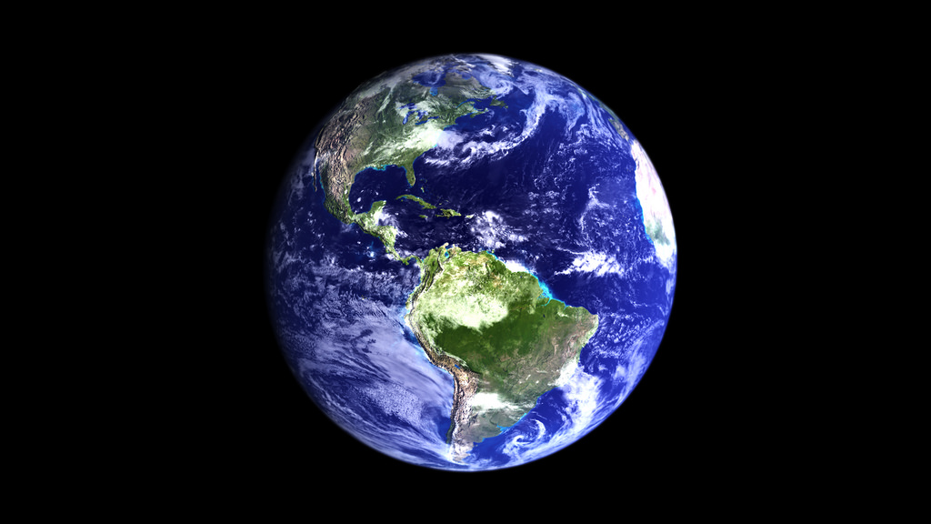
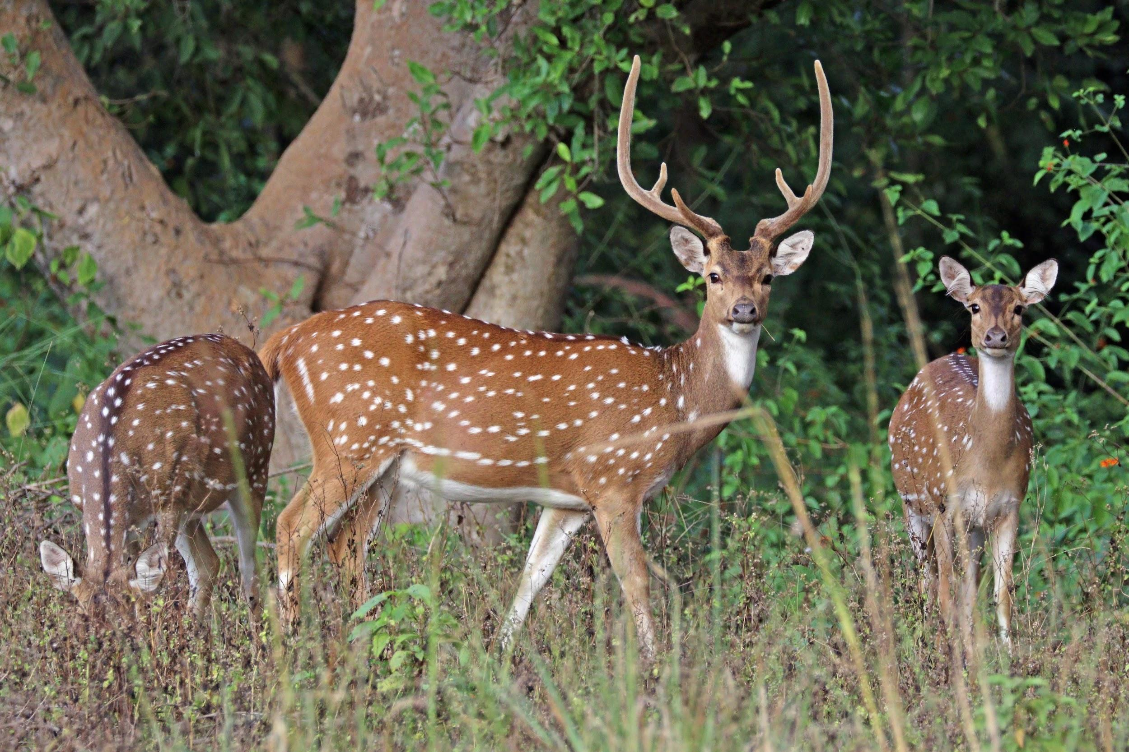
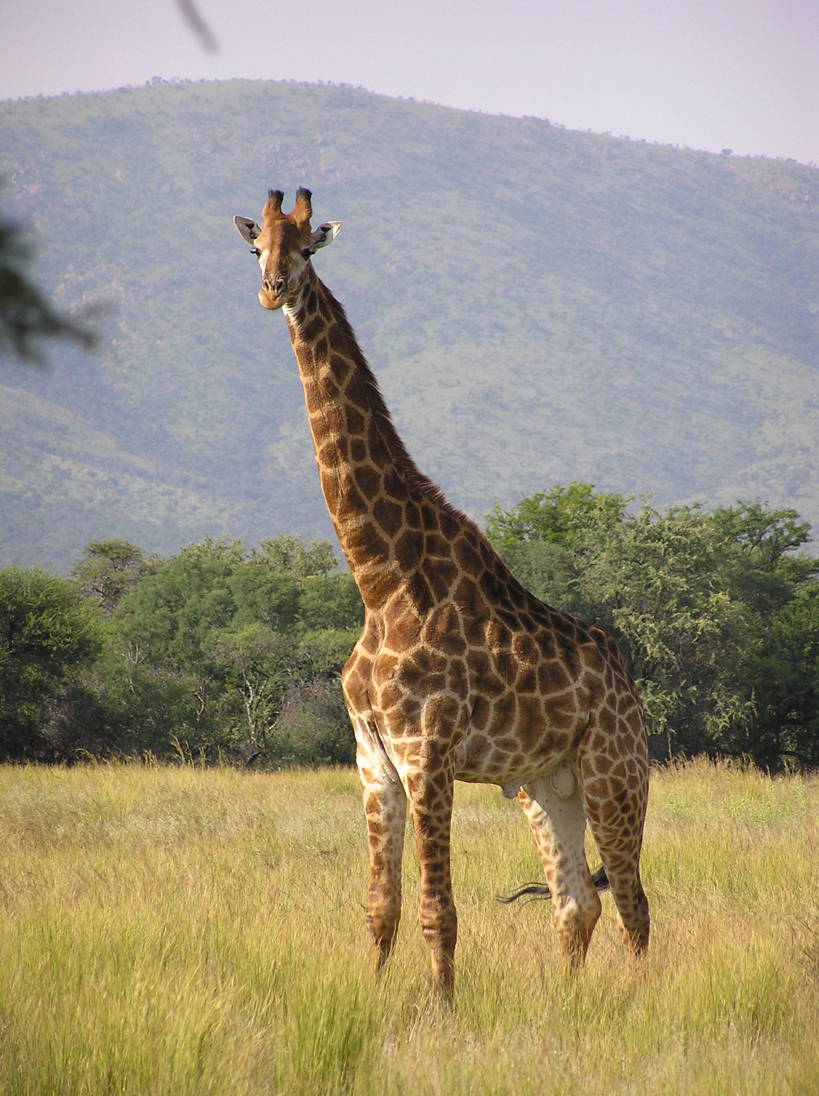
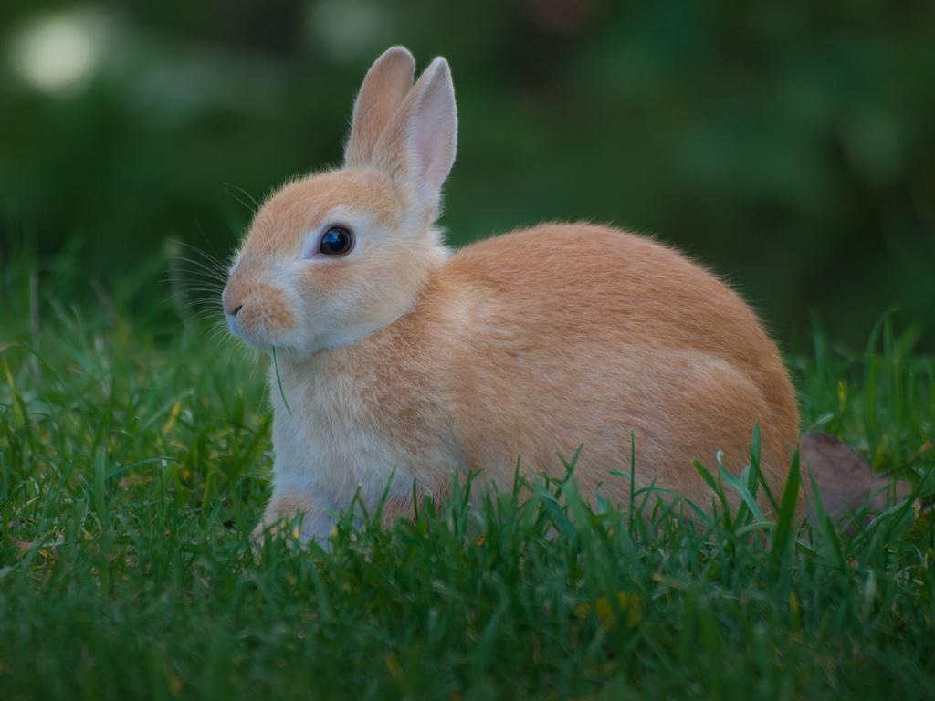
Herbivores!
Herbivores are animals that only eat plants: fruits,vegetables and other types. Ex) giraffes, ducks, deer, cows, rabbits etc.

Slide 7
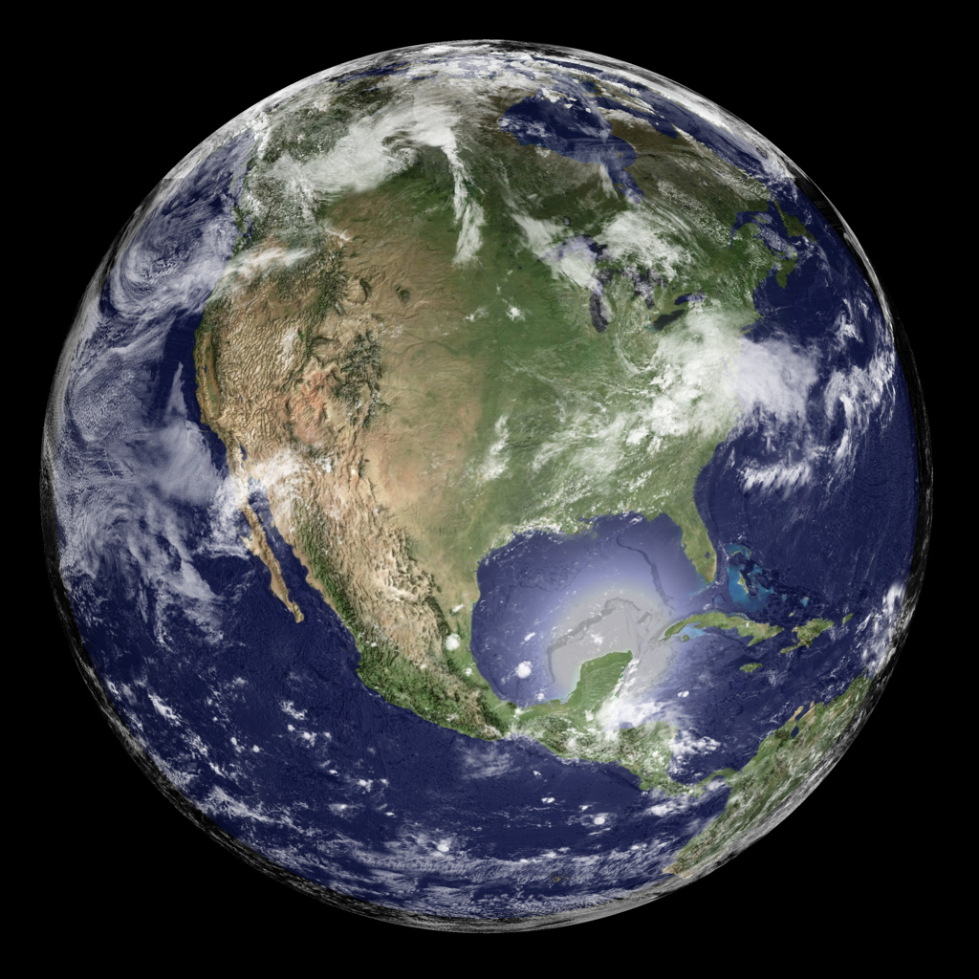
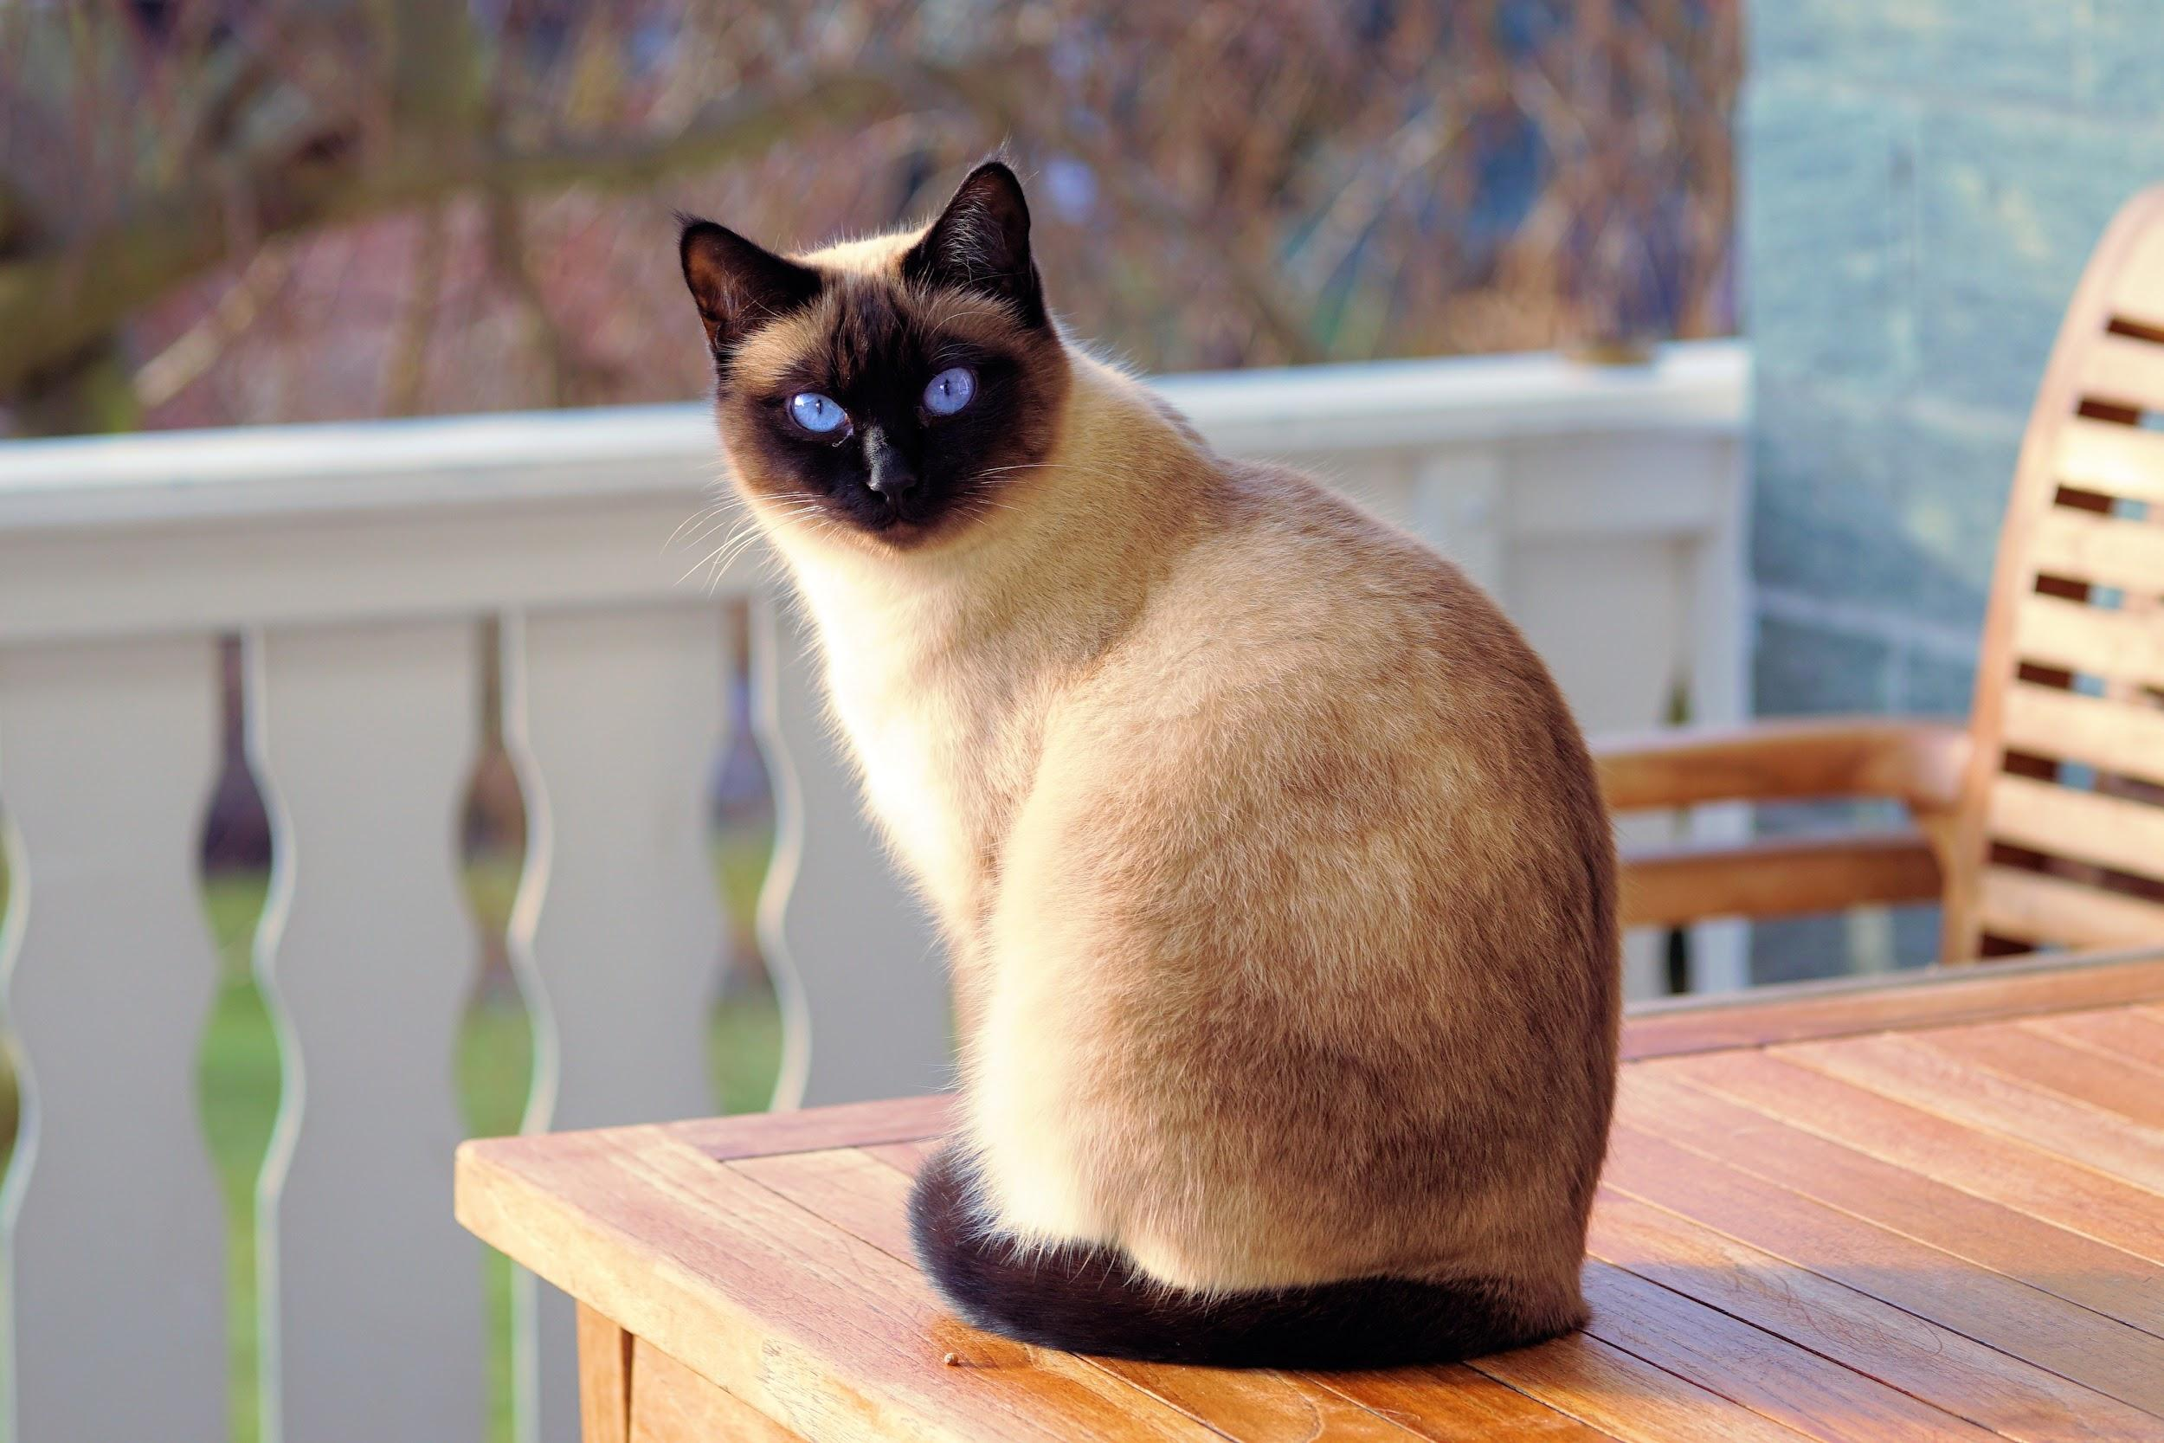

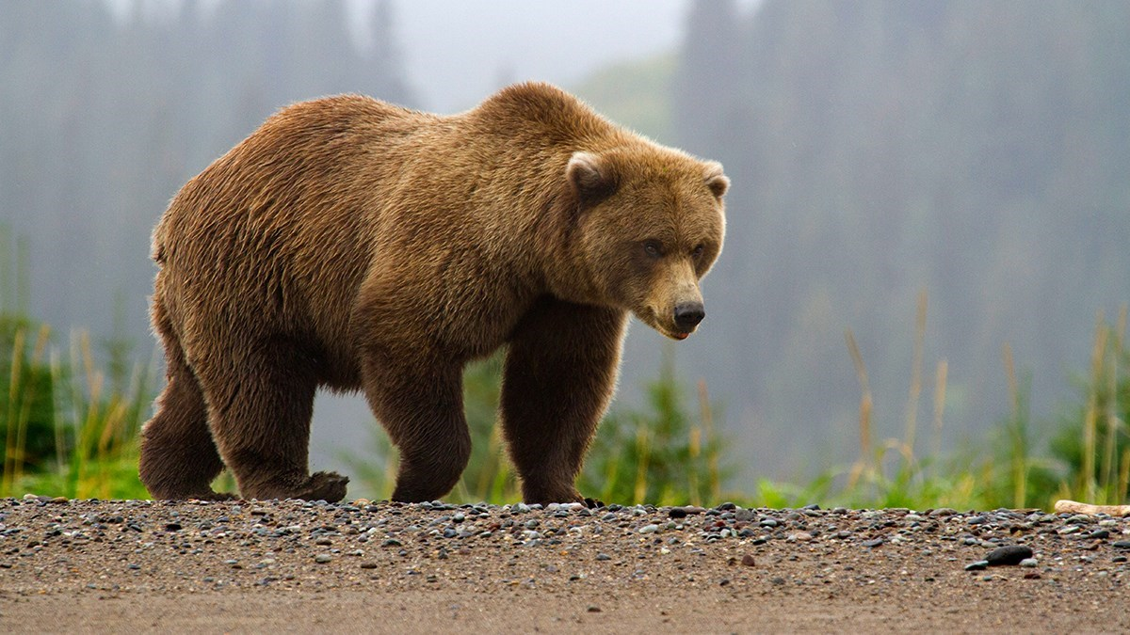
Omnivores
Omnivores eat meat and fruit,vegetables and plants. Examples: dogs, cats, bears, humans, etc

Slide 8
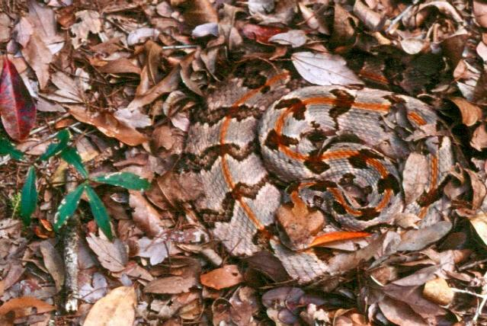
How the Geosphere interacts with Biosphere
The Geosphere interacts with the Biosphere when an animal, such as a snake, uses camouflage to hunt and catch food because it can blend in with its surroundings.

Slide 9
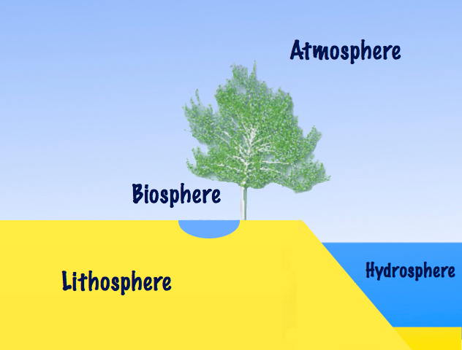
How Biosphere works with the Hydrosphere
The hydrosphere provides water to the animals and plants so they can survive longer and does not stay dehydration

Slide 10
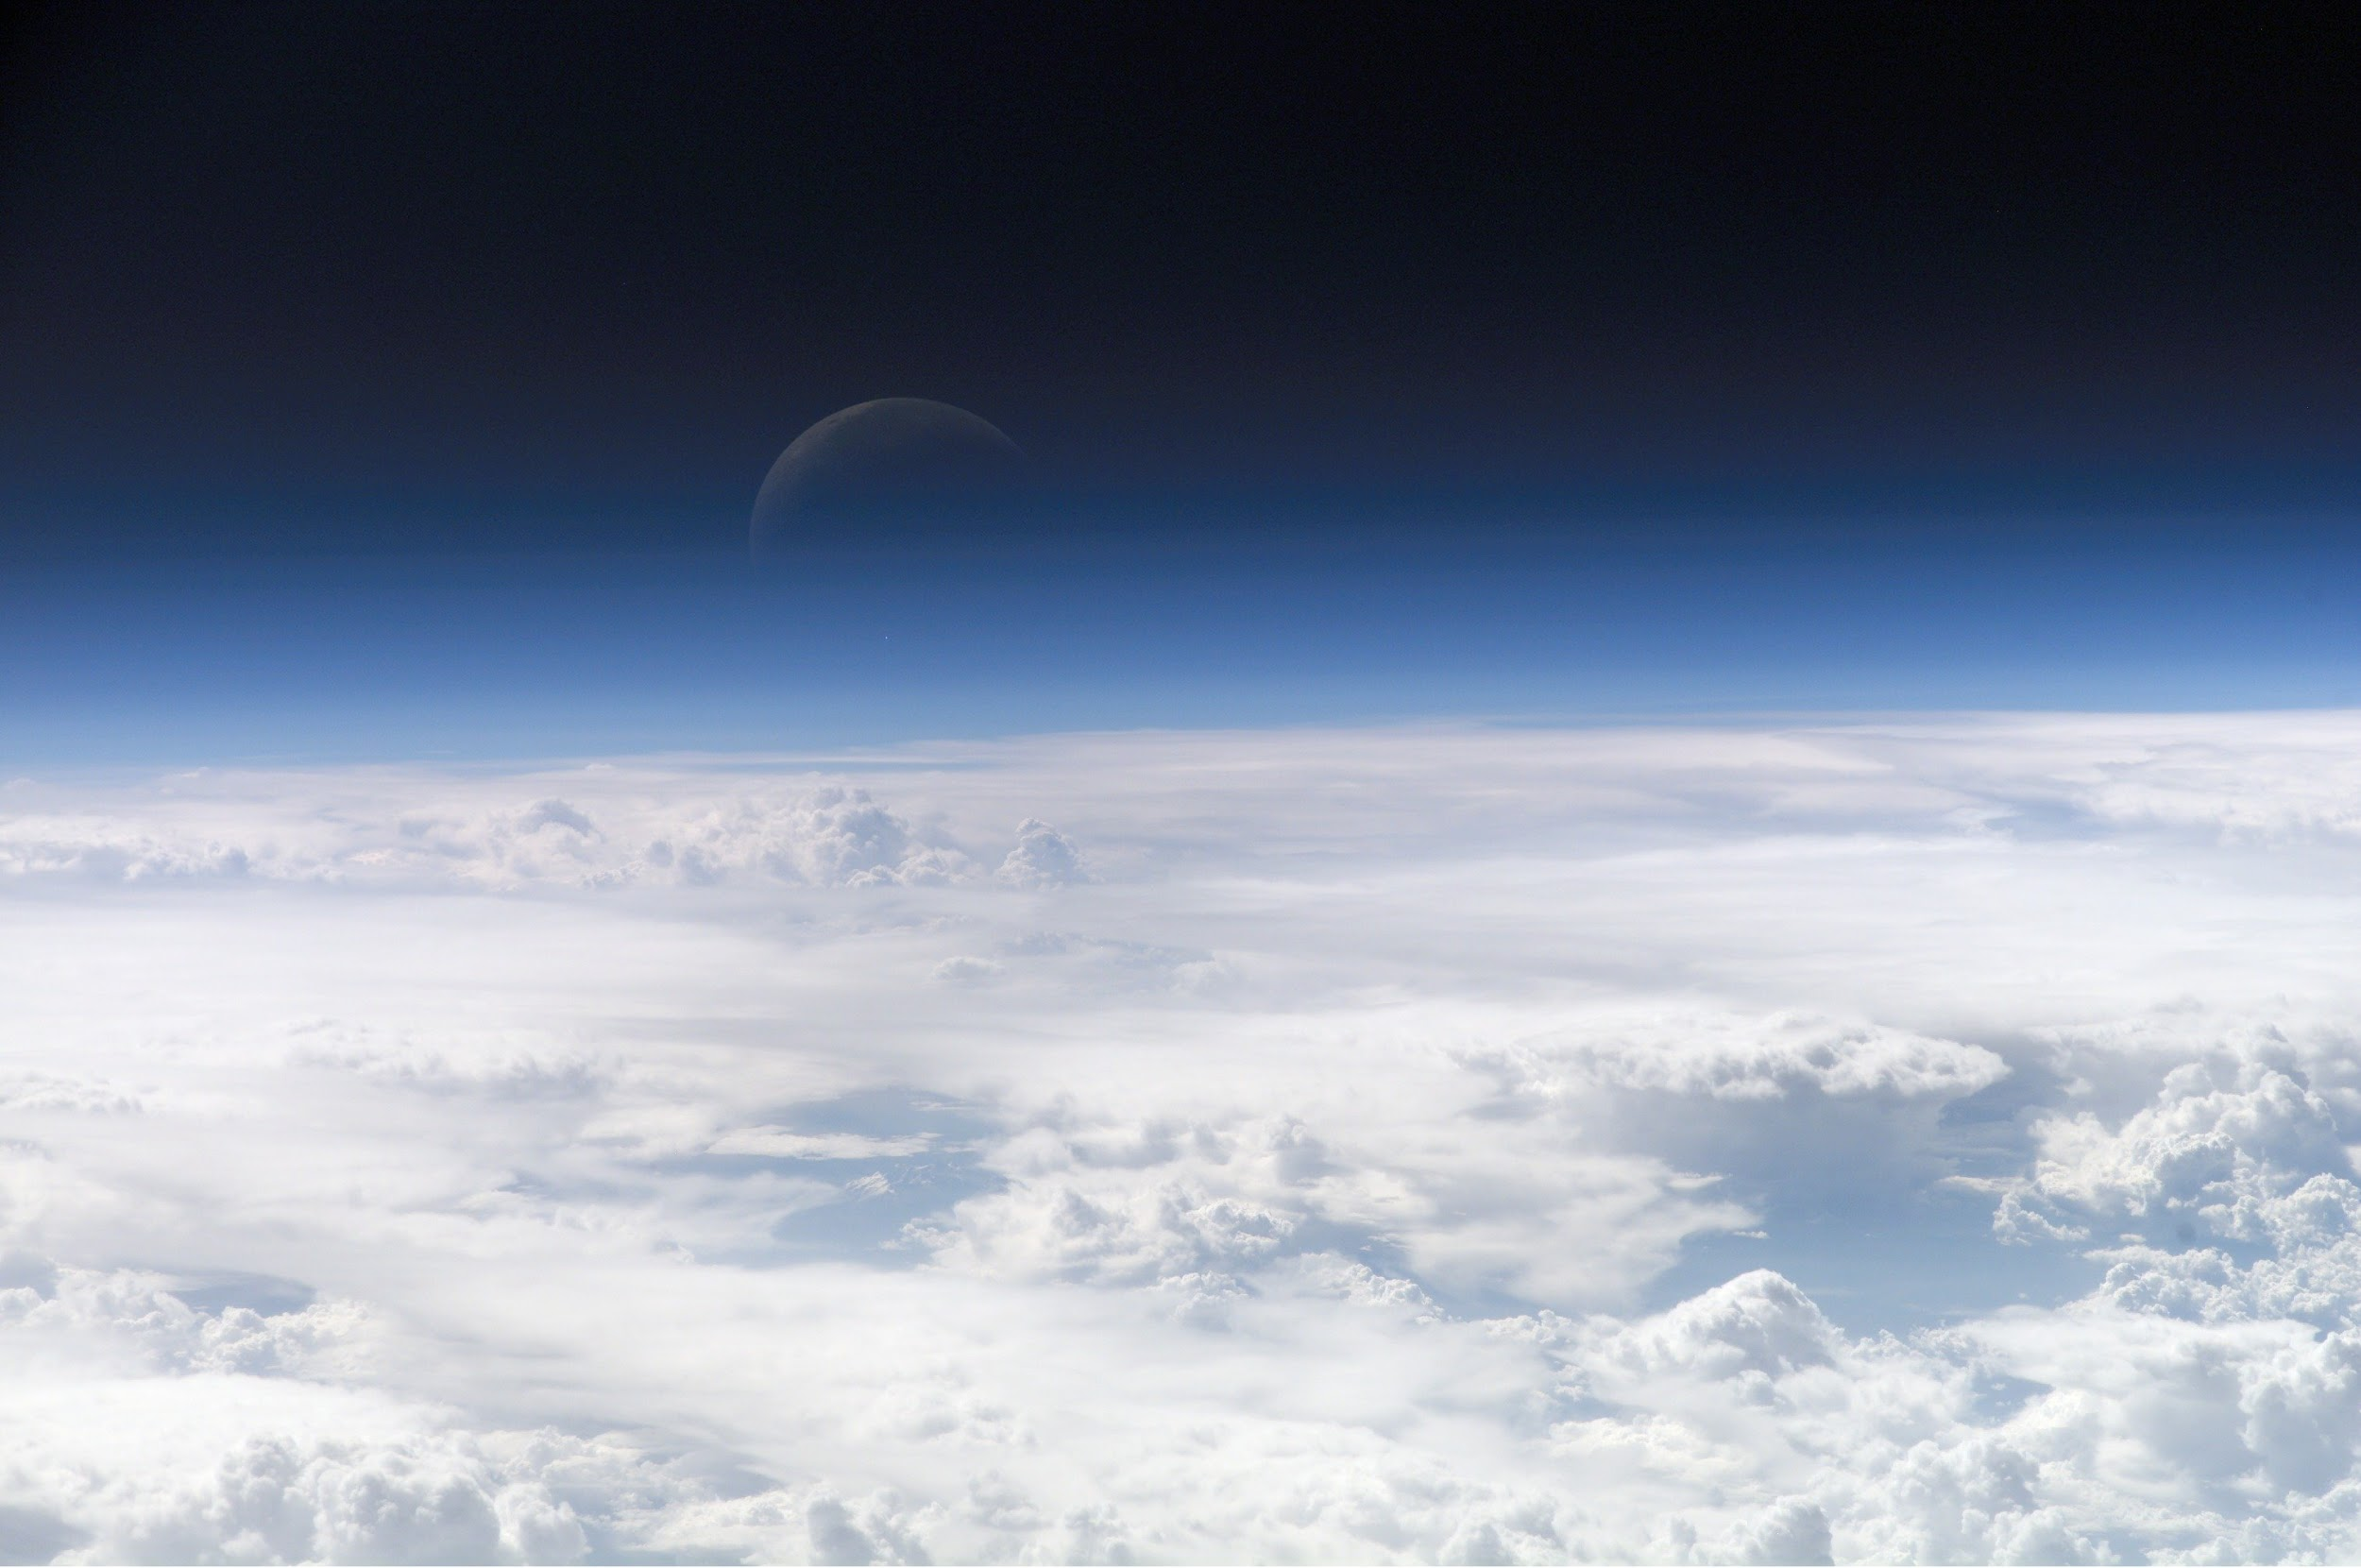
How Biosphere interacts with the Atmosphere
Biosphere interacts in a bad cause because the gas that the animals releases is methane gas which makes a invisible cap and that keeps the heat in .

Slide 11
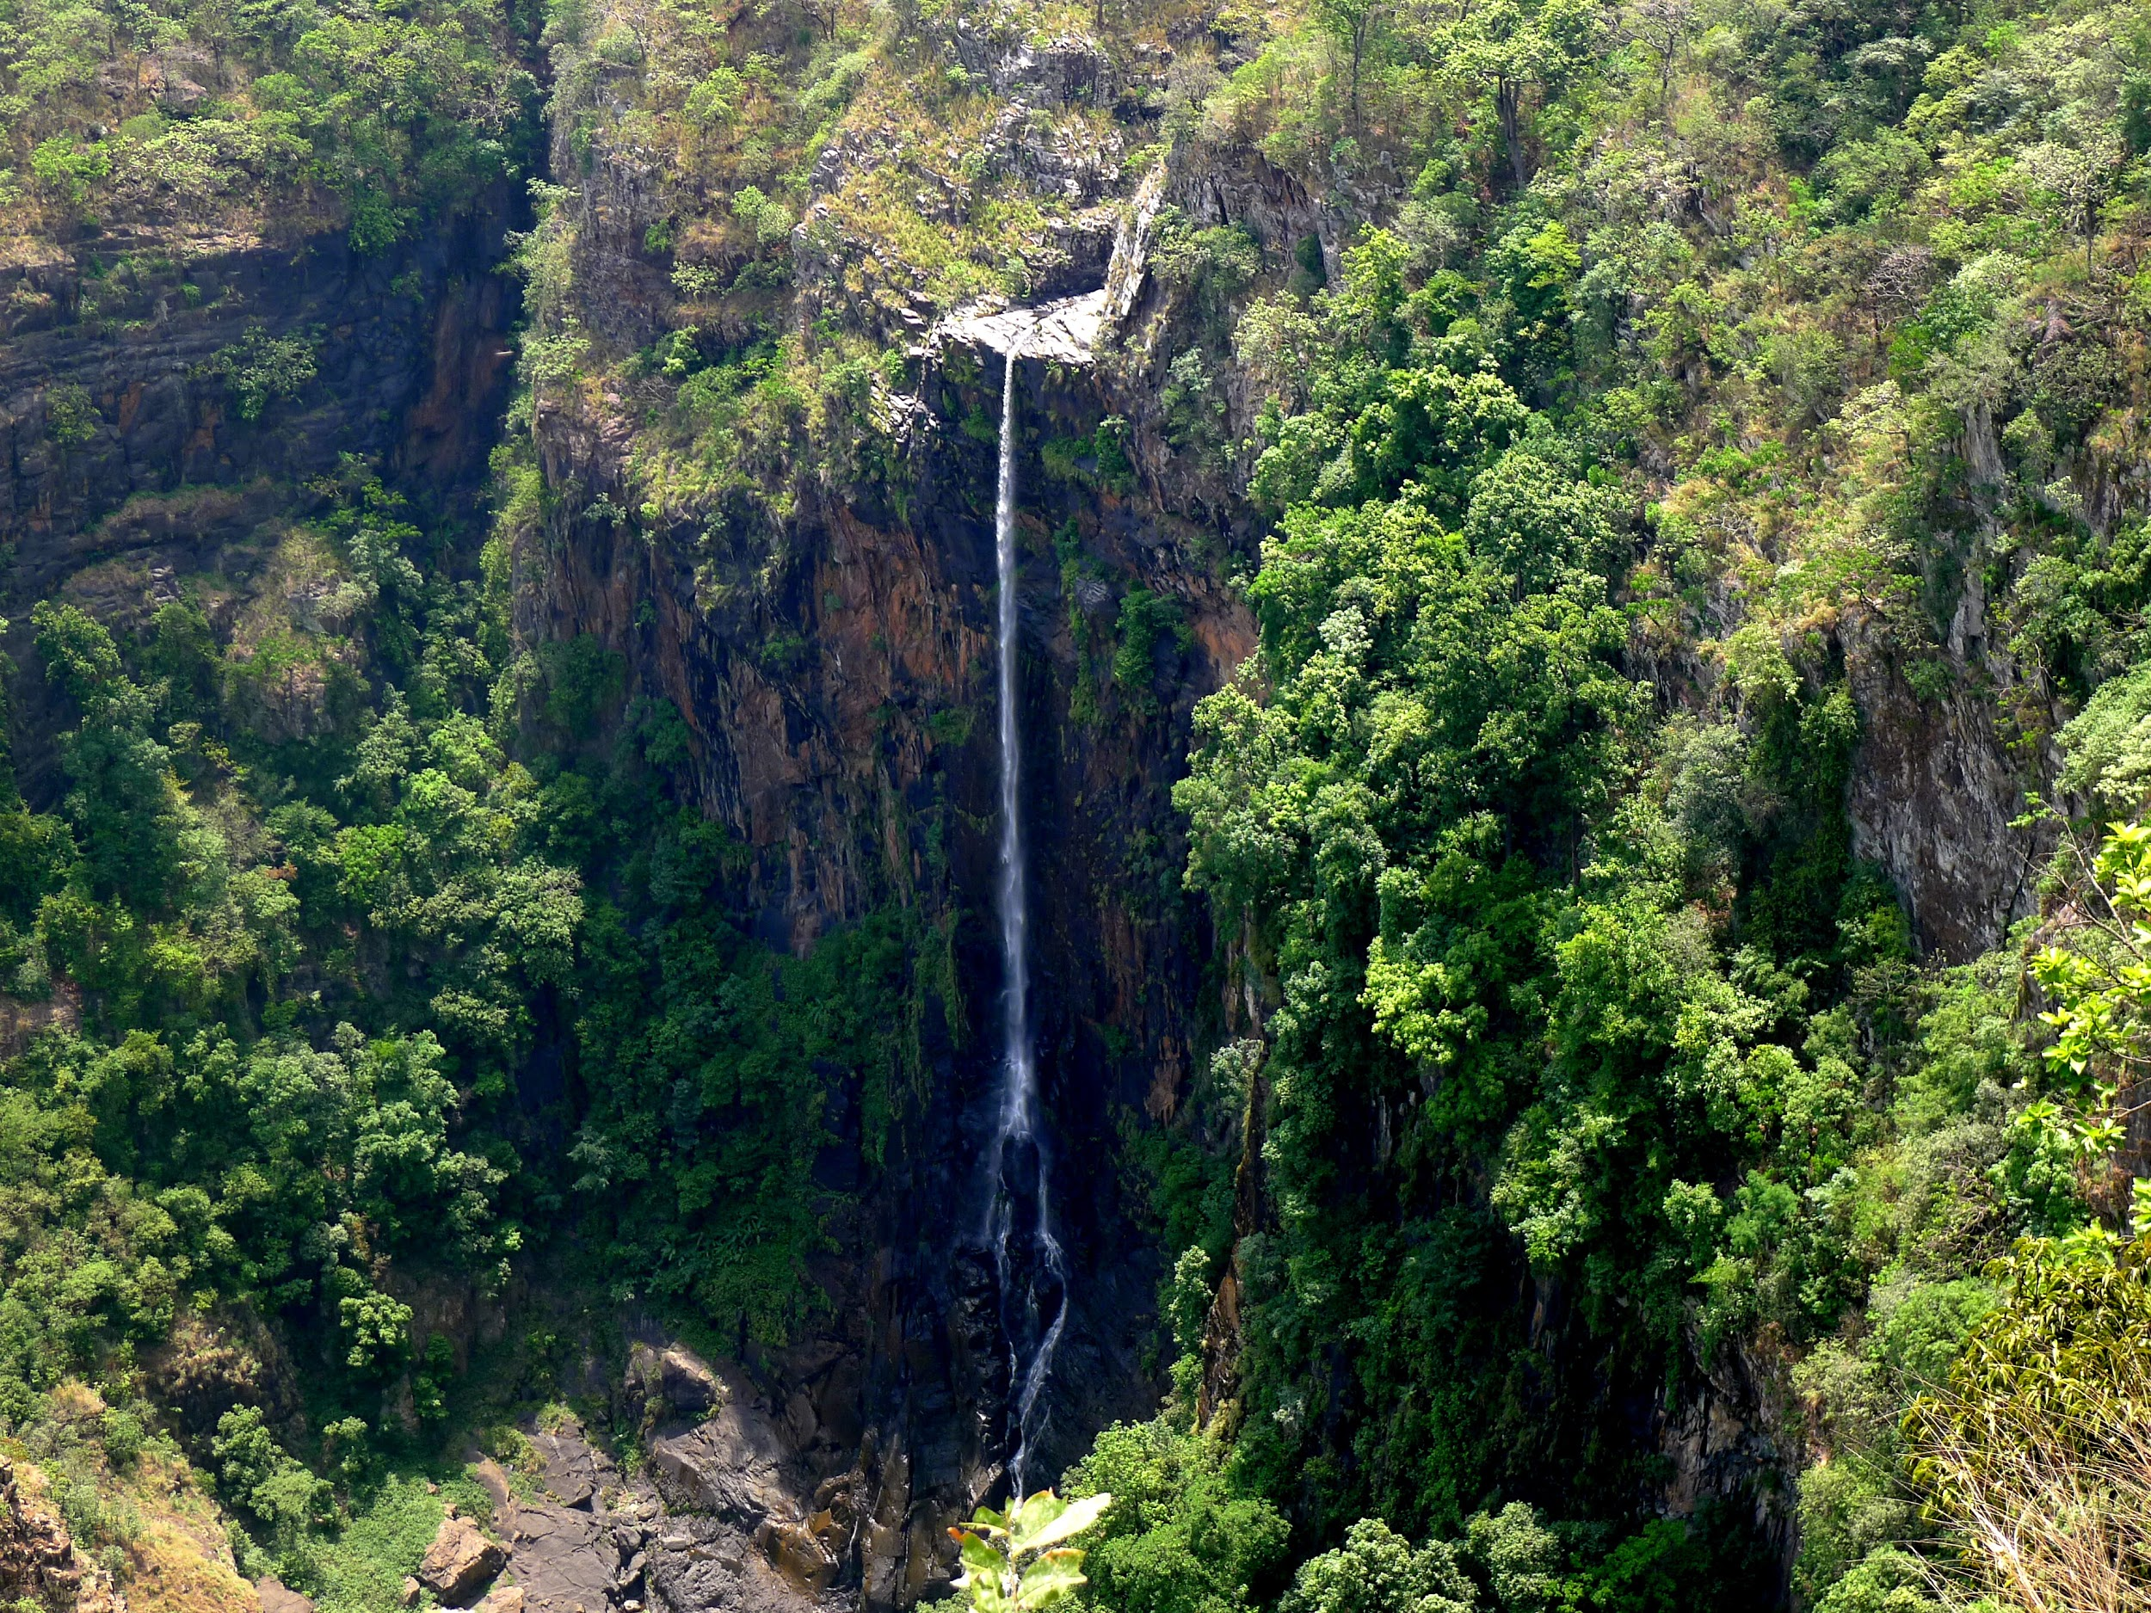
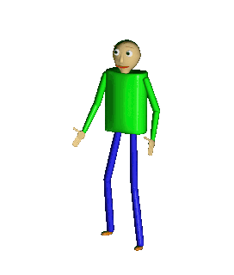
Credits
By David,Rithea,Jayson, & Albin

