Slide 1


Are All Plants The Same?
By Aurora Belleau
Teacher: Adria Alfano
Grade 7
Nathan Bishop
This project utilized GLOBE Hydrology and Phenology protocols

Slide 2
Research Questions
I will be researching the similarities and differences of different plants and their environments in order to answer the question - are all plants the same?

Slide 3
Introduction
I wanted to explore this specific query because during my class investigation - where we observed how different plants reacted to different nitrate levels in their water - it was more than apparent that the results varied depending on the plant species. I simply wanted to prove the point that plants definitely are not all the same.

Slide 4
Predictions
When I first selected the question - Are All Plants The Same- my immediate theory was that I would see differences in coloration, health, growth rate and mainly height average depending on the types of plants I was comparing along with the nitrate levels in their water.
I suspected that some would thrive, growing tall and healthy. Whilst other species, in the same conditions, would wither and die. These at least, were simple differences that I predicted could easily be picked out and recorded.

Slide 5
Methods of Data Collection
My main method of data collection started with the pre existent data chart from my classes previously mentioned nutrient project.
I used this specific source to explore the height of the different plants
I also used other online sites and IRL examples to support my theory

Slide 6
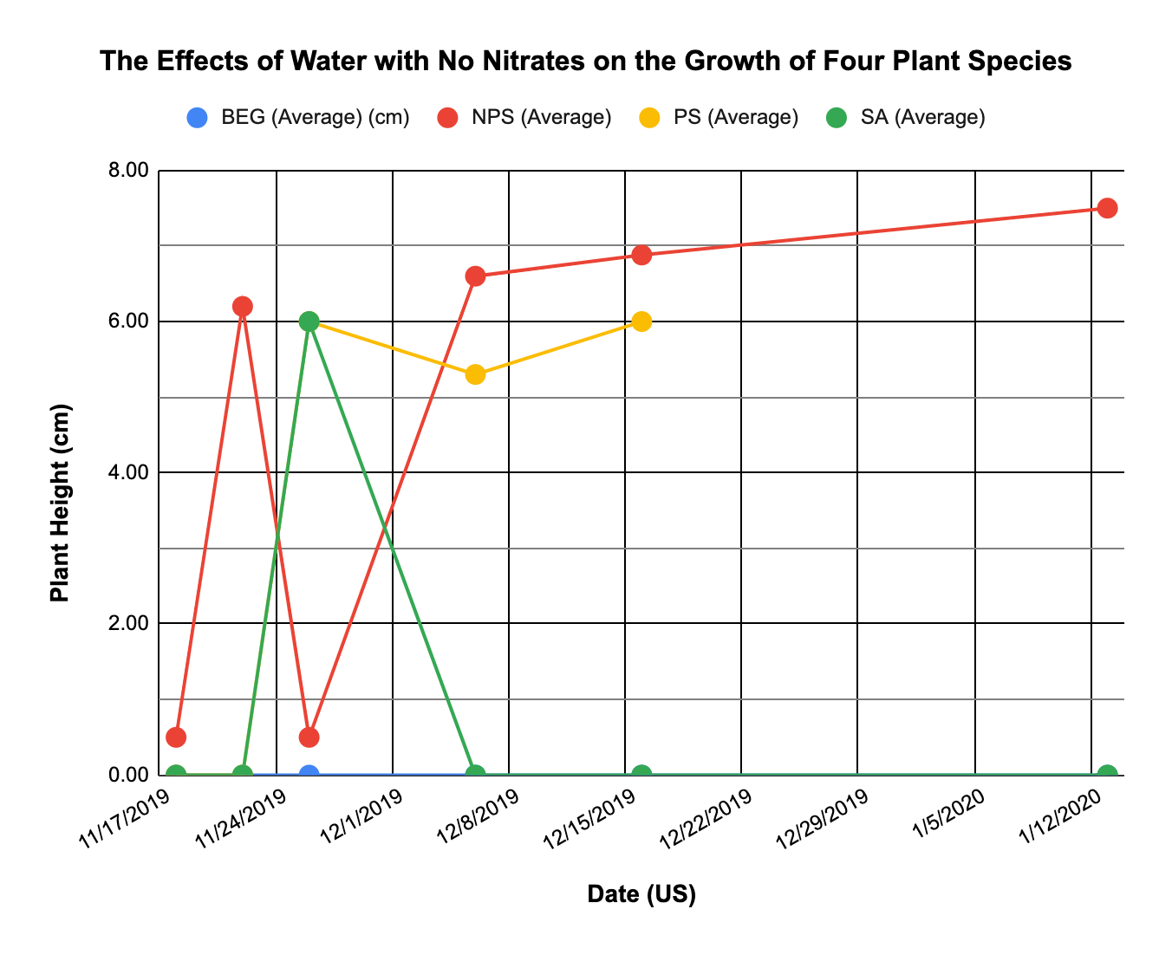
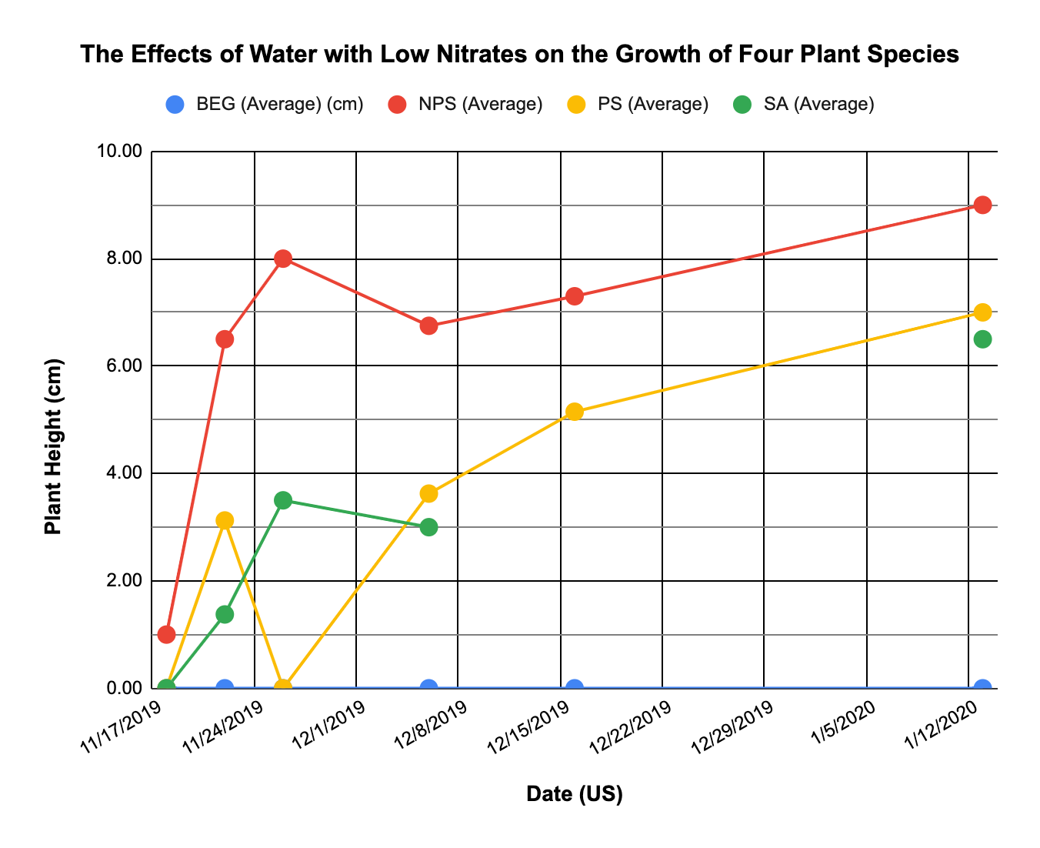
Results

Slide 7
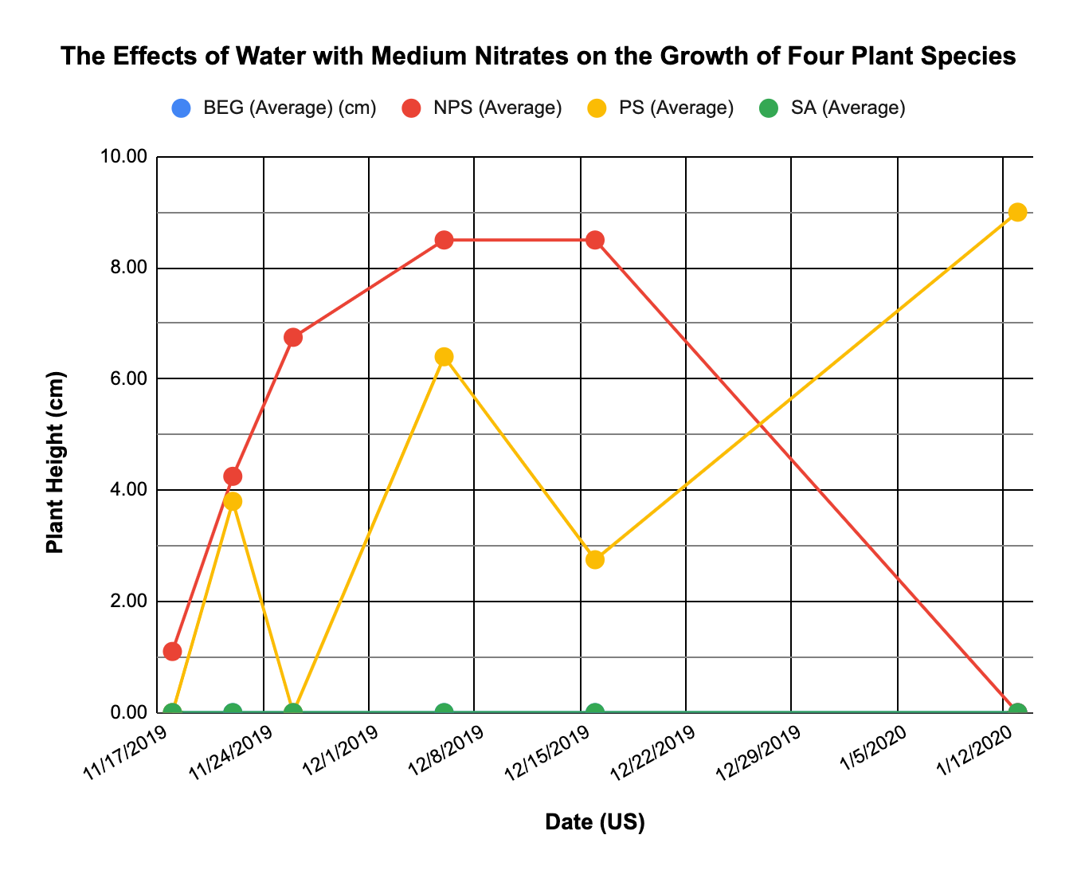
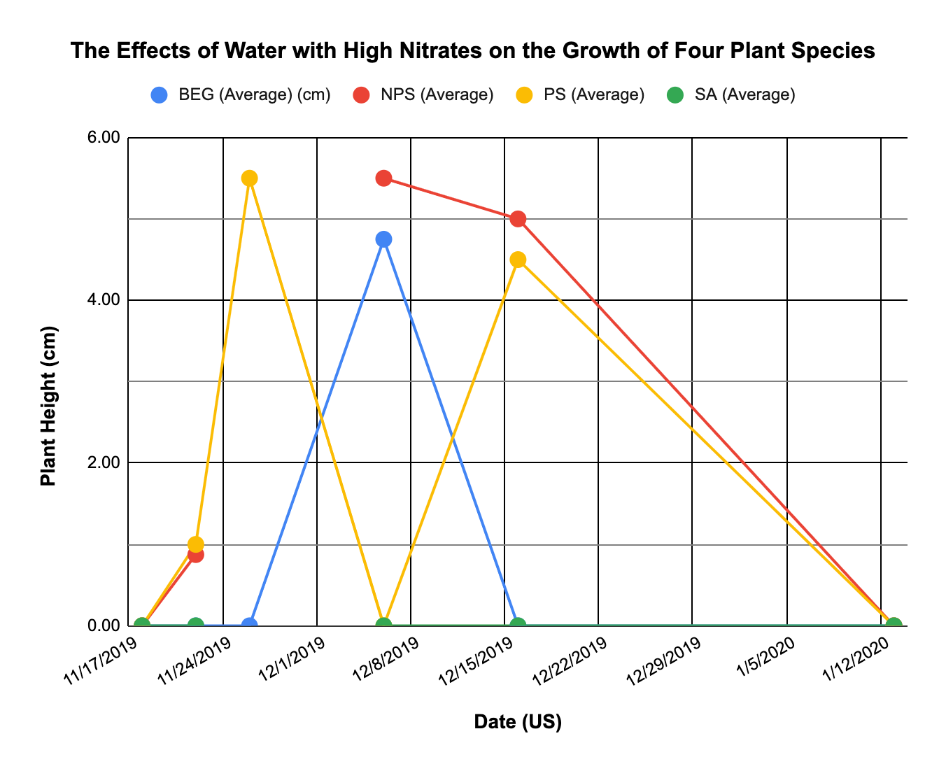
Results

Slide 8
Results
Let's take a look at how each plant reacts to each water type. The water with no nitrates coaxed a final height average of 7.50cm for Blue Eyed Grass, Non-Purple Stemmed Sast plants earned the same, Purple Stemmed Fast Plants averaged 6.00cm and the last recording for Sweet Asylum signified the final average of 0.00, dead.
Moving on to low nitrates, we see that Blue Eyed Grasses last recorded average was 9.00cm. NPS ended up with the same, PS ended with 7cm and SA averaged 6.50cm..
For Medium nitrates all plants ended with the average of 0.00cm except the Purple Stemmed Fast Plant who ended with 9.00cm. It did very well with that specific water whilst others died.

Slide 9
Results
Finally, when tested with high Nitrates, all plants died in the end. With an average of 0.00cm each.
On top of that, a study on the differences in leafs that grow in sun and shade was released to a website called saps.org.uk. Its data showed that leafs that were planted in sun tended to grow smaller and thicker with reddish coloration and a slow wilting rate. This was the exact opposite of the leafs that grew in the shade. Those leafs were bigger and thinner, with green coloration and a quick wilting rate.

Slide 10
Results
Furthermore, i've been taking care of a small venus fly trap whom I refer to as velociraptor. Whilst most other plants grown in my household can be kept alive easily by just pouring about a cup of water directly into their soil about once or twice a day, Velociraptor needs its soil to be constantly wet in order to grow healthily. I actually need to submerge its pot in about a centimeter of water to ensure this.

Slide 11
Conclusions and Future Work
In conclusion, not all plants are the same, They vary from each other. Some need a lot of water, some need a lot of sunlight whilst others need to be kept dry or in a dark place.
Nonetheless, every single plant is a unique collection of cells that have different needs, different looks and contributes to their ecosystems in different ways.

Slide 12
References
Shari Armstrong. 2020. How Does Water Affect Plant Growth? https://www.gardeningknowhow.com/special/children/how-does-water-affect-plant-growth.htm
Multiple authors. Differences in leaves growing in sun and shade. https://www.saps.org.uk/saps-associates/browse-q-and-a/319-why-are-ivy-leaves-grown-in-the-shade-larger-in-area-but-lighter-in-terms-of-weight-than-leaves-grown-in-direct-sunlight

