Slide 1




Urban Heat Islands
Keralys Roman Melendez Juan Crespo Genesis Linares
Mrs. Martha Lawson
Grade 7
Gilbert Stuart Middle School
This project utilized GLOBE Air Temperature, Surface Temperature, and Soil Temperature protocols

Slide 2
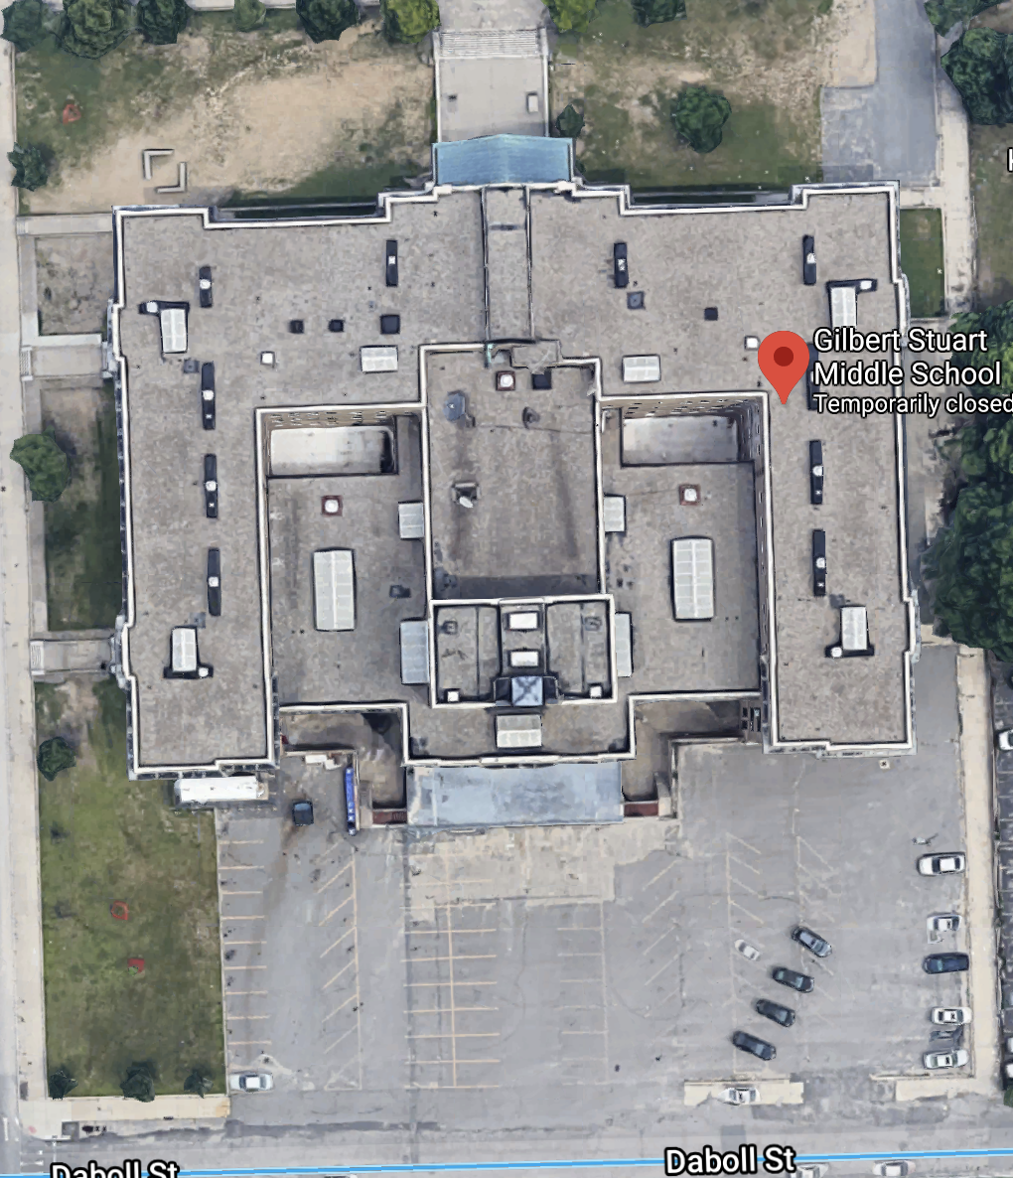
CONTRIBUTORS
Keralys Roman Melendez
Juan Crespo
Genesis Mendez Linares

Slide 3
Research Question
Is there evidence of Urban Heat Island effect around Gilbert Stuart Middle School in Providence, Rhode Island?

Slide 4
Introduction
An urban heat island occurs when a city experiences warmer air, surface, and soil temperatures than rural areas. The sun reaches both of these areas in the same way but urban areas absorb and trap heat more than rural due to the increased amounts of asphalt, concrete and building materials.
Unlike urban areas, rural areas have more grass, plants and trees that cool the area through a process called transpiration.
How do we know Providence contributes to the Urban Heat Island effect? NASA scientist compared satellite pictures of Providence, RI to Buffalo, NY and discovered that there are far more bright spots, which indicate higher temperatures, in Providence than Buffalo.
People living and building in Urban areas need to try and reduce the amount of human impact. This can be done by using lighter colored materials to cover parking lots, sidewalks and roofs. Another solution is to plant gardens on rooftops which would also drive energy costs down.
What can be done to lower the UHI effect?
How do we know Providence, RI is UHI

Slide 5
PREDICTION
We predict that if Providence, RI is an Urban Heat Island, then Gilbert Stuart Middle School is contributing to the Urban Heat Island effect because most of the school is surrounded by limited grass, plants and trees, an asphalt parking lot, cement sidewalks and the roof of our building and surrounding buildings are dark colored.

Slide 6

Methods of Data Collection
We collected and recorded air and soil temperature (using the GLOBE protocols) with a liquid air thermometer during the months of January and February and recorded our data in a table.
Surface temperature was recorded during the same time using an infrared thermometer.
All temperatures were recorded in degrees Celsius.

Slide 7
AIR, SURFACE & SOIL TEMPERATURE DATA
DATE (US) | AIR TEMP (^{O}C) | SURFACE TEMP (^{O}C) | SOIL TEMP (^{O}C)
1/9/2020 | 2 | 10.2 | 0
1/13/2020 | 2 | 10.4 | 9
1/14/2020 | 2 | 9.1 | 6
1/16/2020 | 6 | 19 | 9
1/17/2020 | 7 | 18 | 4
1/22/2020 | 3 | 18 | 3
1/23/2020 | 2 | 23 | 6
1/24/2020 | 2 | 26.3 | 12
1/29/2020 | 20 - HIGH | 29 - HIGH | 14 - HIGH
1/31/2020 | 20 - HIGH | 15.8 | 12
2/3/2020 | 15 | 15.7 | 9
2/6/2020 | 10 | 8.3 | 5

Slide 8
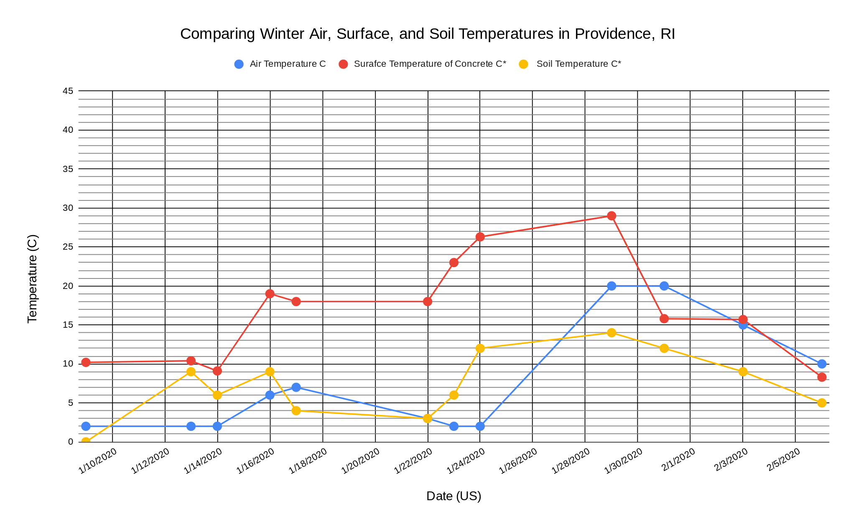
TEMPERATURES DURING JANUARY, FEBRUARY 2020

Slide 9
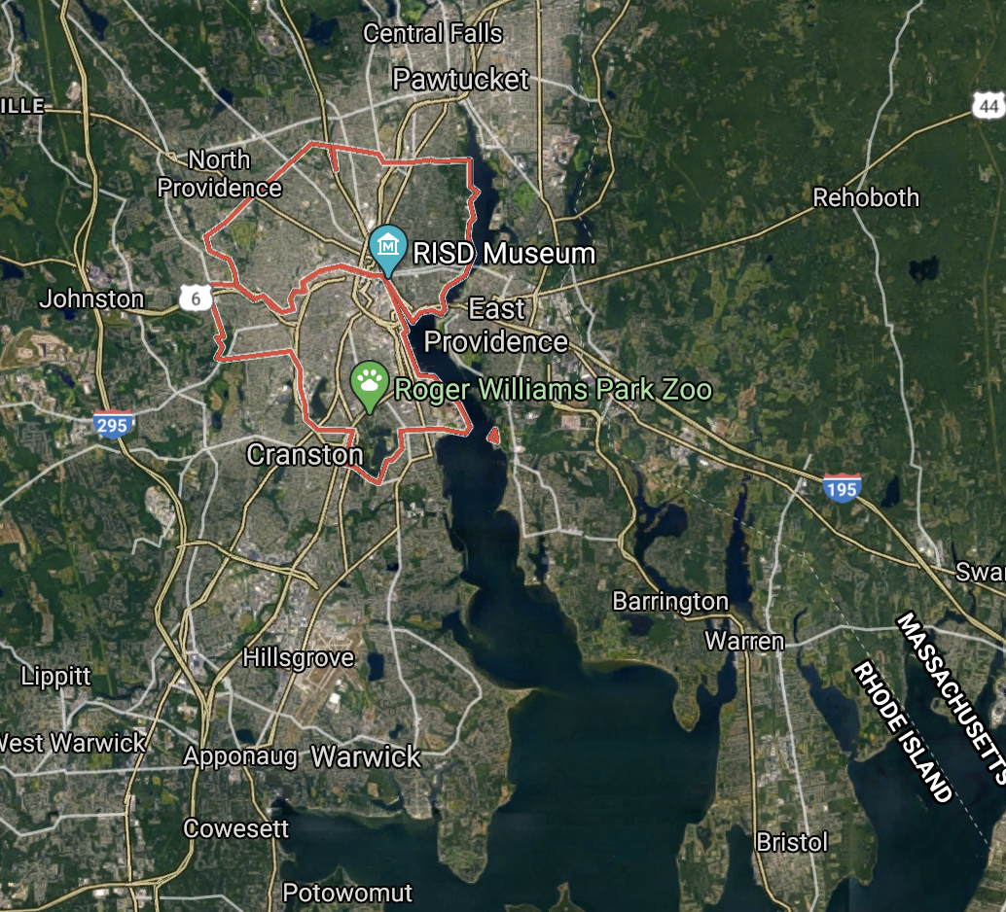
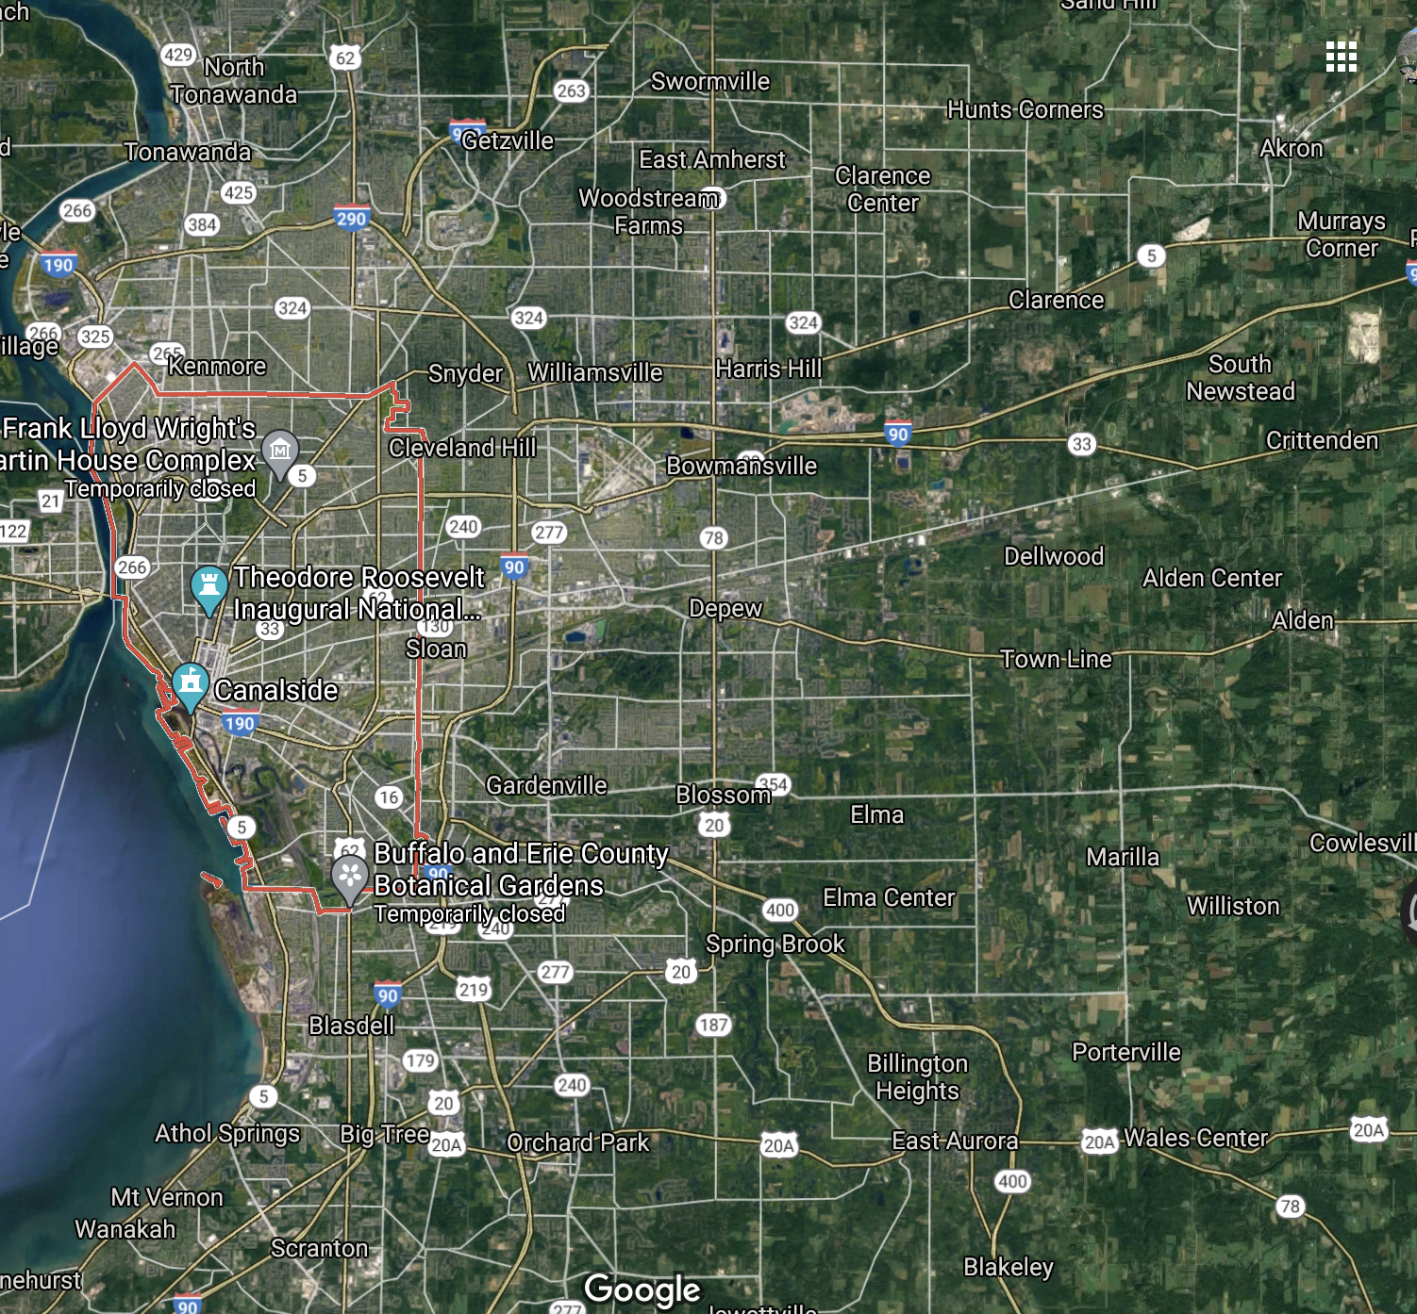
Further Evidence of Providence, RI Contributing to UHI Effect?
Providence, RI 2020
Buffalo, NY 2020

Slide 10
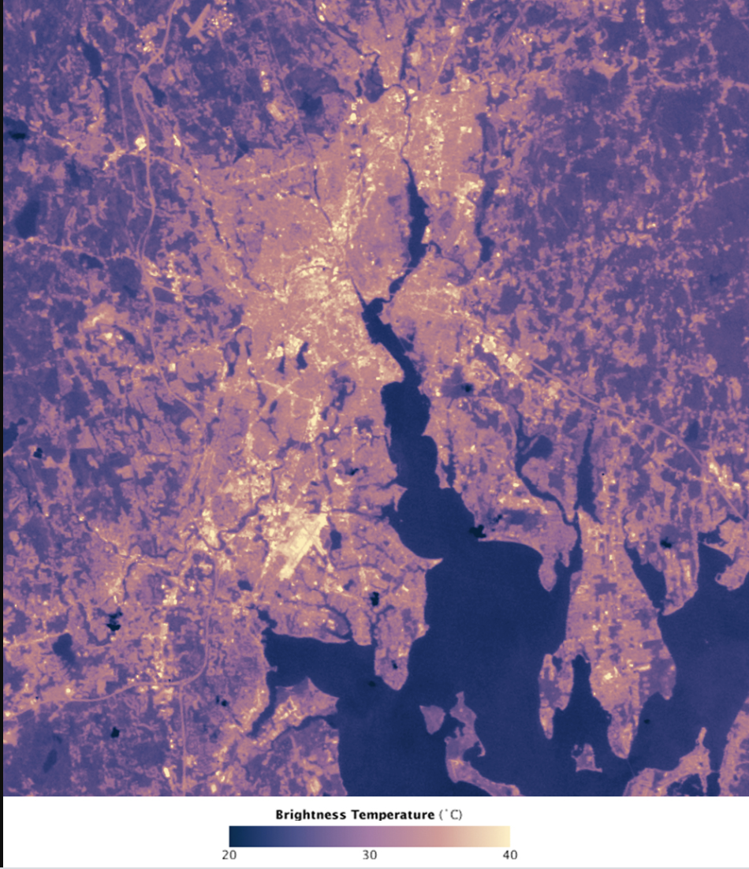
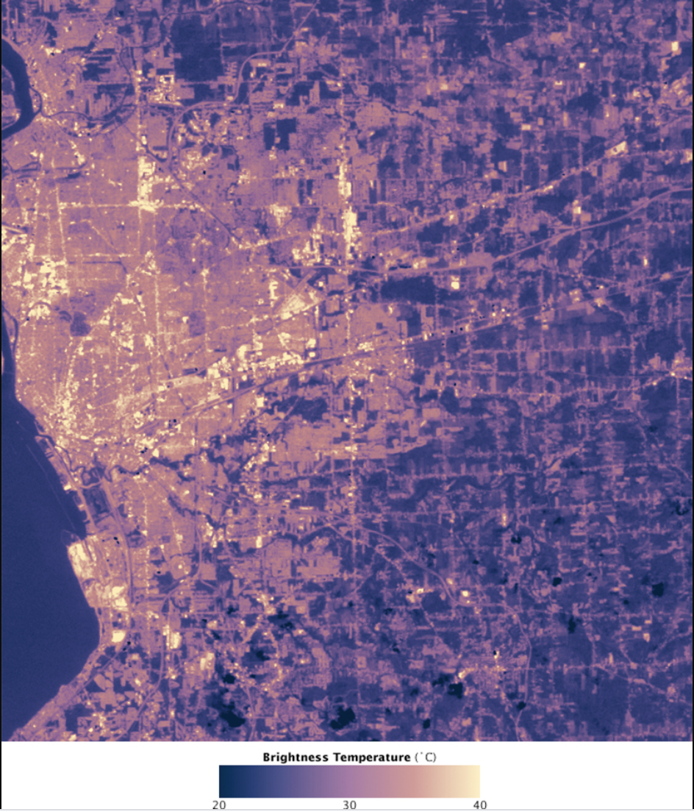
Further Evidence of Providence, RI Contributing to UHI Effect?
Average temps for Jan 2020 (ºC):
Providence, RI: High: 3.0
Low: -6.10
Buffalo, NY: High: -0.44
Low: -7.50
Average temps for Feb 2020 (ºC):
Providence, RI: High:4.61
Low: -4.67
Buffalo, NY: High: 0.72
Low: -7.11
Providence, RI 2010. Bright points are hot points.
Buffalo, NY 2010. Bright points are hot points.
Notes:
For context: the January high for Providence is around what most people’s refrigerators are set at, while the high in Buffalo is just above what most people’s freezers are set at; February is similar

Slide 11
Conclusions
We explored the Urban Heat Island phenomenon around our school by comparing winter air, surface, and soil temperatures during the month of January and February of 2020. We discovered that surface temperature on average, was higher than both air and soil temperatures which suggests that our school is contributing to the Urban Heat Island effect because without the effect we would expect surface and soil temperatures to be the same.
Air temperatures were unseasonably high, reaching 26.3 ºC on January 24 and 29 ºC on January 29. These temperatures were checked against AccuWeather reports for Providence, RI and these temperatures match those of the local weather data.
Approximately 75% of our school grounds are covered in surfaces that store and contribute to UHI. High surface temperatures of concrete that surrounds our school is causing heat to be stored and and adding to the Urban Heat Island effect. Lastly, higher than normal air temperatures during the month of January caused a shift in the onset of spring. These higher temperatures resulted in earlier bud bursts on local area trees. Our data provides evidence of climate change and evidence of UHI effect at our school in Providence, RI.

Slide 12
References
EOKids. 2017. Urban Heat Islands: Hot times in the city. NASA Earth Observatory. Accessible at https://earthobservatory.nasa.gov/blogs/eokids/wp-content/uploads/sites/6/2018/08/EOKids_201701_UHI.pdf
NASA. 2010. Satellites pinpoint drivers of urban heat Islands in the Northeast. Accessible at https://www.nasa.gov/topics/earth/features/heat-island-sprawl.html.
NASA Earth Science Communication Team. 2020. Climate Kids: What is an urban heat island? NASA Jet Propulsion Laboratory. Accessible at https://climatekids.nasa.gov/heat-islands/#:~:text=What%20Is%20an%20Urban%20Heat%20Island%3F,environment%20absorb%20and%20hold%20heat.

Slide 13
Acknowledgements
We would like to thank The Boston University GLOBE team, in particular Ms Kathleen Johnson, Dr Peter Garik, Dr Don DeRosa, Dr Caleb Farny and Dr Bruce Anderson for their dedication and commitment to the Providence GLOBE teachers throughout the year and, in particular, for your encouragement and support during our final projects. We could not have done this without you!

