Slide 1
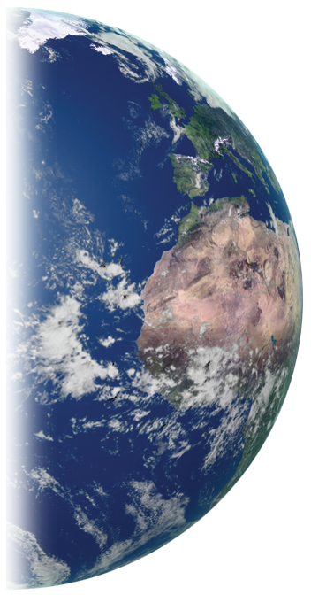
GLOBE Implementation Office
Report to the Community
20th Annual Meeting
Estes Park, Colorado, USA
Celebrating the GLOBE Community
17 July, 2016

Slide 2
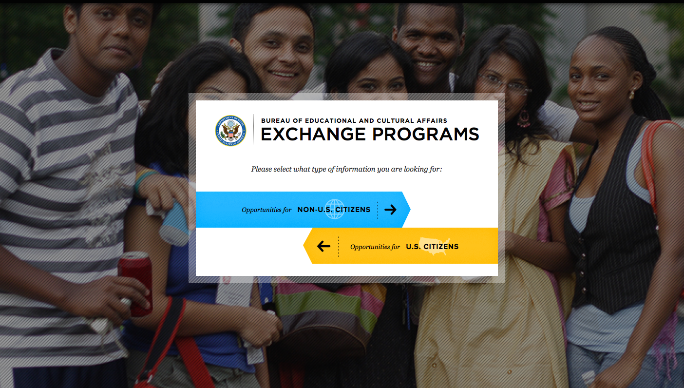
U.S. Department of State
https://exchanges.state.gov/

Slide 3
21st Century Skills for Global Citizens -- notes taken from Global Teaching Dialog, Dept. State --
Critical thinking – ability to research issues and define a problem
Collaboration – ability to prioritize in a group
Problem solving – ability to negotiate together
Communication – teaming building, active listening
Global competence – ability to identify common interests and leverage positively
GLOBE: Scientific Habits of Mind

Slide 5
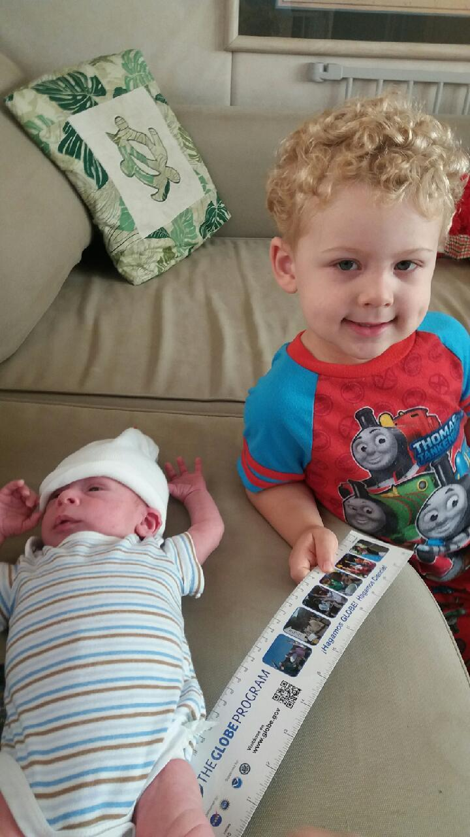

Slide 6
GLOBE Implementation Office
Report to the Community
20th Annual Meeting
Estes Park, Colorado, USA
Celebrating the GLOBE Community
17 July, 2016

Slide 7
Notes:
Argentina
Bermuda
Canada
Costa Rica
Croatia
Czech Republic
Dominican Republic
France
Germany
India
Israel
Japan
Jordan
Kenya
Republic of Korea
Lebanon
Morocco
Netherlands
Nigeria
Oman
Poland
Portugal
South Africa
Sri Lanka
Suriname
Taiwan
Tanzania
Thailand
Trinidad and Tobago
USA
Uruguay
Number of Students: 25
Number of US Students: 8
Number of Teachers: 20
Number of US Teachers: 6
Country Coordinators: 19
US Partners: 29

Slide 8
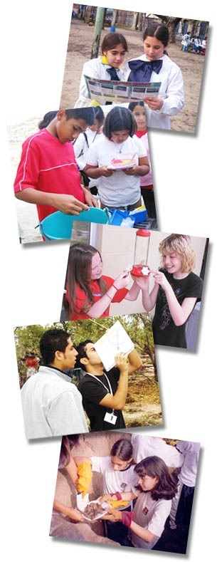
Vision: A worldwide community of students, teachers, scientists, and citizens working together to better understand, sustain, and improve Earth’s environment at local, regional, and global scales.
Mission: To promote the teaching and learning of science, enhance
environmental literacy and stewardship, and promote scientific discovery.
Goals: Improve student achievement across the curriculum with a focus on student research in environmental and Earth system science
Enhance awareness and support activities of individuals throughout
the world to benefit the environment.
Contribute to scientific understanding of Earth as a system
Connect and inspire the next generation of global scientists and other STEM professionals
Notes:
GLOBE Program Vision, Mission and Goals

Slide 9
A Brief History
1994: Earth Day, The GLOBE Program announced by the U.S. Government as a multi-agency effort
1995: GLOBE launches on Earth Day; 33 countries joined the Program, 11 science protocols in the Program
1998: 1st GLOBE Learning Expedition (GLE) held in Finland
2000: 2nd GLE held in the USA
2003: 53 science protocols across atmosphere, biosphere, hydrosphere, and soil (pedosphere)
2003: 3rd GLE held in Croatia
2005: Earth Day; GLOBE celebrates its 10th birthday with 15,000 schools in 106 countries
2008: 4th GLE held in South Africa
2011: Concept of Student Research Campaigns launched with the first topic on climate

Slide 10
A Brief History
2014: Number of projects
First regional student aerosols research campaign led by Europe and Eurasia;
Global Precipitation Measurement (GPM) and Soil Moisture Active Passive (SMAP); and
Student research campaigns with NASA launched
2014: 5th GLE held in India
2015: Number of events and projects
Earth Day, GLOBE celebrates its 20th birthday;
GLOBE launches new data entry app for schools, an enhanced website, and an updated teacher's guide; and
128 million data entries in the international database

Slide 11
A Brief History
2016: GLOBE provides online eTraining;
hosts highly successful GLOBE International Virtual Science; six regional U.S. science fairs;
develops new Citizen Science app; and various student scientific campaigns (El Nino; Aerosols); reaches over 136 million measurements in the international database.

Slide 12
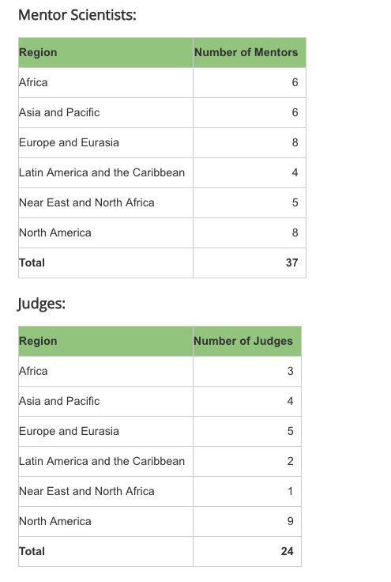
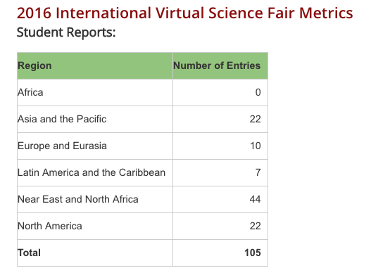
Community Engagement

Slide 13
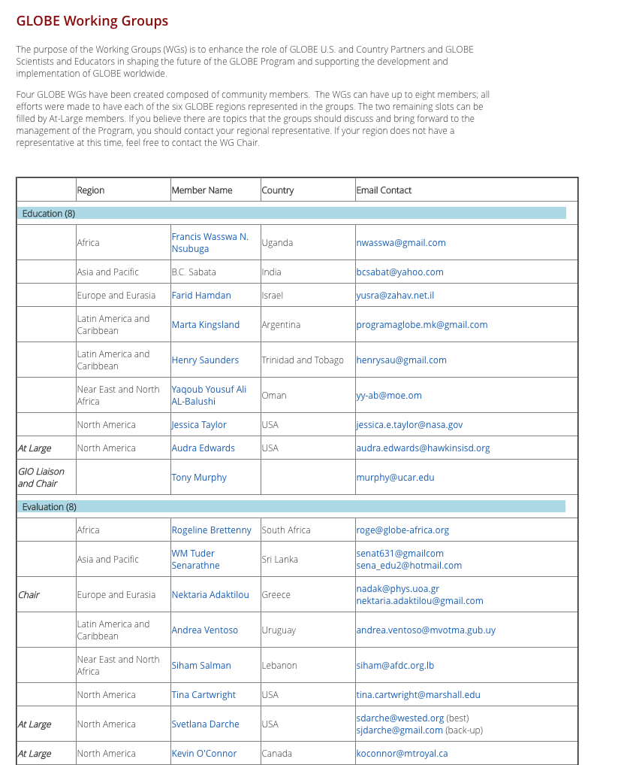
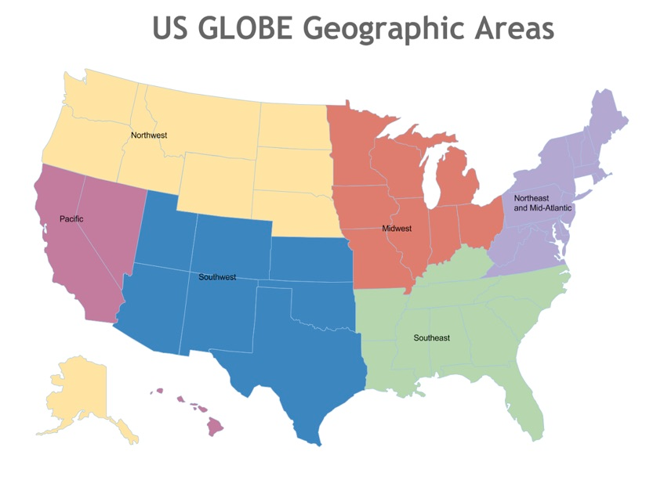
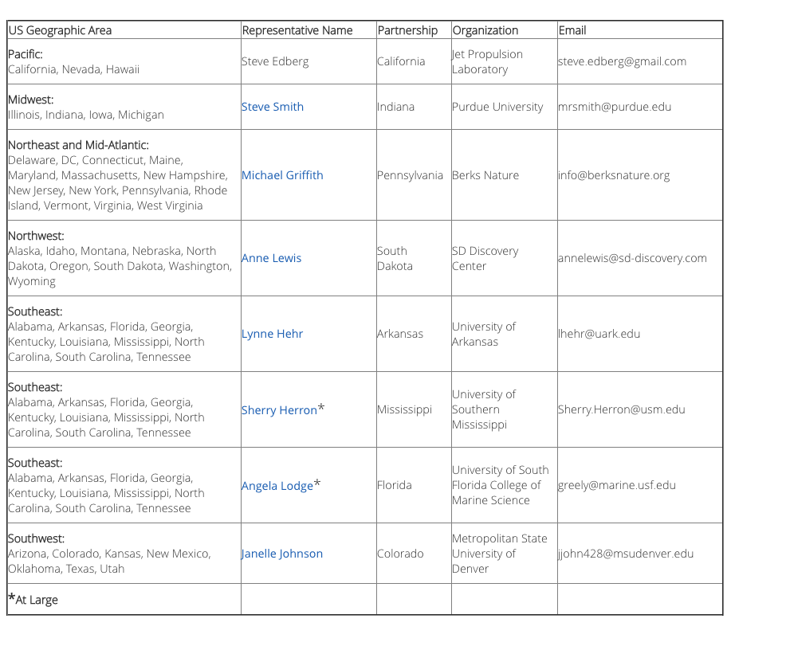

Slide 14
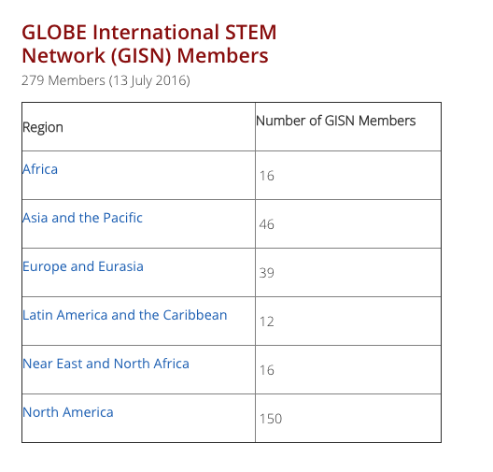

Slide 15
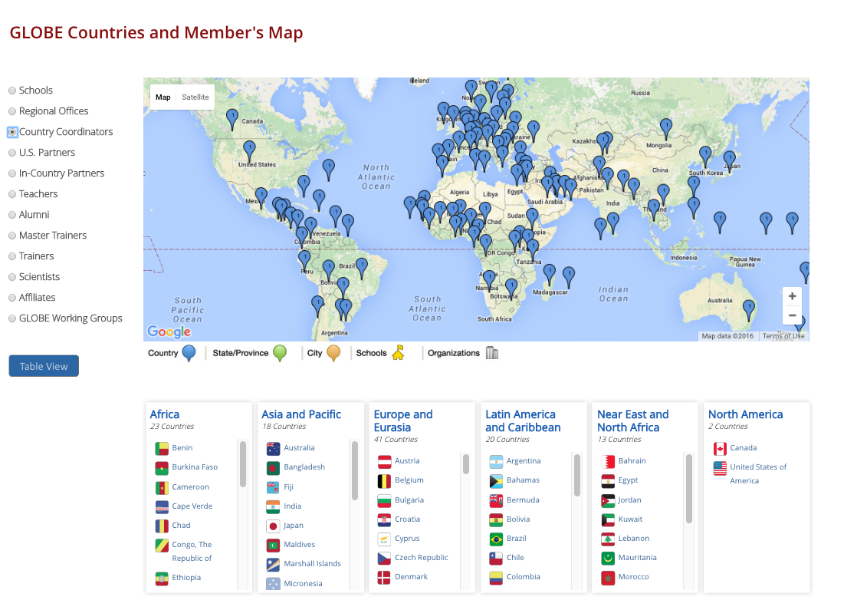
Expanding our GLOBE Community
EcoSchools; Citizen Science-SciStarter; Museums
Notes:
Brazil, Vietnam, Mauritius

Slide 16
Communications to the Community

Slide 17
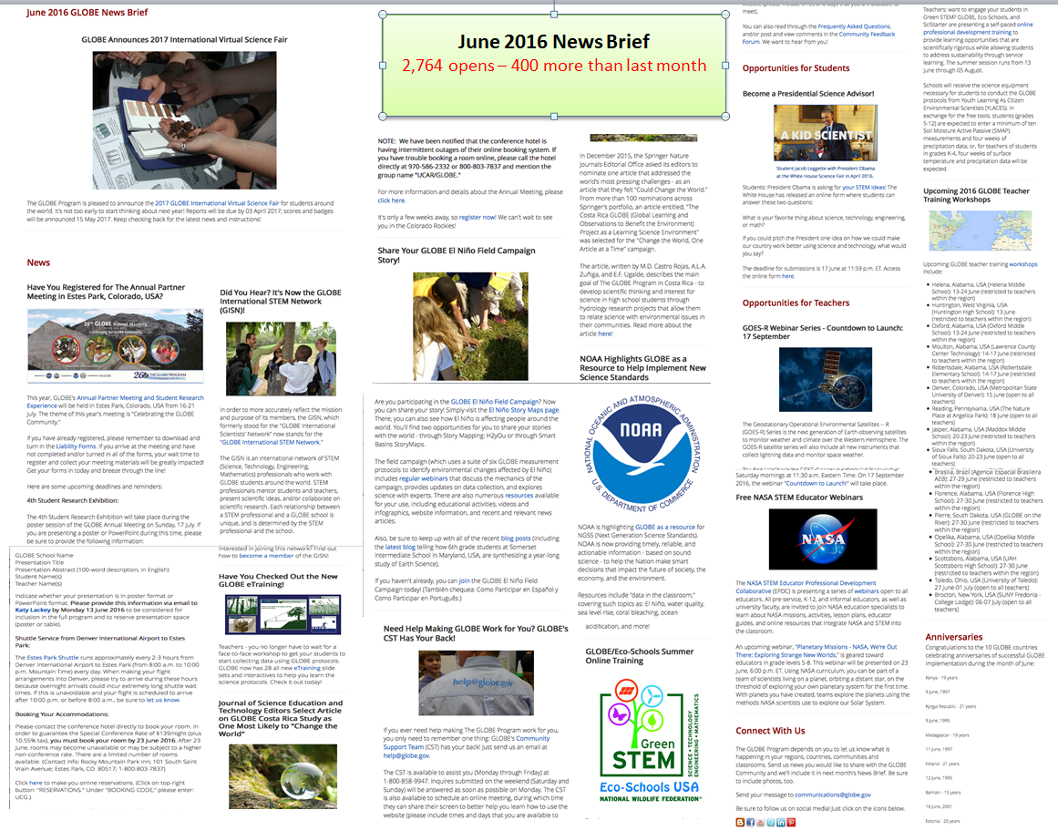

Slide 18
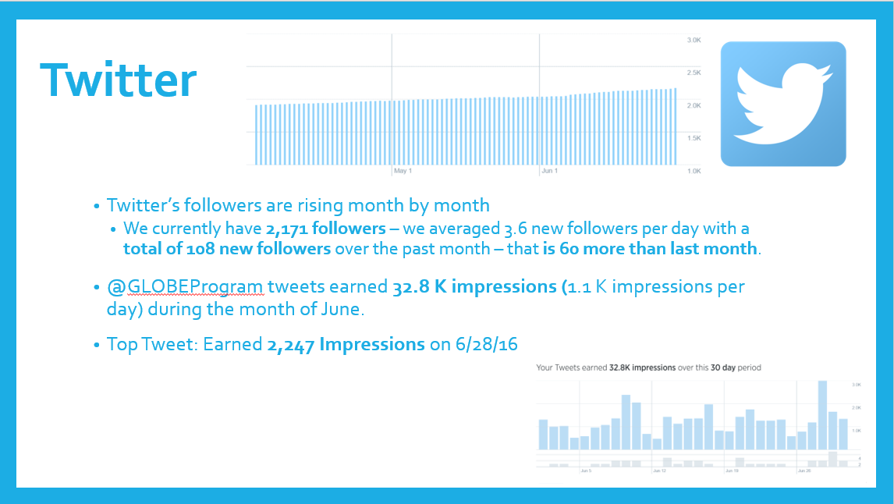
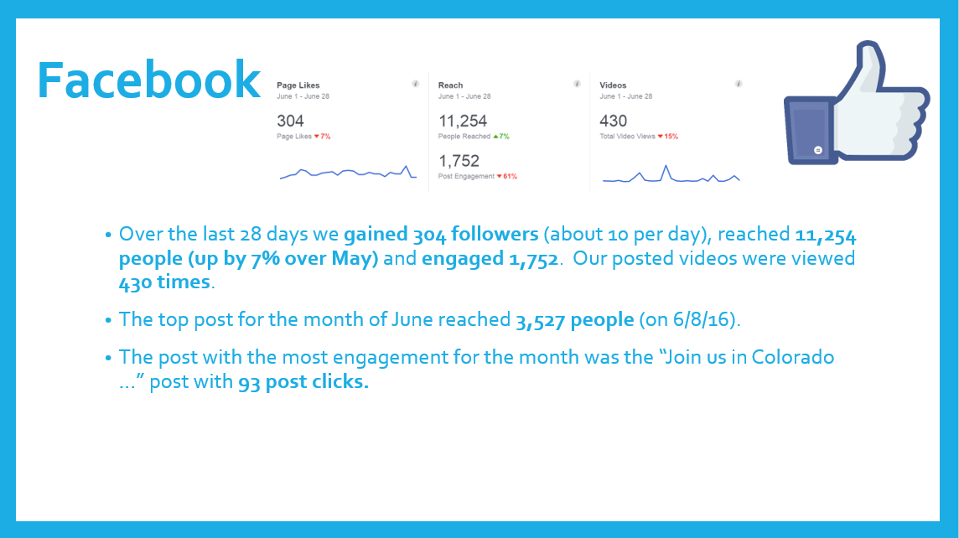
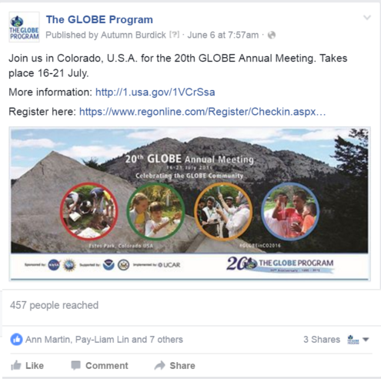
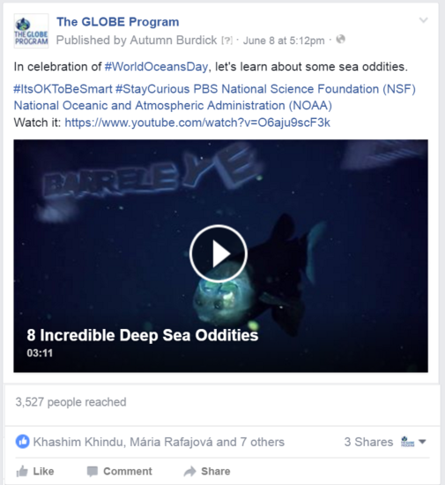
Most
Engagement
Top Post
Top Tweet

Slide 19
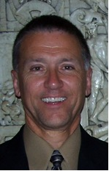
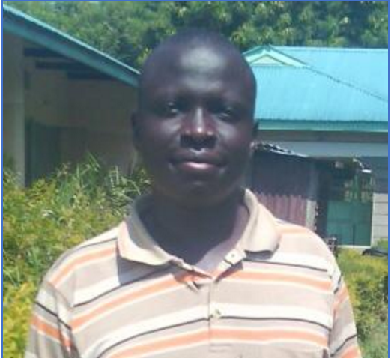
Educator Fellowship
Gary Popiolkowski – USA Fellow
Chartiers-Houston Jr./Sr. High School, Houston, Pennsylvania, USA
GLOBE Teacher since 1995
Middle School Science teacher for 42 years
Will create learning activity about land cover and MUC
Dan Orobi – International Fellow
Homa Bay Boys High School, Homa Bay, Kenya
Involved in Lake Victoria Project
Will create learning activity involving mosquitoes and hydrology

Slide 20
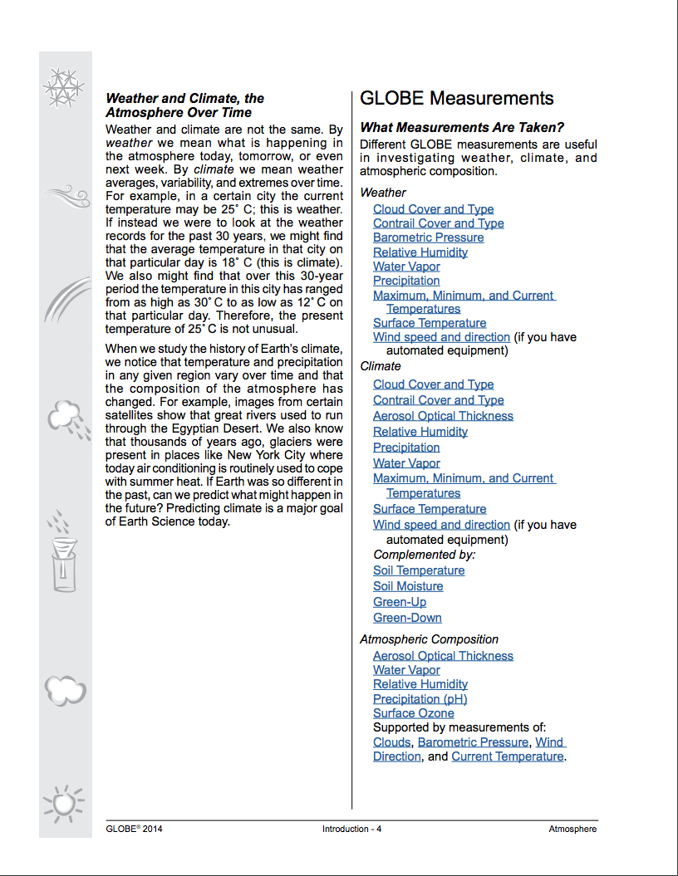
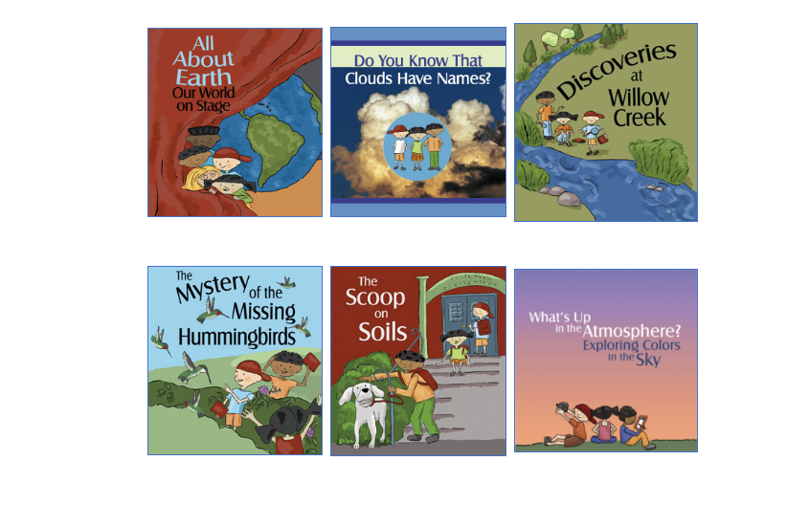
Teacher’s Guide
Elementary GLOBE Storybooks

Slide 21
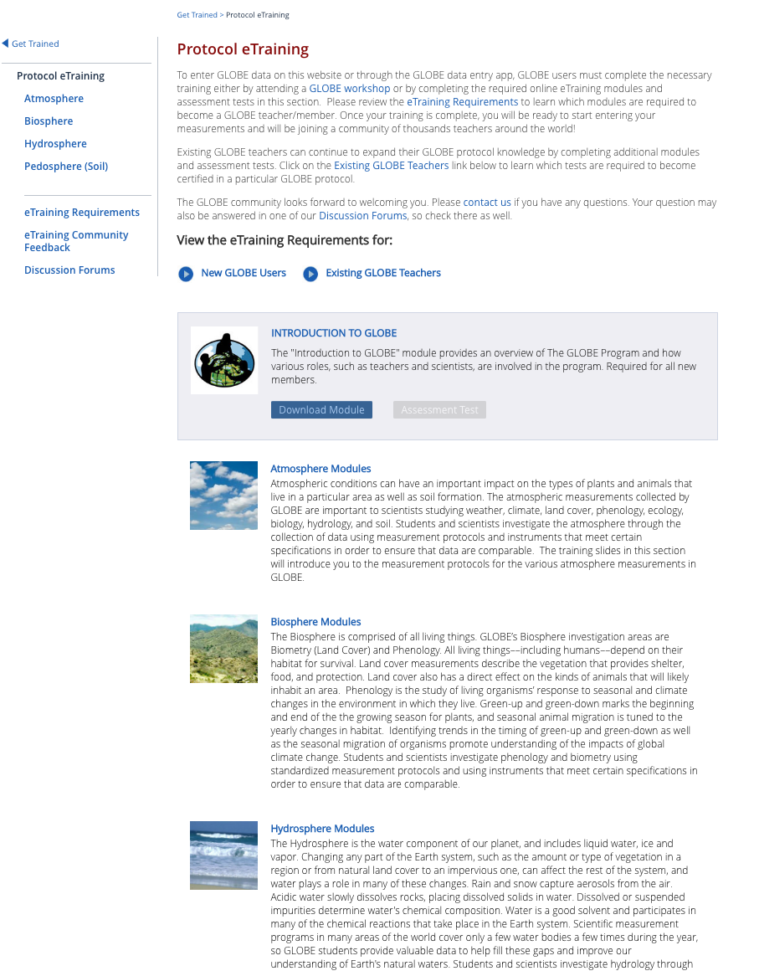
Funded by NASA
Developers:
Atmosphere:
Lin Chambers
Kevin Czajkowski
Biosphere:
Becky Boger
Rusty Low
Hydrosphere:
Becky Boger
Rusty Low
Pedosphere (Soil):
Izolda Trakhtenberg
Dixon Butler

Slide 22
Q: On a scale of 1 to 5, please rate how easy it is to navigate to the following resources on the GLOBE website.
Community Annual Survey
Notes:
Answered: 140 (Partners & Country Coordinators’ responses)

Slide 23
Q: Please estimate your annual funding/budget for GLOBE

Slide 24
Q: Which of the following best describes the primary source (more than 50%) of funding for GLOBE management and operation in your organization or country?

Slide 25
Q: What is the primary way you receive news about GLOBE?

Slide 26
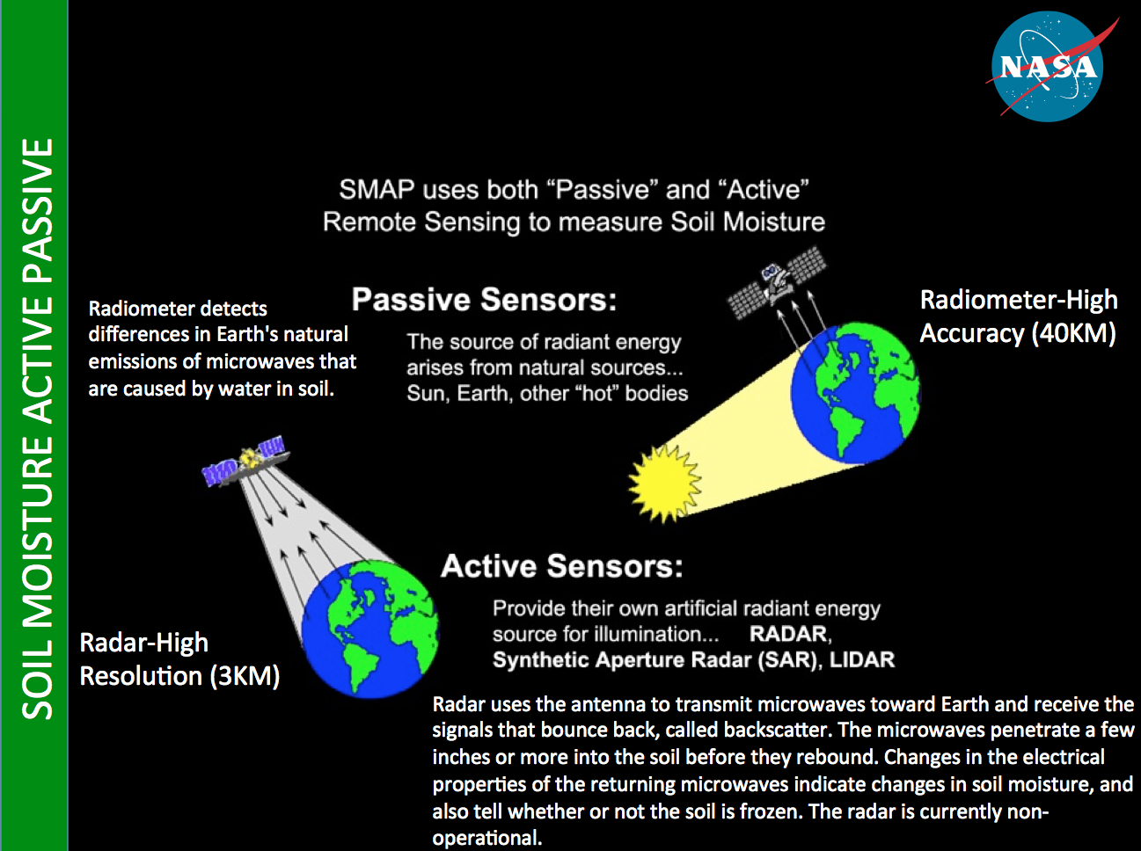
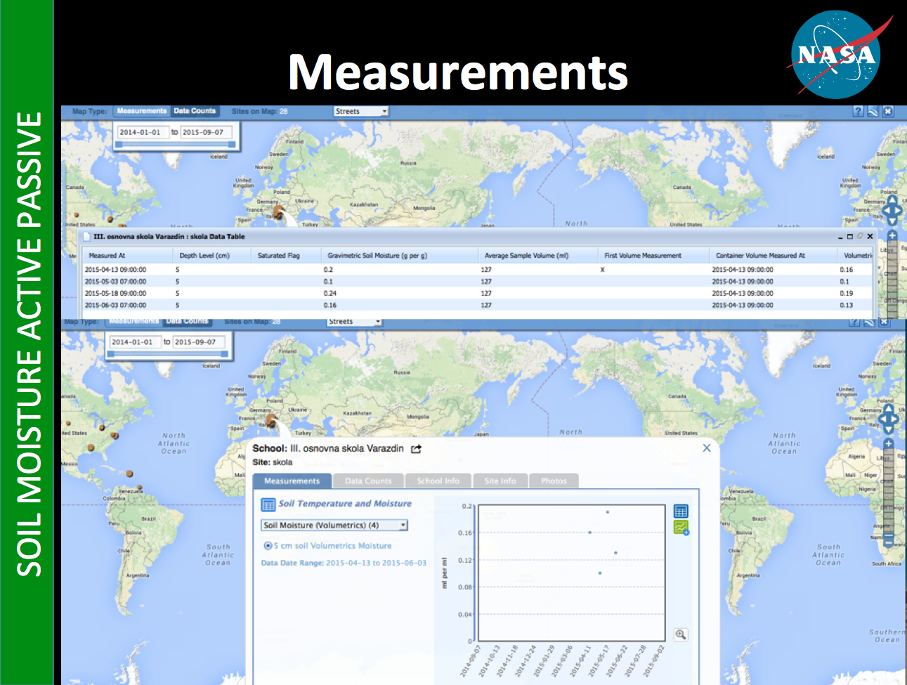
Science
El-Nino Campaign

Slide 27
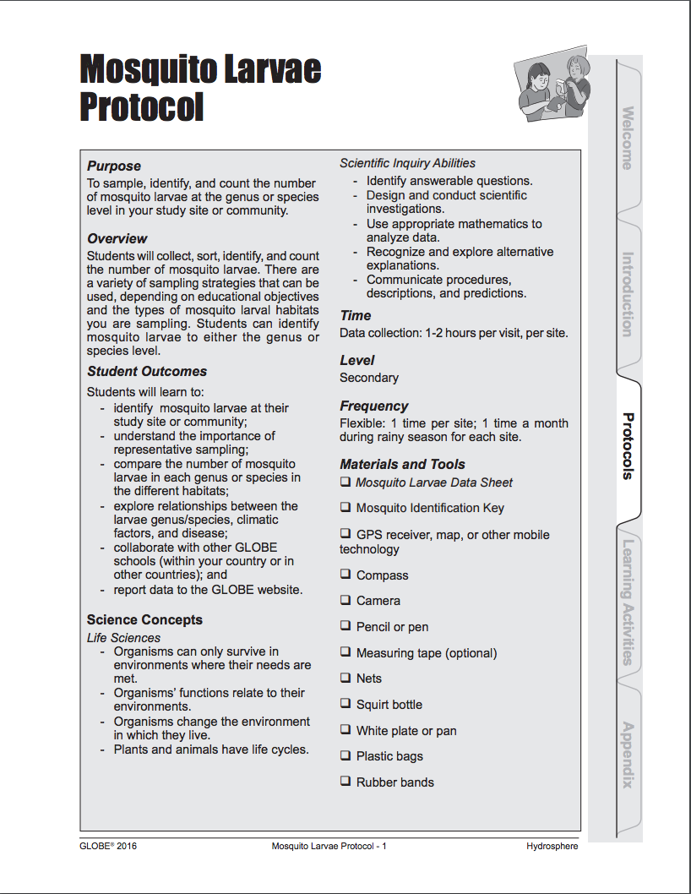
El-Nino Campaign

Slide 28
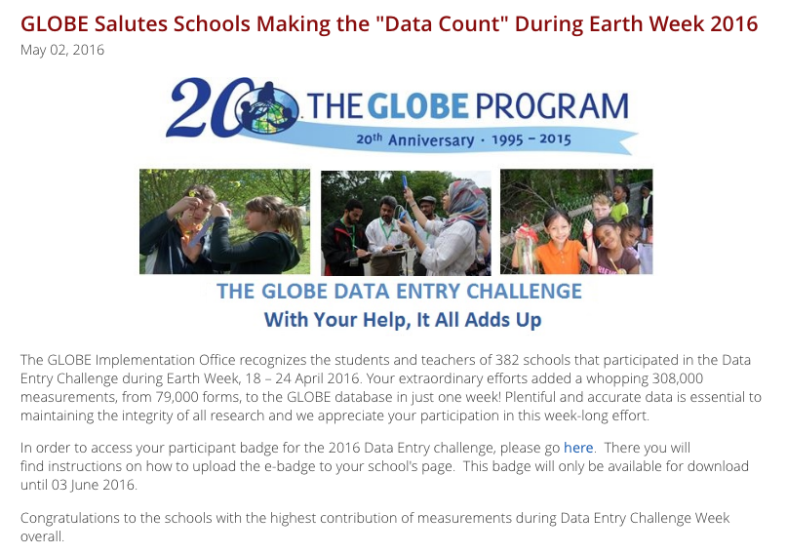

Slide 29
Schools Reporting Data
Number of Schools Reporting Data by Year for the Months of January-June of the Given Year

Slide 30
Countries Entering Data
Number of New Manual Observations
Number of New Automated Observations
Measurements Observed During the Past Month and the Number of Measurements >= 200

Slide 31
Number of Observations
For the Months of January-June of the Given Year
Since GLOBE Began
Oldest → Newest

Slide 32
Data Entry Method
From 20 April 2015 to Present
No. of Schools Method Used
597 Web Forms
30 Email DE
25 Weather Bug
172 Mobile App
120 GLOBE Observer
Mobile App Users per Week

Slide 33
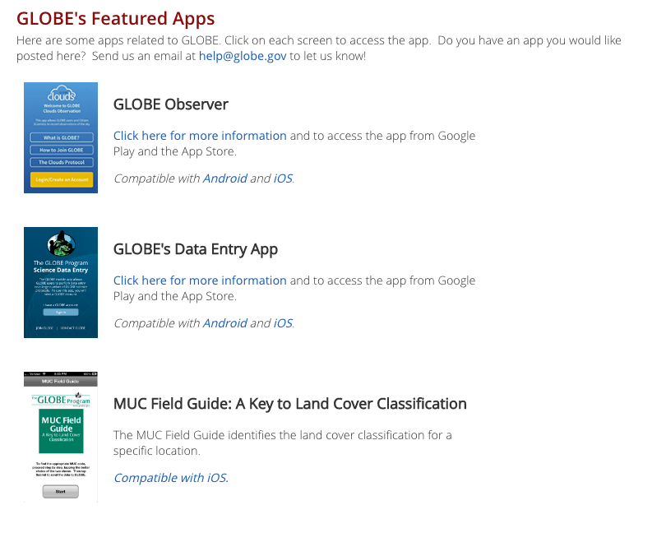
Technology

Slide 34
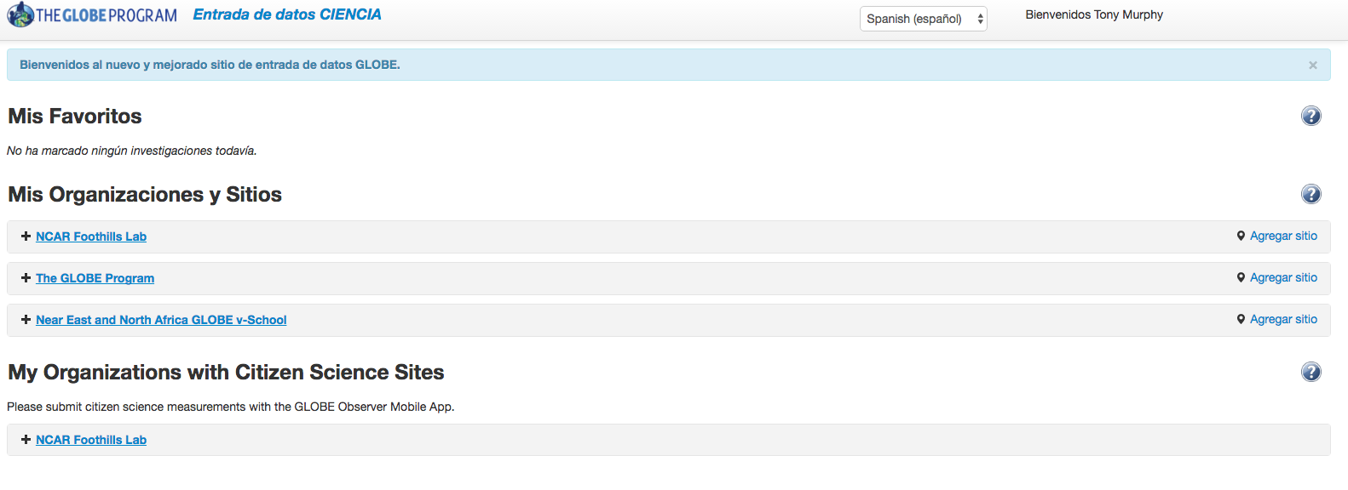
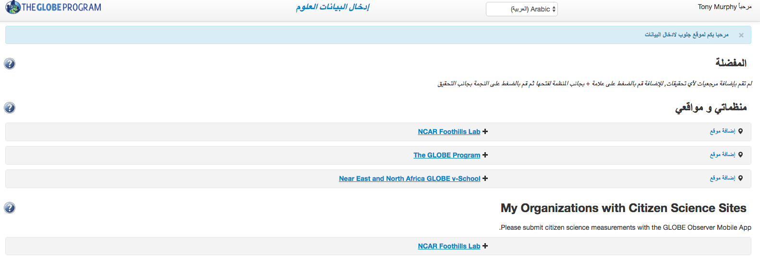
Notes:
8 languages in addition to English
Arabic
Dutch
French
German
Hindi
Russian
Spanish
Thai

Slide 35
Community Support Team Metrics

Slide 36
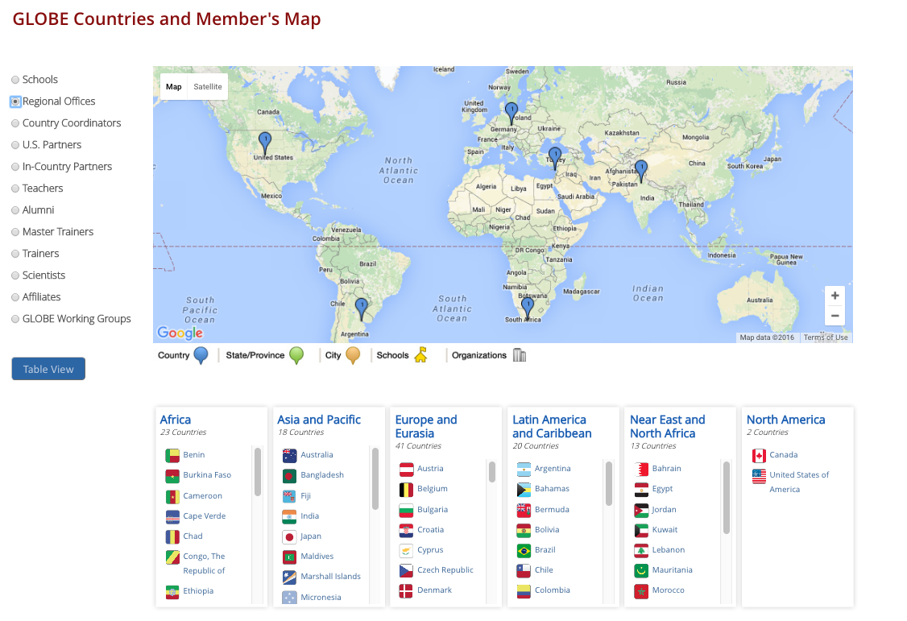
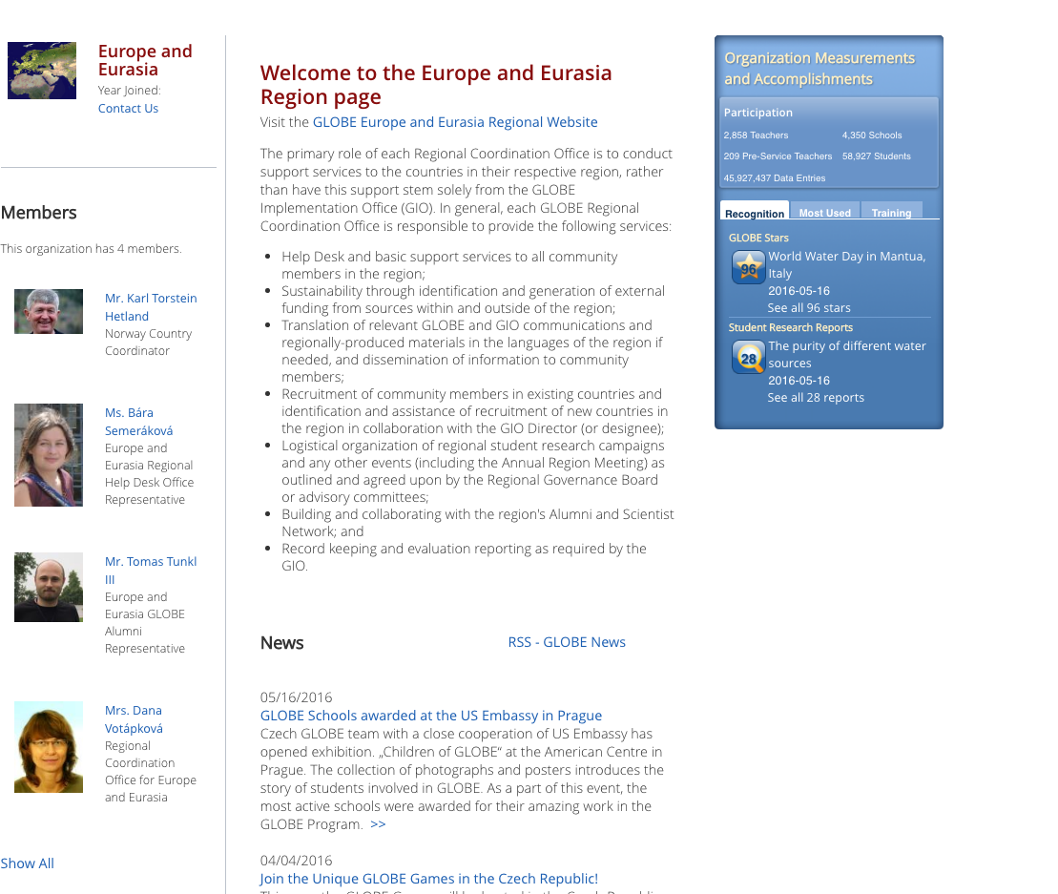

Slide 37
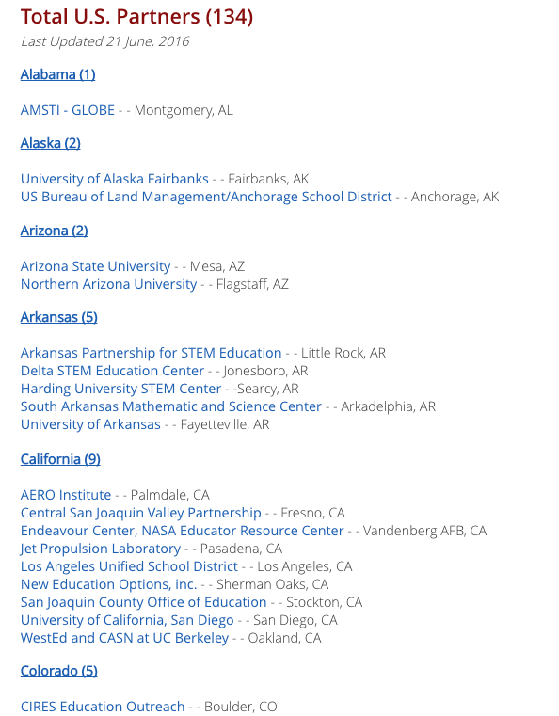
Notes:
US CC
Once at a certain point with an organization hand off any development to GIO and NASA

Slide 38
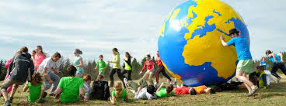
GLOBE 20th Anniversary
Earth Day Video: with WestEd
Data Entry Challenge
Community Google Hangout
GLOBE Data Entry App: with SSAI
International Virtual Science Fair
Community events
Community Videos
Camps
Regional GLEs

Slide 39
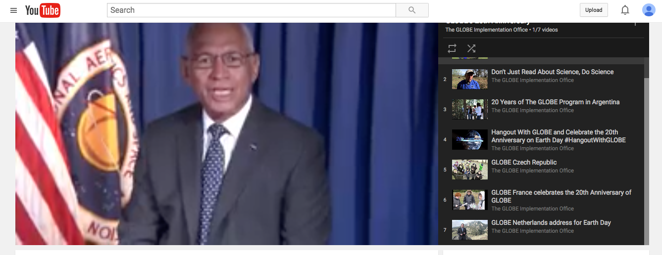
GLOBE 20th Anniversary--Earth Day 2015

Slide 40
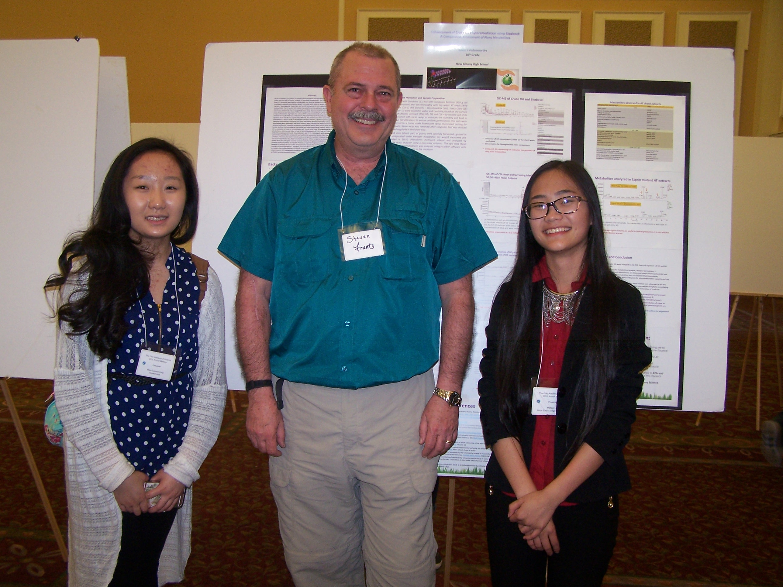
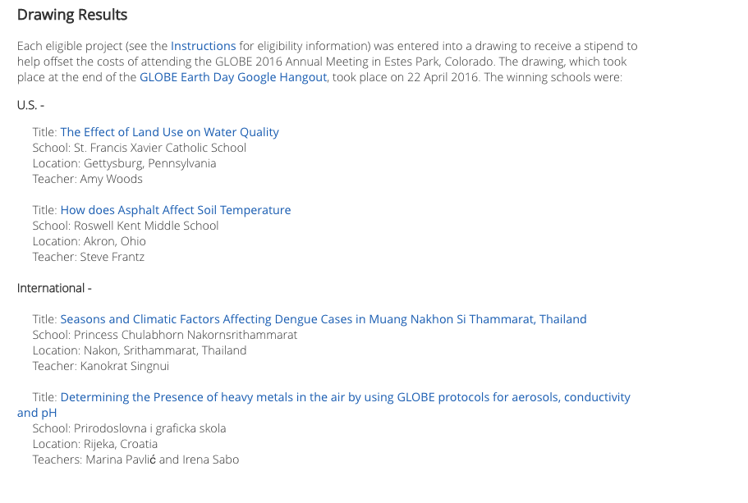
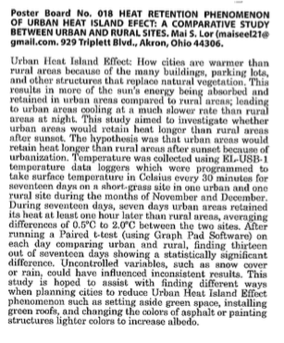
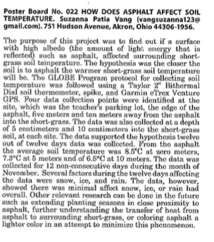
Community Accomplishments
GLOBE students presenting research at local and state science fairs in ALL six GLOBE regions
Teacher: Steve Franz
Notes:
Ohio Academy of Science's 125 Annual Meeting (http://www.ohiosci.org/am-2016/) at Ohio University in Athens, Ohio.
Akron students Mai See Lor (Akron Early College) and Suzanna Vang (Roswell Kent Middle School) presented their GLOBE Program research during the Poster Session. (Pictured with Dr. Stephen McConoughey, OAS CEO).
In addition, Mai, Suzanna, and Selena Turner (NIHF STEM High School) have their research abstracts published in the peer-reviewed Ohio Journal of Science.
This accomplishment means these students earned a Superior rating at the Science Expo at North High School, a Superior rating at the District V Science Fair at the University of Akron, a Superior rating at State Science Day at The Ohio State University, and having their work scrutinized very closely by a scientific committee before being approved for publication!

Slide 41
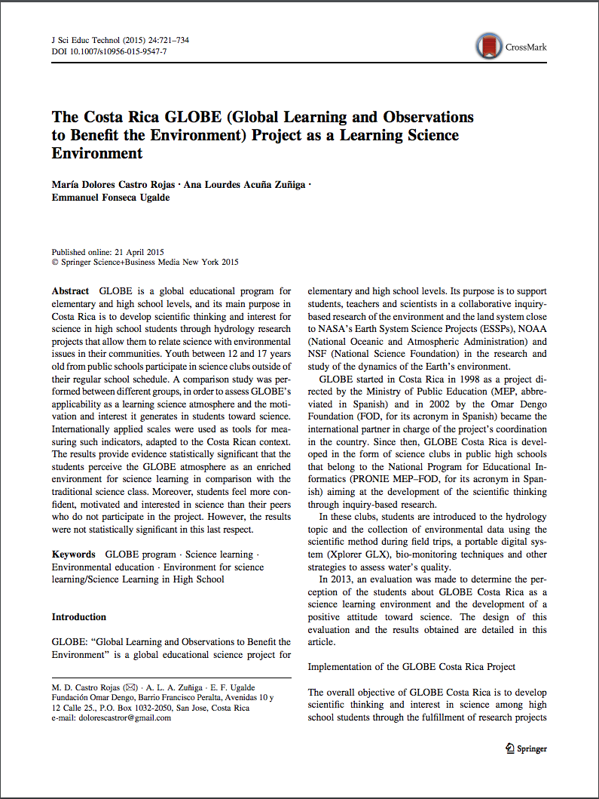
Community Accomplishments
Voted by editors as the
best article of 2015
Journal of Science Education
and Technology

Slide 42
Technology Drawing
Page 16 of Program
Use Hashtag for SM
#GLOBEINCO2016

