Slide 1
GLOBE in the
United States
Anne Lewis &
Jen Bourgeault
July 18, 2016

Slide 2
Geographical Representation
  https://www.globe.gov/globe-community/globe-working-groups/us-partner-forum

Slide 3
Who we are…
NASA Centers
School districts/schools
State Standards – State Dept of Education
Colleges & Universities
  Education Departments
  Science Departments
  Outreach
Informal Science Centers
Research Institutes
Professional development centers
https://www.globe.gov/web/united-states-of-america/resources

Slide 4
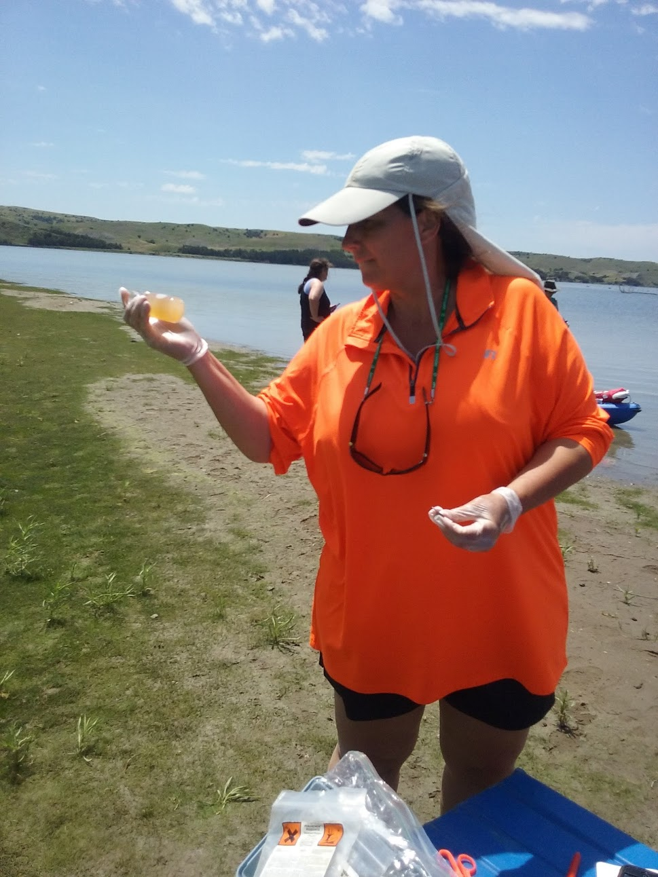
South Dakota
Discovery Center
Funded by South Dakota Department of Environment and Natural Resources to do watershed education and outreach.
Professional development
Student programs (Sci Girls, Envirothon, Upcoming: Earth Systems Event for 4th graders)
Working with tribal communities: Sinte Gleska University (Rosebud) and Ogalala Lakota College (Pine Ridge).
Looking forward: Citizen science app
http://www.globe.gov/web/south-dakota-discovery-center1/overview

Slide 5
Not a state-by-state model, instead target audience
Mission of each Partner organization determines how each operates
Funding comes from the partners, no direct GLOBE support

Slide 6
Partner Models for GLOBE Implementation
Pre-service
Teacher professional development workshops
Grant-based initiatives
Outreach and education (broader impacts, community and student audiences)

Slide 7
Next Generation Science Standards
http://www.nextgenscience.org/
  Disciplinary Core Ideas (DCI)
  Science and Engineering Practices (SEP)
  Cross-Cutting Concepts (CCC)
Partner/Country Opportunity

Slide 9
National Science Fairs http://www.globe.gov/web/united-states-of-america/events/eventsdetail/14718/us-regional-science-fairs
Geographic Area | GLOBE Partners | Teachers | Students
Northwest | 4 | 4 | 20
Pacific | 5 | 5 | 17
Southwest | 2 | 7 | 33
Midwest | 4 | 8 | 40
Southeast | 4 | 4 | 22
Northeast & Mid-Atlantic | 8 | 9 | 32
Total | 27 | 37 | 164 (67 projects)

Slide 10
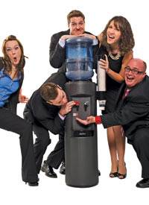
Networking & Collaboration
Watercoolers (virtual meetings every other week on a specific topic)
Emails (sent 2x a month to U.S. partners)
2 Bootcamps this year (Train-the-Trainer and new Partner training)
NARM (North American Regional Meeting)
https://www.bigspeak.com/speakers/the-watercoolers/

Slide 11
Networking & Collaboration
Jen’s Blog (developing)
Connections with other govt. agencies & programs (USDA Forest Service, Project Learning Tree, Project WET and Project WILD)
Google Voice Hotline (Partners call and leave news items to share.)
https://www.bigspeak.com/speakers/the-watercoolers/

