Slide 1
Website Report – 2016 What’s New and What’s Coming
Dave Overoye / Cornell Lewis
Science Systems and Application, Inc.

Slide 2
Introduction
Last Year’s annual meeting we discussed many goals and needs
Attended regional meetings and received input from partners, country coordinators and teachers
Received Support and ideas from the Technology Working Group
Scott Graves
Kris Jaroensutasinee
Charles Mwangi
Nadhira al-harthi
Matthijs Begheyn
Maria Portuguez
Elżbieta Wołoszyńska-Wiśniewska
Meet weekly with GIO and NASA
NASA (Nargess Memarsardeghi)
GIO – Travis Andersen, Julie Malmberg
Dixon Butler

Slide 3
Technology Team
Protect GLOBE

Slide 4
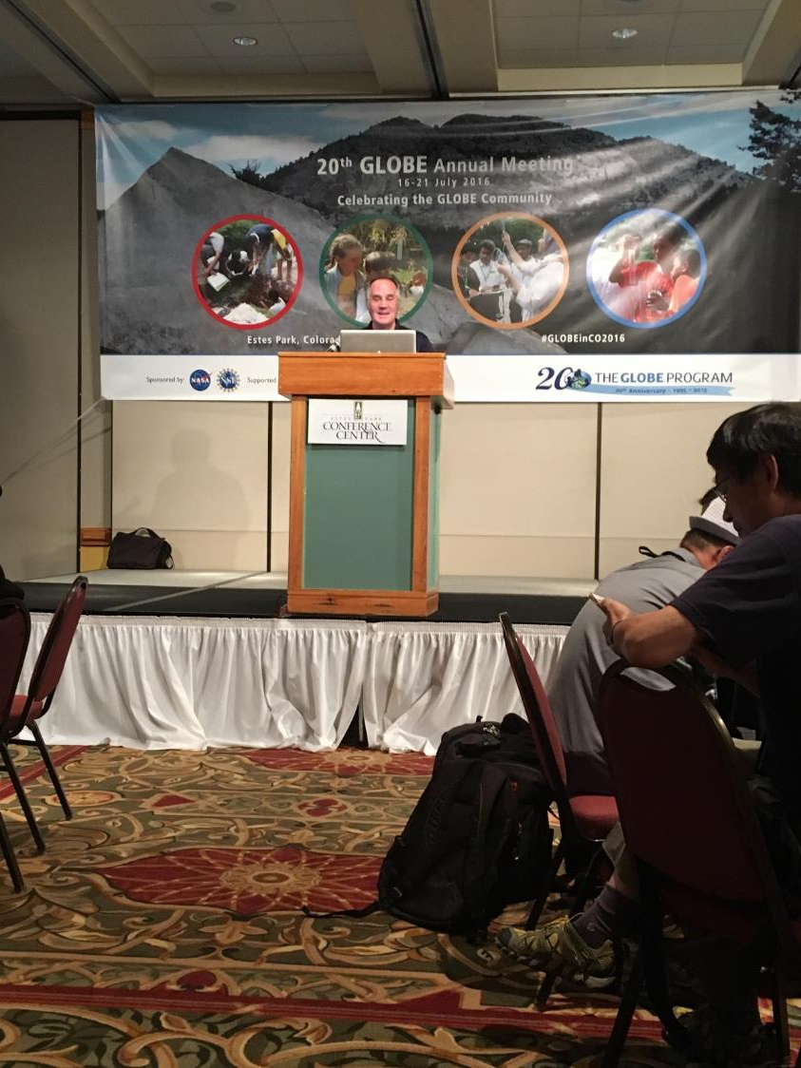

Slide 5
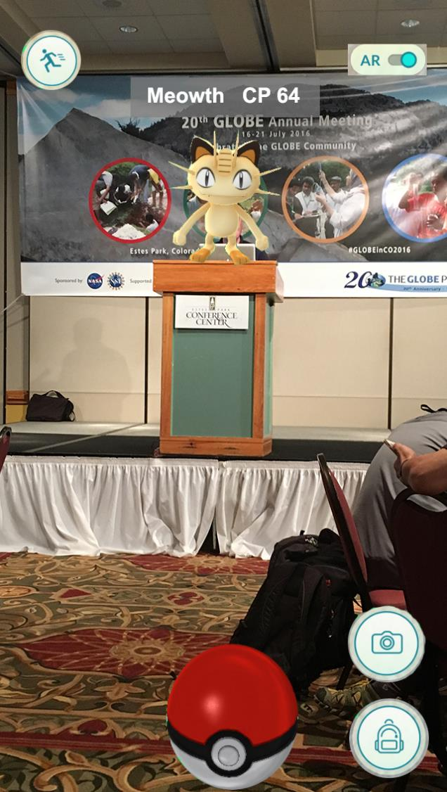

Slide 6
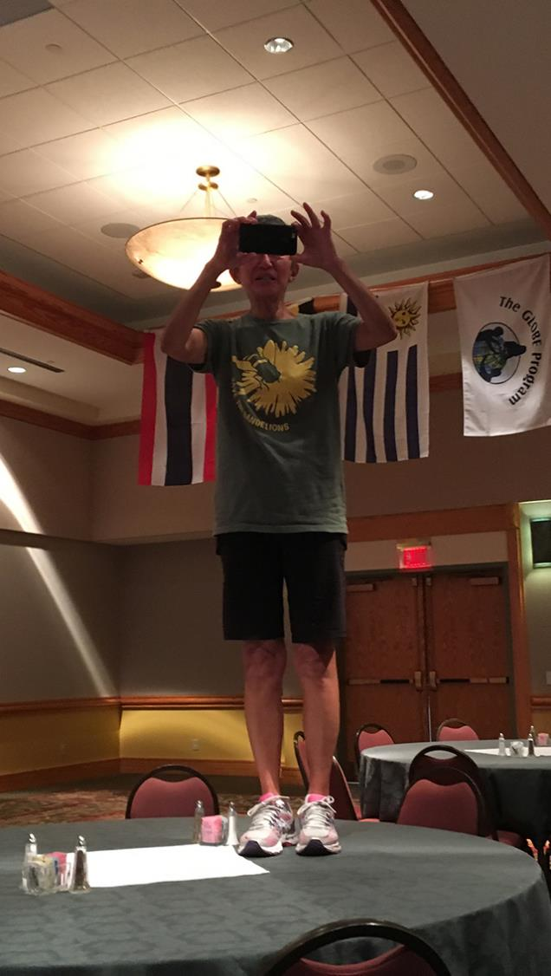

Slide 7
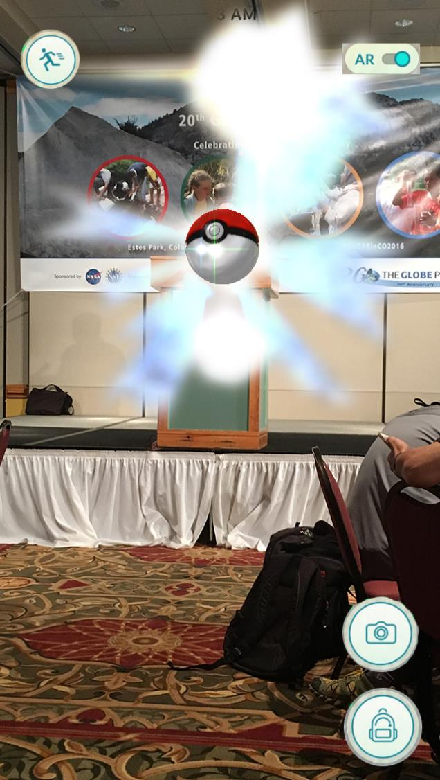

Slide 8
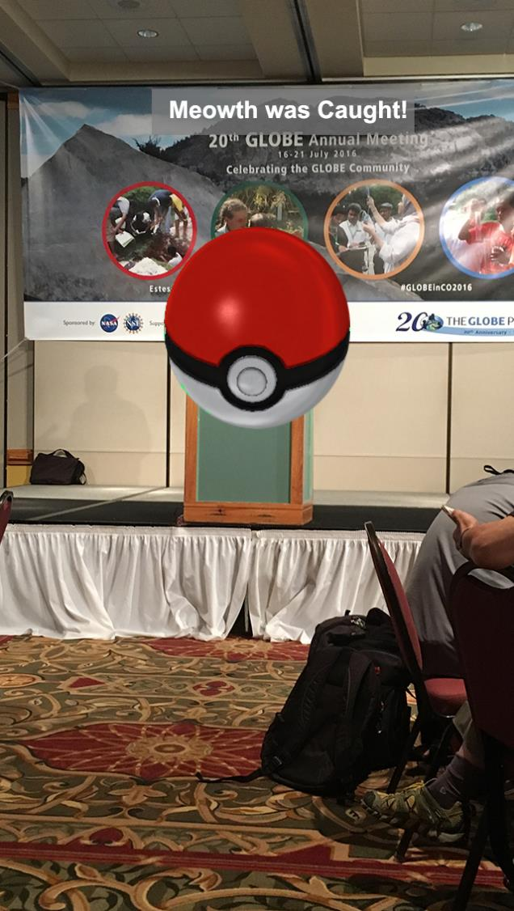

Slide 9
Last year’s annual meeting - What’s Coming?
New Capabilities
Cloud App
E-Learning
GLOBE Classroom
Community Requests
Data Access Tool
Low Bandwidth Site
Translations
System Software Upgrades

Slide 10
2015/2016 – Accomplishments
New Capabilities
Cloud App
E-Learning
GLOBE Classroom
Community Requests
Data Access Tool
Low Bandwidth Site
Translations
System Software Upgrades

Slide 11
2015/2016 – Accomplishments
New Capabilities
Cloud App
E-Learning
GLOBE Classroom
Community Requests
Data Access Tool
Low Bandwidth Site
Translations
System Software Upgrades
Vis System Enhancements
New Layers
Better Mobile Support
Performance
Mosquitos Protocol

Slide 12
What’s New on the Website

Slide 13
The GLOBE website software was upgraded in late 2015
Moved from Liferay Version 6.0 to Liferay Version 6.2
Why?
Version 6.0 was nearly 3 years old
Support/Security patches were going to stop being provided
Version 6.2 has some new features

Slide 14
Software upgrade – What didn’t change
Even though the software “behind the scenes” changed, for most users, there will be little differences
No Changes:
Visualization System Interface
Data Entry System
Website design
User accounts, logins
School, Country, Region and other pages on the site.
Web Content and Collaboration

Slide 15
Software upgrade – What did change
Administration area changed slightly
Administration features are linked directly under “Manage”
Users and Organization management in one section
Easier to post content in multiple languages
Combined documents and media (images/videos) into one area
Better mobile support (administration area)
Other small changes here and there…but not much

Slide 16
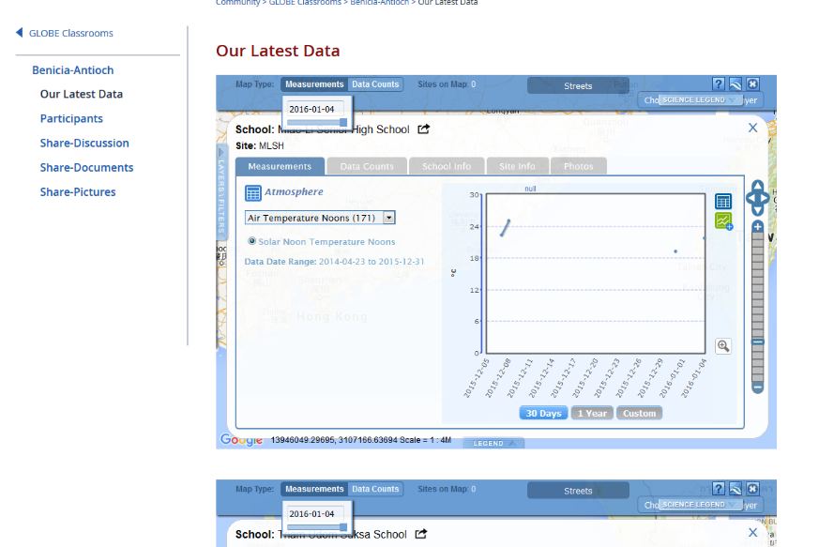
GLOBE Classroom Collaboration – 7/15
Launched the prototype GLOBE Classroom on production with limited access.
A number of GLOBE Schools (U.S. and international) participated in GLOBE over the summer, 2015 and used the classroom to facilitate their collaboration - this was a beta test to see what works and what doesn't.

Slide 17
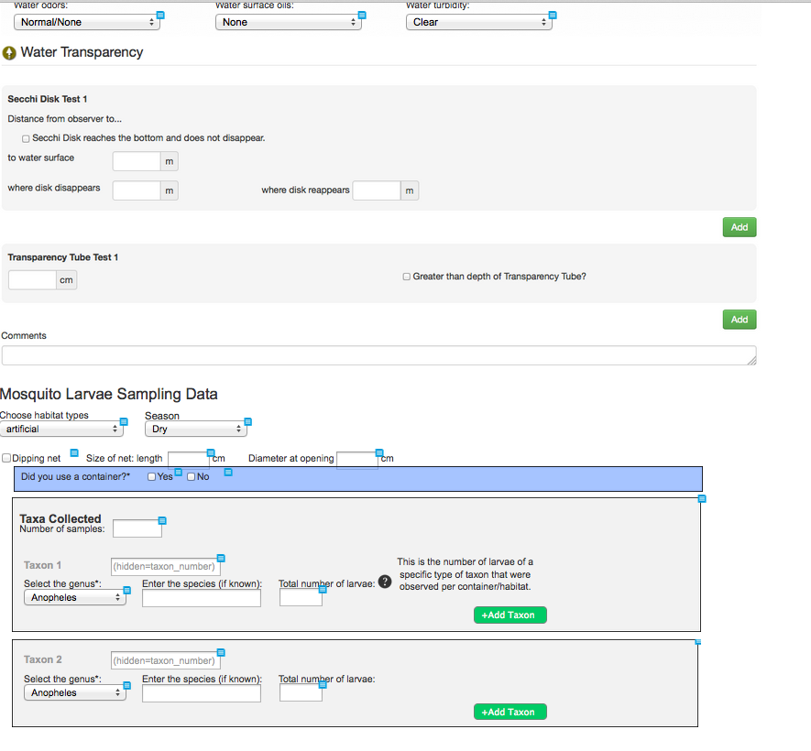
Data Entry - New Mosquitoes Protocol
Tracks number of mosquito larvae of various types
Can be performed “in the field” in existing water sources, or “in the lab” using water containers

Slide 18
GLOBE Observer App – 4/16
New simplified app to support the GLOBE Citizen Science Initiative
An easy to use app to encourage the general public – “Citizen Scientists” - to perform basic GLOBE protocols
Released in April, 2016.
Clouds Observations to start
Future releases will include additional capabilities

Slide 19
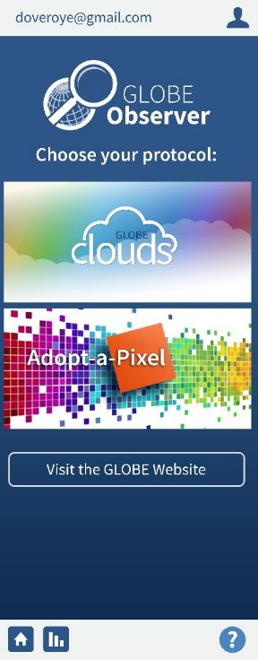
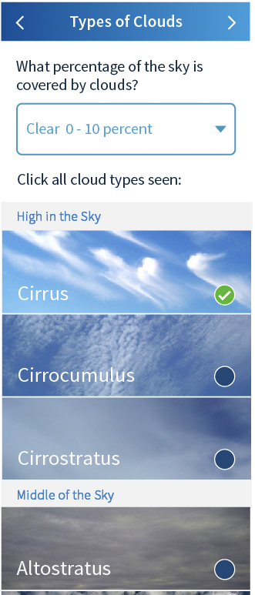
GLOBE Observer (cont.)
Allows GLOBE and non-GLOBE users to record measurements
Simplifies interactions by automatically creating sites, adding location and time
Provides information on satellite flyovers for the observer’s location
With integrated camera, compass and clinometer capability.

Slide 20
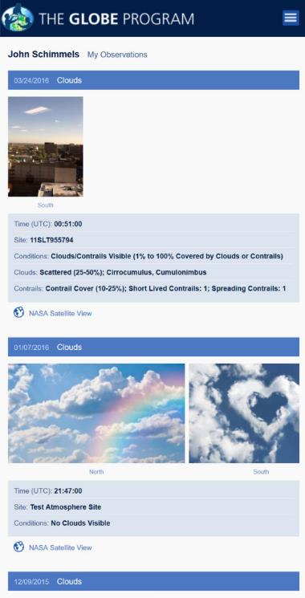
GLOBE Observer (cont.)
My Observations
My Data – view all of your clouds measurements
NASA Data – see a satellite’s view of the clouds over your location

Slide 21
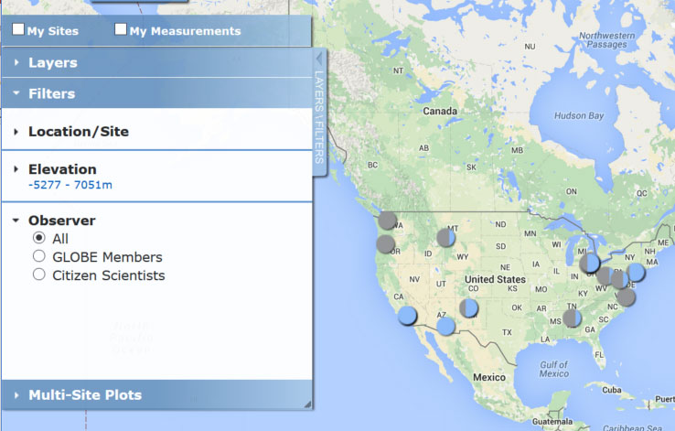
GLOBE Observer (cont.)
See all clouds measurements made on a given day (link to Vis)
Filter to see Citizen Science data only

Slide 22
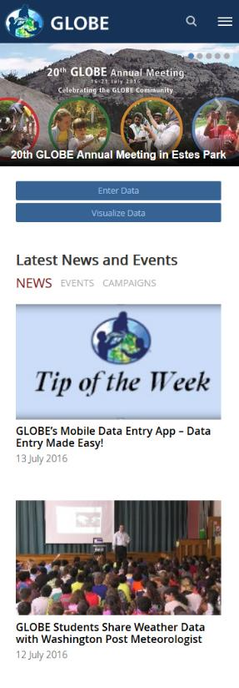
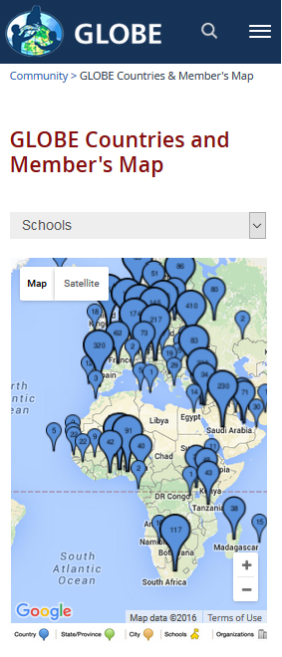
Improved Phone Interface
Phone and tablet display improvements were delivered to improve the overall usability of the website on those devices.

Slide 23
eTraining System – 3/16
Teachers can now become GLOBE Teachers by completing the required online training modules.
Anyone can download the protocol training materials. Users must have the ‘account approved’ status or higher to take the online assessments to become a GLOBE teacher.
Once a GLOBE Teacher, members have the ability to enter GLOBE data on the website or through the GLOBE data entry app.
The Atmosphere modules were launched initially in March with Biosphere, Hydrosphere and Pedosphere added in early April.

Slide 24
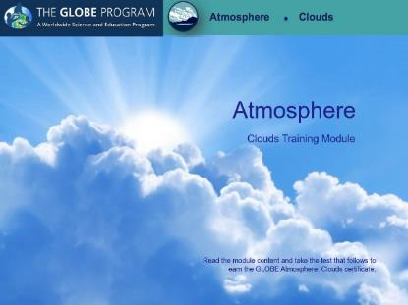
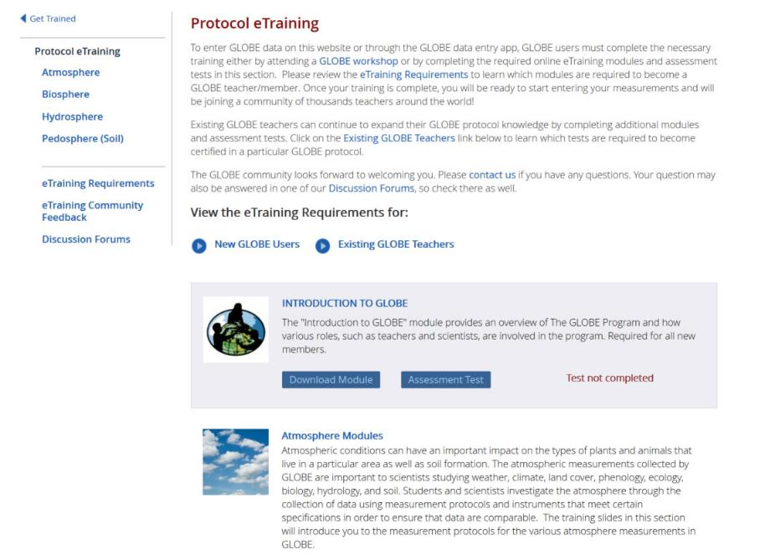
eTraining System – 3/16

Slide 25
Low Bandwidth Home Page – 3/16
Users in low-bandwidth areas now have the option to switch to a text-only version of the home page to allow for faster page loading.
Once selected, a cookie will be set to allow the user to automatically load the low-bandwidth version on subsequent visits.

Slide 26
Data Entry Forms - translations
The Data entry forms are now available in 9 languages.
Most sections are translated (some still have some translations left)
Thanks to volunteers for providing translations

Slide 27
Advanced Data Access Tool
Provides a non- map interface to retrieve GLOBE data
Users can search for data with a variety of parameters
Users can download larger amounts of data
Show me all data measured from 2010-2012 for the air temperature and barometric pressure protocols in the following countries…

Slide 28
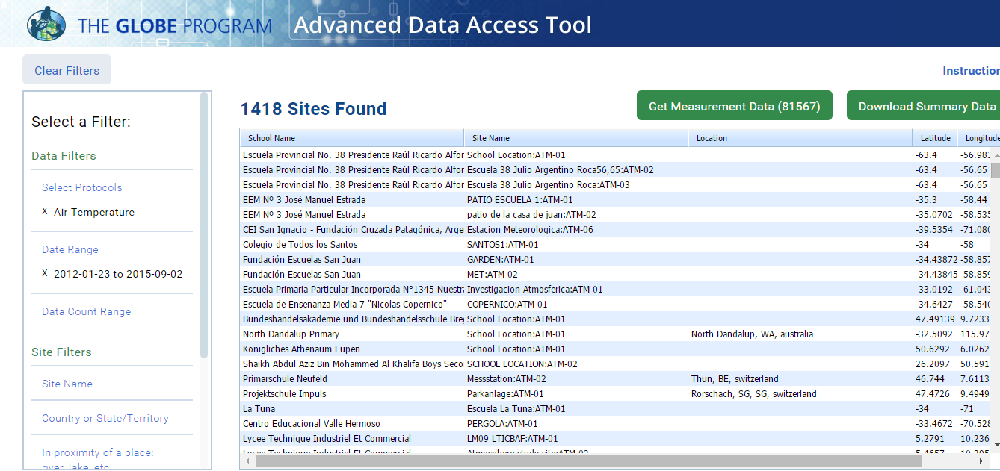
Advanced Data Access Tool

Slide 29
Vis System Enhancements
Added 7 Science base layers (GIBS and SMAP) to allow users to compare their data with real NASA data
Additional filtering added - See just your sites and measurements
Translated into Spanish. More languages coming
New layers added – Mosquitoes, Phen Gardens
Improved interface and photo display
Improved Performance and Optimization

Slide 30
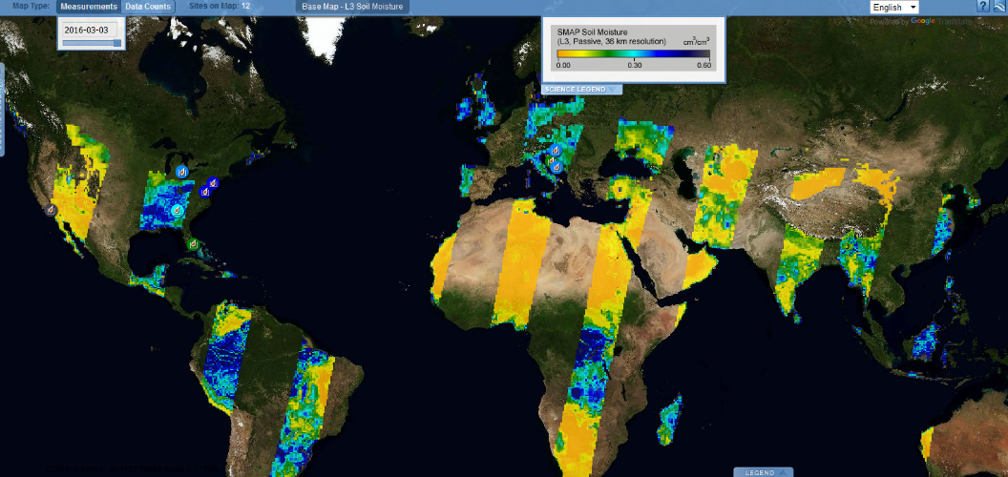
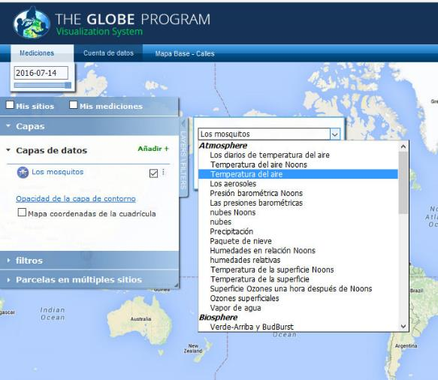
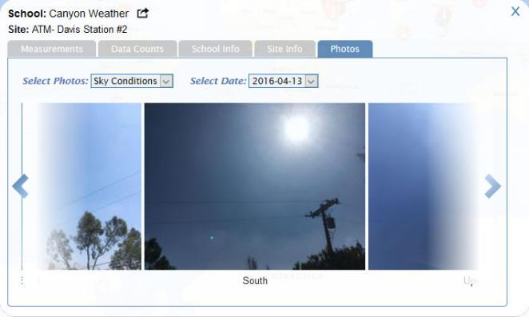
Vis System Enhancements

Slide 31
Future Enhancements

Slide 32
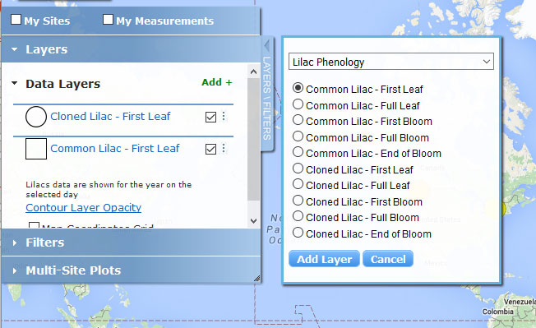
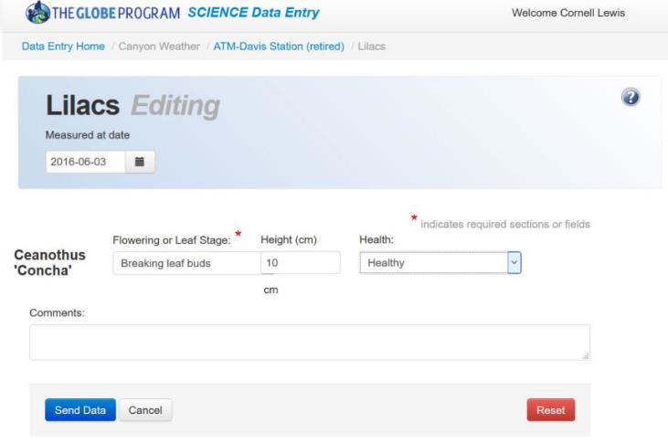
Protocol: Lilacs Phenology (early August)
Data Entry
Visualization

Slide 33
Major upgrade to Aerosols Protocol Interface
Modify interface to more closely match how you collect data
Won’t require you to enter wavelengths over and over!
Trial 1 UTC Time (24 hr)
Manual Input with seconds
(UTC)
Channel Wavelength nm AOT Reading
619
Prepopulate
wavelengths
Channel Wavelength nm AOT Reading
540
Channel Wavelength nm AOT Reading
465
Trial 2 UTC Time (24 hr)
(UTC)
Channel Wavelength nm AOT Reading
619
Channel Wavelength nm AOT Reading
540
Channel Wavelength nm AOT Reading
465

Slide 34
Other New Protocols in review:
HydroColor
Frost Tube
Standing Carbon
Fire Fuel
Hummingbird

Slide 35
Redesign of the home page
Focus on the key GLOBE topics:
GLOBE Around the GLOBE - Consolidate Featured Stories/GLOBE Around the World to better promote world news, events and people.
GLOBE Data - Expand GLOBE Data section to include maps/graphs that show recent measurements to better promote data entry activity around the world.
GLOBE Now – Recent News, Events, Campaigns (with campaigns more prominent).
GLOBE People - Highlight the ‘active’ members. Who’s been the most active the last 30 days, etc.
Get Involved – How to Join and become involved.
GLOBE on Social – Latest feeds and site activity.

Slide 36
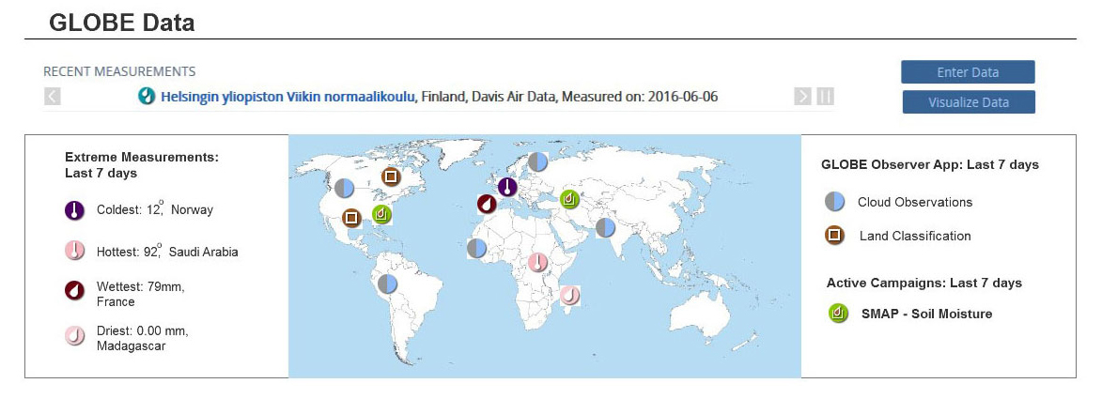
Redesign of the home page

Slide 37
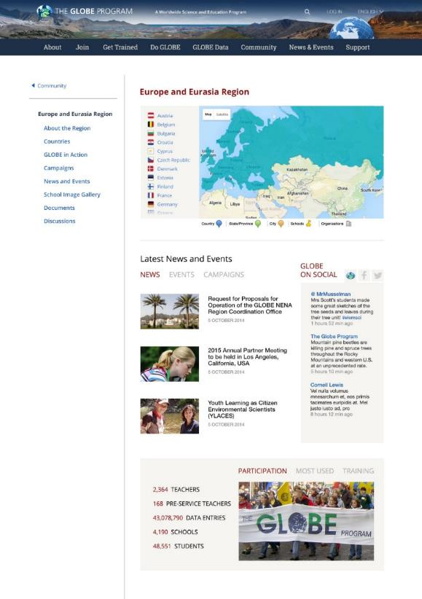
New region and Country Pages
Based on feedback from the community
Regions - ‘landing page’ for regional members
Countries - Improved map and school search
Better management and control of content for Country and Region managers

Slide 38
New Web Capabilities
Tighter integration with social media platforms
Improved search capabilities
Ability to sort your ‘Go to Menu’
Improved ‘Friend’ capability – make it easier to find and add friends
Include STEM Network, Alumni and scientists in the collaborator search tool
Arabic support

Slide 39
New Management Tools
Partner / Country Coordinator Dashboard
Management tool for partners and country coordinators to better manage their teachers. Approve accounts quickly, send out bulk emails to various group members (approved, newly trained, etc.), See what’s going on in your organization by viewing a summary of user activity.
Partner/CC Email Notifications
New Account Email Reminders –
GLOBE accounts waiting for approval (for country coordinators)
Monthly member report with a link to your dashboard
Workshop Email Reminders –
Pending workshop reminder
Workshop completion reminder

Slide 40
New Visualization Capabilities
Save visualization/ADAT filters to reuse and share
View Summary Data Layers – to view specific monthly climate values
View data over time animation
Additional languages to be translated

Slide 41
New App Development
DE GLOBE Mobile App Upgrade v1.2
New version will have the ability to create sites in the field without an internet connection
Add language translations available in desktop version

Slide 42
GLOBE Observer app
V 1.2 out soon
Integrates camera, clinometer and compass
V 1.3 – planned to expand amount and type of Cloud data collected
In planning stages – add mosquitos protocol and land cover protocols

Slide 43
GLOBE Observer Sub-site
Sub-site to support the GLOBE Observer app and the citizen science community.
Unique URL but will live within the GLOBE.gov website

Slide 44
Data Standards
Working to support others to connect to GLOBE Data
Establishing standard interface to “pull” GLOBE data (Adopt a Pixel)
Establish standard API to submit (“push”) data to GLOBE
Establish API for other app developers to submit data to GLOBE

Slide 45
Need Help? Have Ideas?
Material to help to use the GLOBE website
Videos on how to use the various GLOBE features are on the website
http://www.globe.gov/get-trained/using-the-globe-website
Teacher Shortcuts – on this page – quick reminders of how to do things.
UnConferences
Tuesday 10:30, Wednesday 10:30
GLOBE Website Challenge – Test your skills – How well do you know how to use the GLOBE Website – A good intro to using features on the website
GLOBE Visualization and Data Retrieval Systems – Learn how to use these tools with a practical El Nino example.
We’re here all week to help and listen – let us know your thoughts!

Slide 46
Demos – time permitting eLearning ADAT GLOBE Observer

