Slide 1
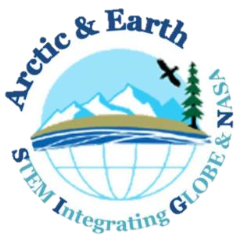
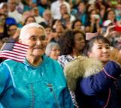
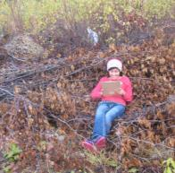
Dr. Elena Sparrow
International Arctic Research Center
School of Natural Resources & Extension
University of Alaska Fairbanks
Impacts & feedbacks of a warming Arctic: Engaging learners in STEM using GLOBE and
NASA Assets

Slide 2
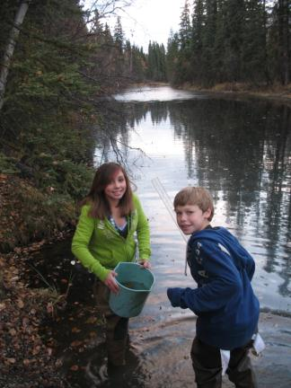
Project Overview
Arctic and Earth SIGNs Objectives
Develop a high quality climate change education program that includes NASA assets (resources and experts), citizen science, and mobile technology for formal and informal science education settings
Engage educators in authentic science and technology learning experiences to model best practice for teaching K-12 Earth Science
Engage community members and youth in informal, authentic science and technology education experiences where they produce and apply new information on the impacts of a changing global climate.

Slide 3
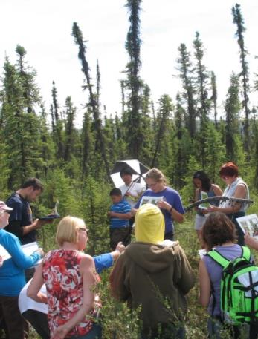
Project Overview
Target Audiences
Primary audience- Educators in rural and indigenous communities, including:
- Pre- and in-service teachers
- 4-H leaders
- Community leaders (elders, tribal or
town council members, etc.)
Secondary- educators in other communities underserved in STEM
Notes:
Through this Arctic and Earth SIGNs project we are integrating culturally responsive locally relevant learning and citizen science.

Slide 4
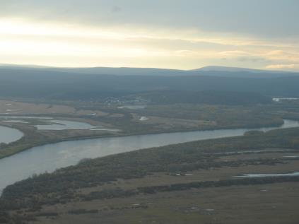
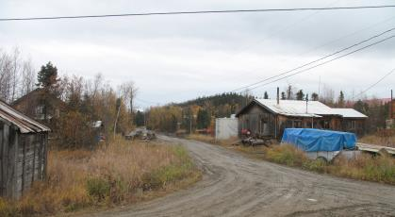
Recipe for Success for GLOBE in rural and indigenous communities
Innoko River School case study:
Shageluk, Alaska Population: 83
Median household income: $26,667
Students preK-12 : 14
Student demographics:
100% Alaska Native
GLOBE involvement: Since 2000
Types of GLOBE Protocols Used:
phenology, weather, landcover,
hydrology

Slide 5
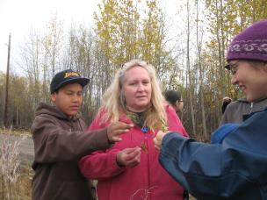
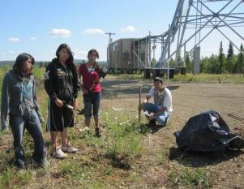
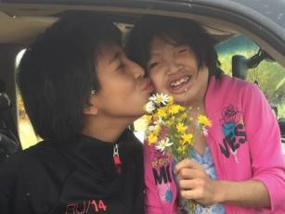
What made for long-term success?
Low teacher-turnover
Community-school connection
Long-term relationships with scientists and GLOBE partner
GLOBE used for meeting curriculum standards across disciplines
GLOBE connected to indigenous knowledge and local concerns
GLOBE knowledge and data used to help solve local problems
Notes:
Joyanne Hamilton, principal and one of two teachers at the school, is an exception to the drastically high turnover in rural Alaskan schools, where teachers usually leave teaching in Alaska altogether within 1 to 3 years. The average turnover is 25% for rural schools each year. She is also very involved in the community. Strong community support for GLOBE has helped keep it as a centerpiece for learning in the school.
Students connected their GLOBE learning with knowledge from their elders, and presented their work in South Africa at a GLOBE Learning Expedition. The concern for changes in subsistence food resources, which most families depend on due to very limited cash economy jobs in the village, is a big motivator for STEM learning among the students and for the community.
At their GLOBE land cover site, the students and teacher noticed the first ever recorded invasive plants in the village. They have been recording plant phenology observations for 16 years. They noticed that the invasive plants’ flowering times overlapped with their subsistence berry species. They noticed it had thousands of flowers and could be stealing pollinators from the plants they depend on for food. They contacted a scientist that they had met through GLOBE connections, who visited their community and conducted an emergency invasive plant control project. Students presented this project at the Alaska Forum for the Environment Conference which decision and policy makers as well as natural resource managers, land planners, community members, educators and scientists attended.

Slide 6
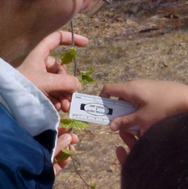
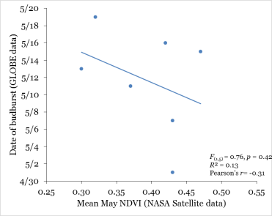
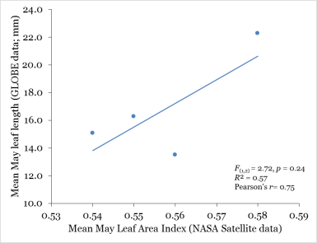
Long-term commitment = better science + better learning

Slide 7
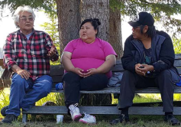
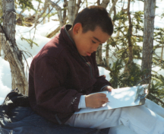
The Arctic and Earth SIGNs model Using GLOBE, NASA, and local knowledge to make STEM learning locally relevant and have an impact
Discover what youth and adults know
Identify key climate change issue for community
Brainstorm investigation and stewardship ideas
EXPLORE
SHARE
Interview local people about signs and impacts of climate change
SHARE
Design and implement stewardship project to help community address the climate change issue
Do exploratory, culturally responsive activities
Talk with a NASA scientist
Select inquiry question
Make sense of research by analyzing data and reviewing information from local experts, NASA data, and existing research
APPLY
EXPLAIN
Collaborate with a scientist & community to develop and implement GLOBE investigation
EXPERIMENT
Notes:
The Shageluk example, along with a comprehensive literature review, insights from past projects, and a needs assessment from our target audiences, has formed the foundation of the learning model we hope to implement and institutionalize for GLOBE learning in rural and indigenous communities. The model includes incorporating wisdom from elders, focusing the GLOBE investigation of local climate change priorities, linking NASA data and scientists to the GLOBE investigation, and using their data, along with NASA and traditional knowledge to inform a stewardship action project that helps address the focus issue.

Slide 8
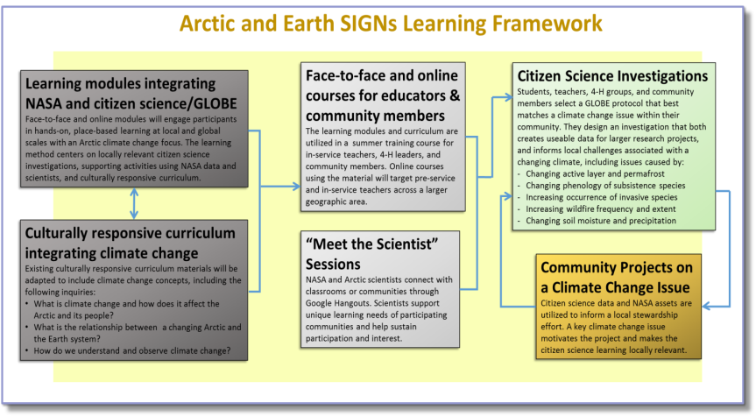
I - Product development II – Educator engagement & training III – Youth & community engagement
Figure 1. The Arctic and Earth SIGNs project learning and performance objectives will be met through the following work phases: phase 1- product development (dark grey boxes), phase 2- educator engagement and training (light grey boxes), and phase 3- youth and community engagement (green and yellow boxes).
Notes:
Here’s how we are making this vision for culturally responsive, inquiry and service-learning based GLOBE citizen science come to life.
There are three project phases:
phase 1- product development (dark grey boxes),
phase 2- educator engagement and training (light grey boxes), and
phase 3- youth and community engagement (green and yellow boxes).

Slide 9
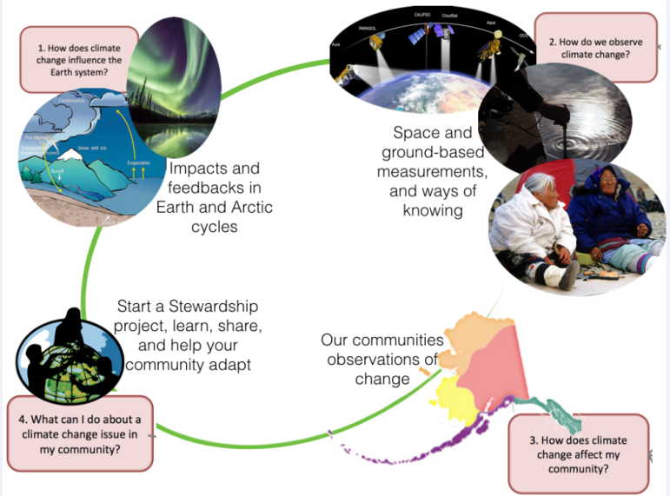
Face to Face and Online Course Units
Notes:
The course and curriculum that we are developing will look something like this…

Slide 10
Timeline
Develop
course & culturally responsive learning materials
Face to face & online course delivery in Alaska
National expansion
2017
Science contribution & sustained relationships
2018
2016-2017
2019
Institutionalization of SIGNs model
2020

Slide 11
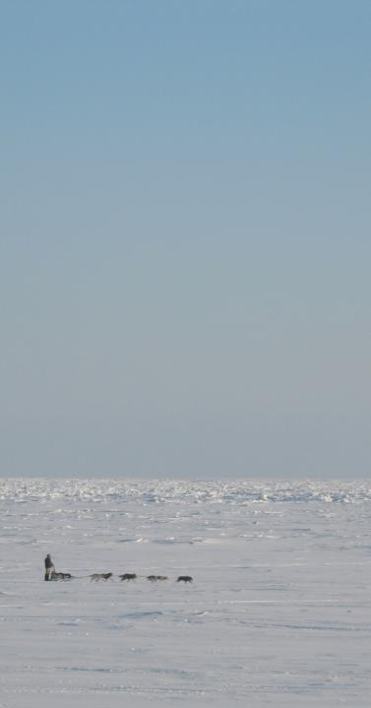
Looking Ahead
STEM Integrating GLOBE & NASA
Arctic & Earth
Arctic and Earth SIGNs Course
Starting June 2017
What are the supports for participants?
Culturally responsive lessons and learning activities
Online data entry for Frost Tube Protocol
Real-time interaction with NASA scientists
Direct collaboration with Arctic scientist on research and stewardship project
Help facilitating opportunities for participants and youth to present to local and national audiences
GLOBE network

Slide 12
Acknowledgements
Principal Investigator
Elena Sparrow, UAF International Arctic Research Center and School of Natural Resources and Extension
Co-Investigators
• Katie Spellman, UAF International Arctic Research Center (Program coordination and post-doc research)
• Cindy Fabbri, UAF School of Education
• David Verbyla, UAF School of Natural Resources & Extension
• Kenji Yoshikawa, UAF School of Northern Engineering
• Gilberto (Javier) Fochsesatto, UAF Geophysical Institute
Teaming Collaborators:
• Josefino Comiso- NASA Goddard Space Flight Center
• Bonnie Murray- NASA Langley Research Office of Education
• Christa Mulder- UAF Institute of Arctic Biology
• Malinda Chase- Association of Interior Native Educators
• Debra Jones- UAF School of Natural Res and Ext; 4-H AK
• Mara Bacsujlaky- UAF Cooperative Extension, 4-H AK
Leveraging Collaborators: • Anthony Murphy- GLOBE Implementation Office • Caitlin Montague- North Slope Borough School District
• Brenda Trefon- Kenaitze Tribe Environmental Program • Yuri Bult-Ito, UAF IARC Communications
Staff :
• Christine Butcher, education outreach assistant (IARC)
• Tohru Saito, travel coordinator (IARC)
• Michael Stewart, Curriculum Developer
Evaluator: • Angela Larson- Goldstream Group, Inc.
GLOBE Frost Tube Data Entry & Visualization Consultant • David Overoye
NASA Program Managers
• Kristen Erickson, NASA Science Education Mission
Directorate
• Ming-Ying Wei, NASA Earth Science
Partnering organizations:
• GLOBE Implementation Office
• NASA Langley Research Center Office of Education
• NASA Goddard Space Flight Center Cryosphere Branch
• North Slope Borough School District and other school districts
• Kenaitze Indian Tribe
• 4-H Club
• Online With Libraries
NASA Cooperative Agreements Cross-Collaborations:
• University of Toledo/ K. Czajkowski & Wayne RESA/ A. Henry- GLOBE Eclipse Campaign
• SSAI-NASA Goddard/ H. Riebeck- pilot GLOBE citizen science protocol and apps with non-school audiences
• NASA JPL Eyes on Earth/ K. Hussey- training for workshop participants on accessing NASA data
• NASA HQ/ D. Scalice- culturally responsive collaborative
• Earth to Sky NASA&NPS/ A. Davis- GLOBE Training at Denali Park workshop
• Space Science Institute / P. Dussenberry- NASA outreach at rural libraries
• American Museum of Natural History / R. Kinzler- explore use of GLOBE data in Open Space projections

