Slide 1
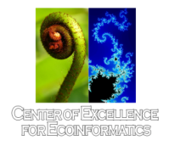
IIMPLEMENTING GLOBE IN
SOUTHERN THAILAND
Paninee Voranetivudti : High School Science Teacher
Paphayomphittayakom School, Phatthalung, Thailand
Notes:
Good……………….. Everyone, It is nice to see so many of you here . My name is Paninee Voranetivudti . I am a teacher at Paphayomphittayakom school, Phatthalung province, from the southern part of Thailand. Today the subject of my talk is imprementing globe in southern Thailand. My presentation should last about 10 minutes. IF you have any question I will be happy to answer them at the end of my talk.

Slide 2
OVERVIEW
1. When I do Globe
2. GLOBE Activities
3. Success Stories
4. What I am going to do next
Notes:
I have divided my talk into 4 main parts. First of all, I will be looking at “When I do Globe”. Second, I will focus on GLOBE Activities . Third, I will give you about success stories. And the last
I will give you information about “What I am going to do next.

Slide 3
When I do Globe
In February 2008 ,
Prof. Kris and Prof. Mullica trained us
at Taksin University about GLOBE Soil Protocol.
In March 2008,
The institute for the Promotion of Teaching
Science and Technology (IPST) trained us on Earth System Science (ESS).

Slide 4
Activities
Implemented the ESS class in grade 8. (Testing it with students)
2. Integrated GLOBE Protocols in Science, and Biology as student research projects.
3. Trained GLOBE Protocols to other teachers in my school. (recruit more staff)
4. Encouraged students to do more GLOBE related research projects

Slide 5
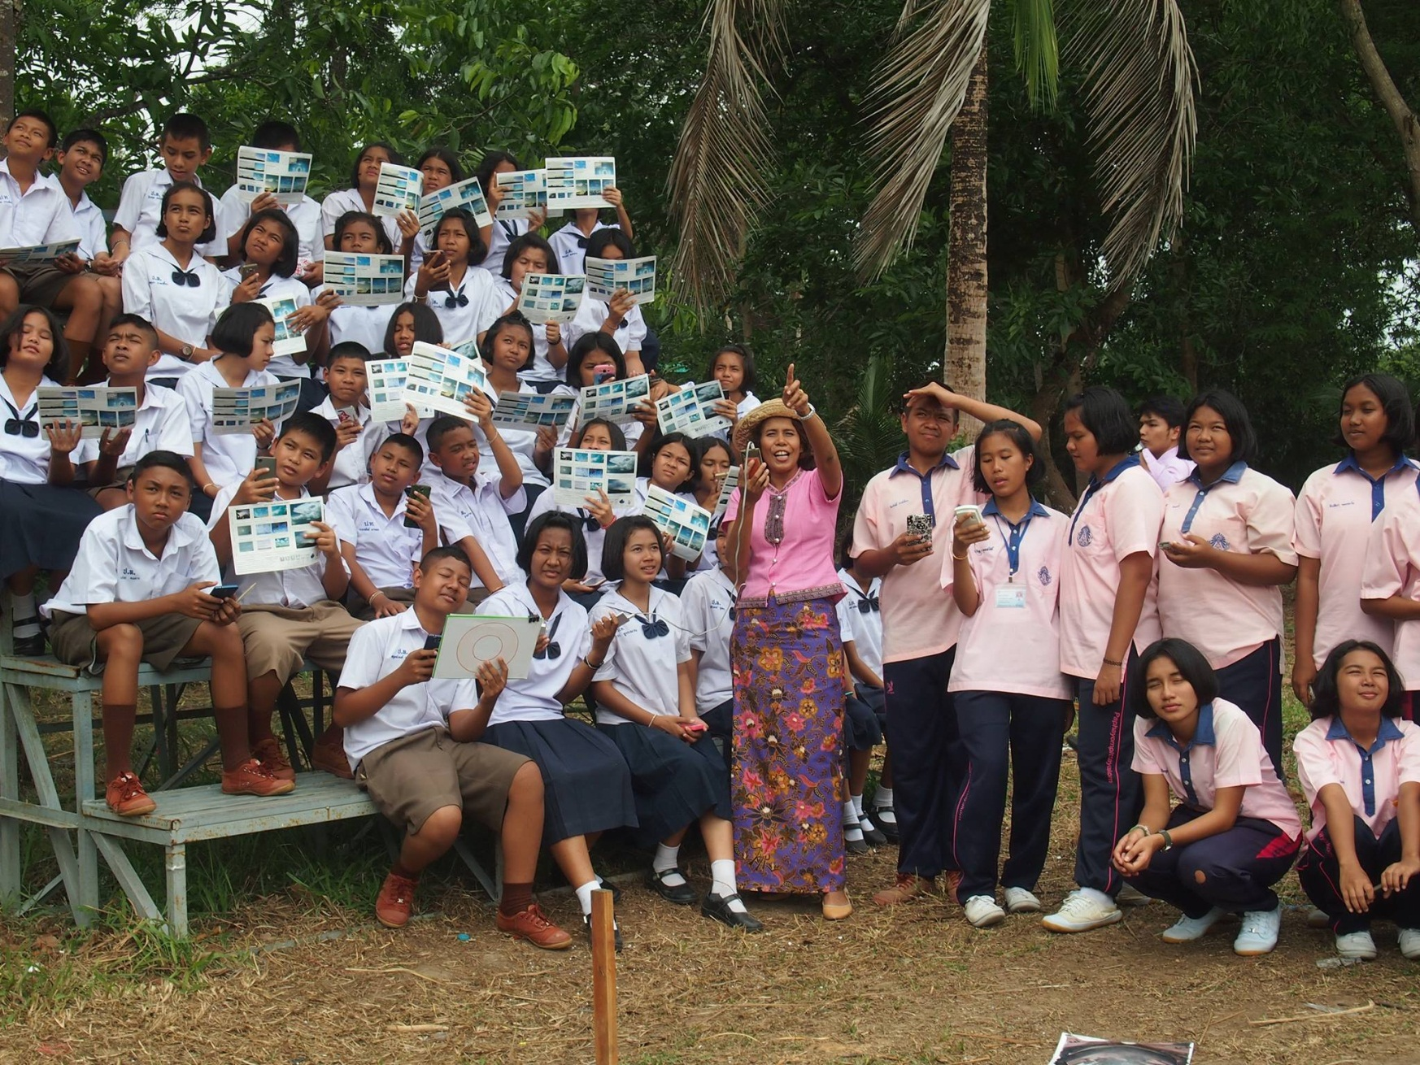
Implemented the ESS class in grade 8

Slide 6
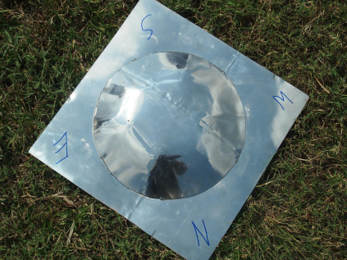
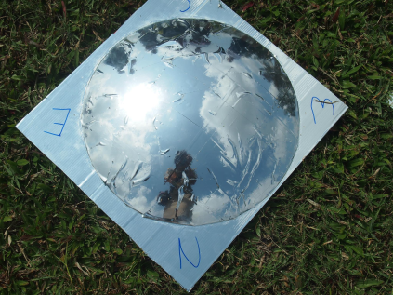
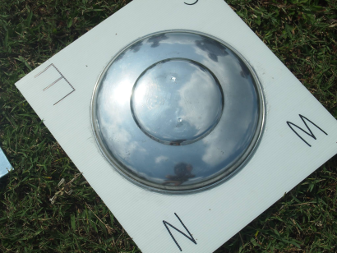
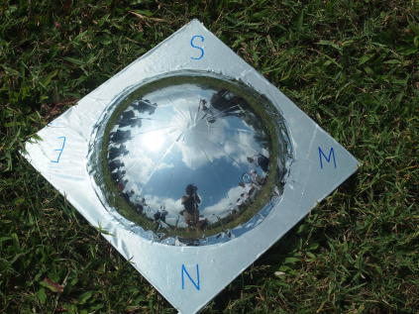
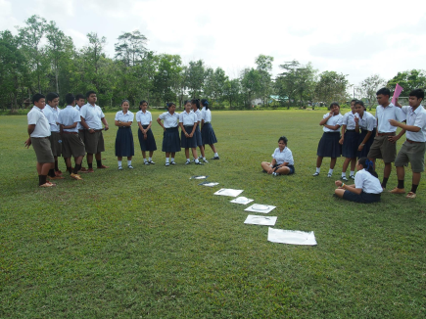
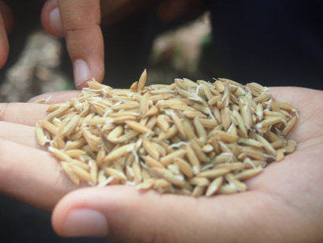
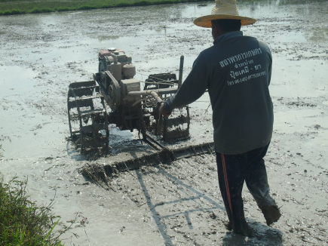
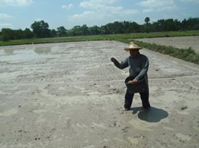
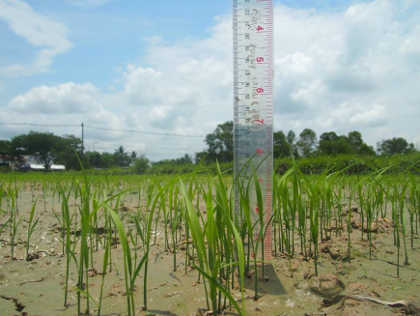
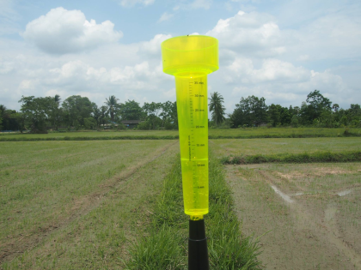
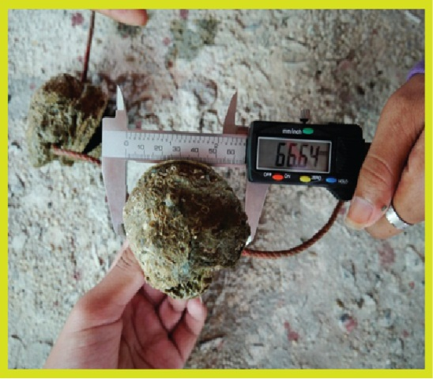
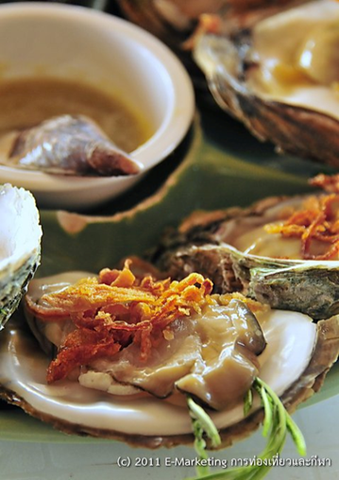
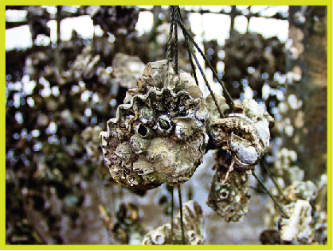
Integrated GLOBE Protocols in Science and Biology as student research projects.

Slide 7
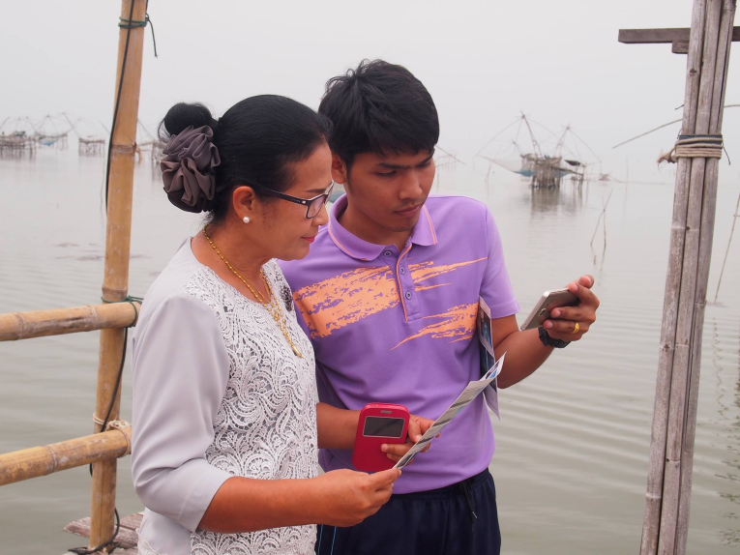
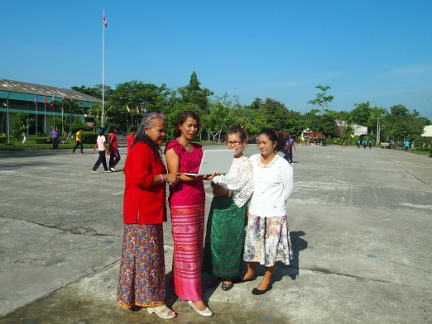
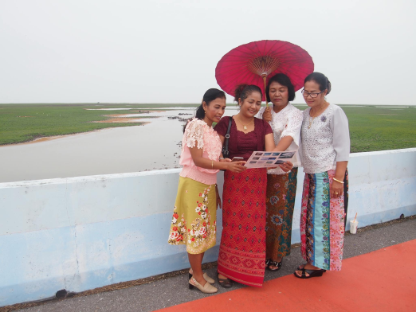
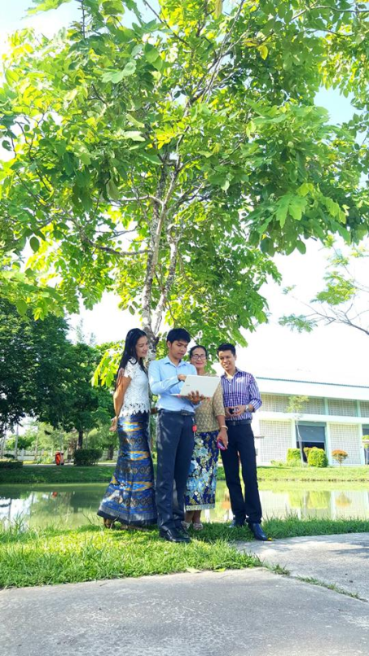
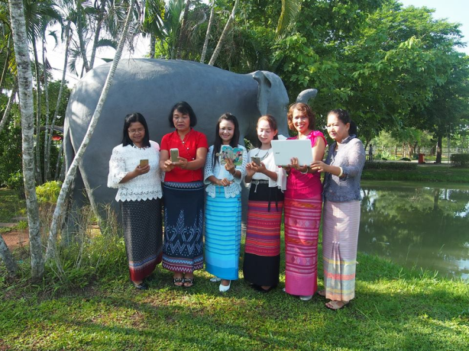
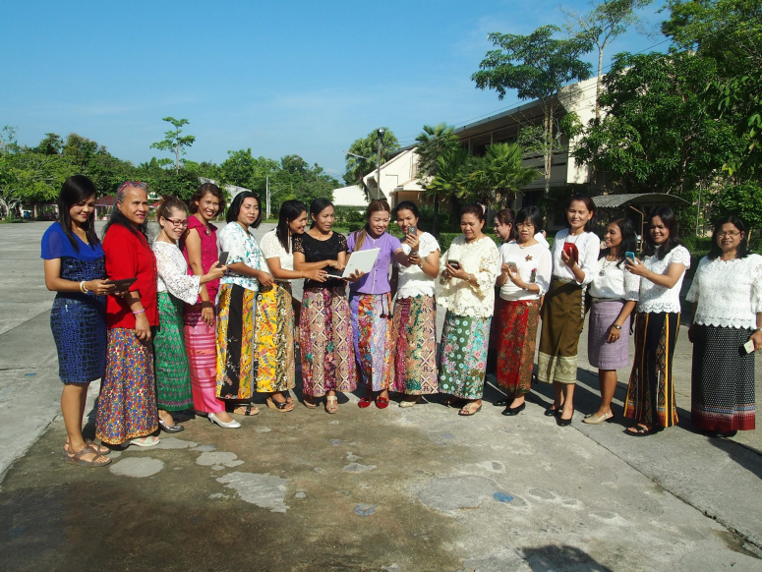
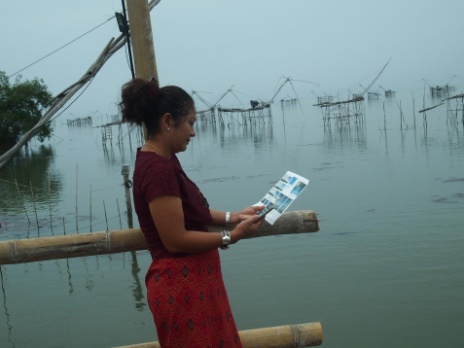
Trained GLOBE Protocols to other teachers in my school.

Slide 8
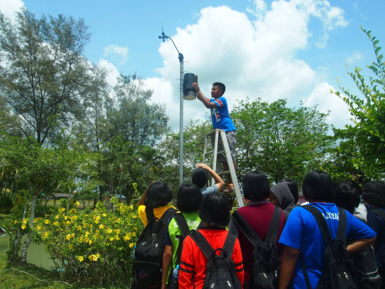
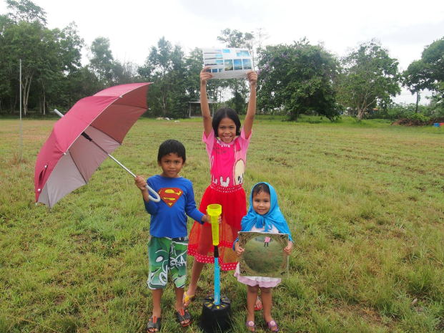
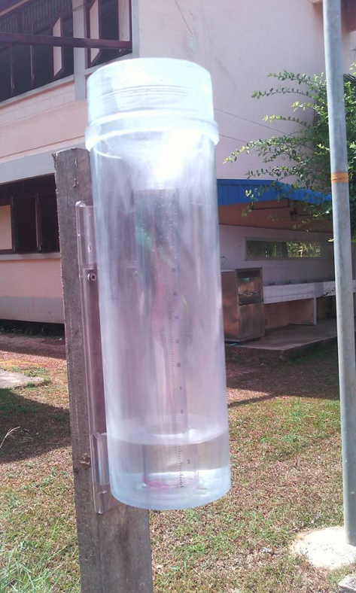
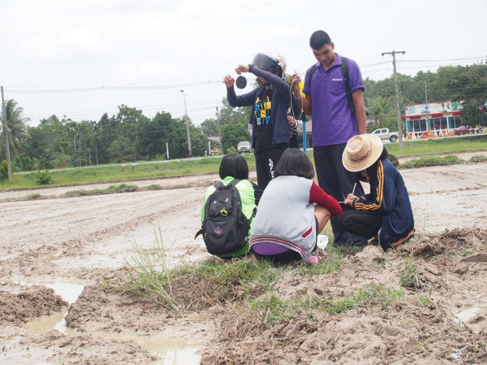
Keep doing researches
We installed an automatic weather station at school
We have the instrument for the field

Slide 9
GLOBE PROTOCOLS
CloudSAT
SMAP
Mosquito
GPM

Slide 10
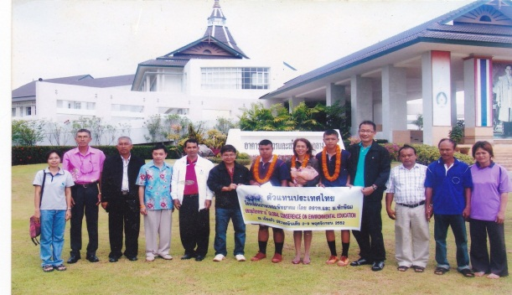
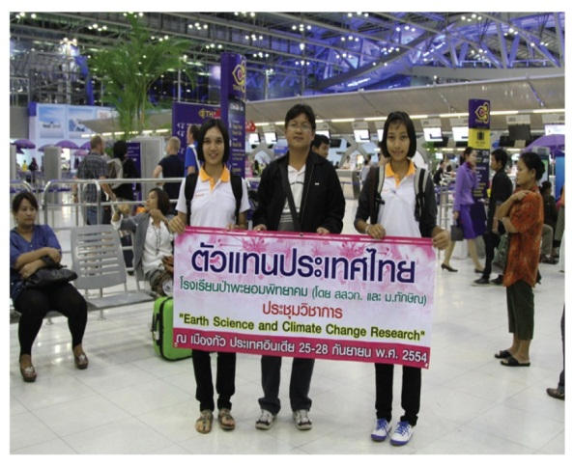
SUCCESS Stories
2009: Comparative Study About Qualities of Soil Between Tropical Rain Forest and Rubber Area at Huay Nam Sai Researvior, Paphayom District, Phatthalung
Presented at 18th Global Conference on Environment Education” in Goa, India
2011: The Effect of burning grass stubble on properties of soil and living things in the soil at Ban Na village, Kotow subdistrict, Paphayom District, Phatthalung
Presented at Earth Science and Climate Change Research in Goa,I ndia

Slide 11
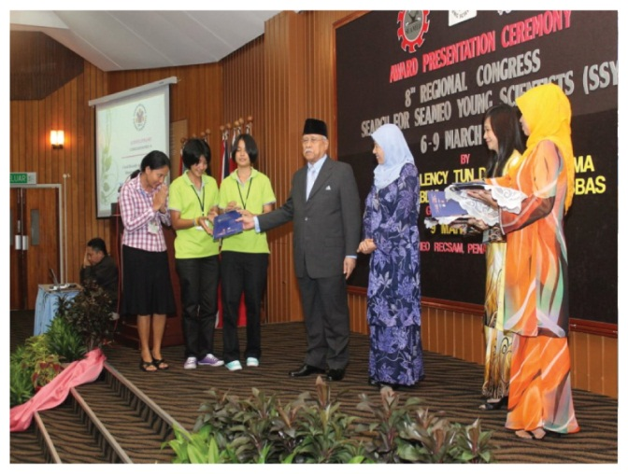
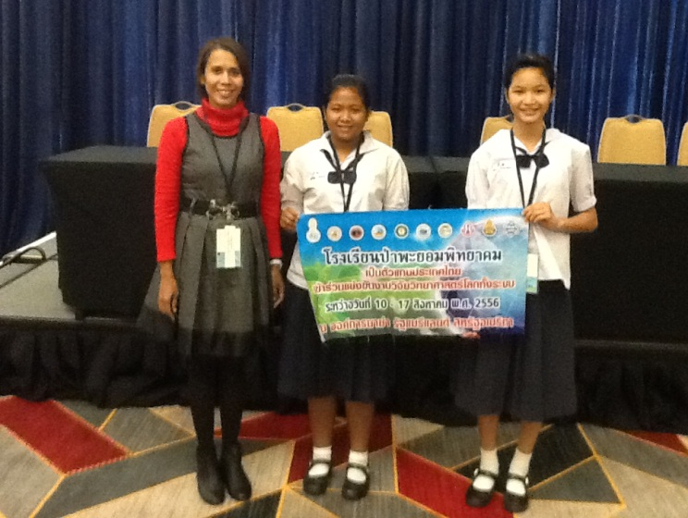
SUCCESS stories
2012: Coral Diversity and Bleaching at Ngai Island and Cheuk Island
Search for SEAMEO Young Scientists
Presented at the 8thRegional Congress
Penung Malaysia, “Consolation Prize base on the theme “Beyond 2012 : Greening the Environment for Sustainable”
2013 : Weather Affecting Amount of Latex Production and Percent Dry
Rubber Content of Rubber Tree
(Hevea brasilliensis Mull. Arg. Var
RRIM 600) in Phatthalung, Thailand.
Presented at the 2nd Annual Student Research Exhibition and 17th Globe Annual Partner Meeting

Slide 12
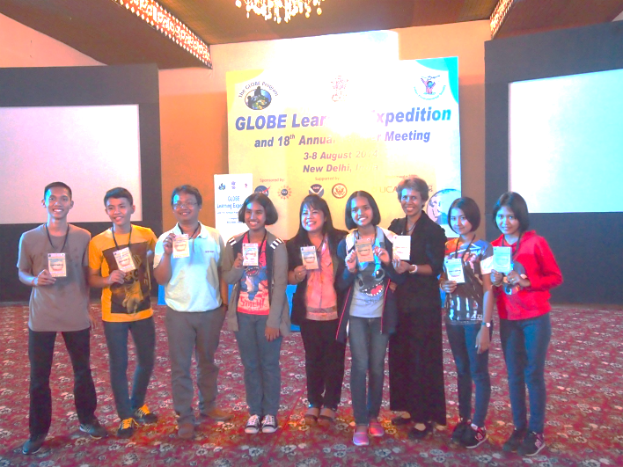
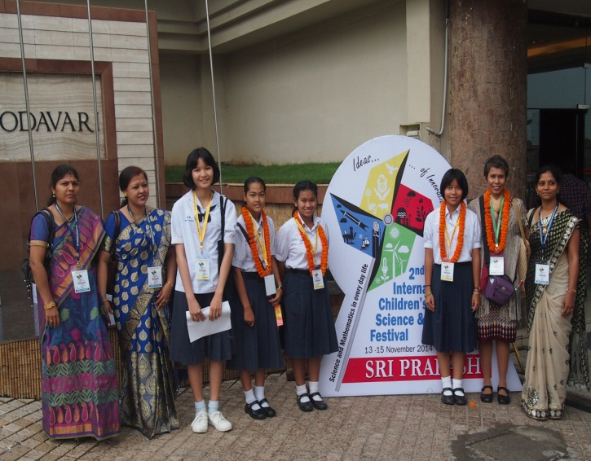
SUCCESS stories
2014: Oyster (Crassostrea belcheri) Growth Rate and water qualities at Bandon Bay. Suratthani, Thailand
Presented at the GLOBE Learning Expedition and 18th Globe Annual Partner Meeting in New Deli, India
2014 : Antibacterial activities of crude extract from various part of Passora foetid Linn. againt Staphyloccus aureus, Paeudomonas aeruginosa and Escherichia coli
Presented at the 2nd International Children’s Science and Mathematics Festival Visakhapatnum, India

Slide 13
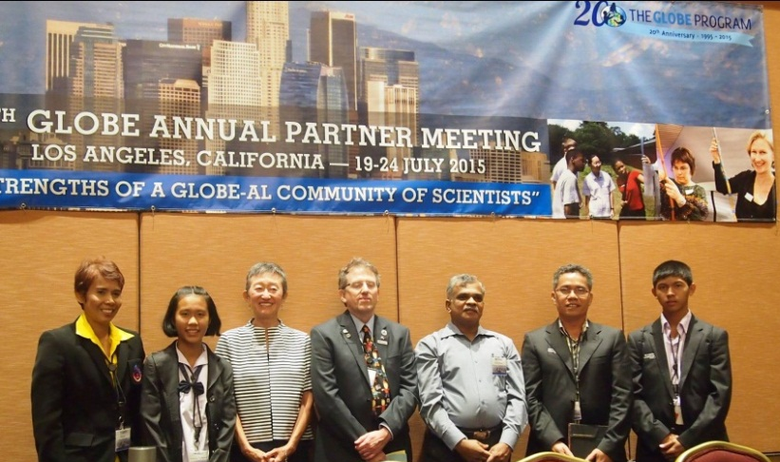
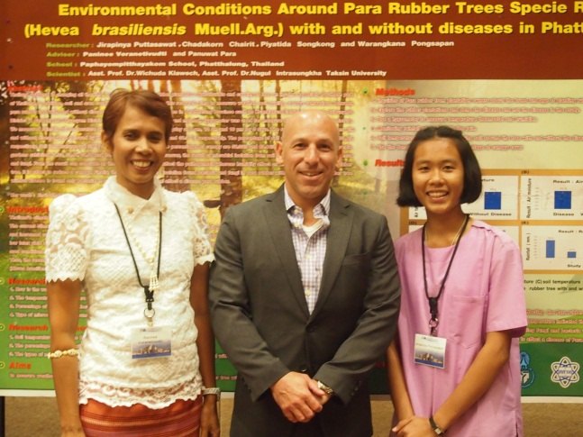
SUCCESS stories
2015: Environment Conditions Around Rubber Tree Specie RRIM 600 (Havea brasiliensis Mull.Arg.) with and without diseases in Phatthalung, Thailand
Presented at the 19th GLOBE Annual Partner Meeting and 20th Anniversary The GLOBE PROGRAM 1995-2015 Los Angeles, California , USA.

Slide 14
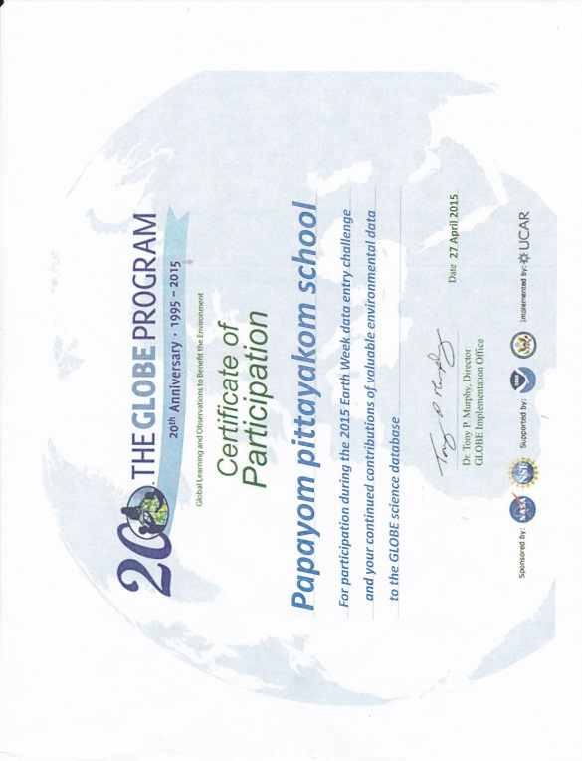
SUCCESS stories

Slide 15
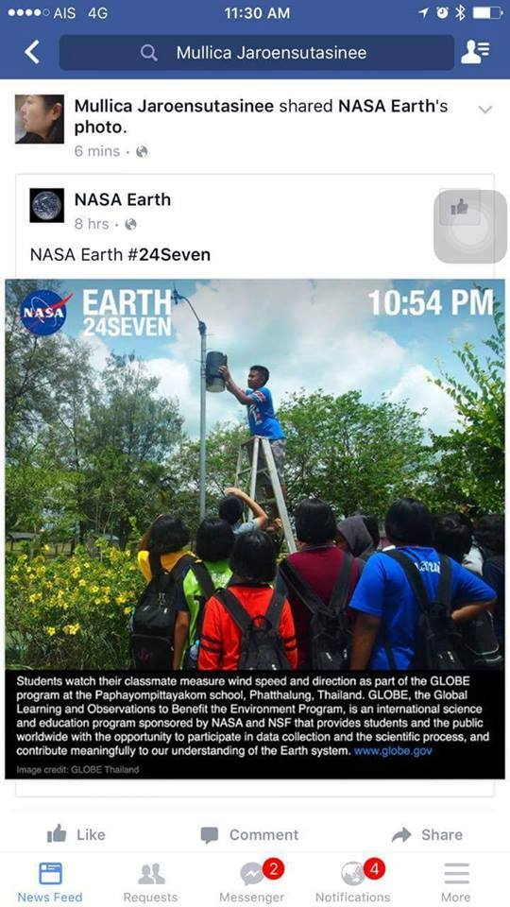
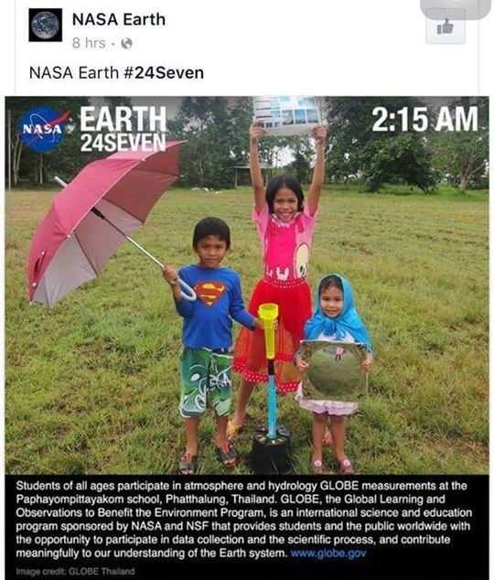
SUCCESS stories

Slide 16
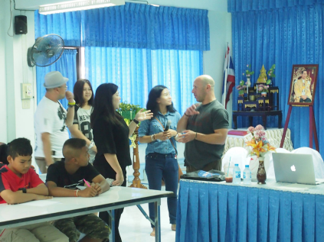
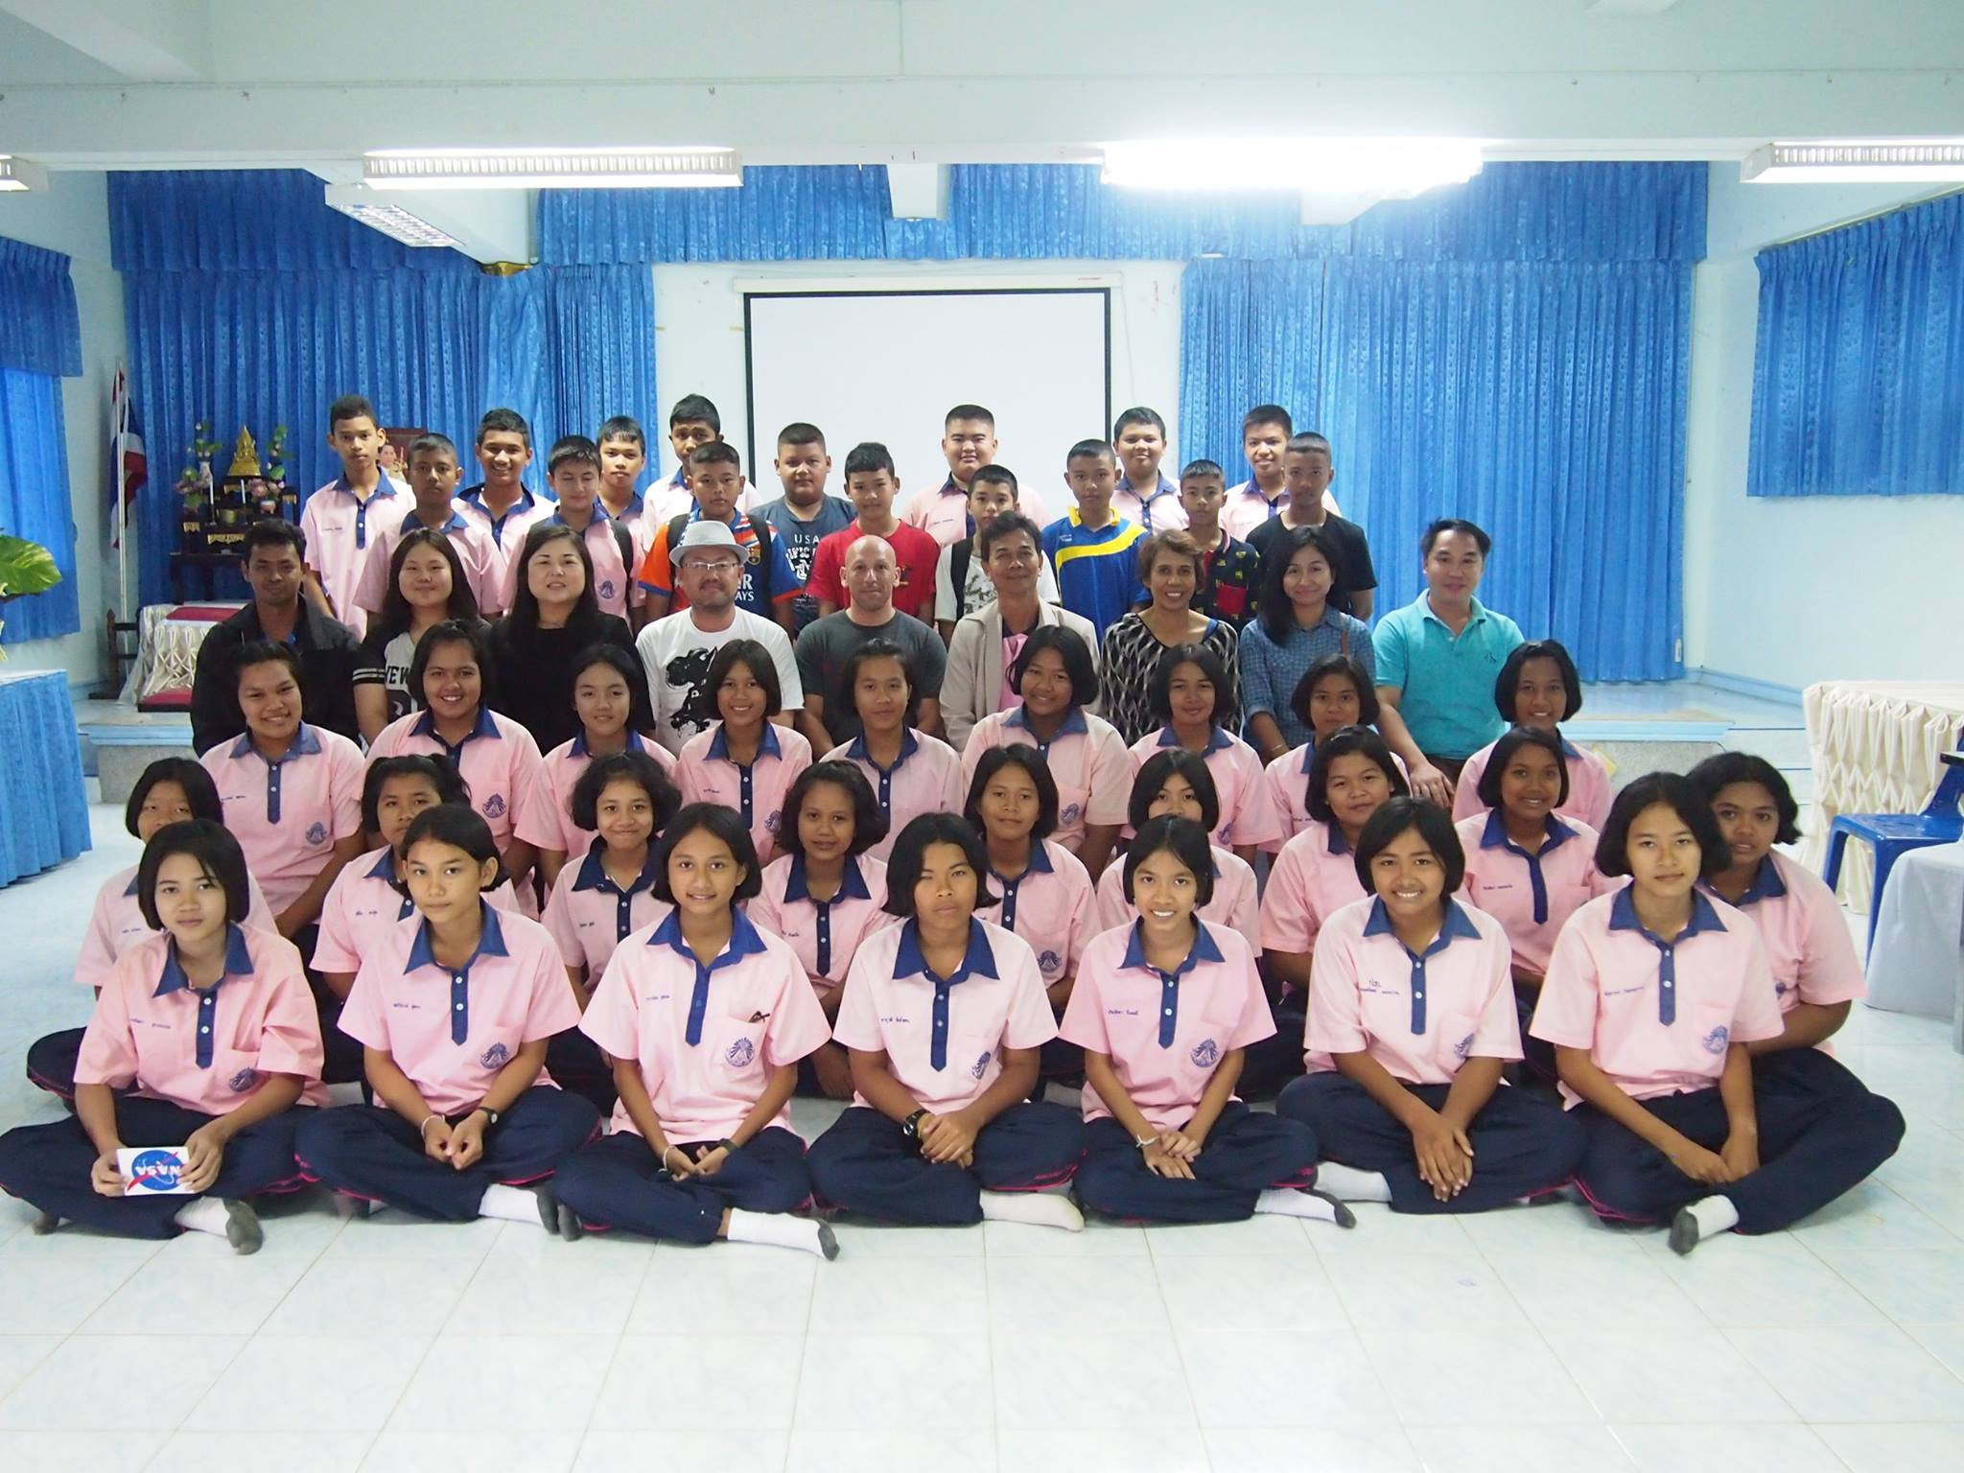
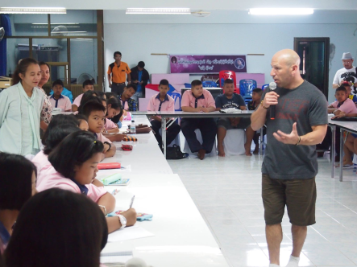
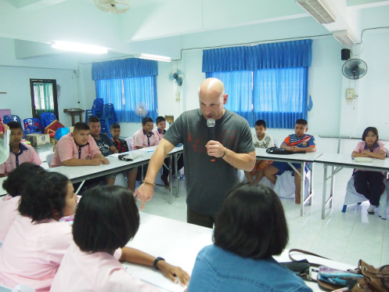
SUCCESS Strories

Slide 17
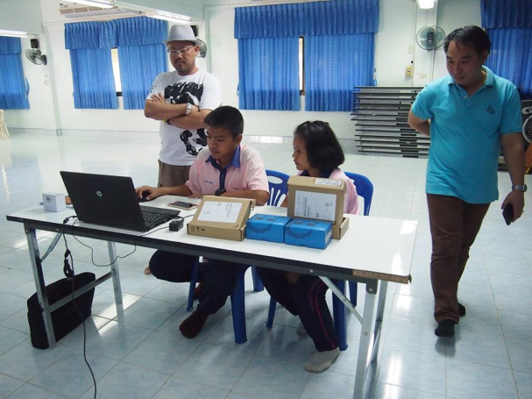
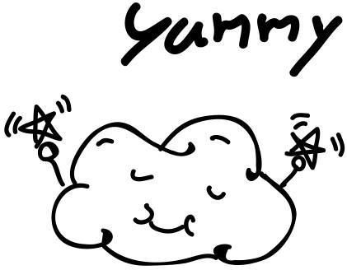
What I am going to do next
GLOBE STEM
GLOBE CARTOON: LINE Stickers

Slide 18
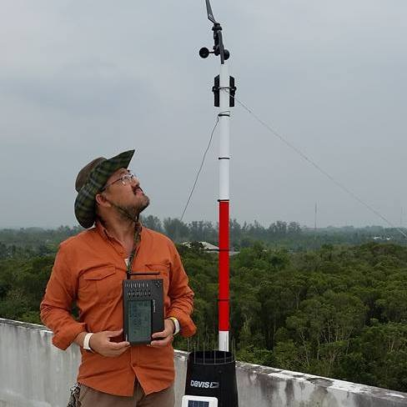
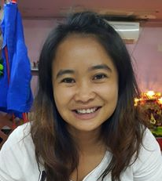
GLOBE Scientists
Prof. Dr. Krisanadej Jaroensutasinee
Prof. Dr.Mullica Jaroensutasinee
Nantida Sutummawong
Asist. Dr.Wichuda Klawech

Slide 19
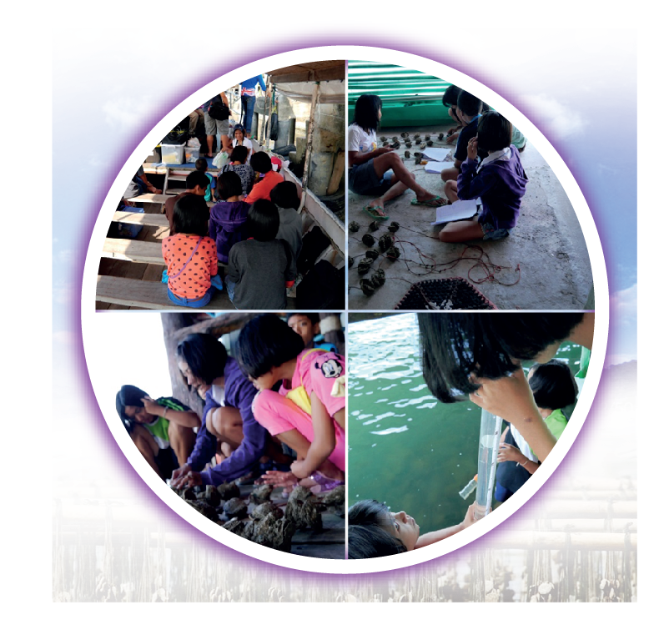
THANK YOU

