Slide 1
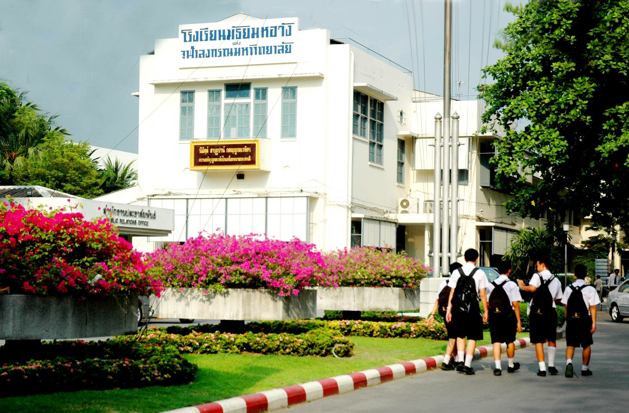
TriamUdomSuksa School, Bangkok ,Thailand
By : Thip-arpa Srivarangkul

Slide 2
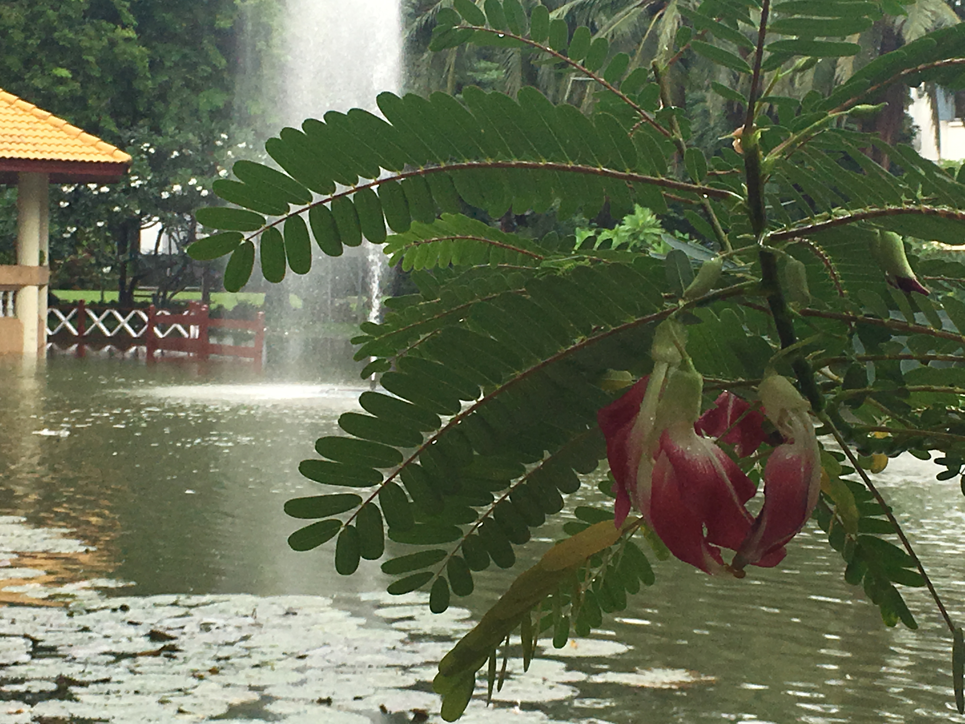
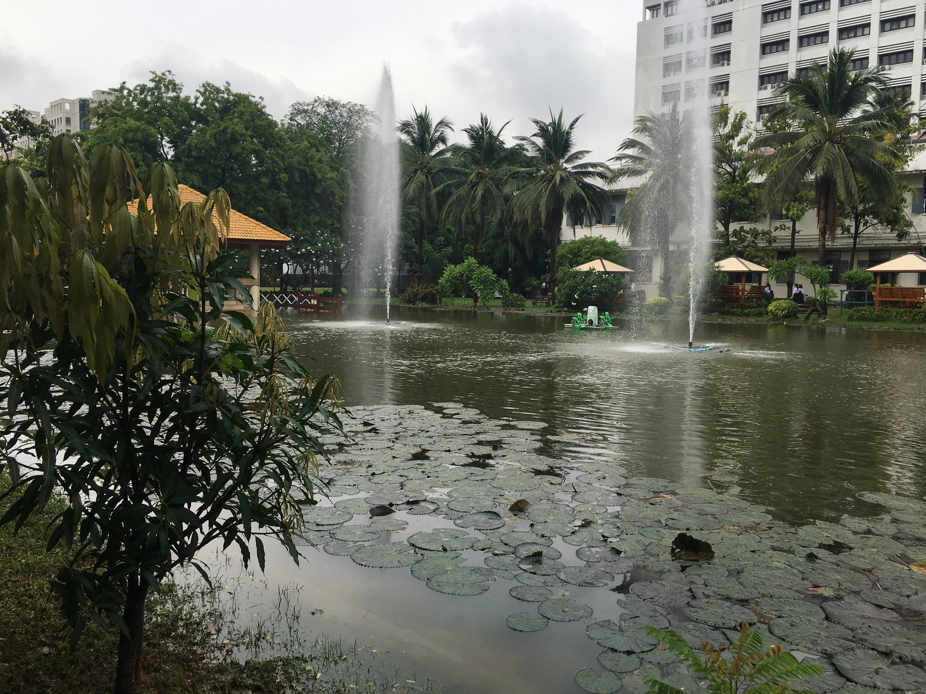
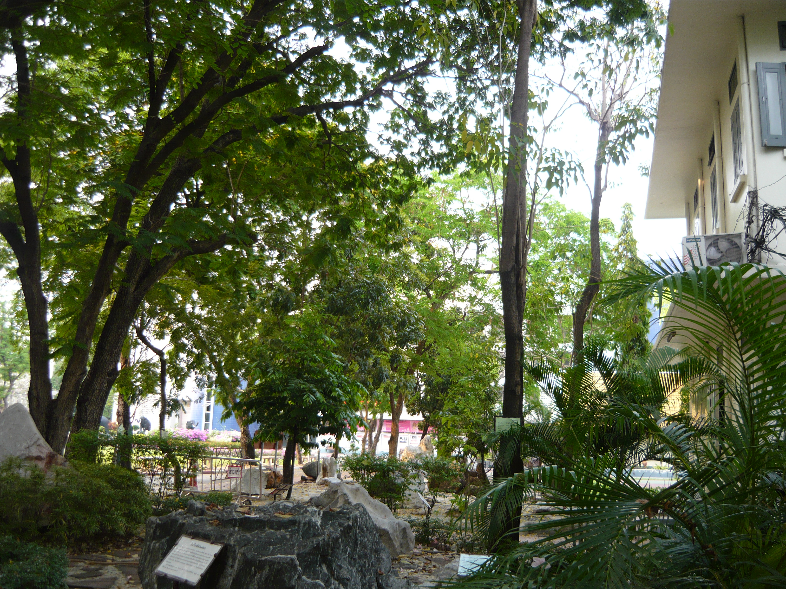
Our School is pretty and has plenty of space for student
to explore the environment.

Slide 3
Globe in Triam Udom is implemented in the selective class. Students who are interested in our environment will be able to involved in various environmental research which utilize many GLOBE protocols.
Implementation

Slide 4
Our Logo
Earth System Science

Slide 5
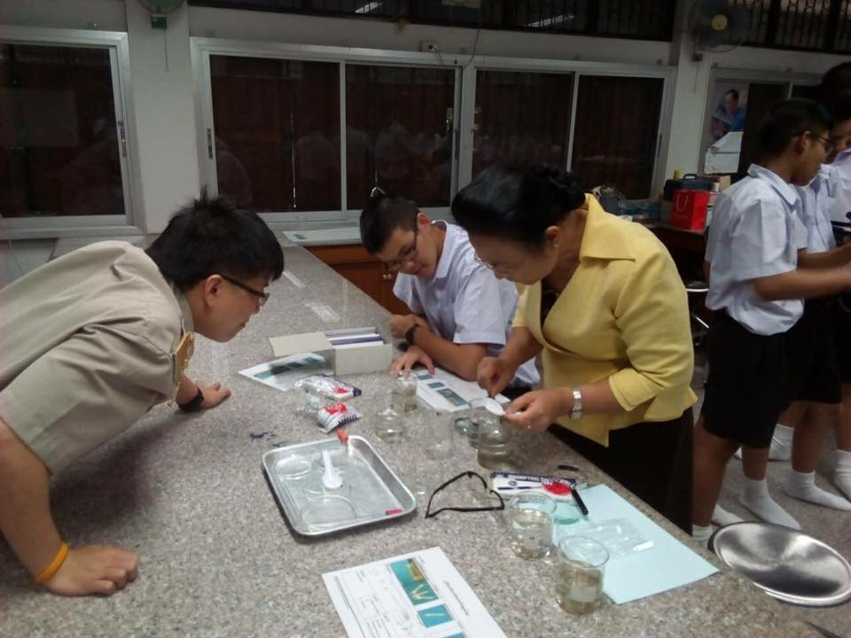
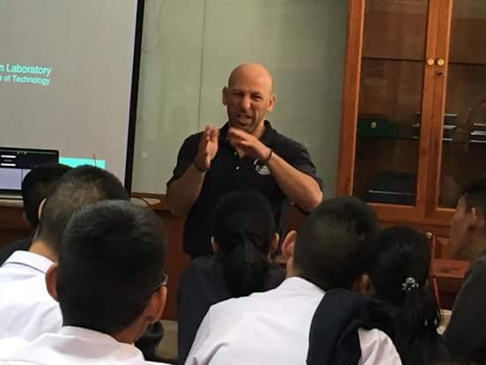
How do our students learn?
We provide students with basic understanding
of the environment as well as how to do it.
We often invite college professors and speakers
to educate our students.

Slide 6
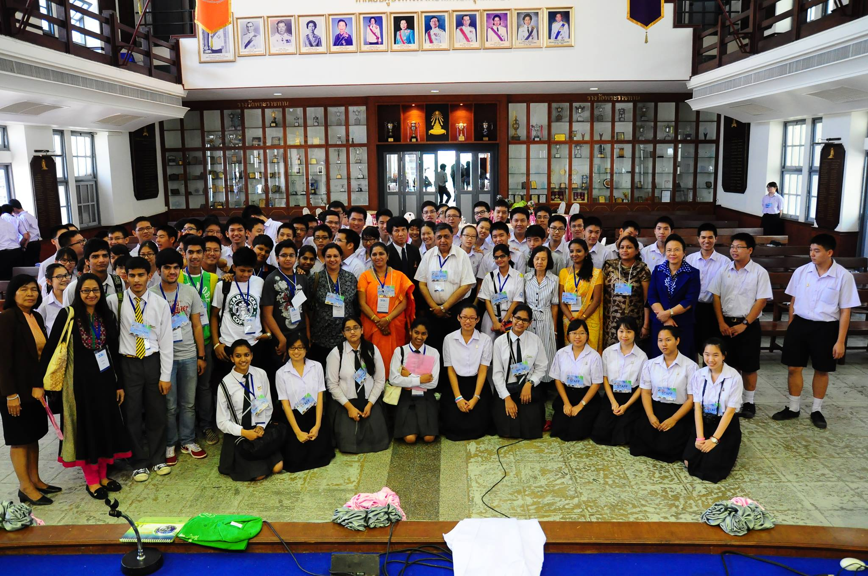
On many occasions, we take our students to GLOBE training programs.

Slide 7
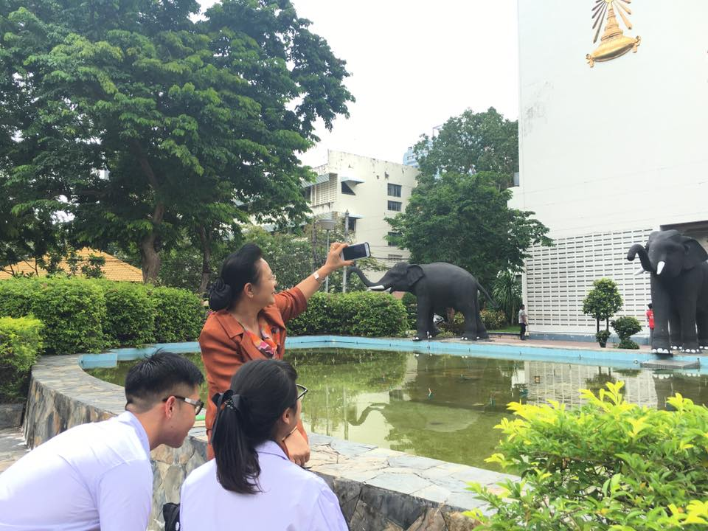
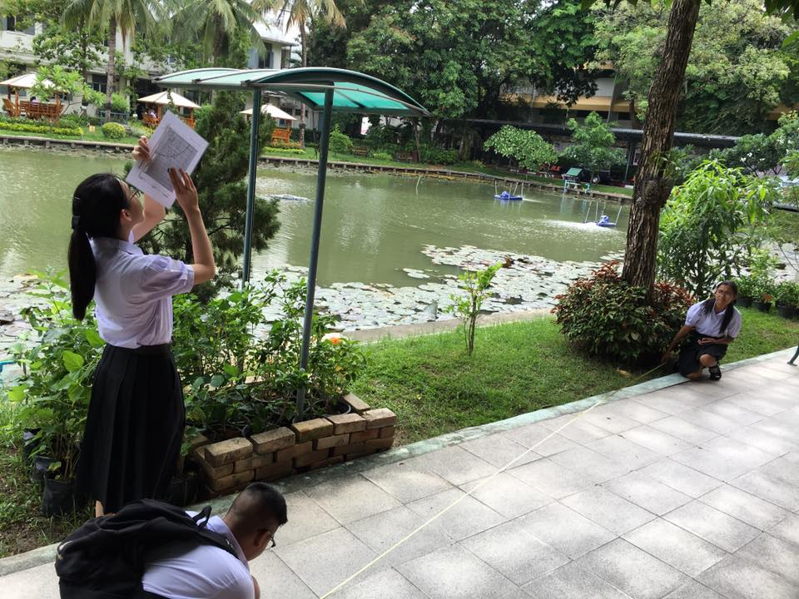
Go out and Do it !
Student use GLOBE protocol to observe clouds and Land Cover in the school.

Slide 8
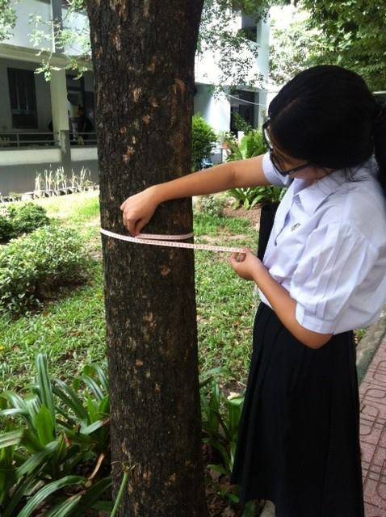
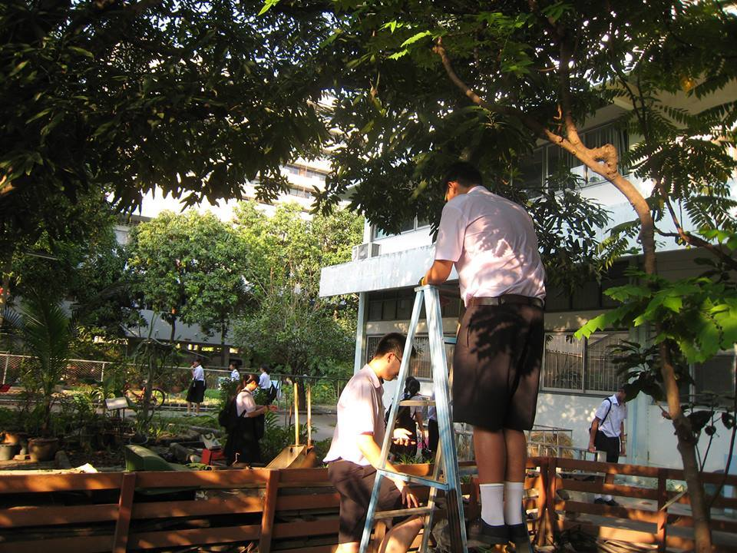
Go out and Do it !
Students learn to use GLOBE protocols to observe trees. (Right : Phenology, Left : Circumference)

Slide 9
Then we put students to work on various research
And We have participated in many GLOBE events both local and international
To show our work and make sure we are doing in the right track

Slide 10
There are mainly two area that we are interested in.

Slide 11
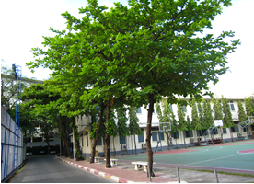
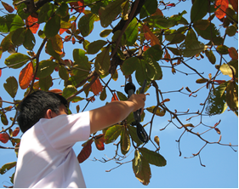
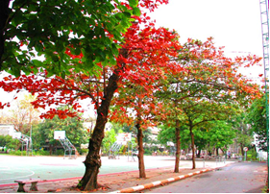
1
“Study of Relationship Between
the Bud Burst of Pterocarpus Indicus and
the Change of Weather Conditions in Triam Udon Suksa School ”

Slide 12
1
“Study of Relationship Between
the Bud Burst of Pterocarpus Indicus and
the Change of Weather Conditions in Triam Udon Suksa School ”
This research was funded by Institute for the Promotion of Teaching Science and Technology
So far as we have been doing this,
we find that the hotter temperature has caused the early Bud Burst

Slide 13
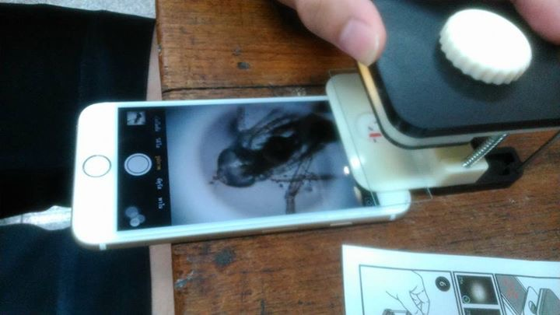
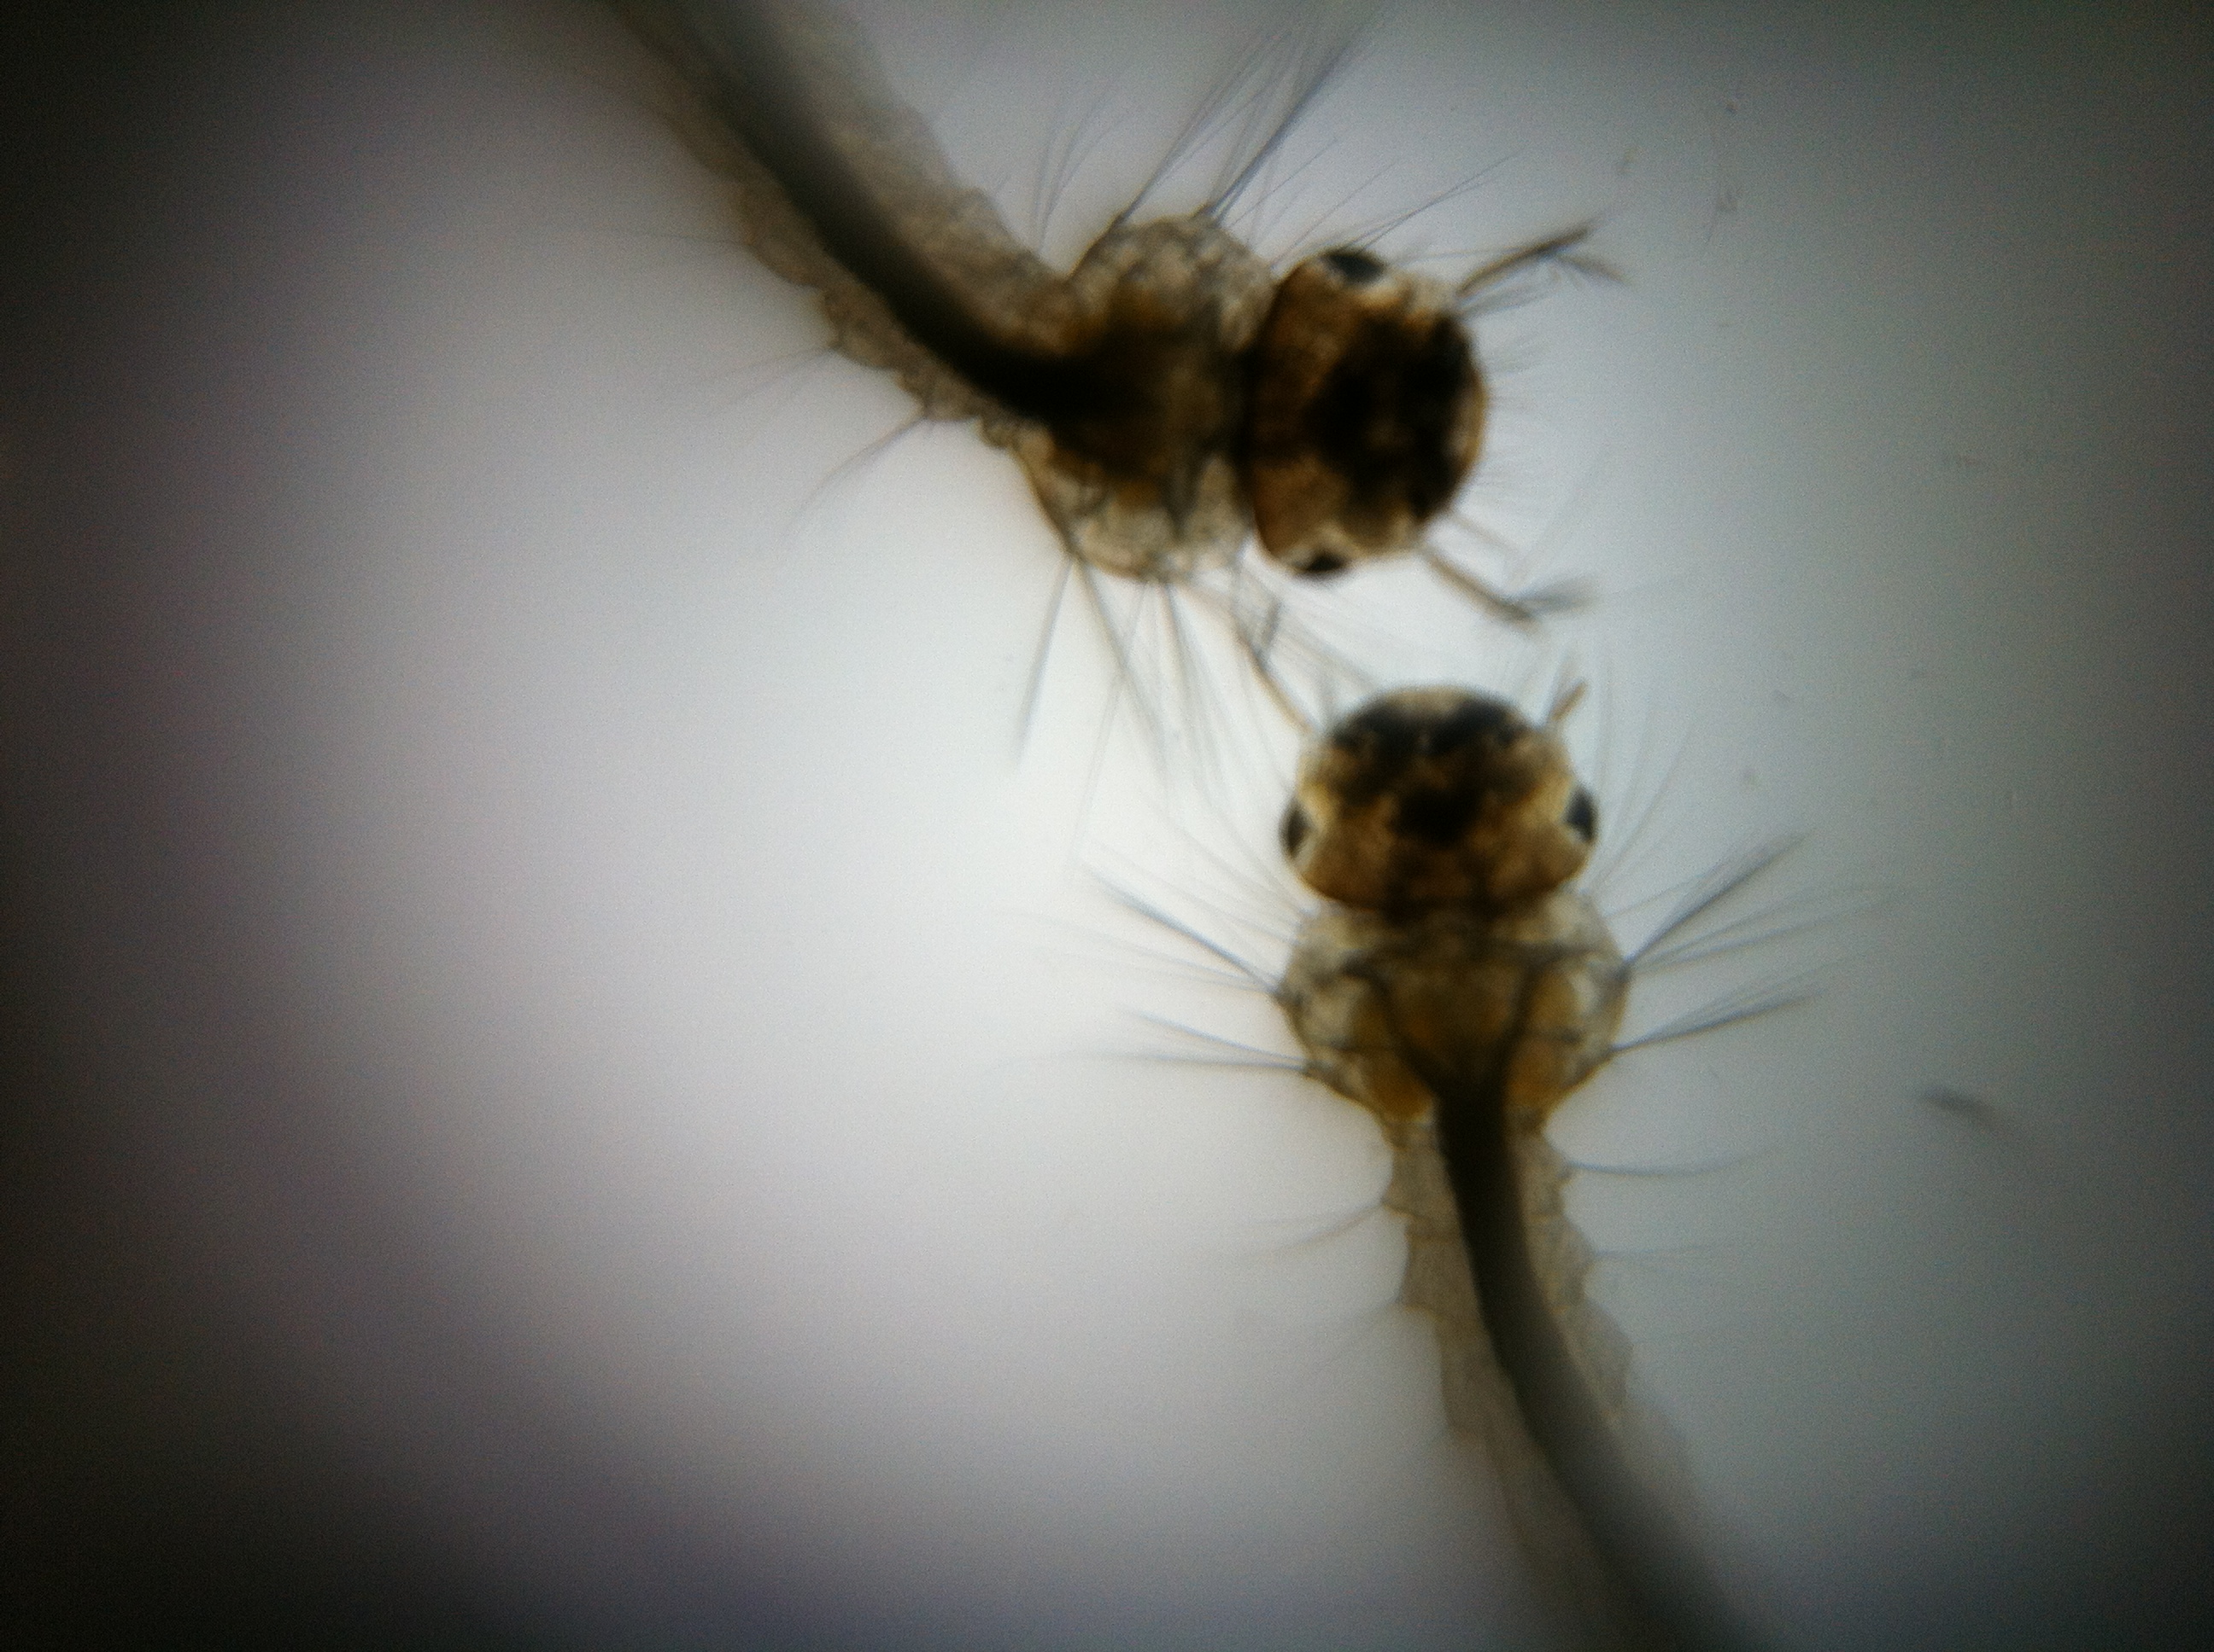
2
“Study of Relationship Between the Yellow Fever Mosquito Breeding Sites,
Change of Weather Conditions and
Number of Dangue Larva in Triam Udom Suksa School”
Note : We even went down to how many students have been infected
To see the direct affect to human health.

Slide 14
2
“Study of Relationship Between the Yellow Fever Mosquito Breeding Sites,
Change of Weather Conditions and
Number of Dangue Larva in Triam Udom Suksa School”
Note : We even went down to how many students have been infected
To see the direct affect to human health.
This research was funded by Institute for the Promotion of Teaching Science and Technology
So far as we have been doing this,
we find that the climate change lately has caused
The increasing number of larva and thus the number of infected students.

Slide 15
After all we have done, we have been trying to spread
what we have learned to create awareness of Global Warming

Slide 16
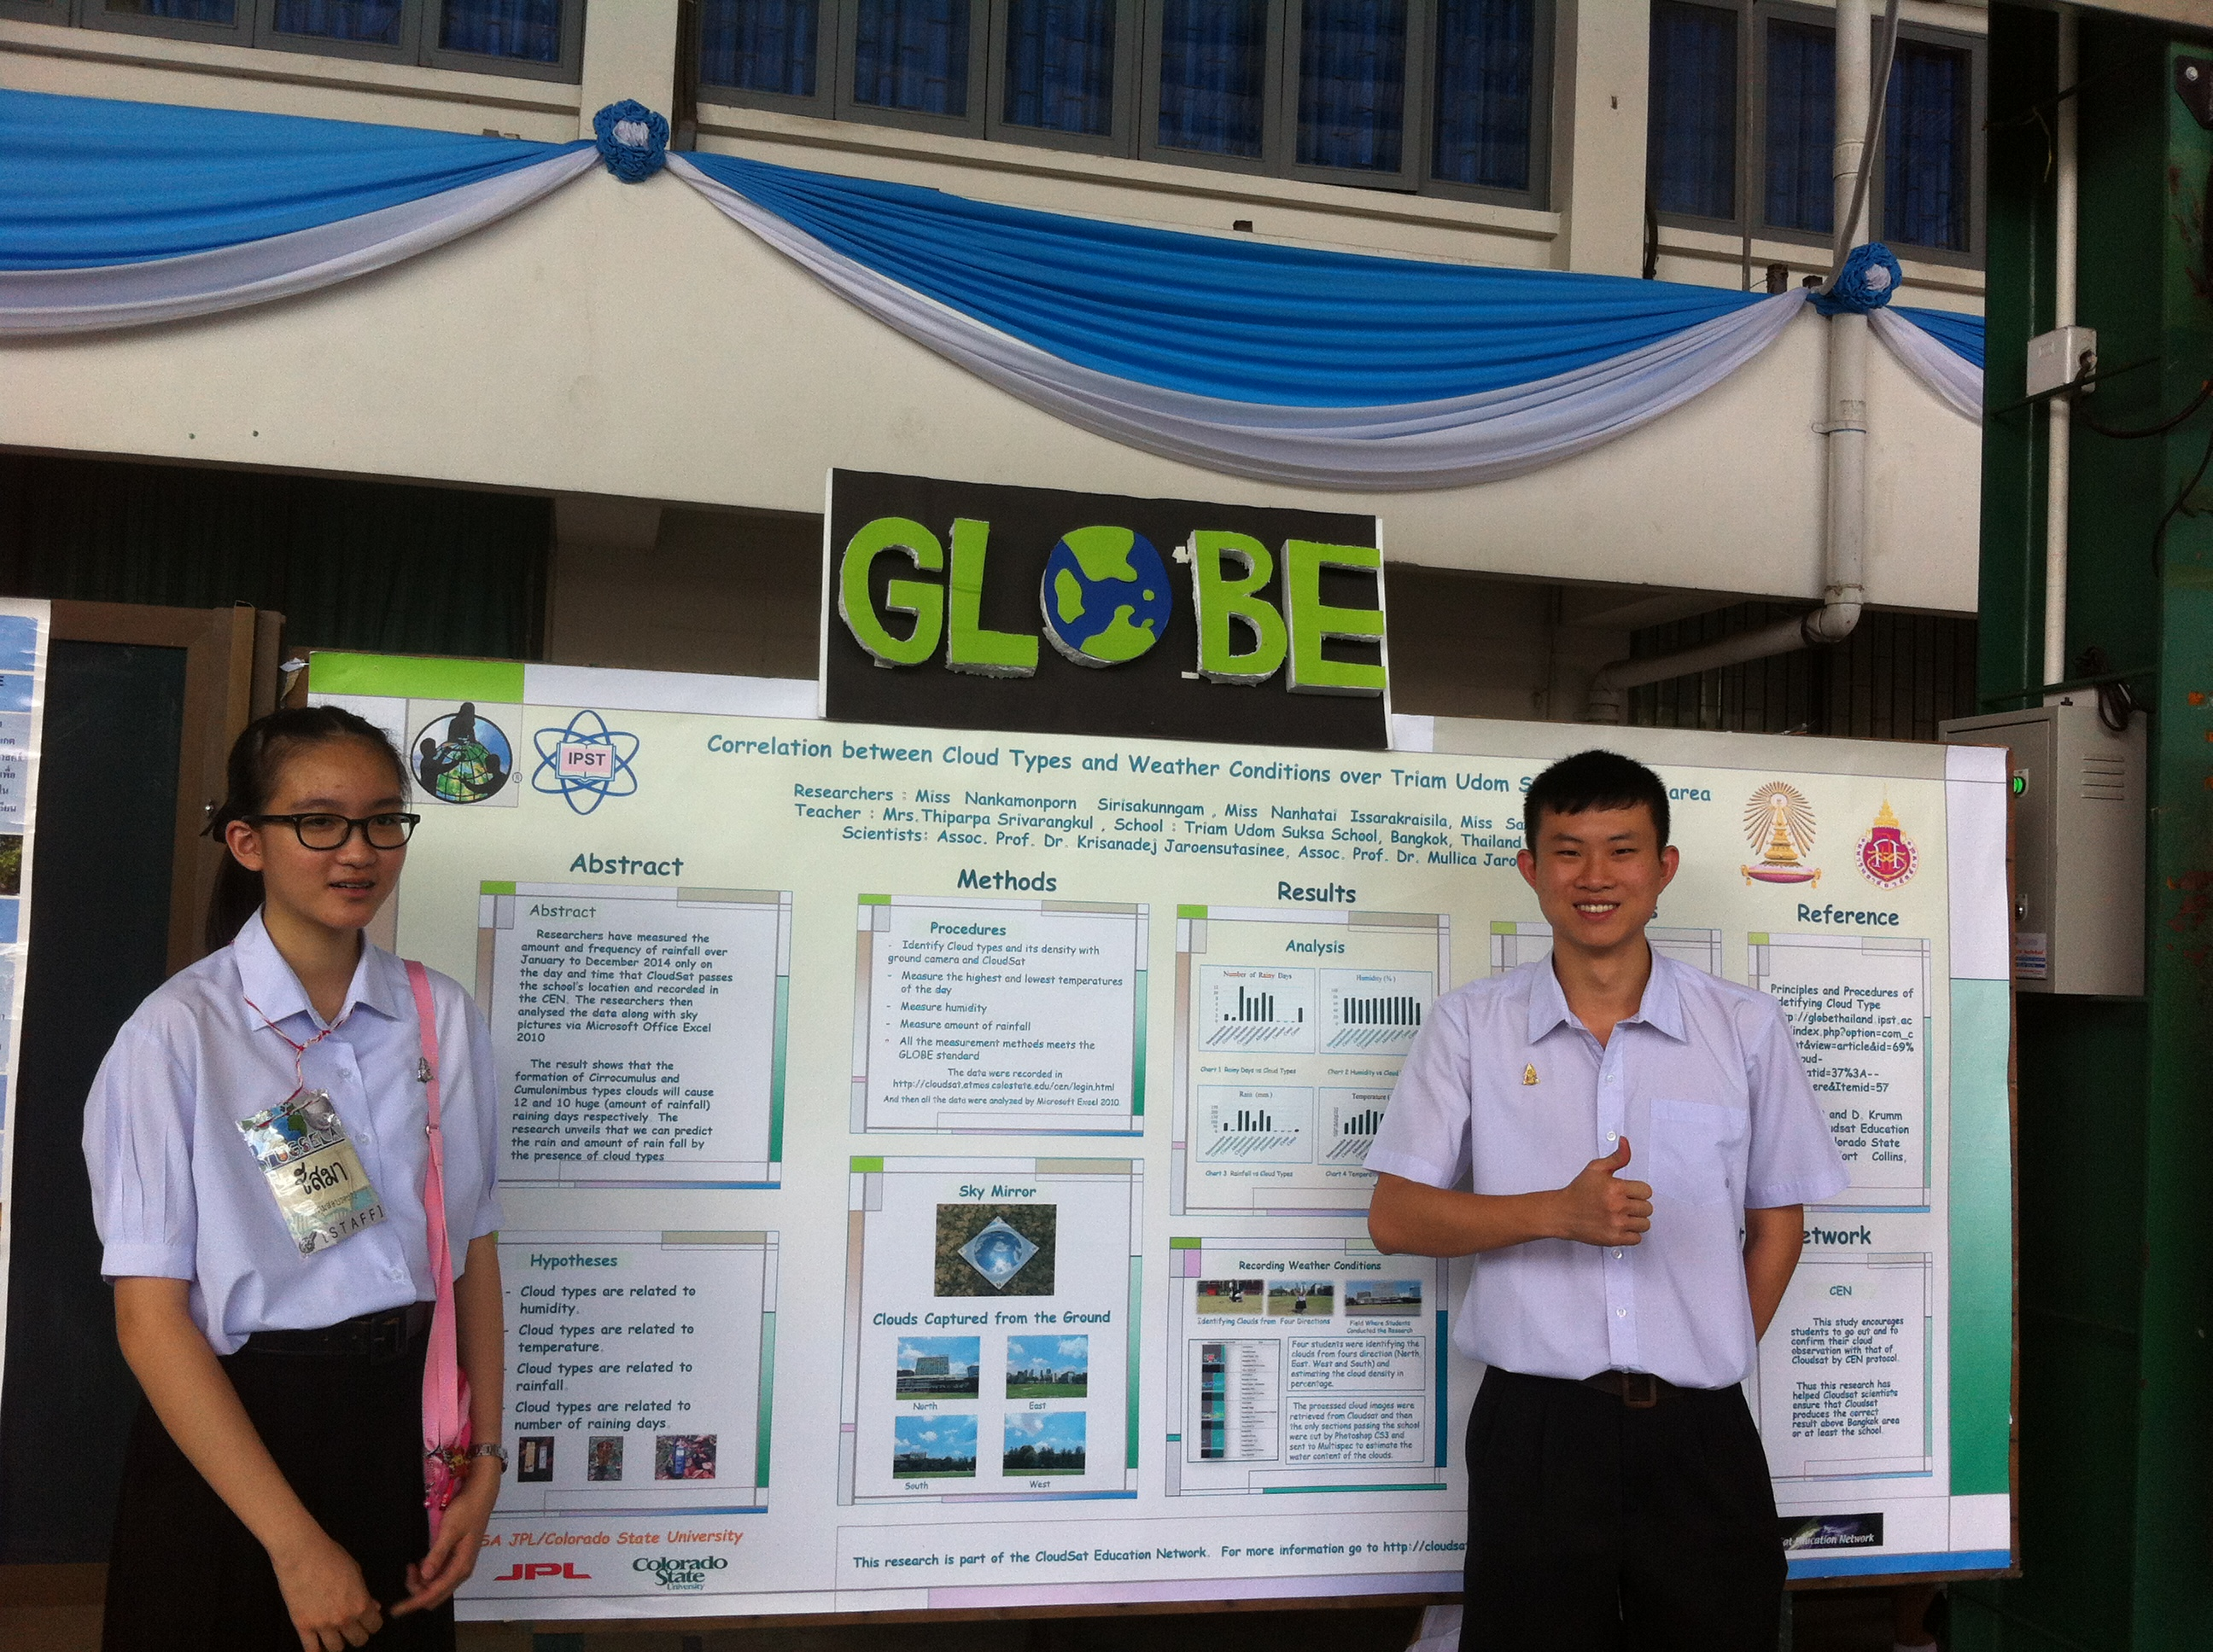
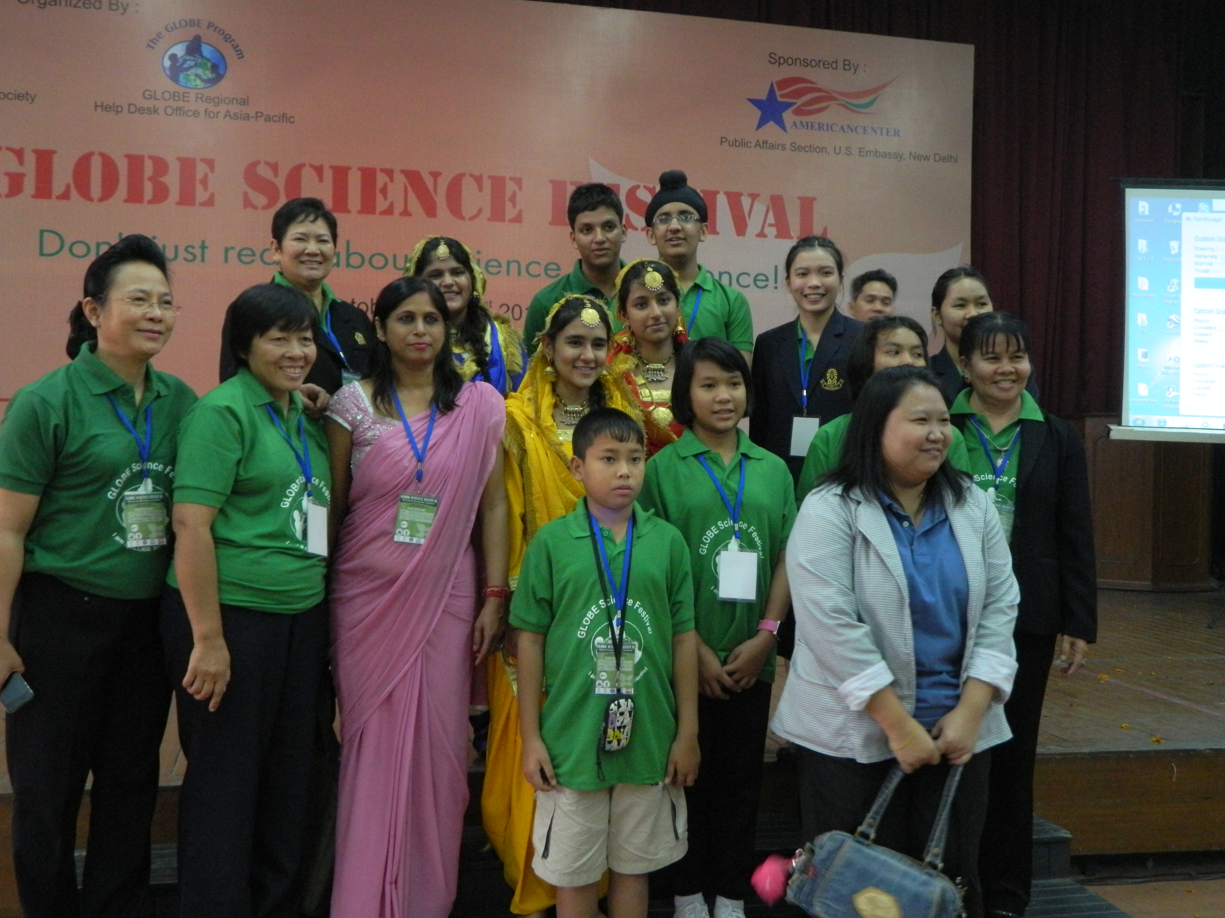
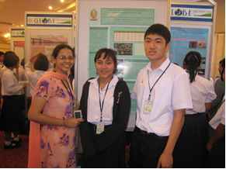
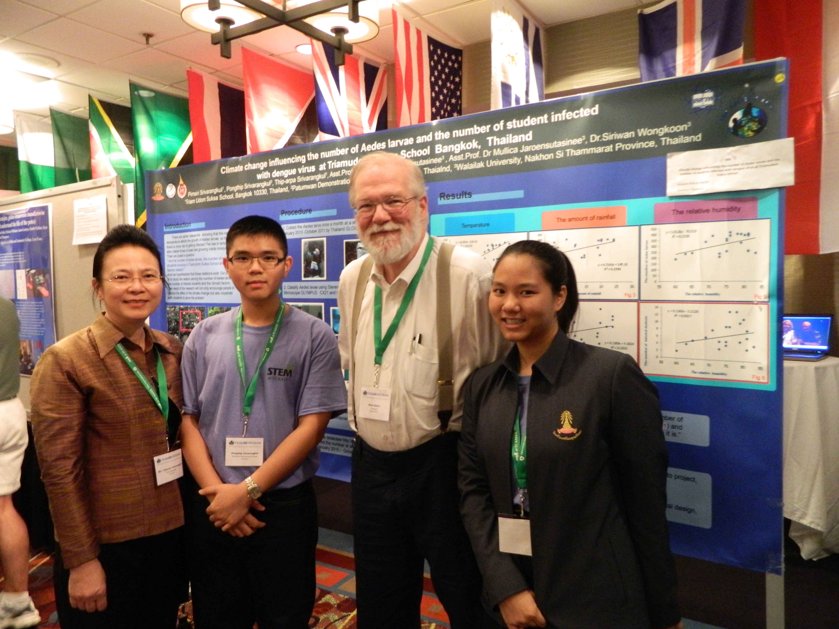
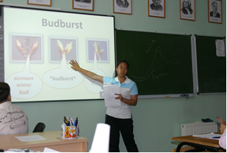
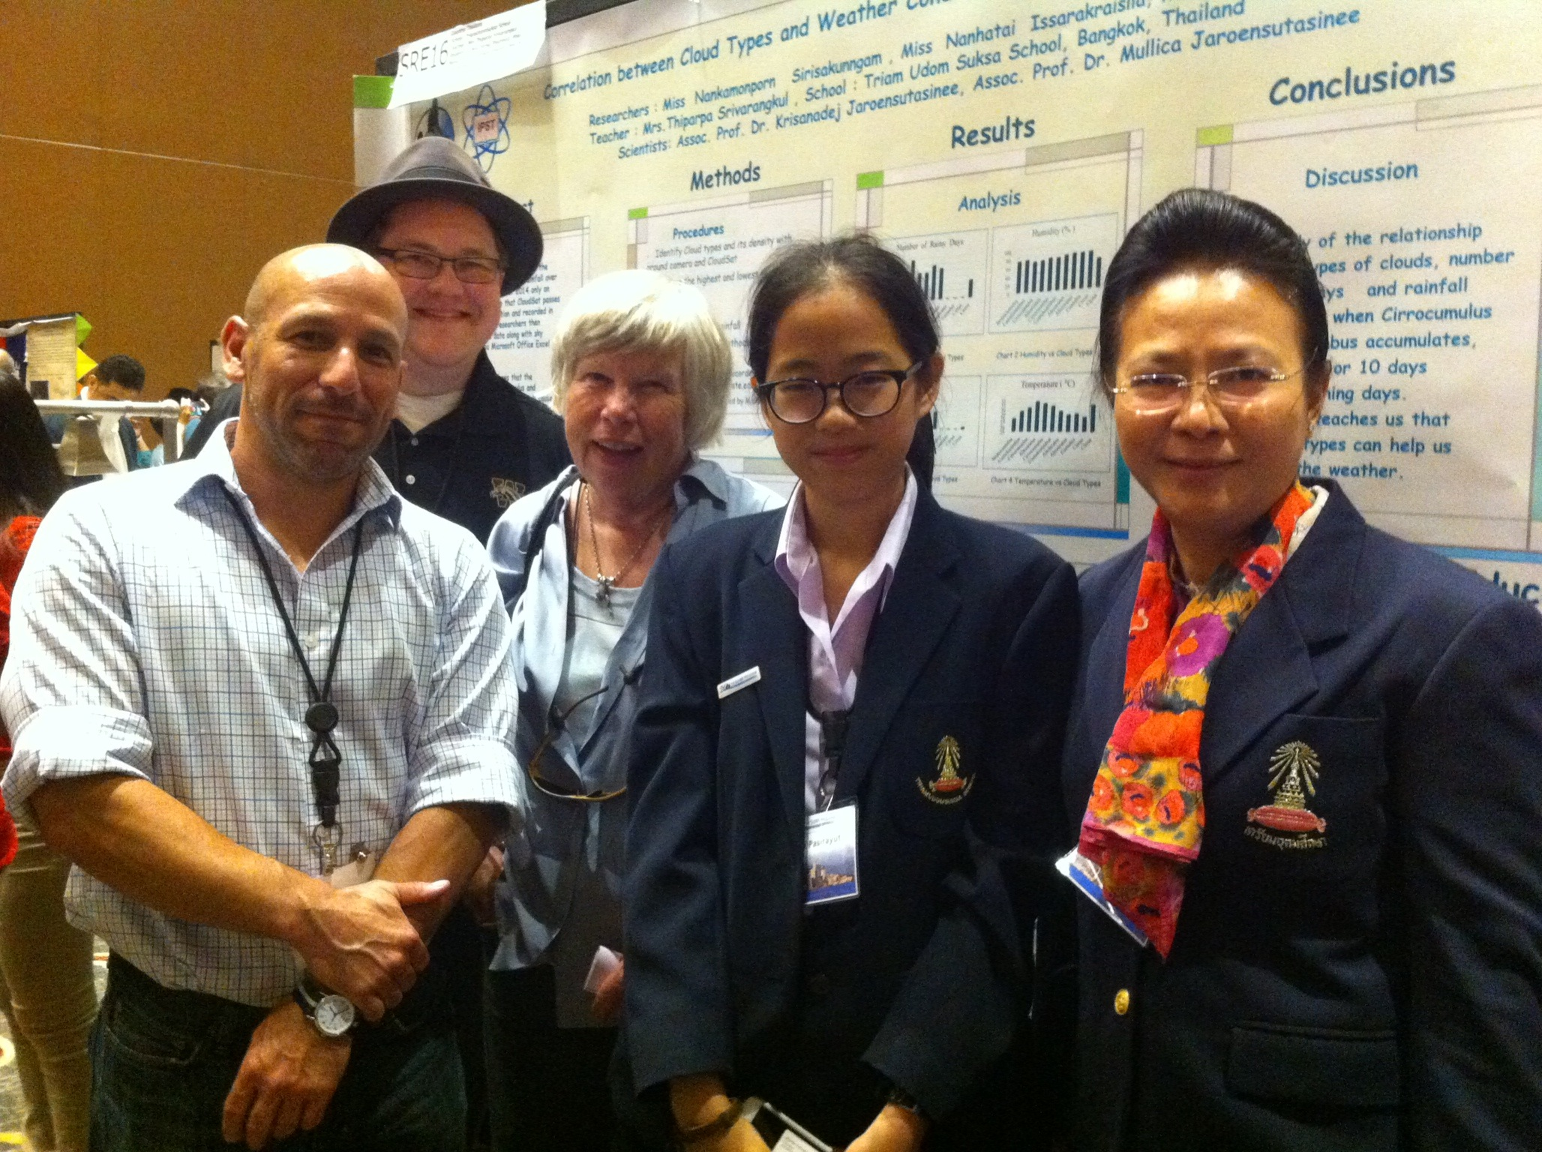
National Science Day
School Activity
Goa, India
Goa, India
Minesota, USA
Vladivostok, Russia
California, USA

Slide 17
Q & A

