Slide 1
The GLOBE International STEM Network (GISN)
Team Presentation
Kristin Wegner
Amy Barfield
Dr. Peder Nelson
Dr. Julie Malmberg
July 19, 2016

Slide 2
Introductions
What is your experience with the GISN?

Slide 3
GISN Updates
Now STEM Network (rather than Scientists’ Network)
279 members (as of 13 July 2016)
Wide participation in GLOBE community efforts
International Virtual Science Fair
Field Campaigns

Slide 4
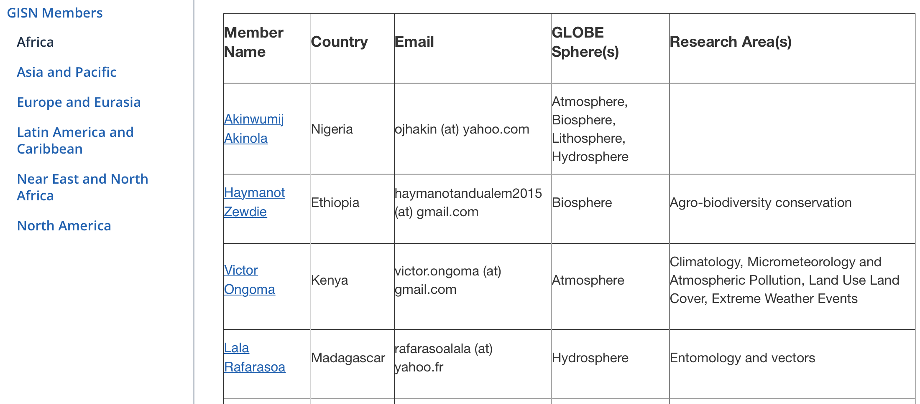
Connect directly to GISN

Slide 5
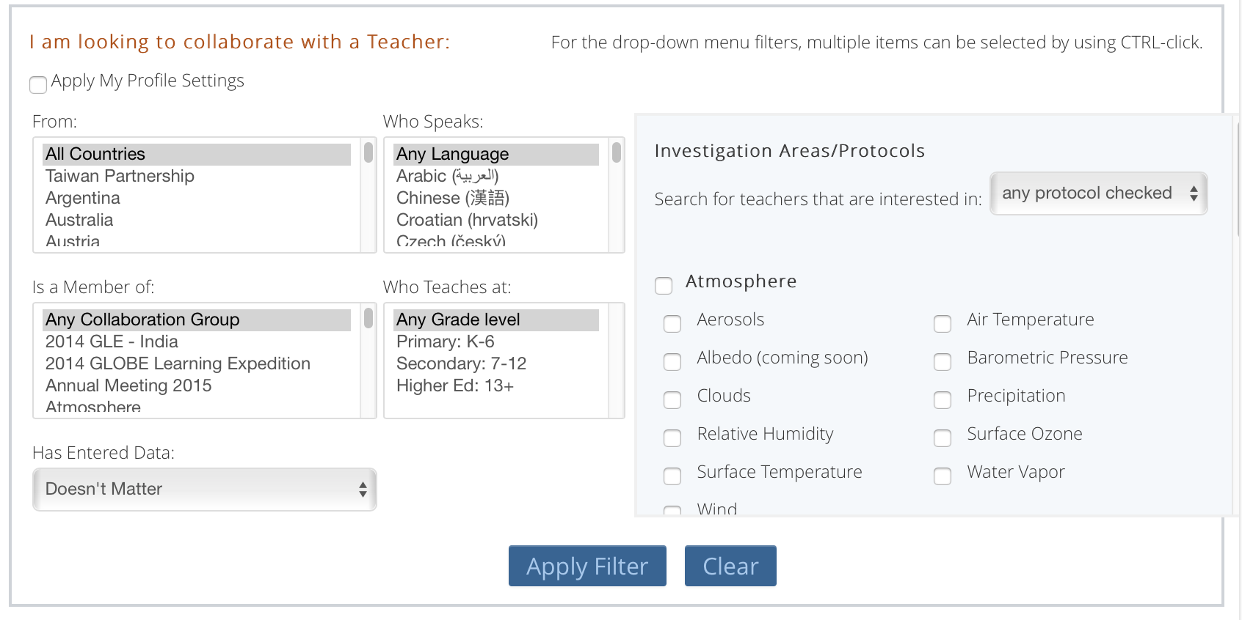
Project Collaborator Tool

Slide 6
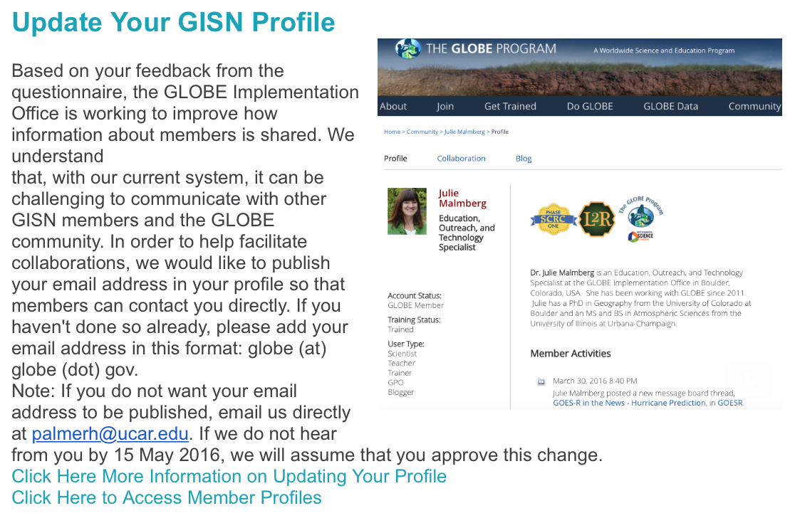
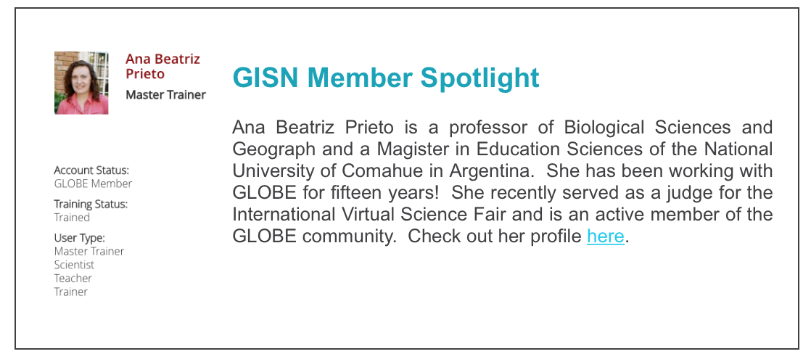
Quarterly Updates

Slide 7
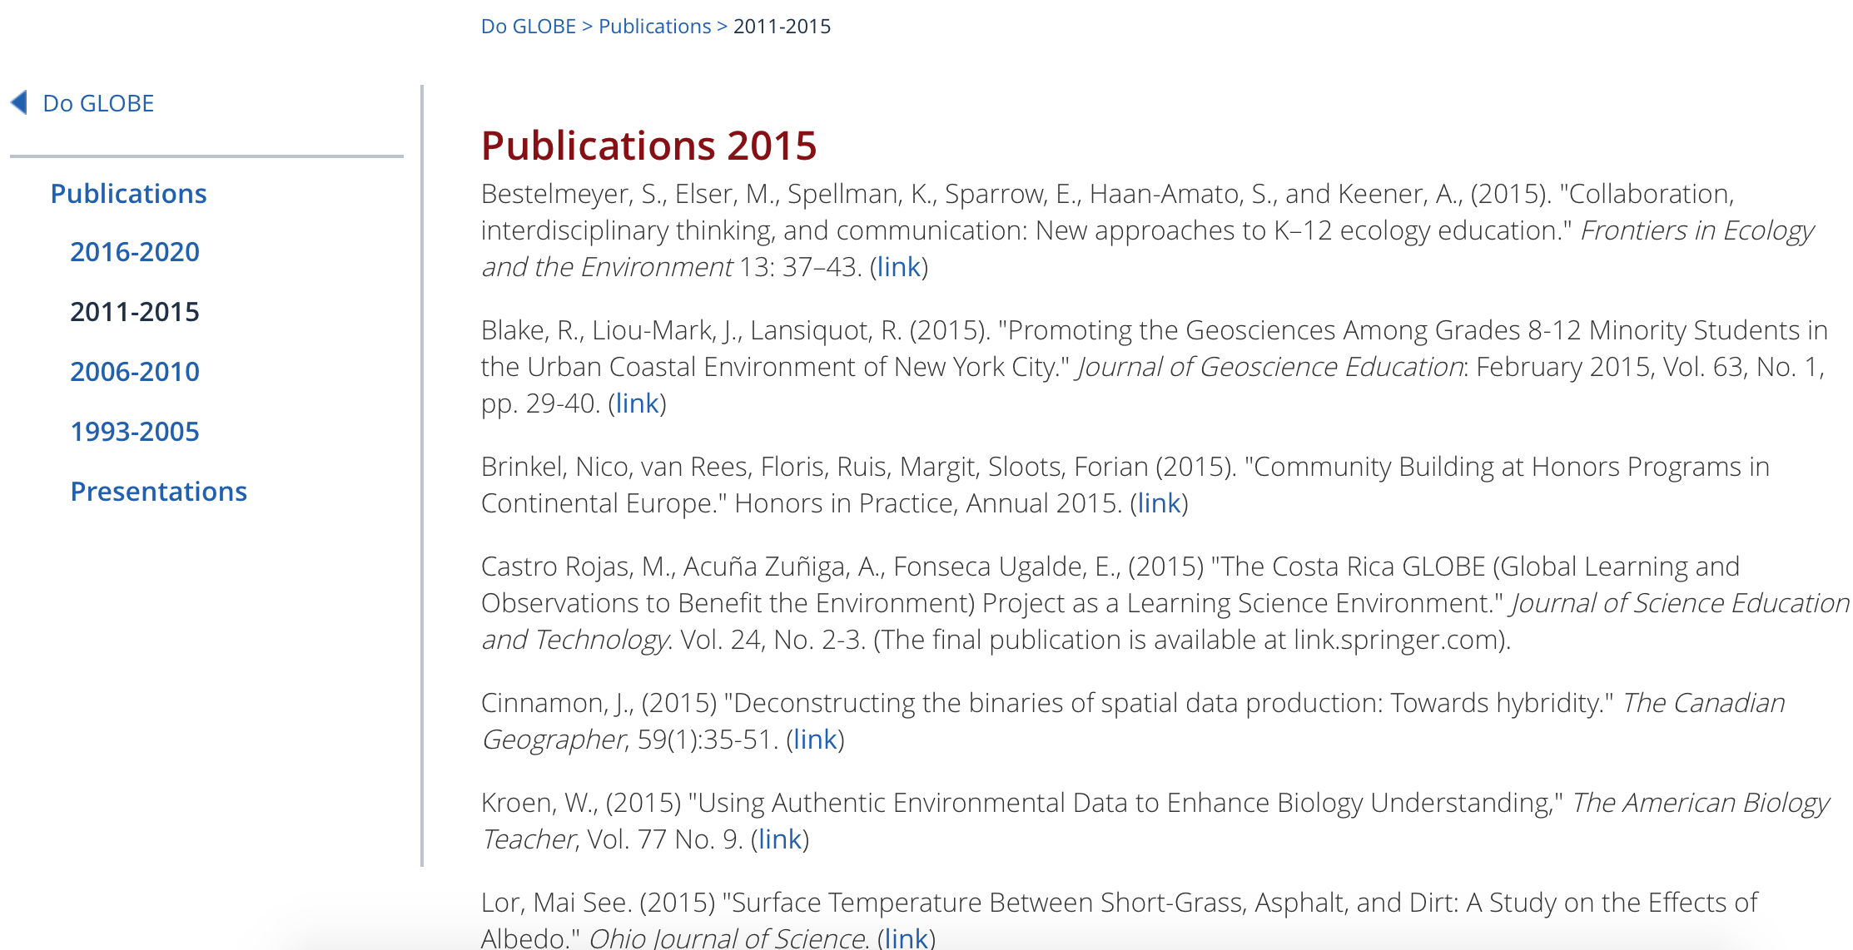

Slide 8
2016 GISN Questionnaire
Amy Barfield
July 19, 2016

Slide 9
Goals: 1. To send an email and questionnaire to the GISN members in order to confirm our existing information on them from CV’s and GLOBE Profiles so that our database of GISN members would be more accurate and complete. 2. To use the information about our members to help facilitate connections between members, students, and teachers as well as encourage members to increase their visibility on globe.gov to assist with connections. 3. Gauge what our members have been doing with the GISN and how involvement with the GISN has benefited or assisted their careers. As well as possibly inspire different ways for members to get involved. 4. Get feedback from members about how the GISN can be improved and utilized more effectively.
Questionnaire and email was sent early 2016 to 263 members in 42 countries across 6 global regions.
(As of July, there are now 279 members from 45 countries)

Slide 10
Questionnaire Questions
Contact Information:
Title, name, company/institution, job title, city/town, state, country, other contact info, languages
Current Research and Projects
Which GLOBE “sphere(s)” does your research fall under?

Slide 11
A few results:
43% of members responded from all 6 regions.
The majority of members are affiliated with a university or other research institute.
The atmosphere and hydrosphere were most commonly identified “spheres” that members’ research fell under, followed by biosphere then pedosphere.
Members were most inspired by the opportunity to connect and collaborate with students followed by the opportunity to collaborate with fellow scientists and the international component of the GISN.

Slide 12
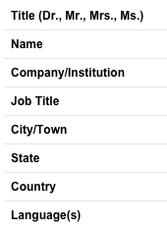
In the US, of the people who responded, the most popular states were: CO, CA, NY, MD, TX, GA, WA, IN, MI, VA, NJ, NC
The most commonly listed languages were: English, Spanish, French, Hindi, Thai, German, Arabic, Czech, Swahili, Russian, Italian

Slide 13
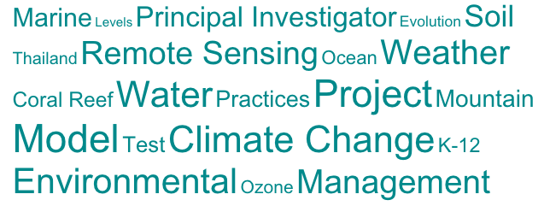
Q 3: Current Research Projects

Slide 14
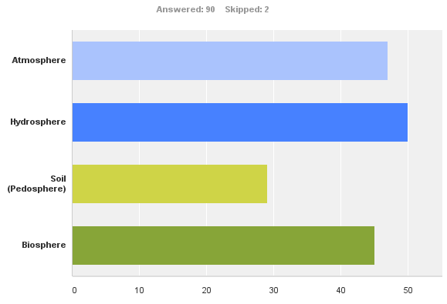
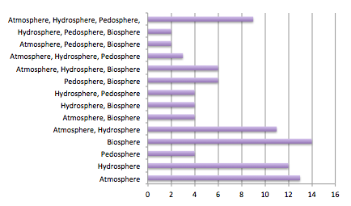
Q4: Which GLOBE “sphere(s)” does your research fall under?

Slide 15
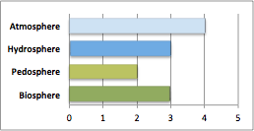
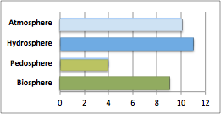
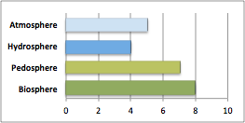
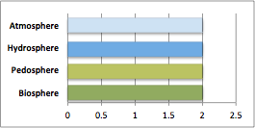
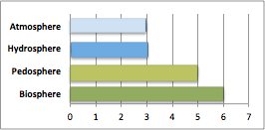
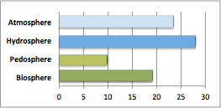
GLOBE spheres by region
Africa
Asia & Pacific
Europe & Eurasia
Latin America & Caribbean
Near East & North Africa
North America

Slide 16
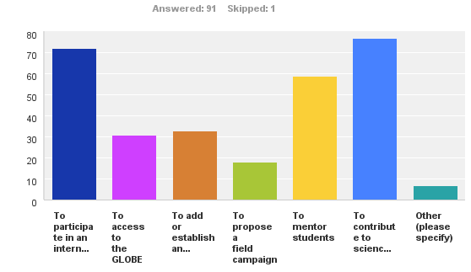
Q5: What are some of the reasons you chose to join the GISN?
“Other” responses:
Peggy LeMone: I was Chief Scientist and continue to follow GLOBE's activities with interest.
Imran Aziz Tunio: Capacity Building to enhance skills
Matt Gilmore: I am also a GLOBE trainer and partner. Because I am a scientist too, it made sense to have multiple roles.
Karl Schneider: to support innovation and internationalization in teacher education programs
Pamela Aishlin Cedillo: GLOBE - TAHMO partnership; And to support Boise State Partner program
Scott Wiley: Contrails were my first exposure to GLOBE and I wanted to utilize my experience and research to assist students in weather and STEM careers.
Meriam Ismail: new experience

Slide 17
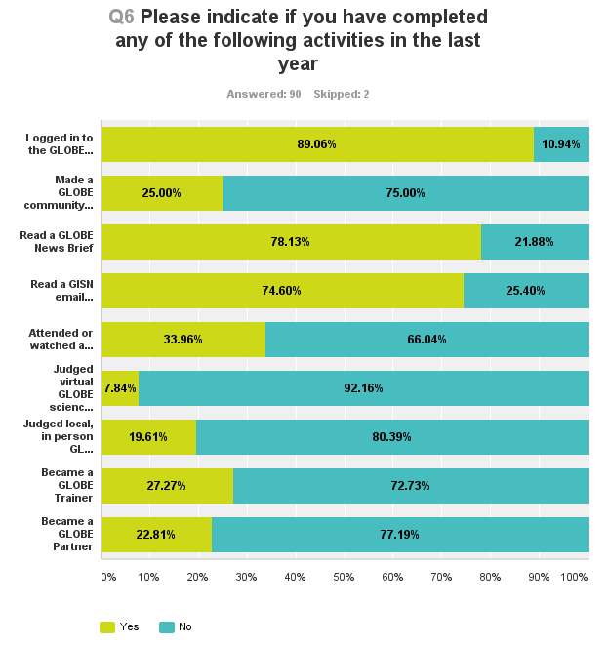
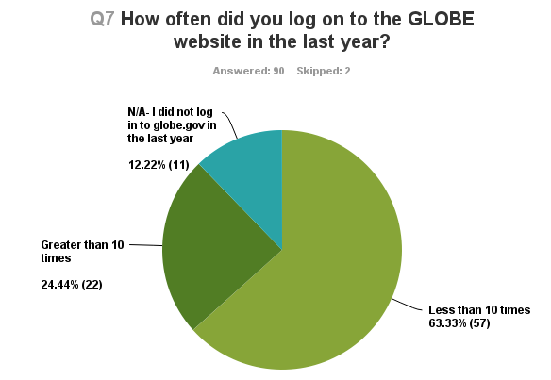
What have you done with the GISN?
*
*On question 6, I had somehow made it so that only one answer per column could be selected (i.e. only one yes and one no) instead of multiple answers (multiple yes or multiple no). This problem was corrected, however it was after the first 33 surveys had already been submitted.

Slide 18
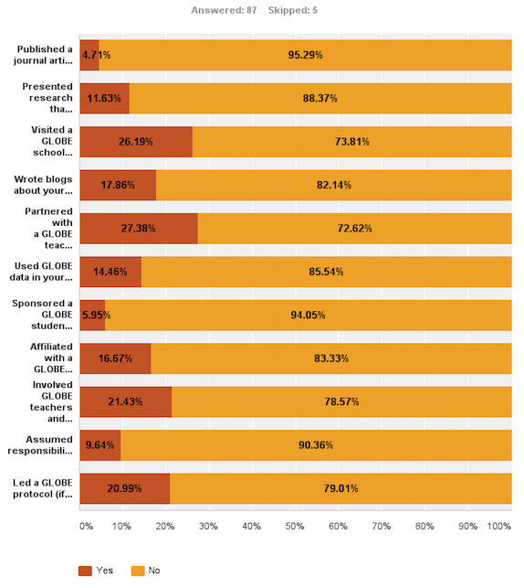
Q8: Please indicate if you have completed any of the following activities in the last year. If you answer yes, please specify or explain (comment).

Slide 19
Questionnaire Questions
What are some of the reasons you chose to join the GISN?
Possible answers in order of popularity: to contribute to science education in a unique way to create a lasting impression on student interest in science and scientific literacy; to participate in an international scientific community; to mentor students; to add or establish an international component to my research; to access the GLOBE database to supplement standard research data; to propose a field campaign
What activities have you completed in the last year?
Possible answers in order of popularity: logged in to the GLOBE website; read a GLOBE news brief; read a GISN email newsletter; attended or watched a recording of a GLOBE webinar; made a GLOBE community member a “friend” on globe.gov; partnered with a GLOBE teacher or school; became a GLOBE trainer or partner; visited a GLOBE school to do an activity; led a GLOBE protocol; judged virtual or local GLOBE science fair projects; involved GLOBE teachers and students in your scientific research; wrote blogs about your field expertise; affiliated with a GLOBE partner; used GLOBE data in your research; presented research including GLOBE data at a conference; assumed responsibilities for GLOBE student research campaigns; sponsored a GLOBE student fair; published a journal article involving GLOBE data; other

Slide 20
With the valuable feedback we received, we have already made improvements to the GISN webpages on globe.gov to address issues concerning guidance and communication between members. We hope you enjoy these changes while we look for more ways to improve the GISN.
Thank you!

Slide 21
What inspires YOU about the GISN?

Slide 22
Peder Nelson

Slide 23
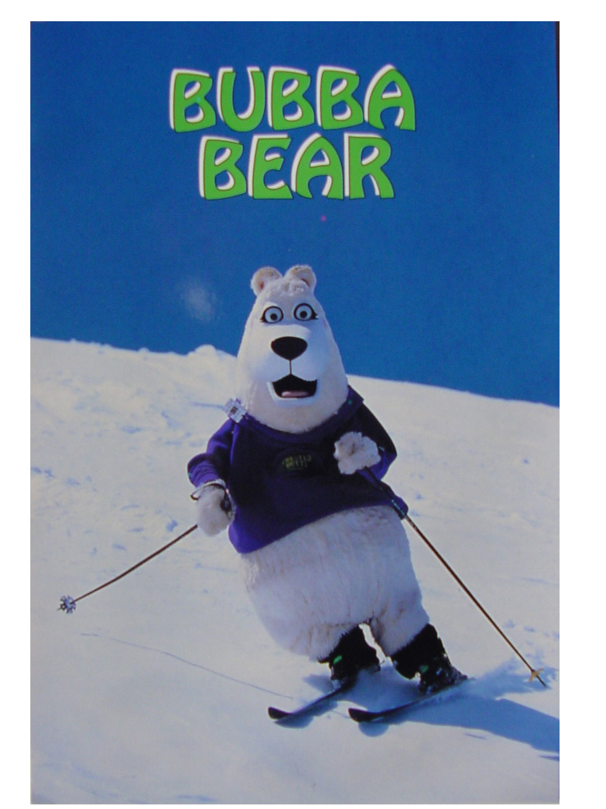
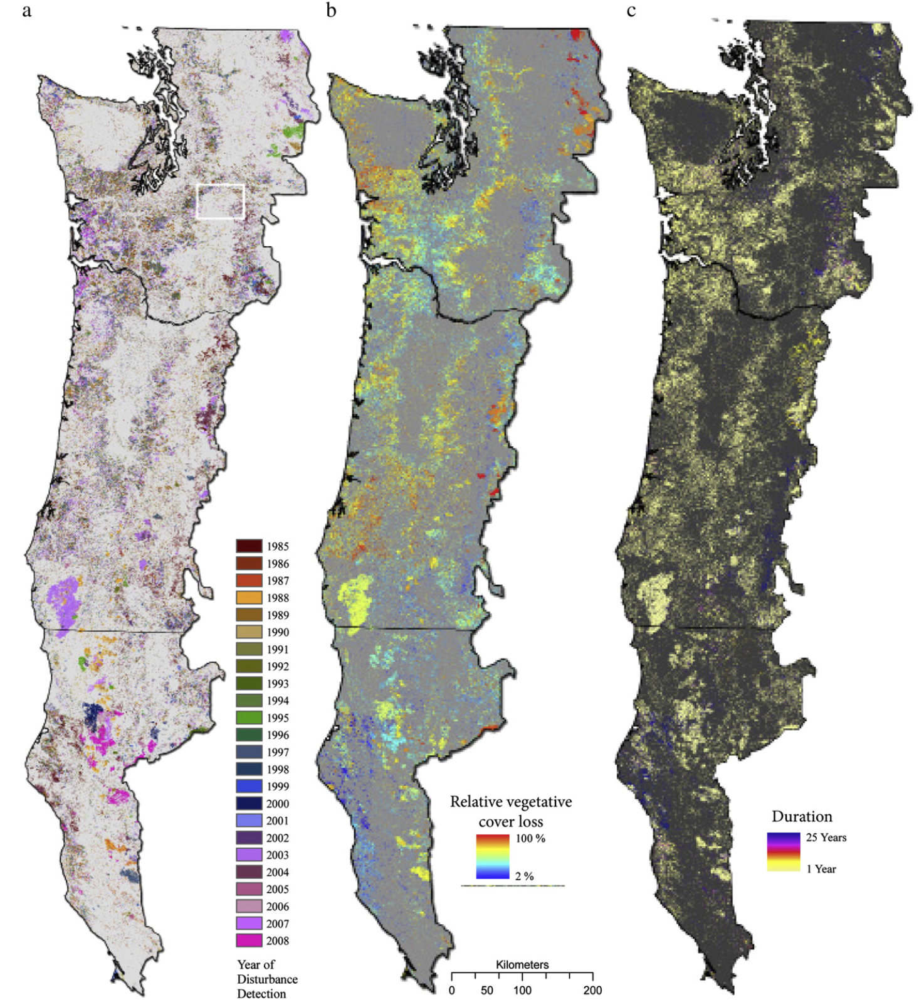
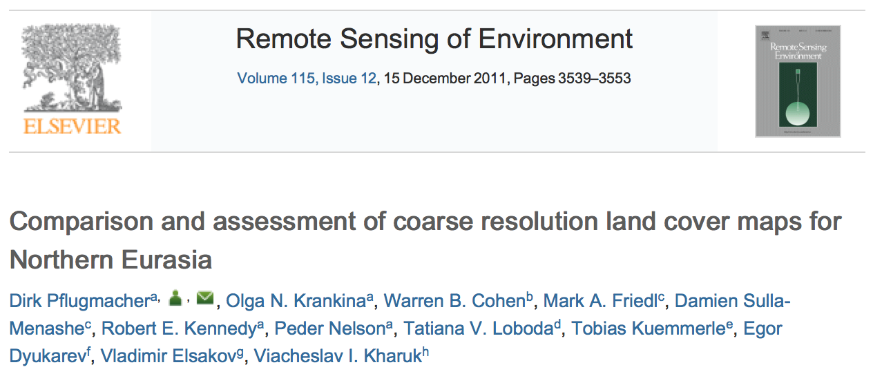
Who I am: Peder Nelson, MS
Instructor (Geography), Oregon State University

Slide 24
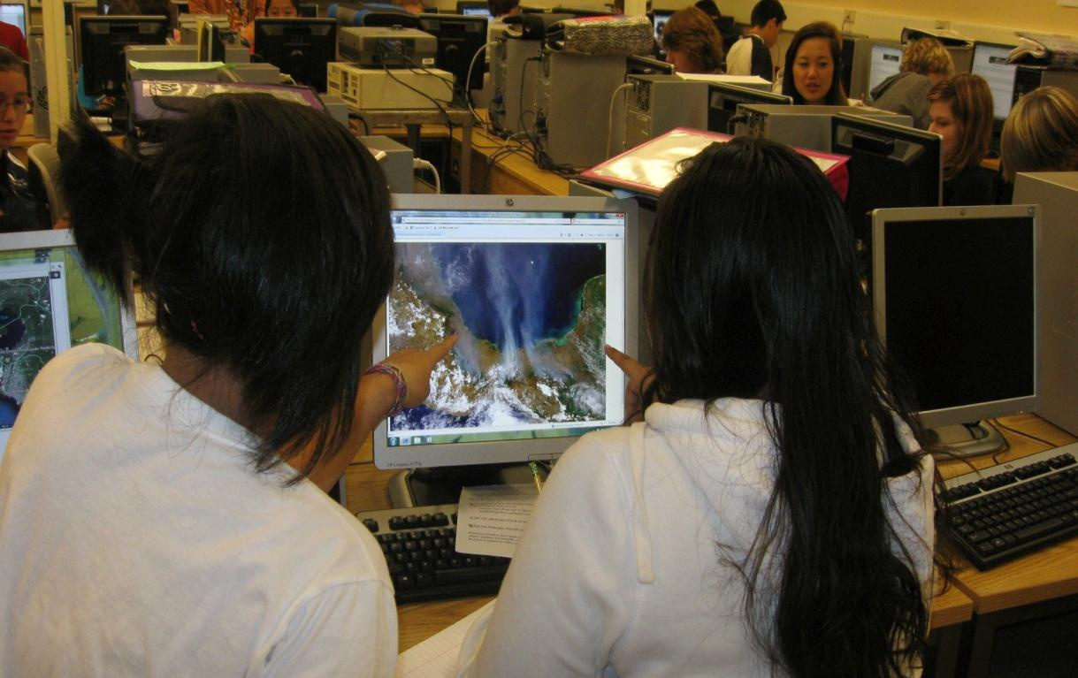
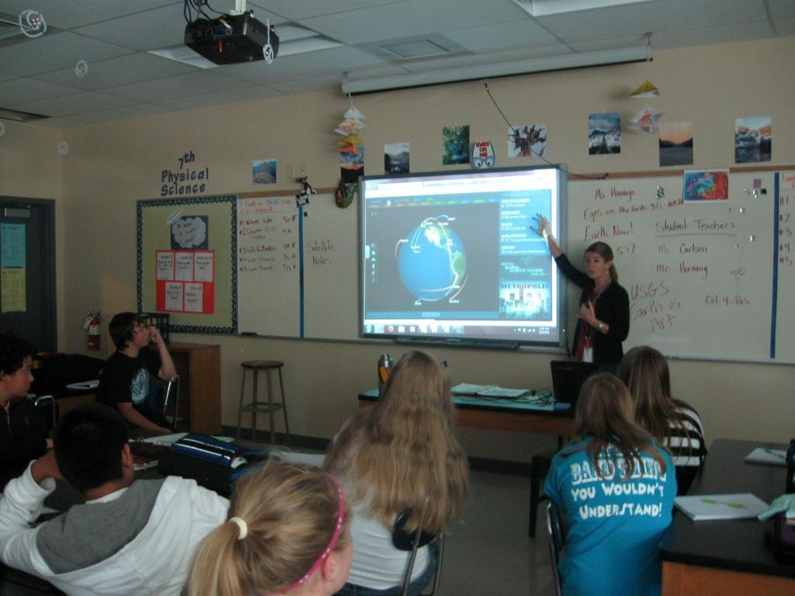
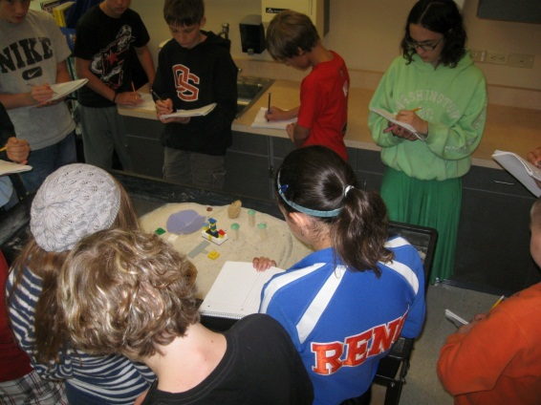
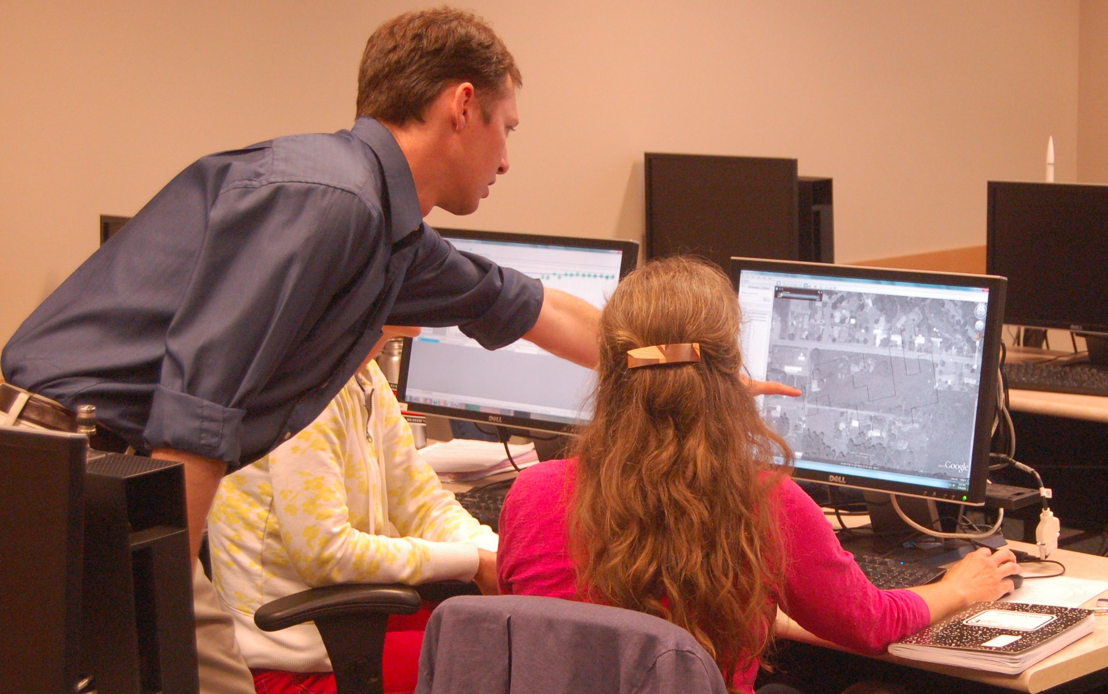
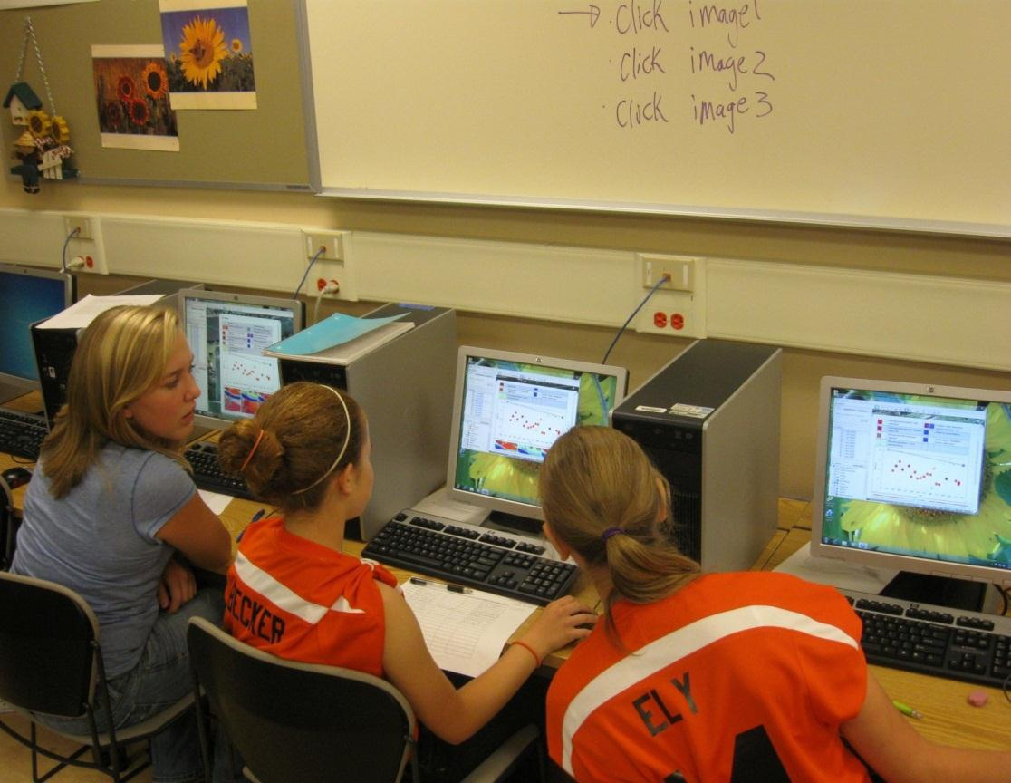
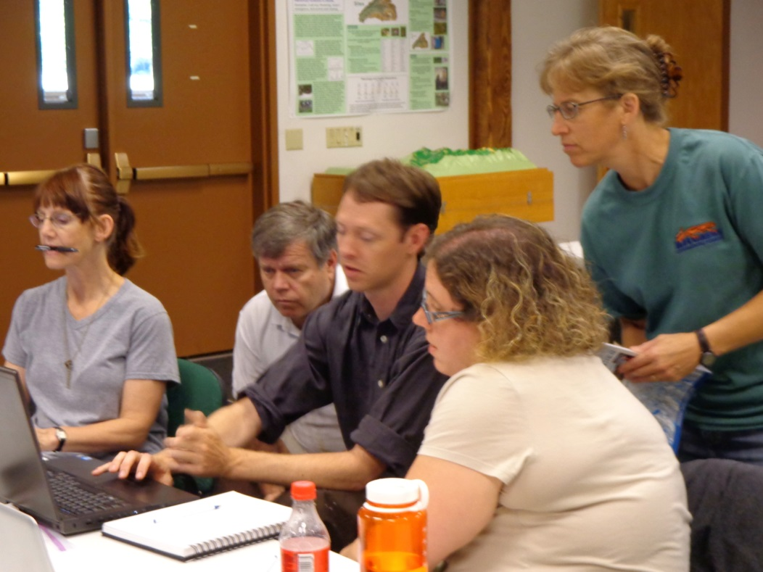
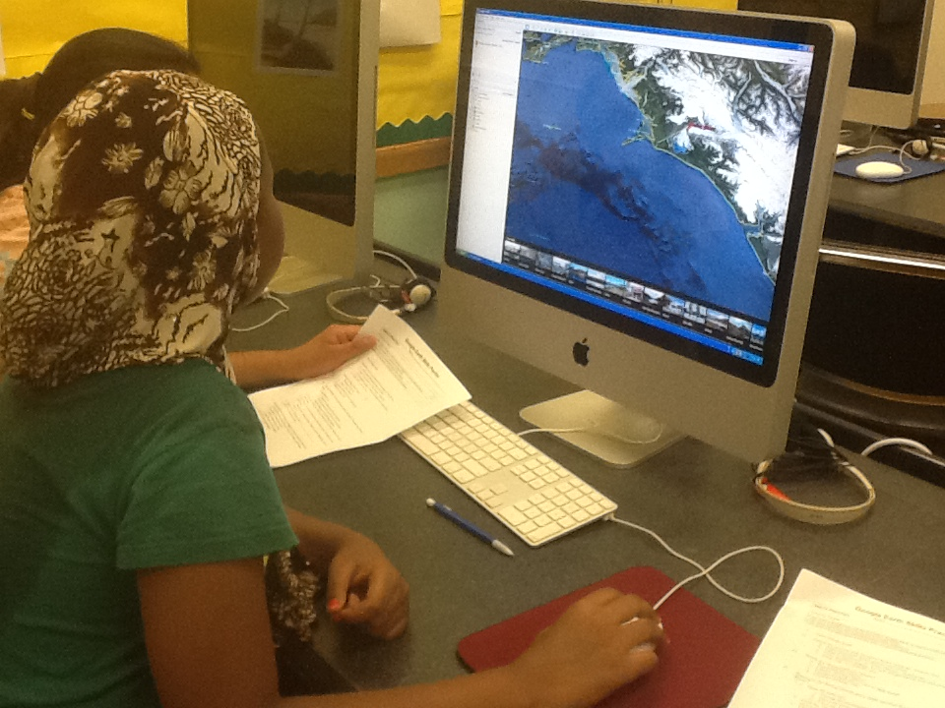
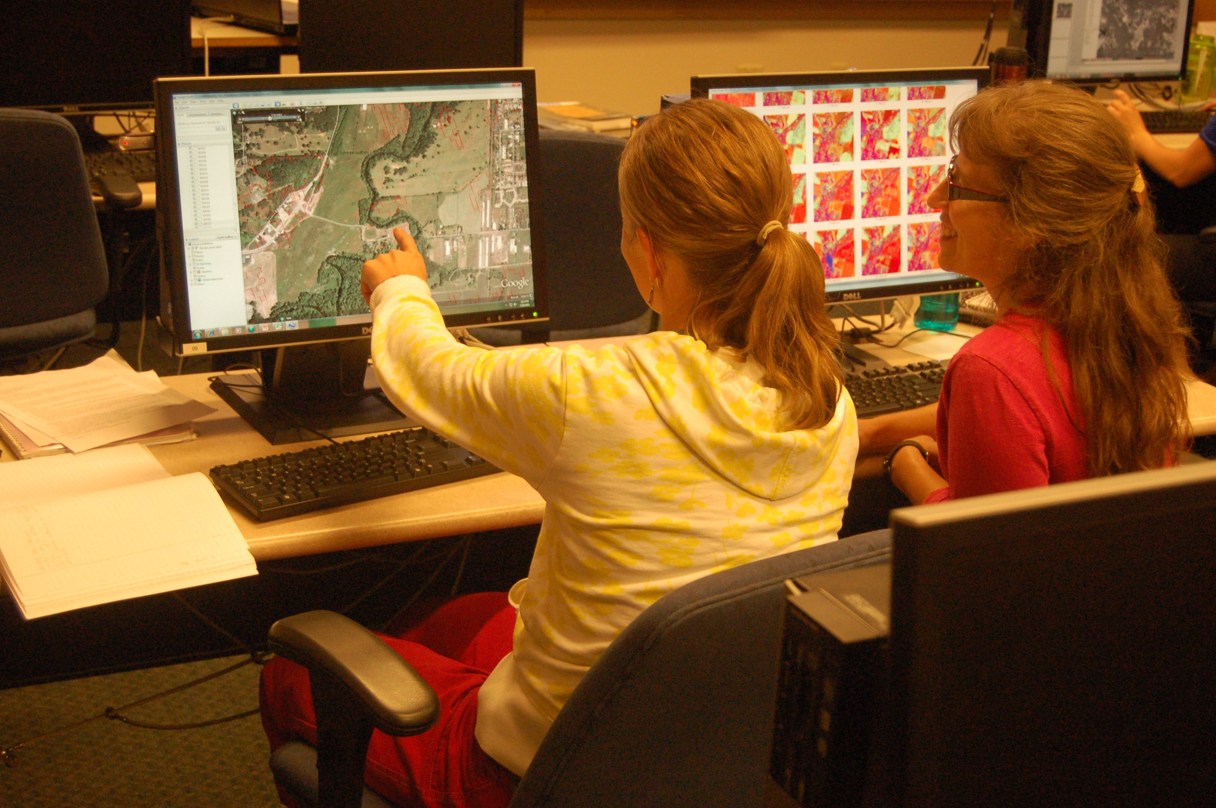
2011-2013: Scientist – Teacher Partnership
NASA Innovations in Climate Education (NNXI0AT82A)
Thematic unit: “Stories from the Earth”
Joe Cameron – Beaverton Middle School, Beaverton, OR
Pad Quinn – Rachel Carson Middle School, Beaverton, OR
Joan Swafford – Jefferson Middle School, Jefferson, OR
Jeanine Hemel Sullivan - Gresham-Barlow School District, Gresham
Angie Ortiz-McNeese - David Douglas School District, Portland, OR
Jamie Rumage
http://people.oregonstate.edu/~nelsonpe/OSTA_2012/
Notes:
Effective PD (e.g., Darling-Hammond, 1995, DuFour, 2004; Hord, 1997; Joyce & Showers, 2002; Loucks-Horsley et al., 2003; Shulman, 1986, 1998)
Situated Cognition and Cognitive Apprenticeship Model (Kardash, 2000; Lave & Wegner, 1991).
Teacher as Researcher/RET Models (Dixon & Wilke, 2007; Morrell, O’Connell, & Sahnow, 2010; Pop et al. 2010; Silverstein et al., 2009)

Slide 25
My motivations for joining the GISN:
Get data!
Validate & improve my 1984-present land cover maps & models
Collaboration
Mentoring
Find more funding to do what I am passionate about

Slide 26
My contributions:
Judged science fairs
international science fair & NW regional science fair
Presented ‘Science Adventures using Satellite Images’ at conferences
Oregon Science Teachers Association (OSTA)
International Society for Technology in Education (ISTE)

Slide 27
Challenges
Lack of land cover GLOBE data
Finding time to engage
Making connections

Slide 28
Julie Malmberg
July 19, 2016

Slide 29
Current GISN
Early Career GISN
In order to be an “Early Career” member of the GISN you must reside and/or be employed in a GLOBE country and meet one of the following criteria:
Be an upper level undergraduate student pursuing a degree in a STEM field
Be a GLOBE Alumni pursuing a degree in a STEM field
Have recently graduated with a B.S. in STEM field
Be working toward a Master’s in a STEM field

Slide 30
Opportunities for Early Career GISN
Write and post blogs
Assist in judging the International Virtual Science Fair and regional science fairs
Connect with GISN members
Classroom visits
Research
…...

Slide 31
Proposed Changes
GISN members must participate in one GLOBE activity each year
Answer yearly survey (very short!) about activity during the previous year
If no reply or no activity, put on probation for three months
Still no activity or reply, removed from GISN
Examples of activities:
Writing a blog on globe.gov
Visit a GLOBE school
Serve as a judge for a regional or international science fair
Mentor student research
Host a webinar for a GLOBE campaign
Use GLOBE data in research (and publishing!)
Creating a collaboration with GLOBE
…..

Slide 32
GISN: Moving Forward
What is working well?
How would you like to see the GISN develop?
How can we engage the GISN to lead this effort?

