Slide 1
GLOBE PROGRAM in Kenya
Implementation of GLOBE Program
GLOBE Annual Meeting – July 2016
Presented by:
Charles Mwangi
GLOBE Program (Kenya)
Deputy Country Coordinator
Member – GLOBE Technology Working Group

Slide 2
Introduction
June 1997 ‐ Kenya joins the GLOBE Program
1997 - 31 GLOBE schools in Kenya and 34 teachers trained during the inaugural GLOBE Teacher Training
2000 - last environmental data measurement recorded in early 2000.
2013 – GLOBE program gets a “fresh boast of life” under the guidance of National Space Secretariat in consultation with the Ministry of Education.
Over 80 GLOBE teachers trained and more reviewing the eTraining resources.
Data being reported by GLOBE Schools in Kenya on a regular basis now…

Slide 3
status 2014-2016
30 pilot schools selected by NSS in consultation with Ministry of Education in September 2014.
Held GLOBE Sensitization workshop for Principals and Teachers of the 30 selected schools on 16th October 2014.
Held GLOBE Teacher Training in CEMASTEA for 40 participants from the selected schools and CEMASTEA staff (host institution) on 1st-5th December 2014
Seeking more partners. Enhance mentorship and conduct more trainings as well as explore possibility of maximizing use of GLOBE Data Entry Apps and GLOBE eTraining modules.

Slide 4
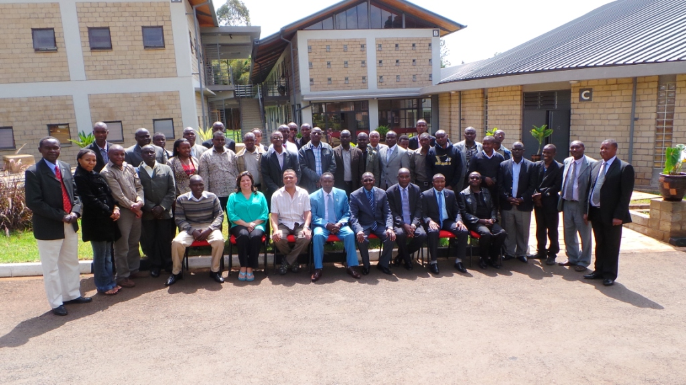
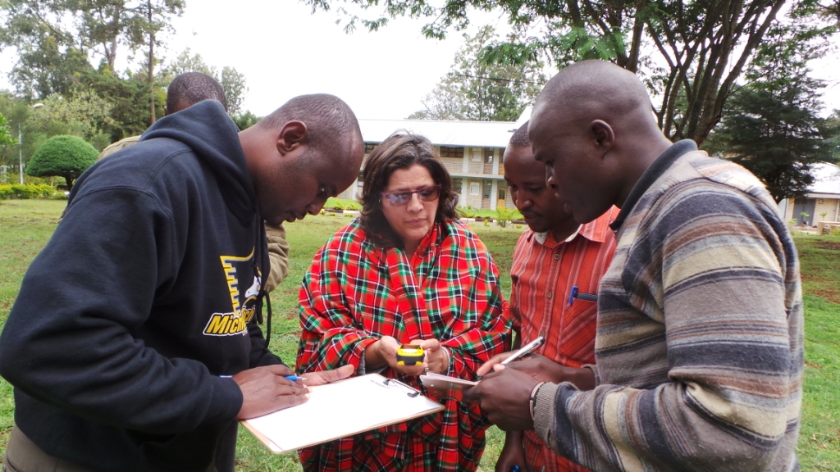
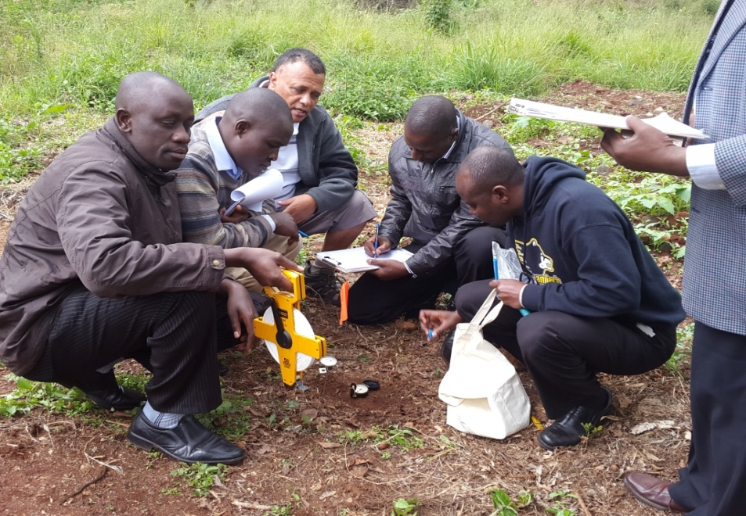
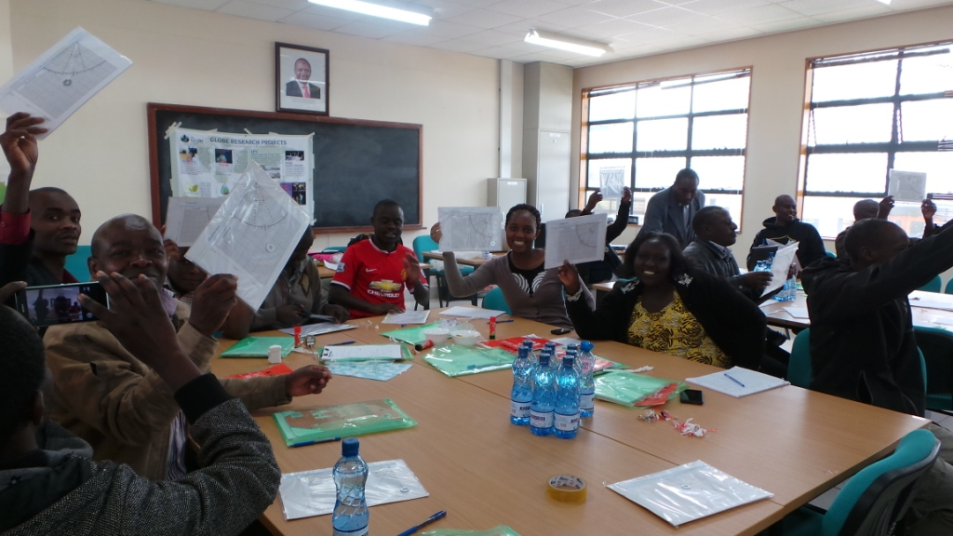
GLOBE Training conducted in CEMASTEA in December 2014

Slide 5
status 2014-2016
NASA/GPM education office donates 12 rain gauges for schools to participate in GLOBE/GPM field campaign (thank you GPM).
Collaboration with the Trans-Africa Hydro-Meteorological Organization (TAHMO) who are planning to install 20,000 Automatic Weather Stations across Africa region.
Bought pH and conductivity meters for a GLOBE school to enable them collect hydrological data for research (iSCENE/Kilimanjaro initiative).
Held a Water Rocket event in St. Scholastica Catholic School to promote STEM Education.

Slide 6
GLOBE-TAHMO Collaboration
TAHMO have installed 28 Automatic Weather Stations (AWS) in GLOBE schools.
Possibility of an additional 50 more stations to be installed in 2016/2017.
Data from these stations accessible from www.school2school.net and available for the students and teachers to use for research.
Training by TAHMO/Decagon/GLOBE (Kenya) on Atmosphere/AWS conducted on 25th-27th January 2016 to train GLOBE teachers.
Outreach/mentorship for TWO GLOBE schools with Decagon/TAHMO team.

Slide 7
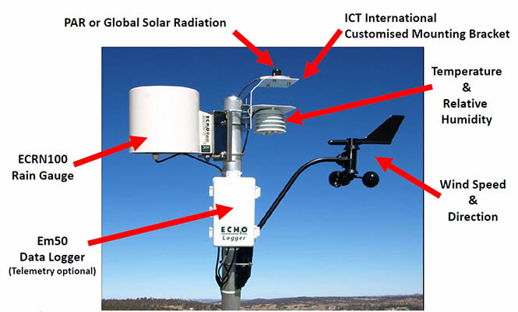
TAHMO AWS in globe schools
Replica of the TAHMO AWS (Manufactured by Decagon) installed in GLOBE Schools

Slide 8
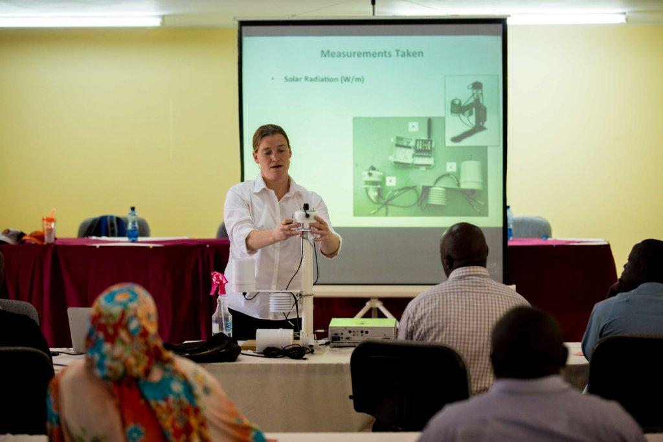
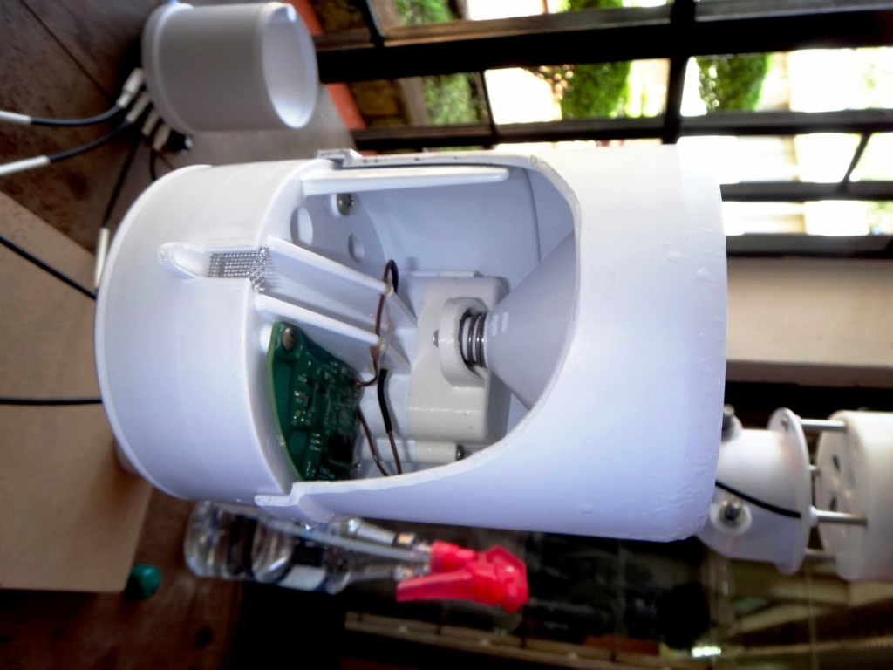
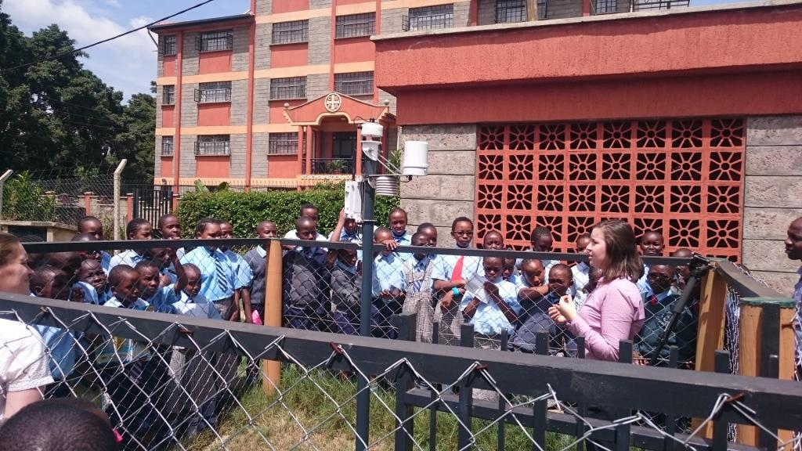
TAHMO/Decagon/GLOBE AWS Teacher Training and outreach

Slide 9
status 2014-2016
Outreach/mentorship for TWO GLOBE schools by Dr. Erika Podest (NASA SMAP Scientist) on 19th February 2016 (thank you Erika).
Established linkage with the United Nations Environmental Program (UNEP)
Areas being explored for UNEP/GLOBE collaboration:
Global Environmental Monitoring System/Water Project (under consideration)
Air Quality (4 GLOBE schools hosting AQ units)
UNEP Live (showcases GLOBE program under Hydro- Meteorological Section)
GEO6 (GLOBE Kenya and a GLOBE School presented at UNEA Pre-assembly meeting on 20th-21st May 2016)

Slide 10
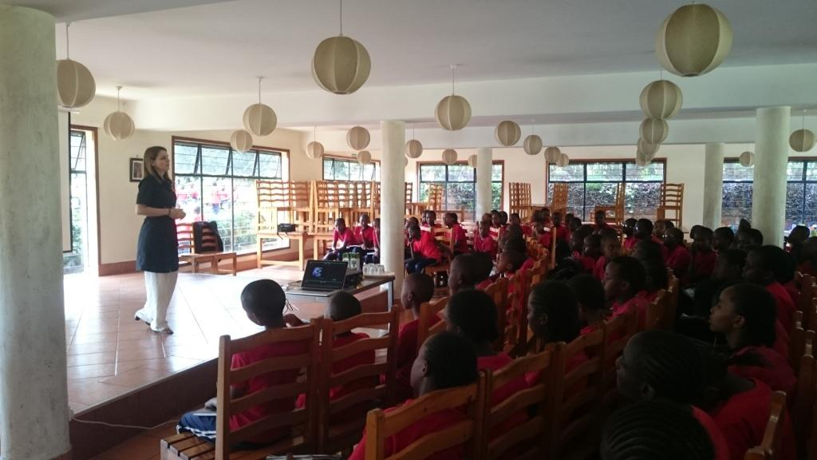
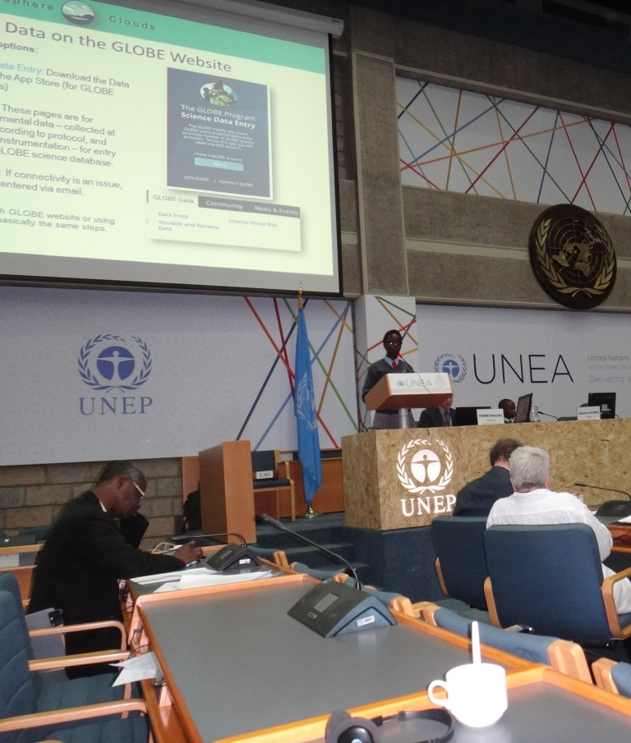
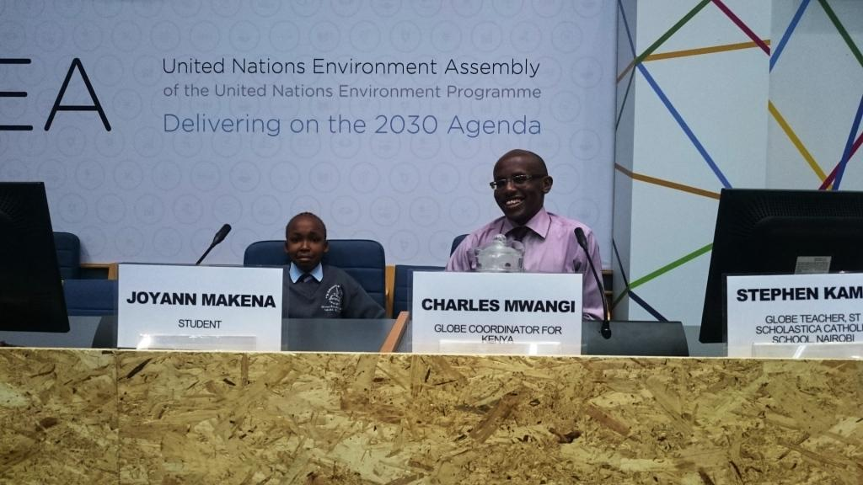
Dr. Erika meets the GLOBE students and Presentations at UNEP Science Policy Forum

Slide 11
Lake victoria initiative
Donation of 3 vernier hydrology kits to GLOBE schools by GLOBE Africa Regional Office (thank you Mark).
To monitor Lake Victoria ecosystem.
Training by Mark Brettenny (GLOBE Africa) and Charles on Hydrology protocol conducted on 15th March 2016 to train UNEP staff.
Training by Mark Brettenny (GLOBE Africa) and Charles on Hydrology protocol conducted on 17th March 2016 to train Homabay Boys & St. Williams Osodo Schools teachers.
Homabay Boys School to be the Hub for the Lake Victoria research initiative/expedition

Slide 12
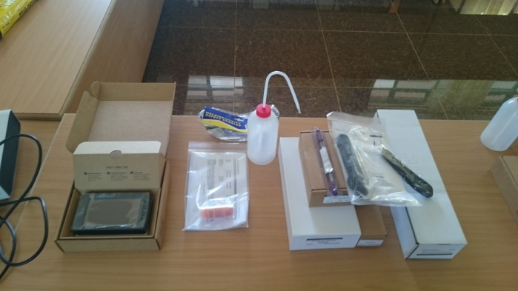
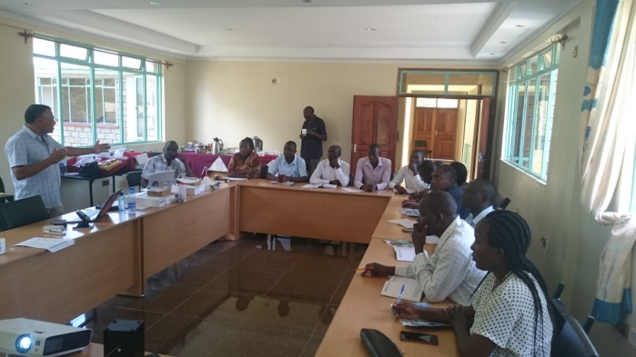
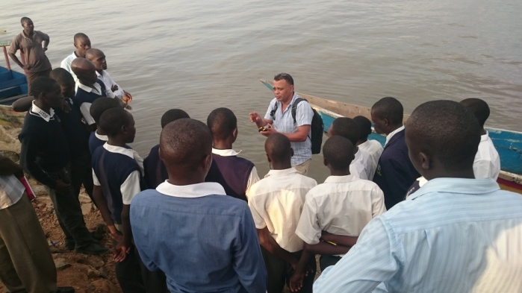
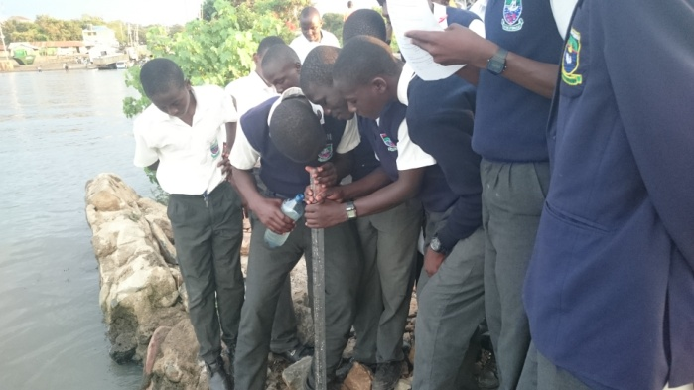
Vernier probeware kit and Hydrology training at Homabay High School

Slide 13
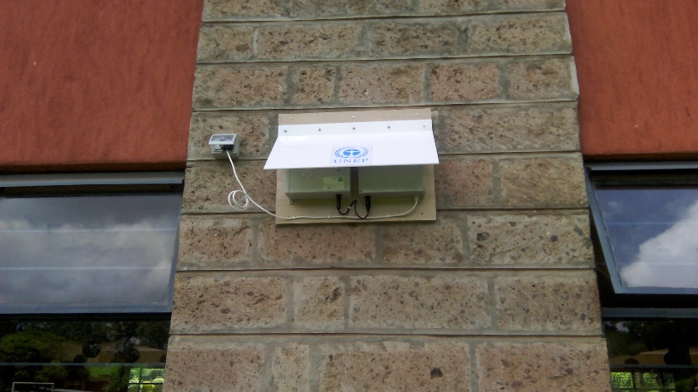
UNEP air quality
UNEP has selected 4 GLOBE Schools located in Capital City of Kenya, Nairobi to host a low-cost Air Quality Kit:
The AQ kit monitors the air quality (pollution)
Data collected include; PM2.5, PM10 (dust), Nitrogen Dioxide and Sulphur Dioxide.
Training on Air Quality to GLOBE Teachers and students conducted on the week of 4th-8th July 2016 by UNEP/GLOBE

Slide 14
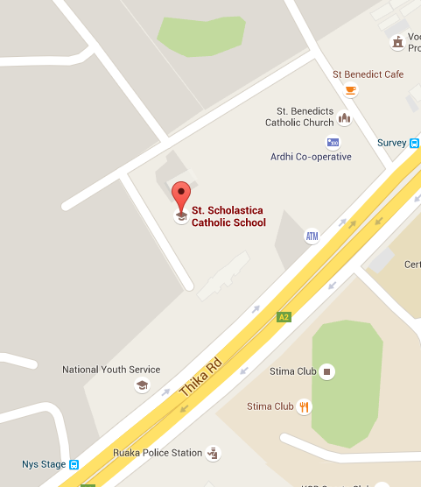
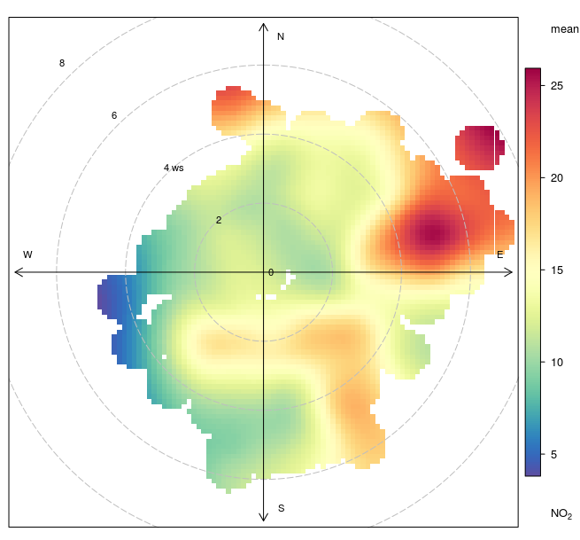
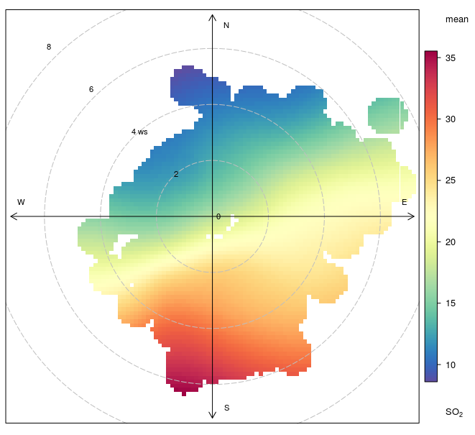
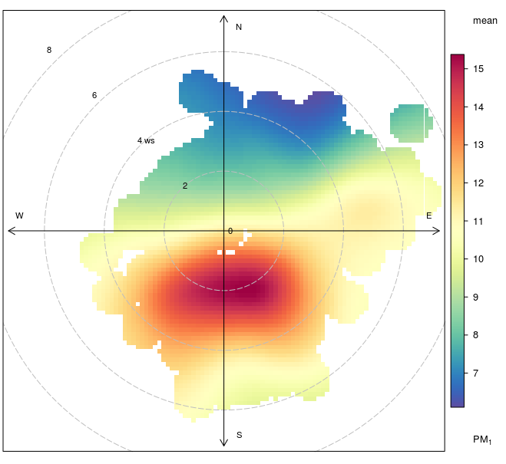
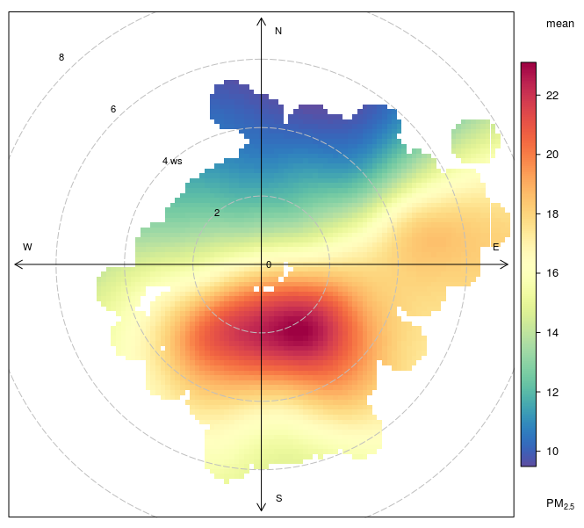
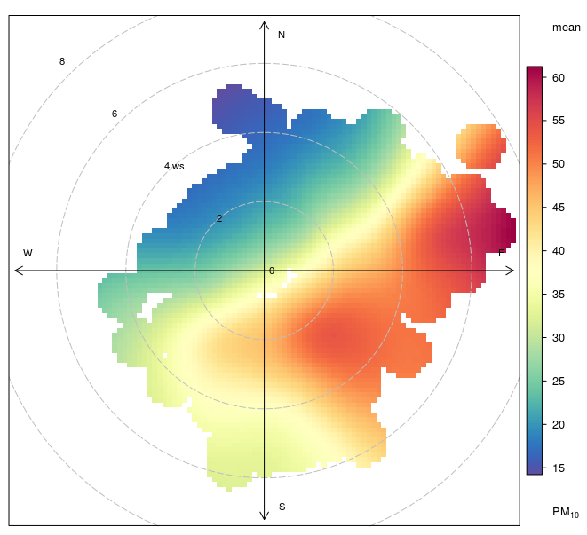
NO2 SO2
PM1 PM 2.5 PM 10
Sample data collected at St. Scholastica Catholic Primary School – Credit Priyanka

Slide 15
conclusion
Opportunities for GLOBE Schools in African countries to benefit from the TAHMO initiative by hosting AWS.
Opportunity for enhanced cooperation with UNEP by renewing/reviewing the UNEP-GLOBE agreement of 1999. Areas of interest;
Global Environmental Monitoring System/Water Project (covered in hydrology protocol)
Air Quality (new protocol?)
Explore possibility of partnering with “large organizations” to enable our GLOBE students benefit from getting requisite GLOBE Instruments and participate in on-going (active) research activities
Need for enhanced support by local US Embassies (I could be making this presentation in person ☺)

Slide 16
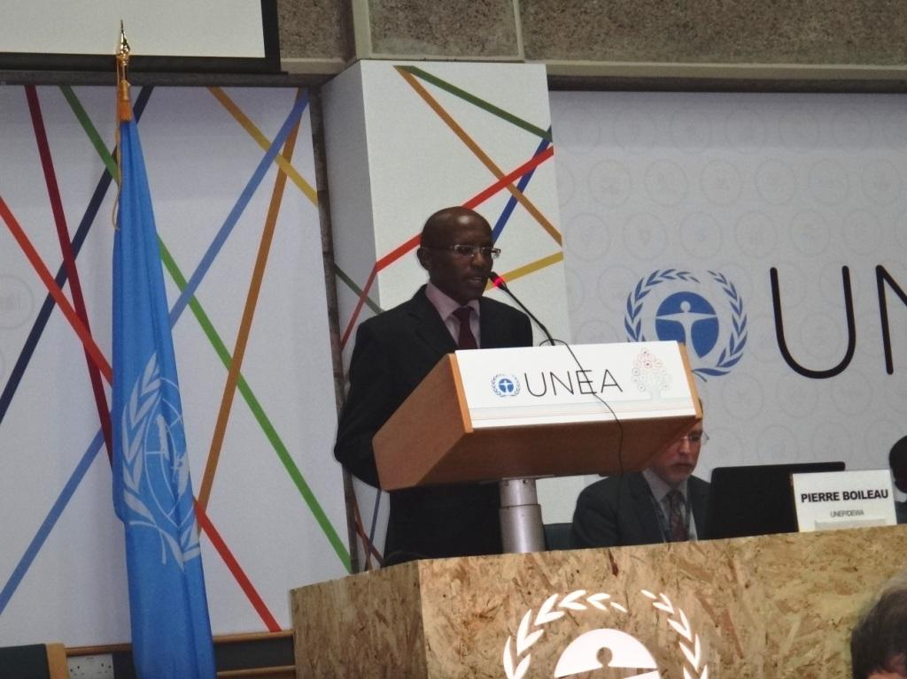
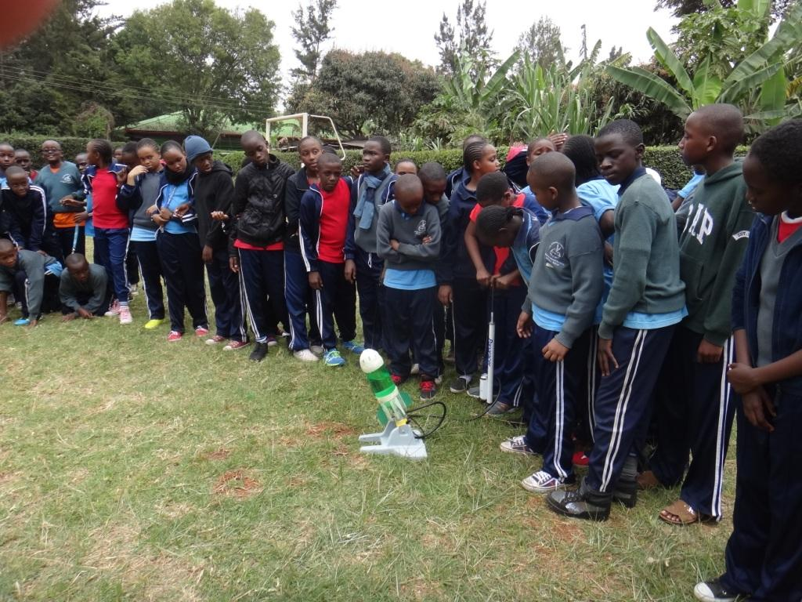
Thank you
Contact: Charles Mwangi
Email: maina.charles@gmail.com

