Slide 1
GLOBE Science School A cross curricular learning trajectory for inquiry in science education
Matthijs Begheyn, cc Netherlands

Slide 2
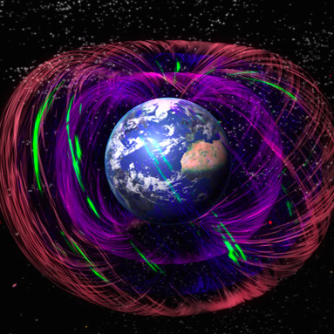
Morphogenetic field

Slide 3
Program
What is the GLOBE Science School
Why?
Some theory about inquiry
Building blocks
What’s in it for you?

Slide 4
GLOBE Science School
Do GLOBE every year!
Learning trajectory for inquiry
Subjects: biology, chemistry, physics, geography
Supporting national standards
Based on scientific research (Utrecht University)
Certification
Continued support

Slide 5
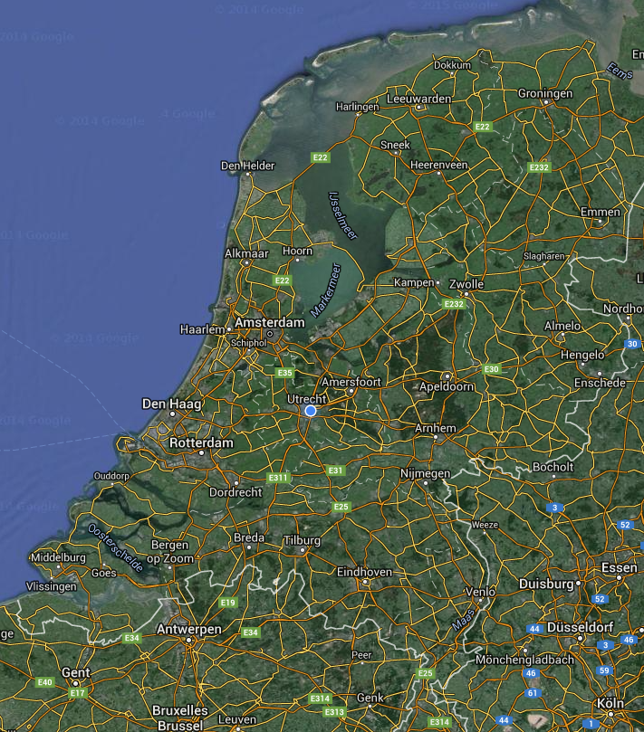
Pilot school year 2015-2016

Slide 6
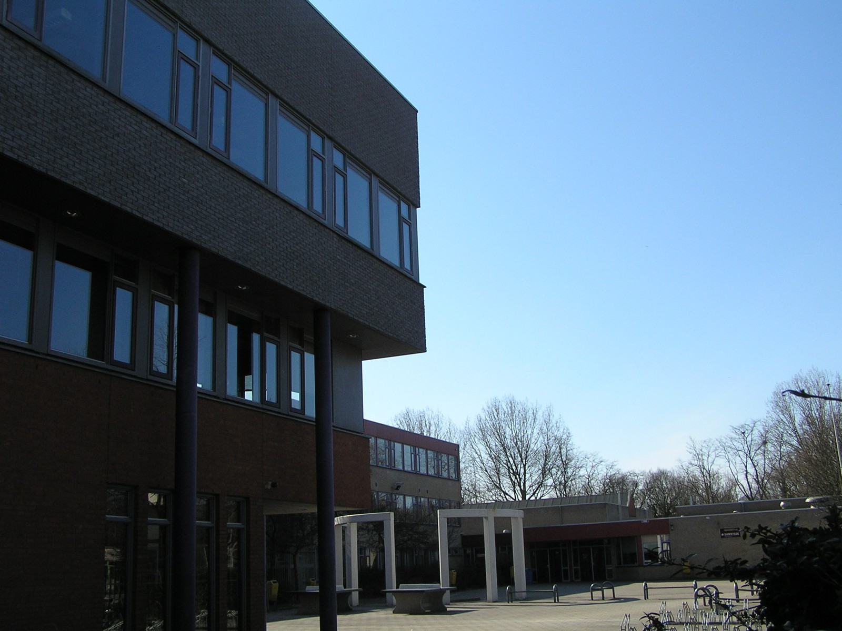

Slide 7
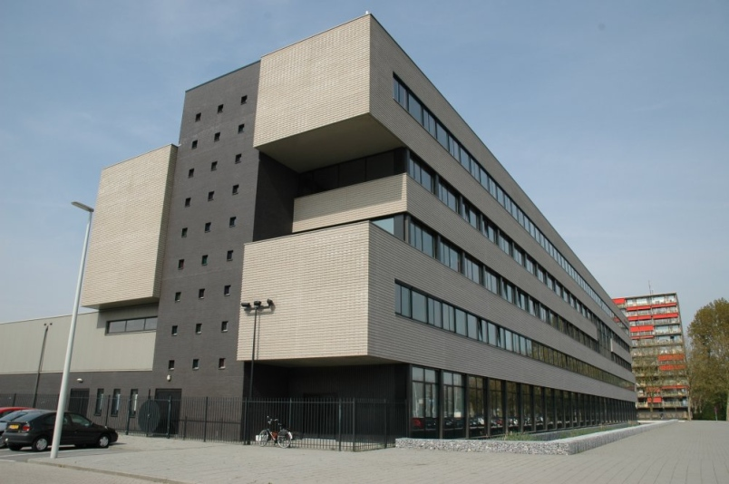

Slide 8
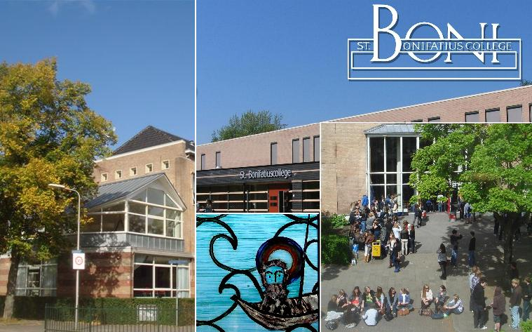

Slide 9
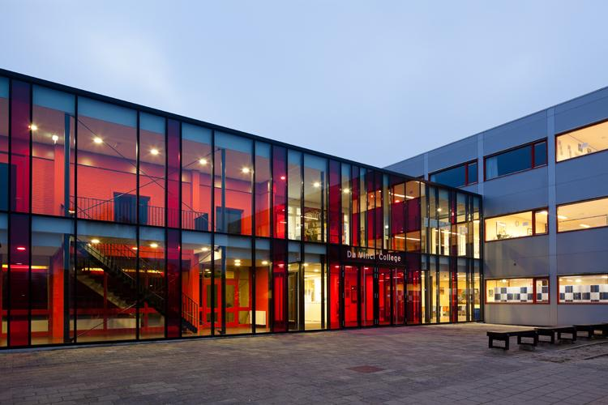

Slide 10
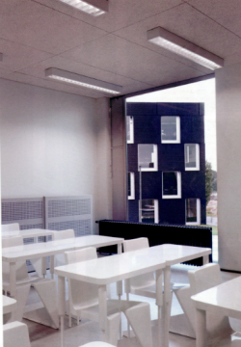
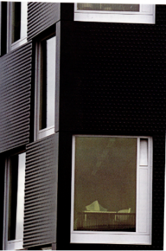
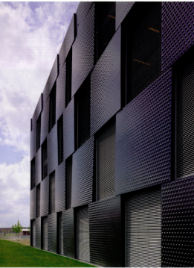

Slide 11
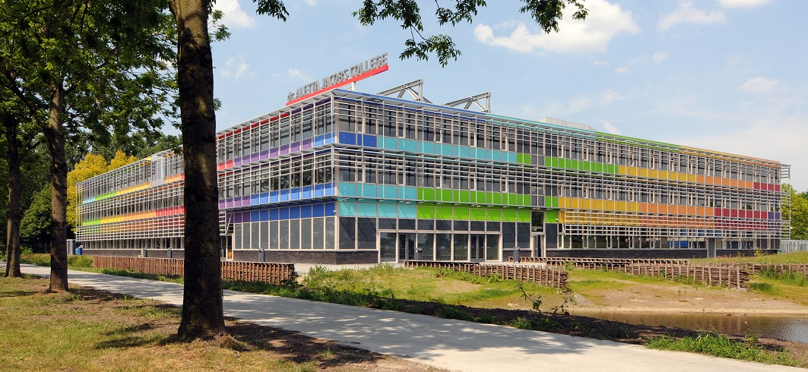

Slide 12
What does it mean? A cross curricular learning trajectory for inquiry in science education

Slide 13
What does it mean? A cross curricular learning trajectory for inquiry in science education

Slide 14
What does it mean? A cross curricular learning trajectory for inquiry in science education
Notes:
National Science Education Standards:
"the diverse ways in which scientists study the natural world and propose explanations based on the evidence derived from their work. Scientific inquiry also refers to the activities through which students develop knowledge and understanding of scientific ideas, as well as an understanding of how scientists study the natural world."

Slide 15
What does it mean? A cross curricular learning trajectory for inquiry in science education

Slide 16
Why did we start it?
No more funding
From 1 participating teacher to whole school approach
Support schools (demand driven)

Slide 17
Investigation on schools
The Dutch government prescribes that development of inquiry skills is part of the school curriculum, BUT:
75% of teachers thinks the students skills of doing inquiry are too low
Quality of final research report (profielwerkstuk) is variable
In only a quarter of the schools doing inquiry has been written down clearly in the curriculum
There is a lack of coherence between (and even within) subjects. Therefor there is no real learning trajectory
90% of the teachers rates inquiry education with an 8 or higher

Slide 18
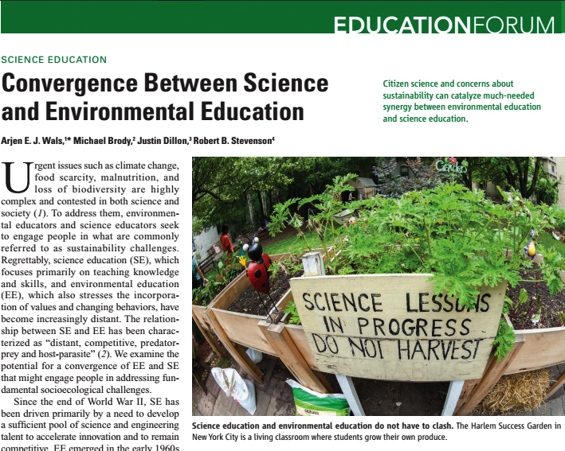

Slide 19
GLOBE Science School
Whole school approach with GLOBE as context for making inquiry meaningful.
Create a business model
Notes:
Wederzijds belang! Zowel GLOBE als de school leert hier van!

Slide 20
Why inquiry in secondary education?
Doing research…
…motivates students →more autonomy in what to learn and how to learn.
…gives the opportunity to excel → to challenge themselves in learning.
…provides the ability for critical thinking and systematic knowledge acquisition, needed in higher education & in society.

Slide 21
Inquiry in science education
Inquiry as a means to acquire content knowledge | Inquiry as a learning goal
Inquiry based learning Get insight into complex natural phenomena, and relationships between them | Learning to do inquiry Acquire knowledge and skills about doing research

Slide 22
Inquiry in science education
Inquiry as a means to acquire content knowledge | Inquiry as a learning goal
Inquiry based learning Get insight into complex natural phenomena, and relationships between them | Learning to do inquiry Acquire knowledge and skills about doing research
To discover how chemical water quality interact with the quality of waterlife | To discover how to: develop a research plan, carry out an experiment, present your results.

Slide 23
Inquiry in science education
Inquiry as a means to acquire content knowledge | Inquiry as a learning goal
Inquiry based learning Get insight into complex natural phenomena, and relationships between them | Learning to do inquiry Acquire knowledge and skills about doing research
To discover how chemical water quality interact with the quality of waterlife | To discover how to: develop a research plan, carry out an experiment, present your results.
Common didactical approaches | Common didactical approaches
Standard practical work (recreate lessons from the book) Limited degrees of freedom in choosing research problem & methods Strong teacher guidance | ‘Teaching’ how to do research (lecturing) ‘Inquiry’ as a school subject (not related to the content knowledge disciplines) Practicing all research steps seperately (in isolation) No guidance at all (‘just do it’)

Slide 25
Inquiry in science education
Inquiry as a means to acquire content knowledge | Inquiry as a learning goal
Inquiry based learning Get insight into complex natural phenomenon, and relationships between them | Learning to do inquiry Acquire knowledge and skills about doing research
Desired didactical approaches | Desired didactical approaches
Solving a problem for which there is no obvious solution (no hiding of eastern eggs) Create support structures (guidelines, teacher help), to help students focus on the content knowledge | Engage in meaningful scientific research activities: Solving a new problem which is urgent for the student. Go through the whole research cycle Teacher help is directed to stimulate their own thinking about what is good research & how to carry out good research

Slide 26
Inquiry in science education
Inquiry as a means to acquire content knowledge | Inquiry as a learning goal
Inquiry based learning Get insight into complex natural phenomena, and relationships between them | Learning to do inquiry Acquire knowledge and skills about doing research
GLOBE:
combining these perspectives

Slide 27
Contract with 6 pilot schools
Support from school management
Commitment teachers (biology, physics, chemistry & science)
5 meetings during 1 year
End ceremony with handing over of panel
Costs:
€3,600 initial year
€1,450 follow up year

Slide 28
Multi disciplinary teams
Biology, physics, chemistry, geography, science

Slide 29
Building blocks for the learning trajectory

Slide 30
1. Existing lessons
Investigation of all existing lessons that are used to teach inquiry for all participating subjects:
Year
Time of year
Specific teaching goal
Relation to steps in the research cycle

Slide 31
2. Common language

Slide 32
2. Common language
Poster in the classroom of every participating subject

Slide 33
2. Common language
Webtool to guide students through all the steps:
General
For every GLOBE research area

Slide 34
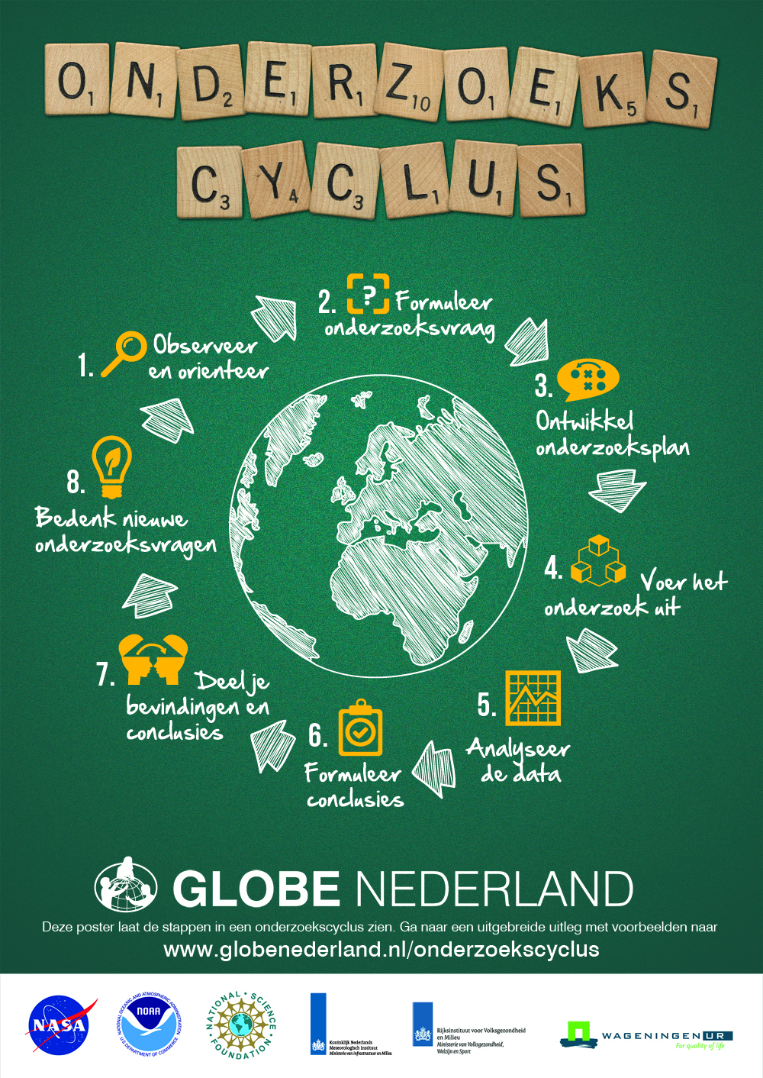
3. Levels of complexity
Dimension | Easy | More complex | Most complex
Teacher guidance | High | Moderate | Low
Technical vocabulary | Low | Moderate | High
Number of STEM subjects | One | Two | More than two
Research methods | One (field or experimental research) | Two (field/exp in comb with literature research) | Two or more (field AND experimental res. AND lit. res.
Number of variables (parameters) | One (descriptive research) | Two (comparative research) | Two or more (explanatory research)

Slide 35
4. GLOBE research
Go through the entire research cycle every year with at least one big GLOBE project (spread out over different subjects)
Year | GLOBE module
1 | Introduction on doing research (geo) Phenology (bio)
2 | Water (bio, chem, geo)
3 | Weather and climate (geo, phys)
4 | Soil (bio, chem, geo)
5 | Aerosols (phys, chem) Phenology (bio, geography)
6 | Final research report

Slide 36
4. GLOBE research
Online implementation plans in Google Drive

Slide 37
4. Connecting the dots
Connect existing lessons to:
Research cycle
Levels of complexity
Each other (between years and subjects)
GLOBE research

Slide 38
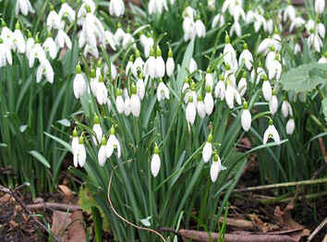
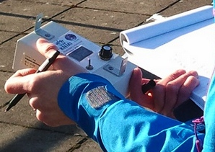
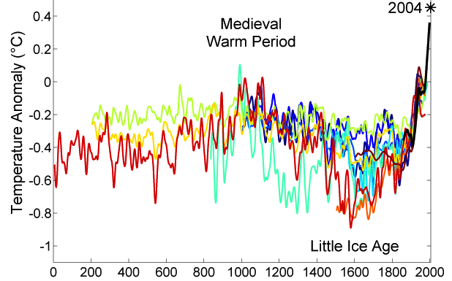
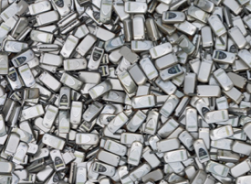
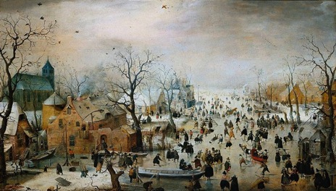
Coherence using cross curricular project
Climate Change
Biology
Physics/chemistry
Geography
Art
Economy
(art)history
Hendrick Avercamp, 1608
Math
Modern languages
Notes:
Kleine ijstijd: 15e t/m 19e eeuw
Is een Klimaatneutrale economie mogelijk?

Slide 39
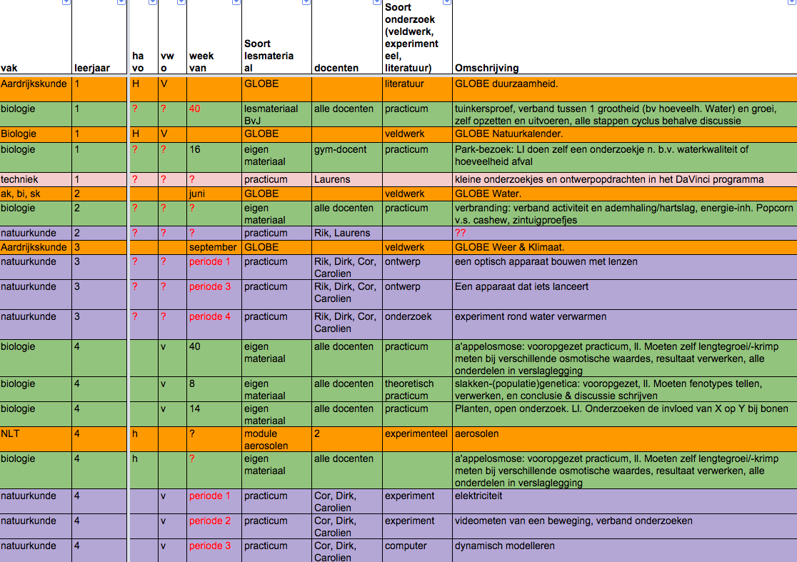
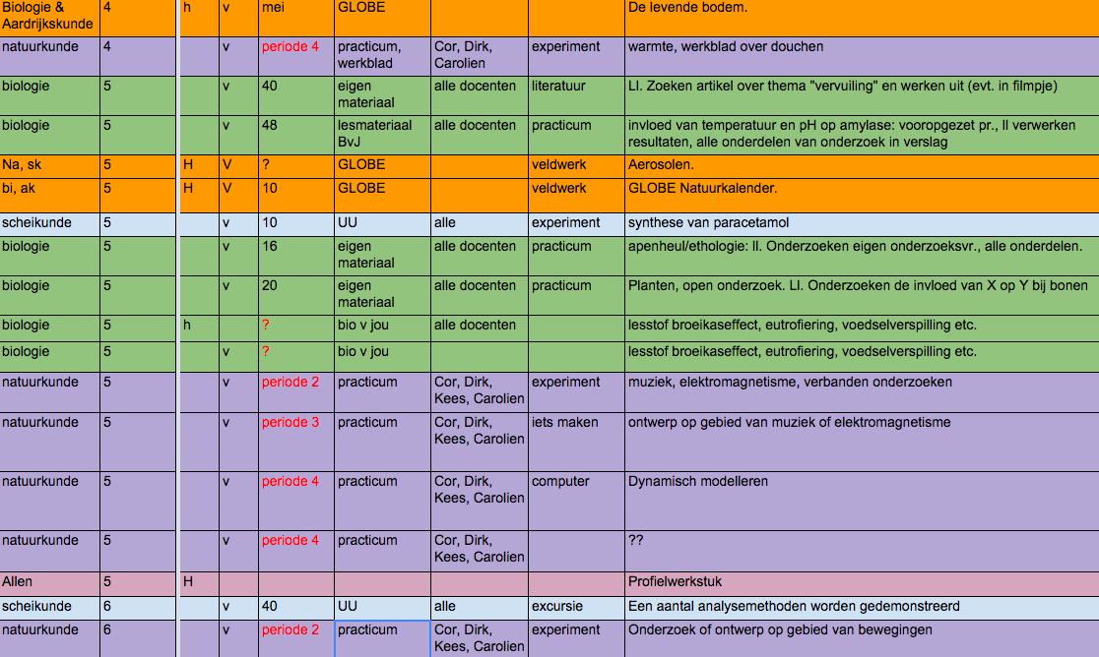
School specific learning trajectory

Slide 40
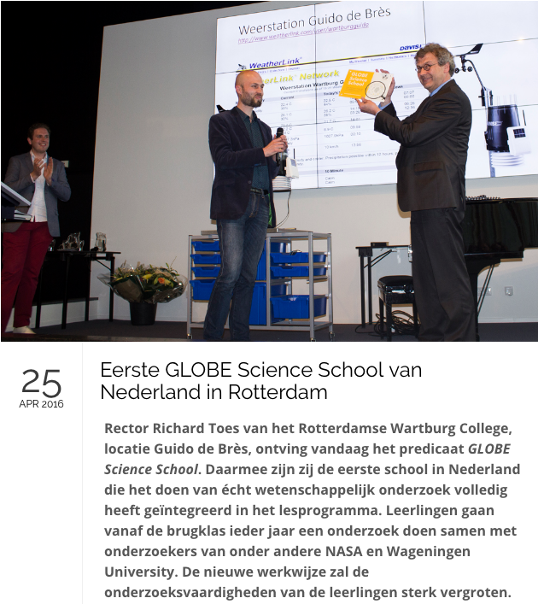
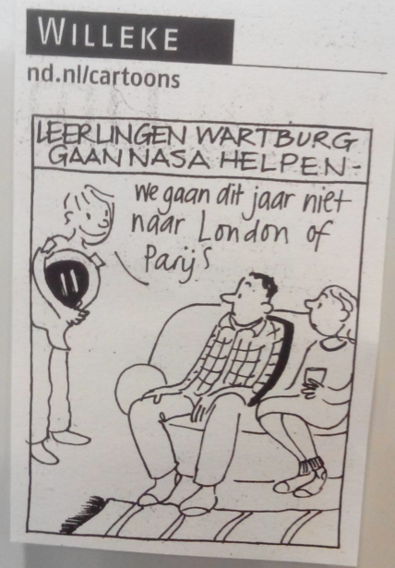
GLOBE Science School

Slide 41
Business model
 | 2016 | 2017 | 2018 | 2019
Normal | 70 | 73 | 76 | 79
Science school year 1 | 5 | 5 | 5 | 5
Science school 2+ | 3 | 4 | 7 | 10
TOTAL | 78 | 82 | 88 | 94
 | 2016 | 2017 | 2018 | 2019 | TOTAL
Normal | 16.170 | 17.593 | 19.076 | 20.619 | 73.458
Science school year 1 | 16.000 | 20.250 | 20.250 | 20.250 | 76.750
Science school 2+ | 2.484 | 3.304 | 5.782 | 8.260 | 19.830
TOTAL | 34.654 | 41.147 | 45.108 | 49.129 | 170.038

Slide 42
Lessons learnt
Teachers are the worst in this galaxy when it comes to doing their homework!
Teachers are very busy. Try to do as much as possible in work sessions with laptops
Don’t go to fast. Discuss and let teachers invent
Google documents is great, but don’t expect everyone to immediately understand it
Involve the whole team all the time
Schools can pay for support if you offer them support connected to their budgets (professionalization) and priorities (inquiry)
They like to have continued support, but it’s hard to make them pay for that

Slide 44
Reflection & Discussion
What are you going to do concretely with what you learned today?
If you’re a teacher:
What do you want to integrate into your teaching practice?
What new knowledge or skills do you want to acquire?
What do you want to share with your colleagues at school?
If you’re a cc or other:
What can you do in your country with this example?
What knowledge or partners do you need (for example collaboration with university

Slide 45
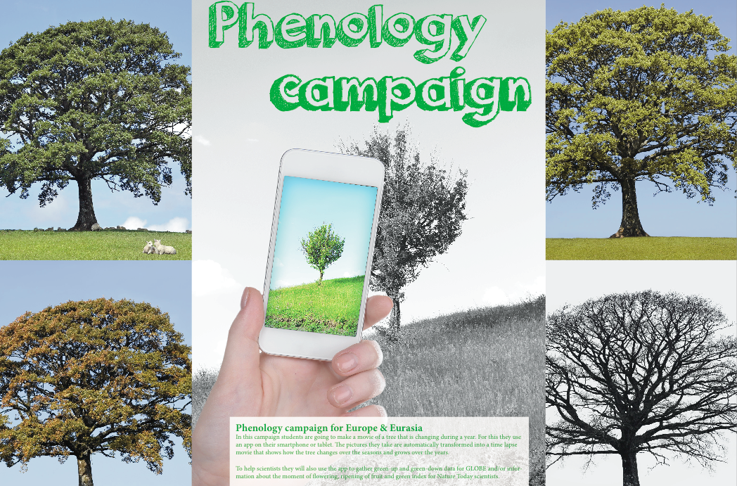
Phenology app
Wednesday 8:30
www.globe.gov/web/european-phenology-campaign

