Slide 1
The 2015-2016 El Niño Event
Using GLOBE Visualization Tools and Data for Analysis
David Overoye

Slide 2
Agenda
What is El Niño?
What GLOBE protocols could be used to study it?
What GLOBE data retrieval tools can be used to determine or visualize the impact?

Slide 3
What is El Niño
“An irregularly occurring and complex series of climatic changes affecting the equatorial Pacific region…every few years, characterized by the appearance of unusually warm..water off northern Peru and Ecuador, typically in late December.”
“El Niño is an oscillation of the ocean-atmosphere system in the tropical Pacific having important consequences for weather around the globe.”
“Among these consequences are increased rainfall across the southern tier of the US and in Peru”
http://www.oxforddictionaries.com/us/definition/american_english/el-nino http://www.pmel.noaa.gov/elnino/what-is-el-nino

Slide 4
FYI - GLOBE El Niño campaign
http://www.globe.gov/web/el-nino/el-nino-campaign/meet-the-team
Educator team - Brian Campbell, Dorian Janney, Peter Falcon, Kristin Weaver, Claudia Caro, Vascos Manta

Slide 5
What GLOBE protocols? -- El Niño Campaign – major event 2015/2016
“Collect data for at least two of the following six protocols”
Precipitation
Air Temperature
Surface Temperature
Soil Temperature
SMAP Soil Moisture
Biometry – Canopy and Ground Cover
“Take observations at least 21 days per season”
March 1 – May 31
June 1 – August 31
September 1 – November 30
December 1 – February 28/29

Slide 6
Two GLOBE tools to retrieve data
GLOBE Advanced Data Access Tool (ADAT) - http://datasearch.globe.gov/
Used to find and return data from across sites and protocols
Allows you to filter by location, date and other parameters
Focus in on retrieving data across sites or locations
GLOBE Visualization system - http://vis.globe.gov/GLOBE/
Used to see data points on a map
See a particular day’s data – Show me the temperature today
Can also show data observed and graph over a period of time.
Focus is on specific set of data at a specific site

Slide 7
Using the Advanced Data Access Tool (ADAT)
Tool allows you to download GLOBE data from multiple protocols, schools, regions or dates without using the map
Select GLOBE Data -> Retrieve GLOBE Data or http://datasearch.globe.gov/
Two Steps –
Select Filters
Protocol, Date Range, Country, School or Teacher etc.
Select “Download Measurement Data” (may take a little while!)

Slide 8
Think you already know how to use ADAT?
There are two schools in the US state of Washington that collected precipitation data from 12/1/2015 – 2/28/2016 and 12/1/2013 – 2/28/2014.
Retrieve the data from these schools.
Which school do you think is better to use for analysis? Why?
What are the problems caused when a school doesn’t report “no rainfall”?
Examine the data for the school with the most data to see if the school recorded any El Niño effect

Slide 9
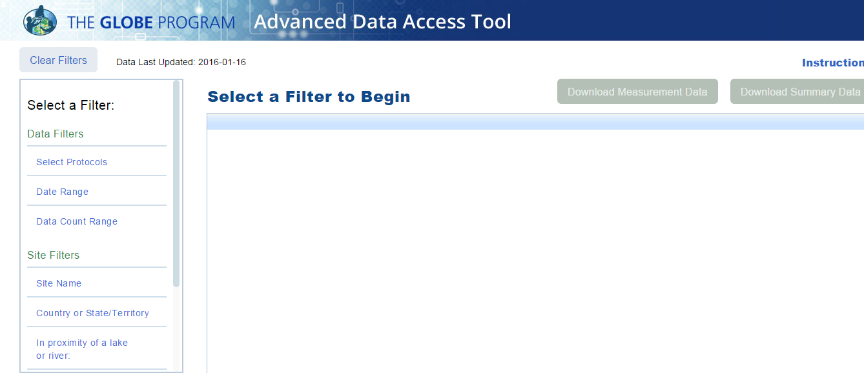
Select Filters from the left to see matching sites

Slide 10
What would be a good filter to setup for El Niño data?
Protocols?
Date Range?

Slide 11
What would be a good filter to setup for El Niño data?
Protocols?
Precipitation – one of the campaign protocols
Date Range?
A campaign data collection time range - December 1, 2015 – February 28/29, 2016

Slide 12
Protocol
Date Range

Slide 13
What would be a good filter to setup for El Niño data?
Protocols?
Precipitation – one of the campaign protocols
Date Range?
December 1, 2015 – February 28/29, 2016 – a campaign data collection time range
Location too!
California, Oregon, Washington (US West Coast)

Slide 14
Locations

Slide 16
What would be a good filter to setup for El Niño data?
Protocols?
Precipitation – one of the campaign protocols
Date Range?
December 1, 2015 – February 28/29, 2016 – a campaign data collection time range
Compare to 2013/2014
Location too?
California, Oregon, Washington (US West Coast)

Slide 17
New Date Range
Data 2013 and 2015

Slide 18
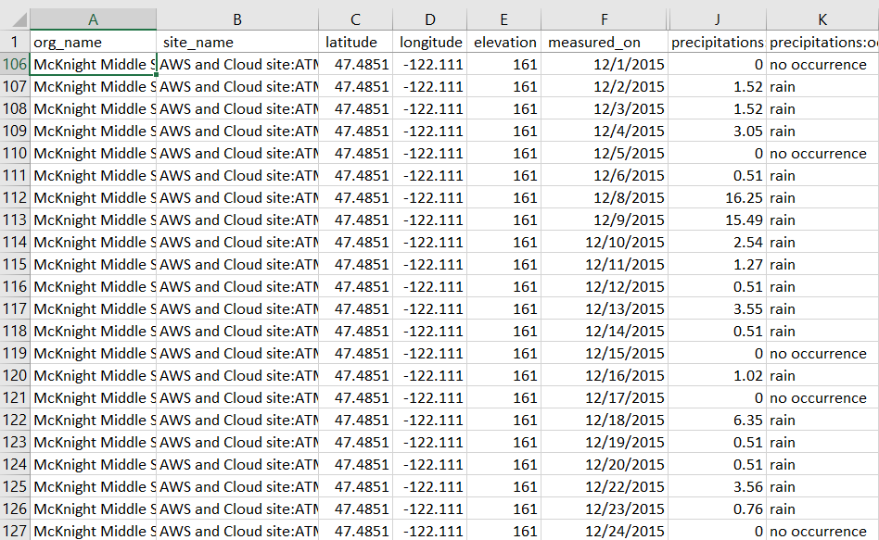
McKnight Middle School – Data 2013 and 2015 Download to Excel

Slide 19
Comparison 2013 and 2015 Precipitation

Slide 21
Using the Visualization System to examine El Nino protocols
Is there a correlation between precipitation and soil moisture?

Slide 22
Think you know the vis system?
The Ramey School in Puerto Rico has done an excellent job of monitoring precipitation and Soil Moisture during the El Niño Campaign
Start with 9/9/2015
Add Soil Moisture – SMAP Block Pattern
Plot the data from the Ramey School for the period 9/1/2015 – 5/31/2016
Add the data to a combined plot
Switch to precipitation for the same period and add it to the multi-site plot
View the multi-site plot for this period and determine if there is a correlation between the two variables

Slide 23
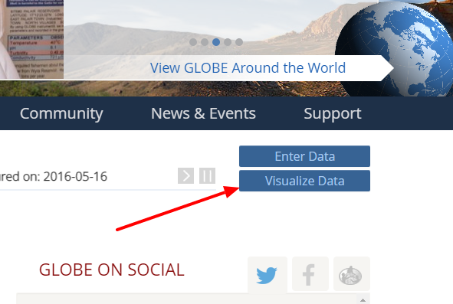
The Basics of the Visualization System
Go to the homepage and select “Visualize Data”
Three Steps to Visualize your Data:
Select the type of data you want to see (Add Layers)
Select the Date you want to see the data for
Click on a data point on the map to receive table and graph information
Full Training material – slides and video available at: http://www.globe.gov/get-trained/using-the-globe-website/retrieve-and-visualize-your-data

Slide 24
Step 1 – Add Data Layers – Choose the Protocol

Slide 25
Step 2 – Select the Date

Slide 26
Step 3 – Click on the Data Point

Slide 27
Vis system popup window
See all Atmosphere Data
Go to this school’s page
See Plot Data in a Table
Add this Data to a multi-site Plot
Change the X axis Timeline

Slide 28
Advanced Features
Use Filters - Location/Site/Elevation to find specific locations – school, country, city etc.
Use the graph with the + icon to select multiple data sets to graph
Allows you to overlay data from multiple sites
Export layers to KMZ format for using with Google Earth and other similar tools
Use “Data Counts” to see schools which have entered the most data during a particular period of time
Full Training material – slides and video available at: http://www.globe.gov/get-trained/using-the-globe-website/retrieve-and-visualize-your-data

Slide 29
SMAP Measurement-Ramey School 9/9/2015

Slide 30
PLOT of measured SMAP data with multi-site setup

Slide 31
PLOT of measured SMAP data with multi-site setup

Slide 32
Data Comparison – do you see a correlation?

Slide 33
Questions?
Thank you!

